Slide 1
INTRODUCTION TO 18-792
ADVANCED DIGITAL SIGNAL PROCESSING
Richard M. Stern
18-792 lecture
August 26, 2024
Department of Electrical and Computer Engineering
Carnegie Mellon University
Pittsburgh, Pennsylvania 15213

Slide 2
Welcome to 18-792 Advanced DSP!
Today will
  Review mechanics of course
  Review course content
  Preview material in 18-792 (Advanced DSP)

Slide 3
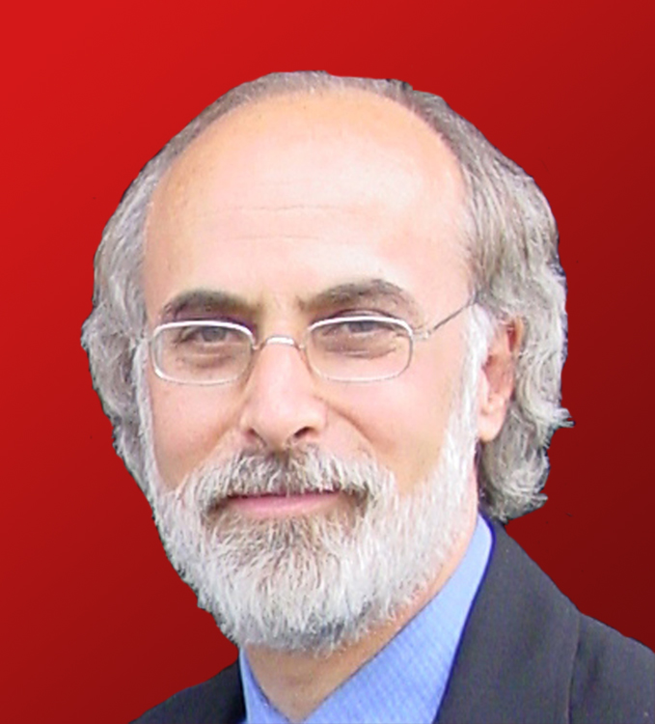


Important people (for this course at least)
Instructor: Richard Stern
  PH A26, (412) 916-7386, rms@cs.cmu.edu
Teaching assistants:
Albdulhamid Aldoobie, Tony Su
  apillay@andrew.cmu.edu, (412) 214-26534
  owright@sei.cmu.edu, (225) 276-0289
ECE academic services center, Cassie Pfannenstiel
  HH 1113, 8-4951, cpfannen@andrew.cmu.edu

Slide 4
And, of course, the most important people are you!

Slide 5
Some course details
Meeting time and place:
  Lectures here and now (Wednesdays as well)
  Recitations Friday 10:00 – 11:50, PH 125B
Pre-requisites (you really need these!):
  Basic DSP course like 18-491/691
  Basic probability course like 36-217
  Some MATLAB or Python background
  (Stochastic processes not needed)
  Please chat with me after class if you have not taken 18-491 or 36-217 already

Slide 6
What topics in DSP do I really need to know?
Relationships of DT representations
  Sample response/convolution
  Discrete-time Fourier transform (DTFT)
  Z-transform + ROC
  Difference equations + initial conditions
  Pole-zero locations + gain for one frequency
Topics related to the DFT
  Difference between the discrete Fourier transform and the DTFT
  Linear versus circular convolution
  Convolving using the overlap-add and overlap-save methods
Signal flow diagrams

Slide 7
Does our work get graded?
Yes!
Grades based on:
  Machine problems and other homework (35-45%)
    Gradescope is now being used for all homework assignments
    Machine problems will be turned in using a standard format
  Three exams (55-65%)
    Two midterms (October 9 and November 20), and final exam

Slide 8
Some details on homework
Issued Thursday evenings
Due Friday at 0100 one week later
  Lowest homework grade dropped
  Up to 5 late days of late homework permitted, max 2 per week
Start your work over the weekend!

Slide 9
Other support sources
Office hours:
  2 hours per week for Stern, Abdulhamid, and Su, TBA
  You can schedule additional times with me as needed
Course home page:
  http://www.ece.cmu.edu/~ece792 [not much there yet]
Canvass to be used for grades (but probably not much else)
Piazza to be used for discussions
  Faculty responses within 24 hours but not necessarily immediately
Gradescope to be used for homework assignments
  MATLAB/Python code will be turned in directly for execution

Slide 10
Textbooks
Major texts:
  Lim and Oppenheim: Advanced Topics in Signal Processing (out of print)
  Oppenheim and Schafer: Discrete-Time Signal Processing (from last semester)
Newish: ADSP class notes!
Material to be supplemented by papers and other sources
Many other texts listed in syllabus

Slide 11
Diversity and inclusion
Engineering is a classic profession for upwardly-mobile people
Here and elsewhere we suffer from long-term endemic discrimination based on race, ethnic origin, religion, sexual preference, gender identity, disability, etc. etc.
The multiple killings of black and brown people spring 2020 (and for a long time before and after) have sparked a good national discussion, although it is not clear if/when long-term change will happen.
It is our collective responsibility to treat everyone fairly and equally, based on merit
The ECE Diversity, Inclusion, and Outreach committee’s home page is
https://www.ece.cmu.edu/student-resources/dio.html

Slide 12
Register and Vote!!!!!
Vote in Pennsylvania if you can
Allegheny County voter registration page:
  https://www.alleghenycounty.us/elections/voter-registration.aspx
  Registration deadline is Monday October 21 at 5 pm
Voting by mail is possible

Slide 13
Academic stress and sources of help
This is a hard course
Take good care of yourself
If you are having trouble, seek help
  Teaching staff
  CMU Counseling and Psychological Services (CaPS)
We are here to help!

Slide 14
Academic integrity (i.e. cheating and plagiarism)
CMU’s take on academic integrity:
  http://www.cmu.edu/academic-integrity/index.html
ECE’s take on academic integrity:
  http://www.ece.cmu.edu/programs-admissions/masters/academic-integrity.html
Most important rule: Don’t cheat!
But what do we mean by that?
  Discussing general strategies on homework with other students is OK
  Solving homework together is NOT OK
  Accessing material from previous years is NOT OK
  “Collaborating” on exams is REALLY REALLY NOT OK!

Slide 15
One new technology on the horizon …
Generative AI tools (e.g. ChatGPT)
  For the first time, performance is good enough to render a potential impact on classwork
  Use of generative AI tools for doing homework is strictly prohibited (at least for now)
  We can continue to discuss this

Slide 16
Advanced digital signal processing: some core concepts
The biggest difference between 18-491/691 (DSP) and 18-792 is that ADSP is primarily concerned with processing random signals
Key application areas:
  Signal representation
  Signal modeling
  Signal enhancement
  Signal modification
  Signal separation

Slide 17
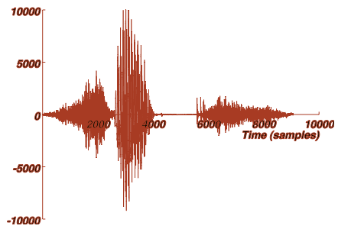
Signal representation: why perform signal processing?
A look at the time-domain waveform of “six”:
It’s hard to infer much from the time-domain waveform

Slide 18
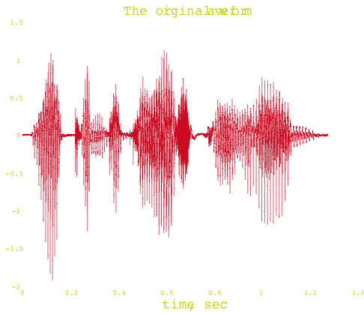

Signal representation: why perform signal processing?
A speech waveform in time:
“Welcome to DSP I”

Slide 19
A time-frequency representation of “welcome” is much more informative
Implemented
In Problem Set 4

Slide 20
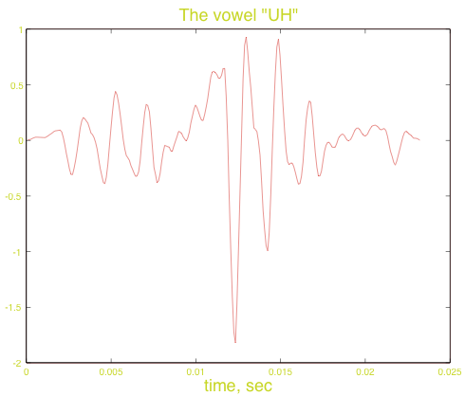
Signal modeling: let’s consider the “uh” in “welcome:”

Slide 21
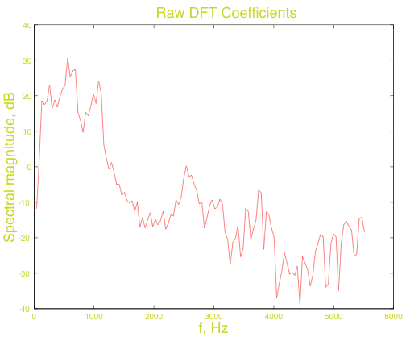
The raw spectrum

Slide 22
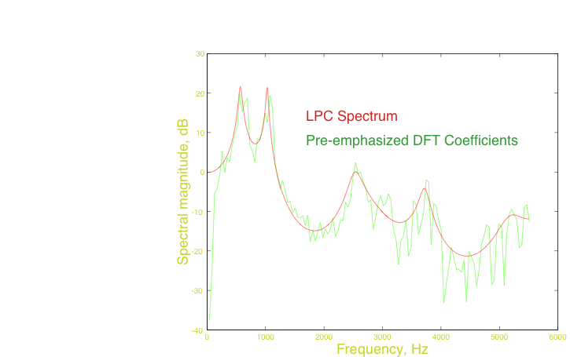
All-pole modeling: the LPC spectrum

Slide 23
Another type of modeling: the source-filter model of speech
A useful model for representing the generation of speech sounds:
Pitch
Amplitude
Pulse train source
p[n]
Vocal tract model
Noise source

Slide 24
An application of LPC modeling: separating the vocal tract excitation and and filter
Original speech:
Speech with 75-Hz excitation:
Speech with 150 Hz excitation:
Speech with noise excitation:
Comment: this is a major techniques used in speech coding
Implemented
In Problem Set 9
Notes:
Welcome16
Welcome 75
Welcome 150
Welcome 0

Slide 25
Classical signal enhancement: compensation of speech for noise and filtering
Approach of Acero, Moreno, Raj, et al. (1990-1997)…
Compensation achieved by estimating parameters of noise and filter and applying inverse operations
“Clean” speech
Degraded speech
x[m]
h[m]
z[m]
Linear filtering
n[m]
Additive noise

Slide 26
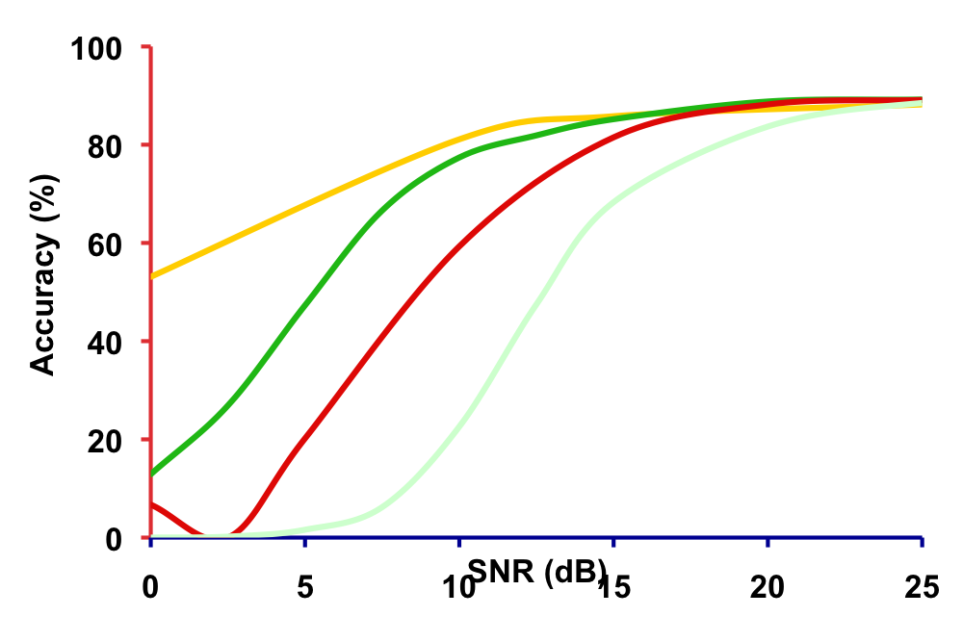
“Classical” combined compensation improves accuracy in stationary environments
Threshold shifts by ~7 dB
Accuracy still poor for low SNRs
Complete retraining
–7 dB 13 dB Clean
VTS (1997)
Original
CDCN (1990)
“Recovered”
CMN (baseline)
Notes:
out_pre0_norm out_new_pre20 out
out_post0_norm out_new_post20

Slide 27
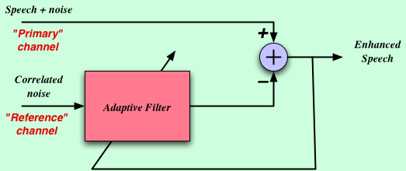
Another type of signal enhancement: adaptive noise cancellation
Speech + noise enters primary channel, correlated noise enters reference channel
Adaptive filter attempts to convert noise in secondary channel to best resemble noise in primary channel and subtracts
Performance degrades when speech leaks into reference channel and in reverberation
Notes:
Push-to-talk will make life MUCH easier!!

Slide 28
Simulation of noise cancellation for a PDA using two mics in “endfire” configuration
Speech in cafeteria noise, no noise cancellation
Speech with noise cancellation
But …. simulation assumed no reverb
Implemented
In Problem Set 10
Notes:
ANC_base
ANC_cancel

Slide 29
Signal separation: speech is quite intelligible, even when presented only in fragments
Procedure:
  Determine which time-frequency time-frequency components appear to be dominated by the desired signal
  Reconstruct signal based on “good” components
A Monaural example:
  Mixed signals -
  Separated signals -
Implemented
In Problem Set 4
Notes:
5_spk
1st_spk 2nd_spk 3rd_spk 4th_spk 5th_spk

Slide 30
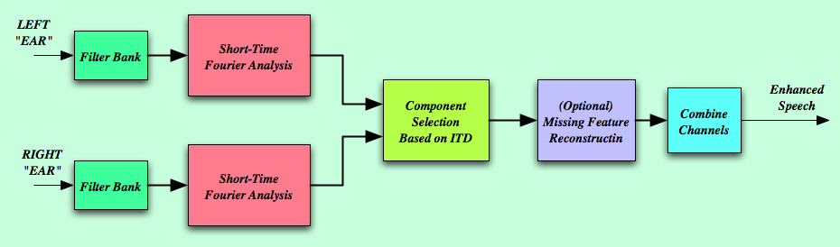
Practical signal separation: Audio samples using selective reconstruction based on ITD
RT60 (ms) 0 300
No Proc
Delay-sum
ZCAE-bin
ZCAE-cont
Implemented
In Problem Set 5
Notes:
Brian-Ba-R0I0 Brian-Ba-R3I0
Brian-DS-R0I0 Brian-DS-R3I0
Brian-ZB-R0I0 Brian-ZB-R3I0
Brian-ZC-R0I0 Brian-ZC-R3I0

Slide 31

Phase vocoding: changing time scale and pitch
Changing the time scale:
  Original speech
  Faster by 4:3
  Slower by 1:2
Transposing pitch:
  Original music
  After phase vocoding
  Transposing up by a major third
  Transposing down by a major third
Comment: this is one of several techniques used to perform autotuning
Implemented
In Problem Set 6
Notes:
Welcome16
Welcome 75
Welcome 150
Welcome 0

Slide 32
18-792: major topic areas
Multi-rate DSP
Short-time Fourier analysis
Overview of important properties of stochastic processes
Traditional and modern spectral analysis
Linear prediction
Adaptive filtering
Adaptive array processing
Additional topics and applications
Notes:
Orange headings refer to deterministic topics

Slide 33
Multi-rate DSP
Review of sampling rate conversion
Polyphase implementation of FIR filters for rate conversion
Multistage implementations, with application to speech and music analysis
Design of quadrature and multi-channel filterbanks
Notes:
Orange headings refer to deterministic topics

Slide 34
Short-time Fourier analysis
Interpretation as windowed Fourier transform or filter bank
Filter design techniques
Analysis-synthesis systems
Applications to speech and music analysis
  Phase vocoding
  Manipulation of time and frequency
Generalized time-frequency representations
  Wigner distributions and wavelet functions

Slide 35
Introduction to random processes
Stochastic process definitions and properties
Ensemble and time averages
Power spectral density functions and their computation
Random processes and linear filters
Gaussian and other special random processes

Slide 36
Traditional and modern spectral analysis
Introduction to statistical estimation and estimators
Estimates of autocorrelation functions
Traditional approaches based on the periodogram
Performance of smoothed spectral estimates
Nonlinear estimation: the maximum entropy method
Parametric approaches to spectral estimation; linear prediction

Slide 37
Linear prediction
Linear prediction using covariance and autocorrelation approaches
Levinson-Durbin recursion and Cholesky decomposition
Design and interpretation of lattice filters
Applications to speech, bioinformation processing, and geophysics

Slide 38
Adaptive filtering
Introduction to adaptive signal processing
Objective measures of goodness
Least squares derivations
Steepest descent
The LMS and RLS algorithms
Adaptive lattice filters
Kalman filters
Multi-sensor adaptive array processing and beamforming

Slide 39
Some possible additional topics
Homomorphic signal processing and the complex cepstrum
Blind source separation
Signal processing for speech analysis, synthesis, and recognition

Slide 40
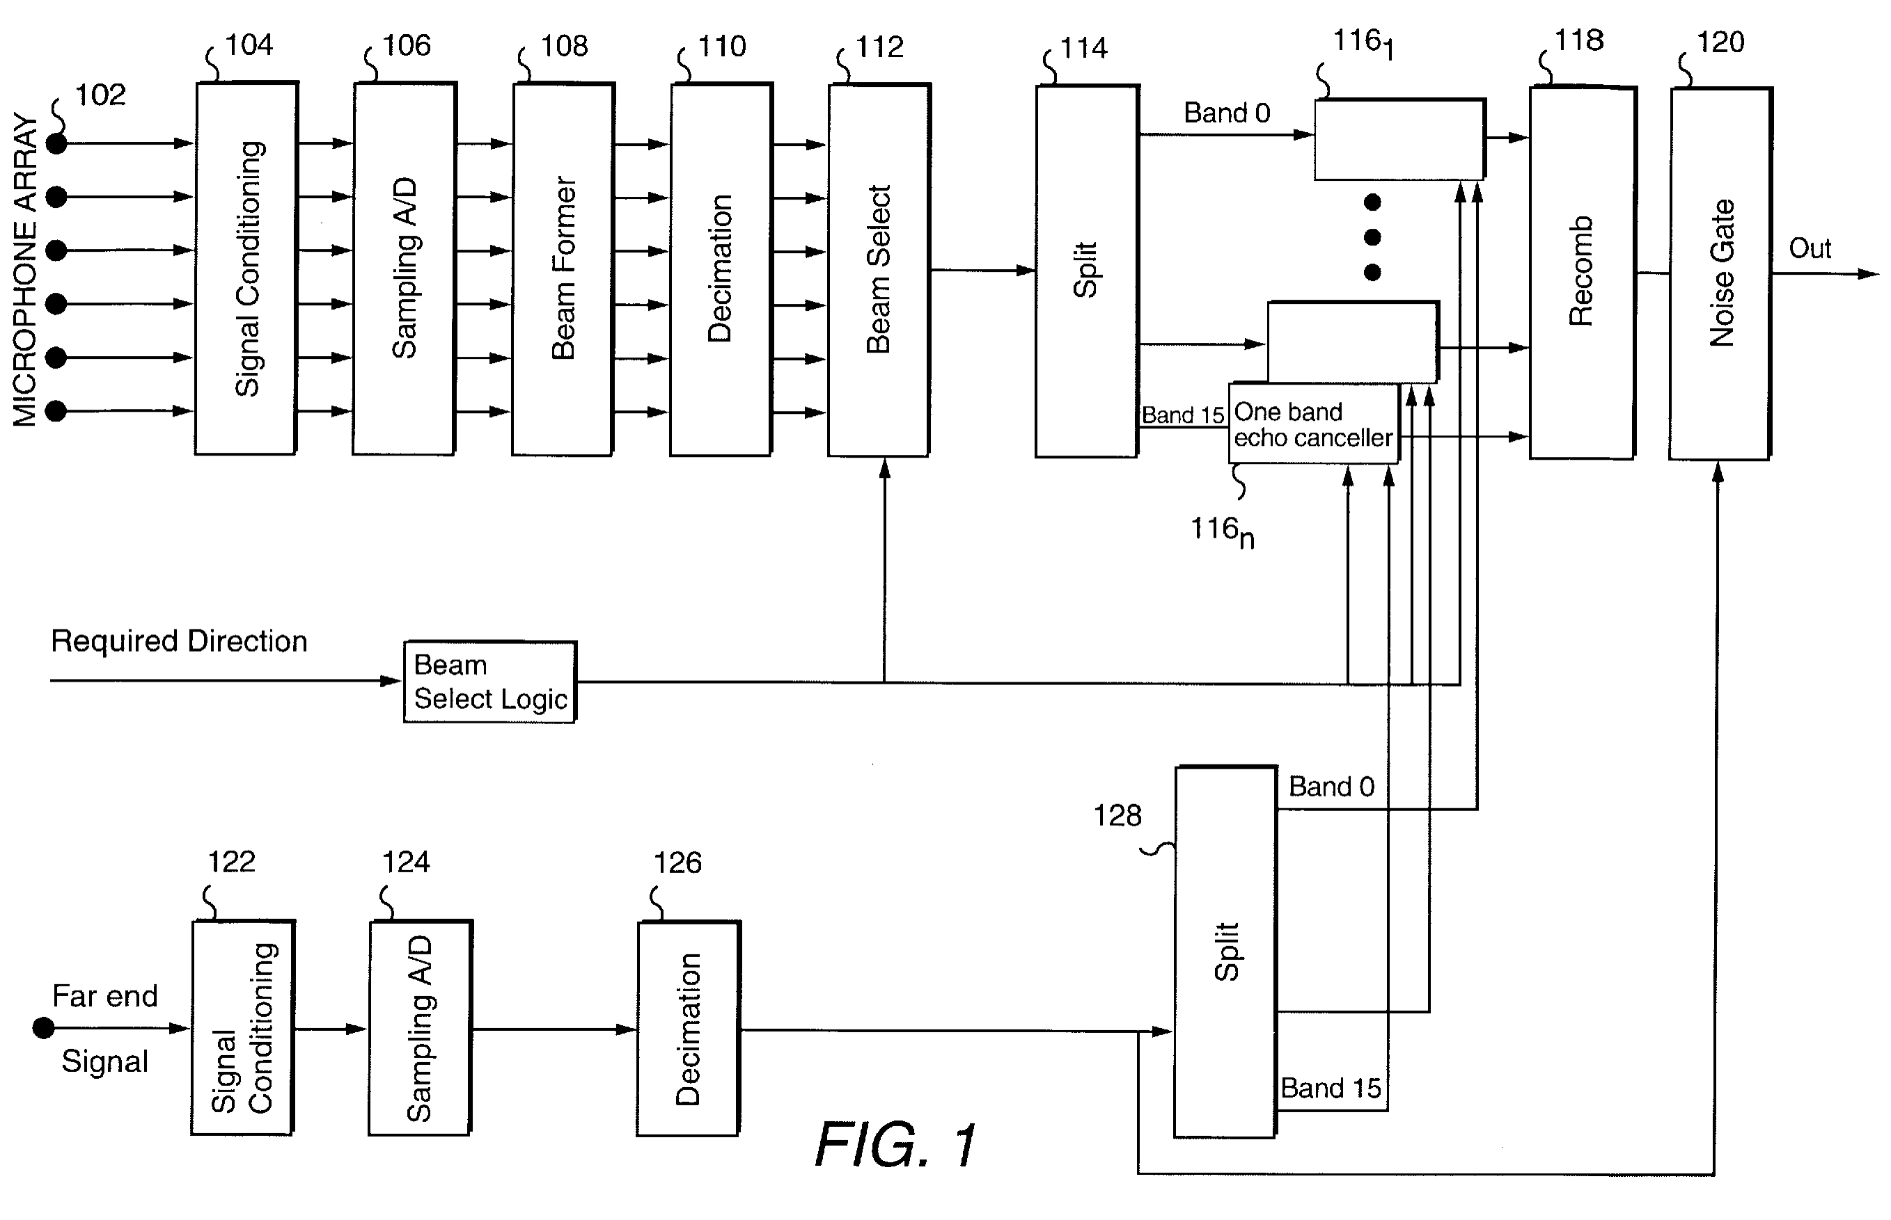
Comment … one of my consulting cases in 2015
(Andrea v Dell et al.)
US patent 6,049,607

Slide 41
Comment … one of my consulting cases in 2015
(Andrea v Dell et al.)
US patent 6,049,607

Slide 42
Summary
Lots of interesting topics that extend core material from DSP
Greater emphasis on implementation and applications
Greater emphasis on statistically-optimal signal processing
I hope that you have as much fun with this material as I have had!

