Slide 1
18-742: Research in
Parallel Computer Architecture
Memory Systems Research
Prof. Onur Mutlu
Carnegie Mellon University
Fall 2014
September 3, 2014
Notes:
1

Slide 2
Reminders
Homework 0’s and Main Memory Scaling reviews
Please send me and Yixin your 3 papers
  Your paper reviews are due September 4
Hamming talk review due September 6
Think about your projects
  Project handout will be online soon
  Proposal will be due ~September 30

Slide 3
Exciting Reading & Project Topic Areas
Rethinking Memory System Design for Data-Intensive Computing
  All aspects of DRAM, Flash Memory, Emerging Technologies
Single-Level Stores: Merging Memory and Storage with Fast NVM
GPUs as First-Class Computing Engines
In-memory Computing: Enabling Near-Data Processing
Predictable Systems: QoS Everywhere in the System
Secure and Easy-to-Program/Manage Memories: DRAM, Flash, NVM
Heterogeneous Systems: Architecting and Exploiting Asymmetry
Efficient and Scalable Interconnects
Genome Sequence Analysis & Assembly: Algorithms and Architectures

Slide 4
Sample Past Projects from 740/742
"ATLAS: A Scalable and High-Performance Scheduling Algorithm for Multiple Memory Controllers" , HPCA 2010 Best Paper Session.
"Next Generation On-Chip Networks: What Kind of Congestion Control Do We Need?" , HotNets 2010.
"Thread Cluster Memory Scheduling: Exploiting Differences in Memory Access Behavior" , MICRO 2010, IEEE Micro Top Picks 2011.
"Reducing Memory Interference in Multicore Systems via Application-Aware Memory Channel Partitioning”, MICRO 2011.
"RAIDR: Retention-Aware Intelligent DRAM Refresh”, ISCA 2012.
"On-Chip Networks from a Networking Perspective: Congestion and Scalability in Many-core Interconnects”, SIGCOMM 2012.
"Row Buffer Locality Aware Caching Policies for Hybrid Memories”, ICCD 2012 Best Paper Award.
"HAT: Heterogeneous Adaptive Throttling for On-Chip Networks”, SBAC-PAD 2012.
"Asymmetry-Aware Execution Placement on Manycore Chips”, SFMA 2013.
"Exploiting Compressed Block Size as an Indicator of Future Reuse”, SAFARI Technical Report 2013.

Slide 5
Next Week
Want two presenters for next week (Tuesday and Thursday)
Pick a set of papers to present so that we can have a discussion
  We will decide this at the end of this meeting
Signup sheet for later weeks will be posted

Slide 6


Rethinking Memory/Storage System Design
Onur Mutlu
onur@cmu.edu
http://users.ece.cmu.edu/~omutlu/

Slide 7

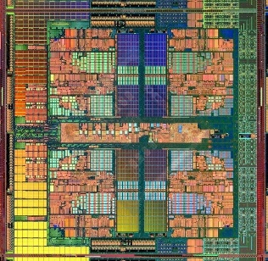

The Main Memory System
Main memory is a critical component of all computing systems: server, mobile, embedded, desktop, sensor
Main memory system must scale (in size, technology, efficiency, cost, and management algorithms) to maintain performance growth and technology scaling benefits
Processor
and caches
Main Memory
Storage (SSD/HDD)

Slide 8
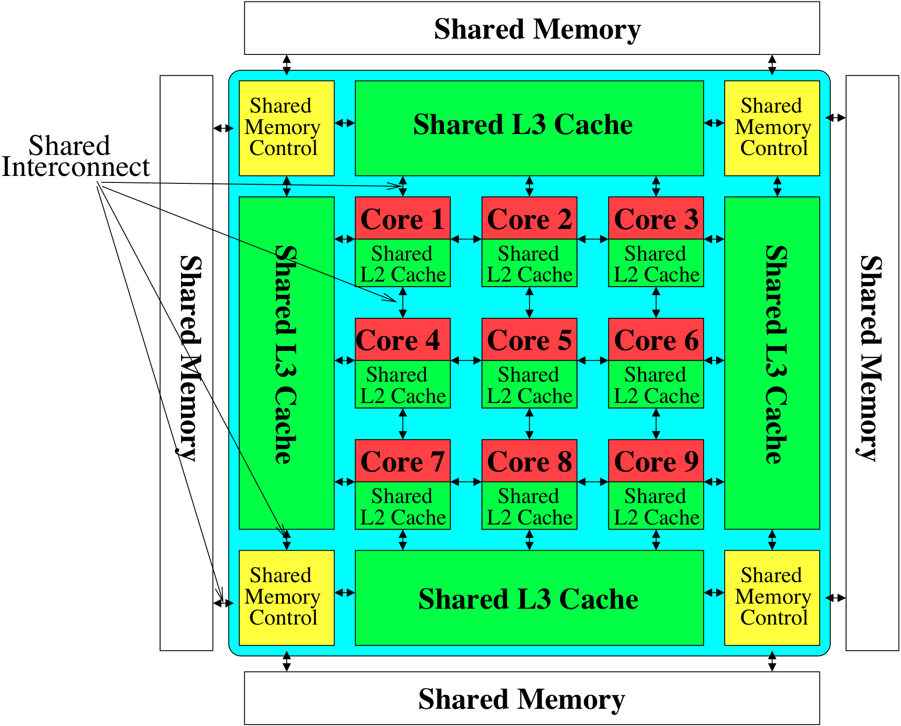
Memory System: A Shared Resource View
Storage

Slide 9
State of the Main Memory System
Recent technology, architecture, and application trends
  lead to new requirements
  exacerbate old requirements
DRAM and memory controllers, as we know them today, are (will be) unlikely to satisfy all requirements
Some emerging non-volatile memory technologies (e.g., PCM) enable new opportunities: memory+storage merging
We need to rethink the main memory system
  to fix DRAM issues and enable emerging technologies
  to satisfy all requirements

Slide 10
Agenda
Major Trends Affecting Main Memory
The Memory Scaling Problem and Solution Directions
  New Memory Architectures
  Enabling Emerging Technologies: Hybrid Memory Systems
How Can We Do Better?
Summary

Slide 11
Major Trends Affecting Main Memory (I)
Need for main memory capacity, bandwidth, QoS increasing
Main memory energy/power is a key system design concern
DRAM technology scaling is ending

Slide 12
Major Trends Affecting Main Memory (II)
Need for main memory capacity, bandwidth, QoS increasing
  Multi-core: increasing number of cores/agents
  Data-intensive applications: increasing demand/hunger for data
  Consolidation: cloud computing, GPUs, mobile, heterogeneity
Main memory energy/power is a key system design concern
DRAM technology scaling is ending

Slide 13
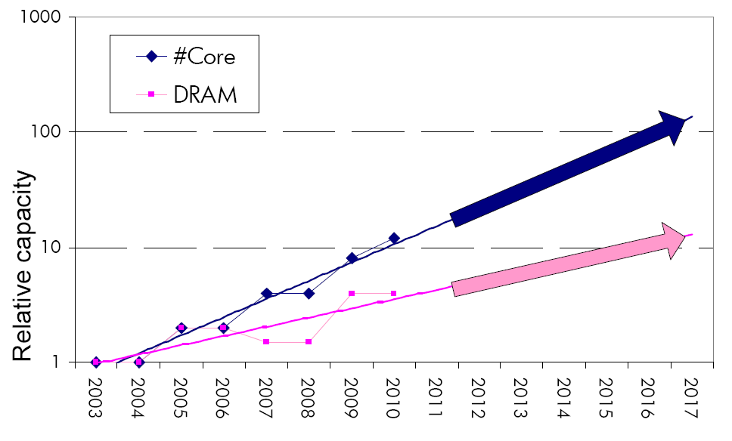
Example: The Memory Capacity Gap
Core count doubling ~ every 2 years
DRAM DIMM capacity doubling ~ every 3 years
Memory capacity per core expected to drop by 30% every two years
Trends worse for memory bandwidth per core!

Slide 14
Major Trends Affecting Main Memory (III)
Need for main memory capacity, bandwidth, QoS increasing
Main memory energy/power is a key system design concern
  ~40-50% energy spent in off-chip memory hierarchy [Lefurgy, IEEE Computer 2003]
  DRAM consumes power even when not used (periodic refresh)
DRAM technology scaling is ending

Slide 15
Major Trends Affecting Main Memory (IV)
Need for main memory capacity, bandwidth, QoS increasing
Main memory energy/power is a key system design concern
DRAM technology scaling is ending
  ITRS projects DRAM will not scale easily below X nm
  Scaling has provided many benefits:
    higher capacity (density), lower cost, lower energy

Slide 16
Agenda
Major Trends Affecting Main Memory
The Memory Scaling Problem and Solution Directions
  New Memory Architectures
  Enabling Emerging Technologies: Hybrid Memory Systems
How Can We Do Better?
Summary

Slide 17
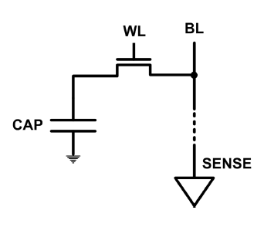
The DRAM Scaling Problem
DRAM stores charge in a capacitor (charge-based memory)
  Capacitor must be large enough for reliable sensing
  Access transistor should be large enough for low leakage and high retention time
  Scaling beyond 40-35nm (2013) is challenging [ITRS, 2009]
DRAM capacity, cost, and energy/power hard to scale

Slide 18
An Example of The Scaling Problem
Row of Cells
Wordline
Row
Victim Row
Row
Aggressor Row
V_{LOW}
Opened
V_{HIGH}
Closed
Row
Victim Row
Row
Repeatedly opening and closing a row induces disturbance errors in adjacent rows in most real DRAM chips [Kim+ ISCA 2014]

Slide 19
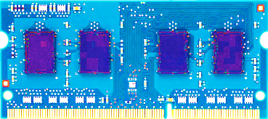
Most DRAM Modules Are at Risk
A company
B company
C company
86%
(37/43)
83%
(45/54)
88%
(28/32)
Up to
1.0×10⁷
errors
Up to
2.7×10⁶
errors
Up to
3.3×10⁵
errors
Kim+, “Flipping Bits in Memory Without Accessing Them: An Experimental Study of DRAM Disturbance Errors,” ISCA 2014.

Slide 20

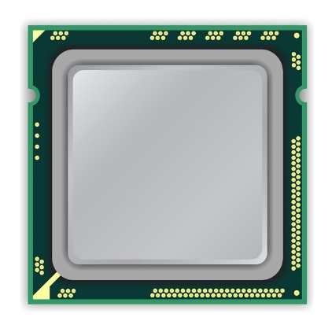
x86 CPU
DRAM Module
loop:
mov (X), %eax
mov (Y), %ebx
clflush (X)
clflush (Y)
mfence
jmp loop
X
Y
Notes:
We demonstrate the errors on multiple x86 systems. Shown to the bottom-left is a “disturbance kernel”. When executed, it forces two rows to be opened and closed one after the other – over and over again. Consequently, it induces many errors in the module.

Slide 21
x86 CPU
DRAM Module
loop:
mov (X), %eax
mov (Y), %ebx
clflush (X)
clflush (Y)
mfence
jmp loop
X
Y
Notes:
We demonstrate the errors on multiple x86 systems. Shown to the bottom-left is a “disturbance kernel”. When executed, it forces two rows to be opened and closed one after the other – over and over again. Consequently, it induces many errors in the module.

Slide 22
x86 CPU
DRAM Module
loop:
mov (X), %eax
mov (Y), %ebx
clflush (X)
clflush (Y)
mfence
jmp loop
X
Y
Notes:
We demonstrate the errors on multiple x86 systems. Shown to the bottom-left is a “disturbance kernel”. When executed, it forces two rows to be opened and closed one after the other – over and over again. Consequently, it induces many errors in the module.

Slide 23
x86 CPU
DRAM Module
loop:
mov (X), %eax
mov (Y), %ebx
clflush (X)
clflush (Y)
mfence
jmp loop
X
Y
Notes:
We demonstrate the errors on multiple x86 systems. Shown to the bottom-left is a “disturbance kernel”. When executed, it forces two rows to be opened and closed one after the other – over and over again. Consequently, it induces many errors in the module.

Slide 24
Observed Errors in Real Systems
In a more controlled environment, we can induce as many as ten million disturbance errors
Disturbance errors are a serious reliability issue
CPU Architecture | Errors | Access-Rate
Intel Haswell (2013) | 22.9K | 12.3M/sec
Intel Ivy Bridge (2012) | 20.7K | 11.7M/sec
Intel Sandy Bridge (2011) | 16.1K | 11.6M/sec
AMD Piledriver (2012) | 59 | 6.1M/sec
Kim+, “Flipping Bits in Memory Without Accessing Them: An Experimental Study of DRAM Disturbance Errors,” ISCA 2014.
Notes:
When we executed the code on four different processors, all four of them yielded errors. Intel Haswell has the most errors, at 23 thousand, because it has the highest rate of accessing DRAM.
Later on, I’ll show that we can induce as many as ten million disturbance errors in a more controlled environment.
From this, we conclude that disturbance errors are a serious reliability issue.

Slide 25
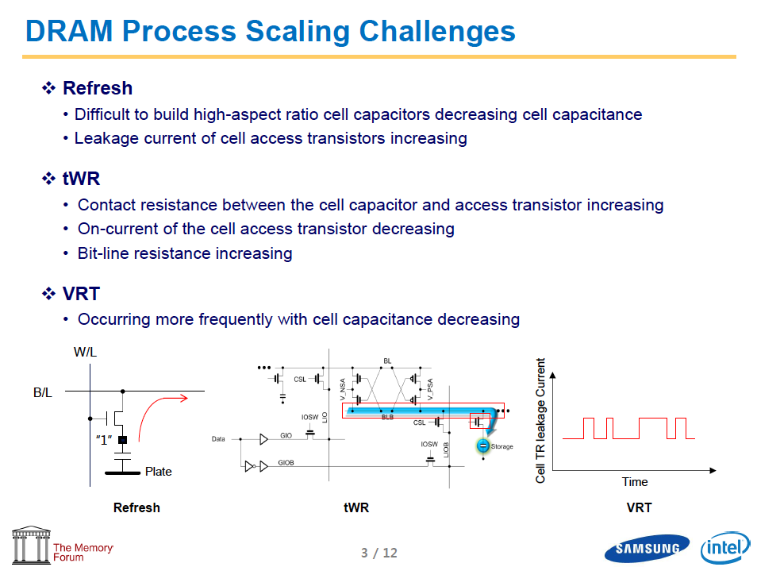
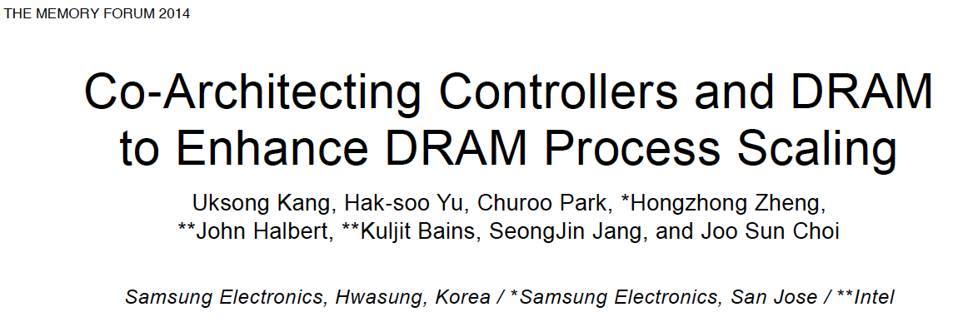
The DRAM Scaling Problem

Slide 26
Solutions to the DRAM Scaling Problem
Two potential solutions
  Tolerate DRAM (by taking a fresh look at it)
  Enable emerging memory technologies to eliminate/minimize DRAM
Do both
  Hybrid memory systems

Slide 27
Solution 1: Tolerate DRAM
Overcome DRAM shortcomings with
  System-DRAM co-design
  Novel DRAM architectures, interface, functions
  Better waste management (efficient utilization)
Key issues to tackle
  Reduce energy
  Enable reliability at low cost
  Improve bandwidth and latency
  Reduce waste
  Enable computation close to data

Slide 28
Solution 1: Tolerate DRAM
Liu+, “RAIDR: Retention-Aware Intelligent DRAM Refresh,” ISCA 2012.
Kim+, “A Case for Exploiting Subarray-Level Parallelism in DRAM,” ISCA 2012.
Lee+, “Tiered-Latency DRAM: A Low Latency and Low Cost DRAM Architecture,” HPCA 2013.
Liu+, “An Experimental Study of Data Retention Behavior in Modern DRAM Devices,” ISCA 2013.
Seshadri+, “RowClone: Fast and Efficient In-DRAM Copy and Initialization of Bulk Data,” MICRO 2013.
Pekhimenko+, “Linearly Compressed Pages: A Main Memory Compression Framework,” MICRO 2013.
Chang+, “Improving DRAM Performance by Parallelizing Refreshes with Accesses,” HPCA 2014.
Khan+, “The Efficacy of Error Mitigation Techniques for DRAM Retention Failures: A Comparative Experimental Study,” SIGMETRICS 2014.
Luo+, “Characterizing Application Memory Error Vulnerability to Optimize Data Center Cost,” DSN 2014.
Kim+, “Flipping Bits in Memory Without Accessing Them: An Experimental Study of DRAM Disturbance Errors,” ISCA 2014.
Avoid DRAM:
Seshadri+, “The Evicted-Address Filter: A Unified Mechanism to Address Both Cache Pollution and Thrashing,” PACT 2012.
Pekhimenko+, “Base-Delta-Immediate Compression: Practical Data Compression for On-Chip Caches,” PACT 2012.
Seshadri+, “The Dirty-Block Index,” ISCA 2014.

Slide 29
Solution 2: Emerging Memory Technologies
Some emerging resistive memory technologies seem more scalable than DRAM (and they are non-volatile)
Example: Phase Change Memory
  Expected to scale to 9nm (2022 [ITRS])
  Expected to be denser than DRAM: can store multiple bits/cell
But, emerging technologies have shortcomings as well
  Can they be enabled to replace/augment/surpass DRAM?
Lee, Ipek, Mutlu, Burger, “Architecting Phase Change Memory as a Scalable DRAM Alternative,” ISCA 2009, CACM 2010, Top Picks 2010.
Meza, Chang, Yoon, Mutlu, Ranganathan, “Enabling Efficient and Scalable Hybrid Memories,” IEEE Comp. Arch. Letters 2012.
Yoon, Meza et al., “Row Buffer Locality Aware Caching Policies for Hybrid Memories,” ICCD 2012.
Kultursay+, “Evaluating STT-RAM as an Energy-Efficient Main Memory Alternative,” ISPASS 2013.
Meza+, “A Case for Efficient Hardware-Software Cooperative Management of Storage and Memory,” WEED 2013.
Notes:
Even if DRAM continues to scale there could be benefits to examining and enabling these new technologies.

Slide 30
Hybrid Memory Systems
CPU
Meza+, “Enabling Efficient and Scalable Hybrid Memories,” IEEE Comp. Arch. Letters, 2012.
Yoon, Meza et al., “Row Buffer Locality Aware Caching Policies for Hybrid Memories,” ICCD 2012 Best Paper Award.
DRAMCtrl
PCM Ctrl
DRAM
Phase Change Memory (or Tech. X)
Fast, durable
Small,
leaky, volatile,
high-cost
Large, non-volatile, low-cost
Slow, wears out, high active energy
Hardware/software manage data allocation and movement
to achieve the best of multiple technologies

Slide 31
An Orthogonal Issue: Memory Interference
Main
Memory
Core
Core
Core
Core
Cores’ interfere with each other when accessing shared main memory
Notes:
In a multicore system, multiple applications running on the different cores share the main memory.
These applications interfere at the main memory. The result of this interference is unpredictable application slowdowns.

Slide 32
An Orthogonal Issue: Memory Interference
Problem: Memory interference between cores is uncontrolled
  → unfairness, starvation, low performance
  → uncontrollable, unpredictable, vulnerable system
Solution: QoS-Aware Memory Systems
  Hardware designed to provide a configurable fairness substrate
    Application-aware memory scheduling, partitioning, throttling
  Software designed to configure the resources to satisfy different QoS goals
QoS-aware memory controllers and interconnects can provide predictable performance and higher efficiency

Slide 33
Designing QoS-Aware Memory Systems: Approaches
Smart resources: Design each shared resource to have a configurable interference control/reduction mechanism
  QoS-aware memory controllers [Mutlu+ MICRO’07] [Moscibroda+, Usenix Security’07] [Mutlu+ ISCA’08, Top Picks’09] [Kim+ HPCA’10] [Kim+ MICRO’10, Top Picks’11] [Ebrahimi+ ISCA’11, MICRO’11] [Ausavarungnirun+, ISCA’12][Subramanian+, HPCA’13]
  QoS-aware interconnects [Das+ MICRO’09, ISCA’10, Top Picks ’11] [Grot+ MICRO’09, ISCA’11, Top Picks ’12]
  QoS-aware caches
Dumb resources: Keep each resource free-for-all, but reduce/control interference by injection control or data mapping
  Source throttling to control access to memory system [Ebrahimi+ ASPLOS’10, ISCA’11, TOCS’12] [Ebrahimi+ MICRO’09] [Nychis+ HotNets’10] [Nychis+ SIGCOMM’12]
  QoS-aware data mapping to memory controllers [Muralidhara+ MICRO’11]
  QoS-aware thread scheduling to cores [Das+ HPCA’13]

Slide 34
A Mechanism to Reduce Memory Interference
Memory Channel Partitioning
  Idea: System software maps badly-interfering applications’ pages to different channels [Muralidhara+, MICRO’11]
Separate data of low/high intensity and low/high row-locality applications
Especially effective in reducing interference of threads with “medium” and “heavy” memory intensity
  11% higher performance over existing systems (200 workloads)
Time Units
Time Units
Channel 0
Channel 0
5
4
3
2
1
5
4
3
2
1
Bank 0
Bank 0
Core 0
App A
Core 0
App A
Bank 1
Bank 1
Bank 0
Core 1
App B
Bank 0
Core 1
App B
Bank 1
Bank 1
Channel 1
Channel 1
Conventional Page Mapping
Channel Partitioning

Slide 35
More on Memory Channel Partitioning
Sai Prashanth Muralidhara, Lavanya Subramanian, Onur Mutlu, Mahmut Kandemir, and Thomas Moscibroda,
"Reducing Memory Interference in Multicore Systems via Application-Aware Memory Channel Partitioning"
Proceedings of the 44th International Symposium on Microarchitecture (MICRO), Porto Alegre, Brazil, December 2011. Slides (pptx)

Slide 36
Designing QoS-Aware Memory Systems: Approaches
Smart resources: Design each shared resource to have a configurable interference control/reduction mechanism
  QoS-aware memory controllers [Mutlu+ MICRO’07] [Moscibroda+, Usenix Security’07] [Mutlu+ ISCA’08, Top Picks’09] [Kim+ HPCA’10] [Kim+ MICRO’10, Top Picks’11] [Ebrahimi+ ISCA’11, MICRO’11] [Ausavarungnirun+, ISCA’12][Subramanian+, HPCA’13]
  QoS-aware interconnects [Das+ MICRO’09, ISCA’10, Top Picks ’11] [Grot+ MICRO’09, ISCA’11, Top Picks ’12]
  QoS-aware caches
Dumb resources: Keep each resource free-for-all, but reduce/control interference by injection control or data mapping
  Source throttling to control access to memory system [Ebrahimi+ ASPLOS’10, ISCA’11, TOCS’12] [Ebrahimi+ MICRO’09] [Nychis+ HotNets’10] [Nychis+ SIGCOMM’12]
  QoS-aware data mapping to memory controllers [Muralidhara+ MICRO’11]
  QoS-aware thread scheduling to cores [Das+ HPCA’13]

Slide 37
In class meeting on September 3, we discussed until here.

Slide 38
QoS-Aware Memory Scheduling
Resolves memory contention by scheduling requests
How to schedule requests to provide
  High system performance
  High fairness to applications
  Configurability to system software
Memory controller needs to be aware of threads
Core
Core
Memory Controller
Memory
Core
Core

Slide 39
QoS-Aware Memory Scheduling: Evolution
Stall-time fair memory scheduling [Mutlu+ MICRO’07]
  Idea: Estimate and balance thread slowdowns
  Takeaway: Proportional thread progress improves performance, especially when threads are “heavy” (memory intensive)
Parallelism-aware batch scheduling [Mutlu+ ISCA’08, Top Picks’09]
  Idea: Rank threads and service in rank order (to preserve bank parallelism); batch requests to prevent starvation
ATLAS memory scheduler [Kim+ HPCA’10]

Slide 40
Within-Thread Bank Parallelism
thread A
Key Idea:
rank
thread B
thread B
req
req
Bank 1
req
req
Bank 1
thread A
req
req
Bank 0
req
req
Bank 0
memory service timeline
memory service timeline
SAVED CYCLES
thread A
WAIT
thread A
WAIT
thread B
WAIT
thread B
WAIT
thread execution timeline
thread execution timeline
Notes:
A memory scheduler can actively exploit bank-level parallelism to reduce the effective memory access latency. Here’s how.
Let us assume a case where two threads send two memory requests to two different banks.
A naïve memory scheduler that doesn’t exploit bank-level parallelism would schedule the requests in the order they arrived.
As shown in their thread execution timeline, both threads must wait for two bank latencies before all their requests are serviced.
In contrast, a memory scheduler that is aware of bank-level parallelism was proposed by Mutlu and Moscibroda.
Their key idea was to rank the threads so that thread’s memory requests are prioritized in the same order across all the banks.
In this case, let us assume that the blue thread’s request are the most prioritized.
The scheduler would then reorder the requests at bank 1’s request buffer…
so that the blue requests are serviced concurrently, after which the red requests can be serviced concurrently.
The memory service timeline shows how the access latencies for requests from the same thread are overlapped.
And, as a result, thread A has to wait less for its requests to be serviced.

Slide 41
Parallelism-Aware Batch Scheduling [ISCA’08]
Principle 1: Schedule requests from a thread back to back
  Preserves each thread’s bank parallelism
  But, this can cause starvation…
Principle 2: Group a fixed number of oldest requests from each thread into a “batch”
  Service the batch before all other requests
  Form a new batch when the current batch is done
  Eliminates starvation, provides fairness
T0
T0
T3
T1
T3
T3
T2
T3
Batch
T1
T2
T3
T0
T0
T1
Bank 0
Bank 1
Notes:
Threads are ordered such that 1) system throughput is maximized and 2) stall-time fairness is maintained
(An ordering/ranking is formed among threads)
The key idea of this ordering is to maximize system throughput

Slide 42
QoS-Aware Memory Scheduling: Evolution
Stall-time fair memory scheduling [Mutlu+ MICRO’07]
  Idea: Estimate and balance thread slowdowns
  Takeaway: Proportional thread progress improves performance, especially when threads are “heavy” (memory intensive)
Parallelism-aware batch scheduling [Mutlu+ ISCA’08, Top Picks’09]
  Idea: Rank threads and service in rank order (to preserve bank parallelism); batch requests to prevent starvation
  Takeaway: Preserving within-thread bank-parallelism improves performance; request batching improves fairness
ATLAS memory scheduler [Kim+ HPCA’10]
  Idea: Prioritize threads that have attained the least service from the memory scheduler
  Takeaway: Prioritizing “light” threads improves performance

Slide 43
Throughput vs. Fairness
Throughput biased approach
Fairness biased approach
  Prioritize less memory-intensive threads
  Take turns accessing memory
  Good for throughput
  Does not starve
thread A
less memory
intensive
thread B
higher
priority
thread C
thread A
thread B
thread C
not prioritized ➔
reduced throughput
starvation ➔ unfairness
Single policy for all threads is insufficient
Notes:
So why do previous algorithms fail?
On the one hand there is the throughput biased approach that prioritizes less memory-intensive threads.
Servicing memory requests from such threads allow them to make progress in the processor, increasing throughput.
However, the most memory-intensive thread, thread C, remains persistently deprioritized and and becomes prone to starvation causing large slowdowns and, ultimately, unfairness.
On the other hand there is the fairness biased approach where threads take turns accessing the memory.
In this case, the most memory-intensive thread does not starve.
However, the least memory-intensive thread, thread A, is not prioritized, leading to reduced throughput.
As you can see, a single policy applied to all threads is insufficient since different threads have different memory access needs.

Slide 44

Achieving the Best of Both Worlds
higher
priority
For Throughput
  Prioritize memory-non-intensive threads
thread
thread
thread
For Fairness
thread
  Unfairness caused by memory-intensive being prioritized over each other
    Shuffle thread ranking
  Memory-intensive threads have
  different vulnerability to interference
    Shuffle asymmetrically
thread
thread
thread
thread
thread
thread
thread
thread
Notes:
So how do we achieve the best of both worlds? Our algorithm is based on the following insights:
First, we would like to prioritize the memory-non-intensive threads to increase system throughput.
Doing so does not degrade unfairness, since memory-non-intensive threads are inherently “light” and rarely cause interference for the memory-intensive threads.
For fairness, we discovered that unfairness is usually caused when one memory-intensive thread is prioritized over another.
As we’ve seen, the most deprioritized thread can starve.
To address this problem, we would like to shuffle their priority so that no single thread is persistently prioritized over another thread.
However, memory-intensive threads are not created equal.
They have different vulnerability to memory interference.
To address their differences, shuffling should be performed in an asymmetric manner.

Slide 45
Thread Cluster Memory Scheduling [Kim+ MICRO’10]
Group threads into two clusters
Prioritize non-intensive cluster
Different policies for each cluster
higher
priority
Memory-non-intensive
Non-intensive
cluster
thread
Throughput
thread
thread
thread
thread
thread
Prioritized
higher
priority
thread
thread
thread
thread
Threads in the system
Memory-intensive
Intensive cluster
Fairness
Notes:
Our algorithm, Thread Cluster Memory Scheduling, first groups threads into two clusters.
Among the threads executing in the system, some are memory-non-intensive whereas some are memory-intensive.
We isolate the memory-non-intensive threads into the non-intensive cluster and the memory-intensive threads into the intensive cluster.
This is so that we can apply different policies for different threads.
Subsequently, we prioritize the non-intensive cluster over the intensive cluster since the non-intensive threads have greater potential for making progress IN THEIR CORES [ONUR].
Finally, we apply different policies within each cluster, one optimized for throughput and the other for fairness.

Slide 46
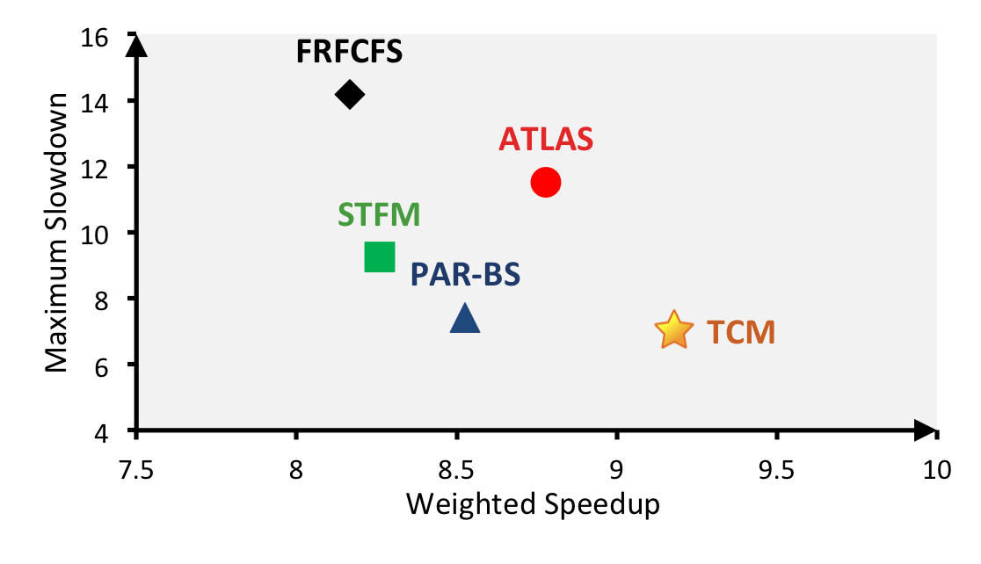
TCM: Throughput and Fairness
24 cores, 4 memory controllers, 96 workloads
Better fairness
Better system throughput
TCM, a heterogeneous scheduling policy,
provides best fairness and system throughput
Notes:
This figure shows the performance of the four previous scheduling algorithms in addition to TCM, averaged over 96 workloads.
FRFCFS has low system throughput and fairness.
STFM and PAR-BS is biased towards fairness, while ATLAS is biased towards system throughput.
TCM lies towards the lower right part of the figure and provides the best fairness and system throughput.
Compared to ATLAS, TCM provides approx 5% better throughput and 39% better fairness.
Compared to PAR-BS, TCM provides approx 5% better fairness and 8% better throughput.

Slide 47
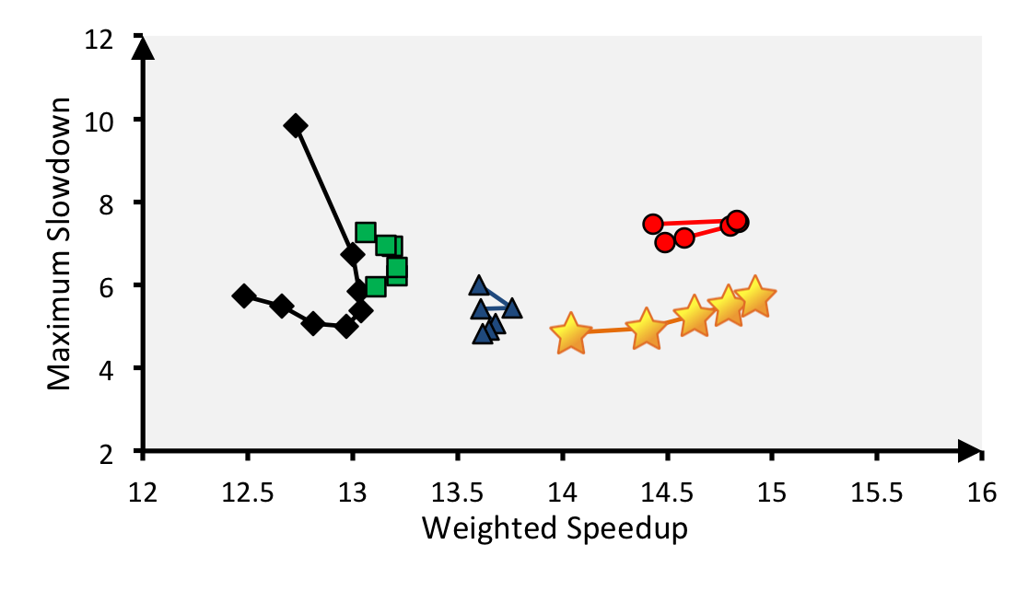
TCM: Fairness-Throughput Tradeoff
When configuration parameter is varied…
Better fairness
FRFCFS
STFM
Better system throughput
ATLAS
PAR-BS
TCM
Adjusting ClusterThreshold
TCM allows robust fairness-throughput tradeoff

Slide 48
Designing QoS-Aware Memory Systems: Approaches
Smart resources: Design each shared resource to have a configurable interference control/reduction mechanism
  QoS-aware memory controllers [Mutlu+ MICRO’07] [Moscibroda+, Usenix Security’07] [Mutlu+ ISCA’08, Top Picks’09] [Kim+ HPCA’10] [Kim+ MICRO’10, Top Picks’11] [Ebrahimi+ ISCA’11, MICRO’11] [Ausavarungnirun+, ISCA’12][Subramanian+, HPCA’13] [Kim+, RTAS’14]
  QoS-aware interconnects [Das+ MICRO’09, ISCA’10, Top Picks ’11] [Grot+ MICRO’09, ISCA’11, Top Picks ’12]
  QoS-aware caches
Dumb resources: Keep each resource free-for-all, but reduce/control interference by injection control or data mapping
  Source throttling to control access to memory system [Ebrahimi+ ASPLOS’10, ISCA’11, TOCS’12] [Ebrahimi+ MICRO’09] [Nychis+ HotNets’10] [Nychis+ SIGCOMM’12]
  QoS-aware data mapping to memory controllers [Muralidhara+ MICRO’11]
  QoS-aware thread scheduling to cores [Das+ HPCA’13]

Slide 49
Predictable Performance in Complex Systems
CPU
CPU
CPU
CPU
GPU
HWA
HWA
Shared Cache
DRAM and Hybrid Memory Controllers
DRAM and Hybrid Memories
Heterogeneous agents: CPUs, GPUs, and HWAs
Main memory interference between CPUs, GPUs, HWAs
How to allocate resources to heterogeneous agents
to mitigate interference and provide predictable performance?

Slide 50
Strong Memory Service Guarantees
Goal: Satisfy performance/SLA requirements in the presence of shared main memory, prefetchers, heterogeneous agents, and hybrid memory/storage
Approach:
  Develop techniques/models to accurately estimate the performance of an application/agent in the presence of resource sharing
  Develop mechanisms (hardware and software) to enable the resource partitioning/prioritization needed to achieve the required performance levels for all applications
  All the while providing high system performance
Example work: Subramanian et al., “MISE: Providing Performance Predictability and Improving Fairness in Shared Main Memory Systems,” HPCA 2013.

Slide 51
Readings on Memory QoS (I)
Moscibroda and Mutlu, “Memory Performance Attacks,” USENIX Security 2007.
Mutlu and Moscibroda, “Stall-Time Fair Memory Access Scheduling,” MICRO 2007.
Mutlu and Moscibroda, “Parallelism-Aware Batch Scheduling,” ISCA 2008, IEEE Micro 2009.
Kim et al., “ATLAS: A Scalable and High-Performance Scheduling Algorithm for Multiple Memory Controllers,” HPCA 2010.
Kim et al., “Thread Cluster Memory Scheduling,” MICRO 2010, IEEE Micro 2011.
Muralidhara et al., “Memory Channel Partitioning,” MICRO 2011.
Ausavarungnirun et al., “Staged Memory Scheduling,” ISCA 2012.
Subramanian et al., “MISE: Providing Performance Predictability and Improving Fairness in Shared Main Memory Systems,” HPCA 2013.
Das et al., “Application-to-Core Mapping Policies to Reduce Memory System Interference in Multi-Core Systems,” HPCA 2013.

Slide 52
Readings on Memory QoS (II)
Ebrahimi et al., “Fairness via Source Throttling,” ASPLOS 2010, ACM TOCS 2012.
Lee et al., “Prefetch-Aware DRAM Controllers,” MICRO 2008, IEEE TC 2011.
Ebrahimi et al., “Parallel Application Memory Scheduling,” MICRO 2011.
Ebrahimi et al., “Prefetch-Aware Shared Resource Management for Multi-Core Systems,” ISCA 2011.

Slide 53
Some Current Directions
New memory/storage + compute architectures
  Rethinking DRAM and flash memory
  Processing close to data; accelerating bulk operations
  Ensuring memory/storage reliability and robustness
Enabling emerging NVM technologies
  Hybrid memory systems with automatic data management
  Coordinated management of memory and storage with NVM
System-level memory/storage QoS
  QoS-aware controller and system design
  Coordinated memory + storage QoS

Slide 54
Agenda
Major Trends Affecting Main Memory
The Memory Scaling Problem and Solution Directions
  New Memory Architectures
  Enabling Emerging Technologies: Hybrid Memory Systems
How Can We Do Better?
Summary

Slide 55
Tolerating DRAM: Example Techniques
Retention-Aware DRAM Refresh: Reducing Refresh Impact
Refresh Access Parallelization: Reducing Refresh Impact
Tiered-Latency DRAM: Reducing DRAM Latency
RowClone: Accelerating Page Copy and Initialization
Subarray-Level Parallelism: Reducing Bank Conflict Impact
Base-Delta-Immediate Compression and Linearly Compressed Pages: Efficient Cache & Memory Compression

Slide 56
DRAM Refresh
DRAM capacitor charge leaks over time
The memory controller needs to refresh each row periodically to restore charge
  Activate each row every N ms
  Typical N = 64 ms
Downsides of refresh
-- Energy consumption: Each refresh consumes energy
  -- Performance degradation: DRAM rank/bank unavailable while refreshed
  -- QoS/predictability impact: (Long) pause times during refresh
  -- Refresh rate limits DRAM capacity scaling

Slide 57
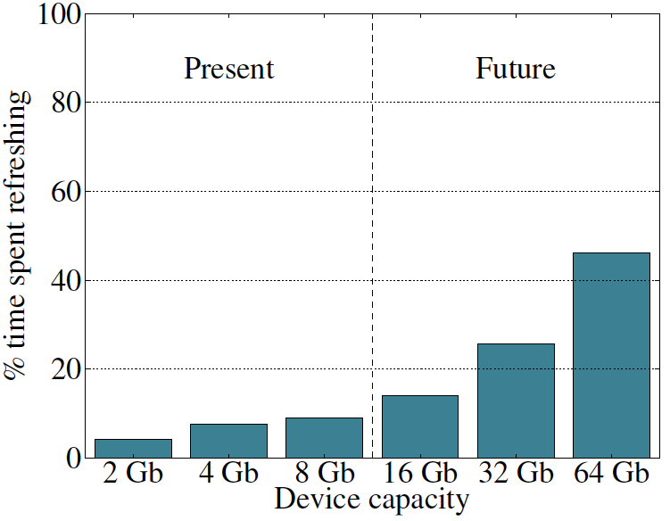
Refresh Overhead: Performance
46%
8%

Slide 58
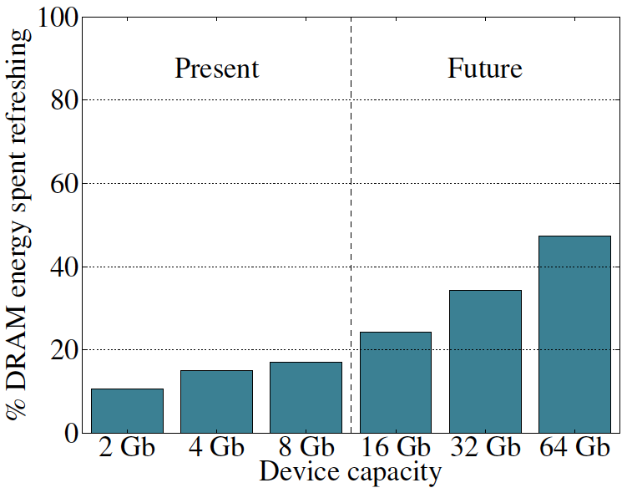
Refresh Overhead: Energy
47%
15%

Slide 59

Retention Time Profile of DRAM

Slide 60
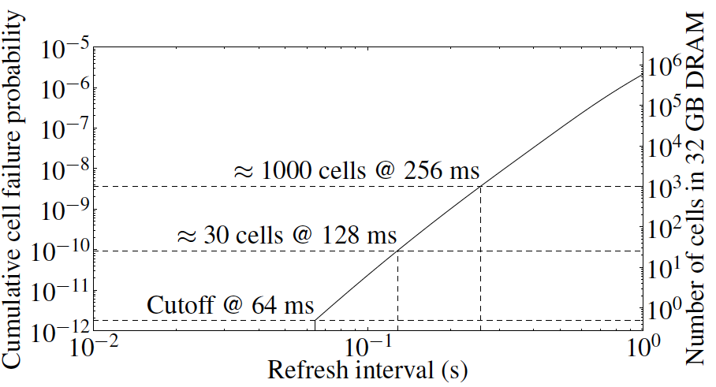
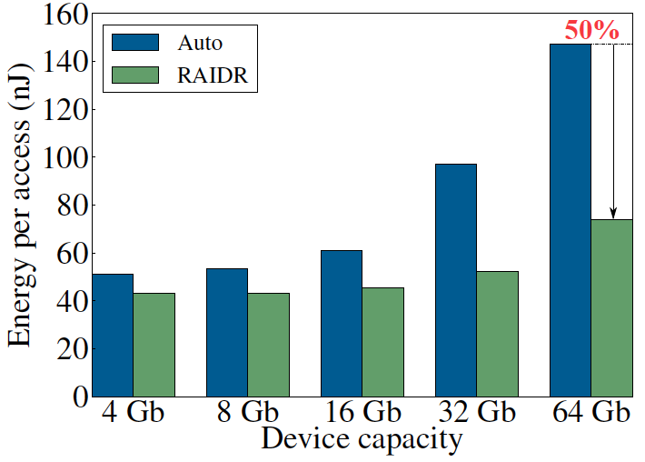
RAIDR: Eliminating Unnecessary Refreshes
Observation: Most DRAM rows can be refreshed much less often without losing data [Kim+, EDL’09][Liu+ ISCA’13]
Key idea: Refresh rows containing weak cells
more frequently, other rows less frequently
  1. Profiling: Profile retention time of all rows
  2. Binning: Store rows into bins by retention time in memory controller
  Efficient storage with Bloom Filters (only 1.25KB for 32GB memory)
  3. Refreshing: Memory controller refreshes rows in different bins at different rates
Results: 8-core, 32GB, SPEC, TPC-C, TPC-H
  74.6% refresh reduction @ 1.25KB storage
  ~16%/20% DRAM dynamic/idle power reduction
  ~9% performance improvement
  Benefits increase with DRAM capacity
Liu et al., “RAIDR: Retention-Aware Intelligent DRAM Refresh,” ISCA 2012.

Slide 61
Going Forward (for DRAM and Flash)
How to find out and expose weak memory cells/rows
  Liu+, “An Experimental Study of Data Retention Behavior in Modern DRAM Devices: Implications for Retention Time Profiling Mechanisms”, ISCA 2013.
  Khan+, “The Efficacy of Error Mitigation Techniques for DRAM Retention Failures: A Comparative Experimental Study,” SIGMETRICS 2014.
Low-cost system-level tolerance of memory errors
  Luo+, “Characterizing Application Memory Error Vulnerability to Optimize Data Center Cost,” DSN 2014.
  Cai+, “Error Analysis and Retention-Aware Error Management for NAND Flash Memory,” Intel Technology Journal 2013.
  Cai+, “Neighbor-Cell Assisted Error Correction for MLC NAND Flash Memories,” SIGMETRICS 2014.
Tolerating cell-to-cell interference at the system level
  Kim+, “Flipping Bits in Memory Without Accessing Them: An Experimental Study of DRAM Disturbance Errors,” ISCA 2014.
  Cai+, “Program Interference in MLC NAND Flash Memory: Characterization, Modeling, and Mitigation,” ICCD 2013.

Slide 62
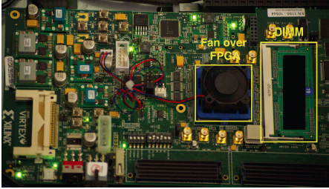
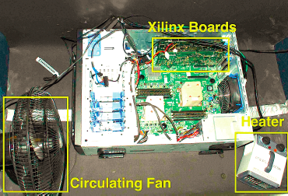
Experimental Infrastructure (DRAM)
  Liu+, “An Experimental Study of Data Retention Behavior in Modern DRAM Devices: Implications for Retention Time Profiling Mechanisms”, ISCA 2013.
  Khan+, “The Efficacy of Error Mitigation Techniques for DRAM Retention Failures: A Comparative Experimental Study,” SIGMETRICS 2014.

Slide 63

Experimental Infrastructure (DRAM)
Temperature
Controller
FPGAs
Heater
FPGAs
PC
  Kim+, “Flipping Bits in Memory Without Accessing Them: An Experimental Study of DRAM Disturbance Errors,” ISCA 2014.

Slide 64
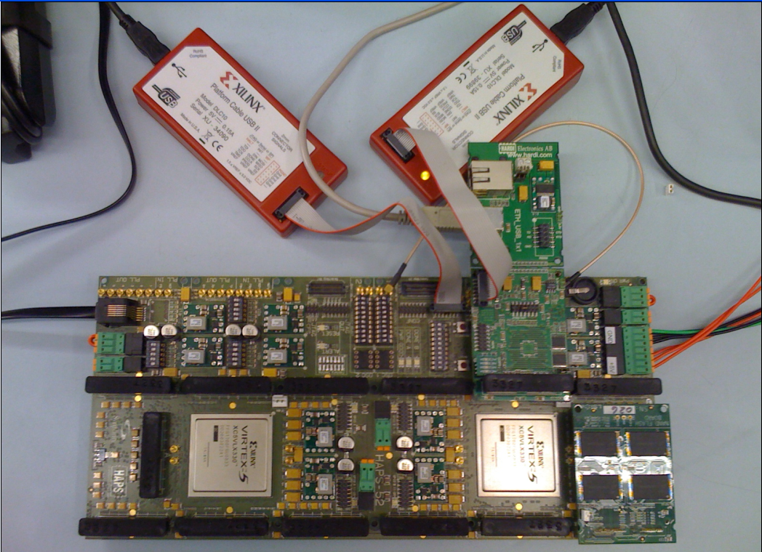
Experimental Infrastructure (Flash)
USB Daughter Board
USB Jack
HAPS-52 Mother Board
Virtex-II Pro
(USB controller)
3x-nm
NAND Flash
Virtex-V FPGA
(NAND Controller)
[Cai+, DATE 2012, ICCD 2012, DATE 2013, ITJ 2013, ICCD 2013, SIGMETRICS 2014]
NAND Daughter Board

Slide 65
Another Talk: NAND Flash Scaling Challenges
Cai+, “Error Patterns in MLC NAND Flash Memory: Measurement, Characterization, and Analysis,” DATE 2012.
Cai+, “Flash Correct-and-Refresh: Retention-Aware Error Management for Increased Flash Memory Lifetime,” ICCD 2012.
Cai+, “Threshold Voltage Distribution in MLC NAND Flash Memory: Characterization, Analysis and Modeling,” DATE 2013.
Cai+, “Error Analysis and Retention-Aware Error Management for NAND Flash Memory,” Intel Tech Journal 2013.
Cai+, “Program Interference in MLC NAND Flash Memory: Characterization, Modeling, and Mitigation,” ICCD 2013.
Cai+, “Neighbor-Cell Assisted Error Correction for MLC NAND Flash Memories,” SIGMETRICS 2014.

Slide 66

Error Management in MLC NAND Flash
Problem: MLC NAND flash memory reliability/endurance is a key challenge for satisfying future storage systems’ requirements
Our Goals: (1) Build reliable error models for NAND flash memory via experimental characterization, (2) Develop efficient techniques to improve reliability and endurance
This talk provides a “flash” summary of our recent results published in the past 3 years:
  Experimental error and threshold voltage characterization [DATE’12&13]
  Retention-aware error management [ICCD’12]
  Program interference analysis and read reference V prediction [ICCD’13]
  Neighbor-assisted error correction [SIGMETRICS’14]

Slide 67
Tolerating DRAM: Example Techniques
Retention-Aware DRAM Refresh: Reducing Refresh Impact
Refresh Access Parallelization: Reducing Refresh Impact
Tiered-Latency DRAM: Reducing DRAM Latency
RowClone: Accelerating Page Copy and Initialization
Subarray-Level Parallelism: Reducing Bank Conflict Impact
Base-Delta-Immediate Compression and Linearly Compressed Pages: Efficient Cache & Memory Compression

Slide 68
DRAM Latency-Capacity Trend
16X
-20%
DRAM latency continues to be a critical bottleneck, especially for response time-sensitive workloads
Notes:
The figure shows the historical trends of DRAM during the last 12-years, from 2000 to 2011.
We can see that, during this time, DRAM capacity has increased by 16 times.
On the other hand, during the same period of time, DRAM latency has reduced by only 20%.
As a result, the high DRAM latency continues to be a critical bottleneck for system performance.

Slide 69
What Causes the Long Latency?
DRAM Chip
DRAM Chip
cell array
subarray
Subarray
I/O
I/O
I/O
channel
channel
DRAM Latency = Subarray Latency + I/O Latency
DRAM Latency = Subarray Latency + I/O Latency
Dominant
Notes:
To understand what causes the long latency, let me take a look at the DRAM organization.
DRAM consists of two components, the cell array and the I/O circuitry. The cell array consists of multiple subarrays.
To read from a DRAM chip, the data is first accessed from the subarray and then the data is transferred over the channel by the I/O circuitry.
So, the DRAM latency is the sum of the subarray latency and the I/O latency.
We observed that the subarray latency is much higher than the I/O latency.
As a result, subarray is the dominant source of the DRAM latency as we explained in the paper.

Slide 70
Why is the Subarray So Slow?
Subarray
Cell
cell
wordline
bitline: 512 cells
access
row decoder
row decoder
transistor
capacitor
sense amplifier
bitline
sense amplifier
large sense amplifier
Long bitline
  Amortizes sense amplifier cost → Small area
  Large bitline capacitance → High latency & power
Notes:
The cell’s capacitor is small and can store only a small amount of charge.
That is why a subarray also has sense-amplifiers, which are specialized circuits that can detect the small amount of charge.
Unfortunately, a sense-amplifier size is about *100* times the cell size.
So, to amortize the area of the sense-amplifiers,
hundreds of cells share the same sense-amplifier through a long bitline.
However, a long bitline has a large capacitance that increases latency and power consumption.
Therefore, the long bitline is one of the dominant sources of high latency and high power consumption.
To understand why the subarray is so slow,
let me take a look at the subarray organization.

Slide 71
Trade-Off: Area (Die Size) vs. Latency
Long Bitline
Short Bitline
Faster
Smaller
Trade-Off: Area vs. Latency
Notes:
A naïve way to reduce the DRAM latency is to have short bitlines that have lower latency.
Unfortunately, short bitlines significantly increase the DRAM area.
Therefore, the bitline length exposes an important trade-off between area and latency.

Slide 72
Trade-Off: Area (Die Size) vs. Latency
32
Fancy DRAM
Short Bitline
Commodity DRAM
Long Bitline
64
Cheaper
128
256
512 cells/bitline
GOAL
Faster
Notes:
This figure shows the trade-off between DRAM area and latency as we change the bitline length.
Y-axis is the normalized DRAM area compared to a DRAM using 512 cells/bitline. A lower value is cheaper.
X-axis shows the latency in terms of tRC, an important DRAM timing constraint. A lower value is faster.
Commodity DRAM chips use long bitlines to minimize area cost. On the other hand, shorter bitlines achieve lower latency at higher cost.
Our goal is to achieve the best of both worlds: low latency and low area cost.

Slide 73
Approximating the Best of Both Worlds
Long Bitline
Long Bitline
Our Proposal
Short Bitline
Short Bitline
Small Area
Large Area
Small Area
High Latency
Low Latency
Low Latency
Need Isolation
Add Isolation Transistors
Short Bitline ➔ Fast
Notes:
To sum up, both long and short bitline do not achieve small area and low latency.
Long bitline has small area but has high latency while short bitline has low latency but has large area.
To achieve the best of both worlds, we first start from long bitline, which has small area.
After that, to achieve the low latency of short bitline, we divide the long bitline into two smaller segments.
The bitline length of the segment nearby the sense-amplifier is same as the length of short bitline.
Therefore, the latency of the segment is as low as the latency of the short bitline.
To isolate this fast segment from the other segment, we add isolation transistors that selectively connect the two segments.

Slide 74
Approximating the Best of Both Worlds
Long Bitline
Tiered-Latency DRAM
Our Proposal
Short Bitline
Long Bitline
Short Bitline
Small Area
Small Area
Large Area
High Latency
Low Latency
Low Latency
Small area using long bitline
Low Latency
Notes:
This way, our proposed approach achieves small area and low latency.
We call this new DRAM architecture as Tiered-Latency DRAM

Slide 75
Tiered-Latency DRAM
Divide a bitline into two segments with an isolation transistor
Far Segment
Isolation Transistor
Near Segment
Sense Amplifier
Lee+, “Tiered-Latency DRAM: A Low Latency and Low Cost DRAM Architecture,” HPCA 2013.
Notes:
Again, the key idea is to divide a subarray into two segments with isolation transistors.
The segment, directly connected to the sense amplifier, is called the near segment.
The other segment is called the far segment.

Slide 76
Commodity DRAM vs. TL-DRAM
DRAM Latency (tRC)
DRAM Power
  +49%
  +23%
  (52.5ns)
Latency
Power
  –56%
  –51%
  Near Far
  Near Far
  Commodity DRAM
  Commodity DRAM
  TL-DRAM
  TL-DRAM
DRAM Area Overhead
  ~3%: mainly due to the isolation transistors
Notes:
This figure compares the latency.
Y-axis is normalized latency.
Compared to commodity DRAM, TL-DRAM’s near segment has 56% lower latency, while the far segment has 23% higher latency.
The right figure compares the power.
Y-axis is normalized power.
Compared to commodity DRAM, TL-DRAM’s near segment has 51% lower power consumption and the far segment has 49% higher power consumption.
Lastly, mainly due to the isolation transistor, Tiered-latency DRAM increases the die-size by about 3%.

Slide 77
Trade-Off: Area (Die-Area) vs. Latency
32
64
Cheaper
128
256
512 cells/bitline
Near Segment
Far Segment
GOAL
Faster
Notes:
Again, the figure shows the trade-off between area and latency in existing DRAM.
Unlike existing DRAM, TL-DRAM achieves low latency using the near segment while increasing the area by only 3%.
Although the far segment has higher latency than commodity DRAM, we show that efficient use of the near segment enables TL-DRAM to achieve high system performance.

Slide 78
Leveraging Tiered-Latency DRAM
TL-DRAM is a substrate that can be leveraged by the hardware and/or software
Many potential uses
  Use near segment as hardware-managed inclusive cache to far segment
  Use near segment as hardware-managed exclusive cache to far segment
  Profile-based page mapping by operating system
  Simply replace DRAM with TL-DRAM
Notes:
There are multiple ways to leverage the TL-DRAM substrate by hardware or software.
In this slide, I describe many such ways.
First, the near segment can be used as a hardware-managed inclusive cache to the far segment.
Second, the near segment can be used as a hardware-managed exclusive cache to the far segment.
Third, the operating system can intelligently allocate frequently-accessed pages to the near segment.
Forth mechanism is to simple replace DRAM with TL-DRAM without any near segment handling
While our paper provides detailed explanations and evaluations of first three mechanism,
in this talk, we will focus on the first approach, which is to use the near segment as a hardware managed cache for the far segment.

Slide 79
Performance & Power Consumption
12.4%
11.5%
10.7%
–23%
–24%
–26%
Normalized Performance
Normalized Power
Core-Count (Channel)
Core-Count (Channel)
Using near segment as a cache improves performance and reduces power consumption
Notes:
This figure shows the IPC improvement of our three caching mechanisms over commodity DRAM.
All of them improve performance and benefit-based caching shows maximum performance improvement by 12.7%.
The right figure shows the normalized power reduction of our three caching mechanisms over commodity DRAM.
All of them reduce power consumption and benefit-based caching shows maximum power reduction by 23%.
Therefore, using near segment as a cache improves performance and reduces power consumption at the cost of 3% area overhead.

Slide 80
Tolerating DRAM: Example Techniques
Retention-Aware DRAM Refresh: Reducing Refresh Impact
Refresh Access Parallelization: Reducing Refresh Impact
Tiered-Latency DRAM: Reducing DRAM Latency
RowClone: Accelerating Page Copy and Initialization
Subarray-Level Parallelism: Reducing Bank Conflict Impact
Base-Delta-Immediate Compression and Linearly Compressed Pages: Efficient Cache & Memory Compression

Slide 81
Today’s Memory: Bulk Data Copy
1) High latency
Memory
3) Cache pollution
L3
CPU
L2
L1
MC
2) High bandwidth utilization
4) Unwanted data movement
1046ns, 3.6uJ

Slide 82
Future: RowClone (In-Memory Copy)
3) No cache pollution
1) Low latency
Memory
L3
CPU
L2
L1
MC
2) Low bandwidth utilization
4) No unwanted data movement
1046ns, 3.6uJ
90ns, 0.04uJ

Slide 83
DRAM Subarray Operation (load one byte)
4 Kbits
Step 1: Activate row
Transfer row
DRAM array
Row Buffer (4 Kbits)
Step 2: Read
Transfer byte onto bus
8 bits
Data Bus
Notes:
say you want a byte

Slide 84
RowClone: In-DRAM Row Copy
4 Kbits
Step 1: Activate row A
Step 2: Activate row B
Transfer row
DRAM array
Transfer
row
0.01% area cost
Row Buffer (4 Kbits)
8 bits
Data Bus
Notes:
copy

Slide 85
RowClone: Latency and Energy Savings
11.6x
74x
Seshadri et al., “RowClone: Fast and Efficient In-DRAM Copy and Initialization of Bulk Data,” MICRO 2013.

Slide 86
End-to-End System Design
Application
How does the software communicate occurrences of bulk copy/initialization to hardware?
Operating System
How to ensure cache coherence?
ISA
How to maximize latency and energy savings?
Microarchitecture
DRAM (RowClone)
How to handle data reuse?

Slide 87
RowClone: Overall Performance

Slide 88
RowClone: Multi-Core Performance

Slide 89
Goal: Ultra-Efficient Processing By Data
CPU
core
CPU
core
mini-CPU
core
GPU
(throughput)
core
GPU
(throughput)
core
video
core
GPU
(throughput)
core
GPU
(throughput)
core
CPU
core
CPU
core
Memory
imaging
core
LLC
Specialized
compute-capability
in memory
Memory Controller
Memory Bus
Goal: Memory similar to a “conventional” accelerator

Slide 90
Enabling Ultra-Efficient Search
What is the right partitioning of computation capability?
What is the right low-cost memory substrate?
What memory technologies are the best enablers?
How do we rethink/ease (visual) search algorithms/applications?
Memory
Processor
Core
Database
Cache
Query vector
Interconnect
Results

Slide 91
Tolerating DRAM: Example Techniques
Retention-Aware DRAM Refresh: Reducing Refresh Impact
Refresh Access Parallelization: Reducing Refresh Impact
Tiered-Latency DRAM: Reducing DRAM Latency
RowClone: Accelerating Page Copy and Initialization
Subarray-Level Parallelism: Reducing Bank Conflict Impact
Base-Delta-Immediate Compression and Linearly Compressed Pages: Efficient Cache & Memory Compression

Slide 92
More Efficient Cache Utilization
Compressing redundant data
  Gennady Pekhimenko, Vivek Seshadri, Onur Mutlu, Philip B. Gibbons, Michael A. Kozuch, and Todd C. Mowry,
  "Base-Delta-Immediate Compression: Practical Data Compression for On-Chip Caches"
  Proceedings of the 21st ACM International Conference on Parallel Architectures and Compilation Techniques (PACT), Minneapolis, MN, September 2012. Slides (pptx)
  Gennady Pekhimenko, Vivek Seshadri, Yoongu Kim, Hongyi Xin, Onur Mutlu, Michael A. Kozuch, Phillip B. Gibbons, and Todd C. Mowry,
  "Linearly Compressed Pages: A Low-Complexity, Low-Latency Main Memory Compression Framework"
  Proceedings of the 46th International Symposium on Microarchitecture (MICRO), Davis, CA, December 2013. Slides (pptx) (pdf) Lightning Session Slides (pptx) (pdf)
Reducing pollution and thrashing
  Vivek Seshadri, Onur Mutlu, Michael A. Kozuch, and Todd C. Mowry,
  "The Evicted-Address Filter: A Unified Mechanism to Address Both Cache Pollution and Thrashing"
  Proceedings of the 21st ACM International Conference on Parallel Architectures and Compilation Techniques (PACT), Minneapolis, MN, September 2012. Slides (pptx)

Slide 93
Key Data Patterns in Real Applications
  Zero Values: initialization, sparse matrices, NULL pointers
  Low Dynamic Range:
  Differences between values are significantly smaller than the values themselves
0x00000000
0x00000000
0x00000000
0x00000000
…
  Repeated Values: common initial values, adjacent pixels
0x000000FF
0x000000FF
0x000000FF
0x000000FF
…
  Narrow Values: small values stored in a big data type
0x00000000
0x0000000B
0x00000003
0x00000004
…
  Other Patterns: pointers to the same memory region
0xC04039C0
0xC04039C8
0xC04039D0
0xC04039D8
…

Slide 94
Key Idea: Base+Delta (B+Δ) Encoding
4 bytes
32-byte Uncompressed Cache Line
0xC04039C0
0xC04039C8
0xC04039D0
…
0xC04039F8
0xC04039C0
Base
12-byte
Compressed Cache Line
0x00
0x08
0x10
…
0x38
1 byte
1 byte
1 byte
  ✓ Fast Decompression: vector addition
  ✓ Simple Hardware:
  arithmetic and comparison
  20 bytes saved
  ✓ Effective: good compression ratio

Slide 95
Can We Do Better?
Uncompressible cache line (with a single base):
Key idea:
Use more bases, e.g., two instead of one
Pro:
  More cache lines can be compressed
Cons:
  Unclear how to find these bases efficiently
  Higher overhead (due to additional bases)
0x00000000
0x09A40178
0x0000000B
0x09A4A838
…

Slide 96
How to Find Two Bases Efficiently?
  First base - first element in the cache line
  Second base - implicit base of 0
Advantages over 2 arbitrary bases:
  Better compression ratio
  Simpler compression logic
  ✓ Base+Delta part
  ✓ Immediate part
  Base-Delta-Immediate (BΔI) Compression

Slide 97
Agenda
Major Trends Affecting Main Memory
The Memory Scaling Problem and Solution Directions
  New Memory Architectures
  Enabling Emerging Technologies: Hybrid Memory Systems
How Can We Do Better?
Summary

Slide 98
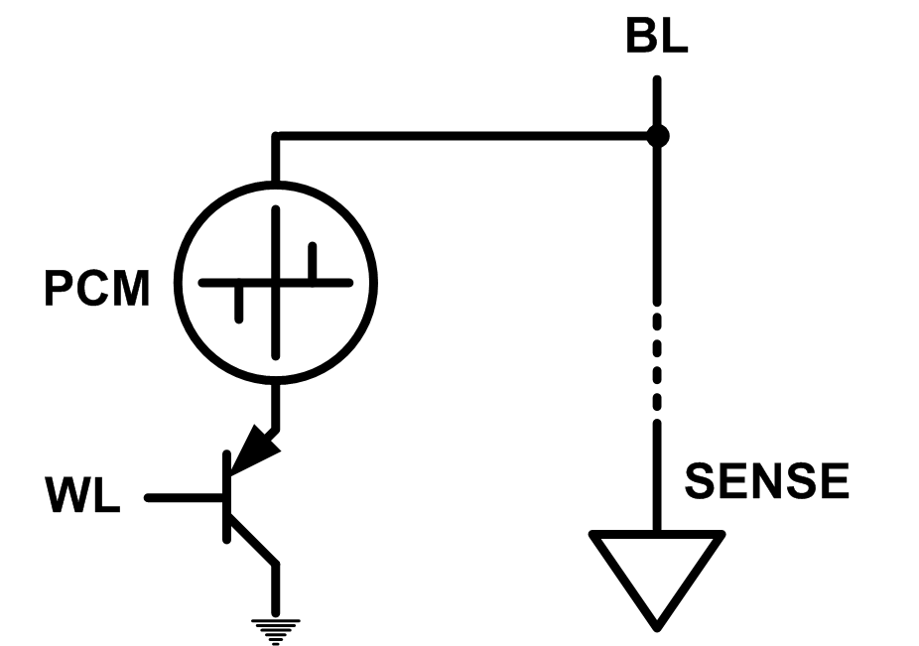
Solution 2: Emerging Memory Technologies
Some emerging resistive memory technologies seem more scalable than DRAM (and they are non-volatile)
Example: Phase Change Memory
  Data stored by changing phase of material
  Data read by detecting material’s resistance
  Expected to scale to 9nm (2022 [ITRS])
  Prototyped at 20nm (Raoux+, IBM JRD 2008)
  Expected to be denser than DRAM: can store multiple bits/cell
But, emerging technologies have (many) shortcomings
  Can they be enabled to replace/augment/surpass DRAM?
Notes:
Even if DRAM continues to scale there could be benefits to examining and enabling these new technologies.

Slide 99
Charge vs. Resistive Memories
Charge Memory (e.g., DRAM, Flash)
  Write data by capturing charge Q
  Read data by detecting voltage V
Resistive Memory (e.g., PCM, STT-MRAM, memristors)
  Write data by pulsing current dQ/dt
  Read data by detecting resistance R

Slide 100
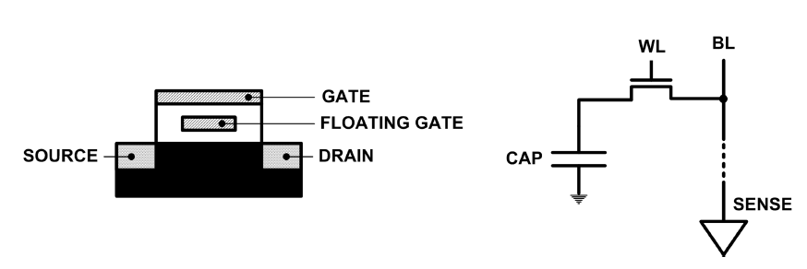
Limits of Charge Memory
Difficult charge placement and control
  Flash: floating gate charge
  DRAM: capacitor charge, transistor leakage
Reliable sensing becomes difficult as charge storage unit size reduces

Slide 101
Promising Resistive Memory Technologies
PCM
  Inject current to change material phase
  Resistance determined by phase
STT-MRAM
  Inject current to change magnet polarity
  Resistance determined by polarity
Memristors/RRAM/ReRAM
  Inject current to change atomic structure
  Resistance determined by atom distance

Slide 102
Phase Change Memory: Pros and Cons
Pros over DRAM
  Better technology scaling (capacity and cost)
  Non volatility
  Low idle power (no refresh)
Cons
  Higher latencies: ~4-15x DRAM (especially write)
  Higher active energy: ~2-50x DRAM (especially write)
  Lower endurance (a cell dies after ~10⁸ writes)
  Reliability issues (resistance drift)
Challenges in enabling PCM as DRAM replacement/helper:
  Mitigate PCM shortcomings
  Find the right way to place PCM in the system

Slide 103
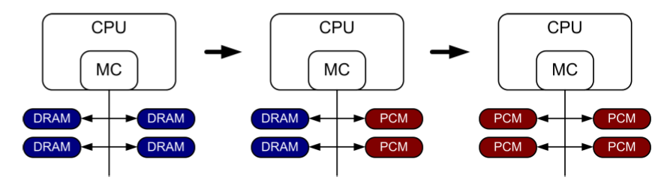
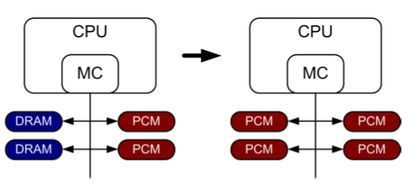
PCM-based Main Memory (I)
How should PCM-based (main) memory be organized?
Hybrid PCM+DRAM [Qureshi+ ISCA’09, Dhiman+ DAC’09]:
  How to partition/migrate data between PCM and DRAM

Slide 104
PCM-based Main Memory (II)
How should PCM-based (main) memory be organized?
Pure PCM main memory [Lee et al., ISCA’09, Top Picks’10]:
  How to redesign entire hierarchy (and cores) to overcome PCM shortcomings

Slide 105
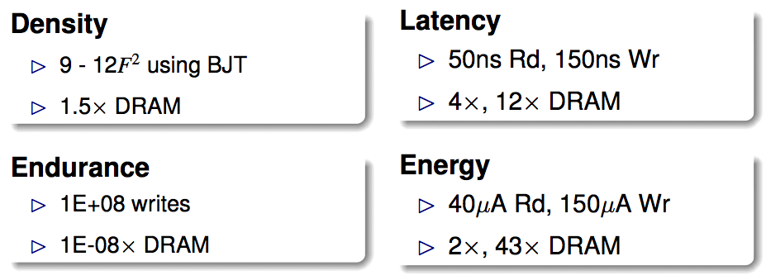
An Initial Study: Replace DRAM with PCM
Lee, Ipek, Mutlu, Burger, “Architecting Phase Change Memory as a Scalable DRAM Alternative,” ISCA 2009.
  Surveyed prototypes from 2003-2008 (e.g. IEDM, VLSI, ISSCC)
  Derived “average” PCM parameters for F=90nm

Slide 106
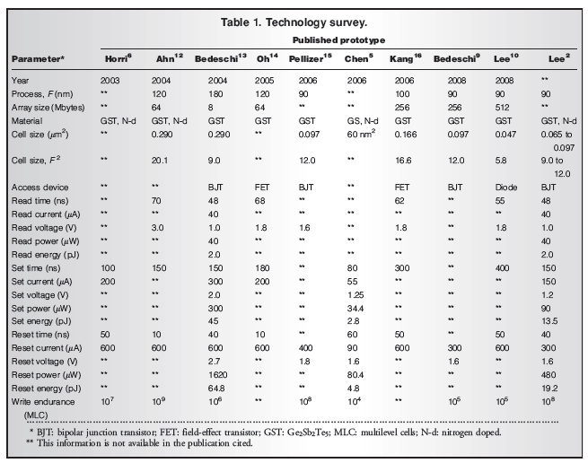

Slide 107
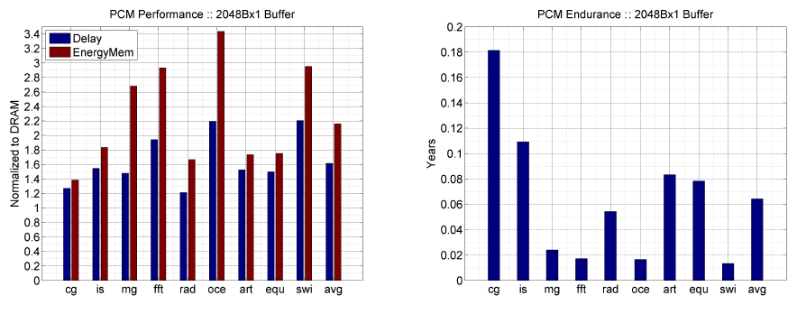
Results: Naïve Replacement of DRAM with PCM
Replace DRAM with PCM in a 4-core, 4MB L2 system
PCM organized the same as DRAM: row buffers, banks, peripherals
1.6x delay, 2.2x energy, 500-hour average lifetime
Lee, Ipek, Mutlu, Burger, “Architecting Phase Change Memory as a Scalable DRAM Alternative,” ISCA 2009.

Slide 108
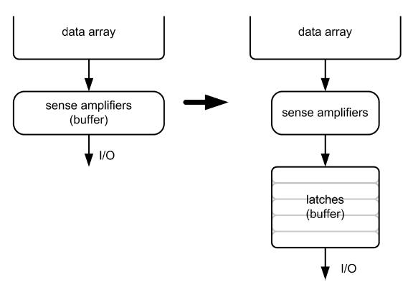
Architecting PCM to Mitigate Shortcomings
Idea 1: Use multiple narrow row buffers in each PCM chip
    → Reduces array reads/writes → better endurance, latency, energy
Idea 2: Write into array at
cache block or word
granularity
→ Reduces unnecessary wear
DRAM
PCM

Slide 109
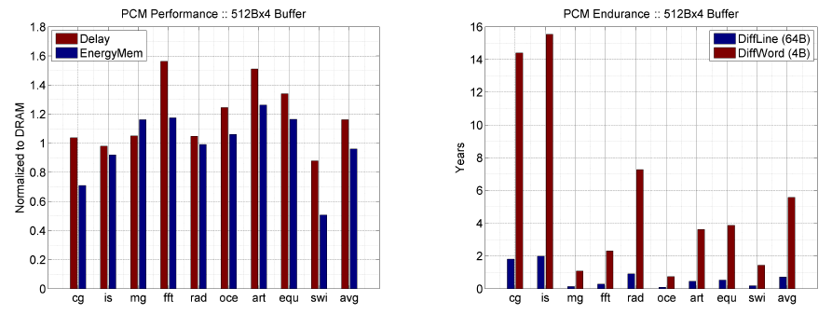
Results: Architected PCM as Main Memory
1.2x delay, 1.0x energy, 5.6-year average lifetime
Scaling improves energy, endurance, density
Caveat 1: Worst-case lifetime is much shorter (no guarantees)
Caveat 2: Intensive applications see large performance and energy hits
Caveat 3: Optimistic PCM parameters?

Slide 110
Hybrid Memory Systems
CPU
Meza+, “Enabling Efficient and Scalable Hybrid Memories,” IEEE Comp. Arch. Letters, 2012.
Yoon, Meza et al., “Row Buffer Locality Aware Caching Policies for Hybrid Memories,” ICCD 2012 Best Paper Award.
DRAMCtrl
PCM Ctrl
DRAM
Phase Change Memory (or Tech. X)
Fast, durable
Small,
leaky, volatile,
high-cost
Large, non-volatile, low-cost
Slow, wears out, high active energy
Hardware/software manage data allocation and movement
to achieve the best of multiple technologies

Slide 111
One Option: DRAM as a Cache for PCM
PCM is main memory; DRAM caches memory rows/blocks
  Benefits: Reduced latency on DRAM cache hit; write filtering
Memory controller hardware manages the DRAM cache
  Benefit: Eliminates system software overhead
Three issues:
  What data should be placed in DRAM versus kept in PCM?
  What is the granularity of data movement?
  How to design a huge (DRAM) cache at low cost?
Two solutions:
  Locality-aware data placement [Yoon+ , ICCD 2012]
  Cheap tag stores and dynamic granularity [Meza+, IEEE CAL 2012]

Slide 112
DRAM vs. PCM: An Observation
Row buffers are the same in DRAM and PCM
Row buffer hit latency same in DRAM and PCM
Row buffer miss latency small in DRAM, large in PCM
Accessing the row buffer in PCM is fast
What incurs high latency is the PCM array access → avoid this
CPU
Row buffer
DRAMCtrl
PCM Ctrl
DRAM Cache
PCM Main Memory
Bank
Bank
Bank
Bank
N ns row hit
Fast row miss
N ns row hit
Slow row miss

Slide 113
Row-Locality-Aware Data Placement
Idea: Cache in DRAM only those rows that
  Frequently cause row buffer conflicts → because row-conflict latency is smaller in DRAM
  Are reused many times → to reduce cache pollution and bandwidth waste
Simplified rule of thumb:
  Streaming accesses: Better to place in PCM
  Other accesses (with some reuse): Better to place in DRAM
Yoon et al., “Row Buffer Locality-Aware Data Placement in Hybrid Memories,” ICCD 2012 Best Paper Award.

Slide 114
Row-Locality-Aware Data Placement: Results
10%
14%
17%
Memory energy-efficiency and fairness also improve correspondingly

Slide 115
Hybrid vs. All-PCM/DRAM
29%
31%
31% better performance than all PCM,
within 29% of all DRAM performance
Notes:
Now let’s compare our mechanism to a homogeneous memory system.
Here the comparison points are a 16GB all-PCM and all-DRAM memory system.
Our mechanism achieves 31% better performance than the all-PCM memory system, and comes within 29% of the all-DRAM performance.
Note that we do not assume any capacity benefits of PCM over DRAM.
And yet, our mechanism bridges the performance gap between the two homogeneous memory systems.
If the capacity benefit of PCM was included, the hybrid memory system will perform even better.

Slide 116
Aside: STT-MRAM as Main Memory
Magnetic Tunnel Junction (MTJ)
  Reference layer: Fixed
  Free layer: Parallel or anti-parallel
Cell
  Access transistor, bit/sense lines
Read and Write
  Read: Apply a small voltage across bitline and senseline; read the current.
  Write: Push large current through MTJ. Direction of current determines new orientation of the free layer.
Kultursay et al., “Evaluating STT-RAM as an Energy-Efficient Main Memory Alternative,” ISPASS 2013.
Logical 0
Reference Layer
Barrier
Free Layer
Logical 1
Reference Layer
Barrier
Free Layer
Word Line
MTJ
Access
Transistor
Bit Line
Sense Line
Notes:
Moving from DRAM to STT-RAM, instead of a capacitor that stores charge, now we have a magnetic tunnel junction that has one reference layer with a fixed magnetic orientation, and a free layer that can be parallel or anti parallel to the reference layer; which determines the resistance, and in turn, the data stored in the MTJ. In addition to the MTJ, the cell, again, has an access transistor.
Reading requires a small voltage to be applied across the bitline and sense line; and the current is sensed. This current varies depending on the resistance of MTJ. To write data, we push a large current into the MTJ, which re-aligns the free layer. The direction of the current determines whether it becomes parallel or anti-parallel; i.e. logical 0 or 1.

Slide 117
Aside: STT-MRAM: Pros and Cons
Pros over DRAM
  Better technology scaling
  Non volatility
  Low idle power (no refresh)
Cons
  Higher write latency
  Higher write energy
  Reliability?
Another level of freedom
  Can trade off non-volatility for lower write latency/energy (by reducing the size of the MTJ)

Slide 118
Architected STT-MRAM as Main Memory
4-core, 4GB main memory, multiprogrammed workloads
~6% performance loss, ~60% energy savings vs. DRAM
Kultursay+, “Evaluating STT-RAM as an Energy-Efficient Main Memory Alternative,” ISPASS 2013.

Slide 119
Agenda
Major Trends Affecting Main Memory
The Memory Scaling Problem and Solution Directions
  New Memory Architectures
  Enabling Emerging Technologies: Hybrid Memory Systems
How Can We Do Better?
Summary

Slide 120
Principles (So Far)
Better cooperation between devices and the system
  Expose more information about devices to upper layers
  More flexible interfaces
Better-than-worst-case design
  Do not optimize for the worst case
  Worst case should not determine the common case
Heterogeneity in design (specialization, asymmetry)
  Enables a more efficient design (No one size fits all)

Slide 121
Other Opportunities with Emerging Technologies
Merging of memory and storage
  e.g., a single interface to manage all data
New applications
  e.g., ultra-fast checkpoint and restore
More robust system design
  e.g., reducing data loss
Processing tightly-coupled with memory
  e.g., enabling efficient search and filtering

Slide 122
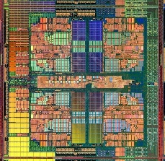
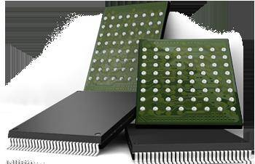

Coordinated Memory and Storage with NVM (I)
The traditional two-level storage model is a bottleneck with NVM
  Volatile data in memory → a load/store interface
  Persistent data in storage → a file system interface
  Problem: Operating system (OS) and file system (FS) code to locate, translate, buffer data become performance and energy bottlenecks with fast NVM stores
Two-Level Store
Load/Store
fopen, fread, fwrite, …
Virtual memory
Operating system
and file system
Processor
and caches
Address translation
Persistent (e.g., Phase-Change)
Memory
Main Memory
Storage (SSD/HDD)

Slide 123
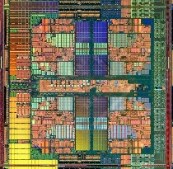
Coordinated Memory and Storage with NVM (II)
Goal: Unify memory and storage management in a single unit to eliminate wasted work to locate, transfer, and translate data
  Improves both energy and performance
  Simplifies programming model as well
Unified Memory/Storage
Persistent Memory
Manager
Processor
and caches
Load/Store
Feedback
Persistent (e.g., Phase-Change) Memory
Meza+, “A Case for Efficient Hardware-Software Cooperative Management of Storage and Memory,” WEED 2013.

Slide 124
The Persistent Memory Manager (PMM)
Exposes a load/store interface to access persistent data
  Applications can directly access persistent memory → no conversion, translation, location overhead for persistent data
Manages data placement, location, persistence, security
  To get the best of multiple forms of storage
Manages metadata storage and retrieval
  This can lead to overheads that need to be managed
Exposes hooks and interfaces for system software
  To enable better data placement and management decisions
Meza+, “A Case for Efficient Hardware-Software Cooperative Management of Storage and Memory,” WEED 2013.
Notes:
Let’s take a closer look at the high-level design goals for a Persistent Memory Manager, or PMM.
[click] The most noticeable feature of the PMM – from the system software perspective – is the fact that it exposes a load/store interface to access all persistent data in the system. This means that applications can allocate portions of persistent memory, just as they would allocate portions of volatile DRAM memory in today’s systems.
[click] Of course, with a diverse array of devices managed by a persistent memory, it will be important for the PMM to leverage each of their strengths – and mitigate each of their weaknesses – as much as possible. To this end, the PMM is responsible for managing how volatile and persistent are placed among devices, to ensure data can be efficiently located, persistence guarantees met, and any security rules enforced.
[click] The PMM is also responsible for managing metadata storage and retrieval. We will later evaluate how such overheads affect system performance.
[click] In addition, to achieve the best performance and energy efficiency for the applications running on a system, it will be necessary for the system software to provide hints to the hardware to be used to make more efficient data placement decisions.

Slide 125
The Persistent Memory Manager (PMM)
Persistent objects
PMM uses access and hint information to allocate, locate, migrate and access data in the heterogeneous array of devices
Notes:
And to tie everything together, here is how a persistent memory would operate. Code allocates persistent objects and accesses them using loads and stores – no different than persistent memory in today’s machines. Optionally, the software can provide hints as to the types of access patterns or requirements of the software.
Then, a Persistent Memory Manager uses this access information and software hints to allocate, locate, migrate, and access data among the heterogeneous array of devices present on the system, attempting to strike a balance between application-level guarantees, like persistence and security, and performance and energy efficiency.

Slide 126
Performance Benefits of a Single-Level Store
~24X
~5X
Results for PostMark

Slide 127
Energy Benefits of a Single-Level Store
~16X
~5X
Results for PostMark

Slide 128
Transparent Hybrid Non-Volatile Memory
Problem: How do you provide consistency and prevent data corruption in NVM upon a system crash?
Goal: Provide efficient programmer-transparent consistency in hybrid NVM
  Efficiency: use hybrid DRAM/NVM for high performance
    DRAM is not (only) a transparent cache
  Transparency: no library APIs or explicit interfaces to access NVM; just loads and stores
    Makes life easier for the programmer
    Easier to support legacy code and hypervisors
Challenges to Solve
  How to guarantee consistency
  How to maximize performance

Slide 129
THNVM: Solution Overview
Idea 1: Transparent checkpointing
  Need to overlap checkpointing and execution
Idea 2: Differentiated consistency schemes for DRAM and NVM
  Writeback: buffer sequential writes in DRAM
  Address Remapping: handle random writes in NVM
Idea 3: Dynamic migration of data for performance
  High write-locality data placed in DRAM
Running
Checkpoint’g
Running
Checkpoint’g
time
time
Epoch 0
Epoch 1
Epoch 0
Epoch 1

Slide 130
Agenda
Major Trends Affecting Main Memory
The Memory Scaling Problem and Solution Directions
  New Memory Architectures
  Enabling Emerging Technologies: Hybrid Memory Systems
How Can We Do Better?
Summary

Slide 131
Summary: Memory/Storage Scaling
Memory scaling problems are a critical bottleneck for system performance, efficiency, and usability
New memory/storage + compute architectures
  Rethinking DRAM; processing close to data; accelerating bulk operations
Enabling emerging NVM technologies
  Hybrid memory systems with automatic data management
  Coordinated management of memory and storage with NVM
System-level memory/storage QoS
Three principles are essential for scaling
  Software/hardware/device cooperation
  Better-than-worst-case design
  Heterogeneity (specialization, asymmetry)

Slide 132
Related Videos and Course Materials
Computer Architecture Lecture Videos on Youtube
  https://www.youtube.com/playlist?list=PL5PHm2jkkXmidJOd59REog9jDnPDTG6IJ
Computer Architecture Course Materials
  http://www.ece.cmu.edu/~ece447/s13/doku.php?id=schedule
Advanced Computer Architecture Course Materials
  http://www.ece.cmu.edu/~ece740/f13/doku.php?id=schedule
Advanced Computer Architecture Lecture Videos on Youtube
  https://www.youtube.com/playlist?list=PL5PHm2jkkXmgDN1PLwOY_tGtUlynnyV6D

Slide 133
Referenced Papers
All are available at
  http://users.ece.cmu.edu/~omutlu/projects.htm
  http://scholar.google.com/citations?user=7XyGUGkAAAAJ&hl=en

Slide 134
Rethinking Memory/Storage System Design
Onur Mutlu
onur@cmu.edu
http://users.ece.cmu.edu/~omutlu/

Slide 135
Aside:
Self-Optimizing Memory Controllers
Engin Ipek, Onur Mutlu, José F. Martínez, and Rich Caruana,
"Self Optimizing Memory Controllers: A Reinforcement Learning Approach"
Proceedings of the 35th International Symposium on Computer Architecture (ISCA),
pages 39-50, Beijing, China, June 2008. Slides (pptx)

