Slide 1
18-742 Fall 2012
Parallel Computer Architecture
Lecture 7: Emerging Memory Technologies
Prof. Onur Mutlu
Carnegie Mellon University
9/21/2012

Slide 2
Reminder: Review Assignments
    Due: Friday, September 21, 11:59pm.
    Smith, “Architecture and applications of the HEP multiprocessor computer system,” SPIE 1981.
    Tullsen et al., “Exploiting Choice: Instruction Fetch and Issue on an Implementable Simultaneous Multithreading Processor,” ISCA 1996.
    Chappell et al., “Simultaneous Subordinate Microthreading (SSMT),” ISCA 1999.
    Reinhardt and Mukherjee, “Transient Fault Detection via Simultaneous Multithreading,” ISCA 2000.

Slide 3
Last Lecture
More on Asymmetric Multi-Core
And, Asymmetry in General

Slide 4
Today
Major Trends Affecting Main Memory
Requirements from an Ideal Main Memory System
Opportunity: Emerging Memory Technologies

Slide 5
Major Trends Affecting Main Memory

Slide 6
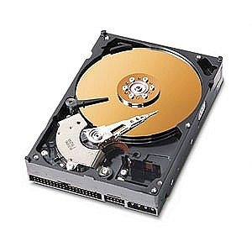
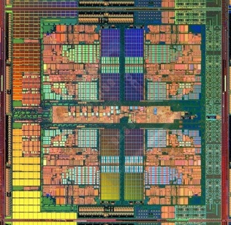
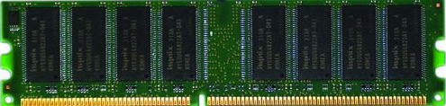
The Main Memory System
Main memory is a critical component of all computing systems: server, mobile, embedded, desktop, sensor
Main memory system must scale (in size, technology, efficiency, cost, and management algorithms) to maintain performance growth and technology scaling benefits
Processor
and caches
Main Memory
Storage (SSD/HDD)

Slide 7
State of the Main Memory System
Recent technology, architecture, and application trends
  lead to new requirements from the memory system
  exacerbate old requirements from the memory system
DRAM alone is (will be) unlikely to satisfy all requirements
Some emerging non-volatile memory technologies (e.g., PCM) appear promising to satisfy these requirements
  and enable new opportunities
We need to rethink the main memory system
  to fix DRAM issues and enable emerging technologies
  to satisfy all new and (exacerbated) old requirements

Slide 8
Major Trends Affecting Main Memory (I)
Need for main memory capacity and bandwidth increasing
Main memory energy/power is a key system design concern
DRAM technology scaling is ending

Slide 9

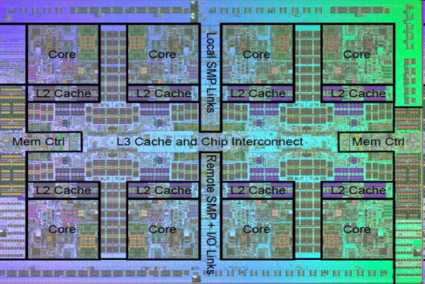
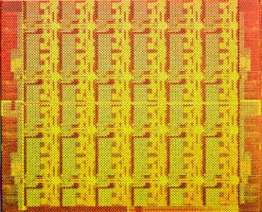
Demand for Memory Capacity
More cores ➔ More concurrency ➔ Larger working set
Emerging applications are data-intensive
Many applications/virtual machines (will) share main memory
  Cloud computing/servers: Consolidation to improve efficiency
  GP-GPUs: Many threads from multiple parallel applications
  Mobile: Interactive + non-interactive consolidation
AMD Barcelona: 4 cores
IBM Power7: 8 cores
Intel SCC: 48 cores

Slide 10
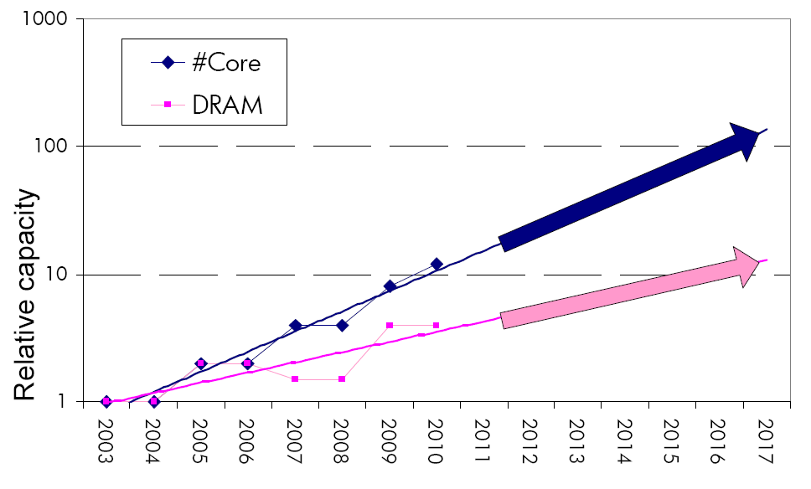
The Memory Capacity Gap
Memory capacity per core expected to drop by 30% every two years
Core count doubling ~ every 2 years
DRAM DIMM capacity doubling ~ every 3 years

Slide 11
Major Trends Affecting Main Memory (II)
Need for main memory capacity and bandwidth increasing
  Multi-core: increasing number of cores
  Data-intensive applications: increasing demand/hunger for data
  Consolidation: Cloud computing, GPUs, mobile
Main memory energy/power is a key system design concern
DRAM technology scaling is ending

Slide 12
Major Trends Affecting Main Memory (III)
Need for main memory capacity and bandwidth increasing
Main memory energy/power is a key system design concern
  IBM servers: ~50% energy spent in off-chip memory hierarchy [Lefurgy, IEEE Computer 2003]
  DRAM consumes power when idle and needs periodic refresh
DRAM technology scaling is ending

Slide 13
Major Trends Affecting Main Memory (IV)
Need for main memory capacity and bandwidth increasing
Main memory energy/power is a key system design concern
DRAM technology scaling is ending
  ITRS projects DRAM will not scale easily below 40nm
  Scaling has provided many benefits:
    higher capacity, higher density, lower cost, lower energy

Slide 14
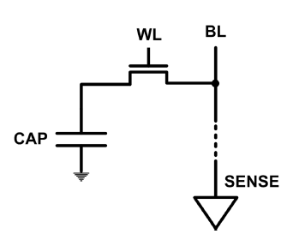
The DRAM Scaling Problem
DRAM stores charge in a capacitor (charge-based memory)
  Capacitor must be large enough for reliable sensing
  Scaling beyond 40-35nm (2013) is challenging [ITRS, 2009]
DRAM capacity, cost, and energy/power hard to scale

Slide 15
Trends: Problems with DRAM as Main Memory
Need for main memory capacity and bandwidth increasing
  DRAM capacity hard to scale
Main memory energy/power is a key system design concern
  DRAM consumes high power due to leakage and refresh
DRAM technology scaling is ending
  DRAM capacity, cost, and energy/power hard to scale

Slide 16
Requirements from an Ideal Main Memory System

Slide 17
Requirements from an Ideal Memory System
Traditional
  Enough capacity
  Low cost
  High system performance (high bandwidth, low latency)
New
  Technology scalability: lower cost, higher capacity, lower energy
  Energy (and power) efficiency
  QoS support and configurability (for consolidation)

Slide 18
Requirements from an Ideal Memory System
Traditional
  Higher capacity
  Continuous low cost
  High system performance (higher bandwidth, low latency)
New
  Technology scalability: lower cost, higher capacity, lower energy
  Energy (and power) efficiency
  QoS support and configurability (for consolidation)
Emerging, resistive memory technologies (NVM) can help

Slide 19
Opportunity: Emerging Memory Technologies

Slide 20
The Promise of Emerging Technologies
Likely need to replace/augment DRAM with a technology that is
  Technology scalable
  And at least similarly efficient, high performance, and fault-tolerant
    or can be architected to be so
Some emerging resistive memory technologies appear promising
  Phase Change Memory (PCM)?
  Spin Torque Transfer Magnetic Memory (STT-MRAM)?
  Memristors?
  And, maybe there are other ones
  Can they be enabled to replace/augment/surpass DRAM?

Slide 21
Opportunity: Emerging Memory Technologies
  Background
  PCM (or Technology X) as DRAM Replacement
  Hybrid Memory Systems

Slide 22
Charge vs. Resistive Memories
Charge Memory (e.g., DRAM, Flash)
  Write data by capturing charge Q
  Read data by detecting voltage V
Resistive Memory (e.g., PCM, STT-MRAM, memristors)
  Write data by pulsing current dQ/dt
  Read data by detecting resistance R

Slide 23
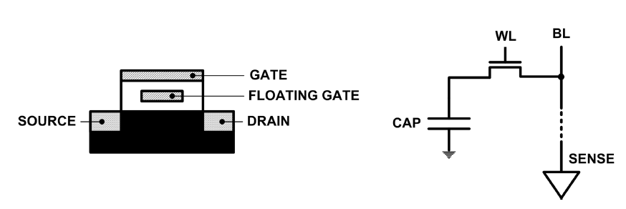
Limits of Charge Memory
Difficult charge placement and control
  Flash: floating gate charge
  DRAM: capacitor charge, transistor leakage
Reliable sensing becomes difficult as charge storage unit size reduces

Slide 24
Emerging Resistive Memory Technologies
PCM
  Inject current to change material phase
  Resistance determined by phase
STT-MRAM
  Inject current to change magnet polarity
  Resistance determined by polarity
Memristors
  Inject current to change atomic structure
  Resistance determined by atom distance

Slide 25
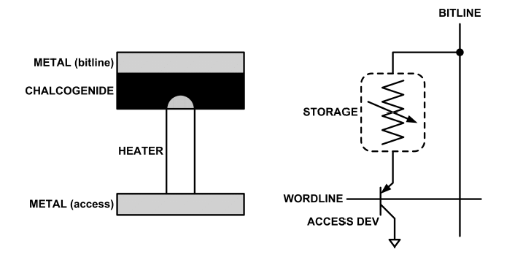
What is Phase Change Memory?
Phase change material (chalcogenide glass) exists in two states:
  Amorphous: Low optical reflexivity and high electrical resistivity
  Crystalline: High optical reflexivity and low electrical resistivity
PCM is resistive memory: High resistance (0), Low resistance (1)
PCM cell can be switched between states reliably and quickly

Slide 26
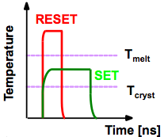
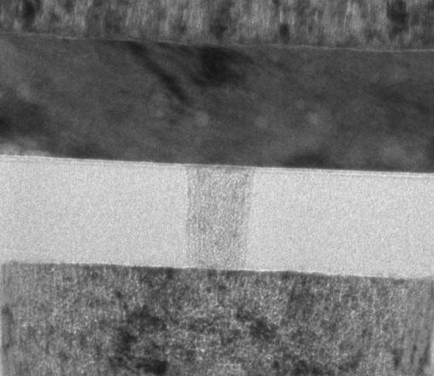
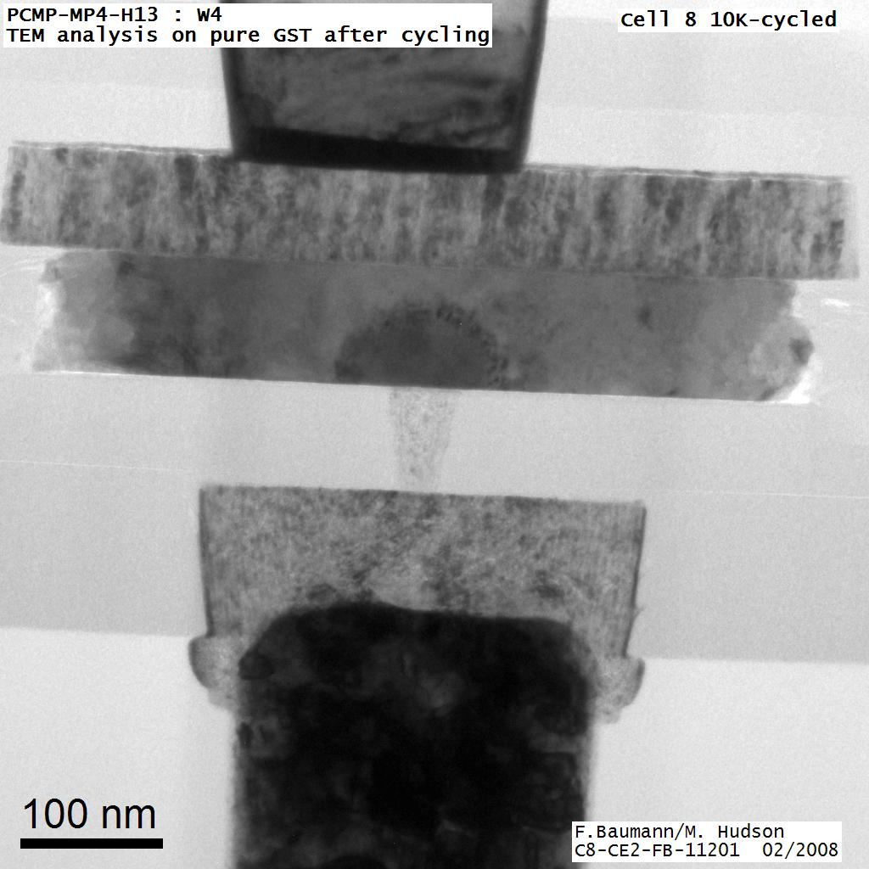
How Does PCM Work?
Write: change phase via current injection
  SET: sustained current to heat cell above Tcryst
  RESET: cell heated above Tmelt and quenched
Read: detect phase via material resistance
  amorphous/crystalline
Large
Current
Small
Current
Memory
Element
SET (cryst)
Low resistance
Access
Device
RESET (amorph)
High resistance
10³-10⁴ Ω
10⁶-10⁷ Ω
Photo Courtesy: Bipin Rajendran, IBM
Slide Courtesy: Moinuddin Qureshi, IBM

Slide 27
Opportunity: PCM Advantages
Scales better than DRAM, Flash
  Requires current pulses, which scale linearly with feature size
  Expected to scale to 9nm (2022 [ITRS])
  Prototyped at 20nm (Raoux+, IBM JRD 2008)
Can be denser than DRAM
  Can store multiple bits per cell due to large resistance range
  Prototypes with 2 bits/cell in ISSCC’08, 4 bits/cell by 2012
Non-volatile
  Retain data for >10 years at 85C
No refresh needed, low idle power

Slide 28
Phase Change Memory Properties
Surveyed prototypes from 2003-2008 (ITRS, IEDM, VLSI, ISSCC)
Derived PCM parameters for F=90nm
Lee, Ipek, Mutlu, Burger, “Architecting Phase Change Memory as a Scalable DRAM Alternative,” ISCA 2009.

Slide 29
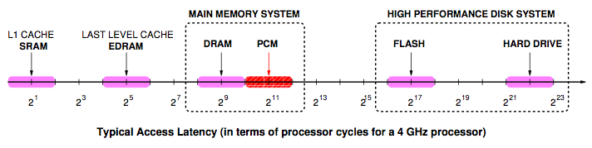
Phase Change Memory Properties: Latency
Latency comparable to, but slower than DRAM
Read Latency
  50ns: 4x DRAM, 10⁻³x NAND Flash
Write Latency
  150ns: 12x DRAM
Write Bandwidth
  5-10 MB/s: 0.1x DRAM, 1x NAND Flash

Slide 30
Phase Change Memory Properties
Dynamic Energy
  40 uA Rd, 150 uA Wr
  2-43x DRAM, 1x NAND Flash
Endurance
  Writes induce phase change at 650C
  Contacts degrade from thermal expansion/contraction
  10⁸ writes per cell
  10⁻⁸x DRAM, 10³x NAND Flash
Cell Size
  9-12F² using BJT, single-level cells
  1.5x DRAM, 2-3x NAND (will scale with feature size, MLC)

Slide 31
Phase Change Memory: Pros and Cons
Pros over DRAM
  Better technology scaling
  Non volatility
  Low idle power (no refresh)
Cons
  Higher latencies: ~4-15x DRAM (especially write)
  Higher active energy: ~2-50x DRAM (especially write)
  Lower endurance (a cell dies after ~10⁸ writes)
Challenges in enabling PCM as DRAM replacement/helper:
  Mitigate PCM shortcomings
  Find the right way to place PCM in the system
  Ensure secure and fault-tolerant PCM operation

Slide 32
PCM-based Main Memory: Research Challenges
Where to place PCM in the memory hierarchy?
  Hybrid OS controlled PCM-DRAM
  Hybrid OS controlled PCM and hardware-controlled DRAM
  Pure PCM main memory
How to mitigate shortcomings of PCM?
How to minimize amount of DRAM in the system?
How to take advantage of (byte-addressable and fast) non-volatile main memory?
Can we design specific-NVM-technology-agnostic techniques?

Slide 33
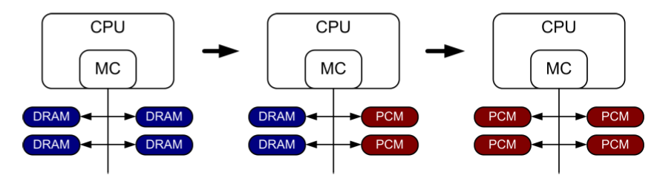
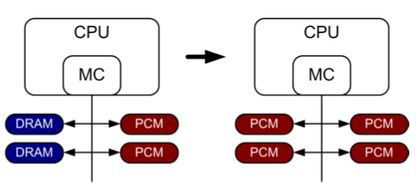
PCM-based Main Memory (I)
How should PCM-based (main) memory be organized?
Hybrid PCM+DRAM [Qureshi+ ISCA’09, Dhiman+ DAC’09, Meza+ IEEE CAL’12]:
  How to partition/migrate data between PCM and DRAM

Slide 34
Hybrid Memory Systems: Research Challenges
Partitioning
  Should DRAM be a cache or main memory, or configurable?
  What fraction? How many controllers?
Data allocation/movement (energy, performance, lifetime)
  Who manages allocation/movement?
  What are good control algorithms?
  How do we prevent degradation of service due to wearout?
Design of cache hierarchy, memory controllers, OS
  Mitigate PCM shortcomings, exploit PCM advantages
Design of PCM/DRAM chips and modules
  Rethink the design of PCM/DRAM with new requirements

Slide 35
Opportunity: Emerging Memory Technologies
  Background
  PCM (or Technology X) as DRAM Replacement
  Hybrid Memory Systems

Slide 36
PCM-based Main Memory (II)
How should PCM-based (main) memory be organized?
Pure PCM main memory [Lee et al., ISCA’09, Top Picks’10]:
  How to redesign entire hierarchy (and cores) to overcome PCM shortcomings

Slide 37
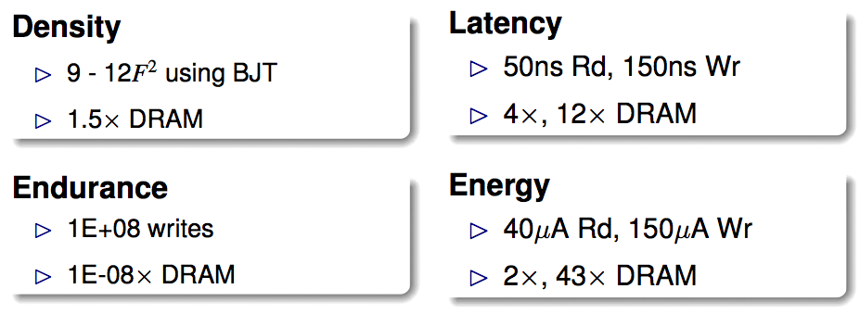
An Initial Study: Replace DRAM with PCM
Lee, Ipek, Mutlu, Burger, “Architecting Phase Change Memory as a Scalable DRAM Alternative,” ISCA 2009.
  Surveyed prototypes from 2003-2008 (e.g. IEDM, VLSI, ISSCC)
  Derived “average” PCM parameters for F=90nm

Slide 38
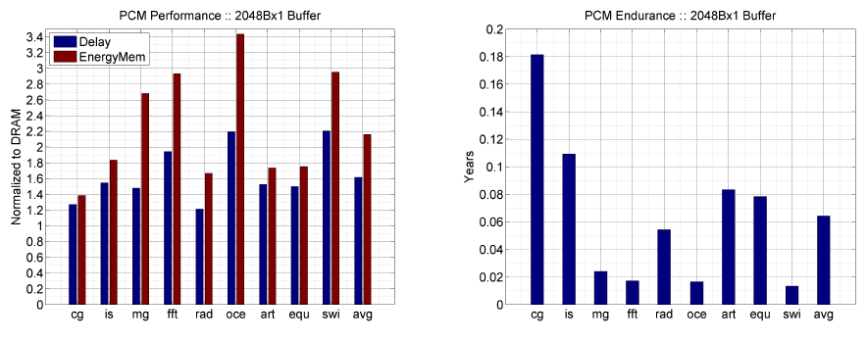
Results: Naïve Replacement of DRAM with PCM
Replace DRAM with PCM in a 4-core, 4MB L2 system
PCM organized the same as DRAM: row buffers, banks, peripherals
1.6x delay, 2.2x energy, 500-hour average lifetime
Lee, Ipek, Mutlu, Burger, “Architecting Phase Change Memory as a Scalable DRAM Alternative,” ISCA 2009.

Slide 39
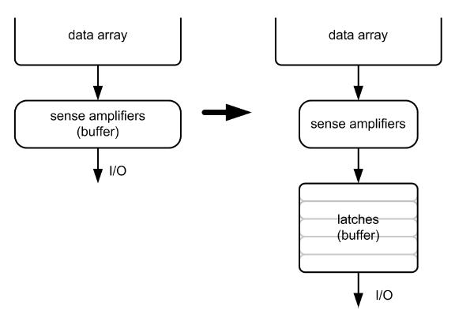
Architecting PCM to Mitigate Shortcomings
Idea 1: Use multiple narrow row buffers in each PCM chip
    → Reduces array reads/writes → better endurance, latency, energy
Idea 2: Write into array at
cache block or word
granularity
→ Reduces unnecessary wear
DRAM
PCM

Slide 40
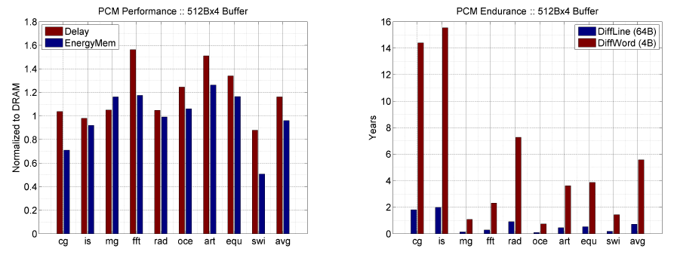
Results: Architected PCM as Main Memory
1.2x delay, 1.0x energy, 5.6-year average lifetime
Scaling improves energy, endurance, density
Caveat 1: Worst-case lifetime is much shorter (no guarantees)
Caveat 2: Intensive applications see large performance and energy hits
Caveat 3: Optimistic PCM parameters?

Slide 41
Opportunity: Emerging Memory Technologies
  Background
  PCM (or Technology X) as DRAM Replacement
  Hybrid Memory Systems

Slide 42
Hybrid Memory Systems
CPU
Meza, Chang, Yoon, Mutlu, Ranganathan, “Enabling Efficient and Scalable Hybrid Memories,” IEEE Comp. Arch. Letters, 2012.
DRAMCtrl
PCM Ctrl
DRAM
Phase Change Memory (or Tech. X)
Fast, durable
Small,
leaky, volatile,
high-cost
Large, non-volatile, low-cost
Slow, wears out, high active energy
Hardware/software manage data allocation and movement
to achieve the best of multiple technologies
(5-9 years of average lifetime)

Slide 43
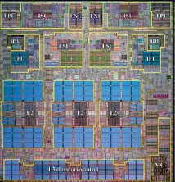
DRAM as PCM Cache
Goal: Achieve the best of both DRAM and PCM/NVM
  Minimize amount of DRAM w/o sacrificing performance, endurance
  DRAM as cache to tolerate PCM latency and write bandwidth
  PCM as main memory to provide large capacity at good cost and power
PCM Main Memory
DATA
Processor
DRAM Buffer
T
DATA
Flash
Or
HDD
T=Tag-Store
PCM Write Queue

Slide 44

Write Filtering Techniques
Lazy Write: Pages from disk installed only in DRAM, not PCM
Partial Writes: Only dirty lines from DRAM page written back
Page Bypass: Discard pages with poor reuse on DRAM eviction
Qureshi et al., “Scalable high performance main memory system using phase-change memory technology,” ISCA 2009.
PCM Main Memory
DATA
Processor
DRAM Buffer
T
DATA
Flash
Or
HDD

Slide 45
Results: DRAM as PCM Cache (I)
Simulation of 16-core system, 8GB DRAM main-memory at 320 cycles, HDD (2 ms) with Flash (32 us) with Flash hit-rate of 99%
Assumption: PCM 4x denser, 4x slower than DRAM
DRAM block size = PCM page size (4kB)
Notes:
Workloads:
Database workloads & Data parallel kernels
1. Database workloads: db1 and db2
2. Unix utilities: qsort and binary search
3. Data Mining : K-means and Gauss Seidal
4. Streaming: DAXPY and Vector Dot Product

Slide 46
Results: DRAM as PCM Cache (II)
PCM-DRAM Hybrid performs similarly to similar-size DRAM
Significant power and energy savings with PCM-DRAM Hybrid
Average lifetime: 9.7 years (no guarantees)

Slide 47
DRAM as a Cache for PCM
PCM is main memory; DRAM caches memory rows/blocks
  Benefits: Reduced latency on DRAM cache hit; write filtering
Memory controller hardware manages the DRAM cache
  Benefit: Eliminates system software overhead
Three issues:
  What data should be placed in DRAM versus kept in PCM?
  What is the granularity of data movement?
  How to design a low-cost hardware-managed DRAM cache?
Two idea directions:
  Locality-aware data placement [Yoon+ , ICCD 2012]
  Cheap tag stores and dynamic granularity [Meza+, IEEE CAL 2012]

Slide 48
Opportunity: Emerging Memory Technologies
  Background
  PCM (or Technology X) as DRAM Replacement
  Hybrid Memory Systems
    Row-Locality Aware Data Placement
    Efficient DRAM (or Technology X) Caches

Slide 49
DRAM vs. PCM: An Observation
DRAM and PCM both have row buffers
Row buffer hit latency similar in DRAM and PCM
Row buffer miss latency small in DRAM, large in PCM
Accessing the row buffer in PCM is fast
What incurs high latency is the PCM array access → avoid this
CPU
Row buffer
DRAMCtrl
PCM Ctrl
DRAM Cache
PCM Main Memory
Bank
Bank
Bank
Bank
N ns row hit
Fast row miss
N ns row hit
Slow row miss

Slide 50
Row-Locality-Aware Data Placement
Idea: Cache in DRAM only those rows that
  Frequently cause row buffer conflicts → because row-conflict latency is smaller in DRAM
  Are reused many times → to reduce cache pollution and bandwidth waste
Simplified rule of thumb:
  Streaming accesses: Better to place in PCM
  Other accesses (with some reuse): Better to place in DRAM
Bridges half of the performance gap between all-DRAM and all-PCM memory on memory-intensive workloads
Yoon et al., “Row Buffer Locality Aware Caching Policies for Hybrid Memories,” ICCD 2012.

Slide 51
Row-Locality-Aware Data Placement: Mechanism
For a subset of rows in PCM, memory controller:
  Tracks row conflicts as a predictor of future locality
  Tracks accesses as a predictor of future reuse
Cache a row in DRAM if its row conflict and access counts are greater than certain thresholds
Determine thresholds dynamically to adjust to application/workload characteristics
  Simple cost/benefit analysis every fixed interval

Slide 52
Evaluation Methodology
Core model
  3-wide issue with 128-entry instruction window
  32 KB L1 D-cache per core
  512 KB L2 cache per core
Memory model
  1 GB DRAM Cache / 16 GB PCM
  Separate memory controllers, 8 banks per device
  Row buffer hit: 40 ns
  Row buffer miss: 80 ns (DRAM); 128, 368 ns (PCM)
  Cache data at 4 KB row granularity

Slide 53
Performance
36 server/cloud workloads, 16 cores, 1 GB DRAM

Slide 54
Performance
36 server/cloud workloads, 16 cores, 1 GB DRAM
Benefits come from: (1) better row buffer locality in PCM (2) reduced bandwidth consumption and reduced pollution

Slide 55
Row-Locality-Aware Data Placement: Results
Heterogeneous DRAM cache + PCM memory with locality-aware data placement on a 16-core system
Compared to all PCM main memory
  31% performance improvement
Compared to an all DRAM main memory
  Within 29% of performance
Power, energy, endurance evaluations in paper
  Yoon et al., “Row Buffer Locality Aware Caching Policies for Hybrid Memories,” ICCD 2012.

Slide 56
Opportunity: Emerging Memory Technologies
  Background
  PCM (or Technology X) as DRAM Replacement
  Hybrid Memory Systems
    Row-Locality Aware Data Placement
    Efficient DRAM (or Technology X) Caches

Slide 57
The Problem with Large DRAM Caches
A large DRAM cache requires a large metadata (tag + block-based information) store
How do we design an efficient DRAM cache?
CPU
LOAD X
Metadata:
X → DRAM
Mem
Ctlr
Mem
Ctlr
DRAM
PCM
X
(small, fast cache)
(high capacity)
Access X

Slide 58
Idea 1: Tags in Memory
Store tags in the same row as data in DRAM
  Store metadata in same row as their data
  Data and metadata can be accessed together
Benefit: No on-chip tag storage overhead
Downsides:
  Cache hit determined only after a DRAM access
  Cache hit requires two DRAM accesses
DRAM row
Cache block 0
Cache block 1
Cache block 2
Tag0
Tag1
Tag2

Slide 59
Idea 2: Cache Tags in SRAM
Recall Idea 1: Store all metadata in DRAM
  To reduce metadata storage overhead
Idea 2: Cache in on-chip SRAM frequently-accessed metadata
  Cache only a small amount to keep SRAM size small

Slide 60
Idea 3: Dynamic Data Transfer Granularity
Some applications benefit from caching more data
  They have good spatial locality
Others do not
  Large granularity wastes bandwidth and reduces cache utilization
Idea 3: Simple dynamic caching granularity policy
  Cost-benefit analysis to determine best DRAM cache block size
  Group main memory into sets of rows
  Some row sets follow a fixed caching granularity
  The rest of main memory follows the best granularity
    Cost–benefit analysis: access latency versus number of cachings
    Performed every quantum

Slide 61
TIMBER Tag Management
A Tag-In-Memory BuffER (TIMBER)
  Stores recently-used tags in a small amount of SRAM
Benefits: If tag is cached:
  no need to access DRAM twice
  cache hit determined quickly
DRAM row
Cache block 0
Cache block 1
Cache block 2
Tag0
Tag1
Tag2
Row Tag
Row0
Tag0
Tag1
Tag2
LOAD X
Row27
Tag0
Tag1
Tag2

Slide 62
TIMBER Tag Management Example (I)
Case 1: TIMBER hit
Our proposal
TIMBER: X → DRAM
Row0
Tag0
Tag1
Tag2
Row27
Tag0
Tag1
Tag2
CPU
LOAD X
Mem
Ctlr
Mem
Ctlr
Bank
Bank
Bank
Bank
X
Access X

Slide 63
TIMBER Tag Management Example (II)
Case 2: TIMBER miss
2. Cache M(Y)
Access Metadata(Y)
Y → DRAM
Row0
Tag0
Tag1
Tag2
Row27
Tag0
Tag1
Tag2
CPU
Row143
Miss
LOAD Y
Mem
Ctlr
Mem
Ctlr
Bank
Bank
Bank
Bank
Y
M(Y)
1. Access M(Y)
3. Access Y (row hit)

Slide 64
Methodology
System: 8 out-of-order cores at 4 GHz
Memory: 512 MB direct-mapped DRAM, 8 GB PCM
  128B caching granularity
  DRAM row hit (miss): 200 cycles (400 cycles)
  PCM row hit (clean / dirty miss): 200 cycles (640 / 1840 cycles)
Evaluated metadata storage techniques
  All SRAM system (8MB of SRAM)
  Region metadata storage
  TIM metadata storage (same row as data)
  TIMBER, 64-entry direct-mapped (8KB of SRAM)

Slide 65
Metadata Storage Performance
(Ideal)

Slide 66
Metadata Storage Performance
Performance degrades due to increased metadata lookup access latency
-48%
(Ideal)

Slide 67
Metadata Storage Performance
Increased row locality reduces average memory access latency
36%
(Ideal)

Slide 68
Metadata Storage Performance
Data with locality can access metadata at SRAM latencies
23%
(Ideal)

Slide 69
Dynamic Granularity Performance
10%
Reduced channel contention and improved spatial locality

Slide 70
TIMBER Performance
-6%
Reduced channel contention and improved spatial locality
Meza, Chang, Yoon, Mutlu, Ranganathan, “Enabling Efficient and Scalable Hybrid Memories,” IEEE Comp. Arch. Letters, 2012.

Slide 71
TIMBER Energy Efficiency
18%
Fewer migrations reduce transmitted data and channel contention
Meza, Chang, Yoon, Mutlu, Ranganathan, “Enabling Efficient and Scalable Hybrid Memories,” IEEE Comp. Arch. Letters, 2012.

Slide 72
Enabling and Exploiting NVM: Issues
Many issues and ideas from technology layer to algorithms layer
Enabling NVM and hybrid memory
  How to tolerate errors?
  How to enable secure operation?
  How to tolerate performance and power shortcomings?
  How to minimize cost?
Exploiting emerging tecnologies
  How to exploit non-volatility?
  How to minimize energy consumption?
  How to exploit NVM on chip?
Problems
Algorithms
Programs
User
Runtime System
(VM, OS, MM)
ISA
Microarchitecture
Logic
Devices

Slide 73
Security Challenges of Emerging Technologies
1. Limited endurance → Wearout attacks
2. Non-volatility → Data persists in memory after powerdown
→ Easy retrieval of privileged or private information
3. Multiple bits per cell → Information leakage (via side channel)

Slide 74
Securing Emerging Memory Technologies
1. Limited endurance → Wearout attacks
Better architecting of memory chips to absorb writes
Hybrid memory system management
Online wearout attack detection
2. Non-volatility → Data persists in memory after powerdown
→ Easy retrieval of privileged or private information
Efficient encryption/decryption of whole main memory
Hybrid memory system management
3. Multiple bits per cell → Information leakage (via side channel)
System design to hide side channel information

Slide 75
Reminder: Project Proposals
    Due: Tuesday, September 25, 11:59pm.
    Extended office hours: Saturday, September 22, 11am-1pm.

