Slide 1
18-740/640 Computer Architecture Lecture 14: Memory Resource Management I
Prof. Onur Mutlu
Carnegie Mellon University
Fall 2015, 10/26/2015

Slide 2
Required Readings
Required Reading Assignment:
Qureshi and Patt, “Utility-Based Cache Partitioning: A Low-Overhead, High-Performance, Runtime Mechanism to Partition Shared Caches,” MICRO 2006.
Recommended References:
Seshadri et al., “The Evicted-Address Filter: A Unified Mechanism to Address both Cache Pollution and Thrashing,” PACT 2012.
Pekhimenko et al., “Base-Delta-Immediate Compression: Practical Data Compression for On-Chip Caches,” PACT 2012.
Lin et al., “Gaining Insights into Multi-Core Cache Partitioning: Bridging the Gap between Simulation and Real Systems,” HPCA 2008.

Slide 3
Shared Resource Design for Multi-Core Systems

Slide 4
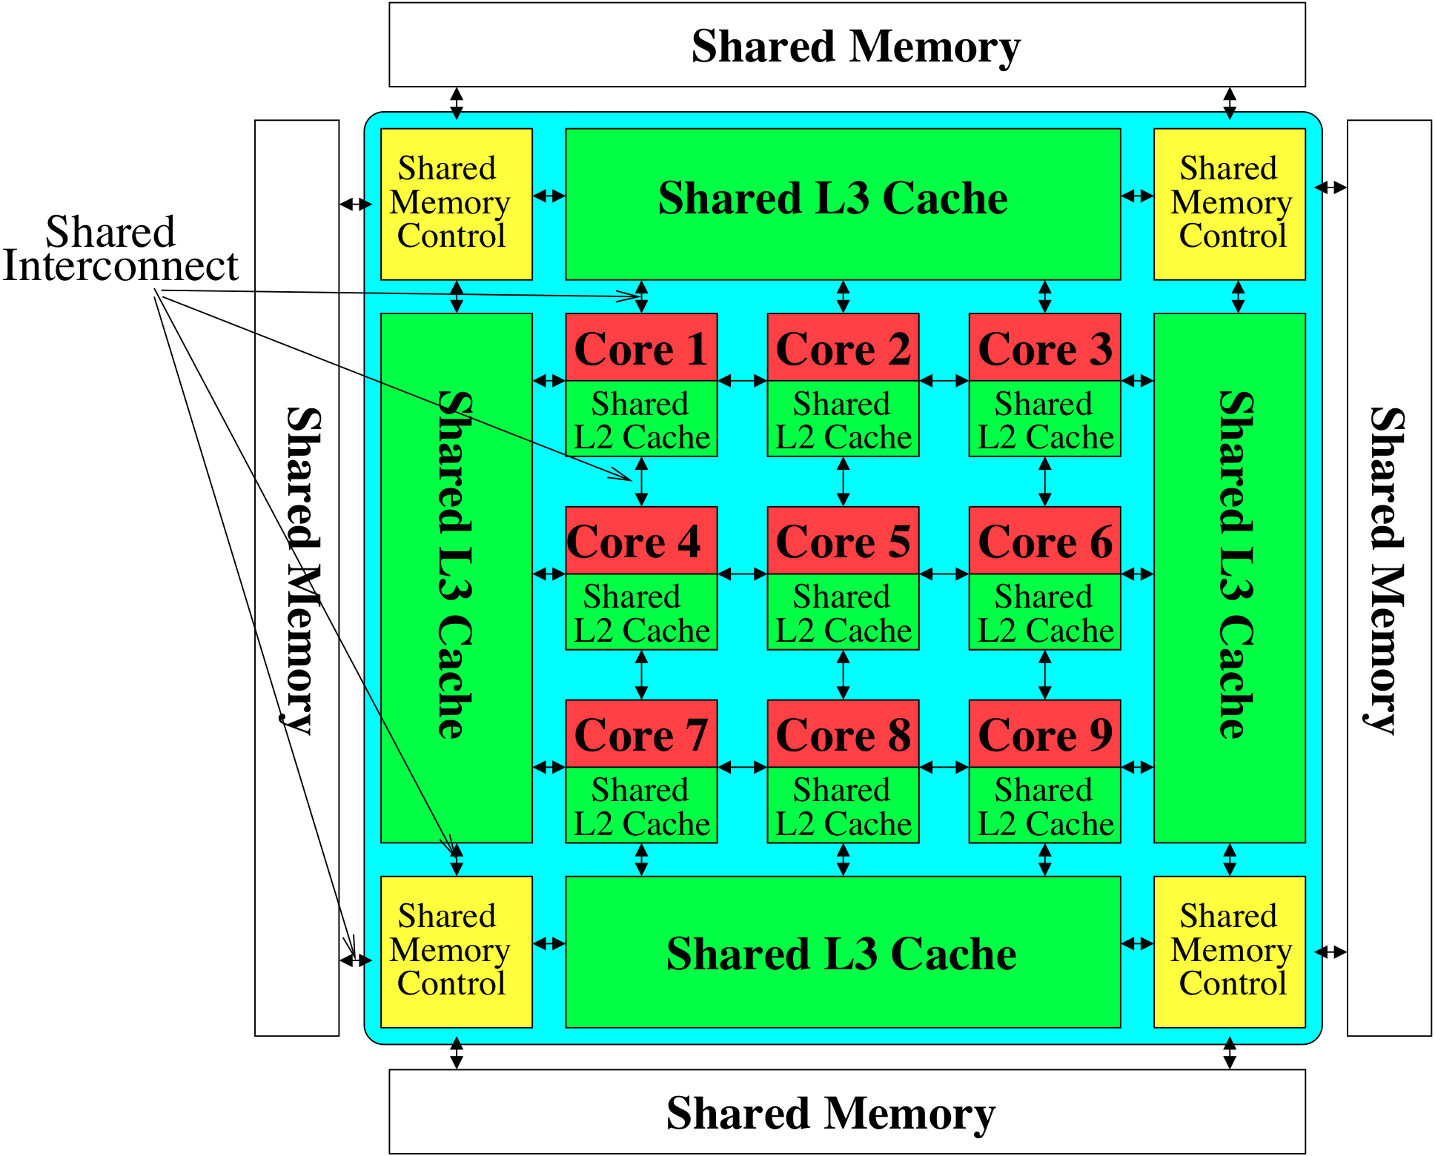
Memory System: A Shared Resource View
Storage

Slide 5
Resource Sharing Concept
Idea: Instead of dedicating a hardware resource to a hardware context, allow multiple contexts to use it
Example resources: functional units, pipeline, caches, buses, memory
Why?
+ Resource sharing improves utilization/efficiency → throughput
When a resource is left idle by one thread, another thread can use it; no need to replicate shared data
+ Reduces communication latency
For example, shared data kept in the same cache in SMT processors
+ Compatible with the shared memory model

Slide 6
Resource Sharing Disadvantages
Resource sharing results in contention for resources
When the resource is not idle, another thread cannot use it
If space is occupied by one thread, another thread needs to re-occupy it
- Sometimes reduces each or some thread’s performance
- Thread performance can be worse than when it is run alone
- Eliminates performance isolation → inconsistent performance across runs
- Thread performance depends on co-executing threads
- Uncontrolled (free-for-all) sharing degrades QoS
- Causes unfairness, starvation
Need to efficiently and fairly utilize shared resources

Slide 7
Example: Problem with Shared Caches
Processor Core 1
←t1
Processor Core 2
L1 $
L1 $
L2 $
……
Kim et al., “Fair Cache Sharing and Partitioning in a Chip Multiprocessor Architecture,” PACT 2004.

Slide 8
Example: Problem with Shared Caches
Processor Core 1
t2→
Processor Core 2
L1 $
L1 $
L2 $
……
Kim et al., “Fair Cache Sharing and Partitioning in a Chip Multiprocessor Architecture,” PACT 2004.

Slide 9
Example: Problem with Shared Caches
Processor Core 1
←t1
t2→
Processor Core 2
L1 $
L1 $
L2 $
……
t2’s throughput is significantly reduced due to unfair cache sharing.
Kim et al., “Fair Cache Sharing and Partitioning in a Chip Multiprocessor Architecture,” PACT 2004.

Slide 10
Need for QoS and Shared Resource Mgmt.
Why is unpredictable performance (or lack of QoS) bad?
Makes programmer’s life difficult
An optimized program can get low performance (and performance varies widely depending on co-runners)
Causes discomfort to user
An important program can starve
Examples from shared software resources
Makes system management difficult
How do we enforce a Service Level Agreement when hardware resources are sharing is uncontrollable?

Slide 11
Resource Sharing vs. Partitioning
Sharing improves throughput
Better utilization of space
Partitioning provides performance isolation (predictable performance)
Dedicated space
Can we get the benefits of both?
Idea: Design shared resources such that they are efficiently utilized, controllable and partitionable
No wasted resource + QoS mechanisms for threads

Slide 12
Shared Hardware Resources
Memory subsystem (in both Multi-threaded and Multi-core)
Non-private caches
Interconnects
Memory controllers, buses, banks
I/O subsystem (in both Multi-threaded and Multi-core)
I/O, DMA controllers
Ethernet controllers
Processor (in Multi-threaded)
Pipeline resources
L1 caches

Slide 13
Multi-core Issues in Caching
How does the cache hierarchy change in a multi-core system?
Private cache: Cache belongs to one core (a shared block can be in multiple caches)
Shared cache: Cache is shared by multiple cores
CORE 0
CORE 1
CORE 2
CORE 3
CORE 0
CORE 1
CORE 2
CORE 3
L2
CACHE
L2
CACHE
L2
CACHE
L2
CACHE
L2
CACHE
DRAM MEMORY CONTROLLER
DRAM MEMORY CONTROLLER

Slide 14
Shared Caches Between Cores
Advantages:
High effective capacity
Dynamic partitioning of available cache space
No fragmentation due to static partitioning
Easier to maintain coherence (a cache block is in a single location)
Shared data and locks do not ping pong between caches
Disadvantages
Slower access
Cores incur conflict misses due to other cores’ accesses
Misses due to inter-core interference
Some cores can destroy the hit rate of other cores
Guaranteeing a minimum level of service (or fairness) to each core is harder (how much space, how much bandwidth?)

Slide 15
Shared Caches: How to Share?
Free-for-all sharing
Placement/replacement policies are the same as a single core system (usually LRU or pseudo-LRU)
Not thread/application aware
An incoming block evicts a block regardless of which threads the blocks belong to
Problems
Inefficient utilization of cache: LRU is not the best policy
A cache-unfriendly application can destroy the performance of a cache friendly application
Not all applications benefit equally from the same amount of cache: free-for-all might prioritize those that do not benefit
Reduced performance, reduced fairness

Slide 16
Handling Shared Caches
Controlled cache sharing
Approach 1: Design shared caches but control the amount of cache allocated to different cores
Approach 2: Design “private” caches but spill/receive data from one cache to another
More efficient cache utilization
Minimize the wasted cache space
by keeping out useless blocks
by keeping in cache blocks that have maximum benefit
by minimizing redundant data

Slide 17
Controlled Cache Sharing: Examples
Utility based cache partitioning
Qureshi and Patt, “Utility-Based Cache Partitioning: A Low-Overhead, High-Performance, Runtime Mechanism to Partition Shared Caches,” MICRO 2006.
Suh et al., “A New Memory Monitoring Scheme for Memory-Aware Scheduling and Partitioning,” HPCA 2002.
Fair cache partitioning
Kim et al., “Fair Cache Sharing and Partitioning in a Chip Multiprocessor Architecture,” PACT 2004.
Shared/private mixed cache mechanisms
Qureshi, “Adaptive Spill-Receive for Robust High-Performance Caching in CMPs,” HPCA 2009.
Hardavellas et al., “Reactive NUCA: Near-Optimal Block Placement and Replication in Distributed Caches,” ISCA 2009.

Slide 18
Efficient Cache Utilization: Examples
Qureshi et al., “A Case for MLP-Aware Cache Replacement,” ISCA 2005.
Seshadri et al., “The Evicted-Address Filter: A Unified Mechanism to Address both Cache Pollution and Thrashing,” PACT 2012.
Pekhimenko et al., “Base-Delta-Immediate Compression: Practical Data Compression for On-Chip Caches,” PACT 2012.

Slide 19
Controlled Shared Caching

Slide 20
Hardware-Based Cache Partitioning

Slide 21
Utility Based Shared Cache Partitioning
Goal: Maximize system throughput
Observation: Not all threads/applications benefit equally from caching → simple LRU replacement not good for system throughput
Idea: Allocate more cache space to applications that obtain the most benefit from more space
The high-level idea can be applied to other shared resources as well.
Qureshi and Patt, “Utility-Based Cache Partitioning: A Low-Overhead, High-Performance, Runtime Mechanism to Partition Shared Caches,” MICRO 2006.
Suh et al., “A New Memory Monitoring Scheme for Memory-Aware Scheduling and Partitioning,” HPCA 2002.

Slide 22
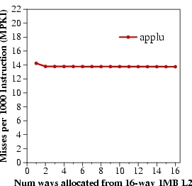
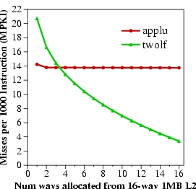
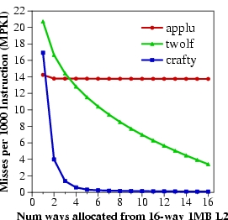
Marginal Utility of a Cache Way
Utility U_{a}^{b} = Misses with a ways – Misses with b ways
Low Utility
Misses per 1000 instructions
High Utility
Saturating Utility
Num ways from 16-way 1MB L2

Slide 23
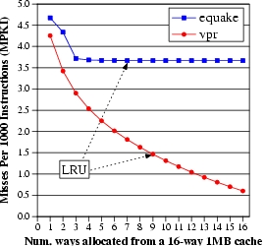
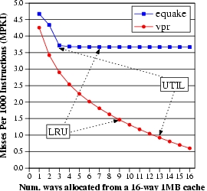
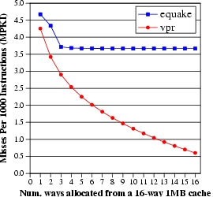
Utility Based Shared Cache Partitioning Motivation
equake
vpr
Improve performance by giving more cache to the application that benefits more from cache
Misses per 1000 instructions (MPKI)
UTIL
LRU
Num ways from 16-way 1MB L2

Slide 24
Utility Based Cache Partitioning (III)
UMON1
PA
UMON2
I$
Shared
L2 cache
I$
Core1
Core2
D$
D$
Main Memory
Three components:
Utility Monitors (UMON) per core
Partitioning Algorithm (PA)
Replacement support to enforce partitions

Slide 25
Utility Monitors
For each core, simulate LRU policy using ATD
Hit counters in ATD to count hits per recency position
LRU is a stack algorithm: hit counts ➔ utility E.g. hits(2 ways) = H0+H1
(MRU)H0 H1 H2…H15(LRU)
MTD
+
+
+
+
Set A
Set A
Set B
Set B
Set C
ATD
Set C
Set D
Set D
Set E
Set E
Set F
Set F
Set G
Set G
Set H
Set H

Slide 26
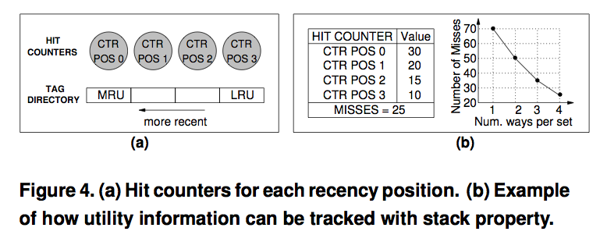
Utility Monitors

Slide 27
Dynamic Set Sampling
Extra tags incur hardware and power overhead
Dynamic Set Sampling reduces overhead [Qureshi, ISCA’06]
32 sets sufficient (analytical bounds)
Storage < 2kB/UMON
(MRU)H0 H1 H2…H15(LRU)
MTD
+
+
+
+
Set A
Set A
Set A
Set B
Set B
ATD
Set B
Set B
Set E
Set C
Set C
Set G
Set C
Set D
Set D
Set D
Set E
Set E
Set E
Set F
Set F
Set F
UMON (DSS)
Set G
Set G
Set G
Set H
Set H
Set H
Qureshi et al., “A Case for MLP-Aware Cache Replacement,” ISCA 2005.

Slide 28
Partitioning Algorithm
Evaluate all possible partitions and select the best
With a ways to core1 and (16-a) ways to core2:
Hits_{core1} = (H₀ + H₁ + … + H_{a-1}) ---- from UMON1 Hits_{core2} = (H₀ + H₁ + … + H_{16-a-1}) ---- from UMON2
Select a that maximizes (Hits_{core1} + Hits_{core2})
Partitioning done once every 5 million cycles

Slide 29
Way Partitioning
Way partitioning support: [Suh+ HPCA’02, Iyer ICS’04]
Each line has core-id bits
On a miss, count ways_occupied in set by miss-causing app
ways_occupied < ways_given
Yes
No
Victim is the LRU line from other app
Victim is the LRU line from miss-causing app

Slide 30
Performance Metrics
Three metrics for performance:
Weighted Speedup (default metric) ➔ perf = IPC₁/SingleIPC₁ + IPC₂/SingleIPC₂ ➔ correlates with reduction in execution time
Throughput ➔ perf = IPC₁ + IPC₂ ➔ can be unfair to low-IPC application
Hmean-fairness ➔ perf = hmean(IPC₁/SingleIPC₁, IPC₂/SingleIPC₂) ➔ balances fairness and performance

Slide 31
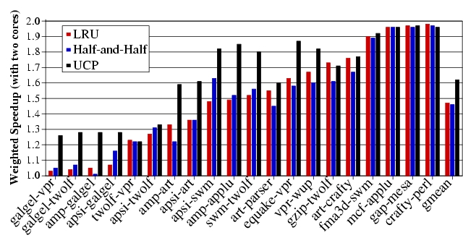
Weighted Speedup Results for UCP

Slide 32
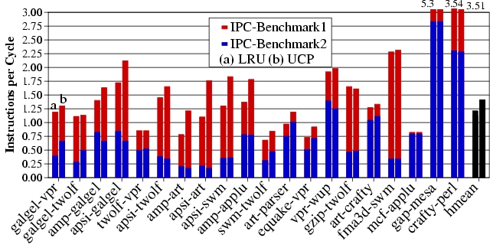
IPC Results for UCP
UCP improves average throughput by 17%

Slide 33
Any Problems with UCP So Far?
- Scalability to many cores
- Non-convex curves?
Time complexity of partitioning low for two cores (number of possible partitions ≈ number of ways)
Possible partitions increase exponentially with cores
For a 32-way cache, possible partitions:
4 cores → 6545
8 cores → 15.4 million
Problem NP hard → need scalable partitioning algorithm

Slide 34
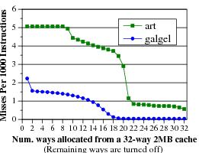
Greedy Algorithm [Stone+ ToC ’92]
Greedy Algorithm (GA) allocates 1 block to the app that has the max utility for one block. Repeat till all blocks allocated
Optimal partitioning when utility curves are convex
Pathological behavior for non-convex curves
Stone et al., “Optimal Partitioning of Cache Memory,” IEEE ToC 1992.

Slide 35
Problem with Greedy Algorithm
Problem: GA considers benefit only from the immediate block. Hence, it fails to exploit large gains from looking ahead
In each iteration, the utility for 1 block:
U(A) = 10 misses U(B) = 0 misses
Misses
All blocks assigned to A, even if B has same miss reduction with fewer blocks
Blocks assigned

Slide 36
Lookahead Algorithm
Marginal Utility (MU) = Utility per cache resource
MU_{a}^{b} = U_{a}^{b}/(b-a)
GA considers MU for 1 block.
LA (Lookahead Algorithm) considers MU for all possible allocations
Select the app that has the max value for MU. Allocate it as many blocks required to get max MU
Repeat until all blocks are assigned

Slide 37
Lookahead Algorithm Example
Iteration 1:
MU(A) = 10/1 block MU(B) = 80/3 blocks
B gets 3 blocks
Misses
Next five iterations:
MU(A) = 10/1 block
MU(B) = 0
A gets 1 block
Blocks assigned
Result: A gets 5 blocks and B gets 3 blocks (Optimal)
Time complexity ≈ ways²/2 (512 ops for 32-ways)

Slide 38
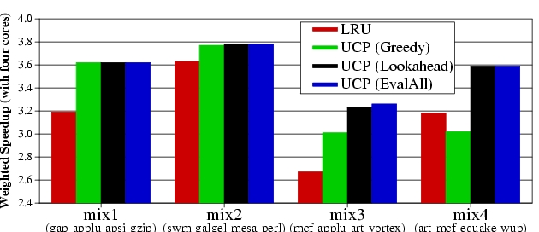
UCP Results
Four cores sharing a 2MB 32-way L2
LRU
UCP(Greedy)
UCP(Lookahead)
UCP(EvalAll)
Mix1
(gap-applu-apsi-gzp)
Mix2
(swm-glg-mesa-prl)
Mix3
(mcf-applu-art-vrtx)
Mix4
(mcf-art-eqk-wupw)
LA performs similar to EvalAll, with low time-complexity

Slide 39
Utility Based Cache Partitioning
Advantages over LRU
+ Improves system throughput
+ Better utilizes the shared cache
Disadvantages
- Fairness, QoS?
Limitations
- Scalability: Partitioning limited to ways. What if you have numWays < numApps?
- Scalability: How is utility computed in a distributed cache?
- What if past behavior is not a good predictor of utility?

Slide 40
Fair Shared Cache Partitioning
Goal: Equalize the slowdowns of multiple threads sharing the cache
Idea: Dynamically estimate slowdowns due to sharing and assign cache blocks to balance slowdowns
Approximate slowdown with change in miss rate
Kim et al., “Fair Cache Sharing and Partitioning in a Chip Multiprocessor Architecture,” PACT 2004.

Slide 41
Dynamic Fair Caching Algorithm
MissRate alone
P1:
P2:
MissRate shared
P1:
P2:
Repartitioning
interval
Target Partition
P1:
P2:

Slide 42
Dynamic Fair Caching Algorithm
MissRate alone
1st Interval
P1:20%
P2: 5%
MissRate shared
MissRate shared
P1:
P1:20%
P2:
P2:15%
Repartitioning
interval
Target Partition
P1:256KB
P2:256KB
Notes:
At the very beginning, the static profiling obtained miss rate of 20% for P1 and 5% for P2.
Initially, target partitions are equal to P1 and P2.
After the 1st interval, we get shared miss rate by dynamic profiling and it has 20% and 15% miss rate.

Slide 43
Dynamic Fair Caching Algorithm
MissRate alone
Repartition!
P1:20%
P2: 5%
Evaluate Slowdown
P1: 20% / 20%
P2: 15% / 5%
MissRate shared
P1:20%
P2:15%
Repartitioning
interval
Target Partition
Target Partition
Partition granularity: 64KB
P1:256KB
P1:192KB
P2:256KB
P2:320KB
Notes:
At repartitioning, we evaluate M3. It equalize the increase in miss rate. P1 has no increase while P2 has 3 times increase.
In this case, we increase partition size for P2. We used 64KB partition granularity.

Slide 44
Dynamic Fair Caching Algorithm
MissRate alone
2nd Interval
P1:20%
P2: 5%
MissRate shared
MissRate shared
MissRate shared
P1:20%
P1:20%
P1:20%
P2:15%
P2:15%
P2:10%
Repartitioning
interval
Target Partition
P1:192KB
P2:320KB
Notes:
In second interval, new target partition is applied. After the execution, we get new shared miss rate. same 20% and 10%. We have 5% reduction in miss rate.

Slide 45
Dynamic Fair Caching Algorithm
MissRate alone
Repartition!
P1:20%
P2: 5%
Evaluate Slowdown
P1: 20% / 20%
P2: 10% / 5%
MissRate shared
MissRate shared
P1:20%
P1:20%
P2:15%
P2:10%
Repartitioning
interval
Target Partition
Target Partition
P1:192KB
P1:128KB
P2:320KB
P2:384KB
Notes:
When we evaluate M3, again P2 requires more cache space. So we increase it.

Slide 46
Dynamic Fair Caching Algorithm
MissRate alone
3rd Interval
P1:20%
P2: 5%
MissRate shared
MissRate shared
MissRate shared
P1:20%
P1:20%
P1:25%
P2:10%
P2:10%
P2: 9%
Repartitioning
interval
Target Partition
P1:128KB
P2:384KB
Notes:
After third interval, dynamic profiling get the miss rate for P1 25% and 9% for P2.

Slide 47
Dynamic Fair Caching Algorithm
MissRate alone
Repartition!
Do Rollback if:
P2: Δ<T_{rollback}
Δ=MR_{old}-MR_{new}
P1:20%
P2: 5%
MissRate shared
MissRate shared
P1:20%
P1:25%
P2:10%
P2: 9%
Repartitioning
interval
Target Partition
Target Partition
P1:128KB
P1:192KB
P2:384KB
P2:320KB
Notes:
There is a hidden step of rollback phase.
In this step, we check whether P2’s miss rate is reduced more than rollback threshold.
Because we increased cache partition, we expected to see reduction in miss rate.
In our example, P2 only reduced 1% miss rate which is smaller than rollback threshold.
So, we cancel our previous decision and go back to the previous partition.

Slide 48
Advantages/Disadvantages of the Approach
Advantages
+ Reduced starvation
+ Better average throughput
+ Block granularity partitioning
Disadvantages and Limitations
- Alone miss rate estimation can be incorrect
- Scalable to many cores?
- Is this the best (or a good) fairness metric?
- Does this provide performance isolation in cache?

Slide 49
Software-Based Shared Cache Partitioning

Slide 50
Software-Based Shared Cache Management
Assume no hardware support (demand based cache sharing, i.e. LRU replacement)
How can the OS best utilize the cache?
Cache sharing aware thread scheduling
Schedule workloads that “play nicely” together in the cache
E.g., working sets together fit in the cache
Requires static/dynamic profiling of application behavior
Fedorova et al., “Improving Performance Isolation on Chip Multiprocessors via an Operating System Scheduler,” PACT 2007.
Cache sharing aware page coloring
Dynamically monitor miss rate over an interval and change virtual to physical mapping to minimize miss rate
Try out different partitions

Slide 51
OS Based Cache Partitioning
Lin et al., “Gaining Insights into Multi-Core Cache Partitioning: Bridging the Gap between Simulation and Real Systems,” HPCA 2008.
Cho and Jin, “Managing Distributed, Shared L2 Caches through OS-Level Page Allocation,” MICRO 2006.
Static cache partitioning
Predetermines the amount of cache blocks allocated to each program at the beginning of its execution
Divides shared cache to multiple regions and partitions cache regions through OS page address mapping
Dynamic cache partitioning
Adjusts cache quota among processes dynamically
Page re-coloring
Dynamically changes processes’ cache usage through OS page address re-mapping

Slide 52
Page Coloring
Physical memory divided into colors
Colors map to different cache sets
Cache partitioning
Ensure two threads are allocated
pages of different colors
Memory page
Cache
Way-1
…………
Way-n
Thread A
Thread B

Slide 53
Page Coloring
Physically indexed caches are divided into multiple regions (colors).
All cache lines in a physical page are cached in one of those regions (colors).
Physically indexed cache
Virtual address
virtual page number
page offset
OS control
Address translation
… …
Physical address
physical page number
Page offset
OS can control the page color of a virtual page through address mapping
(by selecting a physical page with a specific value in its page color bits).
=
Cache address
Cache tag
Set index
Block offset
page color bits
Notes:
Let me introduce page coloring technique first.
1. A virtual address can be divide into two parts: Virtual page number and page offset
(In our experimental system, the page size is 4KB, so length of page offset bits are 12)
2. The virtual address is converted to physical address by address translation controlled by OS.
Virtual page number is mapped to a physical page number and page offset remain same.
3. The physical address is used in a physically indexed cache. The cache address is divided into tag, set index and block offset.
4. The common bits between physical page number and set index are referred as page color bits.
5. The physically indexed cache is then divided into multiple regions. Each OS page will cached in one of those regions. Indexed by the page color.
In a summary, 1) 2)…

Slide 54
Static Cache Partitioning using Page Coloring
OS address mapping
Physical pages are grouped to page bins
according to their page color
1
Physically indexed cache
2
3
4
…
…
……
i
i+1
i+2
…
…
Shared cache is partitioned between two processes through address mapping.
……
Process 1
...
… …
1
2
Cost: Main memory space needs to be partitioned, too.
3
4
…
…
……
i
i+1
i+2
…
…
……
Process 2
Notes:
1. This slide shows an example how we enhance page coloring to partition shared cache between two processes.
2. Physical pages are grouped into page bins according to their page color. The pages in a same bin will be cached in same cache region or cache color in a physically indexed cache.
3. Suppose there are two processes running on a dual-core processor. Each processor has a set of pages need to be mapped to physical pages.
4. If we limit that pages from one process can only be mapped to a subset of page bins. Then pages from a process will only use part of the cache.
In a summary,
… We call this restriction co-partitioning.

Slide 55
Dynamic Cache Partitioning via Page Re-Coloring
Allocated color
Allocated colors
0
Pages of a process are organized into linked lists by their colors.
Memory allocation guarantees that pages are evenly distributed into all the lists (colors) to avoid hot points.
1
2
3
……
Page re-coloring:
Allocate page in new color
Copy memory contents
Free old page
N - 1
page color table
Notes:
This slides show how we mange the pages and how we design the dynamic cache partitioning.
1. We link all the pages allocated to a process by their page colors. A page links table is added to each working process. And Memory allocation guarantees that pages are evenly distributed into all the cache colors to avoid hot points. 2. Suppose at the beginning of execution, 3 colors was assigned to the process: red, green and yellow. Pages are allocated in a round-robin fashion among those 3 colors.
3. If a policy decide to expand number of colors from 3 to 4, for example, the blue color is allocated to the process
4. one of every 4 pages are selected for migration. And we re-coloring those pages to the new color.
The re-coloring procedure includes three steps:
1. Allocate a physical page in new color
2. Copy memory contents from old page to new page
3. Free old page.
We execute these three steps for all pages that need to be re-colored.

Slide 56
Dynamic Partitioning in a Dual-Core System
Init: Partition the cache as (8:8)
Yes
finished
Exit
No
Run current partition (P₀:P₁) for one epoch
Try one epoch for each of the two neighboring
partitions: (P₀ – 1: P₁+1) and (P₀ + 1: P₁-1)
Choose next partitioning with best policy
metrics measurement (e.g., cache miss rate)
Notes:
Next, I will present a simple dynamic partition policy we used for performance.
1. Initially, half cache capacity is allocated to each program.
2. We then enter the loops of trying to find optimal partitioning regarding a policy metrics M.
3. We first run one period for current partitioning, then try one period for each of the two neighboring partitionings.
4. We choosing best partition for the next epoch based on their policy metrics measurement.
We repeat this loop until the completion of the workload.
This is a simple greedy policy which emulate the policy of a HPCA’02 paper

Slide 57
Experimental Environment
Dell PowerEdge1950
Two-way SMP, Intel dual-core Xeon 5160
Shared 4MB L2 cache, 16-way
8GB Fully Buffered DIMM
Red Hat Enterprise Linux 4.0
2.6.20.3 kernel
Performance counter tools from HP (Pfmon)
Divide L2 cache into 16 colors
Notes:
We conducted our experiment on a two-way SMP machine that has two intel dual-core Xeon processors. Each processor has a 4MB 16-way L2 cache shared by two processor cores. The machine has 4 2GB Fully buffered DIMM as main memory.
We install RHEL 4.0 on the machine and use 2.6 kernel and patched the kernel with hardware Performance counter tools from HP.
And we extend linux kernel to support both static and dynamic cache partitioning. The L2 cache is divided into 16 colors.

Slide 58
Performance – Static & Dynamic
Aim to minimize combined miss rate
For RG-type, and some RY-type:
Static partitioning outperforms dynamic partitioning
For RR- and RY-type, and some RY-type
Dynamic partitioning outperforms static partitioning
Notes:
This figures shows the comparison between the performance of best static partitioning and the performance by the dynamic partitioning policies, using combined miss rates as policy metrics.
It is worth noting that we assume full profiling information is available for the static partitioning. Without such profiling information, the dynamic partitioning perform comparable with static partitioning.
If we look into the workload individually, some workloads perform better by static partitioning
while some other workload performance better by dynamic partitioning.

Slide 59
Software vs. Hardware Cache Management
Software advantages
+ No need to change hardware
+ Easier to upgrade/change algorithm (not burned into hardware)
Disadvantages
- Large granularity of partitioning (page-based versus way/block)
- Limited page colors → reduced performance per application (limited physical memory space!), reduced flexibility
- Changing partition size has high overhead → page mapping changes
- Adaptivity is slow: hardware can adapt every cycle (possibly)
- Not enough information exposed to software (e.g., number of misses due to inter-thread conflict)

Slide 60
Private/Shared Caching

Slide 61
Private/Shared Caching
Example: Adaptive spill/receive caching
Goal: Achieve the benefits of private caches (low latency, performance isolation) while sharing cache capacity across cores
Idea: Start with a private cache design (for performance isolation), but dynamically steal space from other cores that do not need all their private caches
Some caches can spill their data to other cores’ caches dynamically
Qureshi, “Adaptive Spill-Receive for Robust High-Performance Caching in CMPs,” HPCA 2009.

Slide 62
Revisiting Private Caches on CMP
Private caches avoid the need for shared interconnect
++ fast latency, tiled design, performance isolation
CACHE A
CACHE B
CACHE C
CACHE D
Memory
Core A
I$
D$
Core B
I$
D$
Core D
Core C
I$
D$
I$
D$
Problem: When one core needs more cache and other core
has spare cache, private-cache CMPs cannot share capacity

Slide 63
Cache Line Spilling
Spill evicted line from one cache to neighbor cache
- Co-operative caching (CC) [ Chang+ ISCA’06]
Spill
Cache A
Cache B
Cache C
Cache D
Problem with CC:
Performance depends on the parameter (spill probability)
All caches spill as well as receive ➔ Limited improvement
Goal: Robust High-Performance Capacity Sharing with Negligible Overhead
Chang and Sohi, “Cooperative Caching for Chip Multiprocessors,” ISCA 2006.

Slide 64
Spill-Receive Architecture
Each Cache is either a Spiller or Receiver but not both
- Lines from spiller cache are spilled to one of the receivers
- Evicted lines from receiver cache are discarded
Spill
Cache A
Cache B
Cache C
Cache D
S/R =1
(Spiller cache)
S/R =0
(Receiver cache)
S/R =1
(Spiller cache)
S/R =0
(Receiver cache)
What is the best N-bit binary string that maximizes the performance of Spill Receive Architecture ➔ Dynamic Spill Receive (DSR)
Qureshi, “Adaptive Spill-Receive for Robust High-Performance Caching in CMPs,” HPCA 2009.

Slide 65
Efficient Cache Utilization

Slide 66
Efficient Cache Utilization: Examples
Qureshi et al., “A Case for MLP-Aware Cache Replacement,” ISCA 2005.
Seshadri et al., “The Evicted-Address Filter: A Unified Mechanism to Address both Cache Pollution and Thrashing,” PACT 2012.
Pekhimenko et al., “Base-Delta-Immediate Compression: Practical Data Compression for On-Chip Caches,” PACT 2012.

Slide 67
Cache Utilization is Important
Large latency
Memory
Core
Core
Core
Last-Level Cache
Core
Core
Increasing contention
Effective cache utilization is important
Notes:
All high-performance processors employ on-chip caches.
In most modern systems, multiple cores share the last-level cache.
With the large latency of main memory access and increasing contention between multiple cores, effective cache utilization is critical for system performance.
For effective cache utilization, the cache should be filled with blocks that are likely to be reused.

Slide 68
Reuse Behavior of Cache Blocks
Different blocks have different reuse behavior
Access Sequence:
A
B
C
A
B
C
S
T
U
V
W
X
Y
Z
A
B
C
High-reuse block
Low-reuse block
Ideal Cache
A
B
C
.
.
.
.
.
Notes:
However, different blocks have different reuse behaviors.
For example, consider the following access sequence.
Blocks A, B and C are accessed repeatedly.
We refer to such blocks as High reuse blocks.
On the other hand, the remaining blocks are not reused. We refer to such blocks as low-reuse blocks.
Ideally, the cache should be filled with high-reuse blocks such as A, B and C.
But traditional cache management policies such as LRU suffer from two problems.

Slide 69
Cache Pollution
Problem: Low-reuse blocks evict high-reuse blocks
Cache
H
S
T
G
H
S
F
G
H
E
F
G
D
E
F
C
D
E
B
C
S
D
T
U
G
F
E
D
C
B
A
A
A
H
B
B
A
LRU Policy
C
MRU
LRU
Idea: Predict reuse behavior of missed blocks. Insert low-reuse blocks at LRU position.
G
F
E
D
C
B
A
A
S
S
A
T
H
U
A
S
T
MRU
LRU
Notes:
The first problem, referred to as cache pollution, is one where blocks with low-reuse evict blocks with high-reuse from the cache.
Consider the following example of a cache following the LRU policy. Although the cache is filled with high–reuse blocks, the LRU policy inserts even blocks with low-reuse at the MRU position, evicting more useful blocks from the cache. So the future accesses to blocks A, B and C will miss in the cache.
To address this problem, prior work proposed the idea of predicting the reuse behavior of missed cache blocks and inserting low-reuse blocks at the LRU position. This mitigates the impact of pollution as shown in the example.

Slide 70
Cache Thrashing
Problem: High-reuse blocks evict each other
Cache
LRU Policy
H
I
J
B
G
H
I
C
F
G
H
D
E
F
G
E
D
E
F
F
C
D
E
G
B
C
D
H
I
J
A
K
A
I
B
A
J
K
A
B
H
G
F
E
D
C
B
A
C
MRU
LRU
Cache
Idea: Insert at MRU position with a very low probability (Bimodal insertion policy)
A fraction of working set stays in cache
G
F
E
D
C
B
A
I
J
K
A
A
H
I
I
A
J
MRU
LRU
Qureshi+, “Adaptive insertion policies for high performance caching,” ISCA 2007.
Notes:
The second problem, referred to as thrashing, occurs when the number of high-reuse blocks is more than what the cache can handle, as shown in the example.
In this case, the LRU policy leads to these high-reuse blocks evicting each other from the cache, leading to zero cache hits.
Prior work proposed to achieve this using the bimodal insertion policy, which inserts blocks at the MRU position with a very low probability.
As a result, majority of the blocks are inserted at the LRU position.
For a thrashing working set, this results in a fraction of the working set to be retained in the cache, leading to cache hits for at least that fraction.

Slide 71
Handling Pollution and Thrashing
Need to address both pollution and thrashing concurrently
Cache Pollution
Need to distinguish high-reuse blocks from low-reuse blocks
Cache Thrashing
Need to control the number of blocks inserted with high priority into the cache
Notes:
The motivation behind this work is that prior works do not address both pollution and thrashing concurrently.
Prior works on pollution do not have control over the number of high-reuse blocks. As a result, if there are more high-reuse blocks than what the cache can handle, these approaches can suffer from thrashing.
On the other hand, prior works on cache thrashing have no mechanism to distinguish high-reuse blocks from low-reuse blocks. As a result, when a working set is not thrashing, these approaches can suffer from pollution.
Our goal in this work is to design a mechanism to address both cache pollution and thrashing. In this talk, I will present our mechanism, the Evicted-address filter, that achieves our goal.

Slide 72
Reuse Prediction
High reuse
Miss
Missed-block
?
Low reuse
Keep track of the reuse behavior of every cache block in the system
Impractical
High storage overhead
Look-up latency
Notes:
The reuse prediction problem asks the following question. On a cache miss, does the missed cache block have high reuse or low reuse?
One possible way to answer this question is to keep track of the reuse behavior of every block in the system.
But such an approach is impractical due to its high storage overhead and look-up latency.
So, how do prior works address this problem?

Slide 73
Approaches to Reuse Prediction
Use program counter or memory region information.
2. Learn group behavior
1. Group Blocks
3. Predict reuse
PC 1
PC 2
PC 1
PC 2
PC 1
C
C
A
B
S
T
A
B
S
T
PC 2
U
U
Same group → same reuse behavior
No control over number of high-reuse blocks
Notes:
Previous approaches proposed to predict the reuse behavior of missed blocks indirectly using program-counter or memory-region information. At a high level, the program-counter based mechanism operates in three steps.
First, the mechanism groups blocks based on the program counter that caused their cache miss.
Second, the mechanism learns the reuse behavior of each group based on the blocks that were previously accessed by the program counter.
Third, the learned behavior of each group is used to predict the reuse behavior of future blocks accessed by the corresponding program counter.
Such an approach has two shortcomings.
First, blocks belonging to the same program counter may not have the same reuse behavior.
Second, the mechanism has no control over the number of blocks predicted to have high reuse. As a result, this approach can potentially suffer from thrashing.

Slide 74
Per-block Reuse Prediction
Use recency of eviction to predict reuse
A
A
Time
Accessed soon after eviction
Time of eviction
Accessed long time after eviction
Time
S
S
Notes:
In this work, we propose a mechanism to predict the reuse behavior of a block based on its own past behavior.
The key idea behind our mechanism is to use the recency of eviction of a block to predict its reuse on its next access.
More specifically, if a block is accessed soon after getting evicted, our mechanism concludes that the block was prematurely evicted and predicts it to have high reuse.
On the other hand, if a block is accessed a long time after eviction, our mechanism concludes that the block is unlikely to be accessed in the near future and predicts it to have low reuse.
The above idea suggests that it is sufficient to keep track of a small number of recently evicted blocks to distinguish between high-reuse blocks and low-reuse blocks.

Slide 75
Evicted-Address Filter (EAF)
Evicted-block address
EAF
(Addresses of recently evicted blocks)
Cache
MRU
LRU
Yes
No
In EAF?
High Reuse
Low Reuse
Miss
Missed-block address
Notes:
Based on this observation, our mechanism augments the cache with a structure called the Evicted-address filter that keeps track of addresses of recently evicted blocks.
When a block is evicted from the cache, our mechanism inserts its address into the EAF.
On a cache miss, if the missed block address is present in the EAF, then the block was evicted recently. Therefore, our mechanism predicts that the block has high reuse and inserts it at the MRU position. It also removes the block address from the EAF to create space for more evicted addresses.
On the other hand, if the missed block address is not present in the EAF, there is one of two possibilities: either the block was accessed before and evicted a long time ago or the block is accessed for the first time. In both cases, our mechanism predicts that the block has low reuse and inserts it at the LRU position.
Although the EAF is a simple mechanism to predict the reuse behavior of missed blocks, one natural question is how to implement it in hardware?

Slide 76
Naïve Implementation: Full Address Tags
Recently evicted address
EAF
?
Need not be 100% accurate
1. Large storage overhead
2. Associative lookups – High energy
Notes:
A naïve implementation of the EAF would be to implement it as a tag store where each tag entry corresponds to the address or a recently evicted block.
However, such an implementation suffers from two problems: 1) it has a large storage overhead and 2) it requires associative lookups which consume high energy.
But notice that the EAF need not be 100% accurate as it is just a prediction structure. This raises the possibility of implementing EAF using a more compact structure which doesn’t have the two shortcomings. So, we consider implementing the EAF using a Bloom filter.

Slide 77
Low-Cost Implementation: Bloom Filter
EAF
?
Need not be 100% accurate
Implement EAF using a Bloom Filter
Low storage overhead + energy
Notes:
A naïve implementation of the EAF would be to implement it as a tag store where each tag entry corresponds to the address or a recently evicted block.
However, such an implementation suffers from two problems: 1) it has a large storage overhead and 2) it requires associative lookups which consume high energy.
But notice that the EAF need not be 100% accurate as it is just a prediction structure. This raises the possibility of implementing EAF using a more compact structure which doesn’t have the two shortcomings. So, we consider implementing the EAF using a Bloom filter.

Slide 78
Bloom Filter
Compact representation of a set
✗
May remove multiple addresses
Insert
✓
Remove
Clear
Test
False positive
1. Bit vector
Y
X
Z
W
2. Set of hash functions
H1
H2
0
0
1
0
0
1
0
0
0
0
0
1
0
0
0
0
0
1
0
0
X
Y
H1
H2
Inserted Elements:
X
Y
Notes:
Let me give you a quick overview of a Bloom filter. A Bloom filter is a compact representation of a set, in this case, a set of addresses.
It consists of a bit vector and a set of hash functions.
All the bits in the bit-vector are initialized to zero.
To insert an address X into the set, the Bloom filter computes the values of the two hash functions and sets the corresponding elements in the filter.
To insert another address Y, the Bloom filter repeats the process.
To test if an address is present in the filter, the Bloom filter computes the values of the hash functions and checks if all the corresponding bits are set. If yes, the Bloom filter concludes that the address is present in the set. This is the case for the address X.
However, even if one of the bits is not set, the Bloom filter concludes that the address is not present in the set.
When we test for the address W, the Bloom filter will conclude that W is present in the set. But W was never inserted. The left bit was set due to the insertion of X and the right bit was set due to the insertion of Y. This situation is referred to as a false positive. The false positive rate of a Bloom filter can be made low by controlling the parameters of the Bloom filter.
Since multiple addresses can map to the same bits, a Bloom filter does not support removing individual addresses from the set.
However, all the addresses can be cleared from the set by simply resetting all the bits in the Bloom filter.
Now, let us look at how we can implement EAF using a Bloom filter.

Slide 79
EAF using a Bloom Filter
EAF
2
Clear
when full
✓
Insert
Bloom Filter
Remove
✗
Evicted-block address
FIFO address
when full
✓
Test
Missed-block address
Remove
✗
1
If present
Bloom-filter EAF: 4x reduction in storage overhead, 1.47% compared to cache size
Notes:
Let us quickly revisit the operations performed on the EAF.
First, on a cache eviction, the evicted block address is inserted into the EAF.
Second, on a cahce miss, our mechanism tests if the missed block address is present in the EAF. If yes, the address is also removed from the EAF.
Finally, when the EAF is full, an address is removed in a FIFO manner to create space for more recently evicted addresses.
A Bloom filter based implementation of EAF will support the insert and the test operations.
However, as we saw in the previous slide, the Bloom filter does not support the remove operations. So we need to somehow eliminate these remove operations. For this purpose, we propose two changes to the EAF design.
First, on a cache miss, if the missed block address is present in the EAF, we choose to retain the block address in the EAF instead of removing it.
Second, when the EAF becomes full, we propose to clear the EAF completely instead of removing an address in a FIFO manner.
With these changes, we can implement the EAF using a Bloom filter.
Doing so can reduce the storage overhead of EAF by 4x, to around 1.47% compared to the cache size.

Slide 80
EAF-Cache: Final Design
1
Cache eviction
Insert address into filter
Increment counter
Bloom Filter
Cache
Counter
3
Counter reaches max
Clear filter and counter
2
Cache miss
Test if address is present in filter
Yes, insert at MRU. No, insert with BIP
Notes:
Lets take a look at the final design of our mechanism, the EAF-cache.
It augments the cache with a Bloom filter and a counter that keeps track of the number of addresses inserted into the Bloom filter.
On a cache eviction, the evicted address is inserted into the filter and the counter is incremented.
On a cache miss, if the missed block address is present in the Bloom filter, the block is inserted at the MRU position. Otherwise it is inserted with the bimodal insertion policy.
Finally, when the counter reaches a maximum, both the filter and the counter are cleared.

Slide 81
EAF: Advantages
Cache eviction
Bloom Filter
Cache
Counter
Cache miss
1. Simple to implement
2. Easy to design and verify
3. Works with other techniques (replacement policy)
Notes:
Apart from its ability to mitigate both pollution and thrashing, EAF has three other advantages.
First, it adds only a Bloom filter and a counter. Hardware implementations of the Bloom filter are well studied. So, EAF-cache is simple to implement.
Second, both the Bloom filter and the counter are outside the cache. As a result, our mechanism is easy to design and verify on top of existing cache implementations.
Finally, all operations on the EAF happen on a cache miss. As a result, EAF can work well with other techniques that monitor cache hits to improve performance, for example, the cache replacement policy.

Slide 82
EAF Performance – Summary
Notes:
This slide presents the summary of our performance results for systems with different number of cores.
As shown, our mechanisms outperform all prior approaches for all the three systems. Also, the multicore results are significantly better than the single core results. This is because, in a multicore system, pollution or thrashing caused by an application will affect useful blocks of other concurrently running applications.
SAY THAT LAST TWO BARS ARE EAF AND D-EAF

Slide 83
Cache Compression

Slide 84
Motivation for Cache Compression
Significant redundancy in data:
0x00000000
0x0000000B
0x00000003
0x00000004
…
How can we exploit this redundancy?
Cache compression helps
Provides effect of a larger cache without making it physically larger

Slide 85
Background on Cache Compression
Hit
L2 Cache
CPU
L1 Cache
Decompression
Uncompressed
Uncompressed
Compressed
Key requirements:
Fast (low decompression latency)
Simple (avoid complex hardware changes)
Effective (good compression ratio)

Slide 86
Summary of Major Works
Compression Mechanisms | Decompression Latency | Complexity | Compression Ratio
Zero | ✓ | ✓ | ✗

Slide 87
Summary of Major Works
Compression Mechanisms | Decompression Latency | Complexity | Compression Ratio
Zero | ✓ | ✓ | ✗
Frequent Value | ✗ | ✗ | ✓

Slide 88
Summary of Major Works
Compression Mechanisms | Decompression Latency | Complexity | Compression Ratio
Zero | ✓ | ✓ | ✗
Frequent Value | ✗ | ✗ | ✓
Frequent Pattern | ✗ | ✗/✓ | ✓

Slide 89
Summary of Major Works
Compression Mechanisms | Decompression Latency | Complexity | Compression Ratio
Zero | ✓ | ✓ | ✗
Frequent Value | ✗ | ✗ | ✓
Frequent Pattern | ✗ | ✗/✓ | ✓
BΔI | ✓ | ✓ | ✓

Slide 90
Key Data Patterns in Real Applications
Zero Values: initialization, sparse matrices, NULL pointers
0x00000000
0x00000000
0x00000000
0x00000000
…
Repeated Values: common initial values, adjacent pixels
0x000000FF
0x000000FF
0x000000FF
0x000000FF
…
Narrow Values: small values stored in a big data type
0x00000000
0x0000000B
0x00000003
0x00000004
…
Other Patterns: pointers to the same memory region
0xC04039C0
0xC04039C8
0xC04039D0
0xC04039D8
…

Slide 91
How Common Are These Patterns?
SPEC2006, databases, web workloads, 2MB L2 cache
“Other Patterns” include Narrow Values
43% of the cache lines belong to key patterns

Slide 92
Key Data Patterns in Real Applications
Zero Values: initialization, sparse matrices, NULL pointers
Low Dynamic Range:
Differences between values are significantly smaller than the values themselves
0x00000000
0x00000000
0x00000000
0x00000000
…
Repeated Values: common initial values, adjacent pixels
0x000000FF
0x000000FF
0x000000FF
0x000000FF
…
Narrow Values: small values stored in a big data type
0x00000000
0x0000000B
0x00000003
0x00000004
…
Other Patterns: pointers to the same memory region
0xC04039C0
0xC04039C8
0xC04039D0
0xC04039D8
…

Slide 93
Key Idea: Base+Delta (B+Δ) Encoding
4 bytes
32-byte Uncompressed Cache Line
0xC04039C0
0xC04039C8
0xC04039D0
…
0xC04039F8
0xC04039C0
Base
12-byte
Compressed Cache Line
0x00
0x08
0x10
…
0x38
1 byte
1 byte
1 byte
✓ Fast Decompression: vector addition
✓ Simple Hardware:
arithmetic and comparison
20 bytes saved
✓ Effective: good compression ratio

Slide 94
Can We Do Better?
Uncompressible cache line (with a single base):
Key idea:
Use more bases, e.g., two instead of one
Pro:
More cache lines can be compressed
Cons:
Unclear how to find these bases efficiently
Higher overhead (due to additional bases)
0x00000000
0x09A40178
0x0000000B
0x09A4A838
…

Slide 95
B+Δ with Multiple Arbitrary Bases
✓ 2 bases – the best option based on evaluations

Slide 96
How to Find Two Bases Efficiently?
First base - first element in the cache line
Second base - implicit base of 0
Advantages over 2 arbitrary bases:
Better compression ratio
Simpler compression logic
✓ Base+Delta part
✓ Immediate part
Base-Delta-Immediate (BΔI) Compression

Slide 97
B+Δ (with two arbitrary bases) vs. BΔI
Average compression ratio is close, but BΔI is simpler

Slide 98
BΔI Cache Compression Implementation
Decompressor Design
Low latency
Compressor Design
Low cost and complexity
BΔI Cache Organization
Modest complexity

Slide 99
BΔI Decompressor Design
Compressed Cache Line
B₀
B₀
Δ₀
Δ₀
Δ₁
Δ₁
Δ₂
Δ₂
Δ₃
Δ₃
B₀
B₀
B₀
B₀
+
+
+
+
Vector addition
V₀
V₁
V₂
V₃
V₀
V₁
V₂
V₃
Uncompressed Cache Line

Slide 100
BΔI Compressor Design
32-byte Uncompressed Cache Line
8-byte B₀
1-byte Δ
CU
8-byte B₀
2-byte Δ
CU
8-byte B₀
4-byte Δ
CU
4-byte B₀
1-byte Δ
CU
4-byte B₀
2-byte Δ
CU
2-byte B₀
1-byte Δ
CU
Zero
CU
Rep.
Values
CU
CFlag &
CCL
CFlag &
CCL
CFlag &
CCL
CFlag &
CCL
CFlag &
CCL
CFlag &
CCL
CFlag &
CCL
CFlag &
CCL
CFlag &
CCL
Compression Selection Logic (based on compr. size)
Compression Flag & Compressed Cache Line
Compressed Cache Line

Slide 101
BΔI Compression Unit: 8-byte B₀ 1-byte Δ
32-byte Uncompressed Cache Line
8 bytes
V₀
V₀
V₀
V₁
V₁
V₂
V₂
V₃
V₃
B₀=
V₀
B₀
B₀
B₀
B₀
-
-
-
-
Δ₀
Δ₁
Δ₂
Δ₃
Within 1-byte range?
Within 1-byte range?
Within 1-byte range?
Within 1-byte range?
Is every element within 1-byte range?
Yes
No
B₀
B₀
Δ₀
Δ₀
Δ₁
Δ₁
Δ₂
Δ₂
Δ₃
Δ₃

Slide 102
BΔI Cache Organization
Tag Storage:
Data Storage:
32 bytes
Conventional 2-way cache with 32-byte cache lines
Set₀
…
…
Set₀
…
…
Set₁
Tag₀
Tag₁
Set₁
Data₀
Data₁
…
…
…
…
Way₀
Way₁
Way₀
Way₁
BΔI: 4-way cache with 8-byte segmented data
Tag Storage:
8 bytes
Set₀
…
…
…
…
Set₀
…
…
…
…
…
…
…
…
Tag₀
Tag₁
Tag₂
Tag₃
S₀
Set₁
Set₁
S₀
S₁
S₂
S₃
S₄
S₅
S₆
S₇
_{C}
✓C - Compr. encoding bits
…
…
…
…
…
…
…
…
…
…
…
…
Way₀
Way₁
Way₂
Way₃
✓Twice as many tags
✓Tags map to multiple adjacent segments
2.3% overhead for 2 MB cache

Slide 103
Qualitative Comparison with Prior Work
Zero-based designs
ZCA [Dusser+, ICS’09]: zero-content augmented cache
ZVC [Islam+, PACT’09]: zero-value cancelling
Limited applicability (only zero values)
FVC [Yang+, MICRO’00]: frequent value compression
High decompression latency and complexity
Pattern-based compression designs
FPC [Alameldeen+, ISCA’04]: frequent pattern compression
High decompression latency (5 cycles) and complexity
C-pack [Chen+, T-VLSI Systems’10]: practical implementation of FPC-like algorithm
High decompression latency (8 cycles)

Slide 104
Cache Compression Ratios
SPEC2006, databases, web workloads, 2MB L2
1.53
BΔI achieves the highest compression ratio

Slide 105
Single-Core: IPC and MPKI
3.6%
16%
5.6%
4.9%
24%
5.1%
21%
5.2%
13%
8.1%
19%
14%
BΔI achieves the performance of a 2X-size cache
Performance improves due to the decrease in MPKI

Slide 106
Multi-Core Workloads
Application classification based on
Compressibility: effective cache size increase
(Low Compr. (LC) < 1.40, High Compr. (HC) >= 1.40)
Sensitivity: performance gain with more cache
(Low Sens. (LS) < 1.10, High Sens. (HS) >= 1.10; 512kB -> 2MB)
Three classes of applications:
LCLS, HCLS, HCHS, no LCHS applications
For 2-core - random mixes of each possible class pairs (20 each, 120 total workloads)

Slide 107
Multi-Core: Weighted Speedup
If at least one application is sensitive, then the performance improves
BΔI performance improvement is the highest (9.5%)

Slide 108
Readings for Lecture 15 (Next Monday)
Required Reading Assignment:
Mutlu and Moscibroda, “Parallelism-Aware Batch Scheduling: Enhancing both Performance and Fairness of Shared DRAM Systems,” ISCA 2008.
Recommended References:
Muralidhara et al., “Reducing Memory Interference in Multicore Systems via Application-Aware Memory Channel Partitioning,” MICRO 2011.
Ebrahimi et al., “Parallel Application Memory Scheduling,” MICRO 2011.
Wang et al., “A-DRM: Architecture-aware Distributed Resource Management of Virtualized Clusters,” VEE 2015.

Slide 109
Guest Lecture on Wednesday (10/28)
Bryan Black, AMD
3D die stacking technology

Slide 110
18-740/640 Computer Architecture Lecture 14: Memory Resource Management I
Prof. Onur Mutlu
Carnegie Mellon University
Fall 2015, 10/26/2015

