Slide 1
CARP: Compression-Aware Replacement Policies
Tyler Huberty, Rui Cai, Gennady Pekhimenko

Slide 2
Executive Summary
Traditional cache replacement and insertion policies mainly focus on block reuse
In a compressed cache, size is an additional dimension
Problem: How can we maximize cache performance utilizing both block reuse and size?
Observation: The block most likely to be reused soon may no longer be the best block to keep in the cache
Key Idea: Use compressed block size in making cache replacement and insertion decisions
Solution: We propose three mechanisms: Min-LRU, Min-Eviction, Global Min-Eviction
Notes:
Tyler

Slide 3
Background
Promising cache compression mechanisms proposed recently include Base-Delta-Immediate Compression [Pekhimenko+, PACT’12] and Frequent Pattern Compression [Alameldeen+, ISCA’04]
To our understanding, no prior work considered special replacement policies that take compressibility into account
Notes:
Rui

Slide 4
Motivation
BDI FPC
Different workloads have varying distributions of compressed block sizes
Use this variability in size to improve replacement decision

Slide 5
Application Groupings
Not compressible
Homogeneous compressible
Little variation in compressible size
Heterogeneous compressible
Variation in compressible sizes
Notes:
Tyler

Slide 6
Mechanisms
Min-LRU
Min-Eviction
Global Min-Eviction
Notes:
Rui

Slide 7
Min-LRU
Observation: LRU evicts more blocks than necessary
Key Idea: Evict only the minimum number of LRU blocks
Notes:
Rui

Slide 8
Example
4x
4x
Insert
LRU
Naïve LRU
4x
x
x
x
Set 0
LRU
Min-LRU
4x
x
x
x
Set 0
Notes:
Rui

Slide 9
Min-Eviction
Observation: Keeping multiple compressible blocks with less reuse may be more valuable than a single uncompressible block of higher reuse
Key Idea: Assign a value based on reuse and compressibility to all blocks and on replacement, evict the set of blocks with the least value
Notes:
Tyler

Slide 10
Example
2x
Insert
{70%,2x}
{50%,x}
{50%,x}
Set 0
Compute Values
Sort
35
50
50
Evict
Set 0
Probability of reuse
Compressed size
Value Function =
Notes:
Tyler

Slide 11
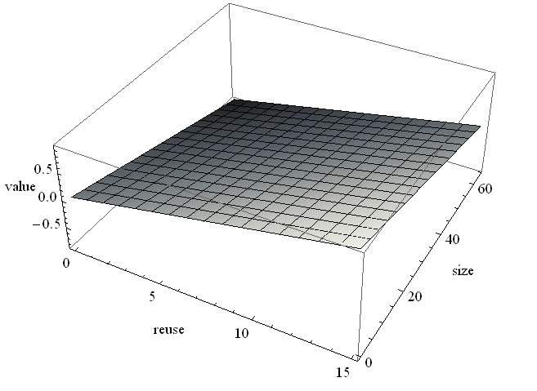
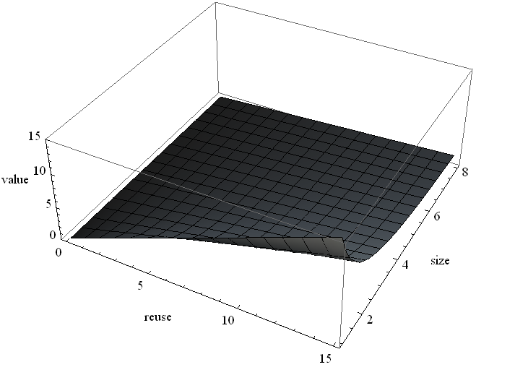
Min-Eviction Value Function
f(block reuse, block size)
Monotonically increasing with respect to block reuse (r)
Monotonically decreasing with respect to block size (s)
Probability of reuse predictor: RRIP [Jaleel+, ISCA’10] derivative
Examples
Plane
r/s
Notes:
Tyler

Slide 12
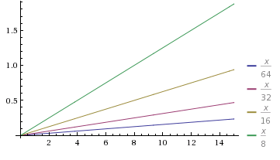
Min-Eviction
Weaknesses
Value function potentially difficult to implement in hardware
Probability of near reuse is hard to estimate (use RRIP-like mechanism [Jaleel+, ISCA’10])
Value inversion

Slide 13
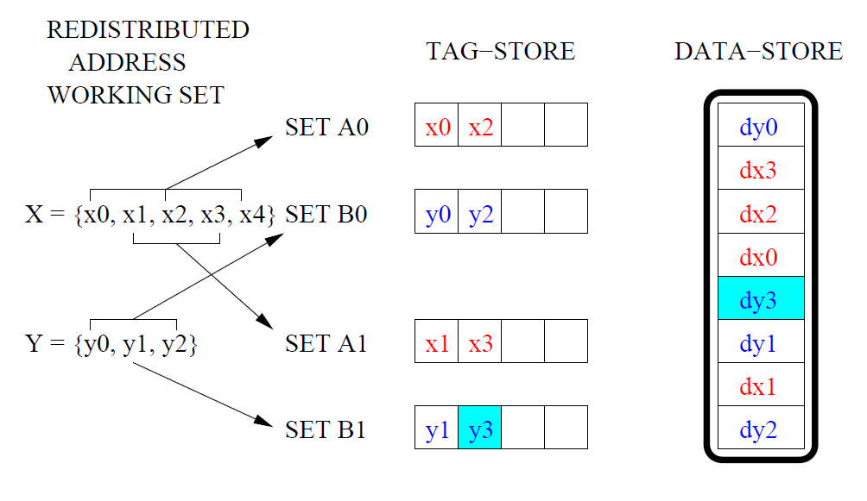
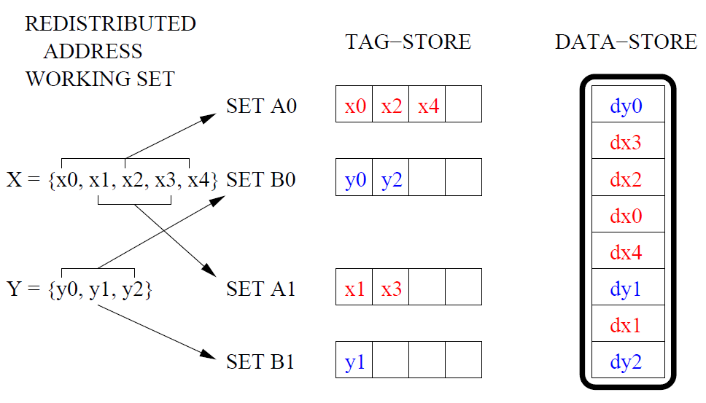
Decoupled Cache
“The V-way cache: Demand based associativity via global replacement”, Qureshi, Thompson, and Patt, ISCA 2005

Slide 14
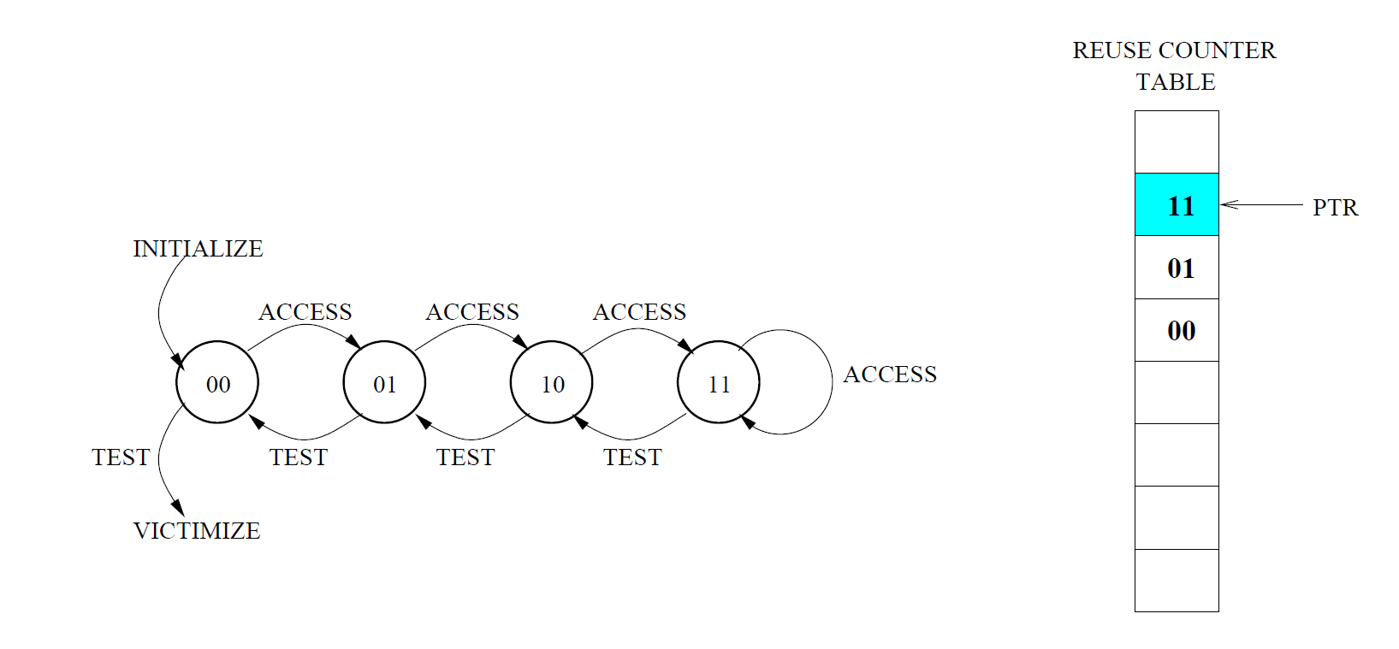
Global Replacement Policies
Global Min-Eviction:
Consider next 64 valid entries, starting from PTR
Run min-eviction

Slide 15
Methodology
Simulator
x86 event-driven simulator based on Simics [Magnusson+, Computer’02]
Workloads
SPEC2006 Benchmarks
1-2 core simulations for 1 billion representative instructions
System Parameters
L1/L2/L3 cache latencies from CACTI [Thoziyoor+, ISCA’08]
4GHz, x86 in-order core, 2MB L2, simple memory model (300-cycle latency for row-misses)
Notes:
Rui

Slide 16
Single-Core Results
Min-Eviction outperforms RRIP and LRU

Slide 17
Homogeneous-Homogeneous
GeoMean
In a shared cache, some Homogeneous-Homogeneous workloads act like a Heterogeneous workload

Slide 18
Heterogeneous-Homogeneous
Min-Eviction shows varied improvement over LRU in Heterogeneous-Homogeneous workloads, 3.5% overall

Slide 19
Heterogeneous-Heterogeneous
Min-Eviction outperforms LRU on average 6.4% in Heterogeneous-Heterogeneous workloads
Notes:
Rui

Slide 20
Next Ideas (CARP ver.next)
Insertion policy
LCP integration
Consider compressibility in prefetch decision
Replace value function?
New curve
New inputs
Dynamic weights on inputs
Heterogeneous value function
Bucketed or staged decision making (i.e. TCM-like)

Slide 21
Further Investigations
Classifying applications
Standard deviation, sensitivity
Entire data store block size distribution
Study of reuse predictors (D-RRIP, EAF, etc)
Ideal?

Slide 22
Backup Slides

Slide 23
Spatial Footprint Predictor*
Predicts neighboring words that are useful to prefetch
Idea: “Variable Cache Line Size Cache”
Spatial locality varies across applications
Cache line size choice affects performance
Use Spatial Footprint Predictor to predict at fine-grain optimal line size
Compressed cache structure supports variable line sizes
Variable cache line size → size-aware replacement policy
Also consider: Spatial Memory Streaming [Somogyi et. al. ISCA’06]
* [Wilkerson & Kumar, ISCA’98]

Slide 24
Multi-Core Results: Overall
4.6%
1.9%
0.8%
The best speedup is exhibited in workloads with the largest variability in size, 1.9% overall with 2-cores

Slide 25
Next Steps
Analyze Dynamic History-Based Partitioning results for further insight
Continuing simulating and improving Min-Value Eviction
Improve value function: try to eliminate division
Explore fairness
Idea: add application-awareness to value function (i.e. f(r,s,a))
Idea: enforce application partitions in Dynamic History-Based Partitioning
Notes:
Rui

Slide 26
References
Belady. A study of replacement algorithms for a virtual-storage computer. In IBM Systems Journal 1966.
Hallnor et al. A Fully Software-Managed Cache Design. In ISCA 2000.
Jaleel et al. High Performance Cache Replacement Using Re-Reference Interval Prediction (RRIP). In ISCA 2010.
Pekhimenko et al. Base-Delta-Immediate Compression: Practical Data Compression for On-Chip Caches. In PACT 2012.
Qureshi et al. Utility-Based Cache Partitioning: A Low-Overhead, High-Performance, Runtime Mechanism to Partition Shared Caches. In Micro 2006.
Seshadri et al. The Evicted-Address Filter: A unified mechanism to address both cache pollution and thrashing. In PACT 2012.

