Slide 1
Computer Architecture: Memory Interference and QoS (Part I)
Prof. Onur Mutlu
Carnegie Mellon University

Slide 2
Memory Interference and QoS Lectures
These slides are from a lecture delivered at INRIA (July 8, 2013)
Similar slides were used at the ACACES 2013 course
http://users.ece.cmu.edu/~omutlu/acaces2013-memory.html

Slide 3
QoS-Aware Memory Systems
Onur Mutlu
onur@cmu.edu
July 8, 2013
INRIA

Slide 4
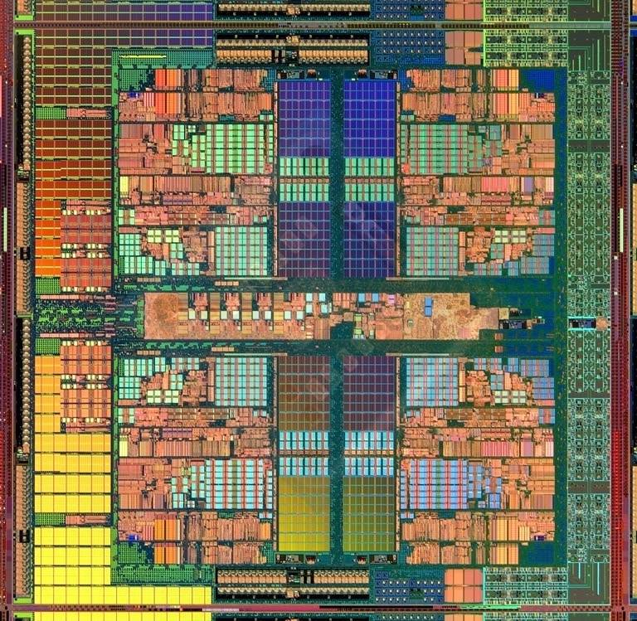
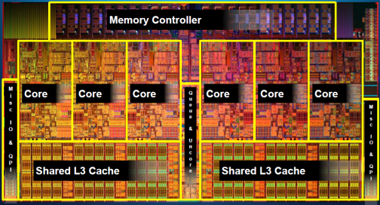
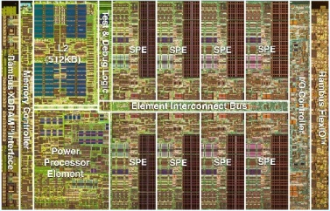
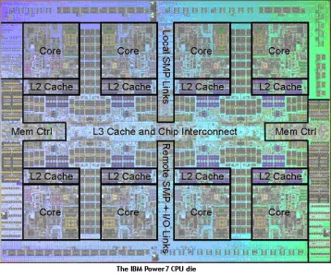
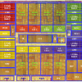
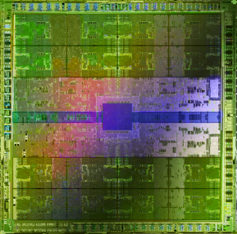
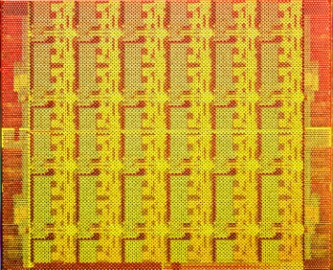
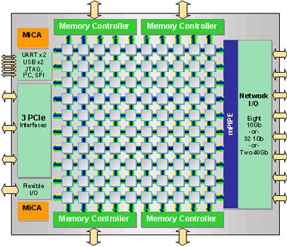
Trend: Many Cores on Chip
Simpler and lower power than a single large core
Large scale parallelism on chip
Intel Core i7 8 cores
IBM Cell BE 8+1 cores
IBM POWER7
8 cores
AMD Barcelona
4 cores
Nvidia Fermi
448 “cores”
Intel SCC
48 cores, networked
Tilera TILE Gx
100 cores, networked
Sun Niagara II
8 cores

Slide 5
Many Cores on Chip
What we want:
N times the system performance with N times the cores
What do we get today?

Slide 6
Unfair Slowdowns due to Interference
High priority
Memory Performance Hog
Low priority
matlab
(Core 1)
gcc
(Core 2)
(Core 0)
(Core 1)
Moscibroda and Mutlu, “Memory performance attacks: Denial of memory service
in multi-core systems,” USENIX Security 2007.
Notes:
What kind of performance do we expect when we run two applications on a multi-core system? To answer this question, we performed an experiment. We took two applications we cared about, ran them together on different cores in a dual-core system, and measured their slowdown compared to when each is run alone on the same system. This graph shows the slowdown each app experienced. (DATA explanation…)
Why do we get such a large disparity in the slowdowns?
Is it the priorities? No. We went back and gave high priority to gcc and low priority to matlab. The slowdowns did not change at all. Neither the software or the hardware enforced the priorities.
Is it the contention in the disk? We checked for this possibility, but found that these applications did not have any disk accesses in the steady state. They both fit in the physical memory and therefore did not interfere in the disk.
What is it then? Why do we get such large disparity in slowdowns in a dual core system?
I will call such an application a “memory performance hog”
Now, let me tell you why this disparity in slowdowns happens.
Is it that there are other applications or the OS interfering with gcc, stealing its time quantums? No.

Slide 7
Uncontrolled Interference: An Example
CORE 1
gcc
Multi-Core
Chip
matlab
CORE 2
L2
CACHE
L2
CACHE
unfairness
INTERCONNECT
Shared DRAM
Memory System
DRAM MEMORY CONTROLLER
DRAM
Bank 0
DRAM
Bank 1
DRAM
Bank 2
DRAM
Bank 3
Notes:
-In a multi-core chip, different cores share some hardware resources. In particular, they share the DRAM memory system. The shared memory system consists of this and that.
When we run matlab on one core, and gcc on another core, both cores generate memory requests to access the DRAM banks. When these requests arrive at the DRAM controller, the controller favors matlab’s requests over gcc’s requests. As a result, matlab can make progress and continues generating memory requests. These requests are again favored by the DRAM controller over gcc’s requests. Therefore, gcc starves waiting for its requests to be serviced in DRAM whereas matlab makes very quick progress as if it were running alone.
Why does this happen? This is because the algorithms employed by the DRAM controller are unfair.
But, why are these algorithms unfair? Why do they unfairly prioritize matlab accesses?
To understand this, we need to understand how a DRAM bank operates.
Almost all systems today contain multi-core chips
Multi-core systems consist of multiple on-chip cores and caches
Cores share the DRAM memory system
DRAM memory system consists of
DRAM banks that store data (multiple banks to allow parallel accesses)
DRAM memory controller that mediates between cores and DRAM memory
It schedules memory operations generated by cores to DRAM
This talk is about exploiting the unfair algorithms in the memory controllers to perform denial of service to running threads
To understand how this happens, we need to know about how each DRAM bank operates

Slide 8
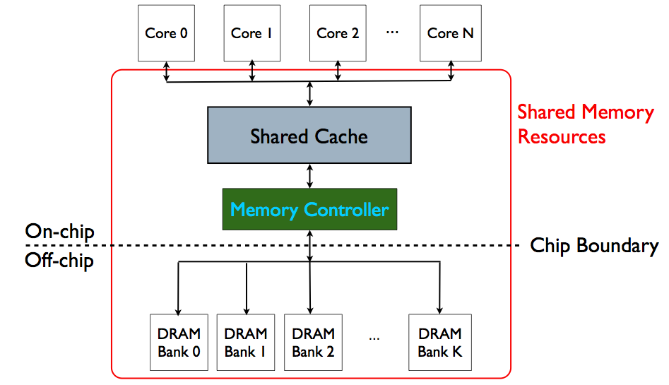
Memory System is the Major Shared Resource
threads’ requests
interfere

Slide 9
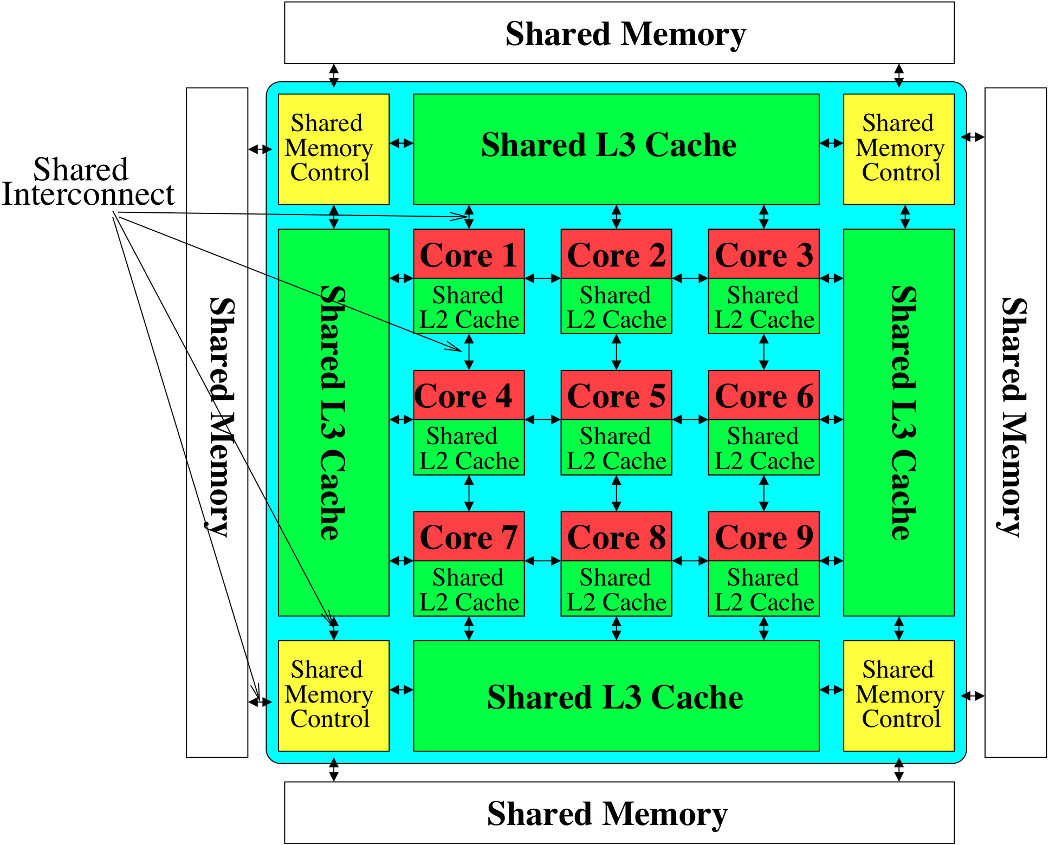
Much More of a Shared Resource in Future

Slide 10
Inter-Thread/Application Interference
Problem: Threads share the memory system, but memory system does not distinguish between threads’ requests
Existing memory systems
Free-for-all, shared based on demand
Control algorithms thread-unaware and thread-unfair
Aggressive threads can deny service to others
Do not try to reduce or control inter-thread interference

Slide 11
Unfair Slowdowns due to Interference
matlab
(Core 1)
gcc
(Core 2)
(Core 0)
(Core 1)
Moscibroda and Mutlu, “Memory performance attacks: Denial of memory service
in multi-core systems,” USENIX Security 2007.
Notes:
What kind of performance do we expect when we run two applications on a multi-core system? To answer this question, we performed an experiment. We took two applications we cared about, ran them together on different cores in a dual-core system, and measured their slowdown compared to when each is run alone on the same system. This graph shows the slowdown each app experienced. (DATA explanation…)
Why do we get such a large disparity in the slowdowns?
Is it the priorities? No. We went back and gave high priority to gcc and low priority to matlab. The slowdowns did not change at all. Neither the software or the hardware enforced the priorities.
Is it the contention in the disk? We checked for this possibility, but found that these applications did not have any disk accesses in the steady state. They both fit in the physical memory and therefore did not interfere in the disk.
What is it then? Why do we get such large disparity in slowdowns in a dual core system?
I will call such an application a “memory performance hog”
Now, let me tell you why this disparity in slowdowns happens.
Is it that there are other applications or the OS interfering with gcc, stealing its time quantums? No.

Slide 12
Uncontrolled Interference: An Example
CORE 1
random
Multi-Core
Chip
stream
CORE 2
L2
CACHE
L2
CACHE
unfairness
INTERCONNECT
Shared DRAM
Memory System
DRAM MEMORY CONTROLLER
DRAM
Bank 0
DRAM
Bank 1
DRAM
Bank 2
DRAM
Bank 3
Notes:
-In a multi-core chip, different cores share some hardware resources. In particular, they share the DRAM memory system. The shared memory system consists of this and that.
When we run matlab on one core, and gcc on another core, both cores generate memory requests to access the DRAM banks. When these requests arrive at the DRAM controller, the controller favors matlab’s requests over gcc’s requests. As a result, matlab can make progress and continues generating memory requests. These requests are again favored by the DRAM controller over gcc’s requests. Therefore, gcc starves waiting for its requests to be serviced in DRAM whereas matlab makes very quick progress as if it were running alone.
Why does this happen? This is because the algorithms employed by the DRAM controller are unfair.
But, why are these algorithms unfair? Why do they unfairly prioritize matlab accesses?
To understand this, we need to understand how a DRAM bank operates.
Almost all systems today contain multi-core chips
Multi-core systems consist of multiple on-chip cores and caches
Cores share the DRAM memory system
DRAM memory system consists of
DRAM banks that store data (multiple banks to allow parallel accesses)
DRAM memory controller that mediates between cores and DRAM memory
It schedules memory operations generated by cores to DRAM
This talk is about exploiting the unfair algorithms in the memory controllers to perform denial of service to running threads
To understand how this happens, we need to know about how each DRAM bank operates

Slide 13
A Memory Performance Hog
// initialize large arrays A, B
for (j=0; j<N; j++) {
index = j*linesize;
A[index] = B[index];
…
}
// initialize large arrays A, B
for (j=0; j<N; j++) {
index = rand();
A[index] = B[index];
…
}
streaming
random
STREAM
RANDOM
Sequential memory access
Very high row buffer locality (96% hit rate)
Memory intensive
Random memory access
Very low row buffer locality (3% hit rate)
Similarly memory intensive
Moscibroda and Mutlu, “Memory Performance Attacks,” USENIX Security 2007.
Notes:
Streaming through memory by performing operations on two 1D arrays.
Sequential memory access
Each access is a cache miss (elements of array larger than a cache line size) → hence, very memory intensive
Link to the real code…

Slide 14
What Does the Memory Hog Do?
Row decoder
T0: Row 0
T0: Row 0
T0: Row 0
T0: Row 0
T0: Row 0
T0: Row 0
T0: Row 0
T1: Row 5
T1: Row 111
T0: Row 0
T1: Row 16
T0: Row 0
Memory Request Buffer
Row 0
Row Buffer
Row 0
Column mux
Row size: 8KB, cache block size: 64B
128 (8KB/64B) requests of T0 serviced before T1
T0: STREAM
T1: RANDOM
Data
Moscibroda and Mutlu, “Memory Performance Attacks,” USENIX Security 2007.
Notes:
Pictorially demonstrate how stream denies memory service to rdarray
Stream continuously accesses columns in row 0 in a streaming manner (streams through a row after opening it)
In other words almost all its requests are row-hits
RDarray’s requests are row-conflicts (no locality)
The DRAM controller reorders streams requests to the open row over other requests (even older ones) to maximize DRAM throughput
Hence, rdarray’s requests do not get serviced as long as stream is issuing requests at a fast-enough rate
In this example, the red thread’s request to another row will not get serviced until stream stops issuing a request to row 0
With those parameters, 128 requests of stream would be serviced before 1 from rdarray
As row-buffer size increases, which is the industry trend, this problem will become more severe
This is not the worst case, but it is easy to construct and understand
Stream falls off the row buffer at some point
I leave it to the listeners to construct a case worse than this (it is possible)

Slide 15
DRAM Controllers
A row-conflict memory access takes significantly longer than a row-hit access
Current controllers take advantage of the row buffer
Commonly used scheduling policy (FR-FCFS) [Rixner 2000]*
(1) Row-hit first: Service row-hit memory accesses first
(2) Oldest-first: Then service older accesses first
This scheduling policy aims to maximize DRAM throughput
But, it is unfair when multiple threads share the DRAM system
*Rixner et al., “Memory Access Scheduling,” ISCA 2000.
*Zuravleff and Robinson, “Controller for a synchronous DRAM …,” US Patent 5,630,096, May 1997.

Slide 16
Effect of the Memory Performance Hog
2.82X slowdown
Slowdown
1.18X slowdown
Results on Intel Pentium D running Windows XP
(Similar results for Intel Core Duo and AMD Turion, and on Fedora Linux)
Moscibroda and Mutlu, “Memory Performance Attacks,” USENIX Security 2007.
Notes:
RANDOM was given higher OS priority in the experiments

Slide 17
Greater Problem with More Cores
Vulnerable to denial of service (DoS)
Unable to enforce priorities or SLAs
Low system performance
Uncontrollable, unpredictable system

Slide 18
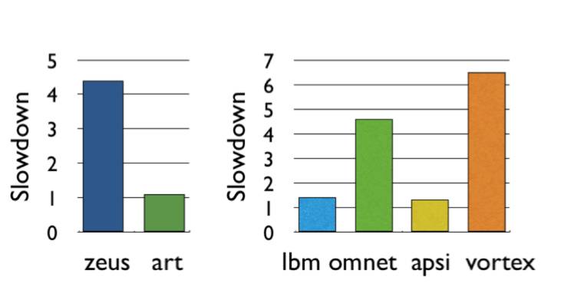
Greater Problem with More Cores
Vulnerable to denial of service (DoS) [Usenix Security’07]
Unable to enforce priorities or SLAs [MICRO’07,’10,’11, ISCA’08’11’12, ASPLOS’10]
Low system performance [IEEE Micro Top Picks ’09,’11a,’11b,’12]
Uncontrollable, unpredictable system

Slide 19
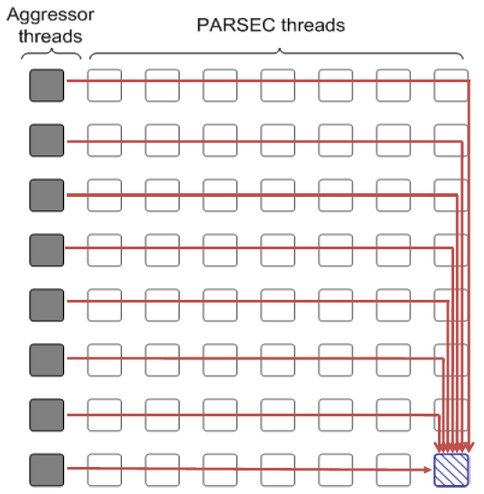
Distributed DoS in Networked Multi-Core Systems
Attackers
(Cores 1-8)
Stock option pricing application
(Cores 9-64)
Cores connected via
packet-switched
routers on chip
~5000X latency increase
Grot, Hestness, Keckler, Mutlu,
“Preemptive virtual clock: A Flexible,
Efficient, and Cost-effective QOS
Scheme for Networks-on-Chip,“
MICRO 2009.

Slide 20
How Do We Solve The Problem?
Inter-thread interference is uncontrolled in all memory resources
Memory controller
Interconnect
Caches
We need to control it
i.e., design an interference-aware (QoS-aware) memory system

Slide 21
QoS-Aware Memory Systems: Challenges
How do we reduce inter-thread interference?
Improve system performance and core utilization
Reduce request serialization and core starvation
How do we control inter-thread interference?
Provide mechanisms to enable system software to enforce QoS policies
While providing high system performance
How do we make the memory system configurable/flexible?
Enable flexible mechanisms that can achieve many goals
Provide fairness or throughput when needed
Satisfy performance guarantees when needed

Slide 22
Designing QoS-Aware Memory Systems: Approaches
Smart resources: Design each shared resource to have a configurable interference control/reduction mechanism
QoS-aware memory controllers [Mutlu+ MICRO’07] [Moscibroda+, Usenix Security’07] [Mutlu+ ISCA’08, Top Picks’09] [Kim+ HPCA’10] [Kim+ MICRO’10, Top Picks’11] [Ebrahimi+ ISCA’11, MICRO’11] [Ausavarungnirun+, ISCA’12][Subramanian+, HPCA’13]
QoS-aware interconnects [Das+ MICRO’09, ISCA’10, Top Picks ’11] [Grot+ MICRO’09, ISCA’11, Top Picks ’12]
QoS-aware caches
Dumb resources: Keep each resource free-for-all, but reduce/control interference by injection control or data mapping
Source throttling to control access to memory system [Ebrahimi+ ASPLOS’10, ISCA’11, TOCS’12] [Ebrahimi+ MICRO’09] [Nychis+ HotNets’10] [Nychis+ SIGCOMM’12]
QoS-aware data mapping to memory controllers [Muralidhara+ MICRO’11]
QoS-aware thread scheduling to cores [Das+ HPCA’13]

Slide 23
QoS-Aware Memory Scheduling
Resolves memory contention by scheduling requests
How to schedule requests to provide
High system performance
High fairness to applications
Configurability to system software
Memory controller needs to be aware of threads
Core
Core
Memory Controller
Memory
Core
Core

Slide 24
QoS-Aware Memory Scheduling: Evolution

Slide 25
QoS-Aware Memory Scheduling: Evolution
Stall-time fair memory scheduling [Mutlu+ MICRO’07]
Idea: Estimate and balance thread slowdowns
Takeaway: Proportional thread progress improves performance, especially when threads are “heavy” (memory intensive)
Parallelism-aware batch scheduling [Mutlu+ ISCA’08, Top Picks’09]
Idea: Rank threads and service in rank order (to preserve bank parallelism); batch requests to prevent starvation
ATLAS memory scheduler [Kim+ HPCA’10]

Slide 26
Within-Thread Bank Parallelism
thread A
Key Idea:
rank
thread B
thread B
req
req
Bank 1
req
req
Bank 1
thread A
req
req
Bank 0
req
req
Bank 0
memory service timeline
memory service timeline
SAVED CYCLES
thread A
WAIT
thread A
WAIT
thread B
WAIT
thread B
WAIT
thread execution timeline
thread execution timeline
Notes:
A memory scheduler can actively exploit bank-level parallelism to reduce the effective memory access latency. Here’s how.
Let us assume a case where two threads send two memory requests to two different banks.
A naïve memory scheduler that doesn’t exploit bank-level parallelism would schedule the requests in the order they arrived.
As shown in their thread execution timeline, both threads must wait for two bank latencies before all their requests are serviced.
In contrast, a memory scheduler that is aware of bank-level parallelism was proposed by Mutlu and Moscibroda.
Their key idea was to rank the threads so that thread’s memory requests are prioritized in the same order across all the banks.
In this case, let us assume that the blue thread’s request are the most prioritized.
The scheduler would then reorder the requests at bank 1’s request buffer…
so that the blue requests are serviced concurrently, after which the red requests can be serviced concurrently.
The memory service timeline shows how the access latencies for requests from the same thread are overlapped.
And, as a result, thread A has to wait less for its requests to be serviced.

Slide 27
Parallelism-Aware Batch Scheduling [ISCA’08]
Principle 1: Schedule requests from a thread back to back
Preserves each thread’s bank parallelism
But, this can cause starvation…
Principle 2: Group a fixed number of oldest requests from each thread into a “batch”
Service the batch before all other requests
Form a new batch when the current batch is done
Eliminates starvation, provides fairness
T0
T0
T3
T1
T3
T3
T2
T3
Batch
T1
T2
T3
T0
T0
T1
Bank 0
Bank 1
Notes:
Threads are ordered such that 1) system throughput is maximized and 2) stall-time fairness is maintained
(An ordering/ranking is formed among threads)
The key idea of this ordering is to maximize system throughput

Slide 28
QoS-Aware Memory Scheduling: Evolution
Stall-time fair memory scheduling [Mutlu+ MICRO’07]
Idea: Estimate and balance thread slowdowns
Takeaway: Proportional thread progress improves performance, especially when threads are “heavy” (memory intensive)
Parallelism-aware batch scheduling [Mutlu+ ISCA’08, Top Picks’09]
Idea: Rank threads and service in rank order (to preserve bank parallelism); batch requests to prevent starvation
Takeaway: Preserving within-thread bank-parallelism improves performance; request batching improves fairness
ATLAS memory scheduler [Kim+ HPCA’10]
Idea: Prioritize threads that have attained the least service from the memory scheduler
Takeaway: Prioritizing “light” threads improves performance

Slide 29
QoS-Aware Memory Scheduling: Evolution
Thread cluster memory scheduling [Kim+ MICRO’10]
Idea: Cluster threads into two groups (latency vs. bandwidth sensitive); prioritize the latency-sensitive ones; employ a fairness policy in the bandwidth sensitive group
Takeaway: Heterogeneous scheduling policy that is different based on thread behavior maximizes both performance and fairness
Integrated Memory Channel Partitioning and Scheduling [Muralidhara+ MICRO’11]
Idea: Only prioritize very latency-sensitive threads in the scheduler; mitigate all other applications’ interference via channel partitioning
Takeaway: Intelligently combining application-aware channel partitioning and memory scheduling provides better performance than either

Slide 30
QoS-Aware Memory Scheduling: Evolution
Parallel application memory scheduling [Ebrahimi+ MICRO’11]
Idea: Identify and prioritize limiter threads of a multithreaded application in the memory scheduler; provide fast and fair progress to non-limiter threads
Takeaway: Carefully prioritizing between limiter and non-limiter threads of a parallel application improves performance
Staged memory scheduling [Ausavarungnirun+ ISCA’12]
Idea: Divide the functional tasks of an application-aware memory scheduler into multiple distinct stages, where each stage is significantly simpler than a monolithic scheduler
Takeaway: Staging enables the design of a scalable and relatively simpler application-aware memory scheduler that works on very large request buffers

Slide 31
QoS-Aware Memory Scheduling: Evolution
MISE [Subramanian+ HPCA’13]
Idea: Estimate the performance of a thread by estimating its change in memory request service rate when run alone vs. shared → use this simple model to estimate slowdown to design a scheduling policy that provides predictable performance or fairness
Takeaway: Request service rate of a thread is a good proxy for its performance; alone request service rate can be estimated by giving high priority to the thread in memory scheduling for a while

Slide 32
QoS-Aware Memory Scheduling: Evolution
Prefetch-aware shared resource management [Ebrahimi+ ISCA’12] [Ebrahimi+ MICRO’09] [Lee+ MICRO’08]
Idea: Prioritize prefetches depending on how they affect system performance; even accurate prefetches can degrade performance of the system
Takeaway: Carefully controlling and prioritizing prefetch requests improves performance and fairness
DRAM-Aware last-level cache policies [Lee+ HPS Tech Report’10] [Lee+ HPS Tech Report’10]
Idea: Design cache eviction and replacement policies such that they proactively exploit the state of the memory controller and DRAM (e.g., proactively evict data from the cache that hit in open rows)
Takeaway: Coordination of last-level cache and DRAM policies improves performance and fairness

Slide 33
Stall-Time Fair Memory Scheduling
Onur Mutlu and Thomas Moscibroda, "Stall-Time Fair Memory Access Scheduling for Chip Multiprocessors" 40th International Symposium on Microarchitecture (MICRO),
pages 146-158, Chicago, IL, December 2007. Slides (ppt)
STFM Micro 2007 Talk

Slide 34
The Problem: Unfairness
Vulnerable to denial of service (DoS) [Usenix Security’07]
Unable to enforce priorities or SLAs [MICRO’07,’10,’11, ISCA’08’11’12, ASPLOS’10]
Low system performance [IEEE Micro Top Picks ’09,’11a,’11b,’12]
Uncontrollable, unpredictable system

Slide 35
How Do We Solve the Problem?
Stall-time fair memory scheduling [Mutlu+ MICRO’07]
Goal: Threads sharing main memory should experience similar slowdowns compared to when they are run alone → fair scheduling
Also improves overall system performance by ensuring cores make “proportional” progress
Idea: Memory controller estimates each thread’s slowdown due to interference and schedules requests in a way to balance the slowdowns
Mutlu and Moscibroda, “Stall-Time Fair Memory Access Scheduling for Chip Multiprocessors,” MICRO 2007.

Slide 36
Stall-Time Fairness in Shared DRAM Systems
A DRAM system is fair if it equalizes the slowdown of equal-priority threads relative to when each thread is run alone on the same system
DRAM-related stall-time: The time a thread spends waiting for DRAM memory
ST_{shared}: DRAM-related stall-time when the thread runs with other threads
ST_{alone}: DRAM-related stall-time when the thread runs alone
Memory-slowdown = ST_{shared}/ST_{alone}
Relative increase in stall-time
Stall-Time Fair Memory scheduler (STFM) aims to equalize Memory-slowdown for interfering threads, without sacrificing performance
Considers inherent DRAM performance of each thread
Aims to allow proportional progress of threads
Notes:
Memory-slowdown is the relative increase in the DRAM-related stall-time due to interference from other threads
For example, if a thread’s DRAM related stall time is 1 hour when running alone, and its stall-time is 2 hours when it runs together with other threads,
Its memory-slowdown is said to be 2.
Give an example at the end: If a thread waits for DRAM 1 hour running by itself and this increases to 2 hours (its slowdown is 2), then a thread that waits for DRAM 2 hours, should now wait for DRAM 4 hours.
Each thread experiences the same slowdown compared to its baseline DRAM performance
The amount of time a thread spends waiting for DRAM memory
Extra time a thread requires to run because DRAM access is not instant
PROPORTIONALITY: Each thread makes the same amount of progress relative to its baseline performance. This is consistent with priority based scheduling mechanisms that allocate the same time quantum for equal-priority threads.
We define two values to compute slowdown.
Proportional slowdown (proportionate progress)
Fairness notion similar to SMT [Cazorla, IEEE Micro’04][Luo, ISPASS’01], SoEMT [Gabor, Micro’06], and shared caches [Kim, PACT’04]

Slide 37
STFM Scheduling Algorithm [MICRO’07]
For each thread, the DRAM controller
Tracks ST_{shared}
Estimates ST_{alone}
Each cycle, the DRAM controller
Computes Slowdown = ST_{shared}/ST_{alone} for threads with legal requests
Computes unfairness = MAX Slowdown / MIN Slowdown
If unfairness < α
Use DRAM throughput oriented scheduling policy
If unfairness ≥ α
Use fairness-oriented scheduling policy
(1) requests from thread with MAX Slowdown first
(2) row-hit first , (3) oldest-first
Notes:
Except for pathological cases, best achievable unfairness value is 1
Maximizes DRAM throughput if it cannot improve fairness
WORK CONSERVING: Does not waste useful bandwidth to improve fairness
If a request does not interfere with any other, it is scheduled

Slide 38
How Does STFM Prevent Unfairness?
T0: Row 0
T1: Row 5
T0: Row 0
T0: Row 0
T1: Row 111
T0: Row 0
T0: Row 0
T0: Row 0
T0: Row 0
T1: Row 16
Row 111
Row Buffer
Row 16
Row 0
Row 0
T0 Slowdown
1.00
1.04
1.04
1.07
1.10
1.03
T1 Slowdown
1.03
1.06
1.08
1.14
1.06
1.11
1.00
Unfairness
1.03
1.06
1.03
1.04
1.06
1.04
1.03
1.00
Data
α
1.05
Notes:
A pictorial example of how our solution prevents stream from being a memory performance hog
Our technique requires the DRAM controller to keep track of slowdowns for each thread and the unfairness value based on these slowdowns
Alpha parameter (maximum tolerable unfairness until the fairness-oriented scheduling policy kicks in) is set to 1.05 in this example
As stream’s requests are prioritized over rdarray’s, rdarray’s slowdown increases and hence unfairness increases
Once unfairness crosses the alpha value, our algorithm kicks in and uses the fairness-oriented scheduling policy
This policy prioritizes requests from the thread with the maximum slowdown (rdarray – thread 1)
Hence, rdarray’s requests do not indefinitely starve
Servicing rdarray’s request increases stream’s slowdown and keeps in check rdarray’s slowdown (thus reduces unfairness)
Therefore, when unfairness becomes tolerable again, our algorithm switches back to the baseline scheduling policy to maximize throughput (i.e. it schedules stream’s row hit requests first, and then the oldest requests)

Slide 39
STFM Pros and Cons
Upsides:
Identifies fairness as an issue in multi-core memory scheduling
Good at providing fairness
Being fair improves performance
Downsides:
Does not handle all types of interference
Somewhat complex to implement
Slowdown estimations can be incorrect

Slide 40
Parallelism-Aware Batch Scheduling
Onur Mutlu and Thomas Moscibroda, "Parallelism-Aware Batch Scheduling: Enhancing both
Performance and Fairness of Shared DRAM Systems” 35th International Symposium on Computer Architecture (ISCA),
pages 63-74, Beijing, China, June 2008. Slides (ppt)
PAR-BS ISCA 2008 Talk

Slide 41
Another Problem due to Interference
Processors try to tolerate the latency of DRAM requests by generating multiple outstanding requests
Memory-Level Parallelism (MLP)
Out-of-order execution, non-blocking caches, runahead execution
Effective only if the DRAM controller actually services the multiple requests in parallel in DRAM banks
Multiple threads share the DRAM controller
DRAM controllers are not aware of a thread’s MLP
Can service each thread’s outstanding requests serially, not in parallel
Notes:
Modern processors try to amortize the latency of DRAM requests by generating multiple outstanding requests
This concept is called memory-level parallelism.
Many techniques, such as OOO, non-blocking caches and runahead execution, are designed or used to tolerate long memory latencies by exploiting memory-level parallelism
These latency tolerance techniques are effective only if the DRAM controller actually services the multiple requests of a thread in parallel in DRAM banks
This is true in a single-threaded system since only one thread has exclusive access to all DRAM banks.
However, in a multi-core system, multiple threads share the DRAM controller.
Unfortunately, existing DRAM controllers are not aware of each thread’s memory level parallelism
As a result they can service each thread’s outstanding requests serially, not in parallel
Let’s take a look at why this happens.
-----------------------------------------
Assuming requests are to different banks
In a single core system this is fine because only one thread has exclusive access to all DRAM banks.
However, in a multi-core system, multiple threads shared the DRAM controller.
Unfortunately, DRAM controllers are unaware of a thread’s MLP. As a result, because threads can interfere with each other in the DRAM system, they can service each thread’s requests serially instead of in parallel.
Let’s take a look at why this happens.

Slide 42
Bank Parallelism of a Thread
2 DRAM Requests
Bank 0
Bank 1
Single Thread:
Thread A :
Compute
Stall
Compute
Bank 0
Bank 1
Thread A: Bank 0, Row 1
Thread A: Bank 1, Row 1
Bank access latencies of the two requests overlapped
Thread stalls for ~ONE bank access latency
Notes:
I will demonstrate this pictorially with an example.
Let’s say a thread A executes until it encounters 2 DRAM requests caused by two of its load instructions. These requests are sent to the DRAM controller. And, the controller services them by first scheduling the request to Bank 0 and then scheduling the request to Bank 1. While the requests are being serviced in parallel in the banks, the thread stalls (waiting for the data). Once the servicing of the requests completes, the thread can continue execution.
Since the requests were serviced in parallel in the two banks, bank access latencies of the two requests are overlapped. As a result, the thread stalls for approximately one bank access latency, instead of two bank access latencies.

Slide 43
Bank Parallelism Interference in DRAM
Baseline Scheduler:
Bank 0
Bank 1
2 DRAM Requests
A :
Compute
Stall
Stall
Compute
Bank 0
Bank 1
Thread A: Bank 0, Row 1
2 DRAM Requests
B:
Compute
Stall
Stall
Compute
Thread B: Bank 1, Row 99
Bank 1
Thread B: Bank 0, Row 99
Bank 0
Thread A: Bank 1, Row 1
Bank access latencies of each thread serialized
Each thread stalls for ~TWO bank access latencies
Notes:
What happens when we run two of these threads together in a dual-core system? Again, both threads execute until each encounters 2 DRAM requests. These requests are sent to the DRAM controller. Assume they arrive in the order shown. And the controller services them in the order they arrive.
The controller first takes Thread A’s request to Bank 0 and schedules it. It then schedules Thread B’s request to Bank 1. While these two requests are serviced in parallel, both threads stall.
Once the first request to Bank 0 is done, the controller takes Thread B’s request to bank 0 and schedules it. And it takes Thread A’s request to Bank 1 and schedules it. While these two requests are serviced in parallel, both threads stall.
Once the requests are complete, the threads continue computation.
In this case, because the threads’ requests interfered with each other in the DRAM system, the bank access latencies of each thread were serialized because the requests were serialized. As a result both threads stall for two bank access latencies instead of 1, which is what each thread experienced when running alone.
This is because the DRAM controller did not try to preserve the bank parallelism of each thread.

Slide 44
Parallelism-Aware Scheduler
Baseline Scheduler:
Bank 0
Bank 1
2 DRAM Requests
A :
Compute
Stall
Stall
Compute
Bank 0
Bank 1
2 DRAM Requests
Thread A: Bank 0, Row 1
B:
Compute
Stall
Stall
Compute
Thread B: Bank 1, Row 99
Bank 1
Thread B: Bank 0, Row 99
Bank 0
Parallelism-aware Scheduler:
Thread A: Bank 1, Row 1
2 DRAM Requests
A :
Compute
Stall
Compute
Saved Cycles
Average stall-time: ~1.5 bank access latencies
Bank 0
Bank 1
2 DRAM Requests
B:
Compute
Stall
Stall
Compute
Bank 0
Bank 1
Notes:
Can we do better than this? Let me describe what a parallelism aware scheduler would do.
This is the same example. The two threads compute until they each generate 2 DRAM requests, which arrive at the controller in the same order as before. The controller first takes Thread A’s request to Bank 0 and schedules it. But then, instead of servicing the requests in their arrival order, it realizes there is another request from Thread A to Bank 1 and if it schedules that one back to back with Thread A’s previous request, thread A’s request latencies would be overlapped.
Therefore, the controller takes Thread A’s request to Bank 1 and schedules it. While these two requests are serviced in parallel in the banks, both threads stall.
Once the request to Bank 0 is complete, the controller takes Thread B’s request to Bank 0 and schedules it. Later, it schedules Thread B’s request to Bank 1. While these two requests are being serviced, Thread B stalls (because it does not have the data it needs), but thread A can do useful computation! This is because its requests were serviced in parallel in the banks, instead of serially, and the thread has all the data it needs to do useful computation. As a result, the execution time of Thread A reduces compared to the baseline scheduler that was not aware of the threads’ bank parallelism.
Overall system throughput also improves because the average stall-time of the threads is 1.5 bank access latencies instead of 2. Instead of stalling, cores can make progress executing their instruction streams.

Slide 45
Parallelism-Aware Batch Scheduling (PAR-BS)
Principle 1: Parallelism-awareness
Schedule requests from a thread (to different banks) back to back
Preserves each thread’s bank parallelism
But, this can cause starvation…
Principle 2: Request Batching
Group a fixed number of oldest requests from each thread into a “batch”
Service the batch before all other requests
Form a new batch when the current one is done
Eliminates starvation, provides fairness
Allows parallelism-awareness within a batch
T1
T1
T2
T0
T2
T2
T3
T2
Batch
T0
T3
T2
T1
T1
T0
Bank 0
Bank 1
Mutlu and Moscibroda, “Parallelism-Aware Batch Scheduling,” ISCA 2008.
Notes:
Parallelism aware batch scheduling uses two key principles. The first principle is parallelism awareness. As I showed you before, a thread’s bank parallelism is improved by scheduling requests from a thread to different banks back to back. Unfortunately, doing this greedily can cause starvation because a thread whose requests are continuously scheduled back to back can keep on generating more requests and therefore deny service to other threads that are waiting to access the same bank.
To avoid this, we use a second principle, called request batching. With this, the controller groups a fixed number of oldest requests from each thread into a “batch”. And, it services the batch before all other requests. It forms a new batch when the current one is done.
Batching eliminates starvation of requests and threads, and provides fairness. It also allows parallelism of each thread to be optimized for within a batch.
Let’s take a look at how this works pictorially.
Multiple threads send requests to the DRAM controller. The controller groups these requests into a batch. Once a batch is formed any newly arriving requests are not included in the batch. Within the batch, the controller schedules each thread’s requests in parallel. It first takes TX’s requests and schedules them in parallel. Then it takes TY’s requests and schedules them in parallel. Note that incoming requests from T3 that are outside the batch are not serviced. Once all requests in the batch are serviced in a parallelism-aware manner, the controller forms a new batch with the requests in the memory request buffer.

Slide 46
PAR-BS Components
Request batching
Within-batch scheduling
Parallelism aware
Notes:
PAR-BS has two components, which I will describe in more detail. The first is request batching. Aside from guaranteeing starvation freedom and providing fairness, a batch provides a flexible substrate that enables aggressive scheduling optimizations (within the batch).
The second component is the within-batch scheduling component. Within a batch, any DRAM scheduling policy can be employed. And, this policy can be very aggressive and possibly unfair in the global sense. Because the overlying batching scheme ensures forward progress in each thread. In fact, we use a globally unfair shortest job first scheduling policy within a batch, to optimize each thread’s bank parallelism.

Slide 47
Request Batching
Each memory request has a bit (marked) associated with it
Batch formation:
Mark up to Marking-Cap oldest requests per bank for each thread
Marked requests constitute the batch
Form a new batch when no marked requests are left
Marked requests are prioritized over unmarked ones
No reordering of requests across batches: no starvation, high fairness
How to prioritize requests within a batch?
Notes:
To implement batching, Each memory request has a bit (called the marked bit) associated with it
When a batch is formed, the controller marks up to a Marking-Cap pending requests per bank for each thread. Marked requests constitute the batch. A new batch is formed when no marked requests are left.
The key idea is that marked requests are always prioritized over unmarked ones. Hence, there is no reordering of requests across batches: As a result, there is no starvation, and a high degree of fairness.
But how does the controller prioritize requests within a batch?

Slide 48
Within-Batch Scheduling
Can use any existing DRAM scheduling policy
FR-FCFS (row-hit first, then oldest-first) exploits row-buffer locality
But, we also want to preserve intra-thread bank parallelism
Service each thread’s requests back to back
Scheduler computes a ranking of threads when the batch is formed
Higher-ranked threads are prioritized over lower-ranked ones
Improves the likelihood that requests from a thread are serviced in parallel by different banks
Different threads prioritized in the same order across ALL banks
HOW?
Notes:
Within a batch, the controller can use any existing DRAM scheduling policy. For example, the baseline FR-FCFS policy is very good at exploiting row buffer locality.
However, in addition to exploiting row-buffer locality, we also want to preserve intra-thread bank parallelism. As I showed you before, this can be accomplished by servicing each thread’s requests back to back
To do so, the DRAM scheduler computes a ranking of threads when the batch is formed
And it prioritizes requests that belong to higher-ranked threads over those that belong to lower ranked ones
This Improves the likelihood that requests from a thread are serviced in parallel by different banks
Because Different threads prioritized in the same order (the RANK ORDER) across ALL banks
But how does the scheduler compute this ranking?

Slide 49
How to Rank Threads within a Batch
Ranking scheme affects system throughput and fairness
Maximize system throughput
Minimize average stall-time of threads within the batch
Minimize unfairness (Equalize the slowdown of threads)
Service threads with inherently low stall-time early in the batch
Insight: delaying memory non-intensive threads results in high slowdown
Shortest stall-time first (shortest job first) ranking
Provides optimal system throughput [Smith, 1956]*
Controller estimates each thread’s stall-time within the batch
Ranks threads with shorter stall-time higher
* W.E. Smith, “Various optimizers for single stage production,” Naval Research Logistics Quarterly, 1956.
Notes:
The thread ranking scheme affects system throughput and fairness
A good ranking scheme should achieve two objectives.
First, it should maximize system throughput
Second, it should minimize unfairness; in other words it should balance the slowdown of the threads compared to when each is run alone.
These two objectives call for the same ranking scheme, as I will show soon.
Maximizing system throughput is achieved by minimizing the average stall-time of the threads within the batch (as I showed in the earlier example). By minimizing the average stall time, we maximize the amount of time the system spends on computation rather than waiting for DRAM accesses.
Minimizing unfairness is achieved by servicing threads with inherently low stall-time early in the batch, The insight is that if a thread has low stall time to begin with (if it is not intensive) delaying that thread would result in very high slowdown compared to delaying a memory-intensive thread.
To achieve both objectives, we use the “shortest job first” principle. Shortest job first scheduling has been proven to provide the optimal throughput in generalized machine scheduling theory. The controller estimates each thread’s stall-time within the batch (assuming the thread is run alone). And, it ranks a thread higher if the thread has a short stall time.

Slide 50
Shortest Stall-Time First Ranking
Maximum number of marked requests to any bank (max-bank-load)
Rank thread with lower max-bank-load higher (~ low stall-time)
Total number of marked requests (total-load)
Breaks ties: rank thread with lower total-load higher
T3
 | max-bank-load | total-load
T0 | 1 | 3
T1 | 2 | 4
T2 | 2 | 6
T3 | 5 | 9
T3
T3
T2
T3
T3
T1
T0
T2
T0
T2
T2
T1
T2
T3
T1
T0
T3
T1
T3
T2
T3
Bank 0
Bank 1
Bank 2
Bank 3
Ranking:
T0 > T1 > T2 > T3
Notes:
How is this exactly done? The controller keeps track of two values for each thread. First, the maximum number of marked requests from the thread to any bank. This is called max-bank-load. A lower value of this correlates with low stall time (and less memory intensiveness). As a result the scheduler ranks a thread with lower max-bank-load higher than a thread with higher max-bank load.
If the max-bank-load of the two threads are equal, the scheduler uses another value it keeps track of to break the ties. It keeps the total number of requests in the batch from each thread. This is called total-load. If a thread has lower total-load it is less intensive, therefore it is ranked higher.
Let’s take a look at these concepts with an example. Assume these are the requests within the batch.
T0 has at most 1 request to any bank, so its max-bank-load is 1. Its total-load is 3 since it has total 3 marked requests.
T1 has at most 2 requests to any bank so its max-bank-load is 2. Its total load is 6.
T2 similarly has a max-bank-load of 2, but its total load is higher.
Finally, T3 has a maximum of 5 requests to Bank 3. Therefore, its max-bank load is 5.
Because T1 has the smallest max-bank-load, it is ranked highest. The scheduler ranks T1 higher than T2 because T1 has fewer total requests. The most memory intensive thread, T2 is ranked the lowest.
----------------------------
Insight: Memory-intensive threads can be delayed more within a batch since their baseline stall-time is high
How do you break the ties? A thread with lower total-load is ranked higher
Goal: Finish non-intensive threads first and fill in the gaps in parallelism as much as possible
Shortest job first within a batch might seem unfair, but remember the batch boundaries. Less intensive threads will be penalized across batches because if their requests are not marked, they cannot be serviced. Shortest job first balances this delay caused to the less intensive threads
Thread 0 has at most one request to any bank
Thread 1 has at most 2: it has two requests to Bank 0.
Thread 2 has at most 2 as well.
Thread 3 has max number of requests to Bank 3 (5 reqs)

Slide 51
Example Within-Batch Scheduling Order
Baseline Scheduling
Order (Arrival order)
T3
7
PAR-BS Scheduling
Order
T3
7
T3
6
T3
6
T3
T2
T3
T3
5
T3
T3
T3
T3
5
4
4
T1
T0
T2
T0
Time
T3
T2
T2
T3
Time
T2
T2
T1
T2
3
T2
T2
T2
T3
3
T3
T1
T0
T3
2
T1
T1
T1
T2
2
T1
T3
T2
T3
1
T1
T0
T0
T0
1
Bank 0
Bank 1
Bank 2
Bank 3
Bank 0
Bank 1
Bank 2
Bank 3
Ranking: T0 > T1 > T2 > T3
T0 | T1 | T2 | T3
4 | 4 | 5 | 7
T0 | T1 | T2 | T3
1 | 2 | 4 | 7
Stall times
Stall times
AVG: 5 bank access latencies
AVG: 3.5 bank access latencies
Notes:
How does this ranking affect the scheduling order? Let’s take a look at this pictorially.
First, let’s look at the baseline scheduler. I will show the time at which the requests are serviced, where time is expressed abstractly in terms of bank access latency. In the baseline scheduler, the batched requests are serviced in their arrival order. As a result, the last request of T0 is serviced after 4 bank access latencies, the last request of T1 is also serviced after 4 bank access latencies. Consequently, the average stall time of the threads is approximately 5 bank access latencies within this batch of requests.
If we use PAR-BS to rank the threads, the scheduler will prioritize requests based on their thread-rank order, which I showed before. It prioritizes T0’s requests first (as shown in the ranking order). As a result, T0’s requests complete after 1 bank access latency. T1’s requests are serviced after 2 bank access latencies. T2’s requests are serviced after 4 bank access latencies.
Note that the bank parallelism of each thread is preserved as much as possible. Because of this, the average stall time reduces by 30%. Thus, system throughput improves.
Also note that, to keep this example simple, I assumed there are no row-buffer hits. A more complicated example with row-buffer hits is provided in the paper, and I encourage you to look at it.
--------------------------------------
Time is in bank access latencies (note that this is an approximation to demonstrate the idea… real DRAM system is much more complex than this…)
Last request from a thread is scheduled at TIME

Slide 52
Putting It Together: PAR-BS Scheduling Policy
PAR-BS Scheduling Policy
(1) Marked requests first
(2) Row-hit requests first
(3) Higher-rank thread first (shortest stall-time first)
(4) Oldest first
Three properties:
Exploits row-buffer locality and intra-thread bank parallelism
Work-conserving
Services unmarked requests to banks without marked requests
Marking-Cap is important
Too small cap: destroys row-buffer locality
Too large cap: penalizes memory non-intensive threads
Many more trade-offs analyzed in the paper
Batching
Parallelism-aware
within-batch
scheduling
Notes:
The resulting scheduling policy of our mechanism is based on four simple prioritization rules.
Marked requests are prioritized over others. This is the batching component.
Within a batch, row-hit requests are prioritized over others to exploit row-buffer locality (as in FR-FCFS). Then, higher-ranked threads’ requests are prioritized over lower ranked threads’ requests (to preserve each thread’s bank parallelism). Finally all else being equal, older requests are prioritized over others.
This scheduling policy has three properties.
First, it exploits both row-buffer locality and intra-thread bank parallelism. I assumed no row buffer hits in the previous example, to keep it simple, but this is taken into account in our scheduling algorithm. There is a balance between exploiting row buffer locality and bank parallelism, and our scheduling algorithm tries to achieve this balance. An example with row hits is provided in the paper.
Second, it is work conserving. It services unmarked requests in banks without marked requests.
Third, and I will not go into much detail on this, Marking-Cap is the most important parameter. Remember that the Marking-Cap determines how many requests from each thread to each bank can be admitted into a batch. If the cap is too small, too few requests from each thread are admitted into the batch. As a result, a thread’s row buffer locality cannot be exploited. If the cap is too large too many requests from intensive threads enter the batch, which slows down non-intensive threads.
Many other similar trade-offs are analyzed in the paper and I encourage you to read it.

Slide 53
Hardware Cost
<1.5KB storage cost for
8-core system with 128-entry memory request buffer
No complex operations (e.g., divisions)
Not on the critical path
Scheduler makes a decision only every DRAM cycle
Notes:
The implementation of PAR-BS is relatively simple. It requires three pieces of logic. Marking logic and thread ranking logic are utilized only when a new batch is formed. Extensions to request prioritization logic are needed to take into account the marked status and the thread-rank of each request.
There are no complex operations and the logic is not on the critical path of execution.
Our implementation requires less than 1.5KB storage cost within a reasonably large system with 8 cores.
More details are provided in the paper.

Slide 54
Unfairness on 4-, 8-, 16-core Systems
Unfairness = MAX Memory Slowdown / MIN Memory Slowdown [MICRO 2007]
1.11X
1.11X
1.08X
Notes:
This graph compares the five schedulers in terms of unfairness averaged over all workloads run on the 4, 8, and 16 core systems. Unfairness is computed as the max memory slowdown in the system divided by the minimum memory slowdown in the system. PAR-BS reduces unfairness significantly compared to the best previous scheduler, STFM, on all systems.
We conclude that the combination of batching and shortest stall-time first within batch scheduling provides good fairness without the need to explicitly estimate each thread’s slowdown and adjust scheduling policy based on that.

Slide 55
System Performance (Hmean-speedup)
8.3%
6.1%
5.1%
Notes:
This graph compares the system performance provided by the five schedulers. Performance is normalized to that of the baseline FR-FCFS scheduler. PAR-BS also improves system performance compared to the best previous scheduler, STFM, on all systems. In the 4-core system, PAR-BS provides an 8.3% performance improvement. The main reason is that PAR-BS improves each thread’s bank level parallelism: as a result, it reduces the average stall time per each request by 7.1% in the four core system (from 301 cycles to 281 cycles)

Slide 56
PAR-BS Pros and Cons
Upsides:
Identifies the problem of bank parallelism destruction across multiple threads
Simple mechanism
Downsides:
Does not always prioritize the latency-sensitive applications → lower overall throughput
Implementation in multiple controllers needs coordination for best performance → too frequent coordination since batching is done frequently

Slide 57
ATLAS Memory Scheduler
Yoongu Kim, Dongsu Han, Onur Mutlu, and Mor Harchol-Balter, "ATLAS: A Scalable and High-Performance
Scheduling Algorithm for Multiple Memory Controllers" 16th International Symposium on High-Performance Computer Architecture (HPCA),
Bangalore, India, January 2010. Slides (pptx)
ATLAS HPCA 2010 Talk

Slide 58
Rethinking Memory Scheduling
A thread alternates between two states (episodes)
Compute episode: Zero outstanding memory requests ➔ High IPC
Memory episode: Non-zero outstanding memory requests ➔ Low IPC
Outstanding memory requests
Time
Memory episode
Compute episode
Goal: Minimize time spent in memory episodes

Slide 59
How to Minimize Memory Episode Time
Prioritize thread whose memory episode will end the soonest
Minimizes time spent in memory episodes across all threads
Supported by queueing theory:
Shortest-Remaining-Processing-Time scheduling is optimal in single-server queue
Remaining length of a memory episode?
Outstanding
memory requests
How much longer?
Time

Slide 60
Predicting Memory Episode Lengths
We discovered: past is excellent predictor for future
Outstanding
memory requests
Time
Attained service
PAST
Remaining service
FUTURE
Large attained service ➔ Large expected remaining service
Q: Why?
A: Memory episode lengths are Pareto distributed…

Slide 61
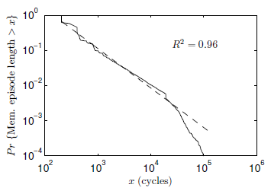
Pareto Distribution of Memory Episode Lengths
Memory episode lengths of
SPEC benchmarks
401.bzip2
Pareto distribution
Pr{Mem. episode > x}
The longer an episode has lasted ➔ The longer it will last further
x (cycles)
Attained service correlates with remaining service
Favoring least-attained-service memory episode
= Favoring memory episode which will end the soonest

Slide 62
Least Attained Service (LAS) Memory Scheduling
Our Approach
Queueing Theory
Prioritize the memory episode with least-remaining-service
Prioritize the job with
shortest-remaining-processing-time
Provably optimal
Remaining service: Correlates with attained service
Attained service: Tracked by per-thread counter
Prioritize the memory episode with least-attained-service
Least-attained-service (LAS) scheduling: Minimize memory episode time
However, LAS does not consider
long-term thread behavior

Slide 63
Long-Term Thread Behavior
Thread 1
Thread 2
Short memory episode
Long memory episode
Short-term thread behavior
>
priority
Mem. episode
Long-term thread behavior
<
priority
Compute episode
Mem. episode
Compute
episode
Prioritizing Thread 2 is more beneficial:
results in very long stretches of compute episodes

Slide 64
Quantum-Based Attained Service of a Thread
Short-term thread behavior
Outstanding memory requests
Time
Attained service
Quantum (millions of cycles)
…
Long-term thread behavior
Outstanding memory requests
Time
Attained service
We divide time into large, fixed-length intervals:
quanta (millions of cycles)

Slide 65
LAS Thread Ranking
During a quantum
Each thread’s attained service (AS) is tracked by MCs
AS_{i} = A thread’s AS during only the i-th quantum
End of a quantum
Each thread’s TotalAS computed as:
TotalAS_{i} = α · TotalAS_{i-1} + (1- α) · AS_{i}
High α ➔ More bias towards history
Threads are ranked, favoring threads with lower TotalAS
Next quantum
Threads are serviced according to their ranking

Slide 66
ATLAS Scheduling Algorithm
ATLAS
Adaptive per-Thread Least Attained Service
Request prioritization order
1. Prevent starvation: Over threshold request
2. Maximize performance: Higher LAS rank
3. Exploit locality: Row-hit request
4. Tie-breaker: Oldest request
How to coordinate MCs to agree upon a consistent ranking?

Slide 67
System Throughput: 24-Core System
System throughput = ∑ Speedup
3.5%
5.9%
8.4%
System throughput
9.8%
17.0%
# of memory controllers
ATLAS consistently provides higher system throughput than all previous scheduling algorithms

Slide 68
System Throughput: 4-MC System
10.8%
8.4%
4.0%
System throughput
3.5%
1.1%
# of cores
# of cores increases ➔ ATLAS performance benefit increases

Slide 69
Properties of ATLAS
Goals
Properties of ATLAS
Maximize system performance
Scalable to large number of controllers
Configurable by system software
LAS-ranking
Bank-level parallelism
Row-buffer locality
Very infrequent coordination
Scale attained service with thread weight (in paper)
Low complexity: Attained service requires a single counter per thread in each MC

Slide 70
ATLAS Pros and Cons
Upsides:
Good at improving overall throughput (compute-intensive threads are prioritized)
Low complexity
Coordination among controllers happens infrequently
Downsides:
Lowest/medium ranked threads get delayed significantly → high unfairness

Slide 71
TCM: Thread Cluster Memory Scheduling
Yoongu Kim, Michael Papamichael, Onur Mutlu, and Mor Harchol-Balter, "Thread Cluster Memory Scheduling:
Exploiting Differences in Memory Access Behavior" 43rd International Symposium on Microarchitecture (MICRO),
pages 65-76, Atlanta, GA, December 2010. Slides (pptx) (pdf)
TCM Micro 2010 Talk

Slide 72
Computer Architecture: Memory Interference and QoS (Part I)
Prof. Onur Mutlu
Carnegie Mellon University

