Slide 1
Computer Architecture: Speculation (in Parallel Machines)
Prof. Onur Mutlu
Carnegie Mellon University

Slide 2
Readings: Speculation
Required
Sohi et al., “Multiscalar Processors,” ISCA 1995.
Zhou, “Dual-Core Execution: Building a Highly Scalable Single-Thread Instruction Window,” PACT 2005.
Herlihy and Moss, “Transactional Memory: Architectural Support for Lock-Free Data Structures,” ISCA 1993.
Rajwar and Goodman, “Speculative Lock Elision: Enabling Highly Concurrent Multithreaded Execution,” MICRO 2001.
Recommended
Colohan et al., “A Scalable Approach to Thread-Level Speculation,” ISCA 2000.
Akkary and Driscoll, “A dynamic multithreading processor,” MICRO 1998.
And, many others

Slide 3
Speculation in Parallel Machines

Slide 4
Speculation
Speculation: Doing something before you know it is needed.
Mainly used to enhance performance
Single processor context
Branch prediction
Data value prediction
Prefetching
Multi-processor context
Thread-level speculation
Transactional memory
Helper threads

Slide 5
Speculative Parallelization Concepts
Idea: Execute threads unsafely in parallel
Threads can be from a sequential or parallel application
Hardware or software monitors for data dependence violations
If data dependence ordering is violated
Offending thread is squashed and restarted
If data dependences are not violated
Thread commits
If threads are from a sequential order, the sequential order needs to be preserved → threads commit one by one and in order

Slide 6
Inter-Thread Value Communication
Can happen via
Registers
Memory
Register communication
Needs hardware support between processors
Dependences between threads known by compiler
Can be producer initiated or consumer initiated
If consumer executes first:
consumer stalls, producer forwards
If producer executes first
producer writes and continues, consumer reads later
Can be implemented with Full/Empty bits in registers

Slide 7
Memory Communication
Memory dependences not known by the compiler
True dependencies between predecessor/successor threads need to be preserved
Threads perform loads speculatively
get the data from the closest predecessor
keep record that they read the data (in L1 cache or another structure)
Stores performed speculatively
buffer the update while speculative (write buffer or L1)
check successors for premature reads
if successor did a premature read: squash
typically squash the offending thread and all successors

Slide 8
Dependences and Versioning
Only true data dependence violations should cause a thread squash
Types of dependence violations:
LD A → ST A: name dependence; hardware may handle
ST A → ST A: name dependence; hardware may handle
ST A → LD A: true dependence; causes a squash
Name dependences can be resolved using versioning
Idea: Every store to a memory location creates a new version
Example: Gopal et al., “Speculative Versioning Cache,” HPCA 1998.

Slide 9
Where to Keep Speculative Memory State
Separate buffers
E.g. store queue shared between threads
Address resolution buffer in Multiscalar processors
Runahead cache in Runahead execution
L1 cache
Speculatively stored blocks marked as speculative
Not visible to other threads
Need to make them non-speculative when thread commits
Need to invalidate them when thread is squashed

Slide 10
Speculation to “Parallelize” Single-Threaded Programs

Slide 11
Referenced Readings
Sohi et al., “Multiscalar Processors,” ISCA 1995.
Herlihy and Moss, “Transactional Memory: Architectural Support for Lock-Free Data Structures,” ISCA 1993.
Smith, “A pipelined, shared resource MIMD computer,” ICPP 1978.
Gopal et al., “Speculative Versioning Cache,” HPCA 1998.
Steffan et al., “A Scalable Approach to Thread-Level Speculation,” ISCA 2000.
Franklin and Sohi, “ARB: A hardware mechanism for dynamic reordering of memory references,” IEEE TC 1996.
Moshovos et al., “Dynamic Speculation and Synchronization of Data Dependences,” ISCA 1997.
Chrysos and Emer, “Memory Dependence Prediction using Store Sets,” ISCA 1998.
Dubois and Song, “Assisted Execution,” USC Tech Report 1998.
Chappell et al., “Simultaneous Subordinate Microthreading (SSMT),” ISCA 1999.
Zilles and Sohi, “Execution-based Prediction Using Speculative Slices”, ISCA 2001.
Mutlu et al., “Runahead Execution: An Alternative to Very Large Instruction Windows for Out-of-order Processors,” HPCA 2003.
Sundaramoorthy et al., “Slipstream Processors: Improving both Performance and Fault Tolerance,” ASPLOS 2000.
Zhou, “Dual-Core Execution: Building a Highly Scalable Single-Thread Instruction Window,” PACT 2005.

Slide 12
Thread Level Speculation
Speculative multithreading, dynamic multithreading, etc…
Idea: Divide a single instruction stream (speculatively) into multiple threads at compile time or run-time
Execute speculative threads in multiple hardware contexts
Merge results into a single stream
Hardware/software checks if any true dependencies are violated and ensures sequential semantics
Threads can be assumed to be independent
Value/branch prediction can be used to break dependencies between threads
Need to verify such predictions: can be done by executing a “safe version” or checking invariants

Slide 13
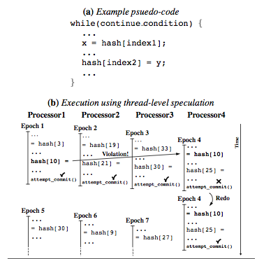
Thread Level Speculation Example
Steffan et al., “A Scalable Approach to Thread-Level Speculation,” ISCA 2000.

Slide 14
TLS Conflict Detection Example

Slide 15
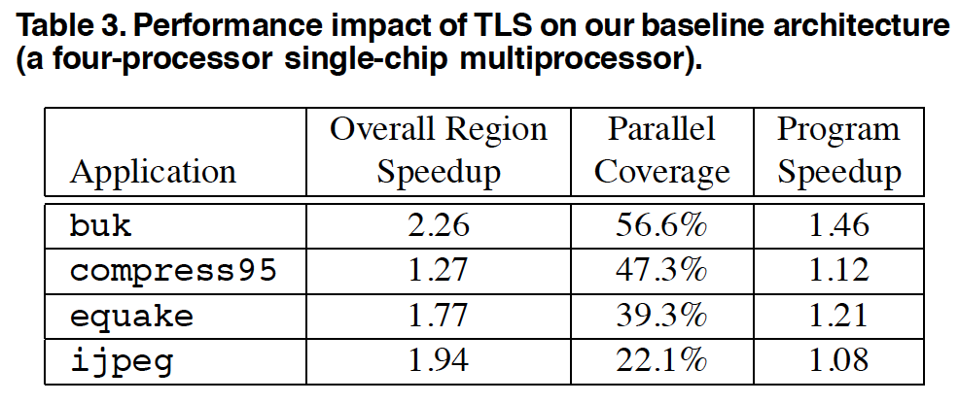
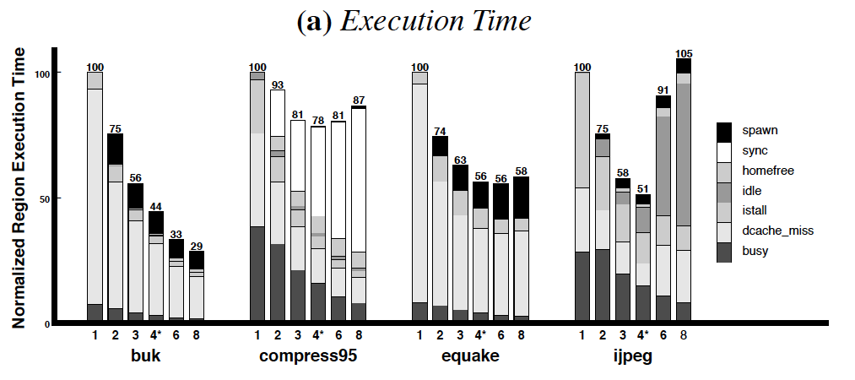
Some Sample Results [Colohan+ ISCA 2000]

Slide 16
Multiscalar Processors (ISCA 1992, 1995)
Exploit “implicit” thread-level parallelism within a serial program
Compiler divides program into tasks
Tasks scheduled on independent processing resources
Hardware handles register dependences between tasks
Compiler specifies which registers should be communicated between tasks
Memory speculation for memory dependences
Hardware detects and resolves misspeculation
Franklin and Sohi, “The expandable split window paradigm for exploiting fine-grain parallelism,” ISCA 1992.
Sohi et al., “Multiscalar processors,” ISCA 1995.

Slide 17
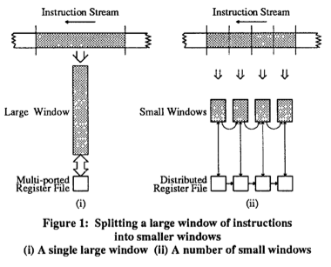
Multiscalar vs. Large Instruction Windows

Slide 18
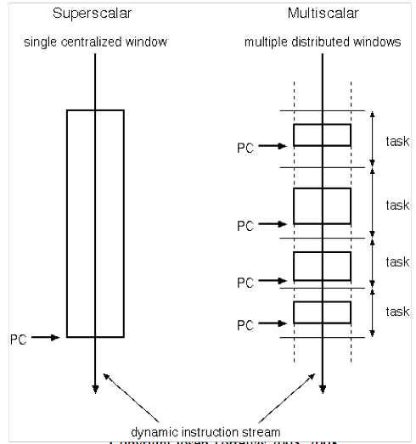
Multiscalar Model of Execution

Slide 19
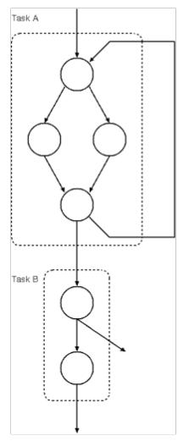
Multiscalar Tasks
A task is a subgraph of the control flow graph (CFG)
e.g., a basic block, multiple basic blocks, loop body, function
Tasks are selected by compiler and conveyed to hardware
Tasks are predicted and scheduled by processor
Tasks may have data and/or control dependences

Slide 20
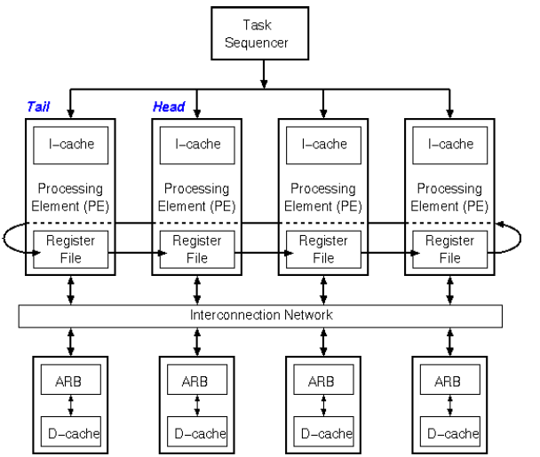
Multiscalar Processor

Slide 21
Multiscalar Compiler
Task selection: partition CFG into tasks
Load balance across processors
Minimize inter-task data dependences
Minimize inter-task control dependences
By embedding hard-to-predict branches within tasks
Convey task and communication information in the executable
Task headers
create_mask (1 bit per register)
Indicates all registers that are possibly modified or created by the task (better: live-out of the task)
Don’t forward instances received from prior tasks
PCs of successor tasks
Release instructions: Release a register to be forwarded to a receiving task

Slide 22
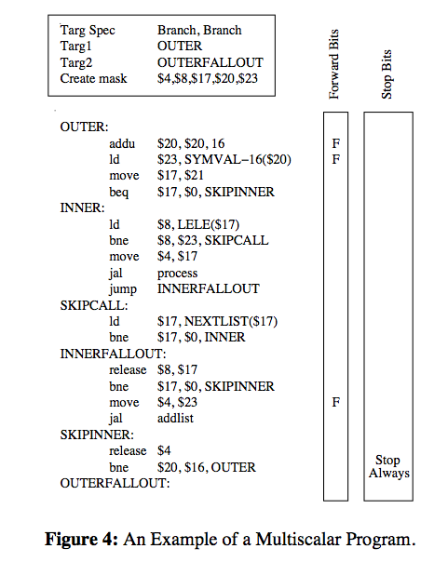
Multiscalar Program Example

Slide 23
Forwarding Registers Between Tasks
Compiler must identify the last instance of write to a register within a task
Opcodes that write a register have additional forward bit, indicating the instance should be forwarded
Stop bits - indicate end of task
Release instruction
tells PE to forward the register value

Slide 24
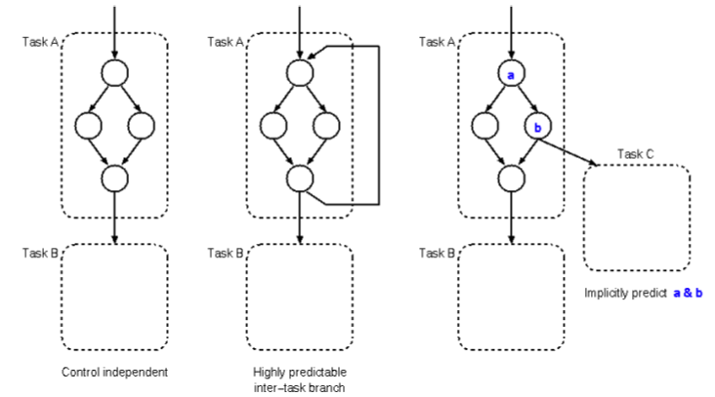
Task Sequencing
Task prediction analogous to branch prediction
Predict inter-task control flow

Slide 25
Handling Inter-Task Dependences
Control dependences
Predict
Squash subsequent tasks on inter-task misprediction
Intra-task mispredictions do not need to cause flushing of later tasks
Data dependences
Register file: mask bits and forwarding (stall until available)
Memory: address resolution buffer (speculative load, squash on violation)

Slide 26
Address Resolution Buffer
Multiscalar issues loads to ARB/D-cache as soon as address is computed
ARB is organized like a cache, maintaining state for all outstanding load/store addresses
Franklin and Sohi, “ARB: A hardware mechanism for dynamic reordering of memory references,” IEEE TC 1996.
An ARB entry:

Slide 27
Address Resolution Buffer
Loads
ARB miss: data comes from D-cache (no prior stores yet)
ARB hit: get most recent data to the load, which may be from D-cache, or nearest prior task with S=1
Stores
ARB buffers speculative stores
If store from an older task finds a load from a younger task to the same address → misspeculation detected
When a task commits, commit all of the task’s stores into the D-cache

Slide 28
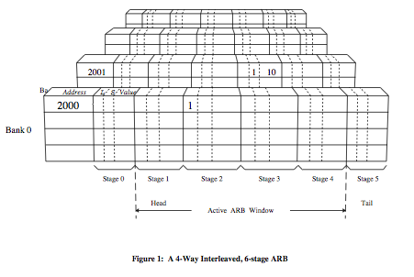
Address Resolution Buffer
Franklin and Sohi, “ARB: A hardware mechanism for dynamic reordering of memory references,” IEEE TC 1996.

Slide 29
Memory Dependence Prediction
ARB performs memory renaming
However, it does not perform dependence prediction
Can reduce intra-task dependency flushes by accurate memory dependence prediction
Idea: Predict whether or not a load instruction will be dependent on a previous store (and predict which store). Delay the execution of the load if it is predicted to be dependent.
Moshovos et al., “Dynamic Speculation and Synchronization of Data Dependences,” ISCA 1997.
Chrysos and Emer, “Memory Dependence Prediction using Store Sets,” ISCA 1998.

Slide 30
Handling of Store-Load Dependencies
A load’s dependence status is not known until all previous store addresses are available.
How does the processor detect dependence of a load instruction on a previous store?
Option 1: Wait until all previous stores committed (no need to check)
Option 2: Keep a list of pending stores in a store buffer and check whether load address matches a previous store address
How does the processor engine treat the scheduling of a load instruction with respect to previous stores?
Option 1: Assume load independent of all previous stores
Option 2: Assume load dependent on all previous stores
Option 3: Predict the dependence of a load on an outstanding store

Slide 31
Memory Disambiguation
Option 1: Assume load independent of all previous stores
+ Simple and can be common case: no delay for independent loads
-- Requires recovery and re-execution of load and dependents on misprediction
Option 2: Assume load dependent on all previous stores
+ No need for recovery
-- Too conservative: delays independent loads unnecessarily
Option 3: Predict the dependence of a load on an outstanding store
+ More accurate. Load store dependencies persist over time
-- Still requires recovery/re-execution on misprediction
Alpha 21264 : Initially assume load independent, delay loads found to be dependent
Moshovos et al., “Dynamic speculation and synchronization of data dependences,” ISCA 1997.
Chrysos and Emer, “Memory Dependence Prediction Using Store Sets,” ISCA 1998.

Slide 32
Memory Disambiguation
Chrysos and Emer, “Memory Dependence Prediction Using Store Sets,” ISCA 1998.
Predicting store-load dependencies important for performance
Simple predictors (based on past history) can achieve most of the potential performance

Slide 33
Multiscalar Comparisons and Questions
vs. superscalar, out-of-order?
vs. multi-core?
vs. CMP and SMT-based thread-level speculation mechanisms
What is different in multiscalar hardware?
Scalability of fine-grained register communication
Scalability of memory renaming and dependence speculation

Slide 34
Helper Threading for Prefetching
Idea: Pre-execute a piece of the (pruned) program solely for prefetching data
Only need to distill pieces that lead to cache misses
Speculative thread: Pre-executed program piece can be considered a “thread”
Speculative thread can be executed
On a separate processor/core
On a separate hardware thread context
On the same thread context in idle cycles (during cache misses)

Slide 35
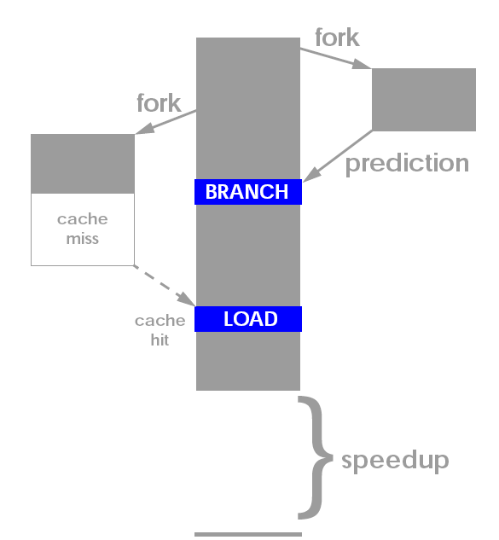
Generalized Thread-Based Pre-Execution
Dubois and Song, “Assisted Execution,” USC Tech Report 1998.
Chappell et al., “Simultaneous Subordinate Microthreading (SSMT),” ISCA 1999.
Zilles and Sohi, “Execution-based Prediction Using Speculative Slices”, ISCA 2001.

Slide 36
Thread-Based Pre-Execution Issues
Where to execute the precomputation thread?
1. Separate core (least contention with main thread)
2. Separate thread context on the same core (more contention)
3. Same core, same context
When the main thread is stalled
When to spawn the precomputation thread?
1. Insert spawn instructions well before the “problem” load
How far ahead?
Too early: prefetch might not be needed
Too late: prefetch might not be timely
2. When the main thread is stalled
When to terminate the precomputation thread?
1. With pre-inserted CANCEL instructions
2. Based on effectiveness/contention feedback

Slide 37
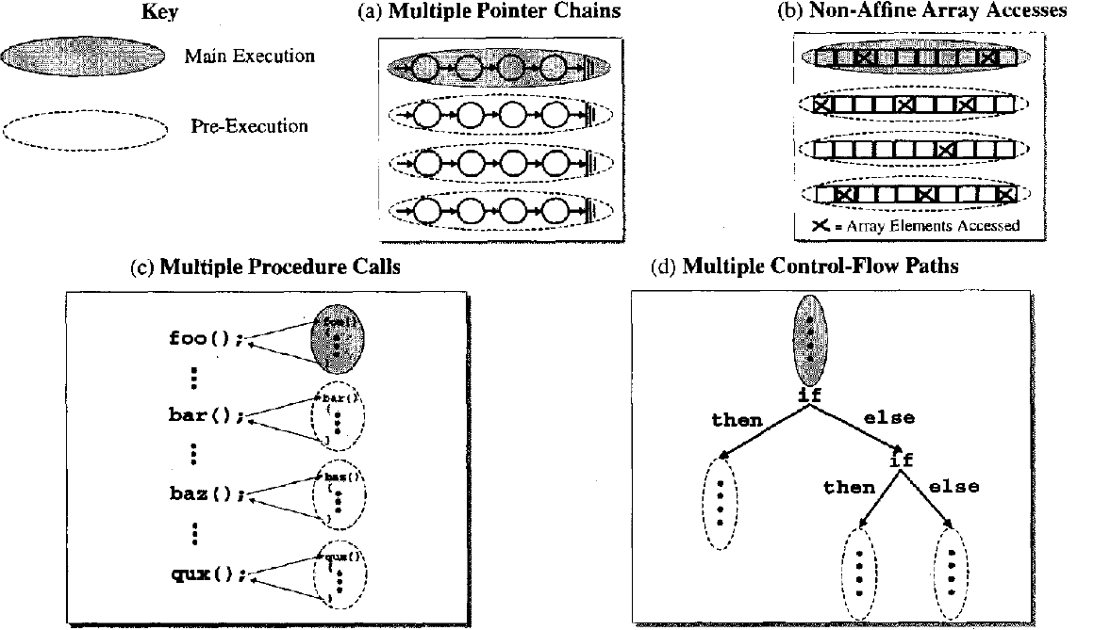
Thread-Based Pre-Execution Issues
Read
Luk, “Tolerating Memory Latency through Software-Controlled Pre-Execution in Simultaneous Multithreading Processors,” ISCA 2001.
Many issues in software-based pre-execution discussed

Slide 38
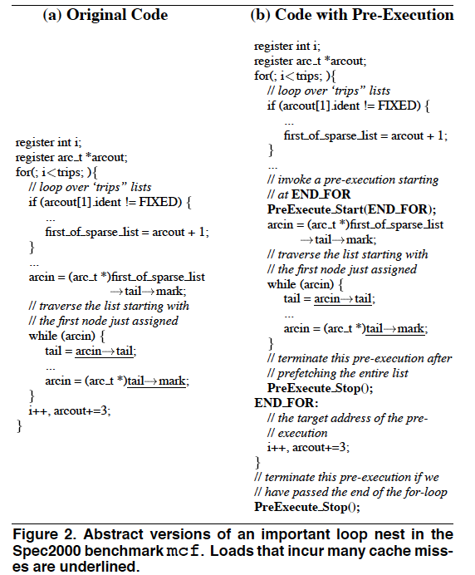
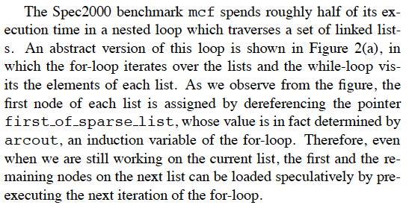
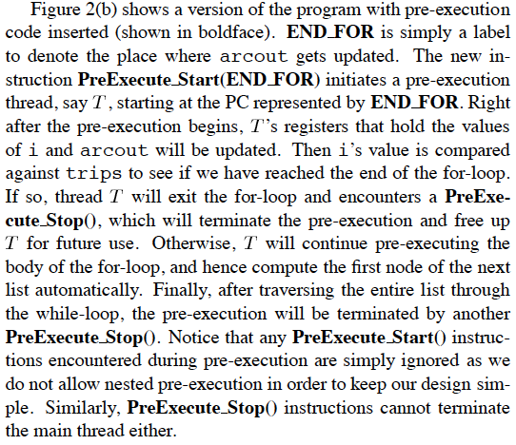
An Example

Slide 39
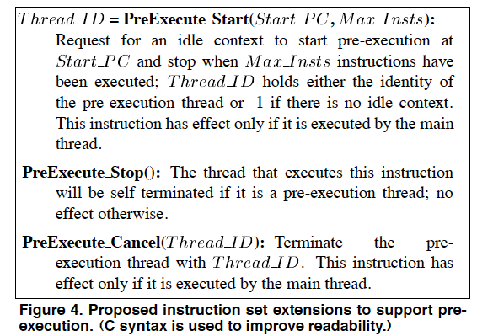
Example ISA Extensions

Slide 40
Results on an SMT Processor

Slide 41
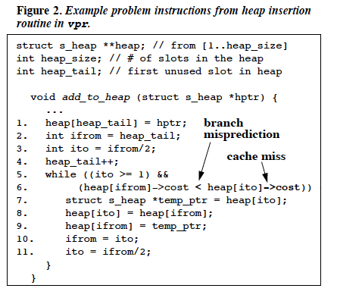
Problem Instructions
Zilles and Sohi, “Execution-based Prediction Using Speculative Slices”, ISCA 2001.
Zilles and Sohi, ”Understanding the backward slices of performance degrading instructions,” ISCA 2000.

Slide 42
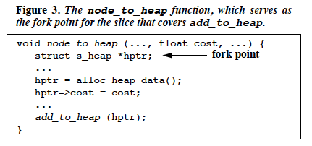
Fork Point for Prefetching Thread

Slide 43
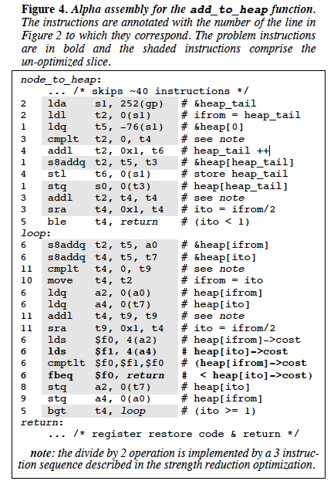
Pre-execution Slice Construction

Slide 44
Review: Runahead Execution
A simple pre-execution method for prefetching purposes
When the oldest instruction is a long-latency cache miss:
Checkpoint architectural state and enter runahead mode
In runahead mode:
Speculatively pre-execute instructions
The purpose of pre-execution is to generate prefetches
L2-miss dependent instructions are marked INV and dropped
Runahead mode ends when the original miss returns
Checkpoint is restored and normal execution resumes
Mutlu et al., “Runahead Execution: An Alternative to Very Large Instruction Windows for Out-of-order Processors,” HPCA 2003.

Slide 45
Review: Runahead Execution (Mutlu et al., HPCA 2003)
Small Window:
Load 1 Miss
Load 2 Miss
Compute
Stall
Compute
Stall
Miss 1
Miss 2
Runahead:
Load 1 Miss
Load 2 Miss
Load 1 Hit
Load 2 Hit
Compute
Runahead
Compute
Saved Cycles
Miss 1
Miss 2

Slide 46
Slipstream Processors
Goal: use multiple hardware contexts to speed up single thread execution (implicitly parallelize the program)
Idea: Divide program execution into two threads:
Advanced thread executes a reduced instruction stream, speculatively
Redundant thread uses results, prefetches, predictions generated by advanced thread and ensures correctness
Benefit: Execution time of the overall program reduces
Core idea is similar to many thread-level speculation approaches, except with a reduced instruction stream
Sundaramoorthy et al., “Slipstream Processors: Improving both Performance and Fault Tolerance,” ASPLOS 2000.

Slide 47
Slipstreaming
“At speeds in excess of 190 m.p.h., high air pressure forms at the front of a race car and a partial vacuum forms behind it. This creates drag and limits the car’s top speed.
A second car can position itself close behind the first (a process called slipstreaming or drafting). This fills the vacuum behind the lead car, reducing its drag. And the trailing car now has less wind resistance in front (and by some accounts, the vacuum behind the lead car actually helps pull the trailing car).
As a result, both cars speed up by several m.p.h.: the two combined go faster than either can alone.”

Slide 48
Slipstream Processors
Detect and remove ineffectual instructions; run a shortened “effectual” version of the program (Advanced or A-stream) in one thread context
Ensure correctness by running a complete version of the program (Redundant or R-stream) in another thread context
Shortened A-stream runs fast; R-stream consumes near-perfect control and data flow outcomes from A-stream and finishes close behind
Two streams together lead to faster execution (by helping each other) than a single one alone

Slide 49
Slipstream Idea and Possible Hardware

Slide 50
Instruction Removal in Slipstream
IR detector
Monitors retired R-stream instructions
Detects ineffectual instructions and conveys them to the IR predictor
Ineffectual instruction examples:
dynamic instructions that repeatedly and predictably have no observable effect (e.g., unreferenced writes, non-modifying writes)
dynamic branches whose outcomes are consistently predicted correctly.
IR predictor
Removes an instruction from A-stream after repeated indications from the IR detector
A stream skips ineffectual instructions, executes everything else and inserts their results into delay buffer
R stream executes all instructions but uses results from the delay buffer as predictions

Slide 51
What if A-stream Deviates from Correct Execution?
Why
A-stream deviates due to incorrect removal or stale data access in L1 data cache
How to detect it?
Branch or value misprediction happens in R-stream (known as an IR misprediction)
How to recover?
Restore A-stream register state: copy values from R-stream registers using delay buffer or shared-memory exception handler
Restore A-stream memory state: invalidate A-stream L1 data cache (or speculatively written blocks by A-stream)

Slide 52
Slipstream Questions
How to construct the advanced thread
Original proposal:
Dynamically eliminate redundant instructions (silent stores, dynamically dead instructions)
Dynamically eliminate easy-to-predict branches
Other ways:
Dynamically ignore long-latency stalls
Static based on profiling
How to speed up the redundant thread
Original proposal: Reuse instruction results (control and data flow outcomes from the A-stream)
Other ways: Only use branch results and prefetched data as predictions

Slide 53
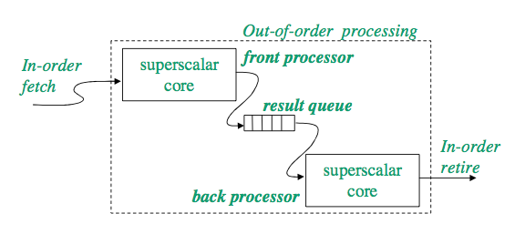
Dual Core Execution
Idea: One thread context speculatively runs ahead on load misses and prefetches data for another thread context
Zhou, “Dual-Core Execution: Building a Highly Scalable Single- Thread Instruction Window,” PACT 2005.

Slide 54
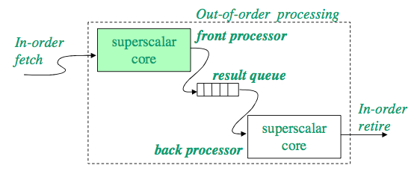
Dual Core Execution: Front Processor
The front processor runs faster by invalidating long-latency cache-missing loads, same as runahead execution
Load misses and their dependents are invalidated
Branch mispredictions dependent on cache misses cannot be resolved
Highly accurate execution as independent operations are not affected
Accurate prefetches to warm up caches
Correctly resolved miss-independent branch mispredictions

Slide 55
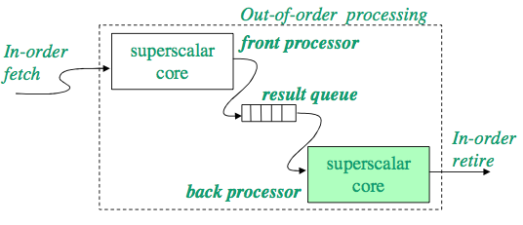
Dual Core Execution: Back Processor
Re-execution ensures correctness and provides precise program state
Resolve branch mispredictions dependent on long-latency cache misses
Back processor makes faster progress with help from the front processor
Highly accurate instruction stream
Warmed up data caches

Slide 56
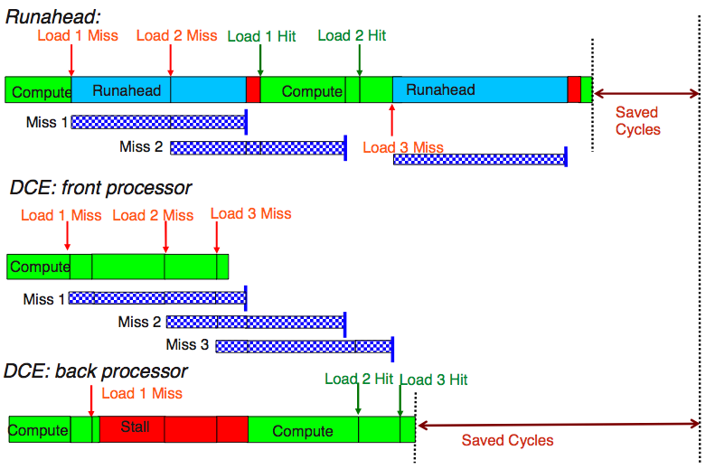
Dual Core Execution

Slide 57
DCE Microarchitecture

Slide 58
Dual Core Execution vs. Slipstream
Dual-core execution does not
remove dead instructions
reuse instruction register results
uses the “leading” hardware context solely for prefetching and branch prediction
+ Easier to implement, smaller hardware cost and complexity
+ Tolerates memory latencies better with the use of runahead execution in the front processor
- “Leading thread” cannot run ahead as much as in slipstream when there are no cache misses
- Not reusing results in the “trailing thread” can reduce overall performance benefit

Slide 59
Some Results

Slide 60
Speculation to Improve Parallel Programs

Slide 61
Computer Architecture: Speculation (in Parallel Machines)
Prof. Onur Mutlu
Carnegie Mellon University

Slide 62
Speculation to Improve Parallel Programs

Slide 63
Referenced Readings
Herlihy and Moss, “Transactional Memory: Architectural Support for Lock-Free Data Structures,” ISCA 1993.
Rajwar and Goodman, “Speculative Lock Elision: Enabling Highly Concurrent Multithreaded Execution,” MICRO 2001.
Martinez and Torrellas, “Speculative Synchronization: Applying Thread-Level Speculation to Explicitly Parallel Applications,” ASPLOS 2002.
Rajwar and Goodman, ”Transactional lock-free execution of lock-based programs,” ASPLOS 2002.
Suleman et al., “Accelerating Critical Section Execution with Asymmetric Multi-Core Architectures,” ASPLOS 2009, IEEE Micro Top Picks 2010.
Jensen et al., “A New Approach to Exclusive Data Access in Shared Memory Multiprocessors,” LLNL Tech Report 1987.
Dice et al., “Early Experience with a Commercial Hardware Transactional Memory Implementation,” ASPLOS 2009.
Wang et al., “Evaluation of Blue Gene/Q Hardware Support for Transactional Memories,” PACT 2012.
Jacobi et al., “Transactional Memory Architecture and Implementation for IBM System Z,” MICRO 2012.
Chung et al., “ASF: AMD64 Extension for Lock-Free Data Structures and Transactional Memory,” MICRO 2010.

Slide 64
Speculation to Improve Parallel Programs
Goal: reduce the impact of serializing bottlenecks
Improve performance
Improve programming ease
Examples
Herlihy and Moss, “Transactional Memory: Architectural Support for Lock-Free Data Structures,” ISCA 1993.
Rajwar and Goodman, “Speculative Lock Elision: Enabling Highly Concurrent Multithreaded Execution,” MICRO 2001.
Martinez and Torrellas, “Speculative Synchronization: Applying Thread-Level Speculation to Explicitly Parallel Applications,” ASPLOS 2002.
Rajwar and Goodman, ”Transactional lock-free execution of lock-based programs,” ASPLOS 2002.

Slide 65
Speculative Lock Elision
Many programs use locks for synchronization
Many locks are not necessary
Stores occur infrequently during execution
Updates can occur to disjoint parts of the data structure
Idea:
Speculatively assume lock is not necessary and execute critical section without acquiring the lock
Check for conflicts within the critical section
Roll back if assumption is incorrect
Rajwar and Goodman, “Speculative Lock Elision: Enabling Highly Concurrent Multithreaded Execution,” MICRO 2001.

Slide 66
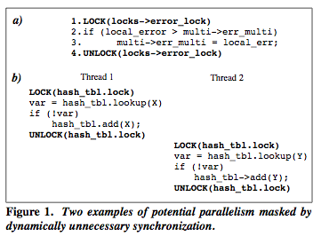
Dynamically Unnecessary Synchronization

Slide 67
Speculative Lock Elision: Issues
Either the entire critical section is committed or none of it
How to detect the lock
How to keep track of dependencies and conflicts in a critical section
Read set and write set
How to buffer speculative state
How to check if “atomicity” is violated
Dependence violations with another thread
How to support commit and rollback

Slide 68
Maintaining Atomicity
If atomicity is maintained, all locks can be removed
Conditions for atomicity:
Data read is not modified by another thread until critical section is complete
Data written is not accessed by another thread until critical section is complete
If we know the beginning and end of a critical section, we can monitor the memory addresses read or written to by the critical section and check for conflicts
Using the underlying coherence mechanism

Slide 69
SLE Implementation
Checkpoint register state before entering SLE mode
In SLE mode:
Store: Buffer the update in the write buffer (do not make visible to other processors), request exclusive access
Store/Load: Set “access” bit for block in the cache
Trigger misspeculation on some coherence actions
If external invalidation to a block with “access” bit set
If exclusive access to request to a block with “access” bit set
If not enough buffering space, trigger misspeculation
If end of critical section reached without misspeculation, commit all writes (needs to appear instantaneous)

Slide 70
Accelerated Critical Sections (ACS) vs. SLE
ACS Advantages over SLE
+ Speeds up each individual critical section
+ Keeps shared data and locks in a single cache (improves shared data and lock locality)
+ Does not incur re-execution overhead since it does not speculatively execute critical sections in parallel
ACS Disadvantages over SLE
- Needs transfer of private data and control to a large core (reduces private data locality and incurs overhead)
- Executes non-conflicting critical sections serially
- Large core can reduce parallel throughput (assuming no SMT)

Slide 71
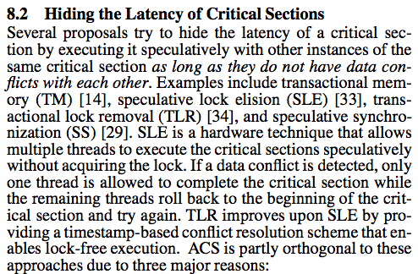
ACS vs. SLE (I)
Suleman et al., “Accelerating Critical Section Execution with Asymmetric Multi-Core Architectures,” ASPLOS 2009, IEEE Micro Top Picks 2010.

Slide 72
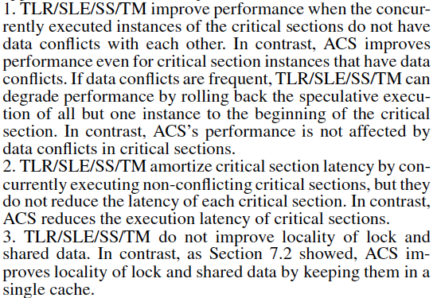
ACS vs. SLE (II)

Slide 73
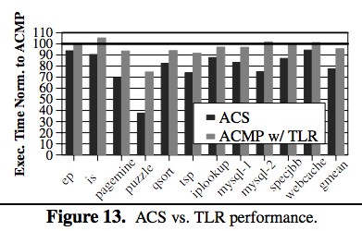
ACS vs. Transactional Lock Removal

Slide 74
ACS vs. SLE (Accelerating vs. Eliding Locks)
Can you combine both?
How would you combine both?
Can you do better than both?

Slide 75
Four Issues in Speculative Parallelization
How to deal with unavailable values: predict vs. wait
How to deal with speculative updates: Logging/buffering
How to detect conflicts
How and when to abort/rollback or commit
Eager vs. lazy approaches are possible for each issue

Slide 76
Transactional Memory

Slide 77
Transactional Memory
Idea: Programmer specifies code to be executed atomically as transactions. Hardware/software guarantees atomicity for transactions.
Motivated by difficulty of lock-based programming
Motivated by lack of concurrency (performance issues) in blocking synchronization (or “pessimistic concurrency”)

Slide 78
Locking Issues
Locks: objects only one thread can hold at a time
Organization: lock for each shared structure
Usage: (block) → acquire → access → release
Correctness issues
Under-locking → data races
Acquires in different orders → deadlock
Performance issues
Conservative serialization
Overhead of acquiring
Difficult to find right granularity
Blocking

Slide 79
Locks vs. Transactions
Locks → pessimistic concurrency
Transactions → optimistic concurrency
Lock issues:
Under-locking → data races
Deadlock due to lock ordering
Blocking synchronization
Conservative serialization
How transactions help:
Simpler interface/reasoning
No ordering
Nonblocking (Abort on conflict)
Serialization only on conflicts

Slide 80
Transactional Memory
Transactional Memory (TM) allows arbitrary multiple memory locations to be updated atomically (all or none)
Basic Mechanisms:
Isolation and conflict management: Track read/writes per transaction, detect when a conflict occurs between transactions
Version management: Record new/old values (where?)
Atomicity: Commit new values or abort back to old values → all or none semantics of a transaction
Issues the same as other speculative parallelization schemes
Logging/buffering
Conflict detection
Abort/rollback or commit

Slide 81
Four Issues in Transactional Memory
How to deal with unavailable values: predict vs. wait
How to deal with speculative updates: logging/buffering
How to detect conflicts: lazy vs. eager
How and when to abort/rollback or commit

Slide 82
Many Variations of TM
Software (STM)
-- High performance overhead (e.g., tracking read and write sets)
++ No virtualization issues
Hardware (HTM)
-- Need support for virtualization
What if buffering is not enough?
Context switches, I/O within transactions?
++ Low performance overhead
Hybrid HW/SW
HTM when buffering is enough and no I/O or context switch
Switch to STM to handle long transactions and buffer overflows

Slide 83
Initial TM Ideas
Load Linked Store Conditional Operations [Jensen+, LLNL 1987]
Lock-free atomic update of a single cache line
Used to implement non-blocking synchronization
Alpha, MIPS, ARM, PowerPC
Load-linked returns current value of a location
A subsequent store-conditional to the same memory location will store a new value only if no updates have occurred to the location
Herlihy and Moss [Herlihy and Moss, ISCA 1993]
Instructions explicitly identify transactional loads and stores
Used dedicated transaction cache for buffering
Size of transactions limited to transaction cache

Slide 84
Herlihy and Moss, ISCA 1993

Slide 85
Current Implementations of TM/SLE
Sun ROCK
Dice et al., “Early Experience with a Commercial Hardware Transactional Memory Implementation,” ASPLOS 2009.
IBM Blue Gene
Wang et al., “Evaluation of Blue Gene/Q Hardware Support for Transactional Memories,” PACT 2012.
IBM System z: Two types of transactions
Best effort transactions: Programmer responsible for aborts
Guaranteed transactions are subject to many limitations
Jacobi et al., “Transactional Memory Architecture and Implementation for IBM System Z,” MICRO 2012.
Intel Haswell
AMD
Chung et al., “ASF: AMD64 Extension for Lock-Free Data Structures and Transactional Memory,” MICRO 2010.

Slide 86
Some TM Research Issues
Scalability
Conflict and version management
Complexity
How to virtualize transactions (without much complexity)
Ensure long transactions execute correctly
In the presence of context switches, paging
Handling I/O within transactions
Hardware complexity
Semantics of nested transactions (more of a language/programming research topic)
Does TM increase programmer productivity?
Does the programmer need to optimize transactions?

Slide 87
Computer Architecture: Speculation (in Parallel Machines)
Prof. Onur Mutlu
Carnegie Mellon University

Slide 88
Backup slides

