Slide 1

Fault Tolerant, Efficient, and
Secure Runtimes
Ben Zorn
Research in Software Engineering (RiSE)
Microsoft Research
In collaboration with:
Emery Berger and Gene Novark, UMass - Amherst
Ted Hart and Karthik Pattabiraman, Microsoft Research

Slide 2
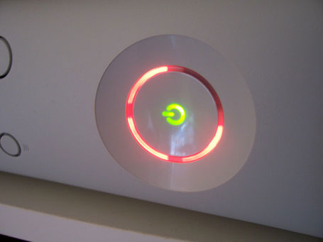
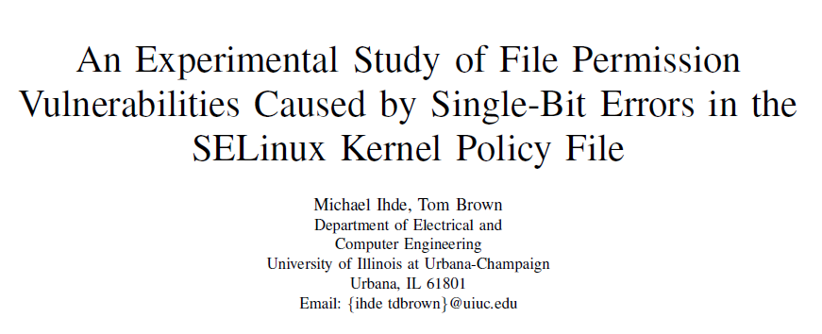
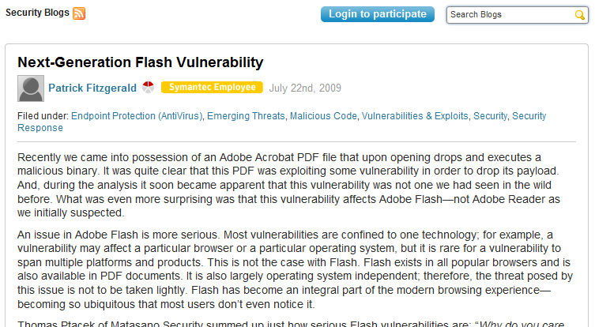
Software and Hardware Bugs are Expensive
Xbox 360 Red Ring of Death

Slide 3





The “Good Enough” Revolution
Source: WIRED Magazine (Sep 2009) – Robert Kapps
http://www.wired.com/gadgets/miscellaneous/magazine/17-09/ff_goodenough
People prefer “cheap and good-enough” over “costly and near-perfect”
Flakey systems are inevitable, so…

Slide 4
Memory Corruption
Buffer overflow
char *c = malloc(100);
c[100] = ‘a’;
Premature call to free
char *p1 = malloc(100);
char *p2 = p1;
free(p1);
p2[0] = ‘x’;
Random bit flip
c
a
0
99
p1
p2
x
0
99
0
1

Slide 5
Goal: Tolerate Memory Errors
Ideally:
  Software continues in presence of errors
  (Failure Oblivious Computing, Martin Rinard)
  Degradation in performance and/or quality acceptable outcome
  Software detects when errors occur and fixes them
  Avoid stopping if error is detected (fail fast)
    Controversial position, especially for security issues
  No changes to existing software
My related projects:
  DieHard, Exterminator, Samurai, Flicker, Nozzle

Slide 6
Platforms: What does 90% Safe Mean?
Platforms necessary in computing ecosystem
  Extensible frameworks provide lattice for 3rd parties
  Tremendously successful business model
  Examples: Windows, iPod/iPhone, browsers, etc.
Platform power derives from extensibility
  Tension between isolation for fault tolerance, integration for functionality
  Platform only as reliable as weakest plug-in
  Tolerating bad plug-ins necessary by design

Slide 7
Outline
Motivation
Exterminator
  Heap that automatically fixes software errors
  Builds on DieHard allocator (PLDI’06, Berger & Zorn)
Samurai
  What if all memory is not equal? Critical Memory
  Eurosys 2008 (Pattabiraman, Grover, and Zorn)
Flikker
  Can intentionally introducing corruption be valuable?
  With Liu, Moscibroda, and Pattabiraman

Slide 8
DieHard Allocator in a Nutshell
Existing heaps are packed tightly to minimize space
  Tight packing increases likelihood of corruption
  Predictable layout is easier for attacker to exploit
Randomize and overprovision the heap
  Expansion factor determines how much empty space
  Does not change semantics
Replication increases benefits
Enables analytic reasoning
Normal Heap
DieHard Heap
Notes:
Empty space can be filled with canaries, allows detection of corruption in non-objects
We define “infinite heap semantics”
Programs execute as if each object allocated with unbounded memory
All frees ignored

Slide 9
Randomized Heaps in Practice
DieHard (now DHard – don’t ask)
  Windows, Linux version implemented by Emery Berger
  Try it right now! (http://prisms.cs.umass.edu/emery/index.php?page=diehard )
  Mechanism automatically redirects malloc calls to DieHard DLL
  DieHard applications: Firefox & Mozilla
    Tolerates known software errors in browsers
RobustHeap
  Windows prototype implemented by Ted Hart to understand applicability to Microsoft applications
  Mechanisms in common with both DieHard and Exterminator

Slide 10
Exterminator Motivation
DieHard limitations
  Tolerates errors probabilistically, doesn’t fix them
  Memory and CPU overhead
  Provides no information about source of errors
“Ideal” solution addresses the limitations
  Program automatically detects and fixes memory errors
  Corrected program has no memory, CPU overhead
  Sources of errors are pinpointed, easier for human to fix
Exterminator = correcting allocator
  Joint work with Emery Berger, Gene Novark
  Plan: isolate / patch bugs with no human intervention while tolerating them

Slide 11
Exterminator Components
Focus on specific issues:
  How to detect heap corruptions effectively?
    DieFast allocator
  How to isolate the cause of a heap corruption precisely?
    Heap differencing algorithms
  How to automatically fix buggy C code without breaking it?
    Correcting allocator + hot allocator patches

Slide 12
Detect: DieFast Allocator
Randomized, over-provisioned heap
  Canary = random bit pattern fixed at startup
  Leverage extra free space by inserting canaries
Inserting canaries
  Initialization – all cells have canaries
  On allocation – no new canaries
  On free – put canary in the freed object with prob. P
Checking canaries
  On allocation – check cell returned
  On free – check adjacent cells
100101011110

Slide 13
Installing and Checking Canaries
Initially, heap full of canaries
Free
Allocate
Allocate
1
1
2
Install canaries
with probability P
Check canary
Check canary

Slide 14
Isolate: Heap Differencing
Strategy
  Run program multiple times with different randomized heaps
  If detect canary corruption, dump contents of heap
  Identify objects across runs using allocation order
Insight: Relation between corruption and object causing corruption is invariant across heaps
  Detect invariant across random heaps
  More heaps => higher confidence of invariant

Slide 15
Attributing Buffer Overflows
corrupted
canary
delta is constant but unknown
?
Run 1
1
2
4
X
3
Run 2
Which object caused?
2
2
4
4
X
3
1
Now only 2 candidates
Run 3
1
2
3
4
4
4
X
One candidate!
Precision increases exponentially with number of runs

Slide 16
Fix: Correcting Allocator
Group objects by allocation site
Patch object groups at allocate/free time
Associate patches with group
  Buffer overrun => add padding to size request
    malloc(32) becomes malloc(32 + delta)
  Dangling pointer => defer free
    free(p) becomes defer_free(p, delta_allocations)
  Changes preserve semantics, no new bugs created
Correcting allocation may != detecting allocator
  Correction allocator can be space, CPU efficient
  “Patches” created separately, installed on-the-fly

Slide 17
Exterminator Overhead

Slide 18
Exterminator Effectiveness
Squid web cache buffer overflow
  Crashes glibc 2.8.0 malloc
  3 runs sufficient to isolate 6-byte overflow
Mozilla 1.7.3 buffer overflow (recall demo)
  Testing scenario - repeated load of buggy page
    23 runs to isolate overflow
  Deployed scenario – bug happens in middle of different browsing sessions
    34 runs to isolate overflow

Slide 19
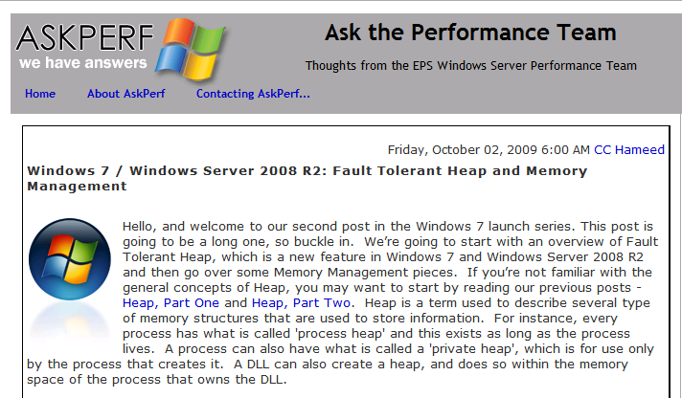
A Commercial Fault Tolerant Heap
Windows 7 shipped with Fault Tolerant Heap (FTH)
  Developed by Solom Heddaya, Silviu Calinoiu, Windows Reliability
  Windows heap improves the reliability of entire ecosystem
  (e.g., any 3rd party apps that use it)
  Detects when applications crash unexpected
  Enables additional mechanisms to reduce likelihood of further crashes
  Identifies causes of crashes and reports through Online Crash Analysis (OCA) reporting
More information
  http://msdn.microsoft.com/en-us/library/dd744764(VS.85).aspx
  http://channel9.msdn.com/shows/Going+Deep/Silviu-Calinoiu-Inside-Windows-7-Fault-Tolerant-Heap/ (in-depth video discussion by Silviu)

Slide 20
Outline
Motivation
Exterminator
  Heap that automatically fixes software errors
  Builds on DieHard allocator (PLDI’06, Berger & Zorn)
Samurai
  What if all memory is not equal? Critical Memory
  Eurosys 2008 (Pattabiraman, Grover, and Zorn)
Flikker
  Can intentionally introducing corruption be valuable?
  With Liu, Moscibroda, and Pattabiraman

Slide 21
The Problem: A Dangerous Mix
Danger 1:
Flat, uniform
address space
0xFE00
555
0x8000
888
Danger 2:
Unsafe
programming
languages
My Code
int *p = 0xFE00;
*p = 555;
int A[1]; // at 0xADE0
A[1] = 777; // off by 1
Library Code
int *p = 0x8000;
*p = 888;
// forge pointer
// to my data
int *q = 0xADE0;
*q= 999;
Danger 3:
Unrestricted
3rd party code
Result: corrupt data, crashes
security risks
0xADE0
999
777

Slide 22
Critical Memory
Insight
  Some data is more important: critical data
  Protect it with isolation & replication
Goals:
  Harden programs from both SW and HW errors
    Unify existing ad hoc solutions
  Enable local reasoning about memory state
    Leverage powerful static analysis tools
  Allow selective, incremental hardening of apps
  Provide compatibility with existing libraries, apps

Slide 23
Motivation for Critical Memory
Code
critical int balance;
balance += 100;
lib_function (x, y);
if (balance < 0) {
chargeCredit();
} else {
// use x, y, etc.
}
Some data really is more important (e.g., balance)
3rd party code (lib_function) can trash important data
Many programs already protect “critical data”
  Save documents to disk
  Protect data structure metadata
  Store some data in a DB
Data
x, y, etc
non-critical
data
balance
critical
data

Slide 24
How Critical Memory Works
int buffer[10];
critical int balance ;
map_critical(&balance);
crit_store(&balance, 100);
store( (buffer+40), 9999);
temp2 = crit_load(&balance);
if (temp2 > 0) { … }
buffer
overflow
into
balance
balance = 100;
buffer[10] = 9999;
…..
if (balance < 0) {
…
NormalMem
0
100
9999
100
Critical
Mem
0
100
100
100
balance

Slide 25
Samurai Implementation
Two replicas
Shadow pointers in metadata
Randomized to reduce correlated errors
base
Replica 1
Critical load checks 2 copies,
detects/repairs on mismatch
Metadata
shadow pointer 1
shadow pointer 2
Update
Base
Object
Vote
Critical store writes to all copies
Replica 2
Metadata protected with checksums/backup
Protection is only probabilistic
regular store causes
memory error !
Heap

Slide 26
Samurai Performance Overheads

Slide 27
Samurai: Protecting Allocator Metadata
Average = 10%

Slide 28
Outline
Motivation
Exterminator
  Heap that automatically fixes software errors
  Builds on DieHard allocator (PLDI’06, Berger & Zorn)
Samurai
  What if all memory is not equal? Critical Memory
  Eurosys 2008 (Pattabiraman, Grover, and Zorn)
Flikker
  Can intentionally introducing corruption be valuable?
  With Liu, Moscibroda, and Pattabiraman

Slide 29

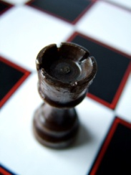







Mobile Computers
Energy constrained general computing platform
  Battery powered
  Wide range of applications
Idle for 95% the time
  Maintain responsiveness
  Keep frequently used applications in memory
Save memory power in idle periods
Data centers have similar patterns
Notes:
With the development of high performance low power processors, mobile system are becoming more and more powerful. Modern mobile system has become an energy constrained general computing platform.
Previous research has shown that mobile systems are left idle for 95% of their life time. On the other hand, mobile systems are supposed to keep responsiveness during these idle periods. The most straight forward solution of maintaining responsiveness is to keep frequently used applications in the memory. Therefore, mobile systems need large memory.
So mobile systems are energy constrained, always idle, and they need large memory. These properties lead to the question how could we save memory power in idle periods. Later we will show that these properties also hold for data centers.

Slide 30
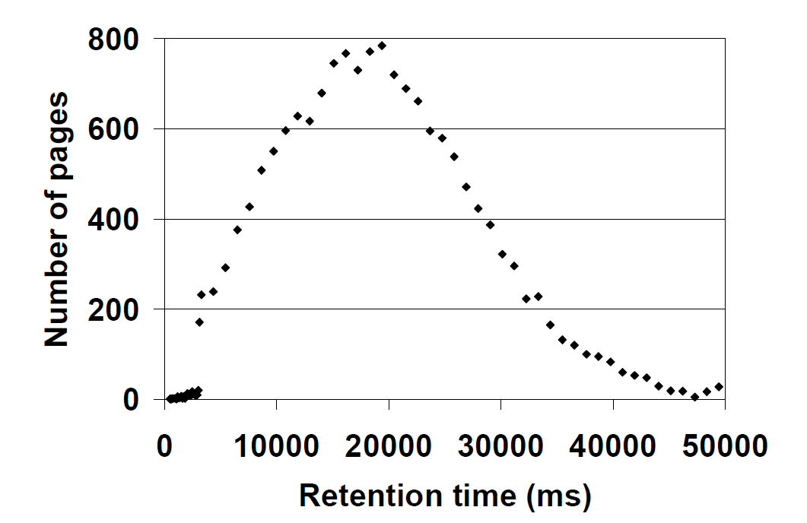
DRAM Energy Consumption
DRAM can be significant energy consumer
Significant variation in retention time
Over refreshed at worst-case retention time (64ms)
Figure from [Venkatesan et al. HPCA’06]
Notes:
DRAM consumes a lot of energy, even in idle period. Because the DRAM cells must be refreshed to keep the data. However, due to process variation, the retention time varies across different DRAM cells. This figure shows the retention time of different pages in a DRAM chips. In state-of-the-art DRAM, all the DRAM cells are refreshed at the worst-case retention time of 64ms for 100% reliability. So most DRAM cells are being over refreshed.

Slide 31
Flicker Motivation: DRAM Refresh
Error rate
Power
The
opportunity
The cost
Refresh cycle time
64 msec
1 sec
Current refresh rate
A better rate?
If we are prepared to tolerate errors, we can lower refresh rates pretty drastically to save power (up to 30% overall memory power)

Slide 32
Flikker: Protect Critical Data
Critical / non-critical data partitioning
Place different data in different parts of the DRAM
Refresh different part of the DRAM at different rates
Exposes errors to the application
Application Data
crit
non-crit
crit
non-crit
High refresh
No error
Low refresh
With error
Notes:
So we have Flicker, which protects critical data. The key idea of Flicker is to partition application data into critical part and non-critical part. Different data are placed in different part of the DRAM and refreshed at different rate. Critical data is placed in high refresh part, which has no error. And non-critical data is placed in low refresh part which consumes less power. With this partitioning, DRAM errors are exposed to the application and handled with software techniques.

Slide 33
Partial Array Self Refresh (PASR)
Self-refresh: low power, keep the data, no R/W
PASR: only refresh part of the memory array, configured among discrete levels before switching to self-refresh state [Samsung, Micron]
Drawback: less DRAM available in idle periods
⅟₁₆
refreshed
⅛
¼
½
not refreshed
1
Notes:
On the other hand, many hardware techniques have been proposed to save DRAM power. For example partial array self refresh. In modern DRAMs, self-refresh is the least power consuming state that could keep the data. No read or write is allowed in self-refresh state. Refresh operations in self refresh state is controlled by the DRAM itself instead of the memory controller. Partial array self refresh further saves energy by limiting refresh operations to part of the memory array. For example, we could only refresh the upper ¼ of the memory array. Before switching to self-refresh state, the partitioning of refreshed part and not refreshed part could be configured among several discrete levels. The problem of partial array self refresh is that it reduces the size of available DRAM in self-refresh state.

Slide 34
Flikker DRAM
Divide memory bank into high refresh part and low refresh part
The partitioning is configured by the OS before switching to self-refresh state
Flikker DRAM Bank
High Refresh
⅟₁₆
⅛
¼
½
Low Refresh
¾
1
Notes:
This figure shows the structure of Flicker DRAM bank. Similar to partial array self-refresh, the memory array is partitioned into two parts, at configurable discrete levels. However, instead of stopping refresh this part, Flicker refresh it at a lower rate.

Slide 35
Flikker Framework
Programmer:
partitions objects
OS
Runtime system
High Refresh Rows
Flikker DRAM
Low Refresh Rows
virtual pages
critical object
physical pages
non-critical object
critical page
non-critical page
Notes:
This figure shows the Flicker framework. We denote critical objects and pages with red. And non-critical ones, with blue.
First, the programmer should specify which objects are critical and which are non-critical.

Slide 36
Critical / Non-critical Data Partitioning
Flikker can be applied incrementally
Existing applications can have all their
data mapped “critical”
code
stack
global
heap
default
code
stack
global
heap
ideal
compiler support
custom allocator
critical
non-critical
Notes:
Now I will talk about data partitioning. In Flicker, all data are critical by default. The reason of this choice is that some applications should be all critical. For example your bank account. In this case, it is not necessary to specify everything as critical. You could just run it and everything is protected. However, if you do want power saving in applications, you could mark some objects as non-critical.
Ideally, the programmer could specify some global data and heap data as non-critical. In our experiments, we only implements the custom allocator, which is used to partition the heap data.

Slide 37
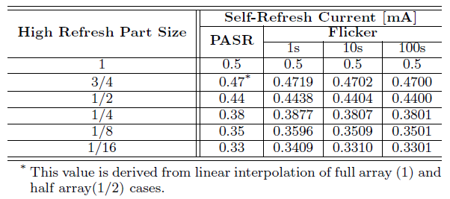
Self-refresh Power Model
Self-refresh power is not just power spent on refresh
P_{self-refresh}= P_{refresh} + P_{other}
Assume P_{refresh} is proportional to refresh rate
power
error rate
refresh cycle [s]
Notes:
It is important to notice that

Slide 38
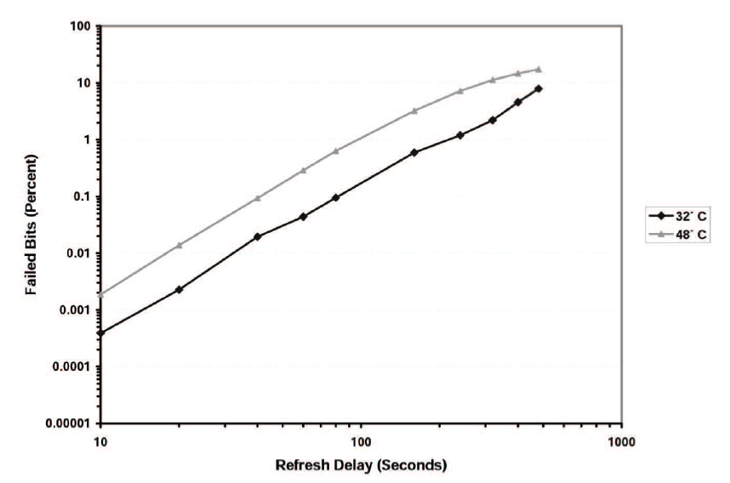
DRAM Error Rate
Refresh cycle [s]
Figure from [Bhalodia, Master Thesis, 2005]

Slide 39
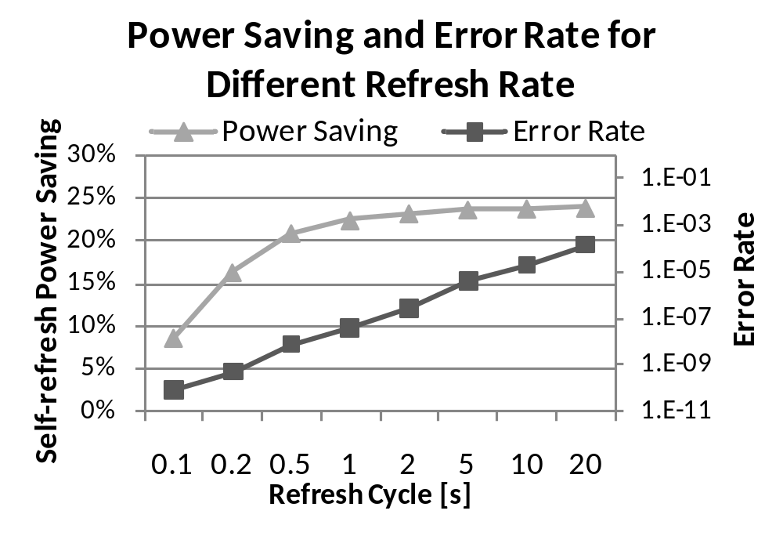
Setting the Refresh Cycle
1s
(¼ array high refresh)

Slide 40
Outline
Background
  Error resilience of applications
  Partial Array Self Refresh
Flikker DRAM and software framework
Self-refresh power model
Experimental results
Future work
Conclusions

Slide 41
Experiments
Approach
  Modify applications to separate critical data
  Measure impact of errors in non-critical data
  Inject simulated errors via program instrumentation (Pin)
Metrics
  Performance (architectural simulator)
    Impact of data partitioning
  Overall DRAM power (simulator, model)
    Active power
    Idle power

Slide 42
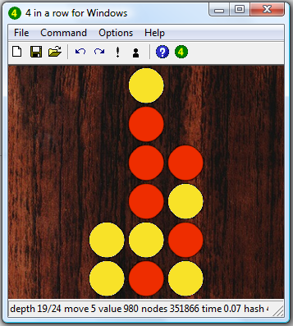
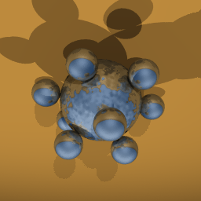
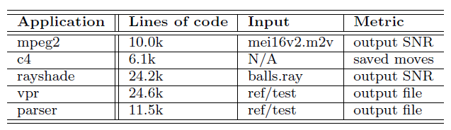
Experiments: Applications
mpeg2
c4 (connect 4, four-in-a-row)
rayshade (ray-traced images)
vpr (FPGA place and route)
parser

Slide 43
Experiments: Configurations
code
stack
global
heap
baseline
code
stack
global
heap
conservative
code
stack
global
heap
ideal
code
stack
global
heap
aggressive
code
stack
global
heap
crazy

Slide 44
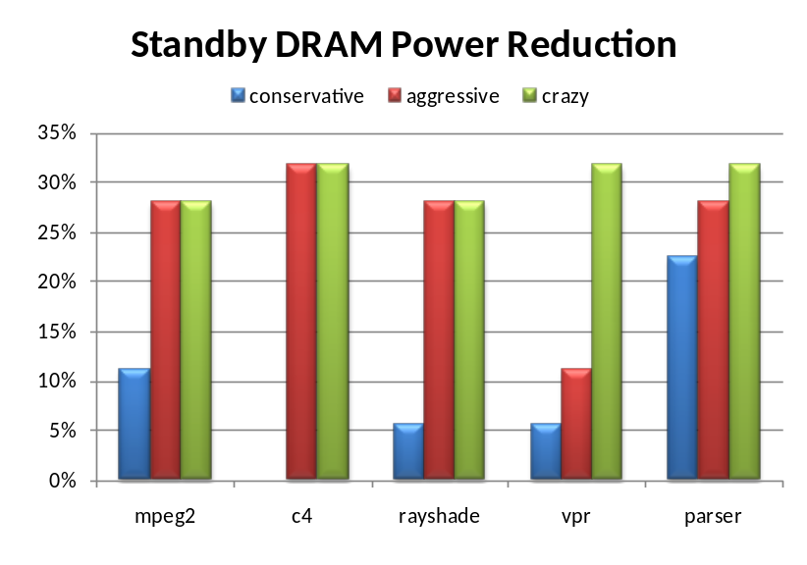
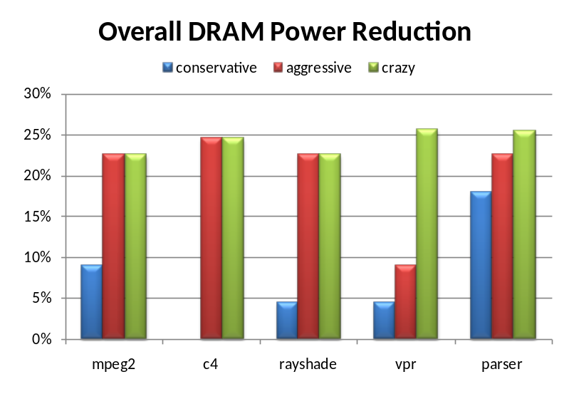
Results: Power Reduction
Estimate the portion of high refresh rate part based on the percentage of the critical pages
  24% critical pages: ¼ high refresh rows
Overall power savings: up to 25%
Notes:
These two figures shows the standby DRAM power reduction and overall DRAM power reduction achieved by Flicker. We estimate the portion of high refresh part based on the percentage of the critical pages. For example, if 24% of the pages are critical, ¼ of the memory array is in high refresh. Therefore, the critical pages could fit in the high refresh part.
In these figures, we see the power saving increases from conservative configuration to crazy configuration. A extreme example is c4, which has 0 power reduction in conservative, because c4 doesn’t have any non-critical heap data. However, c4 achieves over 30% reduction in DRAM standby power when we put global data in the low refresh part. Later I will show that putting global data in the low refresh part doesn’t incur any output degradation for c4.

Slide 45
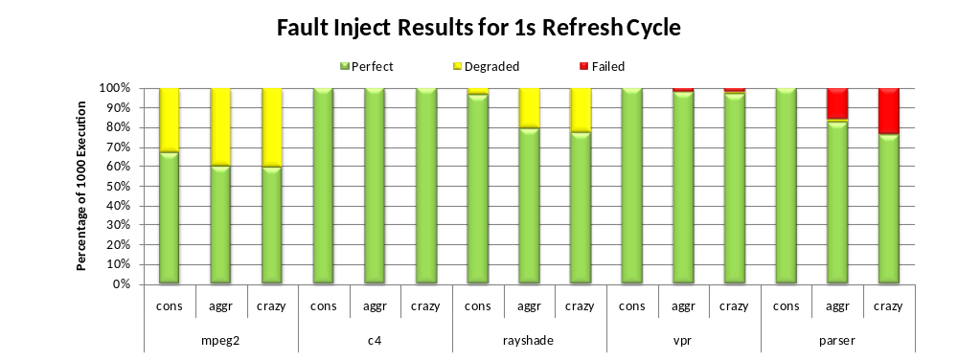
Results: Fault-injection (1sec Refresh)
Output stats (1000 executions): perfect, degraded, failed (hang, crash)
c4: always perfect
mpeg2, rayshade: some degraded output
vpr, parser: some failed in aggressive and crazy
Notes:
This figure shows the output stats of 1000 execution for all applications and all configurations. We categorize the output as perfect degraded, and failed. Overall, conservative configuration works well for all applications. No application fails in conservative configuration. This demonstrates the error resilience of applications. On the other hand, some execution of vpr and parser failed in aggressive and crazy configuration. This confirms the importance of protecting critical data.

Slide 46
Results: Power vs. Output Quality
conservative: parser
aggressive: mpeg2, c4, rayshade
crazy: vpr
Notes:
Compare the power saving with reliability, we find parser performs best on conservative configuration. Since parser has large noncritical heap data, it achieve significant power saving in conservative configuration. Parser also have large critical global data, which leads to many failed executions in aggressive and crazy configurations. On the other hand vpr works well in crazy configurations. This is because a few errors in stack and critical heap data are not likely to impact the final result of simulated annealing algorithm. The other three applications prefers aggressive configuration, where they achieves significant power saving and high quality output.

Slide 47
Fault-injection Result: SNR
Signal-to-Noise-Ratio (SNR): the ratio of signal energy and noise energy
SNR is logarithm scale: 3dB means double the ratio
mpeg2 encoder -> decoder: 35 dB
Flikker yields very high SNR
Configuration | mpeg2 | rayshade
conservative | 95.48 | 101.1
aggressive | 88.34 | 72.84
crazy | 88.04 | 73.63
Average SNR of degraded output of mpeg2 and rayshade [dB].
Notes:
One concern of mpeg2 and rayshade is the degradation in output quality. However, we will show the output degradation is actually negligible. We evaluate the output quality of mpeg2 and rayshade with Signal to noise ratio, SNR. Larger SNR means higher output quality. SNR is usually shown in log scale, where 3dB means double the ratio. We test the SNR of mpeg2 on a video. After encoding and decoding, the final output video achieves 35dB compared with the original video. The SNR of Flicker is much higher than this. As shown in this table Flicker achieves over 70dB SNR for all these configurations, which means the output degradation is negligible.

Slide 48



Rayshade Output with Different SNR
Original
78.9dB
52.0dB
41.3dB
Notes:
We have just quantitatively evaluated the output of Flicker, now let’s see it visually. In this slide, we show four output of rayshade with different SNRs. I could hardly tell the difference between the 78dB figure and the original figure. Some pixels in the 41dB figure is different to the original figure. Overall, the 41.3dB figure is ok.

Slide 49

DRAM in Data Centers
Electricity bills dominate the maintenance cost
Typical utilization of data centers is less than 30%
Large memory
Preliminary results on search benchmark
  Power: Over 30% standby power saving
  Output quality: Over 90% correct output
Notes:
First, fl

Slide 50
Flikker in Other Memories
Variations in the lifetime of different memory cells
  Flash memory
  Phase Change Memory (PCM)
Systems with new memory and old memory
  Critical data: new memory
  Non-critical data: old memory

Slide 51
Conclusion
Software and hardware will have errors
We need to build systems that tolerate errors
  Compatible with existing software
  Low enough overhead to apply widely
My research agenda explores ways to do this
  DieHard / Exterminator / RobustHeap: automatically detect and correct memory errors (with high probability)
  Samurai: enable local reasoning, allow selective hardening, compatibility
  Flikker: Leverage fault-tolerance to reduce power consumption
Open problems
  Reason formally about partially correct systems
  Explore what the programming model looks like

Slide 52
Additional Information
Web sites:
  RobustHeap, Samurai, Flikker are on my home page: http://research.microsoft.com/~zorn
  DieHard: http://prisms.cs.umass.edu/emery/index.php?page=diehard
Publications
  Emery D. Berger and Benjamin G. Zorn, "DieHard: Probabilistic Memory Safety for Unsafe Languages", PLDI’06.
  Karthik Pattabiraman, Vinod Grover, and Benjamin G. Zorn, "Samurai: Protecting Critical Data in Unsafe Languages", Eurosys 2008.
  Gene Novark, Emery D. Berger and Benjamin G. Zorn, “Exterminator: Correcting Memory Errors with High Probability", PLDI’07.
  Paruj Ratanaworabhan, Benjamin Livshits, and Benjamin G. Zorn, “Nozzle: A Defense Against Heap-spraying Code Injection Attacks”, USENIX Security Symposium, 2009.
  Song Liu, Karthik Pattabiraman, Thomas Moscibroda, and Benjamin G. Zorn, “Flikker: Saving Refresh-Power in Mobile Devices through Critical Data Partitioning”, Microsoft Research Technical Report, MSR-TR-2009-138, 2009.

