Slide 1
Recitation on AdFisher
September 29, 2016

Slide 2
Motivation for building AdFisher
Web Browsing
Ad Ecosystem
Ads
Control
Different
Outcome?
Experimental
Slide Credit: Amit Datta
Notes:
We’re interested in finding which flows exist among these entities.
However, Ad Ecosystem is a blackbox.
This lack of visibility prevents us from drawing conclusions about the interactions inside the system.
What we are capable of doing is running experiments to detect flows through the system as a whole.
AdFisher can measure the values set in Google’s Ad Settings page and the ads shown to the agents after the treatments.
It comes with stock functionality for collecting and analyzing text ads.
Experimenters can add methods for image, video, and flash ads.
Can show association, causality is difficult to establish
<number>

Slide 3
How AdFisher works
Simulate users having a particular interest by visiting webpages associated with that interest.
Visit a webpage, collects ads, settings provided to the simulated users.
Automatically analyzes the data to determine whether statistically significant differences between groups of users with different interests exist.
Github: https://github.com/tadatitam/info-flow-experiments

Slide 4
Running experiments on AdFisher to determine if behavioral targeting occurs on the web
Input:
Behaviors the control / experimental groups are to perform (e.g., visiting websites)
Measurements (e.g. ads) to collect afterwards
AdFisher:
Takes input runs experiments collect measurements
Determines if there is a statistically significant difference between the data collected from the control and experimental groups
Notes:
Evidence of causal connection between behaviors and targeting if yes
<number>

Slide 5
Running AdFisher
Technical Details

Slide 6
Installation & Running
Installation
Instructions on Github
Tested on MacOS / Linux only
Windows users may want to use a VM to run AdFisher
Running
Scripts to run experiments and collect data in AdFisher/examples

Slide 7
Modifying AdFisher
Technical Details

Slide 8
AdFisher/core
AdFisher/core/adfisher.py
Runs the entire experiment
AdFisher/core/driver
Stages the experiment and sets up the browser units that collects data
Stores measurements in a log file
AdFisher/core/converter
Reads data written in the log file
Converts data to machine readable format for statistical analysis
AdFisher/core/web
Codes that collect data (such as ads, news articles) from various websites
Groups that want to collect data from various websites
Familiarity with Selenium needed
AdFisher/core/analysis
Determine if the difference between data collected from the control group and data collected from the experimental group is statistically significant
Groups that want to implement different forms of statistical analysis

Slide 9
Selenium Python
Web Scraping tool that simulates a user surfing the Internet
Limitations:
Works only on HTML elements
Does not work on XML, alert boxes, chrome://settings, firefox preferences page, etc
http://selenium-python.readthedocs.io/
Notes:
Demo firefox preferences, alert, chrome settings
<number>

Slide 10
Automated experiments and Site Policies
Technical Details
Notes:
Be sure to obey them
<number>

Slide 11
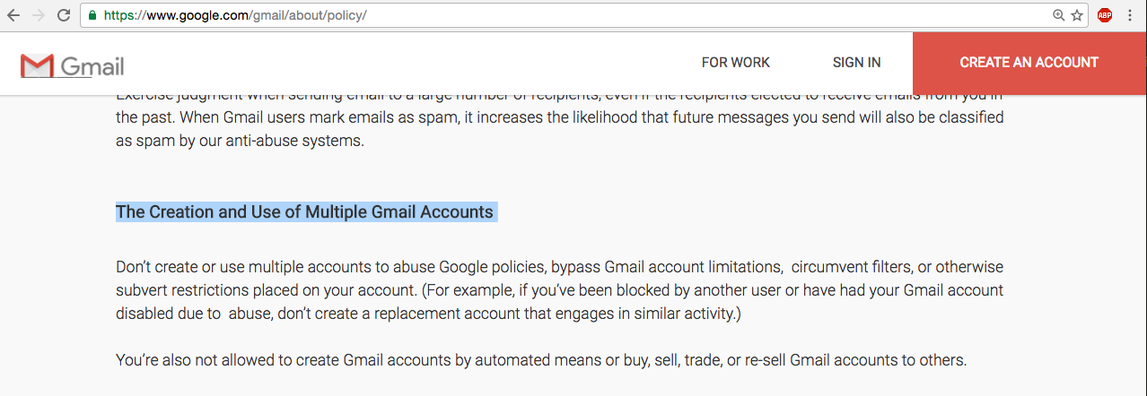
Creating Multiple Accounts

Slide 12
Creating Multiple Accounts

Slide 13
Number of requests a website expects

Slide 14
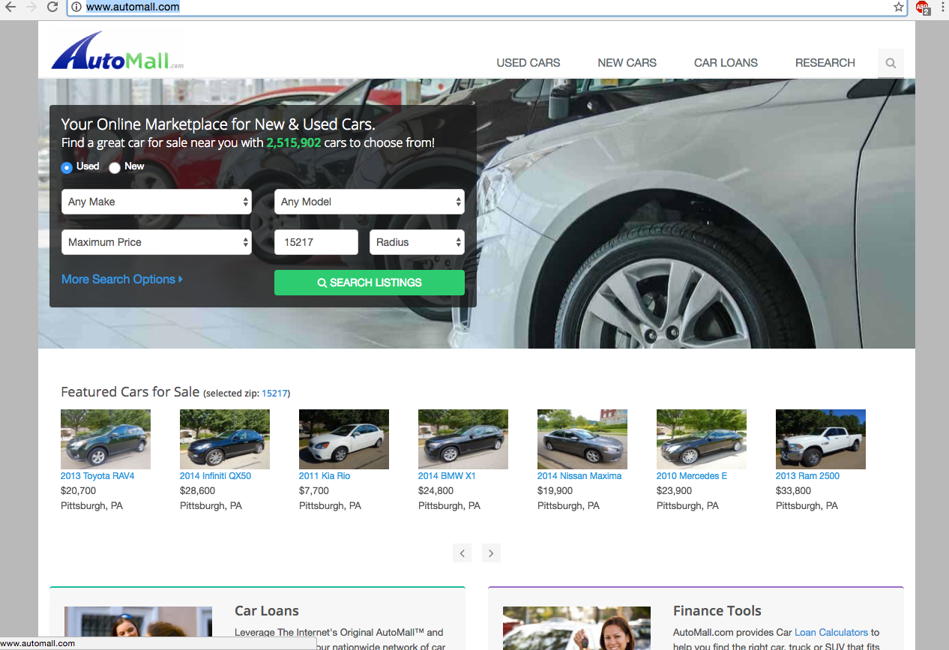
#Requests / unit time

Slide 15
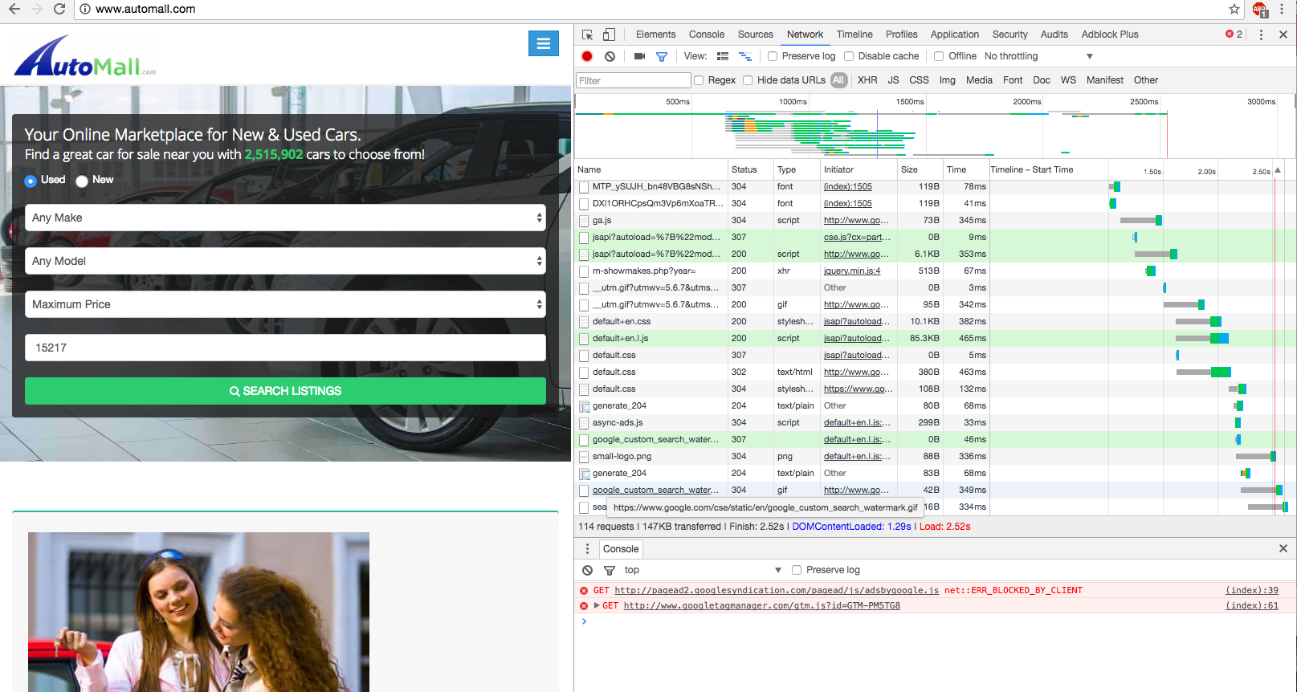
#requests / unit time
http://blog.hubspot.com/marketing/reduce-http-requests#sm.0001t43gs9739cxeq3916bv5w0cmy
Notes:
Console => network => reload page to view 114 requests per page load!
<number>

