Slide 1
A Primer on Machine Learning, Classification, and Privacy
Amit Datta
(slides: Anupam Datta)
Fall 2017
Notes:
Powerpoint Karaoke, BattleDecks

Slide 2
Machine Learning – Classification
A classification algorithm takes as input some examples and their values (labels), and, using these examples, is able to predict the values of new data.
Email: Spam / Not Spam?
Online transactions: Fraudulent (Yes/No)?
Tumor: Malignant/Benign?
Notes:
Examples?

Slide 3









Machine Learning – Classification
A classification algorithm takes as input some examples and their values (labels), and, using these examples, is able to predict the values of new data.
M
M
F
?
F
M
F
M
F
Notes:
Examples?

Slide 4










Machine Learning – Multiclass classification
Multiclass algorithms: more than two labels
Cat
Dog
Fish
Dog
?
Cat
Dog
Fish
Cat
Dog
Fish

Slide 5
Machine Learning – Regression
Labels are real values
Height (cm) | Weight (kg) | Age | Gender | Heart Rate (BPM)
183 | 78 | 35 | M | 72
155 | 60 | 48 | F | 66
160 | 88 | 67 | F | 90
… | … | … | … | …
149 | 55 | 25 | M | ?

Slide 6






ML is Everywhere!
Leading paradigm in big data science (with application to MANY fields in CS/engineering).
  Infer user traits from online behavior
  Image recognition
  Natural Language Processing
Notes:
What do you think are some concerns with the ubiquity of ML?

Slide 7






Big Data for Advertising/Sales

Slide 8
Anonymization and Consent
Certain attributes are considered private/protected.
Users must consent to their data being used.
…. But private/protected data can be inferred with frightening accuracy!
Notes:
Examples of private attributes?

Slide 9

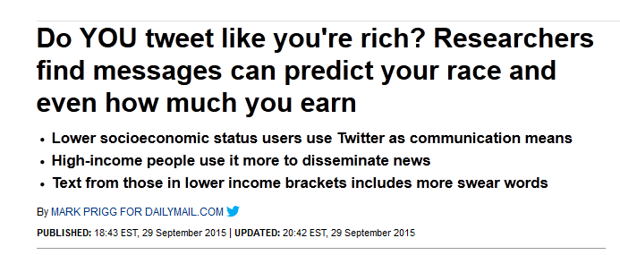
Raising Some Concerns…
Notes:
Facebook study from 2013, study from Cambridge+MSR. Found which likes were highly predictive of IQ, sexuality, etc.
Twitter study from 2015,

Slide 10
ML and Privacy
Unfettered ML as a threat to privacy
  Attacks on privacy using ML
  Examining standard ML models to understand if they present a threat to privacy (Use Privacy)
  Constraining standard ML to ensure that some privacy notions are respected (ML with Differential Privacy)
ML as a tool for protecting privacy
  Using ML to detect threats to privacy and related values (AdFisher and IFE)

Slide 11
This Lecture
Basic concepts in classification
  Training
  Testing
Some examples of classifiers
  Probability Basics
  Bayes Classifier
  Linear Classifier
  Support Vector Machines

Slide 12
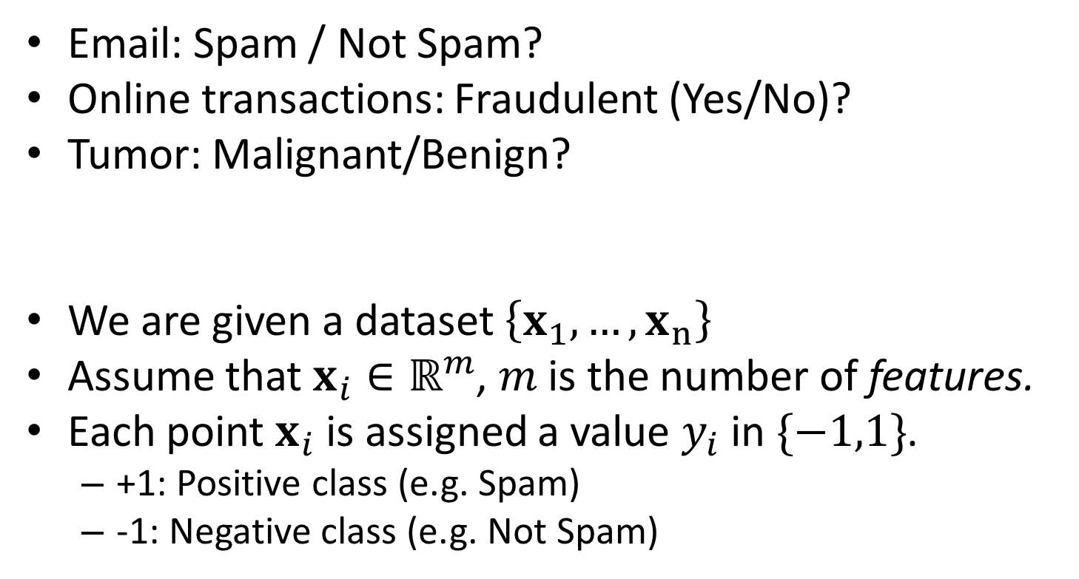
Problem Formulation
Email: Spam / Not Spam?
Online transactions: Fraudulent (Yes/No)?
Tumor: Malignant/Benign?
We are given a dataset $\left\{x_{1},…,x_{n}\right\}$
Assume that $x_{i}∈ℝ^{m}$, $m$ is the number of features.
Each point $x_{i}$ is assigned a value $y_{i}$ in $\{−1,1\}$.
  +1: Positive class (e.g. Spam)
  -1: Negative class (e.g. Not Spam)

Slide 13
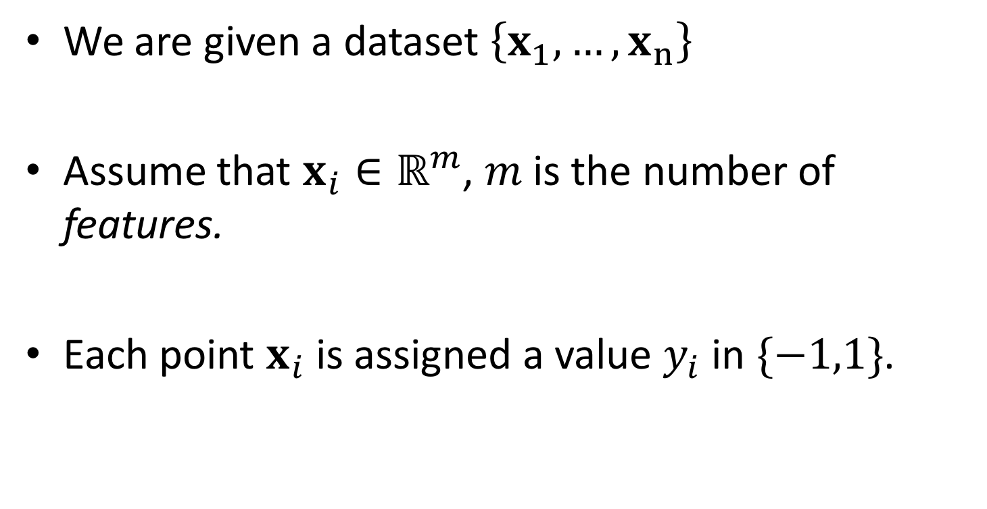
Classification Algorithms
We are given a dataset $\left\{x_{1},…,x_{n}\right\}$
Assume that $x_{i}∈ℝ^{m}$, $m$ is the number of features.
Each point $x_{i}$ is assigned a value $y_{i}$ in $\{−1,1\}$.

Slide 14

Training a Classifier
Our goal is to find a function $y:ℝ^{m}→\{−1,1\}$ that best predicts $y$from $x$.
Tumor size
RBC count

Slide 15
Testing a Classifier
A separate data set used to evaluate the prediction accuracy of the classifier.
What percentage of the predictions are accurate on the test set?

Slide 16
I.
III.
II.

Slide 17
This Lecture
Basic concepts in classification
  Training
  Testing
Some examples of classifiers
  Probability Basics
  Bayes Classifier
  Linear Classifier
  Support Vector Machines

Slide 18
Definition of Probability
Experiment: toss a coin twice
Sample space: possible outcomes of an experiment
  S = {HH, HT, TH, TT}
Event: a subset of possible outcomes
  A={HH}, B={HT, TH}, C={TT}
Probability of an event : an number assigned to an event Pr(A)
  Axiom 1: Pr(A) ≥ 0
  Axiom 2: Pr(S) = 1
  Axiom 3: For every sequence of disjoint events

Slide 19
Definition of Probability
Experiment: toss a coin twice
Sample space: possible outcomes of an experiment
  S = {HH, HT, TH, TT}
Event: a subset of possible outcomes
  A={HH}, B={HT, TH}, C={TT}
  Assuming coin is fair,
  P(A) = ¼ P(B) = ½ P(C) = ¼
  What is the probability that we get at least one head?
  P({HH, HT, TH}) = ¾

Slide 20
Joint Probability
For events A and B, joint probability Pr(A∩B) stands for the probability that both events happen.
Example: A={HH}, B={HT, TH}, what is the joint probability Pr(A∩B)?
P(A∩B) = 0
P(A U B) = P(A) + P(B) – P(A∩B)

Slide 21
Joint Probability
Experiment: toss a coin twice
Sample space: possible outcomes of an experiment
  S = {HH, HT, TH, TT}
Event: a subset of possible outcomes
  A={HH}, B={HT, TH}, C={TT}
P(A∩B) = 0
P(A U B) = P(A) + P(B) – P(A∩B)
P({HH, HT, TH})
= P({HH} U {HT, TH}) = P(A U B) = P(A)+P(B) – P(A∩B)
= ¼ + ½ = ¾

Slide 22
Conditional Probability
If A and B are events with Pr(A) > 0, the conditional probability of B given A is
  Pr(B|A) = Pr(A∩B)/Pr(A)
  Example:
  A={HH, TH}, B={HH}
  Pr(B|A) =
  Pr({HH})/Pr({HH, TH})
  ¼ / ½ = ½

Slide 23
This Lecture
Basic concepts in classification
  Training
  Testing
Some examples of classifiers
  Probability Basics
  Bayes Classifier
  Linear Classifier
  Support Vector Machines

Slide 24
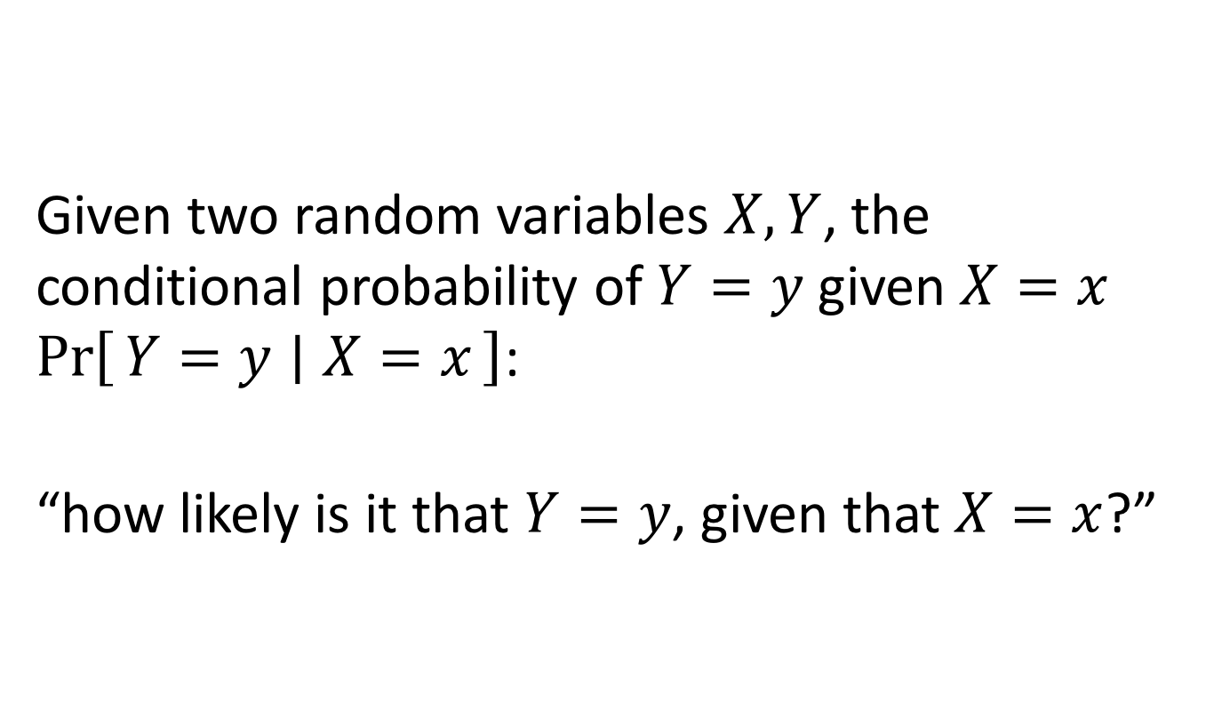
Bayesian Probability
Given two random variables $X,Y$, the conditional probability of $Y=y$ given $X=x$ $\operatorname{Pr}\left[Y=y ∣ X=x\right]$:
“how likely is it that $Y=y$, given that $X=x$?”

Slide 25
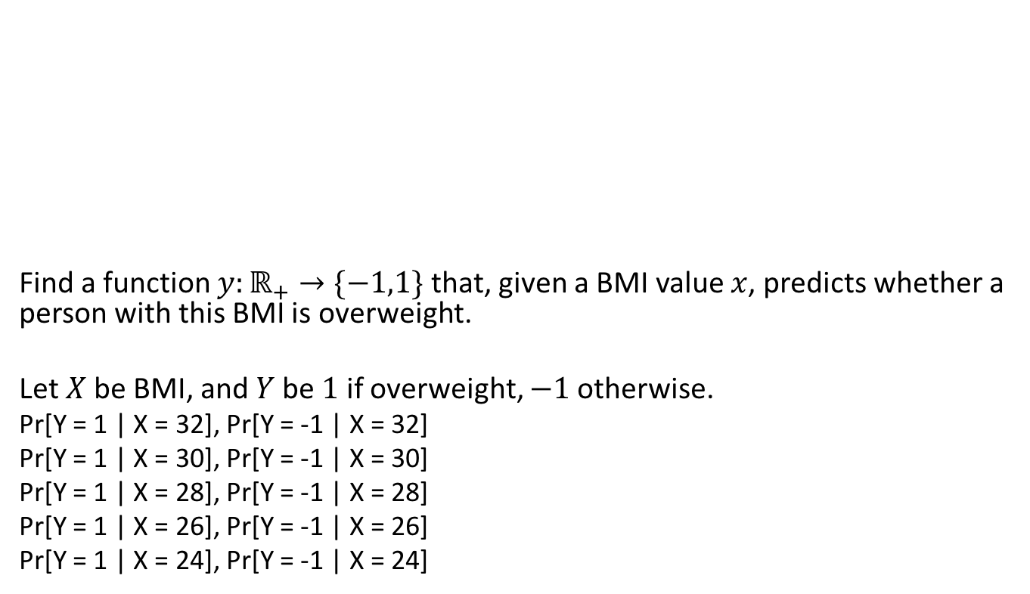
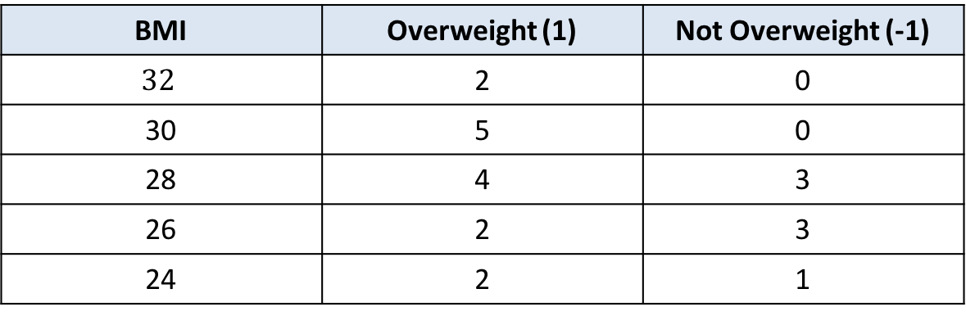
Learning a Classifier
BMI | Overweight (1) | Not Overweight (-1)
$$32$$ | 2 | 0
30 | 5 | 0
28 | 4 | 3
26 | 2 | 3
24 | 2 | 1
Find a function $y:ℝ_{+}→\{−1,1\}$ that, given a BMI value $x$, predicts whether a person with this BMI is overweight.
Let $X$ be BMI, and $Y$ be $1$ if overweight, $−1$ otherwise.
Pr[Y = 1 | X = 32], Pr[Y = -1 | X = 32]
Pr[Y = 1 | X = 30], Pr[Y = -1 | X = 30]
Pr[Y = 1 | X = 28], Pr[Y = -1 | X = 28]
Pr[Y = 1 | X = 26], Pr[Y = -1 | X = 26]
Pr[Y = 1 | X = 24], Pr[Y = -1 | X = 24]
Example adapted from A. Shashua, “Introduction to Machine Learning”, ArXiv 2008

Slide 26
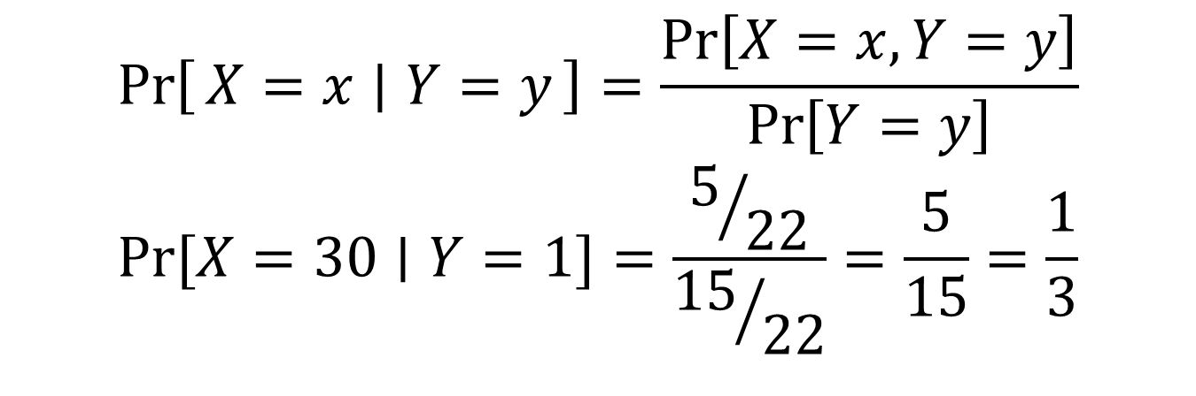
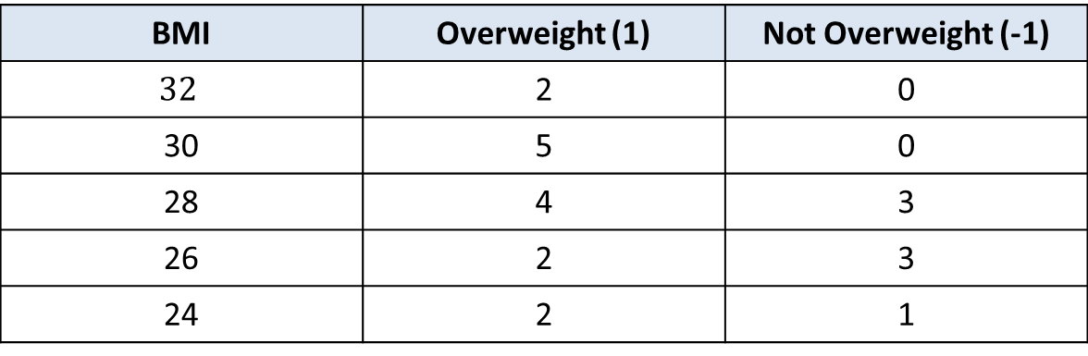
Bayesian Probability
BMI | Overweight (1) | Not Overweight (-1)
$$32$$ | 2 | 0
30 | 5 | 0
28 | 4 | 3
26 | 2 | 3
24 | 2 | 1
$$\operatorname{Pr}\left[X=x ∣ Y=y\right]=\frac{\operatorname{Pr}\left[X=x,Y=y\right]}{\operatorname{Pr}\left[Y=y\right]}$$
$$\operatorname{Pr}{[X=30∣Y=1]}=\frac{5/{22}}{{15}/{22}}=\frac{5}{15}=\frac{1}{3}$$
Example adapted from A. Shashua, “Introduction to Machine Learning”, ArXiv 2008

Slide 27
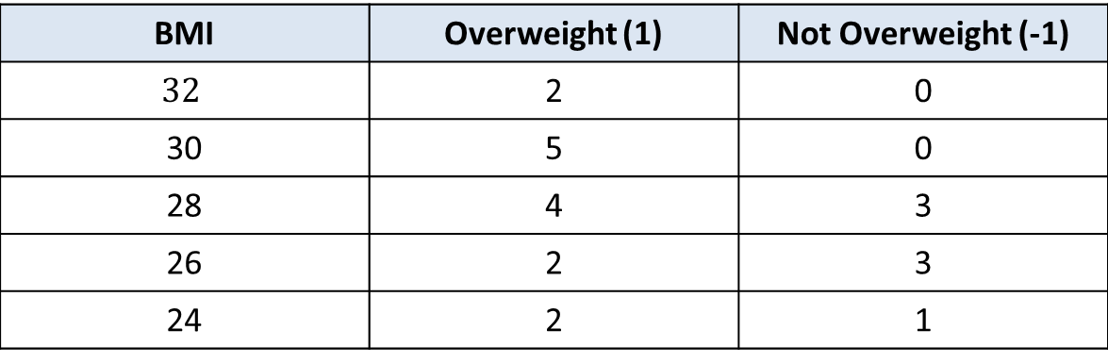
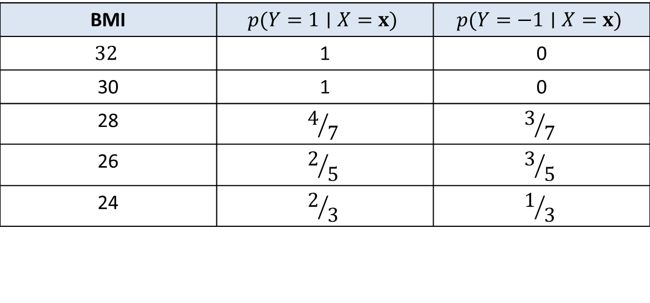
Bayesian Probability
Maximizing the posterior probability:
BMI | Overweight (1) | Not Overweight (-1)
$$32$$ | 2 | 0
30 | 5 | 0
28 | 4 | 3
26 | 2 | 3
24 | 2 | 1
BMI | $$p(Y=1∣X=x)$$ | $$p(Y=−1∣X=x)$$
$$32$$ | 1 | 0
30 | 1 | 0
28 | $$4/7$$ | $$3/7$$
26 | $$2/5$$ | $$3/5$$
24 | $$2/3$$ | $$1/3$$

Slide 28
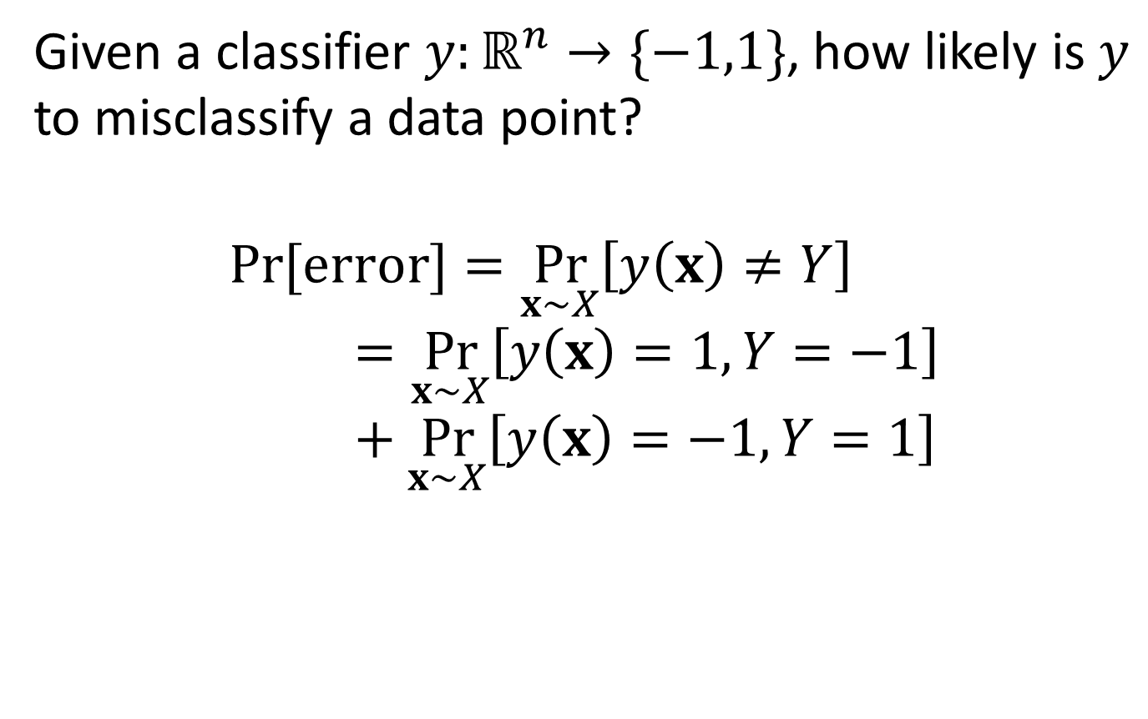
Probability of Error
Given a classifier $y:ℝ^{n}→\{−1,1\}$, how likely is $y$ to misclassify a data point?
$$\operatorname{Pr}{[error]}=\underset{x∼X}{Pr}\left[y\left(x\right)≠Y\right]=\underset{x∼X}{Pr}\left[y\left(x\right)=1,Y=−1\right]+\underset{x∼X}{Pr}\left[y\left(x\right)=−1,Y=1\right]$$

Slide 29
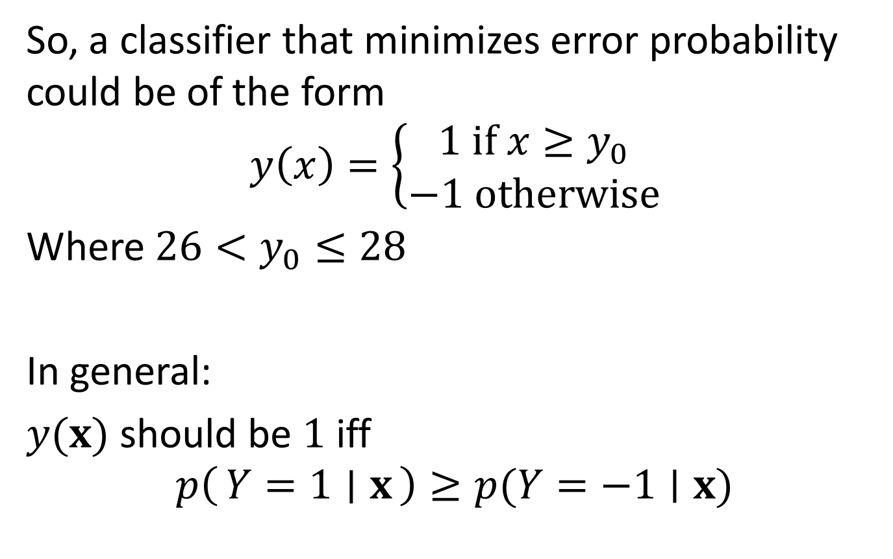
Bayesian Probability
So, a classifier that minimizes error probability could be of the form
$$y\left(x\right)=\left\{\begin{aligned}1 if x≥y_{0} \\ −1 otherwise\end{aligned}\right.$$
Where $26<y_{0}≤28$
In general:
$y(x)$ should be $1$ iff
$$p\left(Y=1 ∣ x\right)≥p(Y=−1∣x)$$

Slide 30
This Lecture
Basic concepts in classification
  Training
  Testing
Some examples of classifiers
  Probability Basics
  Bayes Classifier
  Linear Classifier
  Support Vector Machines

Slide 31
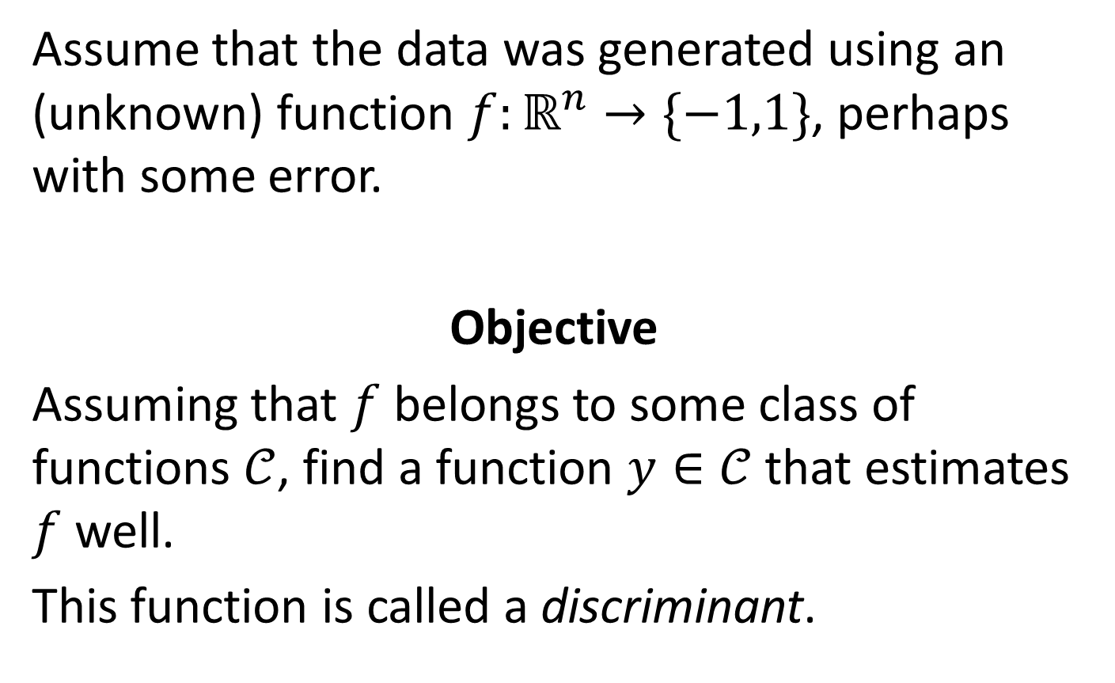
Learning a discriminant function
Assume that the data was generated using an (unknown) function $f:ℝ^{n}→\{−1,1\}$, perhaps with some error.
Objective
Assuming that $f$ belongs to some class of functions $𝒞$, find a function $y∈𝒞$ that estimates $f$ well.
This function is called a discriminant.

Slide 32
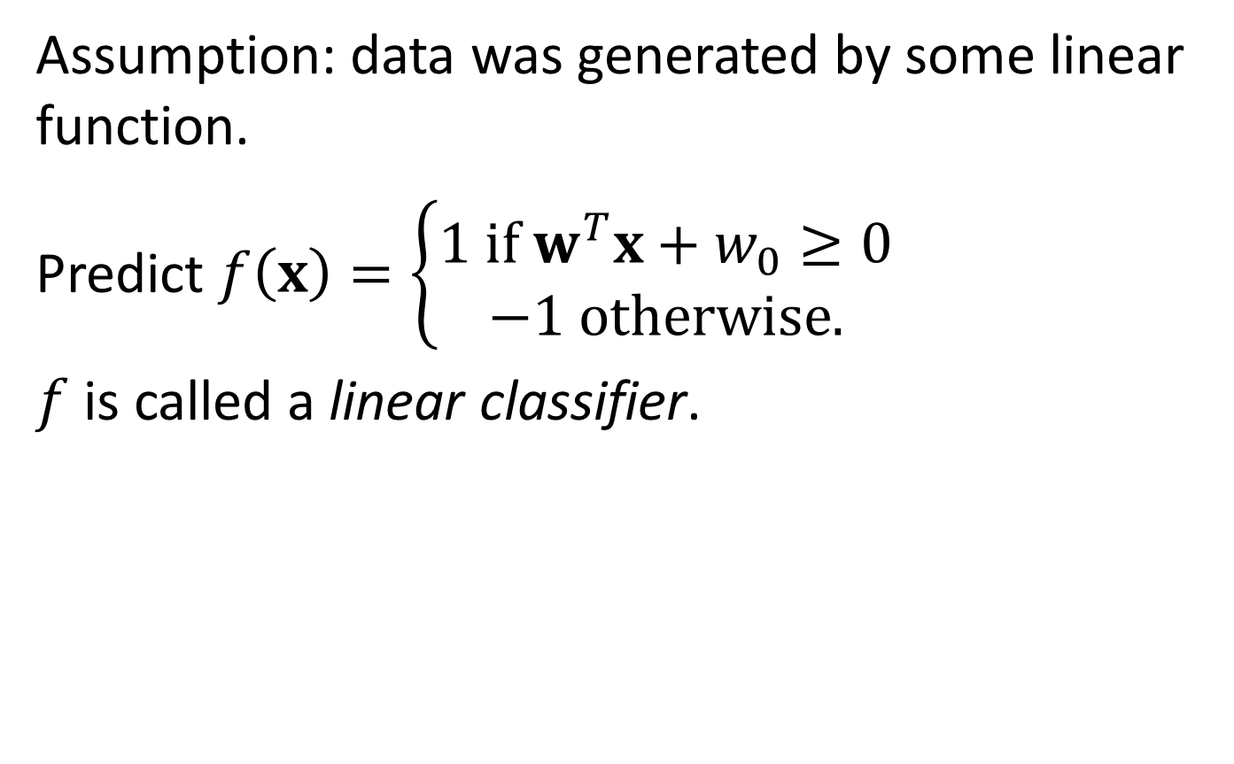

Linear Classifiers
Assumption: data was generated by some linear function.
Predict $f\left(x\right)=\left\{\begin{aligned}1 if w^{T}x+w_{0}≥0 \\ −1 otherwise.\end{aligned}\right.$
$f$ is called a linear classifier.
$$f\left(x,y\right)=𝕀(w_{1}x+w_{2}y+w_{0}≥0)$$

Slide 33
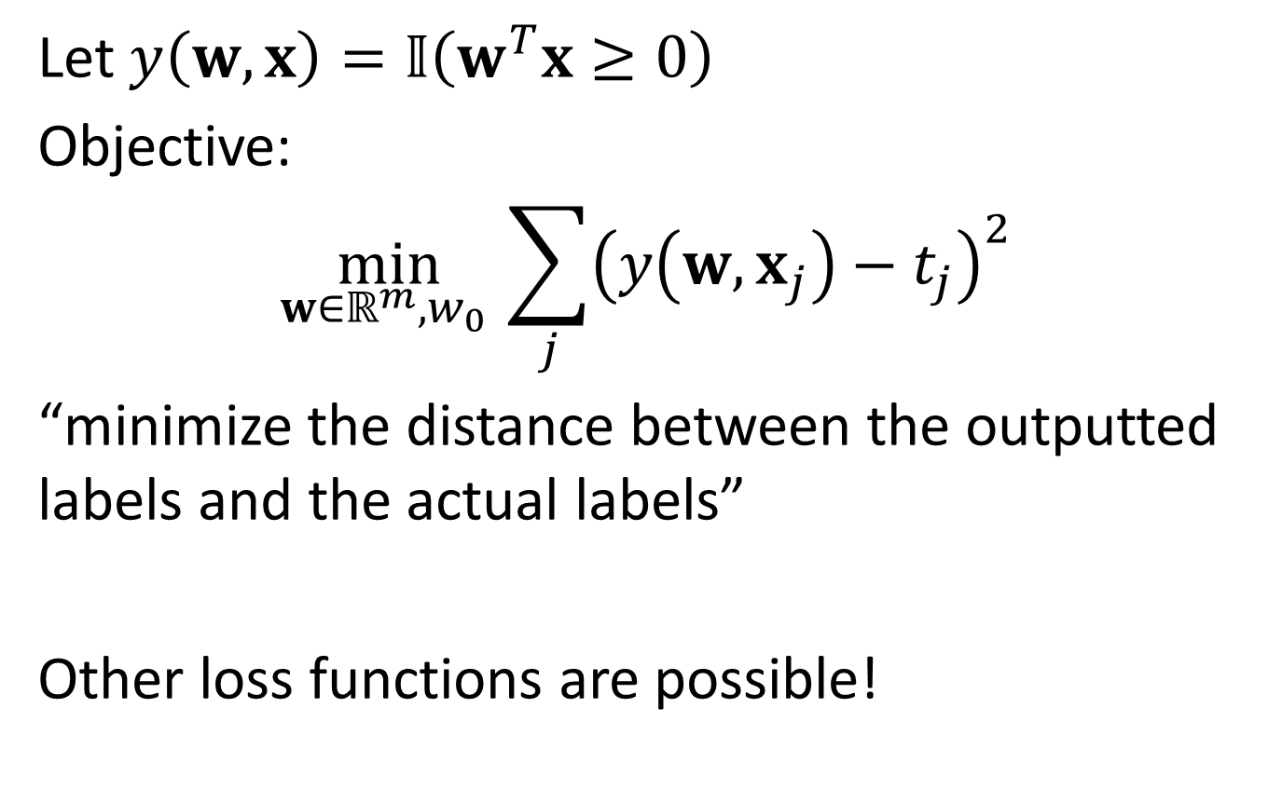
Least Squared Error
Let $y\left(w,x\right)=𝕀\left(w^{T}x≥0\right)$
Objective:
$$\min_{w∈ℝ^{m},w_{0} }{\sum_{j}{{\left(y\left(w,x_{j}\right)−t_{j}\right)}^{2}}}$$
“minimize the distance between the outputted labels and the actual labels”
Other loss functions are possible!

Slide 34
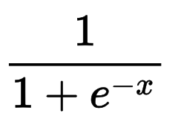
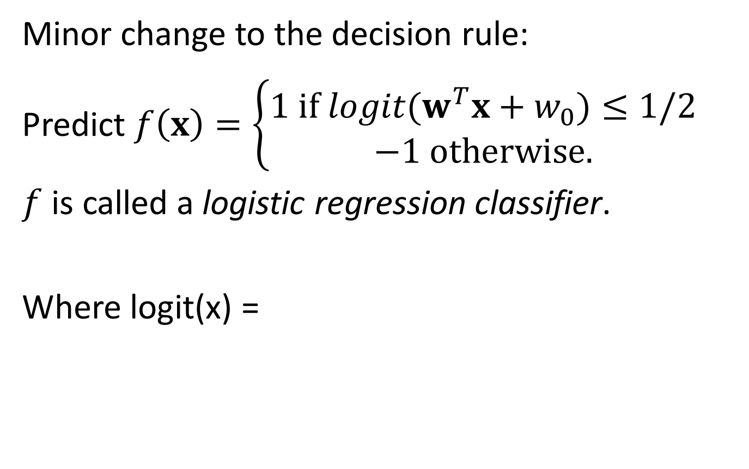
Logistic Regression Classifier
Minor change to the decision rule:
Predict $f\left(x\right)=\left\{\begin{aligned}1 if {logit(w}^{T}x+w_{0})≤1/2 \\ −1 otherwise.\end{aligned}\right.$
$f$ is called a logistic regression classifier.
Where logit(x) =

Slide 35
This Lecture
Basic concepts in classification
  Training
  Testing
Some examples of classifiers
  Probability Basics
  Bayes Classifier
  Linear Classifier
  Support Vector Machines

Slide 36
Linear Classifiers
Question: given a dataset, how would we determine which linear classifier is “good”?

Slide 37
Support Vector Machines
Many candidates for a linear function minimizing LSE; which one should we pick?

Slide 38
Support Vector Machines
Question: why is the purple line “good”?

Slide 39
Support Vector Machines: Key Insight
One possible approach:
find a hyperplane that is “perturbation resistant”

Slide 40
Support Vector Machines: Key Insight
How to mathematically represent this idea?
Margin: Minimal distance from points to classifier hyperplane
Idea: Pick hyperplane that maximizes margin
Can be formulated as optimization problem

Slide 41
Acknowledgments
Augmented slides from Yair Zick for Fall 2015 version of 18734
Material Adapted from:
  C.M. Bishop, “Pattern Recognition & Machine Learning”, Springer, 2006
  A. Shashua, “Introduction to Machine Learning – 67577”, Fall 2008 Lecture Notes, Arxiv.
Useful resource: Andrew Ng’s course on coursera.org

Slide 42
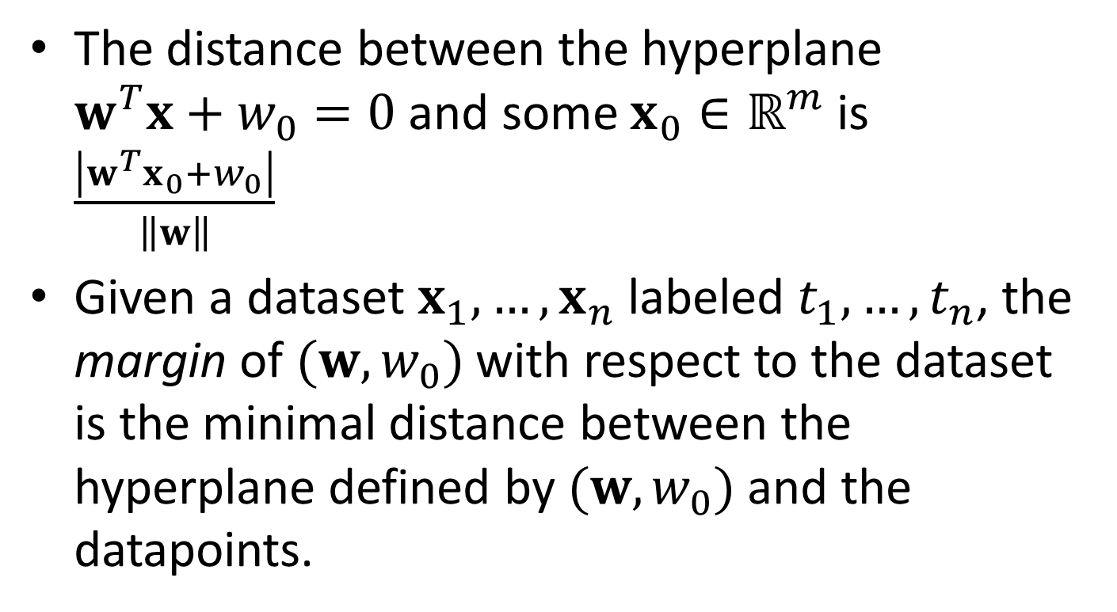
Support Vector Machines
The distance between the hyperplane $w^{T}x+w_{0}=0$ and some $x_{0}∈ℝ^{m}$ is $\frac{\left|w^{T}x_{0}+w_{0}\right|}{\left\|w\right\|}$
Given a dataset $x_{1},…,x_{n}$ labeled $t_{1},…,t_{n}$, the margin of $(w,w_{0})$ with respect to the dataset is the minimal distance between the hyperplane defined by $(w,w_{0})$ and the datapoints.

Slide 43
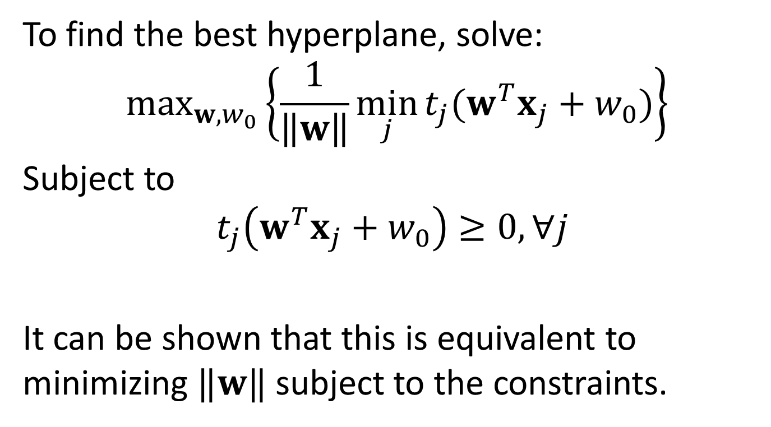
Support Vector Machines
To find the best hyperplane, solve:
$$\max_{w,w_{0}}\left\{\frac{1}{\left\|w\right\|}\min_{j}{t_{j}(w^{T}x_{j}+w_{0})}\right\}$$
Subject to
$$t_{j}\left(w^{T}x_{j}+w_{0}\right)≥0, ∀j$$
It can be shown that this is equivalent to minimizing $‖w‖$ subject to the constraints.

Slide 44
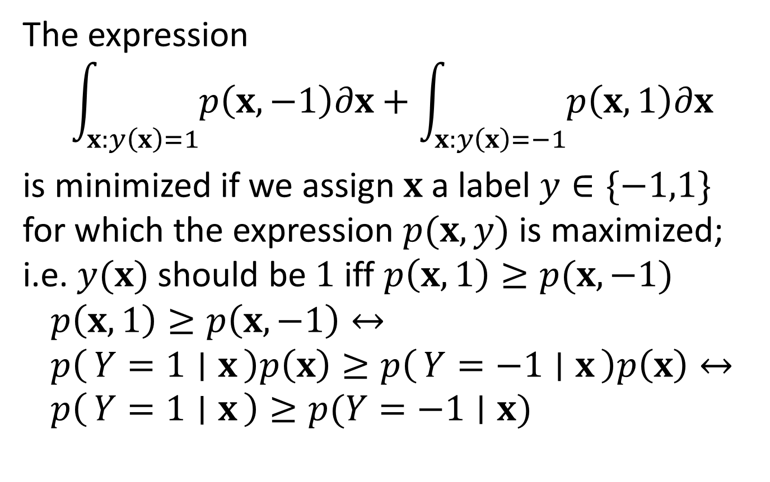
Bayesian Probability
The expression
$$\int_{x:y\left(x\right)=1}{p\left(x,−1\right)∂x}+\int_{x:y\left(x\right)=−1}{p\left(x, 1\right)∂x}$$
is minimized if we assign $x$ a label $y∈\{−1,1\}$ for which the expression $p(x,y)$ is maximized; i.e. $y(x)$ should be $1$ iff $p\left(x,1\right)≥p(x,−1)$
$$p\left(x,1\right)≥p\left(x,−1\right)↔ \\ p\left(Y=1 ∣ x\right)p\left(x\right)≥p\left(Y=−1 ∣ x\right)p\left(x\right)↔ \\ p\left(Y=1 ∣ x\right)≥p(Y=−1∣x)$$

Slide 45
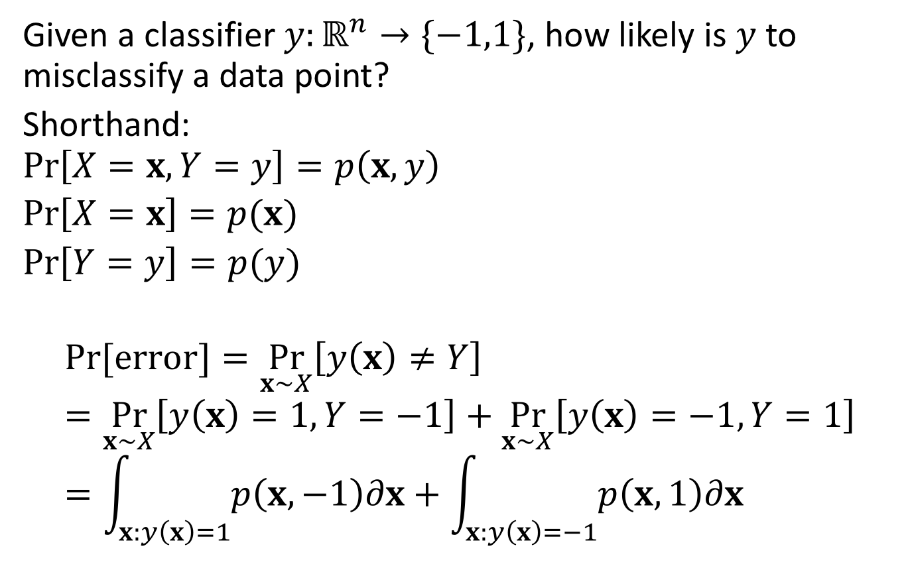
Bayesian Probability
Given a classifier $y:ℝ^{n}→\{−1,1\}$, how likely is $y$ to misclassify a data point?
Shorthand:
$\operatorname{Pr}\left[X=x,Y=y\right]=p\left(x,y\right)$
$\operatorname{Pr}\left[X=x\right]=p(x)$
$\operatorname{Pr}\left[Y=y\right]=p(y)$
$$\operatorname{Pr}{[error]}=\underset{x∼X}{Pr}\left[y\left(x\right)≠Y\right]=\underset{x∼X}{Pr}\left[y\left(x\right)=1,Y=−1\right]+\underset{x∼X}{Pr}\left[y\left(x\right)=−1,Y=1\right]=\int_{x:y\left(x\right)=1}{p\left(x,−1\right)∂x}+\int_{x:y\left(x\right)=−1}{p\left(x, 1\right)∂x}$$

Slide 46
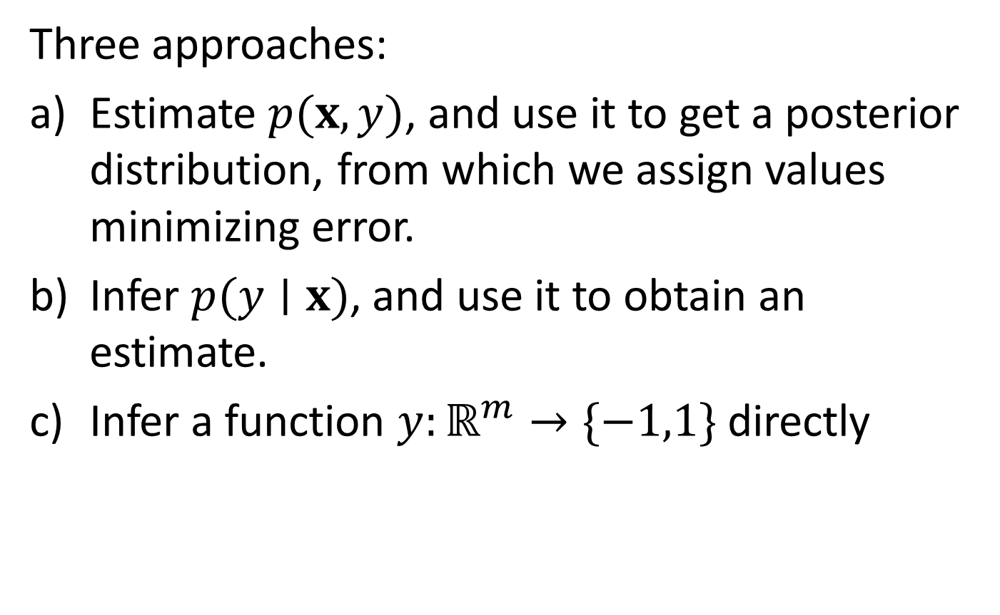
Bayesian Inference
Three approaches:
Estimate $p(x,y)$, and use it to get a posterior distribution, from which we assign values minimizing error.
Infer $p(y∣x)$, and use it to obtain an estimate.
Infer a function $y:ℝ^{m}→\{−1,1\}$ directly

Slide 47
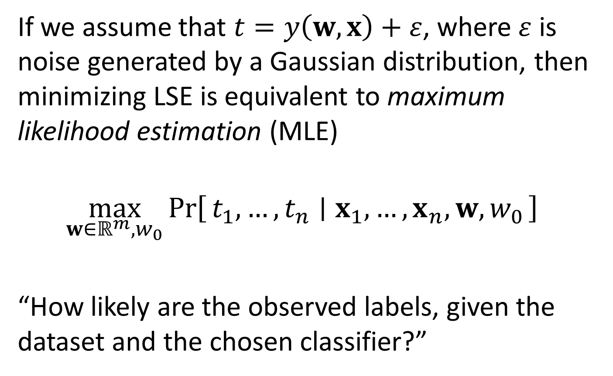
Least Squared Error
If we assume that $t=y\left(w,x\right)+ε$, where $ε$ is noise generated by a Gaussian distribution, then minimizing LSE is equivalent to maximum likelihood estimation (MLE)
$$\max_{w∈ℝ^{m},w_{0}}{\operatorname{Pr}\left[t_{1},…,t_{n} ∣ x_{1},…,x_{n},w,w_{0}\right] }$$
“How likely are the observed labels, given the dataset and the chosen classifier?”

