Slide 1
Bootstrapping Privacy Compliance in Big Data Systems
Anupam Datta
CMU
Fall 2017

Slide 2
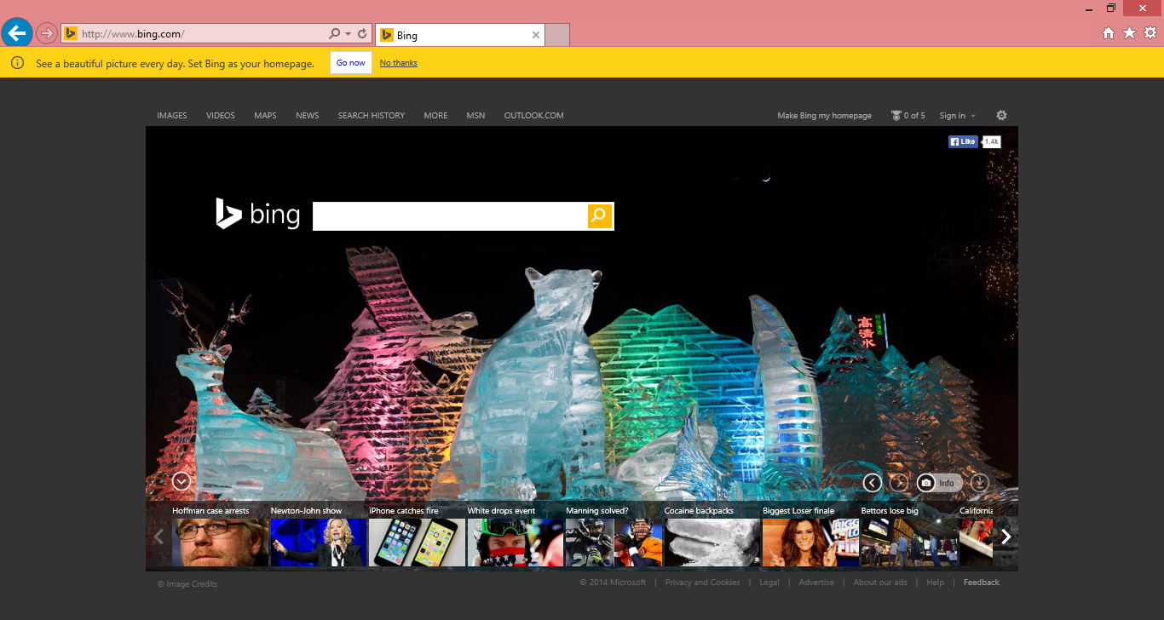
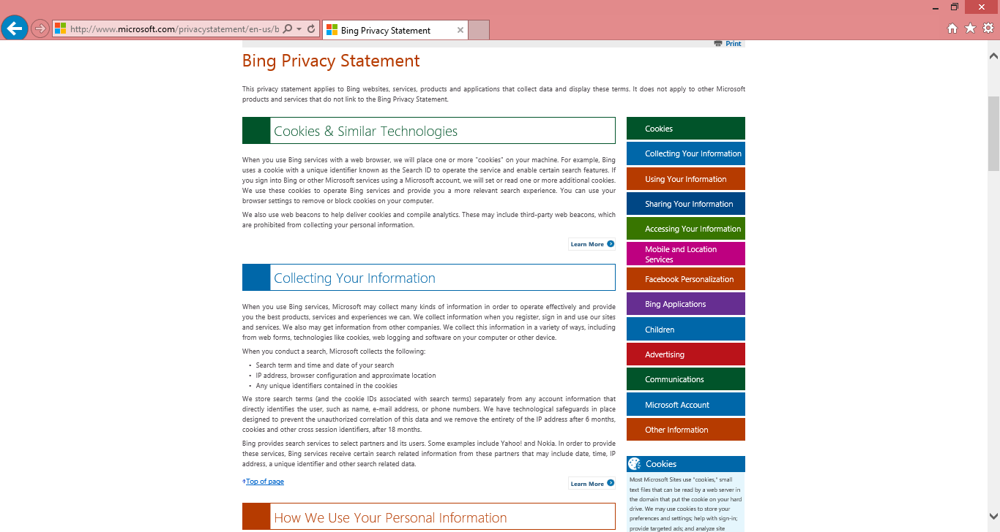

Privacy Compliance for Bing
Setting:
Auditor has access to source code

Slide 3
The Privacy Compliance Challenge
Legal Team
Crafts Policy
English
Privacy Policy
Meetings
Privacy Champion
Interprets Policy
Compliant?
Meetings
Developer
Writes Code
Millions of Lines of
Undocumented Code
Meetings
Audit Team
Verifies Compliance
Notes:
The legal team produces a privacy policy document and guidelines
There is a group of people, called the privacy champions whose task it is
to interpret this policy
and talk to the developers who write code.
Now, to check whether the code matches up with the privacy policy, we have
auditors to check compliance.
Why are companies concerned? Because this process happens through meetings
meetings and meetings.
What is needed to automate this problem?
- You need a formal specification of the policy so that it can be automatically checked
- Need to verify that the code satisfies this policy
- We need to do all of this at industrial scale.

Slide 4
A Streamlined Audit Workflow
Legal Team
Crafts Policy
Encode
Refine
Legalease
A formal policy specification language
Privacy Champion
Interprets Policy
Grok
Data inventory with policy labels
Legalease
Policy
Developer
Writes Code
Annotated
Code
Checker
Code analysis
Update Grok
Potential violations
Developer annotations
Audit Team
Verifies Compliance
Fix code
Notes:
And that's where our work comes in. We propose a new streamlined privacy
compliance workflow that utilizes are two key contributions:
- Legalease : a formal privacy policy language, usable enough for policy authors to be able to code in dire
- Grok : A data inventory that annotates code with policy labels.
Now the annotated code can be checked against the legalease policy to produce a list of potential violations.
Auditors can look at this list and either update grok or ask developers to add annotations

Slide 5
A Streamlined Audit Workflow
Legal Team
Crafts Policy
Workflow for privacy compliance
Legalease, usable yet formal policy specification language
Grok, bootstrapped data inventory for big data systems
Scalable implementation for Bing
Privacy Champion
Interprets Policy
Encode
Refine
Legalease
A formal policy specification language
Grok
Data inventory with policy datatypes
Annotated
Code
Legalease
Policy
Checker
Update Grok
Potential violations
Code analysis, developer annotations
Developer
Writes Code
Audit Team
Verifies Compliance
Fix code
Notes:
The first piece of our workflow is best explained through an example.

Slide 6
Privacy as Restrictions on Personal Information Flow
Purpose & Role based
Temporal
Restrictions
Information Flow
Direct
EPAL
XACML
*-access control
FOTLs
[Formal Contextual Integrity,
Reduce audit algorithm,
Basin et al.]
Purpose → Planning
Interference
[Hayati &
Abadi]
Grok +
Legalease
Jif, FlowCaml,…
Probabilistic
Interference
Information Flow
Experiments
Differential
Privacy
Differential
Privacy

Slide 7
A Streamlined Audit Workflow
Legal Team
Crafts Policy
Privacy Champion
Interprets Policy
Encode
Refine
Legalease
A formal policy specification language
Grok
Data inventory with policy datatypes
Annotated
Code
Legalease
Policy
Checker
Update Grok
Potential violations
Code analysis, developer annotations
Developer
Writes Code
Audit Team
Verifies Compliance
Fix code
Notes:
The first piece of our workflow is best explained through an example.

Slide 8
Specification: Legalease
Usable.
Expressive.
Precise.
Usable by lawyers and privacy champs.
Expressive enough for real-world policies.
Precise semantics for local reasoning.

Slide 9
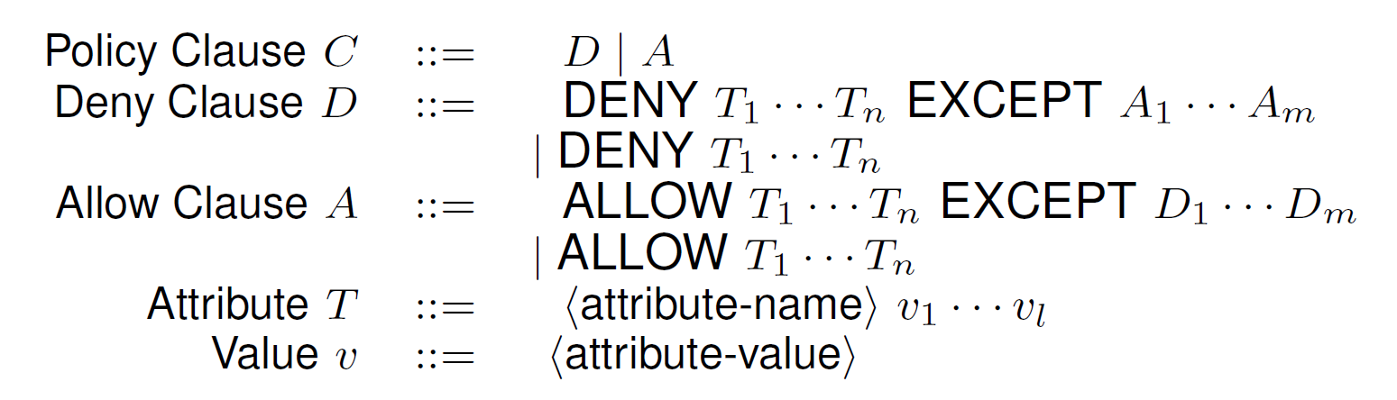
Legalease : Syntax

Slide 10
Legalease
DENY Datatype IPAddress
UseForPurpose Advertising
EXCEPT
ALLOW
Datatype IPAddress:Truncated
ALLOW
UseForPurpose AbuseDetect
EXCEPT
DENY Datatype
IPAddress, AccountInfo
We will not use full IP Address for Advertising. IP Address may be used for detecting abuse. In such cases, it will not be combined with account information.
Notes:
clauses followed by a list of exceptions, each of which may be further refined
Mimics how laws are stated and policies are stated
Adding exceptions to this does not affect rest of the clause
TODO: Need to talk about related work

Slide 11
Legalease
DENY Datatype IPAddress
UseForPurpose Advertising
EXCEPT
ALLOW
Datatype IPAddress:Truncated
ALLOW
UseForPurpose AbuseDetect
EXCEPT
DENY Datatype
IPAddress, AccountInfo
We will not use full IP Address for Advertising. IP Address may be used for detecting abuse. In such cases, it will not be combined with account information.

Slide 12
Designed for Usability
Exceptions
  How legal texts are structured
  One-to one correspondence
Local Reasoning
  Each exception refines its immediate parent
  Formally proven property
Independent of Code
DENY Datatype IPAddress
UseForPurpose Advertising
EXCEPT
ALLOW
Datatype IPAddress:Truncated
ALLOW
UseForPurpose AbuseDetect
EXCEPT
DENY Datatype
IPAddress, AccountInfo
    H. DeYoung, D. Garg, L. Jia, D. Kaynar, and A. Datta, “Experiences in the logical speciﬁcation of the HIPAA and GLBA privacy laws”
Notes:
clauses followed by a list of exceptions, each of which may be further refined
Mimics how laws are stated and policies are stated
Adding exceptions to this does not affect rest of the clause
TODO: Need to talk about related work

Slide 13
Legalease : In Action
Policy Labels
Program
Datatype: IPAddress, AccountInfo
UseForPurpose: AdsAbuseDetection
DENY Datatype IPAddress
UseForPurpose Advertising
EXCEPT
ALLOW
Datatype IPAddress:Truncated
ALLOW
UseForPurpose AbuseDetect
EXCEPT
DENY Datatype
IPAddress, AccountInfo
We will not use full IP Address for Advertising. IP Address may be used for detecting abuse. In such cases, it will not be combined with account information.
We will not use full IP Address for Advertising. IP Address may be used for detecting abuse. In such cases, it will not be combined with account information.
Notes:
clauses followed by a list of exceptions, each of which may be further refined
Mimics how laws are stated and policies are stated
Adding exceptions to this does not affect rest of the clause

Slide 14
A Lattice of Policy Labels
T
IPAddress
…
IPAddress: Truncated
…
…
⊥
If “IPAddress” use is allowed then so is everything below it
If “IPAddress:Truncated” use is denied then so is everything above it

Slide 15
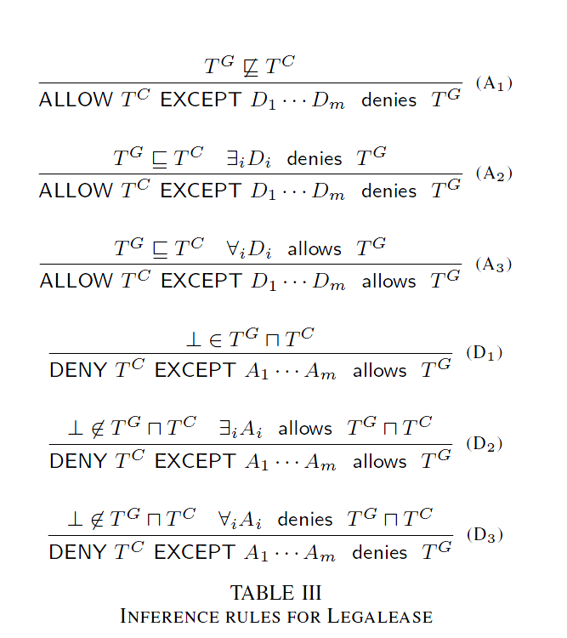
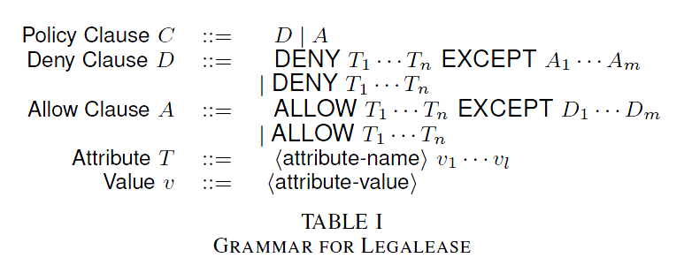
Designed for Precision

Slide 16
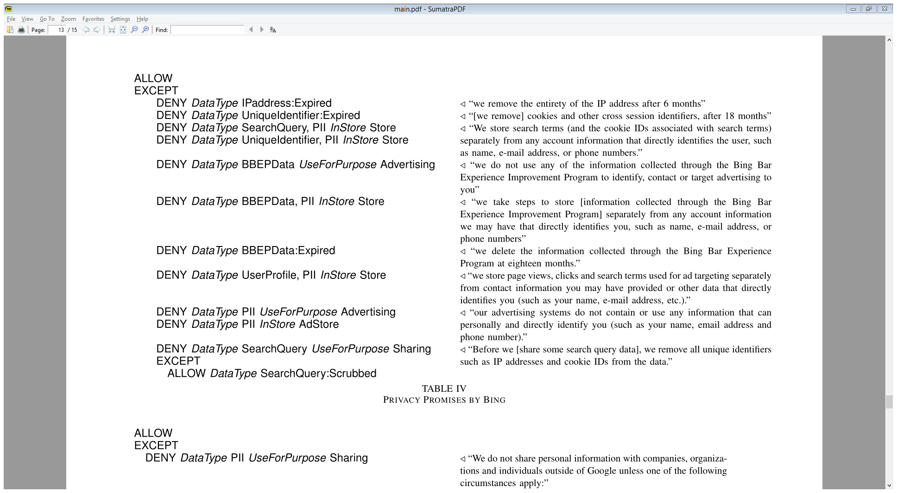
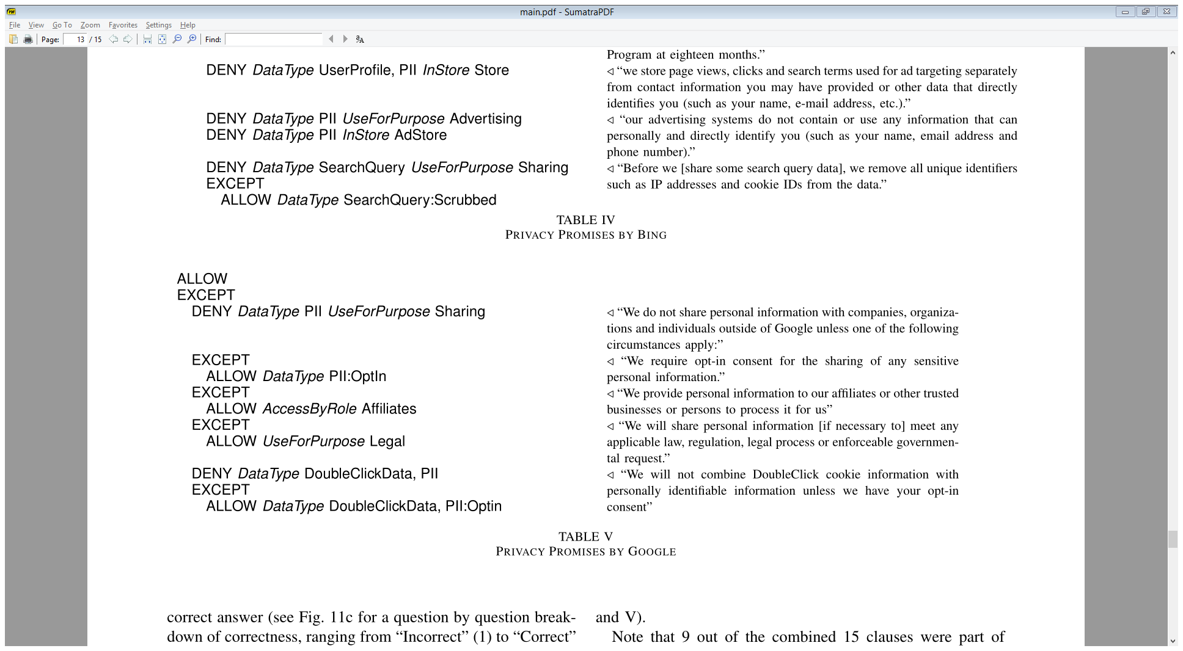
Designed for Expressivity (Bing, October 2013)

Slide 17
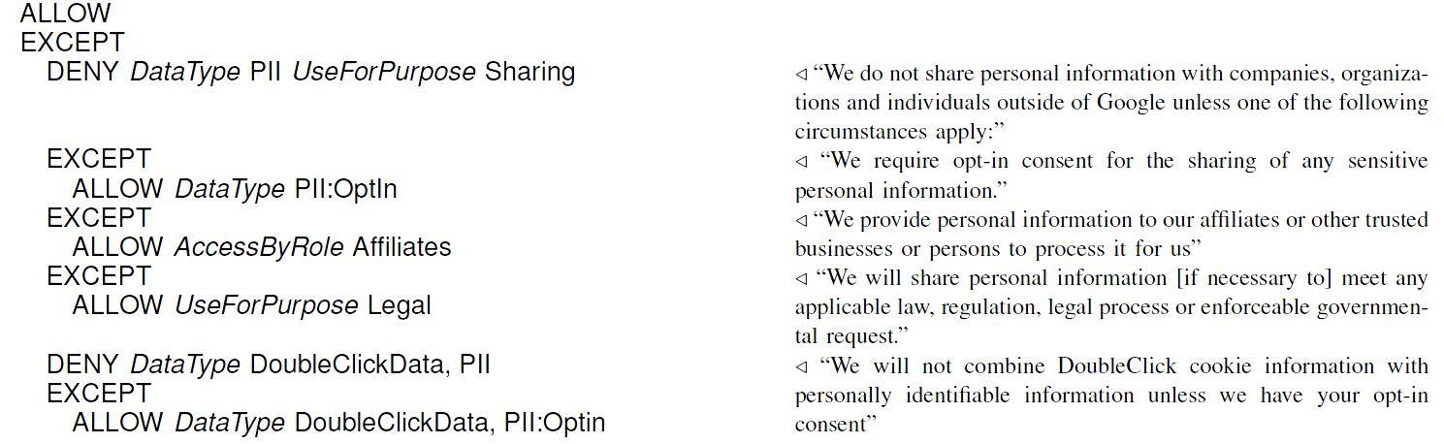
Designed for Expressivity (Google, October 2013)
17

Slide 18
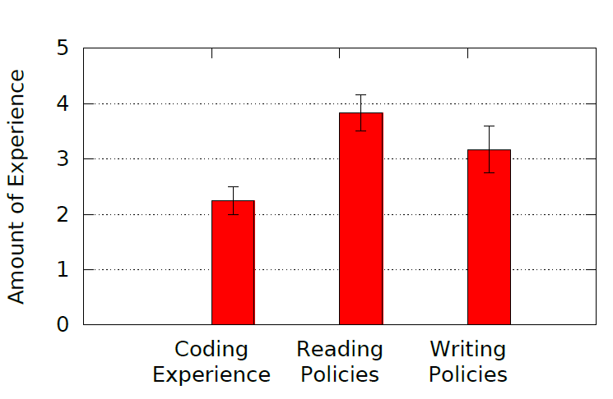
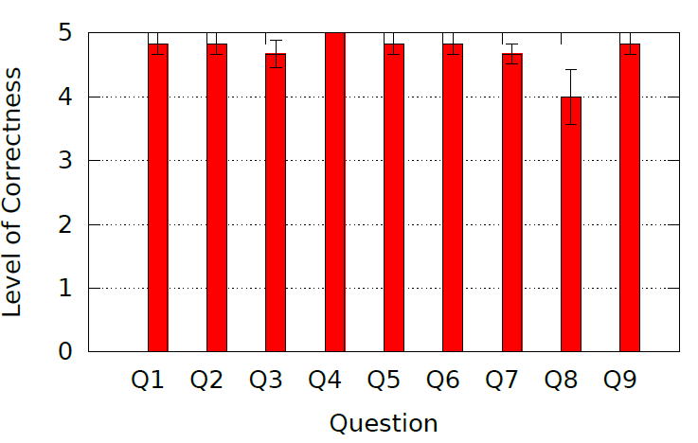
Legalease Usability
Survey taken by 12 policy authors within Microsoft
  Encode Bing data usage policy after a brief tutorial
Time spent
  2.4 mins on the tutorial
  14.3 mins on encoding policy
High overall correctness

Slide 19
A Streamlined Audit Workflow
Legal Team
Crafts Policy
Privacy Champion
Interprets Policy
Encode
Refine
Legalease
A formal policy specification language
Grok
Data inventory with policy labels
Legalease
Policy
Grok
Data inventory with policy labels
Annotated
Code
Checker
Code analysis
Update Grok
Potential violations
Developer annotations
Developer
Writes Code
Audit Team
Verifies Compliance
Fix code
Notes:
We saw that Legalease works perfectly fine, if all the code comes labeled with labels. But code that currently runs is undocumented and there is a disconnect with the high level policy specification and the low level implementation. Grok acts as the bridge between the two.

Slide 20
A Streamlined Audit Workflow
Legal Team
Crafts Policy
Privacy Champion
Interprets Policy
Encode
Refine
Legalease
A formal policy specification language
Grok
Data inventory with policy labels
Annotated
Code
Legalease
Policy
Checker
Update Grok
Potential violations
Code analysis, developer annotations
Developer
Writes Code
Audit Team
Verifies Compliance
Fix code

Slide 21
Map-Reduce Programming Systems
Dataset A
Dataset B
Process 1
Dataset C
Scope, Hive, Dremel
Data in the form of Tables
Code Transforms Columns to Columns
  No Shared State
  Limited Hidden Flows
users =
SELECT _name, _age FROM datasetAB
user_tag =
SELECT GenerateTag(_name, _age)
FROM users
OUTPUT user_tag TO datasetC
21
Notes:
Cosmos is a big-data processing infrastructure, similar to Hadoop, developed by Microsoft to handle its processing needs. The programming language that runs on top of Cosmos is called Scope. Scope is an SQL-like language, designed for easy and efficient parallel processing of data. (Similar to Pig/Hive for Hadoop.).
What does the data flow graph tell us?
- What data goes where.
- What data is correlated
- State transformations
Fix the code image.

Slide 22
Grok
Dataset A
Dataset B
Dataset D
Dataset G
Process 1
Process 4
Dataset C
Dataset H
Dataset I
Process 2
Process 5
Dataset E
Dataset F
Dataset J
Process 3
Process 6
22
Notes:
TODO: Need to talk about related work
Grok largely does two things
It generates initial policy labels for
Flows these labels along the edges
Note that we can’t check for inferred flows here

Slide 23
Grok
Dataset A
Dataset B
Dataset D
Dataset G
Purpose Labels
  Annotate programs with purpose labels
Process 1
Process 4
NewAcct
GeoIP
Dataset C
Dataset H
Dataset I
Process 2
Process 5
Login
Check
Fraud
Dataset E
Dataset F
Dataset J
Process 3
Process 6
Check
Hijack
Reporting
23
Notes:
TODO: Need to talk about related work
Grok largely does two things
It generates initial policy labels for
Flows these labels along the edges
Note that we can’t check for inferred flows here

Slide 24
Grok
Dataset A
Dataset B
Dataset D
Dataset G
Name
Age
IPAddress
IDX
users =
SELECT _name, _age FROM datasetAB
user_tag =
SELECT GenerateTag(_name, _age)
FROM users
OUTPUT user_tag TO datasetC
Purpose Labels
  Annotate programs with purpose labels
Name
Age
Process 1
Process 4
NewAcct
GeoIP
??
Dataset H
Dataset C
Country
Dataset I
IDX
Initial Data Labels
  Heuristics and Annotations
Process 2
Process 5
Login
Check
Fraud
Timestamp
Dataset J
Dataset E
Dataset F
??
Hash
Process 3
Process 6
Check
Hijack
Reporting
24
Notes:
TODO: Need to talk about related work
Grok largely does two things
It generates initial policy labels for
Flows these labels along the edges
Note that we can’t check for inferred flows here

Slide 25
Grok
Dataset A
Dataset B
Dataset D
Dataset G
Name
Age
IPAddress
IDX
users =
SELECT _name, _age FROM datasetAB
user_tag =
SELECT GenerateTag(_name, _age)
FROM users
OUTPUT user_tag TO datasetC
Purpose Labels
  Annotate programs with purpose labels
Name
Age
Process 1
Process 4
NewAcct
GeoIP
Profile
Name + Age
Profile
Dataset H
Dataset C
Country
Dataset I
IDX
Initial Data Labels
  Heuristics and Annotations
Process 2
Process 5
Login
Check
Fraud
Flow Labels
  Source labels propagated via data flow graph
Timestamp
Dataset J
Dataset E
Dataset F
IDX
Hash
Process 3
Process 6
Check
Hijack
Reporting
    D. E. Denning. “A lattice model of secure information ﬂow”
25
Notes:
TODO: Need to talk about related work
Grok largely does two things
It generates initial policy labels for
Flows these labels along the edges
Note that we can’t check for inferred flows here

Slide 26
A Lattice of Policy Labels
T
Profile
…
Name
Age
…
⊥
If “Profile” use is allowed then so is everything below it
If “Name” use is denied then so is everything above it

Slide 27
Implicit flows
users =
SELECT _name, _age FROM datasetAB
users_35 =
SELECT _name
FROM users
WHERE (_age > 35)
OUTPUT users_35 TO datasetC
Name
Age
Profile
Name + Age
Beyond direct flows discussed in healthcare audit examples

Slide 28
Map-Reduce
users =
SELECT _name, _age FROM datasetAB
users_35 =
SELECT _name, _age
FROM users
WHERE (_age > 35)
ages_35 =
SELECT _age, COUNT(_name) AS count
FROM users_35
GROUP BY _age
OUTPUT ages_35 TO datasetC
Map
  Operate on rows
  in parallel
  eg. filtering
Reduce
  Combine groups of rows
  eg. aggregation
Name
Age
Age
Profile

Slide 29
Combine Noisy Sources
Carefully curated regular expressions
Leverages developer conventions
Significant Noise
Very Expensive
Definitive
Need very few of these
Expensive
Low Noise
Variable Name Analysis
Developer Annotations
Auditor
Verification

Slide 30
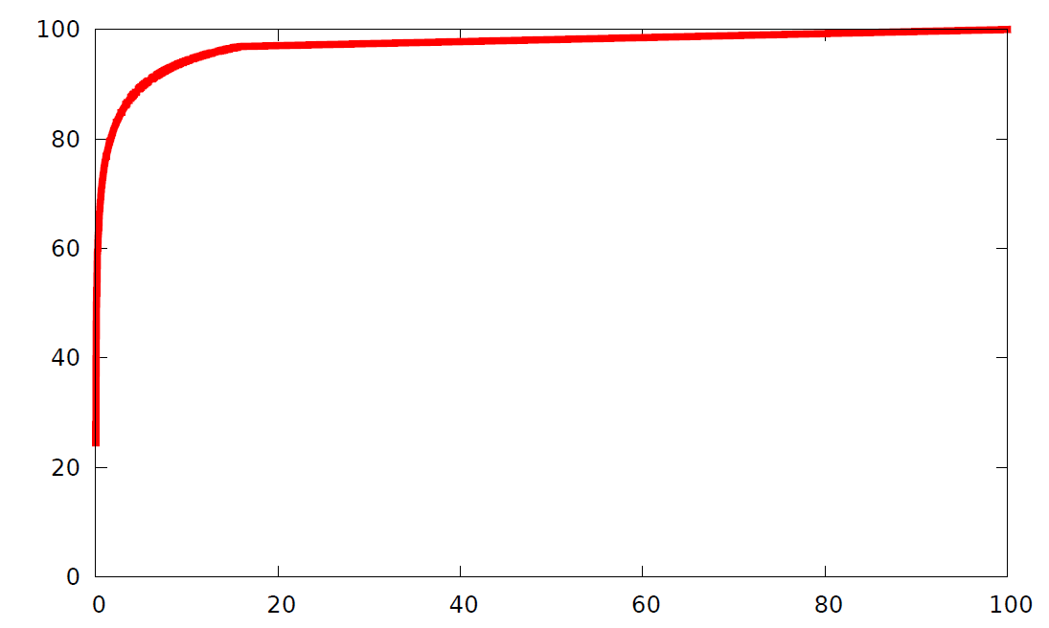
Why Bootstrapping Grok Works
Pick the nodes which will label the most of the graph
  ~200 annotations label 60% of nodes
% graph covered
% nodes labeled
A small number of annotations is enough to get off the ground.

Slide 31
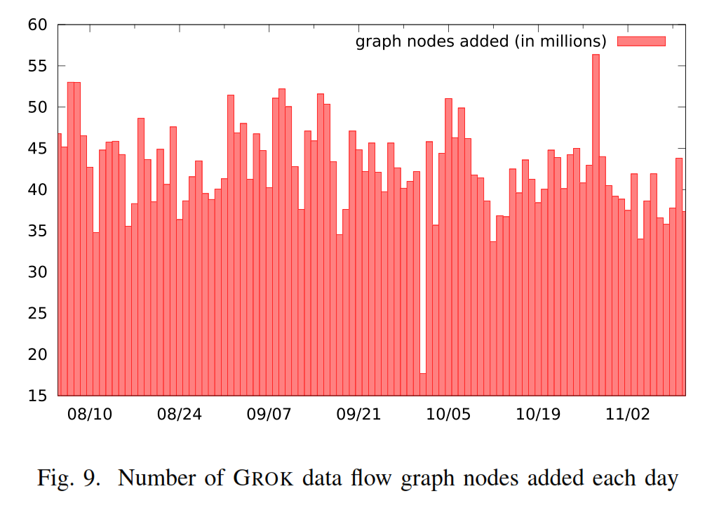
Scale
77,000 jobs run each day
  By 7000 entities
  300 functional groups
1.1 million unique lines of code
  21% changes on avg, daily
  46 million table schemas
  32 million files
Manual audit infeasible
Information flow analysis takes ~30 mins daily

Slide 32
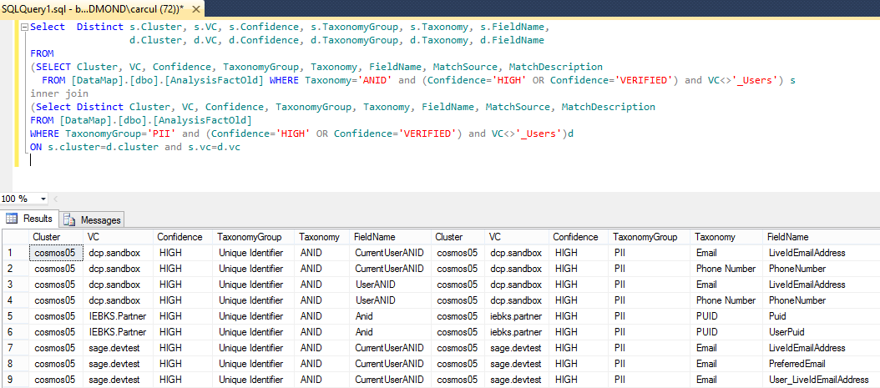
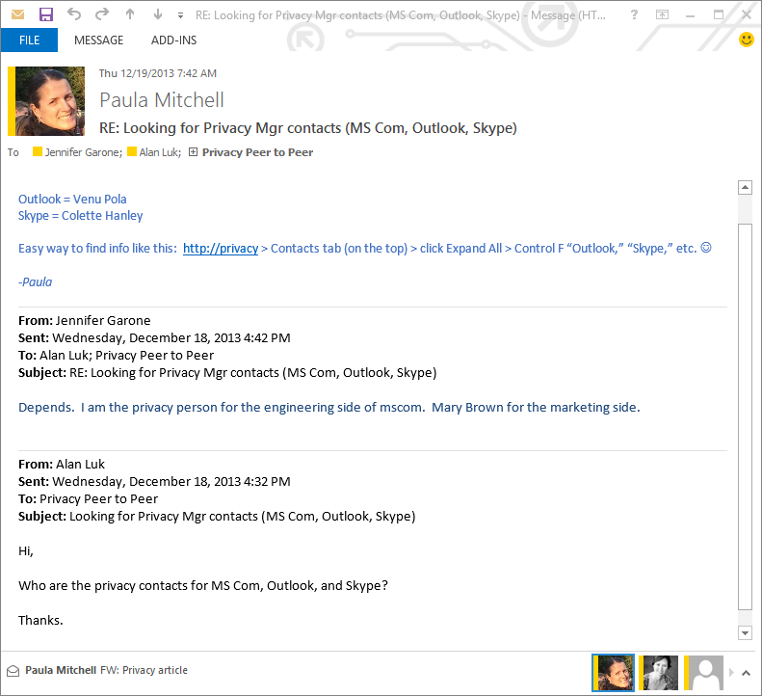
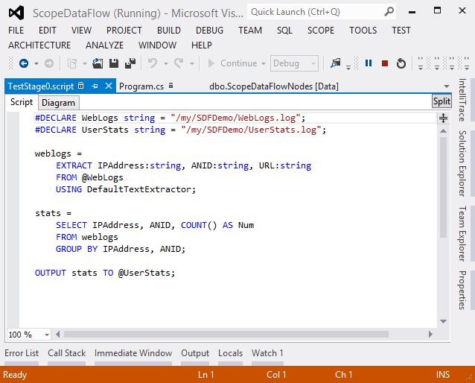
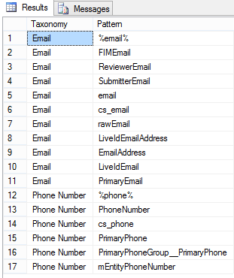
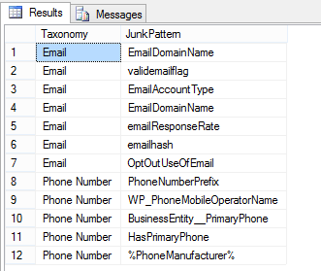
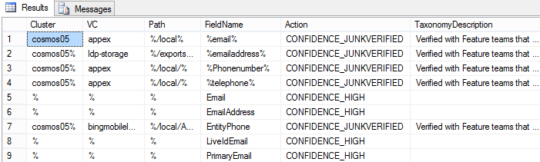
Nightly
Compliance Process
-- DENY DataType UniqueIdentifier WITH PII InStore BingStore
SELECT *
FROM (SELECT * FROM Report
WHERE Taxonomy='ANID' AND Confidence>='High') AS ID
INNER JOIN (SELECT * FROM Report
WHERE TaxonomyGroup='PII' AND Confidence>='High') AS P
ON ID.VC = P.VC
Positive Patterns
(40 Taxonomy values, 400 patterns)
Negative Patterns
(2500 total entries)
Dataset A
Dataset B
Dataset D
Dataset G
FIMLast
Name
LiveIdAge
ss_user_ip
M_ANID
Read Dataset D
Read Dataset G
Process 1
Process 4
…
…
MCMUID
Dataset H
Dataset C
LocIds
Dataset I
msnANID
Transform Data
Process 2
Process 5
…
…
Granular Overrides
(116 total entries)
csts
Dataset J
Dataset E
Dataset F
UserAnidDB
Write
Dataset H, I
msMUID2
Process 3
Process 6
…
…
Static code analysis
Generate report
Manual
Audit
privacy
elements*
300K+
audit
candidates
10K+
teams
8
audit
items
1K+
schemas
2M+
files
25M+
32
Notes:
The 10K to 1K reduction comes from clustering similar potential violations. e.g., consider that on day X some data was accessed from X-300 constituting a potential data-retention violation. Since these accesses are performed as part of some automated pipeline, on day X+1, we will see an access for data from X-300+1, and so on for each day being audited.
(We typically audit a sliding window of 15 days)
Each of these accesses would count as a separate audit candidate, but since they are part of the same pipeline we can treat them as a single item to be audited.
(We identify they are part of the same pipeline automatically based on similarities in the files being accessed and the user/service-account accessing them, etc.)
This yields a reduction from 10K to around 1K.
From the 1K items, the audit team filters out cases already audited in the past (automated), sorts them by priority (manual), identifies the best team to contact (i.e., the team that produced the data implicated in the violation or the team that consumed it; manual), aggregates them by teams (automated), and then contact the top X ranked teams subject to their audit workload. We had some thoughts on a relevance/ranking algorithm to automate more of this 1K->8 workflow, but the audit team felt those developer cycles were better spent improving label confidence further up the pipeline.

Slide 33
A Streamlined Audit Workflow
Legal Team
Crafts Policy
Privacy Champion
Interprets Policy
Encode
Refine
Legalease
A formal policy specification language
Grok
Data inventory with policy labels
Legalease
Policy
Grok
Data inventory with policy labels
Annotated
Code
Checker
Code analysis
Update Grok
Potential violations
Developer annotations
Developer
Writes Code
Audit Team
Verifies Compliance
Fix code

Slide 34
A Streamlined Audit Workflow
Legal Team
Crafts Policy
Workflow for privacy compliance
Legalease, usable yet formal policy specification language
Grok, bootstrapped data inventory for big data systems
Scalable implementation for Bing
Privacy Champion
Interprets Policy
Encode
Refine
Legalease
A formal policy specification language
Grok
Data inventory with policy datatypes
Annotated
Code
Legalease
Policy
Checker
Update Grok
Potential violations
Code analysis, developer annotations
Developer
Writes Code
Audit Team
Verifies Compliance
Fix code
Notes:
The first piece of our workflow is best explained through an example.

Slide 35
Reference
S. Sen, S. Guha, A. Datta, S. Rajamani, J. Tsai, J. M. Wing, Bootstrapping Privacy Compliance in Big Data Systems, in Proceedings of 35th IEEE Symposium on Security and Privacy, May 2014.

Slide 36
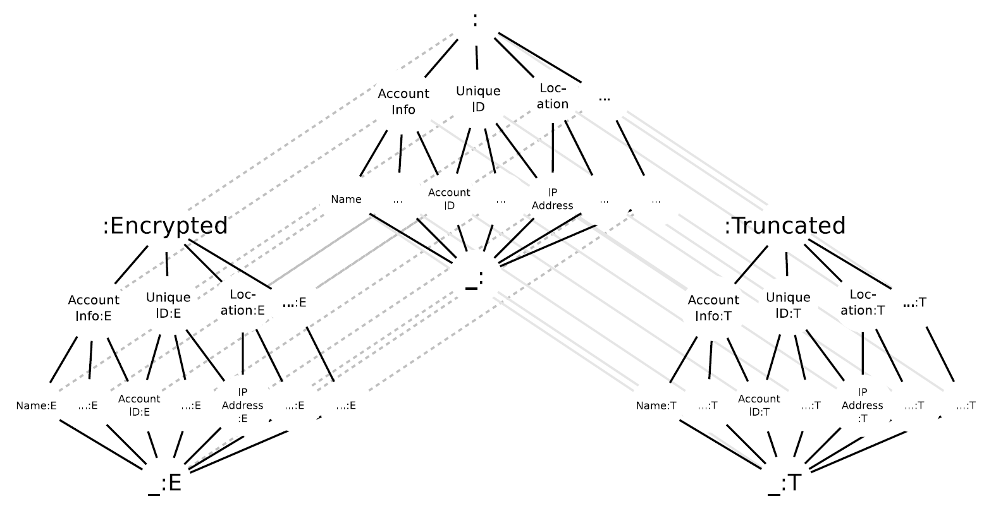
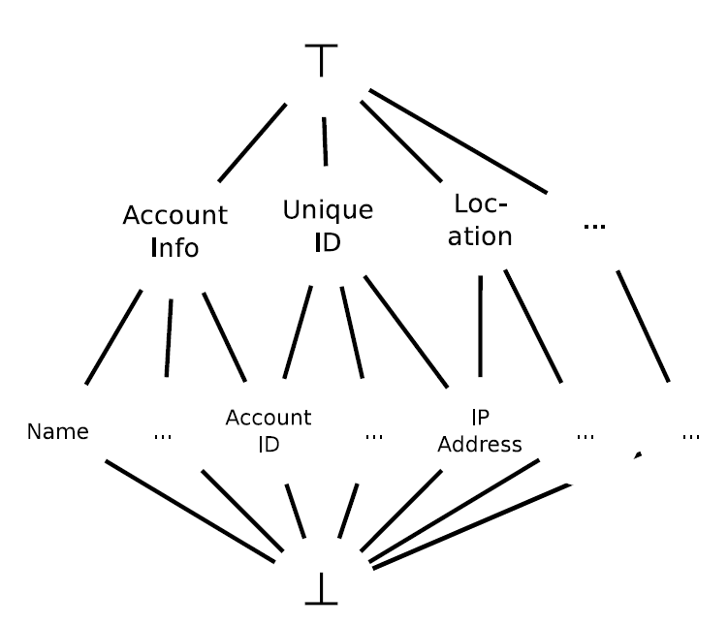
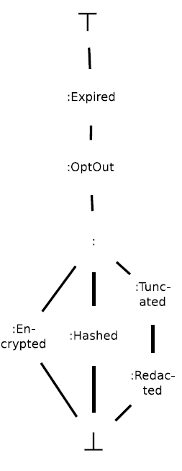
Policy Labels : Datatypes
Going down within a lattice : finer specification
TypeState specifies limited temporal properties

Slide 37
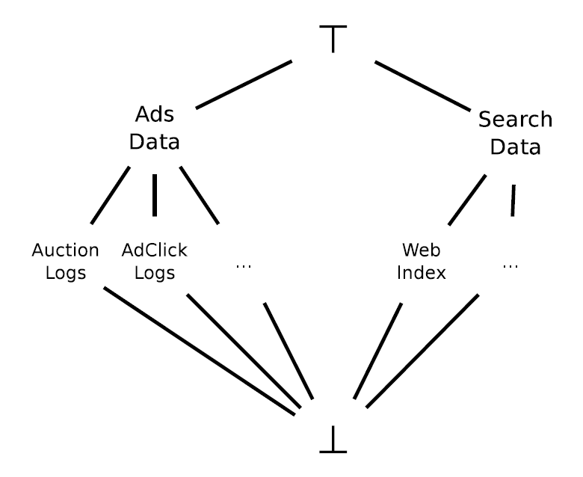
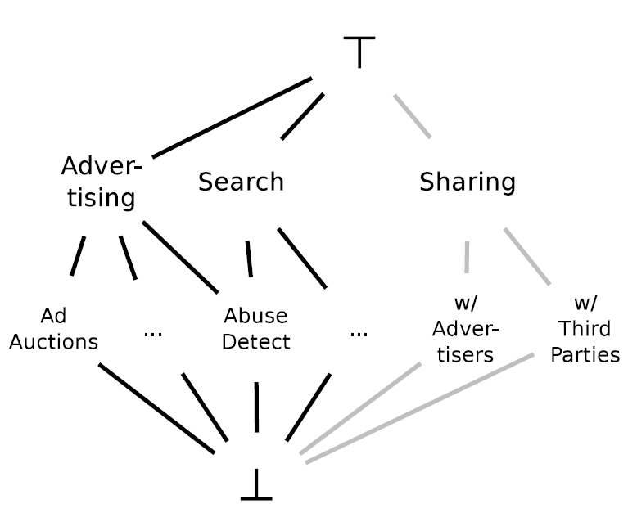
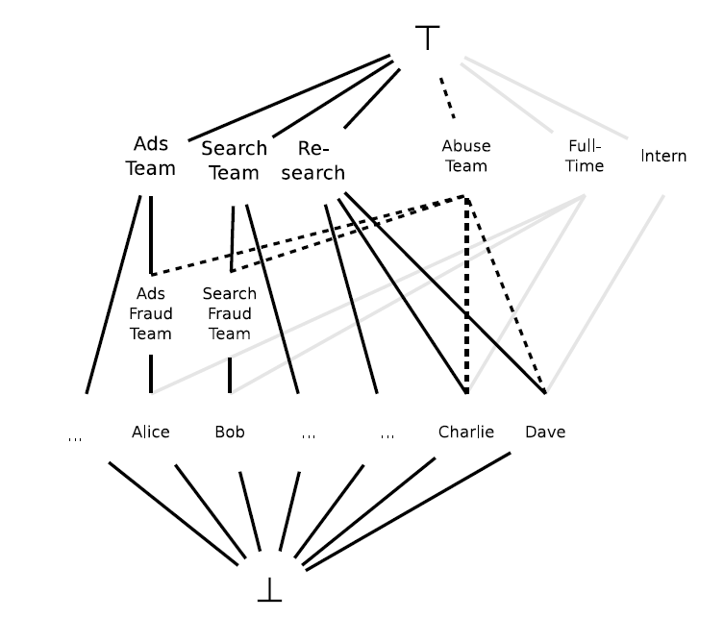
Policy Types : Concept Lattices
InStore Lattice
UseForPurpose Lattice
AccessByRole Lattice
Notes:
Legalease policies are specified in terms of policy types. Each policy type is an instantiation of a lattice.

Slide 38
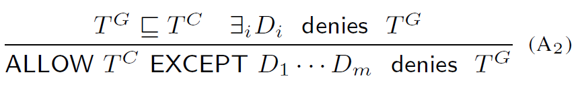
Formal Semantics
Based on Lattice Orderings on Policy Types

Slide 39
Formal Semantics
Recursively check exceptions
  ALLOW clauses have DENY clauses as exceptions
  Top Level clause determines Blacklist/Whitelist

