Slide 1
Group 13: Interactive Art
Nick Gullapalli, Akash Katipally, Xinwu Yang, Solomon Sia

Slide 2
Project Concept, Motivation
Have a interactive project that people will stop what they are doing and use the project
Have an artistic element in the project by the usage of LED Lights.
We looked at this dandelion art project where the users were able to spread the petals of the dandelions by blowing the dandelions and new dandelions will show up.
Have multiple users interact with the project
Have it look cool!!!

Slide 3
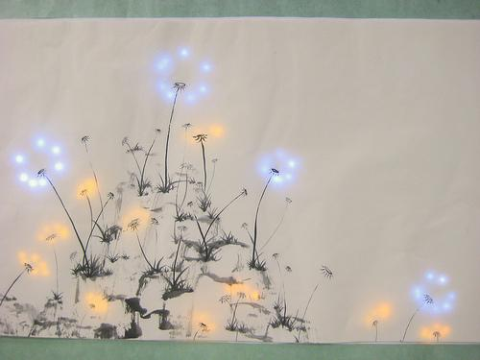
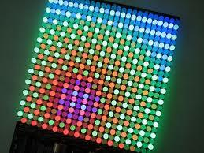
Competitive Analysis
(http://hlt.media.mit.edu/?p=2286) - Dandelion Painting LED Display
http://www.adsavvy.org/diy-open-source-programmable-led-signs-with-the-peggy-2/
http://www.youtube.com/watch?v=CIzLd8zRwXw - Interactive Mcdonalds Billboard
http://www.youtube.com/watch?v=codg9An9HLw - MSP Traveler's Insurance Advertisement

Slide 4
Requirements
Fully Programmable LED array.
User interactivity through touch sensors/ computer inputs.
Large size and visibility.
Must look beautiful
Must be able to do various games

Slide 5
Technical Specifications
500 RGB LEDs (20x 25 grid)
Arduino Mega
30 Touch Sensors
Misc Batteries, Transformers
Hard material
-Wires, Board, Frame, Rice Paper

Slide 6
Architecture
LEDs throughout the board
Touch Sensors
Humans
Computer

Slide 7
Anticipated Risks and Mitigations
Electrical wiring can go terribly wrong
Unable to control large amount of RGB LEDs (Reduce the size of the board unfortunately)
Help from the audience: How can we achieve controlling of mass LEDs by
a microcontroller ?
Too much power usage
Some games might be not feasible
Interaction is not perfect between the sensors and the person.

Slide 8
Suggestions/Feedback/Criticism?

