Slide 1
Bbacksafe Breathalyzer Car Key
Team 13
Andrew Chung (afchung)
Frank Zhou (jifuz)
Charlie Xu
May Zhai
Note: No underage subjects were involved in alcohol testing

Slide 2
Status Update
Done With:
Bluetooth programming – Arduino-Arduino (master-slave)
Bluetooth programming – Arduino-Android (master-slave)
Android application – GPS and SMS functionality
Refining ignition starter circuit
Wind sensor calibration
Battery and circuit power configurations
Mainframe for Arduino final demo code
Made various attempts on alcohol sensor calibration
Working On:
Further calibration of alcohol sensor
Finishing Arduino final demo code (after alcohol sensor calibration)
Packaging final product
Possible integration with car, if facilities management approves

Slide 3
Graphs (Metrics and Implications)
Arduino-Android and Arduino-Arduino Bluetooth connection time:
Time for Bluetooth connection to establish, an element in system delay
Connection time in milliseconds (X axis) to frequencies of occurrence (Y axis)
Testing time vs Arduino reading based on Voltage graph for wind sensor:
Higher the reading, harder the breath
Graph used for sensor calibration
7 trials of 5 second breaths over a time of 140 seconds read in 200ms intervals
Experimental time in sec (X axis) to voltage based reading by Arduino (Y axis)
Time for wind sensor to detect the peak Arduino reading per breath:
Time to detect the peak reading of wind sensor for each breath (X axis) to frequencies of occurrence (Y axis)
Graph used for setting thresholds for breath intensity detection

Slide 4
Graphs (Metrics and Implications)
Time for alcohol sensor to detect the peak Arduino reading per breath:
Graph used to indicate how long user should breathe into device for sensor to detect a peak in alcohol concentration
Time to detect the peak reading of alcohol sensor for each breath (X axis) to frequencies of occurrence (Y axis)
Alcohol sensor reading for each approximated BAC value:
Higher the reading, higher the concentration of alcohol
Graph for sensor calibration and for setting thresholds used in starting cars
Approximated BAC (X axis) vs voltage based reading by Arduino (Y axis)

Slide 5
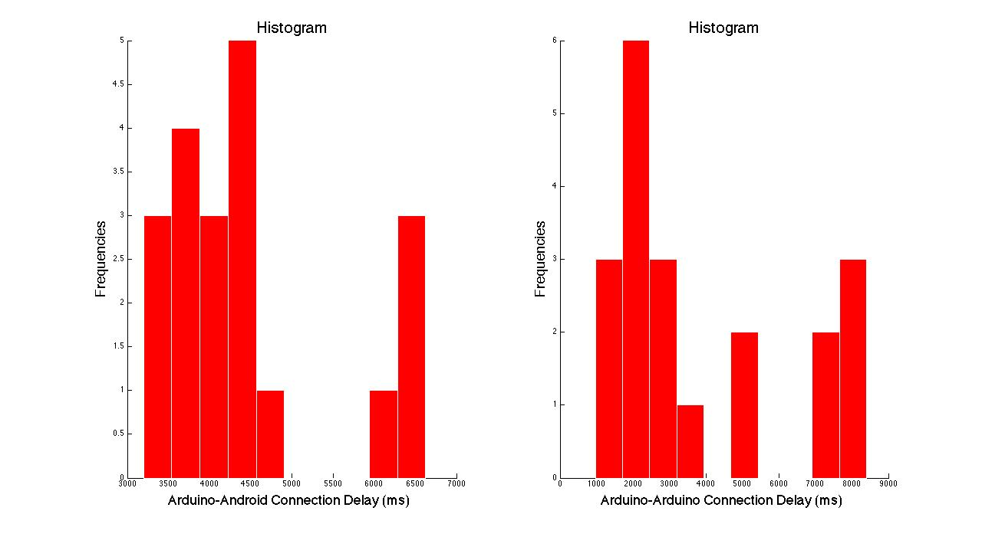
Bluetooth Functionality
Arduino-Android—trials: 20, avg: 4491.5 ms, std: 1077.4 ms
Arduino-Arduino—trials: 20, avg: 3809.6 ms, std: 2565.5 ms

Slide 6
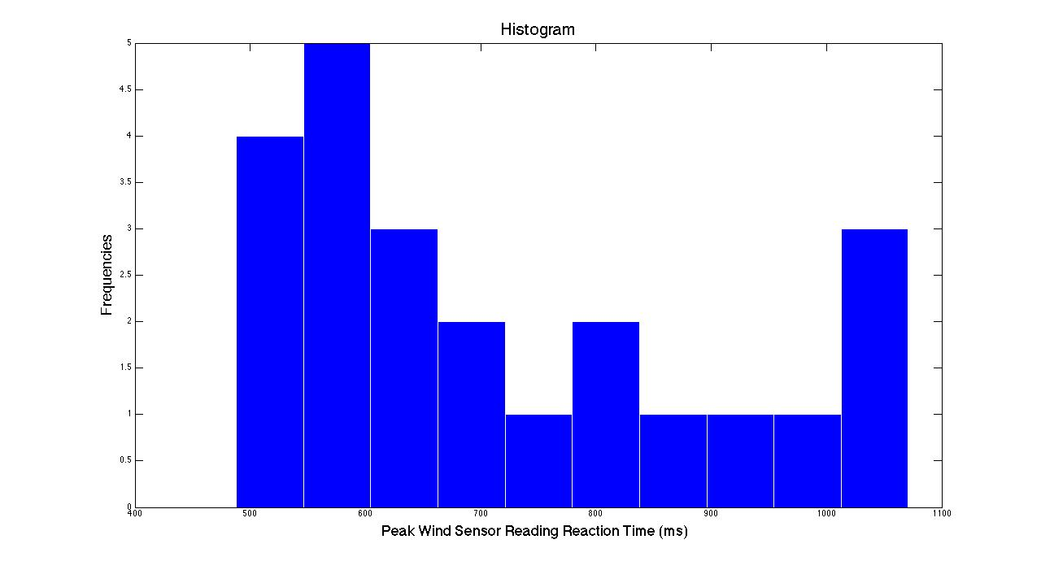
Modern Device Wind Sensor Functionality
Peak time—trials: 23, avg: 716.48 ms, std: 186.87 ms

Slide 7
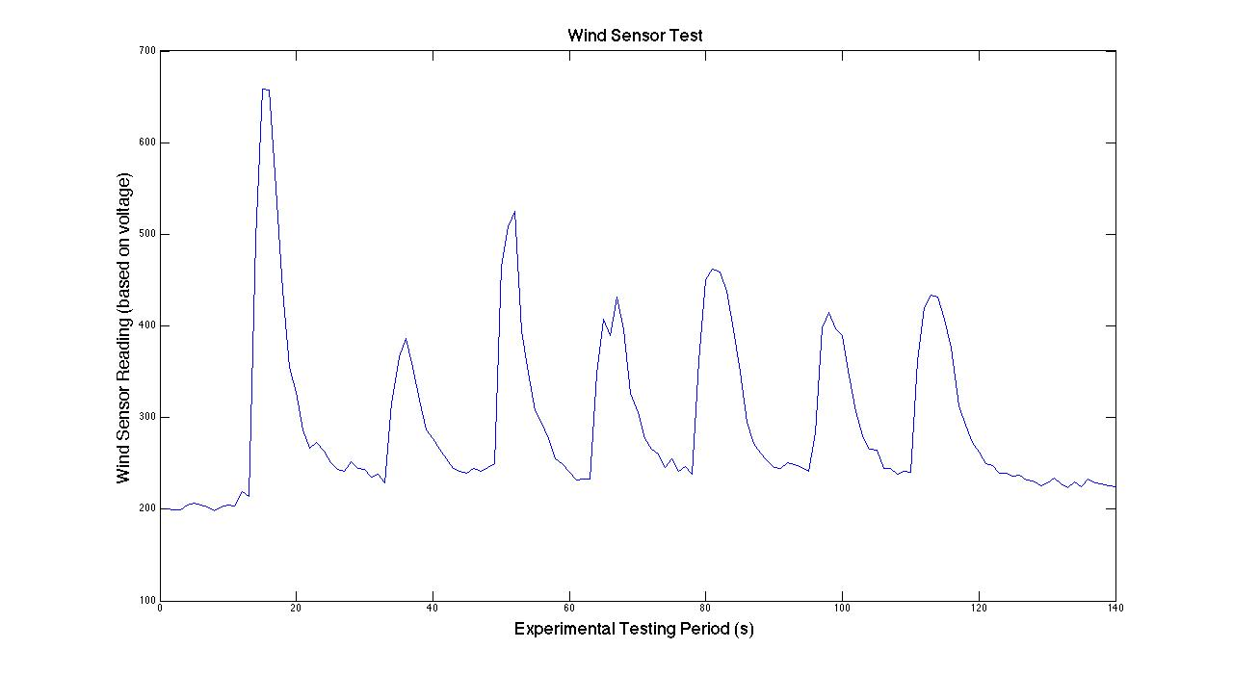
Modern Device Wind Sensor Functionality
5 sec breath—trials: 7 trials, stable reading range: [199, 246], lowest reading jump from stable: 101 (to 357).
Threshold: 50+highest stable reading value

Slide 8
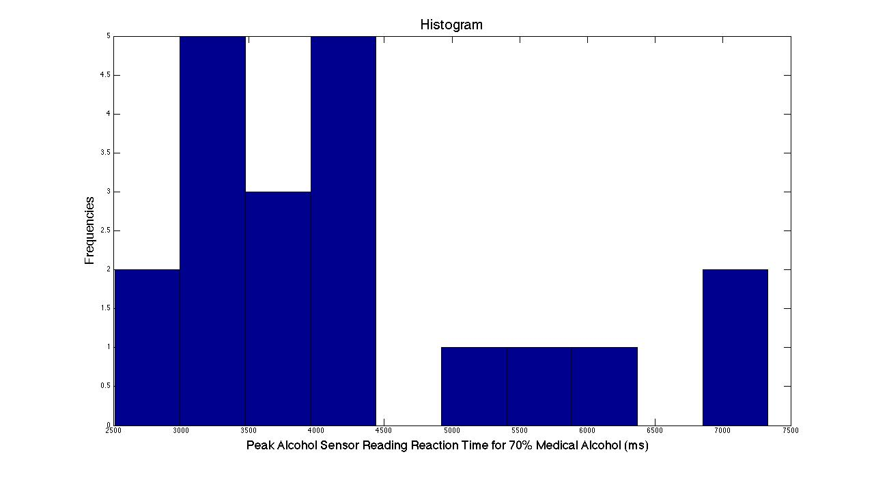
MQ-3 Alcohol Sensor Functionality
Peak alcohol sensor reading reaction time—trials: 20, avg: 4233.1 ms, std: 1366.1 ms

Slide 9
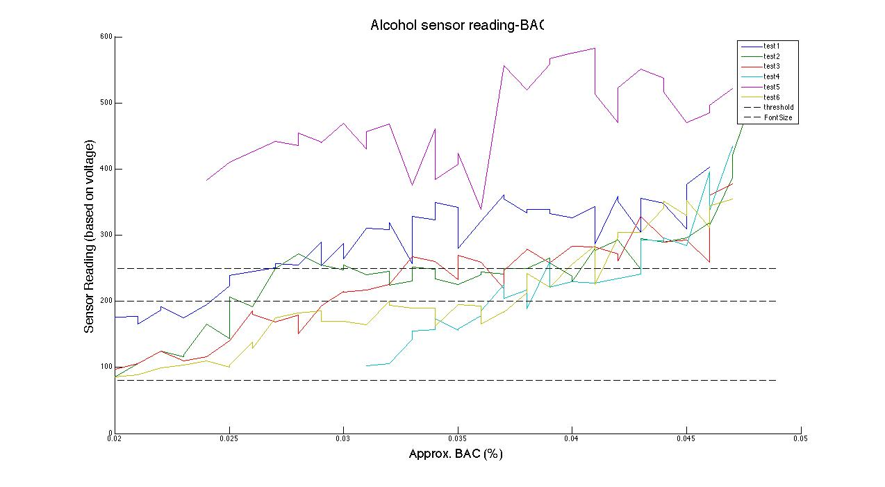
MQ-3 Alcohol Sensor Functionality
6 Independent trials: 250~300 breaths.
Fixed distance and fixed time breath, air-conditioned lab
Proposed “reasonable” threshold: 200 for .025~.030%, 250 for .030~.035%
Zero tolerance threshold: 60~80, but somewhat harsh
Intuitive discernable trend, but too much noise

Slide 10
MQ-3 Alcohol Sensor Problems
Tried out another “better” sensor MR513 and similar sensor TGS 822
MR513 not sensitive enough in addition to long delay time
TGS 822 functions basically the same way
Fuel cell sensors out of price range (not including shipping costs), and most require special orders from outside of the country.
Takes about 104 seconds to startup and stabilize (5 trials)
Lowering/unstable sensitivity
Testing out/burning in a new sensor
Bottom line: Set a “zero tolerance” threshold to ensure safety
Draining too much power
Product lasts for about 25 minutes
Sensor alone pulls ~150 mA of current

Slide 11
Lessons Learned
How to program Bluetooth devices
How to program on Android platforms
Systems integration skills
Product development schedules
Sensor interaction with microprocessors
Reality of working with sensors where noise in environment is an inherent factor of measurement
Behavior of hot-wire alcohol sensors are unstable which makes them hard to calibrate
AlcoKey produced by Saab costs $400 for a reason (fuel cell sensor), though ultimately still lacks support for other brand cars and Bluetooth functionality

