Slide 1
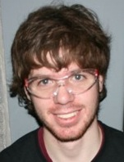
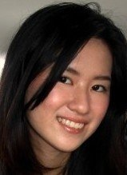
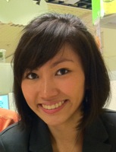
[18549] – 3D.R.AWe
YILING
TAY
ytay
YUMIN
WONG
yuminw
MIKE RALPH
mralph
RYAN
CAHOON
rcahoon

Slide 2
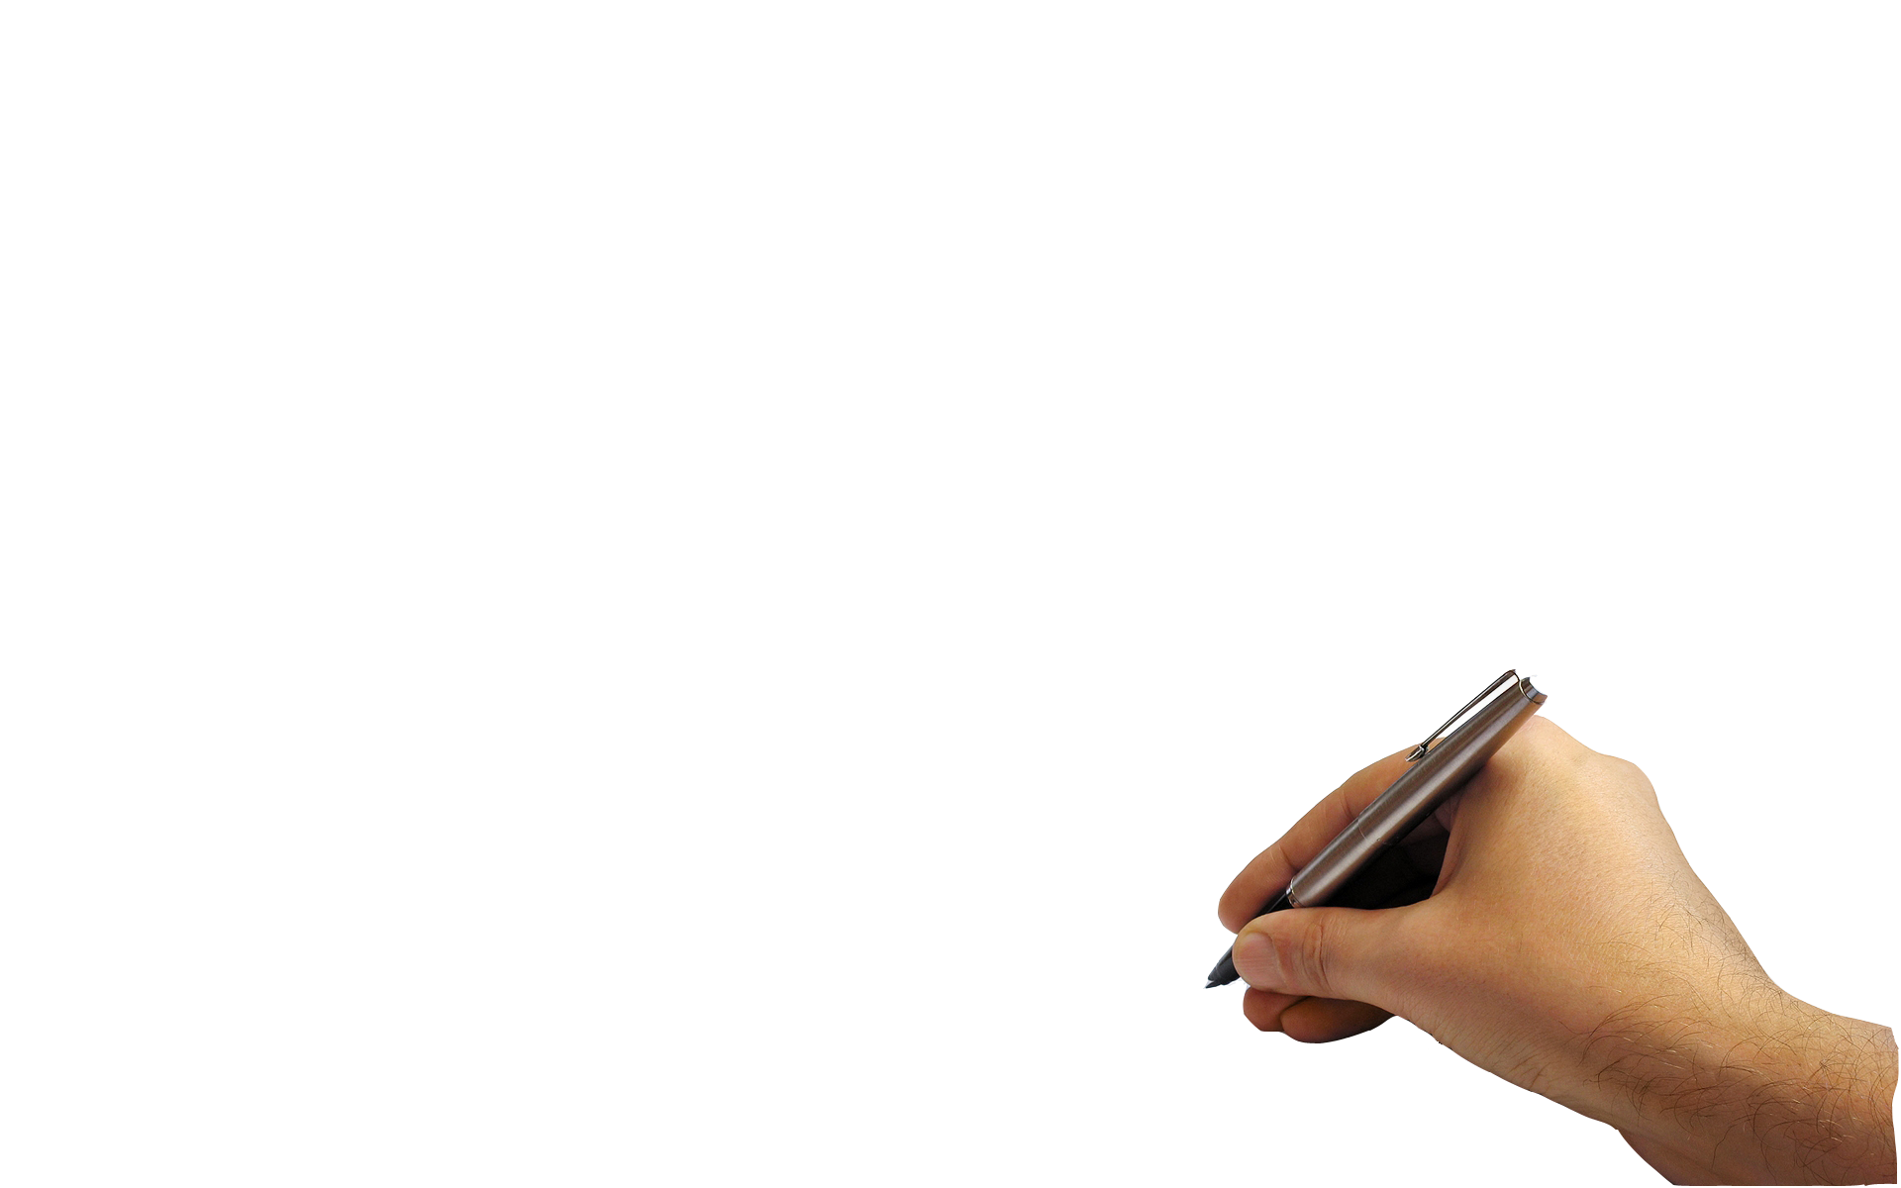
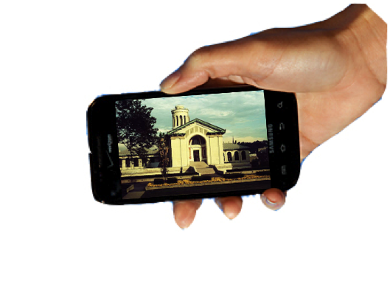
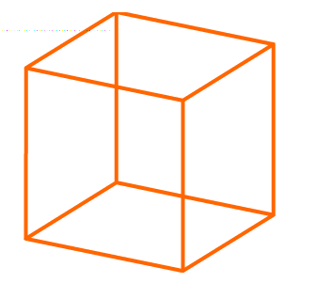
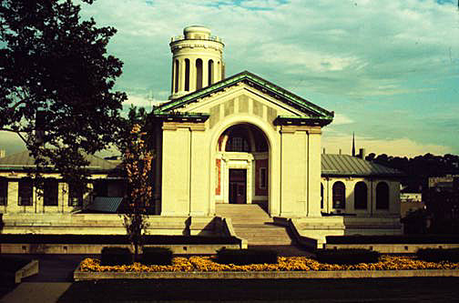
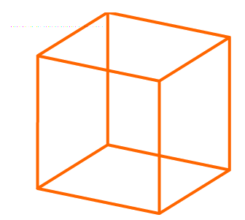
Concept and Motivation
WHAT?
WHY?
This project will allow users to view and add virtual 3D objects embedded in reality via their mobile phones – idea can be expanded for many applications.
The prototype integrates smart phones with graphics technology to create a 3D presentation tool.
People today have the chance to experience augmented reality through current smart phone apps but they are usually fixed in content and non-interactive.
Using our prototype system, the user is in control of a rich and collaborative multimedia environment.

Slide 3
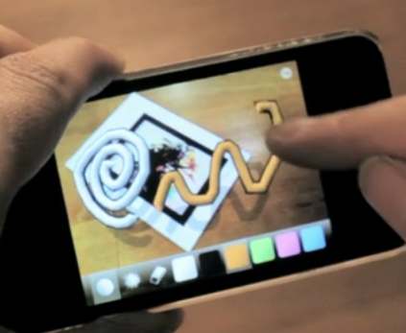
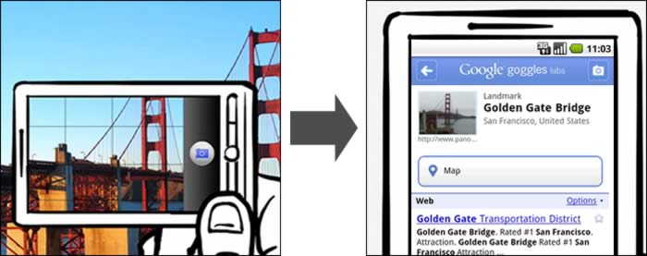
Competitive Analysis
StreetMuseum
Google Goggles
Scrawl
StreetMuseum is an iPhone app that allows you to browse historical photographs in various parts of London in real time.
Our prototype differs in that we are able to add to the existing virtual objects, as well as view the objects in 3D.
Google Goggles is visual search app for Android phones that allows you to search for text/landmarks/books/contact info… based on what is within the frame of reference on your phone.
Our prototype differs in that we can add objects in real time, and view from all angles.
Scrawl is an iPhone app that allows for 3D spatial drawing in augmented reality. The user can move the object to draw at different angles.
Our prototype differs in that we allow for collaboration amongst various users.

Slide 4
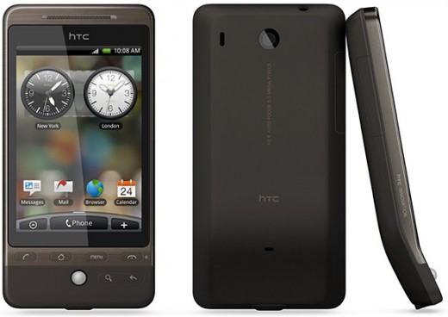
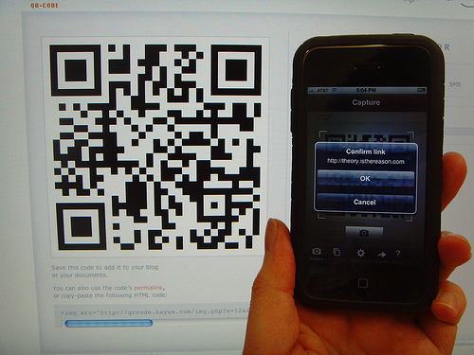
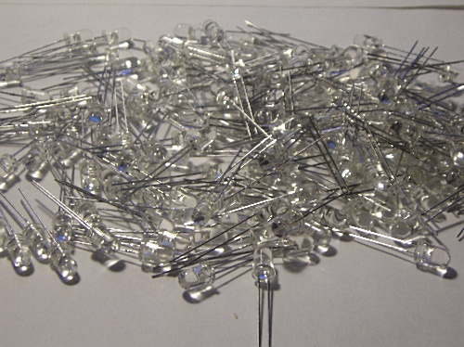
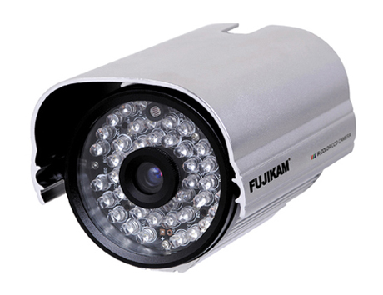
Technical Specifications
Communication
Viewing & Sensing
Local Server
Android phones
QR Codes
Android phones
Drawing Detection
IR Camera
IR LEDs

