Slide 1
[18549] – 3D.R.AWe
YILING
TAY
ytay
YUMIN
WONG
yuminw
MIKE RALPH
mralph
RYAN
CAHOON
rcahoon
Team 5

Slide 2
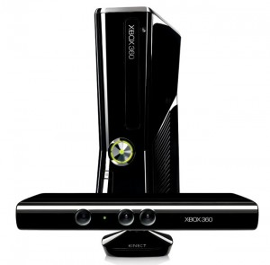
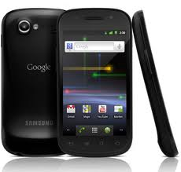
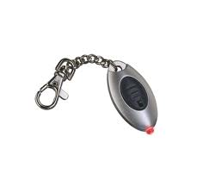
Status Update
3D augmented reality tool
CHANGES: Kinect instead of IR cameras and sensors
KINECT
ANDRIOD
LED

Slide 3
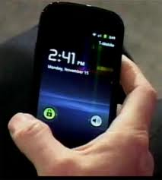
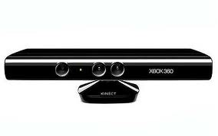
Architecture
SERVER
WIFI
SERIAL CABLE
PHONE
KINECT

Slide 4
Use Cases
Starting up the app: phone establishes a connection with a server
Viewing:
Phone detects orientation and position via QR codes
Phone communicates with the server and downloads object points
Phone does transformation and rendering of points
As phone is moved, object is retransformed based on orientation
Drawing
Kinect is linked to server with serial cable
As user draws in space, kinect sends information to the server, and is stored in local space coordinates
Loading a 3D object
Points can be loaded into the server directly

Slide 5
Risks and Mitigation
RISKS
SOLUTIONS
Limit the number of objects by using a queue
Interpolation and compression algorithms
Store recent objects on the phone, and backup server info at set intervals
Have threshold for number of points based on phone
Overload of users drawing simultaneously
Bad wifi connection
Server crashes
Limited processing capability on certain phones

