Slide 1
ScouTrak
Team:
Jesse Salazar
Rajeev Sharma
Mitch Luban
Owen Jarrett

Slide 2
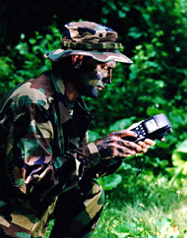
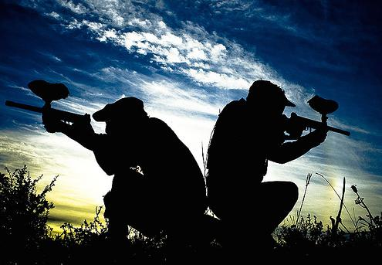
Concept & Motivation
A mounted display indicating location of important objects
Attached via arm band or gun mount
Objects such as friends, enemies, and field items
Possible items: UAV, enemy radar jamming etc.
Tracks objects by periodically polling RSSI
Accuracy of 5-6 feet, hopefully better
Polls every 0.5-2.0 seconds to save power
Minimum of three base stations to triangulate location
More base stations -> better accuracy
Density will not effect tracking accuracy
Uses
Paintball
Military training
Laser Tag

Slide 3
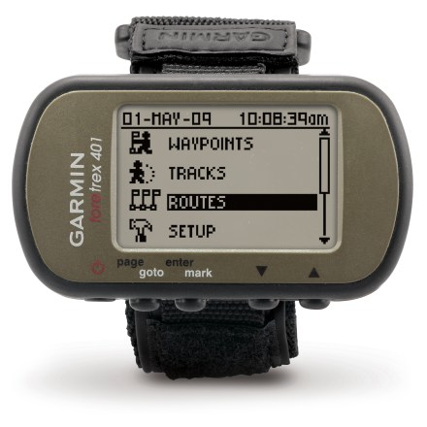
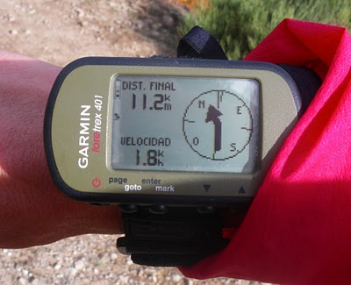
Competitive Analysis
Garmin Foretrex 401 Armband GPS
Not as accurate, not as fast:
Relies on satellite, cloud condition, etc.
Requires continuous satellite data tunnel
Doesn’t receive input from field items!
Doesn’t integrate any game functionality (only gps)!
Basically: Not
even close!

Slide 4
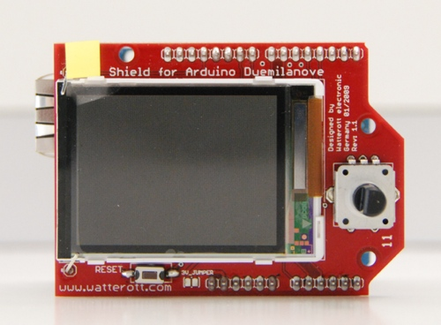
Technical Specifications
RSSI Protocol: ZigBee
Base Station Hardware:
Arduino Mega
XBee Pro 2.5, 50 mW
Large Antenna
Xbee Shield
Client Hardware:
Arduino Uno
XBee Pro 2.5, 2 mW
Antenna
XBee Shield
Color LCD Shield

