Slide 1
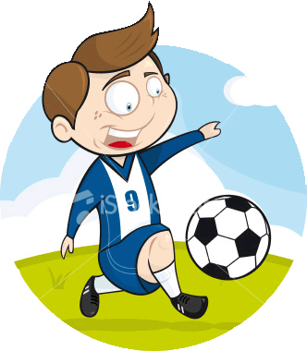
Super Sweet Kicks
Jes Liao, Matt Wagner, Tom Cherry, Seth Rosenblum

Slide 2
Project Concept & Motivation
Project Concept
There are multiple ways to kick a soccer ball.
Some of these ways are incorrect given the situation.
We want to provide feedback to kids in a friendly, easy-to-understand way in order to allow them to improve.
Motivation
We'd like to help kids learn to kick a soccer ball correctly without the emotional anguish they experience after being screamed at by a coach.

Slide 3
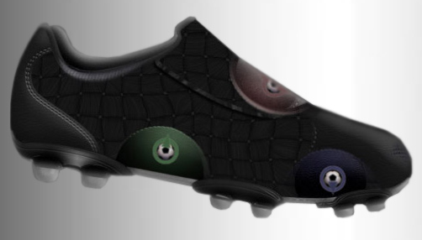
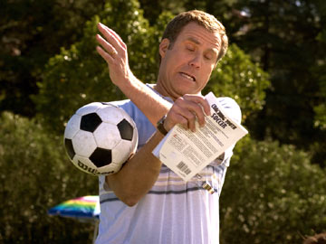
Competitive Analysis
KIXTAR Instructional Soccer Shoes
Designed to teach kids how to cross, pass and shoot with precision
Not available for individual purchase yet
Only indicates where the soccer ball should be kicked, not if the kid actually kicked it there
Instructional videos
Difficult to watch-and-learn at the same time
Screaming Coach
Can cause kid to be frustrated, discouraged, sad, upset

Slide 4
Requirements
Functional
Detect kicks on different parts of foot
Types of kicks: push pass, chipping, instep, etc.
Estimate velocity of kick
Behavioral
Provide light feedback to user based on kick
Lights varying from gradients of red (bad), yellow (satisfactory), green (sweet)

Slide 5
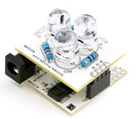
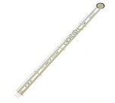
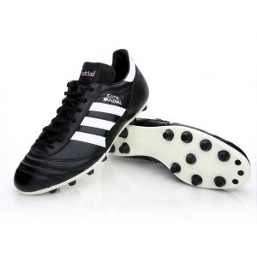
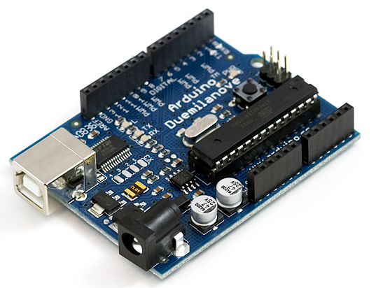
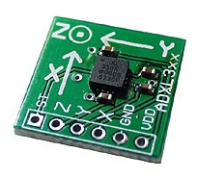
Technical Specifications
Arduino Duemilanove USB Board
Pressure Sensors
Accelerometer
Pair of soccer shoes
BlinkM I2C LED controller
USB Cable
Power Supply

