Slide 1
RTL through OS
B9
Reid Long, Teguh Hofstee

Slide 2

What are we building?
RISC-V Processor
  RV32I-AS
    Integer
    Multiplication and Division
    Atomic
    Supervisor
Kernel
  Pebbles Specification Microkernels
Architecture
  Single Core
  512 256 MB of DRAM
  2 Level, Hardware Walked, Page Table for Virtual Memory

Slide 3
The Journey

Slide 4
Architectural Simulator
Fully models the architecture the processor implements
Written in C
Kept up to date with the microarchitecture throughout project
Used to generate “golden” results for verification
EXTREMELY useful for validating and diagnosing software/hardware bugs

Slide 5
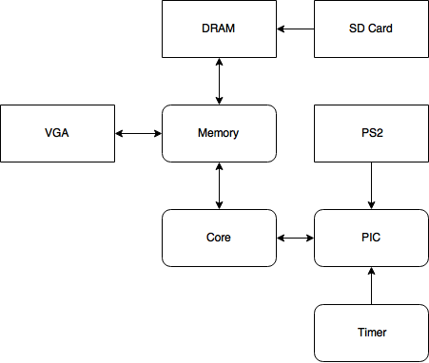
Processor Overview
Custom vs. Off-the-shelf
  VGA: Fully Validated
  DRAM: Fully Validated
  SD Card: Switched to ARM core
  PS2: Being validated
  Memory: Fully validated
  Core: Fully validated
    New features being added daily
  Timer: In progress
  PIC: In progress

Slide 6
Microarchitecture
Memory Management Unit
8 Stage Pipeline (IF1, IF2, ID, EX1, EX2, MEM1, MEM2, WB)
  Branch predictions resolve in EX2
  Data forwarding from EX1, EX2, WB
  27 Performance Counters
Atomic Instructions (Load Reserve/Store Conditional)
Multiplication/Division/Modulus
Not an ASIC on FPGA - Designed specifically with the Zedboard constraints in mind
Three Clock Domains (25Mhz, 50Mhz, 100Mhz)

Slide 7
Peripherals
VGA Display
  640x400 @ 72Hz
  Almost HD
  Full 7 bit color
  Full support of CGA colors
  Crisp Fonts
PS2 Keyboard
  Full keyboard support
  Arrow keys
  Automatic scancode translation
  IBM Personal System/2 Set 1 Scancodes

Slide 8
Software
Vivado
  Switched to TCL scripts instead of using the GUI
    Saved countless hours and suffering
Sophisticated Makefile
  Linking and compiling is a single make command (that took a week to get working)
Kernels
  Full support for C and Assembly kernels

Slide 9
Does it work?

Slide 10
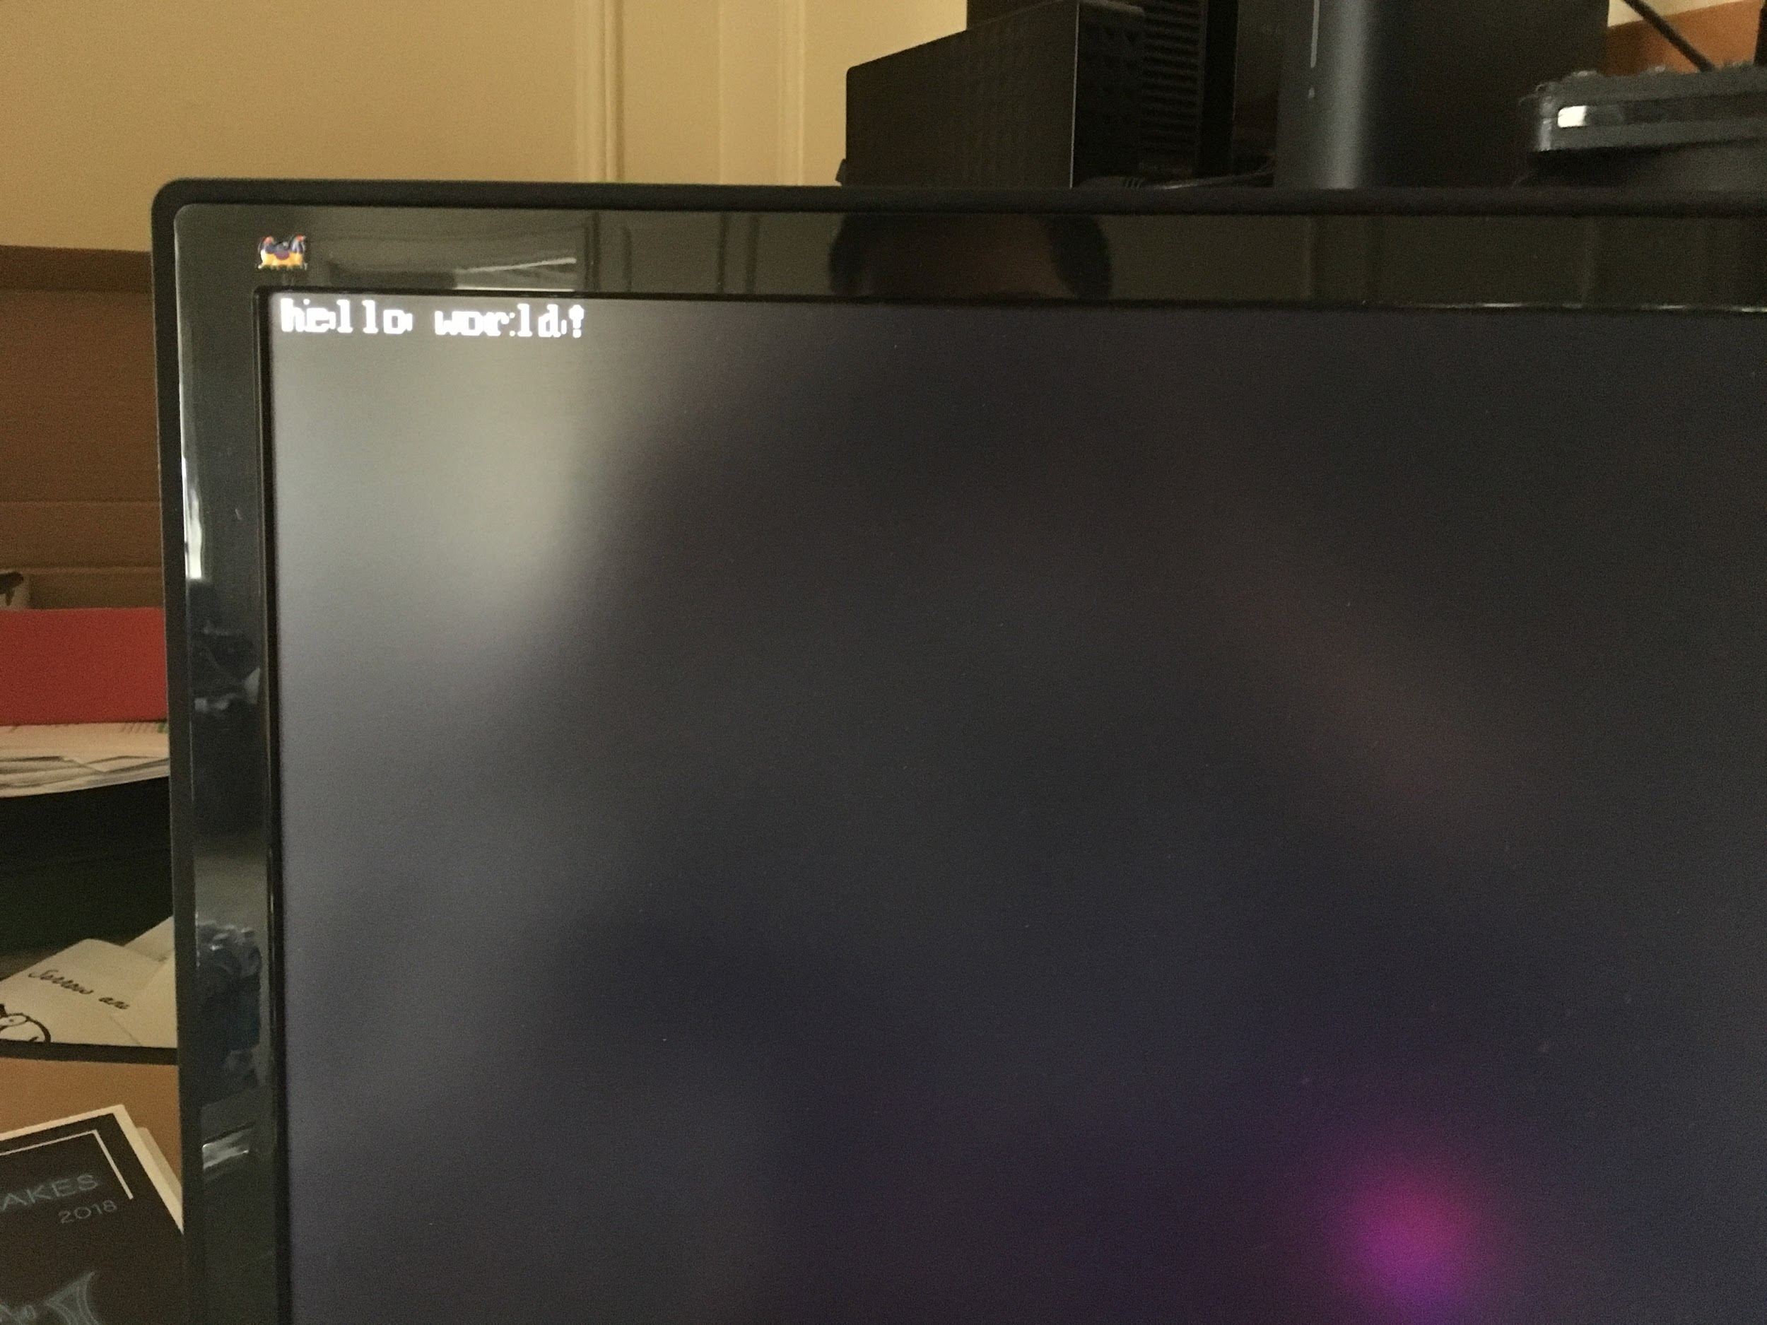
Hello World!
It only took 4.5 months!
“The proudest moment of my life”

Slide 11
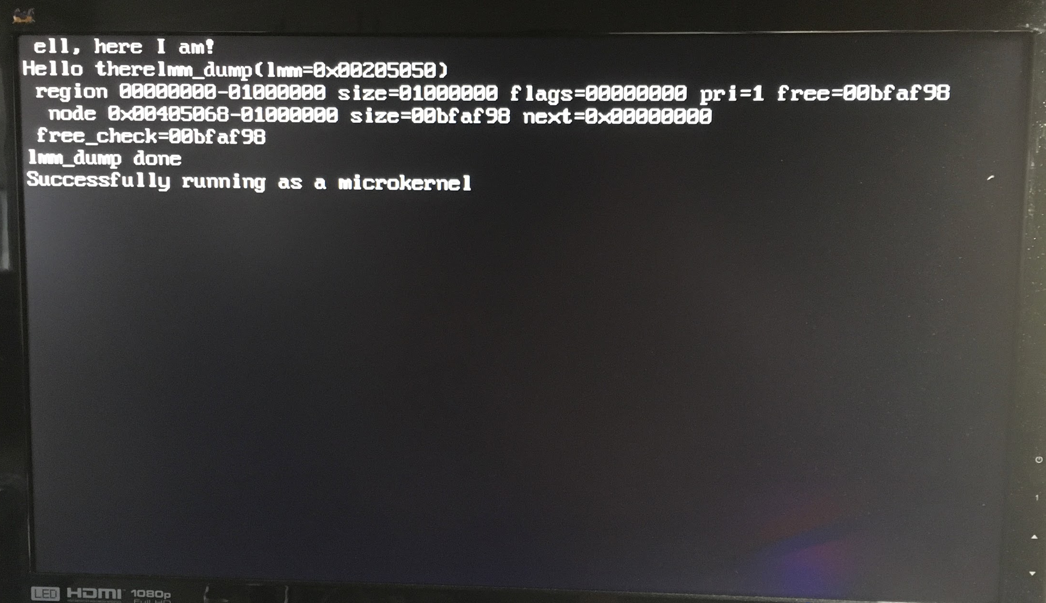
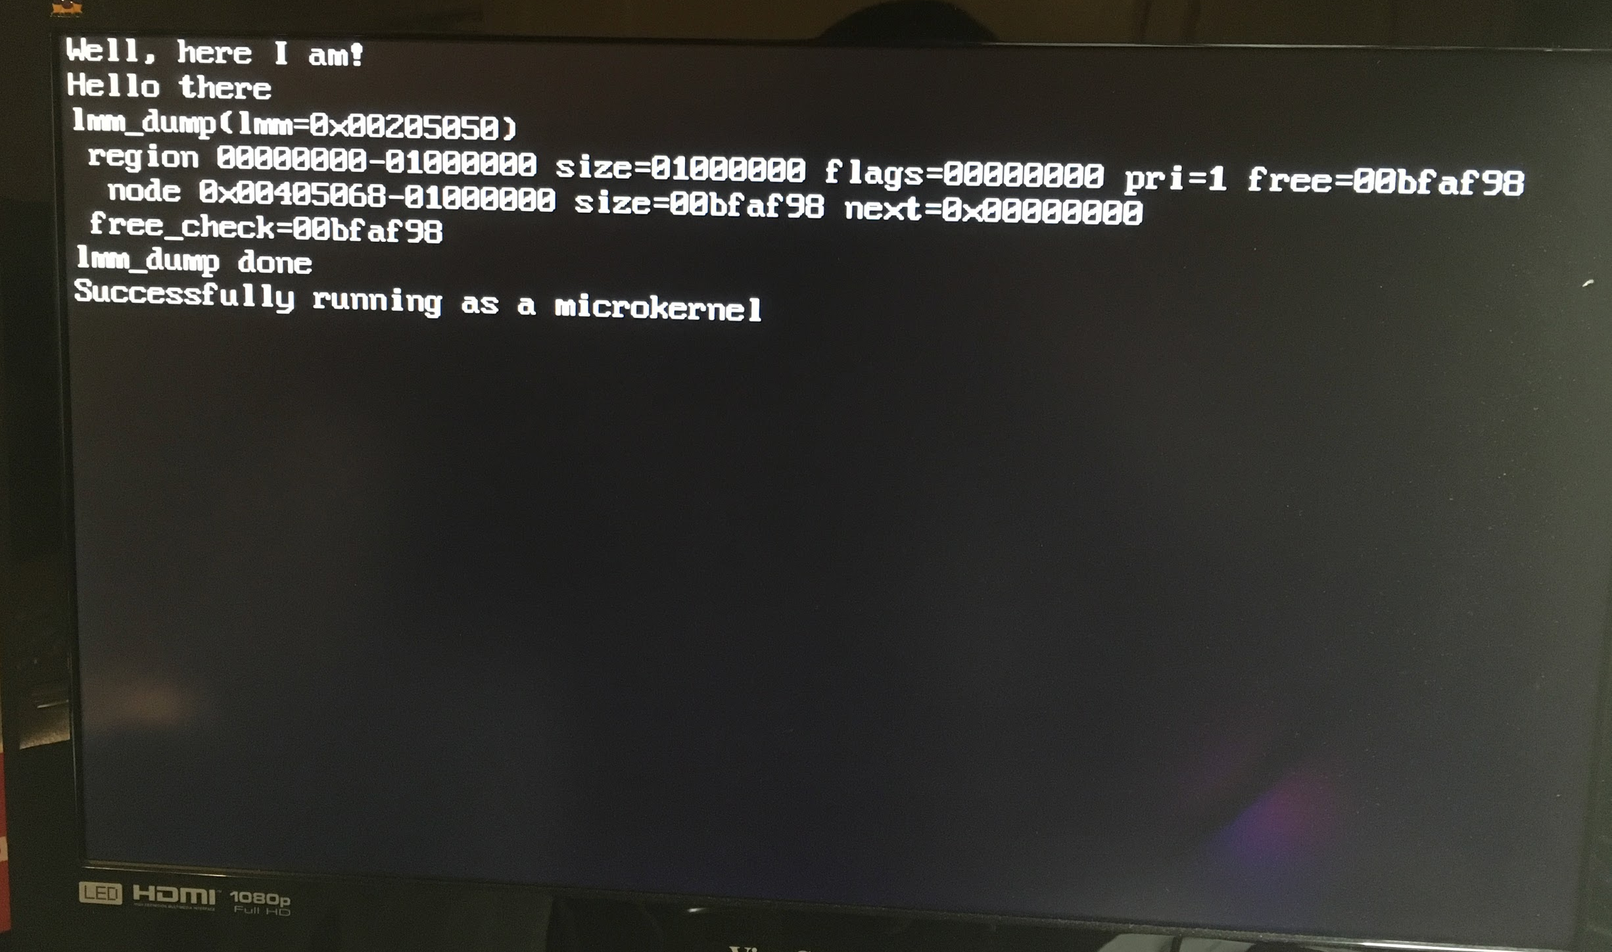
The Bug

Slide 12
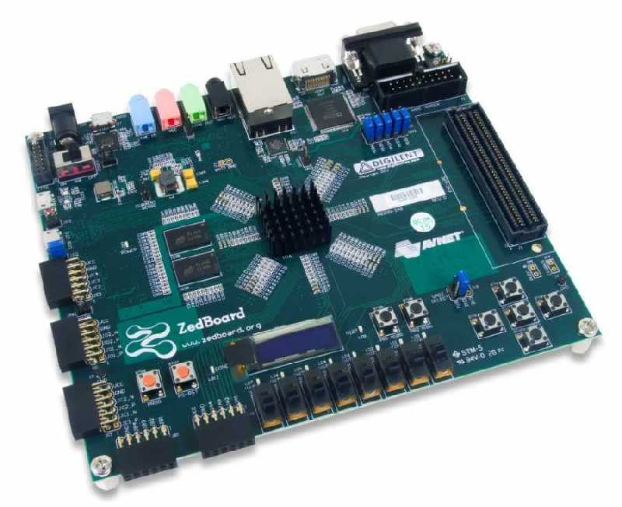
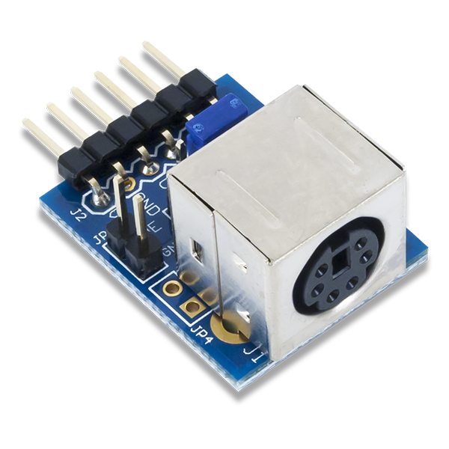
Platform
Hardware
  Zedboard ($0)
  PS2 Keyboard ($0)
  VGA Display ($0)
  PMOD PS2 ($8.99)
  PMOD SD ($9.99)
Software
  Vivado ($0)
  Architectural Simulator (Written by Us) ($0)
Minimum Needed
  Z-7014S or Z-7020 due to BRAM usage, if you shrink that we fit on a Z-7007S or Z-7010
  Zedboard: $475
  Other boards around $100-200 if you upgrade IO to more modern standards

Slide 13
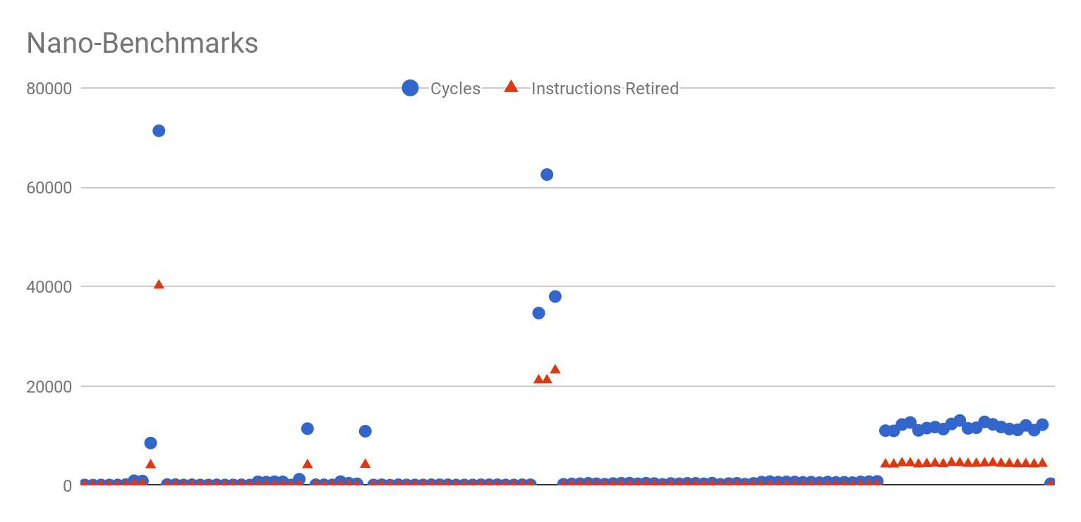
Performance Counters

Slide 14
System Metrics
Metric | Hypothesis | Actual
IPC | 0.70 | 0.39
Forward Branch Accuracy | 85% | 80%
Backward Branch Accuracy | 99.9% | 98%
Instruction Cache Hit |  | 98.9%
Data Cache Hit |  | 95%

Slide 15
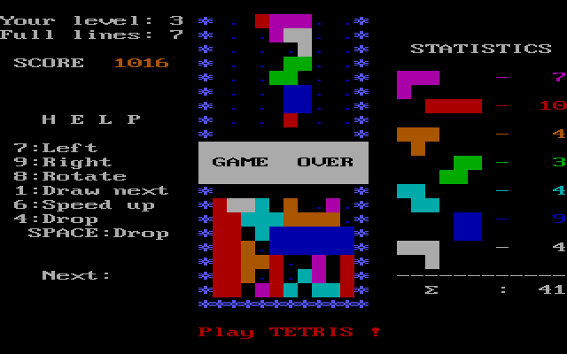
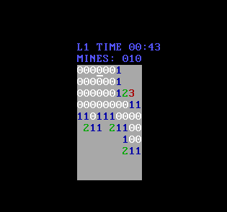
Demo
Play simple kernel game (Minesweeper, Tetris maybe more)
Write assembly/C program - Run it on the processor!
Look at cool performance counters!

Slide 16
Next Steps
Timeline
  Reid:
    Implement additional system instructions
    Implement timer interrupt
    Port Minesweeper
  Teguh:
    Validate PS2 driver
    Validate VGA color support
    Write kernel Tetris

Slide 17
Lessons Learned
Vivado GUI doesn’t work beyond small projects
  Use TCL scripting
Architectural simulators save lives
  The Pentium Chronicles guys had it right
DRAM controllers are extremely difficult to get working
  Plan ahead and anticipate ~6 person weeks of effort
Focus on a solid base implementation first, then add features
  We pivoted around spring break to focusing on super thorough validation and now it makes it very easy to add new features on a solid base
Memory controllers should permit multiple requests in flight
  If we would have had time, we would have rewritten the memory management unit since the critical path in the processor is the latency from BRAM (which we can’t fix in our current single-issue in-order model)

