Slide 1
Robust Speech Recognition in the 21st Century
Richard Stern
(with Chanwoo Kim, Yu-Hsiang Chiu, Evandro Gouvea,
Amir Moghimi, Anjali Menon, Bhiksha Raj, Rita Singh,
and many others)
Robust Speech Recognition Group
Carnegie Mellon University
Telephone: +1 412 268-2535
Fax: +1 412 268-3890
rms@cs.cmu.edu
http://www.ece.cmu.edu/~rms
18-491/691 Final Lecture
April 27, 2022

Slide 2
Introduction
Today is our last regular class (!)
I will begin with a few general remarks about 18-491/691
Most of the class will involve a discussion of DSP technologies to robust speech recognition

Slide 3
Some reminders
Take the final exam!
  Tuesday 5/3, 1:00 to 4:00 pm, HH B131
  Open book (but the book won’t be very useful in limited time; compiling notes is encouraged)
  Coverage through Problem Set 10
  MATLAB may be used for calculations, but not filterDesigner or other design algorithms
Regular office hours this week (with some modifications); NO recitation Friday
18-691 final project due Sunday evening 5:00 pm Gradescope
Quiz review Sunday evening 7:30 pm (use Recitation Zoom ID)
Complete the faculty course evaluations
  Do it for other courses, too!

Slide 4
Some of the big themes of 18-491/691
Multiple ways of representing signals and systems
  Time domain / sample response
  Difference equations (+ initial conditions)
  DT Fourier transforms
  Z-transforms (+ ROC)
  Pole/zero representation (+ gain)
Representation of signals in time and frequency
  Continuous time / discrete time
  Aperiodic / periodic

Slide 5
More big topics
Sampling in time
  Basic C/D and D/C conversion
  Change in sampling rate
The discrete Fourier transform (DFT) / sampling in frequency
  Circular v linear convolution
  Implementation of overlap-add and overlap-save algorithms
The Fast Fourier transform (FFT)
  FFT structures: decimation in time and frequency, non radix-2 FFTs
Implementation of filter structures for IIR, FIR filters
Digital filter design for IIR, FIR filters

Slide 6
Signal processing is very broad!
Some of the things I have worked on in my career:
  Musical sound synthesis and timbre perception
  Fundamental studies of auditory perception / binaural hearing
  Medical instrumentation (Eustacian tube sonometry)
  Signal processing for robust speech recognition
  Sound manipulation for medical transcription
  Detection and classification of brain activity for “silent speech”
  Music information retrieval
  Applications as a consultant in
    Low-bitrate vocoding (via phonetic analysis/synthesis)
    Reverberation suppression for stadiums
    Handheld translators and humanoid robots
    Expert witness testimony (clients range from startups to Apple/Dell/IBM/GM etc.)

Slide 7
Robust speech recognition
As speech recognition is transferred from the laboratory to the marketplace, robust recognition is becoming increasingly important
“Robustness” in 1985:
  Recognition in a quiet room using desktop microphones
Robustness in 2022:
  Recognition ….
    over a cell phone
    in a car
    with the windows down
    and the radio playing
    at highway speeds
Notes:
COMMENTS:
1. Sea change w DNNs. DNNs unquestionably improve WER w in-domain training; Limits
2. KB v statistically-based ASR

Slide 8
The source-filter model of speech production
A useful model for representing the generation of speech sounds:
Pitch
Amplitude
Pulse train source
p[n]
Vocal tract model
Noise source

Slide 9

Signal manipulation: separating excitation from acoustical filtering in speech
Original speech:
Speech with 75-Hz excitation:
Speech with 150-Hz excitation:
Speech with noise excitation:

Slide 10
The importance of frequency analysis
We produce and perceive speech and other sounds according to their frequency components:
An example …. sine waves and square waves

Slide 11
Building square waves from sine waves …

Slide 12
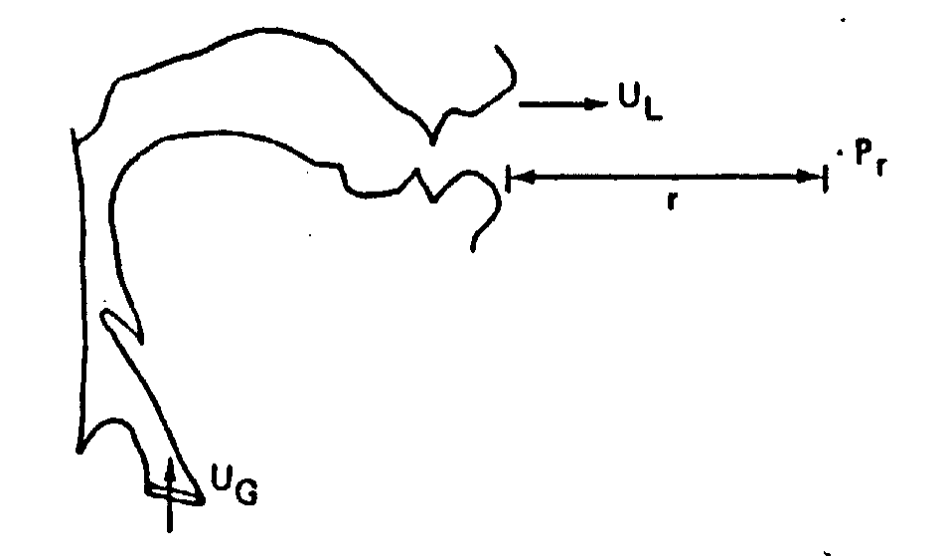
The anatomy of speech production
Important components:
  Sound production in lungs
  Shaping of sound by articulators

Slide 13
The vocal tract has its own resonant frequencies
Boundary conditions:
Glottis
Lips

Slide 14
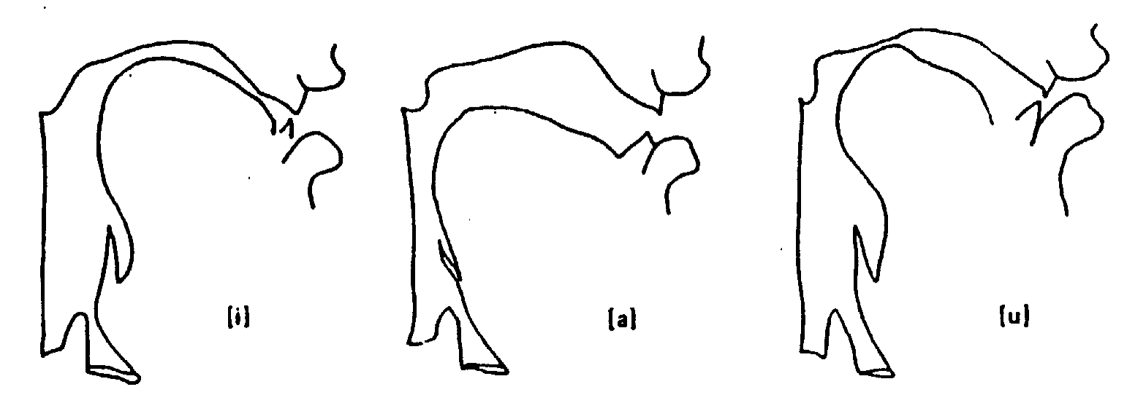
Vowel production in the vocal tract

Slide 15
Sound propagation through a more realistic non-uniform tube
Comment: Resonant frequencies now non-uniform
Glottis
Lips

Slide 16
Vowels are produced by changing the resonant frequencies of the vocal tract

Slide 17
Speech recognition as pattern classification
Speech features
Phoneme
hypotheses
Decision making
procedure
Feature extraction
Major functional components:
  Signal processing to extract features from speech waveforms
  Comparison of features to pre-stored representations
Important design choices:
  Choice of features
  Specific method of comparing features to stored representations

Slide 18
Robust speech recognition: what we will discuss
Review background and motivation for current work:
  Sources of environmental degradation
Discuss selected approaches and their performance:
  Traditional statistical parameter estimation
  Missing-feature/multiband approaches
  Microphone arrays
  Physiologically- and perceptually-motivated signal processing
Comment on current progress for the hardest problems
Notes:
Removing:
Combination of information sources
Signal separation based on scene analysis

Slide 19

Some of the hard problems in ASR
Speech in background music
Speech in background speech
“Operational” data (from RATS devset)
Spontaneous speech
Reverberated speech
Vocoded speech

Slide 20
Challenges in robust recognition
Additive noise combined with linear filtering
Transient degradations
Highly spontaneous speech
Reverberated speech
Speech masked by other speech and/or music
Speech subjected to nonlinear degradation
And ….. how does the emergence of deep neural networks change things?

Slide 21
Solutions to classical problems: joint statistical compensation for noise and filtering
Approach of Acero, Liu, Moreno, and Raj, et al. (1990-1997)…
Compensation achieved by estimating parameters of noise and filter and applying inverse operations
Interaction is nonlinear:
“Clean” speech
Degraded speech
x[m]
h[m]
z[m]
Linear filtering
n[m]
Additive noise

Slide 22
“Classical” combined compensation improves accuracy in stationary environments
Threshold shifts by ~7 dB
Accuracy still poor for low SNRs
Complete retraining
–5 dB 5 dB 15 dB
VTS (1997)
Original
CDCN (1990)
“Recovered”
CMN (baseline)

Slide 23
But model-based compensation does not improve accuracy (much) in transient noise
Possible reasons: nonstationarity of background music and its speechlike nature

Slide 24
Summary: traditional methods
The effects of additive noise and linear filtering are nonlinear
Methods such as CDCN and VTS can be quite effective, but …
… these methods require that the statistics of the received signal remain stationary over an interval of several hundred ms

Slide 25
Introduction: Missing-feature recognition
Speech is quite intelligible, even when presented only in fragments
Procedure:
  Determine which time-frequency time-frequency components appear to be unaffected by noise, distortion, etc.
  Reconstruct signal based on “good” components
A monaural example using “oracle” knowledge:
  Mixed signals -
  Separated signals -

Slide 26
Missing-feature recognition
General approach:
  Determine which cells of a spectrogram-like display are unreliable (or “missing”)
  Ignore missing features or make best guess about their values based on data that are present
Comment:
  Most groups (following the University of Sheffield) modify the internal representations to compensate for missing features
  We attempt to infer and replace missing components of input vector

Slide 27
Example: an original speech spectrogram

Slide 28
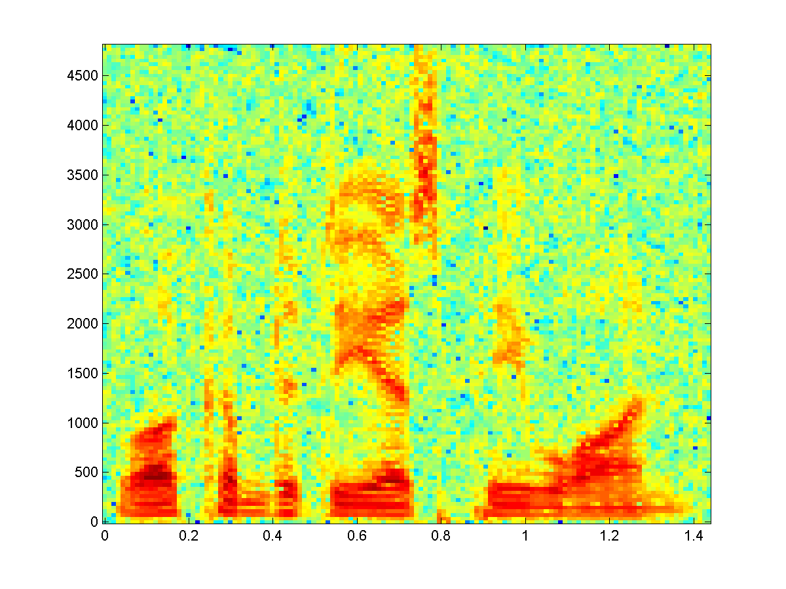
Spectrogram corrupted by noise at SNR 15 dB
Some regions are affected far more than others

Slide 29
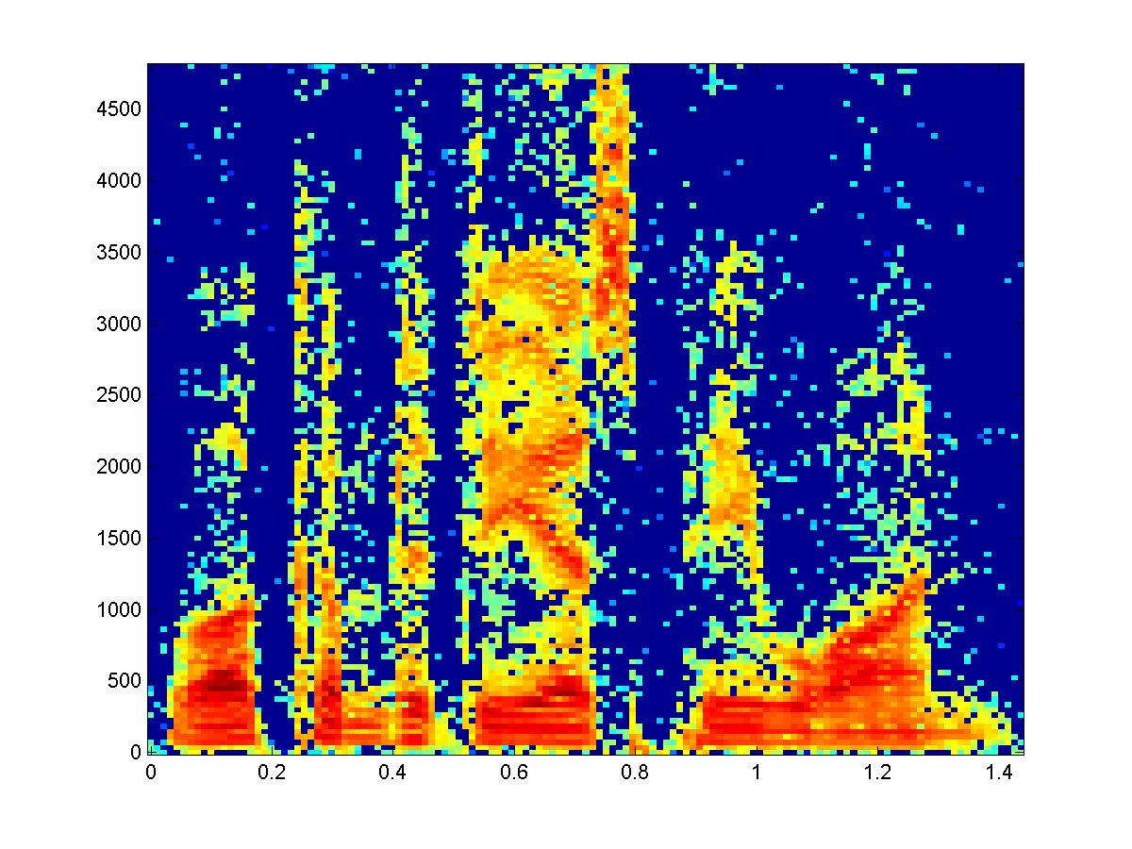
Ignoring regions in the spectrogram that are corrupted by noise
All regions with SNR less than 0 dB deemed missing (dark blue)
Recognition performed based on colored regions alone

Slide 30
Recognition accuracy using compensated cepstra, speech in white noise (Raj, 1998)
Cluster Based Recon.
Temporal Correlations
Spectral Subtraction
Accuracy (%)
Baseline
SNR (dB)
Large improvements in recognition accuracy can be obtained by reconstruction of corrupted regions of noisy speech spectrograms
A priori knowledge of locations of “missing” features needed

Slide 31
Recognition accuracy using compensated cepstra, speech corrupted by music
Cluster Based Recon.
Spectral Subtraction
Temporal Correlations
Accuracy (%)
Baseline
SNR (dB)
Recognition accuracy increases from 7% to 69% at 0 dB with cluster-based reconstruction

Slide 32
Practical recognition error: white noise (Seltzer, 2000)
Speech plus white noise:

Slide 33
Practical recognition error: background music
Speech plus music:

Slide 34
Summary: Missing features
Missing feature approaches can be valuable in dealing with the effects of transient distortion and other disruptions that are localized in the spectro-temporal display
The approach can be effective, but it is limited by the need to determine correctly which cells in the spectrogram are missing, which can be difficult in practice

Slide 35
Multi-band recognition (Hermanksy, Bourlard et al.)
Original approach:
  Decompose speech into several adjacent frequency bands
  Train separate recognizers to process each band
  Recombine information
Comment:
  Motivated by observation of Fletcher (and Allen) that the auditory system processes speech in separate frequency bands
Some implementation decisions:
  How many bands?
  At what level to split and merge?
  How to recombine and weight separate contributions?

Slide 36
Missing features versus multi-band recognition: advantages and disadvanages
Multi-band approaches are typically implemented with a relatively small number of channels while ….
…. with missing feature approaches, every time-frequency point can be considered or ignored
Various techniques developed to choose “best” channels fairly well (as examined in PIRE ‘14 workshop):
  But “quantization” of representation due to limited number of channels
Missing-feature approaches:
  Finer partitioning of the observation space than multi-band method
  But errors made in identifying degraded pixels

Slide 37
Generalizations of multiband analysis:
Information fusion
Partitioning of information does not need to be on a frequency-by-frequency basis
Combination of information can take place at various levels of a speech recognition system
Information fusion is presently a fairly active area of research

Slide 38
Information fusion
Performance can be improved by combining information extracted from different complementary knowledge sources
Sources of information may be from
  Different frequency channels (original implementation)
  Different input modalities (such as speech and video)
  Different feature sets from a single modality

Slide 39
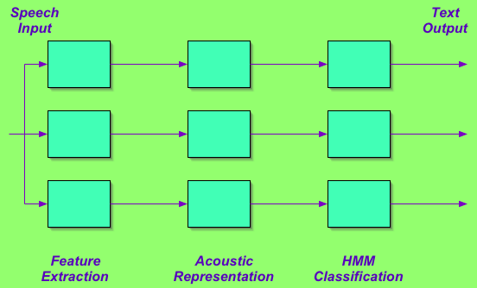
Combination of information streams:
Independent recognition

Slide 40
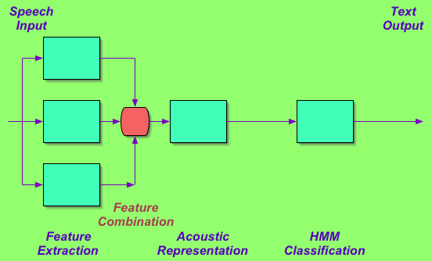
Combination of information streams:
Feature combination

Slide 41
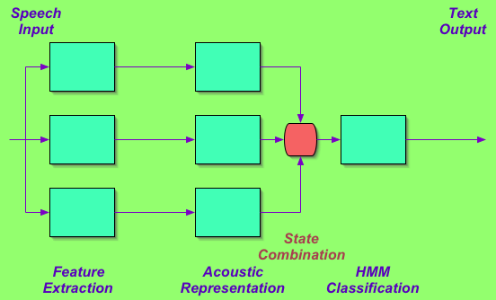
Combination of information streams:
State combination

Slide 42
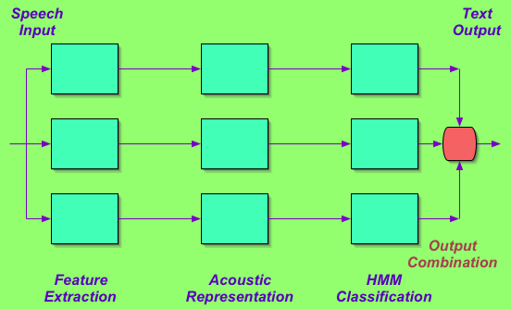
Combination of information streams:
Output combination

Slide 43
Application of hypothesis combination to NRL SPINE 2000 evaluation (Singh)
WER = 35.1%
33.3
32.9
Decode
MFC
Adapt
MFC
Adapt
MFC
32.8
30.3
28.4
38.0
34.8
34.7
Data
Decode
PLP
+
Adapt
PLP
+
Adapt
PLP
+
Combined
Hypothesis
47.4
40.1
38.7
Decode
Bernoulli
Adapt
Bernoulli
Adapt
Bernoulli
Combination of parallel hypotheses derived from complementary feature sets or compensation approaches can dramatically lower word error rate

Slide 44
An example of output combination: hypothesis combination (Singh)
-1
-7
-9
-8
-4
0
4
16
46
76
79
<s>
South
Southwest
Confirmed
</s>
0
<s>
6
Fire
16
Southwest
46
and
54
go
76
</s>
79
-2
-6
-8
-3
-4
-5
-1
-7
-8
4
16
46
76
0
<s>
South
-7.68
Confirmed
79
Southwest
</s>
-3.68
<s>
6
Fire
16
46
and
54
go
76
-2
-6
-3
-4
Likelihoods
Frame number of transition point

Slide 45
Combining features improves error rates
Results from NRL SPINE 2000 task (using output combination):

Slide 46
Combining compensation schemes improves accuracy, too
Further results from SPINE 2000:

Slide 47
Comparing different types of information fusion [RM task] (Li, 2005)
Natural
Features
Optimized
Features
Baseline
Feature Comb
Output Comb

Slide 48
The problem of reverberation
High levels of reverberation are extremely detrimental to recognition accuracy
  In reverberant environments, the “noise” is actually reflected copies of the target speech signals
  Noise-canceling strategies (like the LMS algorithm) based on uncorrelated noise sources fail
  Frame-based compensation strategies also fail because effects of reverberation can be spread over several frames

Slide 49
The problem of reverberation
Comparison of single channel and delay-and-sum beamforming (WSJ data passed through measured impulse responses):
Single channel
Delay and sum

Slide 50


Use of microphone arrays: motivation
Microphone arrays can provide directional response, accepting speech from some directions but suppressing others

Slide 51

Another reason for microphone arrays …
Microphone arrays can focus attention on the direct field in a reverberant environment

Slide 52
Options in the use of multiple microphones…
There are many ways we can use multiple microphones to improve recognition accuracy:
  Fixed delay-and-sum beamforming
  Microphone selection techniques
  Traditional adaptive filtering based on minimizing waveform distortion
  Feature-driven adaptive filtering (LIMABEAM)
  Statistically-driven separation approaches (ICA/BSS)
  Binaural processing based on selective reconstruction (e.g. PDCW)
  Binaural processing for correlation-based emphasis (e.g. Polyaural)
  Binaural processing using precedence-based emphasis (peripheral or central, e.g. SSF)

Slide 53
Delay-and-sum beamforming
Simple processing based on equalizing delays to sensors and summing responses
High directivity can be achieved with many sensors
Baseline algorithm for any multi-microphone experiment

Slide 54
Adaptive array processing
MMSE-based methods (e.g. LMS, RLS ) falsely assume independence of signal and noise; not true in reverberation
  Not as much of an issue with modern methods using objective functions based on kurtosis or negative entropy
Methods reduce signal distortion, not error rate

Slide 55
Speech recognition using microphone arrays
Speech recognition using microphone arrays has been always been performed by combining two independent systems.
This is not ideal:
  Systems have different objectives
  Each system does not exploit information available to the other
MIC₁
MIC₂
Array
processing
Feature
extraction
ASR
MIC₃
MIC₄
Notes:
Say “But for recognition, our criteria are different – not SNR, but WER, retrieval accuracy, semantic content, task completion, etc.
Also, we don’t care what is sounds like, nor do we need to the signal after processing.

Slide 56
Feature-based optimal filtering (Seltzer 2004)
Consider array processing and speech recognition as part of a single system that shares information
Develop array processing algorithms specifically designed to improve speech recognition
MIC₁
MIC₂
Array
processing
Feature
extraction
ASR
MIC₃
MIC₄

Slide 57
Multi-microphone compensation for speech recognition based on cepstral distortion
Multi-mic compensation based on optimizing speech features rather than signal distortion
Array
Proc
Front
End
ASR
Speech
in Room
Delay
and Sum
Optimal
Comp

Slide 58
Sample results
WER vs. SNR for WSJ with added white noise:
  Constructed 50-point filters from calibration utterance using transcription only
  Applied filters to all utterances

Slide 59
“Nonlinear beamforming” – reconstructing sound from fragments
Procedure:
  Determine which time-frequency components appear to be dominated by the desired signal
  Recognize based on subset of features that are “good”
  OR
  Reconstruct signal based on “good” components and recognize using traditional signal processing
  In binaural processing determination of “good” components is based on estimated ITD

Slide 60
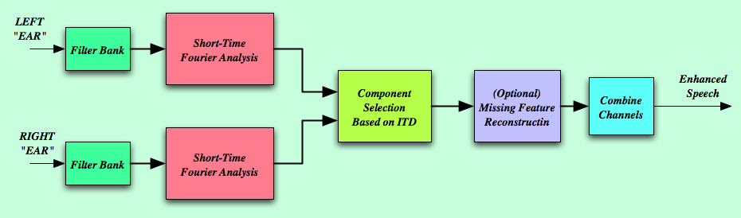
Binaural processing for selective reconstruction (e.g. ZCAE, PDCW processing)
Assume two sources with known azimuths
Extract ITDs in TF rep (using zero crossings, cross-correlation, or phase differences in frequency domain)
Estimate signal amplitudes based on observed ITD (in binary or continuous fashion)
(Optionally) fill in missing TF segments after binary decisions

Slide 61
Audio samples using selective reconstruction
RT60 (ms) 300
No Proc
Delay-sum
PDCW

Slide 62
Selective reconstruction from two mics helps
Examples using the PDCW algorithm (Kim et al. 2009):
  Speech in “natural” noise: Reverberated speech:
Comment: Use of two mics provides substantial improvement that is typically independent of what is obtained using other methods

Slide 63
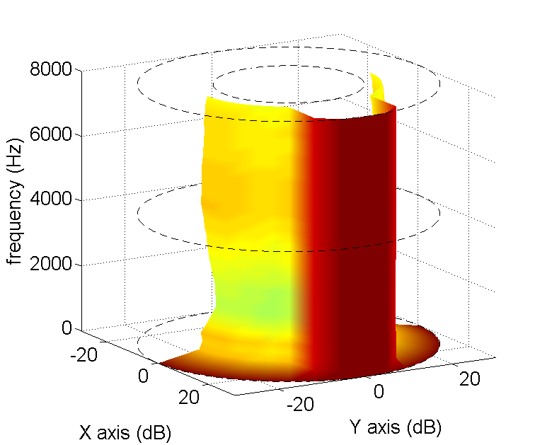
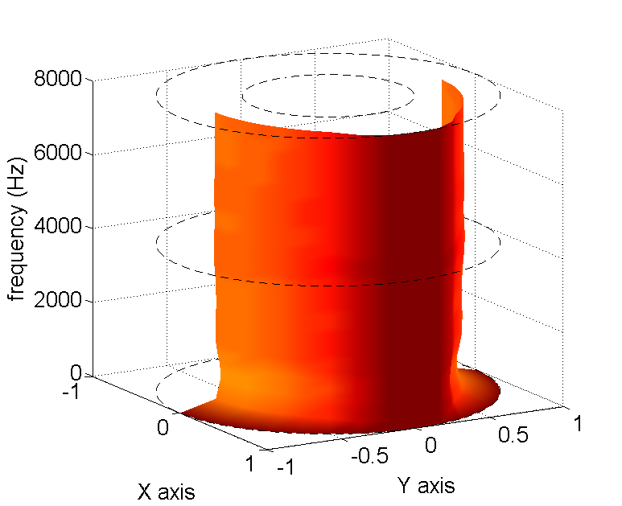
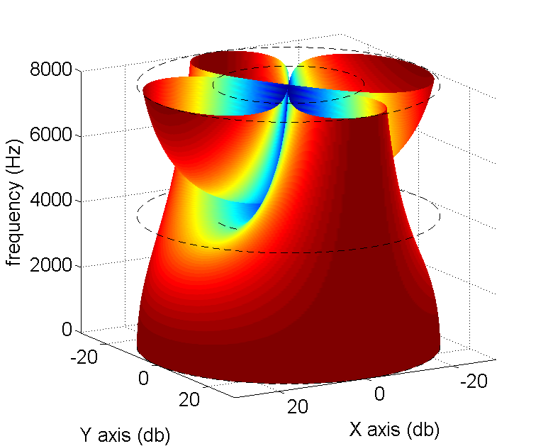
Comparing linear and “nonlinear” beamforming
“Nonlinear beampatterns: Linear beampattern:
SNR = 0 dB SNR = 20 dB
Comments:
  Performance depends on SNR as well as source locations
  More consistent over frequency than linear beamforming
(Moghimi and Stern, ICASSP 2014)

Slide 64
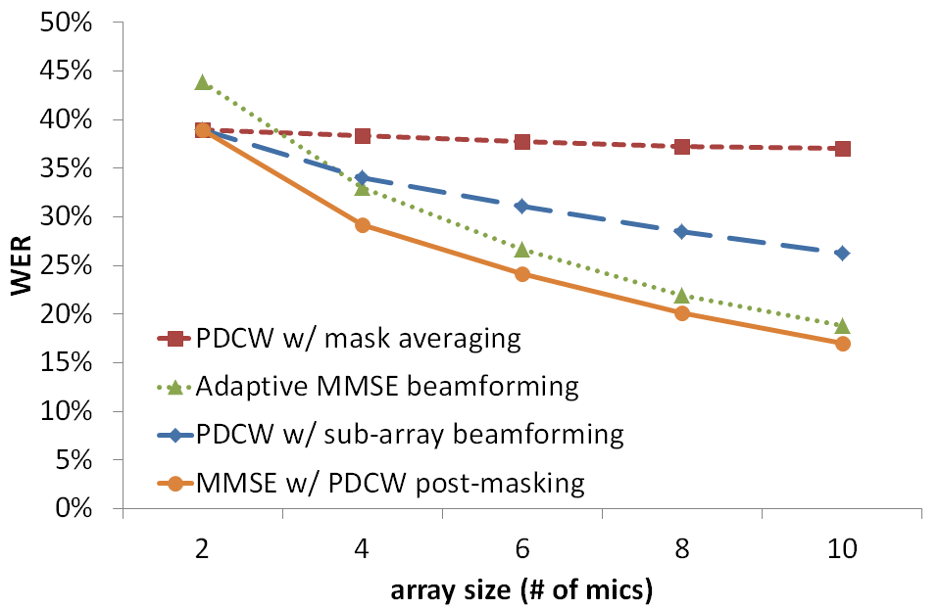
Linear and nonlinear beamforming as a function of the number of sensors
(Moghimi & Stern, Interspeech 2014)

Slide 65
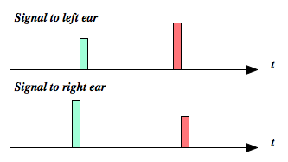
The binaural precedence effect
Basic stimuli of the precedence effect:
Localization is typically dominated by the first arriving pair
Precedence effect believed by some (e.g. Blauert) to improve speech intelligibility
Generalizing, we might say that onset enhancement helps at any level

Slide 66
Effects of onset enhancement (SSF)
RT60 =
500 ms
Before
SSF
After
SSF

Slide 67
Performance of onset enhancement in the SSF algorithm (Kim and Stern, Interspeech 2010)
Background music:
Reverberation:
Comment: Onset enhancment using SSF processing is especially effective in dealing with reverberation

Slide 68
Combining onset enhancement with two-microphone processing:
Comment: the use of both SSF onset enhancement and binaural comparison is especially helpful for improving WER for reverberated speech
(Park et al.,
Interspeech
2014)

Slide 69
Summary: use of multiple mics
Microphone arrays provide directional response which can help interfering sources and in reverberation
Delay-and-sum beamforming is very simple and somewhat effective
Adaptive beamforming provides better performance but not in reverberant environments with MMSE-based objective functions
Adaptive beamforming based on minimizing feature distortion can be very effective but is computationally costly
For only two mics, “nonlinear” beamforming based on selective reconstruction is best
Onset enhancement helps a great deal as well in reverberance

Slide 70
Auditory-based representations
What the speech recognizer sees:
An original spectrogram: Spectrum “recovered” from MFCC:

Slide 71
Comments on MFCC representation
It’s very “blurry” compared to a wideband spectrogram!
Aspects of auditory processing represented:
  Frequency selectivity and spectral bandwidth (but using a constant analysis window duration!)
    Wavelet schemes exploit time-frequency resolution better
  Nonlinear amplitude response (via log transformation only)
Aspects of auditory processing NOT represented:
  Detailed timing structure
  Lateral suppression
  Enhancement of temporal contrast
  Other auditory nonlinearities

Slide 72
Basic auditory anatomy
Structures involved in auditory processing:

Slide 73
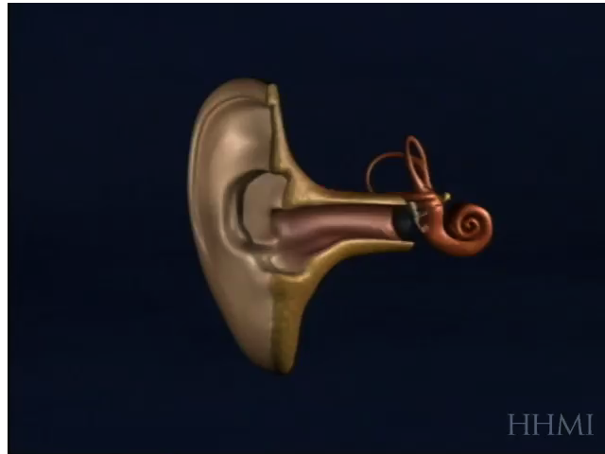
Excitation along the basilar membrane
(courtesy James Hudspeth, HHMI)
Notes:
FIND SOURCE AND CREDIT!!

Slide 74
Central auditory pathways
There is a lot going on!
For the most part, we only consider the response of the auditory nerve
  It is in series with everything else

Slide 75
Some aspects of peripheral neural processing
Bandpass filtering
Rectification and log compression
Enhancement of onsets and offsets in time in each band
Lateral suppression of weaker signals in adjacent bands
Binaural interaction for localization and reverberation suppression

Slide 76
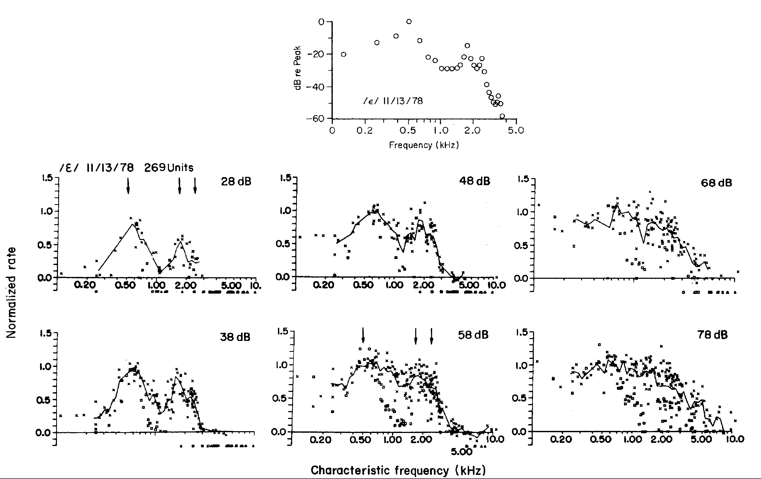
Speech representation using mean rate
Representation of vowels by Young and Sachs using mean rate:
Mean rate representation does not preserve spectral information

Slide 77
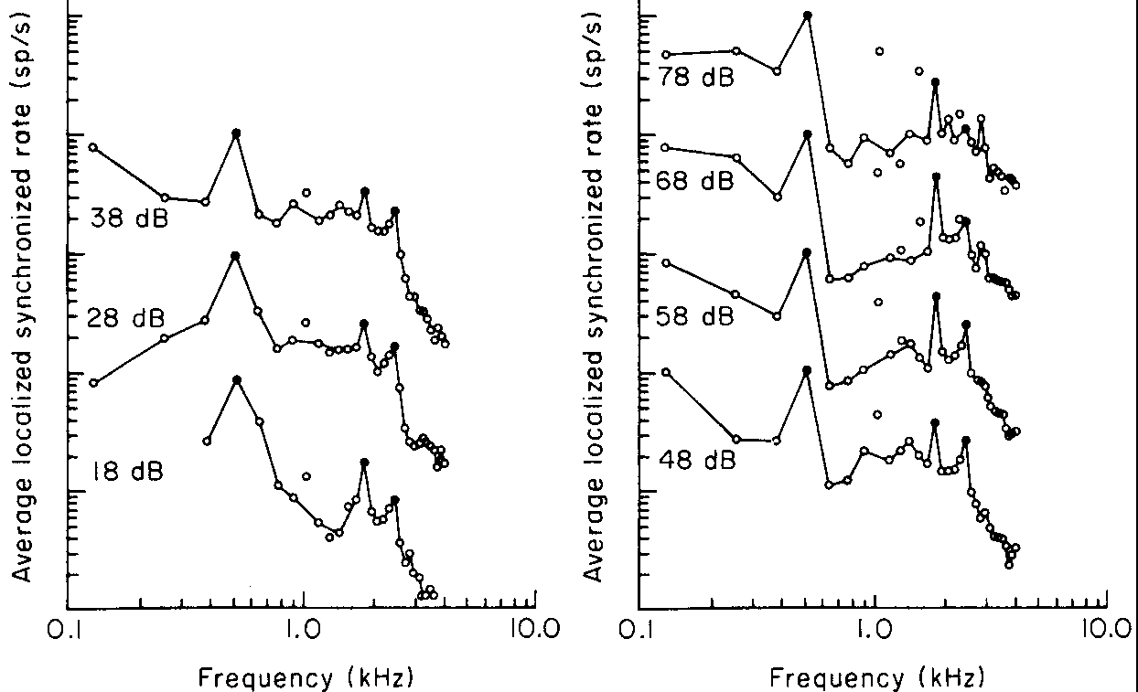
Speech representation using average localized synchrony measure
Representation of vowels by Young and Sachs using ALSR:

Slide 78
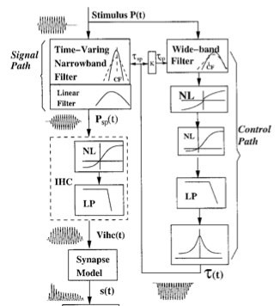
Physiologically-motivated signal processing: the Zhang-Carney-Zilany model of the periphery
We used the “synapse output” as the basis for further processing

Slide 79
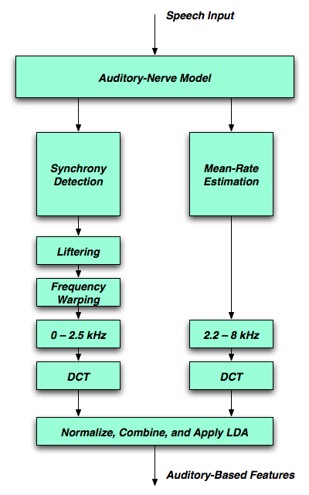
An early evaluation by Kim et al. (Interspeech 2006)
Synchrony response is smeared across frequency to remove pitch effects
Higher frequencies represented by mean rate of firing
Synchrony and mean rate combined additively
Much more processing than MFCCs, but will simplify if results are useful

Slide 80
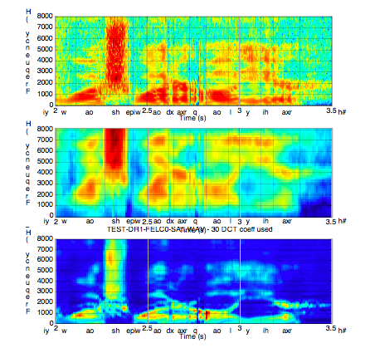
Comparing auditory processing with cepstral analysis: clean speech

Slide 81
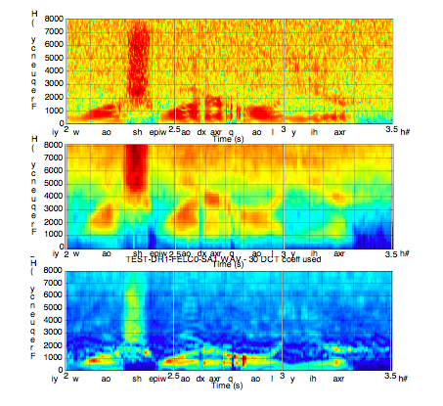
Comparing auditory processing with cepstral analysis: 20-dB SNR

Slide 82
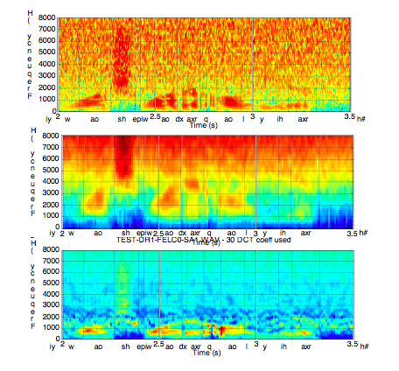
Comparing auditory processing with cepstral analysis: 10-dB SNR

Slide 83
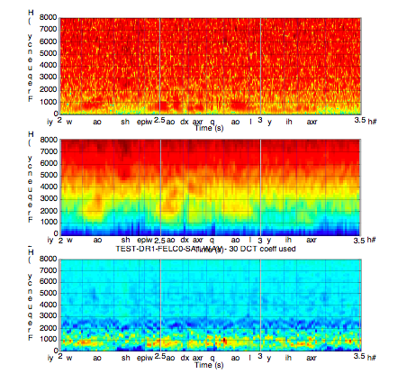
Comparing auditory processing with cepstral analysis: 0-dB SNR

Slide 84
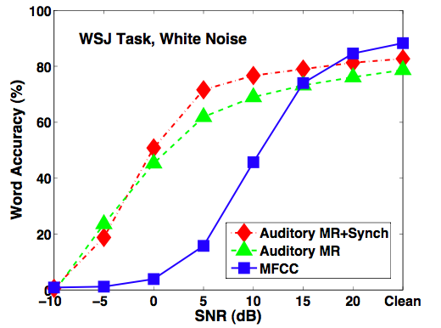
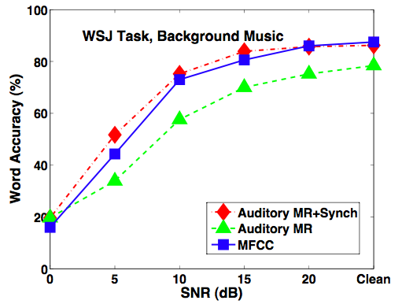
Auditory processing is more effective than MFCCs at low SNRs, especially in white noise
Curves are shifted by 10-15 dB (greater improvement than obtained with VTS or CDCN)
[Results from Kim et al., Interspeech 2006]
Accuracy in background noise: Accuracy in background music:

Slide 85
But do auditory models really need to be so complex?
Model of Zhang et al. 2001: A much simpler model:

Slide 86
Comparing simple and complex auditory models
Comparing MFCC processing, a trivial (filter–rectify–compress) auditory model, and the full Carney-Zhang model:

Slide 87
Aspects of auditory processing we have found to be important in improving WER in noise/reberb
The shape of the peripheral filters
The shape of the auditory nonlinearity
The use of “medium-time” analysis for noise and reverberation compensation
The use of nonlinear filtering to obtain noise suppression and general separation of speechlike from non-speechlike signals (a form of modulation filtering)
The use of nonlinear approaches to effect onset enhancement
Binaural processing for further enhancement of target signals

Slide 88
PNCC processing (Kim and Stern, 2010,2014)
A pragmatic implementation of a number of the principles described:
  Gammatone filterbanks
  Nonlinearity shaped to follow auditory processing
  “Medium-time” environmental compensation using nonlinear cepstral highpass filtering in each channel
  Enhancement of envelope onsets
  Computationally-efficient implementation

Slide 89
PNCC: an integrated front end based on auditory processing
Initial processing
Environmental compensation
Final processing
MFCC RASTA-PLP PNCC

Slide 90
Computational complexity of front ends

Slide 91
Speech in noise after PNCC processing
Speech in white noise”
SNR Original speech Processed speech
∞
10
5
0
–5

Slide 92
Performance of PNCC in white noise (RM)

Slide 93
Performance of PNCC in white noise (WSJ)

Slide 94
Performance of PNCC in background music

Slide 95
Performance of PNCC in reverberation

Slide 96
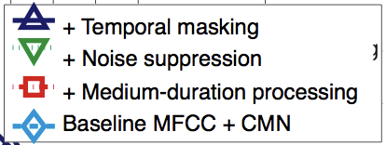
Contributions of PNCC components: white noise (WSJ)
+ Temporal masking
+ Noise suppression
+ Medium-duration processing
Baseline MFCC + CMN
+ Temporal masking
+ Noise protection
+ Medium-time time/freq anal
Baseline MFCC with CMN

Slide 97
Contributions of PNCC components: background music (WSJ)
+ Temporal masking
+ Noise suppression
+ Medium-duration processing
Baseline MFCC + CMN
+ Temporal masking
+ Noise protection
+ Medium-time time/freq anal
Baseline MFCC with CMN

Slide 98
Contributions of PNCC components: reverberation (WSJ)
+ Temporal masking
+ Noise suppression
+ Medium-duration processing
Baseline MFCC + CMN
+ Temporal masking
+ Noise protection
+ Medium-time time/freq anal
Baseline MFCC with CMN

Slide 99
The binaural precedence effect
Basic stimuli of the precedence effect:
Localization is typically dominated by the first arriving pair
Precedence effect believed by some (e.g. Blauert) to improve speech intelligibility
Generalizing, we might say that onset enhancement helps at any level

Slide 100
Performance of onset enhancement in the SSF algorithm (Kim and Stern, Interspeech 2010)
Background music:
Reverberation:
Comment: Onset enhancment using SSF processing is especially effective in dealing with reverberation

Slide 101
The SSF algorithm: suppression after onsets
Impact of suppression:
Suppression after onsets causes responses to clean and reverberated speech to become more similar

Slide 102
Effects of SSF processing
RT60 =
500 ms
Before
SSF
After
SSF

Slide 103
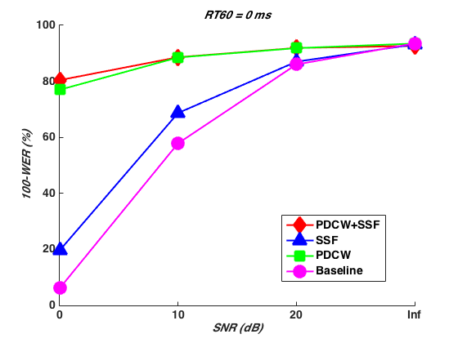
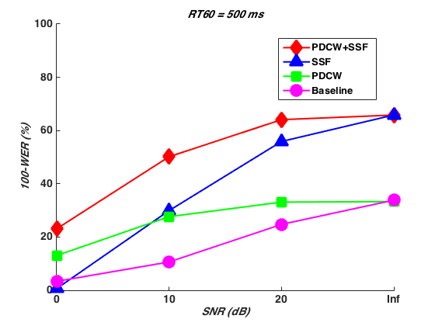
Effectiveness of PDCW and SSF with an interfering speaker and reverberation
No reverberation Reverberation present
Comments:
• PDCW is effective in dealing with additive interference
• SSF is effective in dealing with reverberation

Slide 104
Effects of onset enhancement/temporal masking (SSF processing, Kim ‘10)

Slide 105
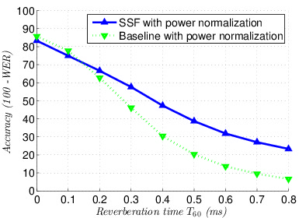
Performance with deep neural nets:
PNCC and SSF @Google

Slide 106
Summary: auditory processing
Exploiting knowledge of the auditory system can improve ASR accuracy. Important aspects include:
  Consideration of filter shapes
  Consideration of rate-intensity function
  Onset enhancement
  Nonlinear modulation filtering
  Temporal suppression

Slide 107
General summary:
Robust recognition in the 21st century
Low SNRs, reverberated speech, speech maskers, and music maskers are difficult challenges for robust speech recognition
Robustness algorithms based on classical statistical estimation fail in the presence of transient degradation
Some more recent techniques that can be effective:
  Missing-feature reconstruction
  Microphone array processing in several forms
  Processing motivated by monaural and binaural physiology and perception
More information about our work (and code!) may be found at
http://www.cs.cmu.edu/~robust

Slide 108
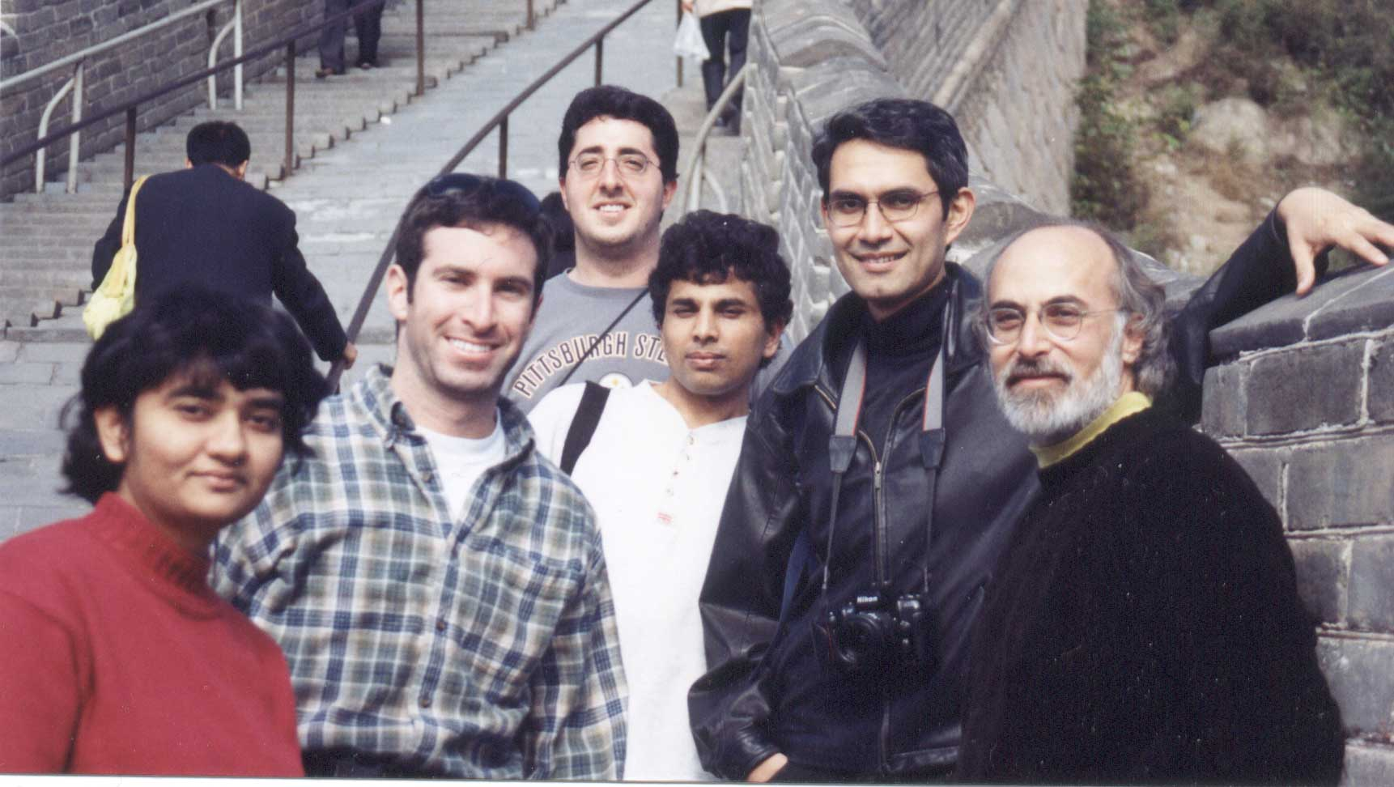
www.cs.cmu.edu/~robust

