Slide 1
AN INTROUCTION TO
2-DIMENSIONAL DSP
Richard M. Stern
18-491/691 lecture
April 17, 2024
Department of Electrical and Computer Engineering
Carnegie Mellon University
Pittsburgh, Pennsylvania 15213

Slide 2
INTRODUCTION
Background: Many types of analyses make use of 2- dimensional images ....
  Photographs
  Satellite images
  X-rays and other medical images
Many concepts from 1-D DSP are directly extensible to two dimensions, but some are not

Slide 3
INTRODUCTION
Goals of this lecture:
  To summarize basic 2-D relationships
  To identify which concepts do or do not extend to 2-D
  To discuss briefly 2-D filter design approaches
For further reading:
  Two-Dimensional Signal and Image Processing by Jae Lim
  Chapter Two-Dimensional Signal Processing by Lim in the edited book by Lim and Oppenheim on Advanced DSP (pseudo-text for ADSP)
  Many many other texts and resources

Slide 4
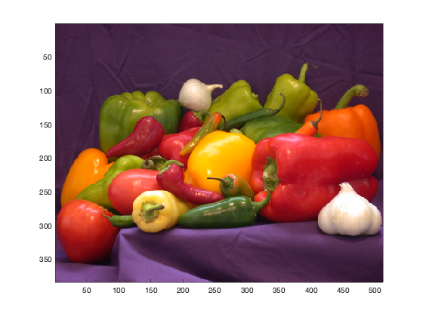
Some examples of original and processed images
Peppers …

Slide 5

Effects of lowpass filtering
Original image:
After lowpass filter:

Slide 6
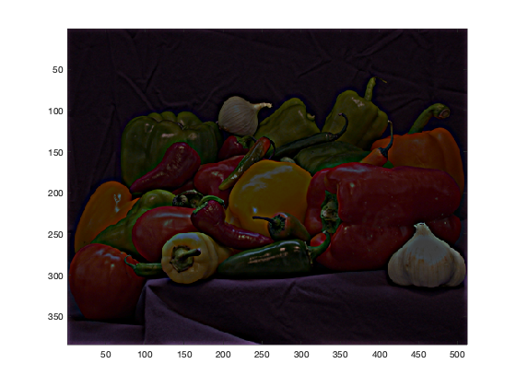
Effects of highpass filtering
Original image:
After highpass filter:

Slide 7
An example of nonlinear processing
Original: Enhancement via homomorphic
homomorphic filtering:

Slide 8
Some examples of 2-D signals
The unit sample function:
The unit step function:
The exponential function:

Slide 9
Some examples of 2-D signals
Cosine functions:
Note: A sequence is separable if

Slide 10
2-D LSI systems
A system is linear if
A system is shift invariant if for all k, l
If a 2-D system is LSI, then
(this is called the point-spread function)

Slide 11
The convolution sum
As in 1-D, we can represent an input as a linear combination of shifted and scaled delta functions producing …
1-D convolution:
2-D convolution:

Slide 12
Convolving separable functions
If both x[n₁,n₂] and h[n₁,n₂] are separable, then
or
In other words, if x and h are separable, the 2-D convolution becomes the product of two 1-D convolutions. For finite sequences of length N, this reduces the number of multiplys from N⁴ to 2N²

Slide 13
Some system properties
A system is causal if
(This is not usually a big deal in 2-D)
A system is stable if

Slide 14
Difference equations for causal systems
In 1 dimension:
In 2 dimensions:

Slide 15
The 2-D discrete-time Fourier transform
In 1-D we have
In 2-D we have

Slide 16
The 2-D discrete-time Fourier transform
From the convolution sum definition we can obtain
and

Slide 17
The 2-D discrete-time Fourier transform
Comments:
  is periodic with period 2π in ω₁ and ω₂
  If is separable, is as well, and computing the 2-D DTFT becomes just a matter of computing the product of two 1-D DTFTs
  Convolution in time ⬄ multiplication in frequency

Slide 18
An example of frequency response
The DTFT is separable and

Slide 19
A second example of a frequency response
This DTFT is not separable! It can be shown that
Note: While this DTFT is not separable, it IS rotation invariant in both time and frequency

Slide 20
2-dimensional z-transforms
In a similar fashion to the 1-D case, we build up z-transforms by modeling functions in space as linear combinations of the function
In particular,
and

Slide 21
An example 2-D z-transform
Consider the simple space function
The corresponding z-transform is
which converges for

Slide 22
The fundamental curse of 2D-DSP

Slide 23
The fundamental curse of 2D-DSP
Comments: no poles and zeros (!), so
  No easy tests for stability
  No parallel or cascade implementations
  No Parks-McClellan algorithm
  etc. etc.

Slide 24
The 2-dimensional discrete Fourier transform
The 2D-DFT is derived in a fashion similar to how it had been in 1-D. Specifically:
and
Comments:
  Multiplying coefficients in frequency corresponds to a 2-D circular (“toroidal”) convolution in space
  Overlap-add, overlap-save algorithms are still valid

Slide 25
Computing the 2-D DFT
Again, the 2D-DF is
This can be rewritten as
Let
then

Slide 26
Computing the 2-D DFT
To compute the 2-D DFT:
  Compute the 1-D DFT of each column and replace in the column
  Compute the row-wise DFTs of the resulting coefficients
Comments:
  This always works… x[n₁,n₂] need not be separable or anything else
  Huge computational savings
    For example: let N₁=N₂=1024≈1000
    Direct computation of 2D-DFT ≈ 10¹² complex mults!
    Using the row/column shortcut we have ≈ 2 10⁹ complex mults
    Using the shortcut and FFT algorithms leaves only 10⁷ complex mults

Slide 27
Some summary observations about 2D-DSP
Many things are obvious extensions of 1-D DSP
  Linearity and shift invariance
  Convolution sum, difference equations
  2-D DTFTs
  2-D DFTs
Some things are fundamentally different:
  2-D z-transforms
    No poles and zeros as we know them

Slide 28
Some summary observations about 2D-DSP
Some other things to keep in mind:
  Tradeoff between separability and rotation invariance
  Physical significance of 2-D complex exponentials
  Efficiencies provided by separability
  Efficient computation of the 2-D DFT
Next topic of discussion:
  2-D discrete-space filter design

Slide 29
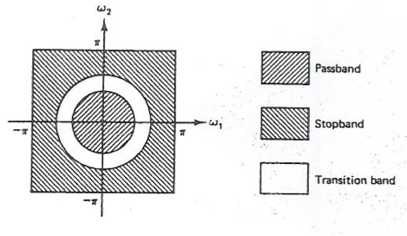
The general 2-D filter design problem

Slide 30
Designing digital filters in two dimensions
We will focus on FIR designs for now because of stability issues with IIR filters (despite computational efficiencies)
Major FIR techniques:
  Window designs
  Frequency-sampled design
  Parks-McClellan algorithm
For the most part, 2-D FIR filters are designed by using successful 1-D techniques and extending to 2-D
Zero-phase filtering is much more important in 2D than 1D

Slide 31
2-dimensional FIR design using windows
Let
Separable window approach:
Rotation-invariant window approach:
where w[n] is a successful 1-D window, usually a Kaiser window

Slide 32
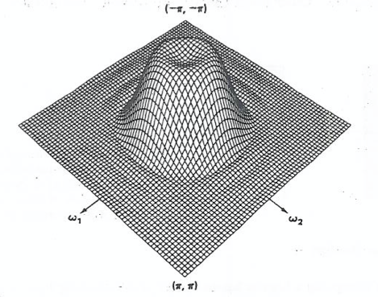
A lowpass example using a separable window
Separable 9x9 Kaiser window, ω_{c} = 0.4π

Slide 33
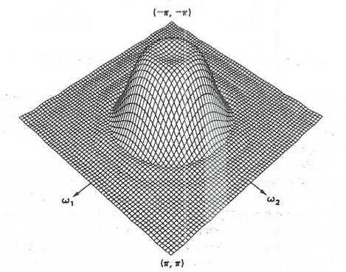
LPF example with a rotation-invariant window
Rotation-invariant 9x9 Kaiser window, ω_{c} = 0.4π

Slide 34
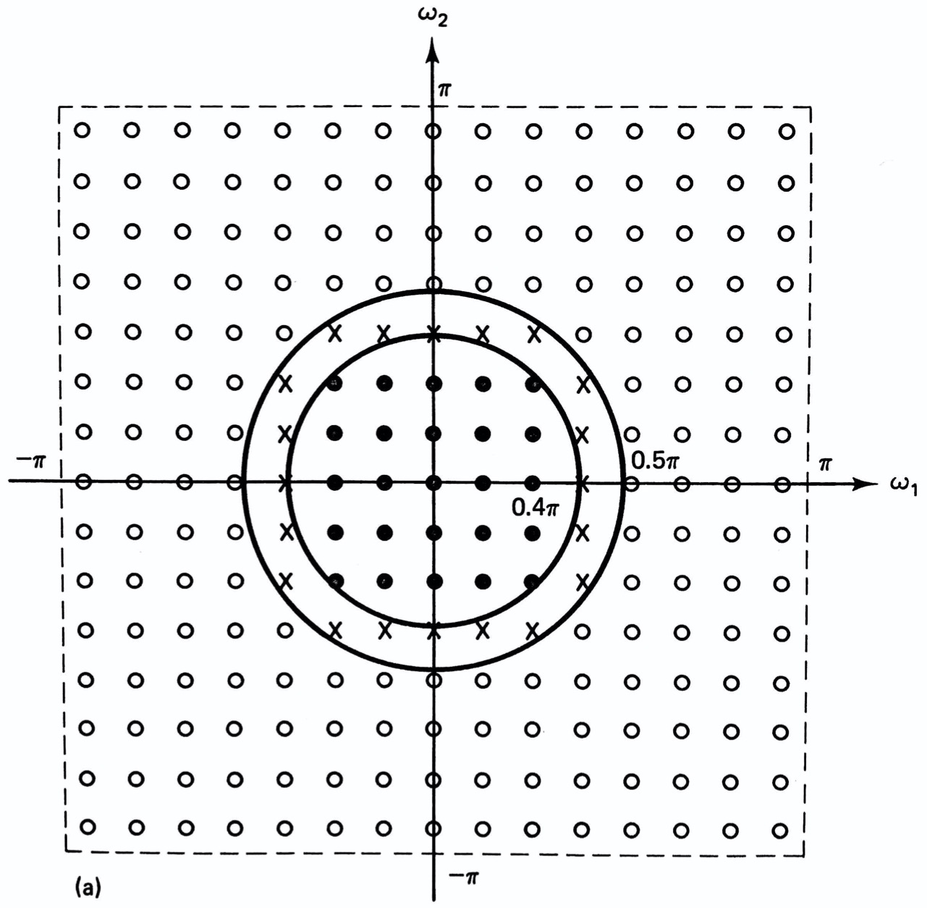
The frequency-sampling approach
15 x 15-point design using frequency sampling

Slide 35
Optimum 2-D FIR filters
General approach:
  Design optimal 1-D filter using Parks-McClellan algorithm
  Transform from 1-D to 2-D using method also developed in McClellan thesis (!)

Slide 36
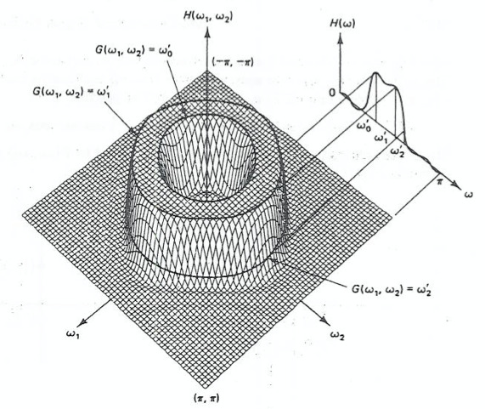
The general approach

Slide 37
The McClellan transformation
As you will recall, for a zero-phase Type I FIR filter we have
The 2-D response is obtained by

Slide 38
The 2-D to 2-D transform
From before,
This can be expressed as

Slide 39
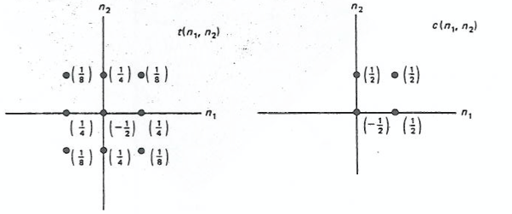
A particularly common special case
An example often used in practice:
The corresponding sequences t[n₁,n₂] and c[n₁,n₂]:

Slide 40
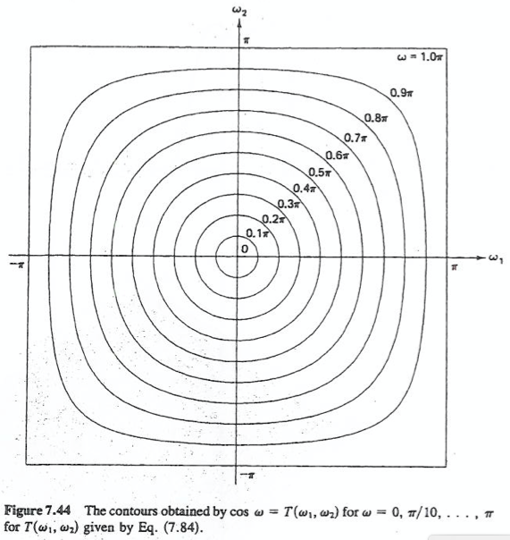
Equivalent contours in 1-D and 2-D

Slide 41
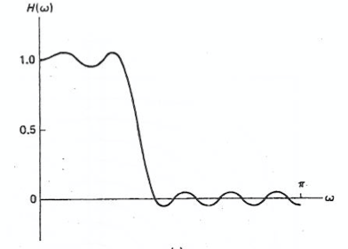
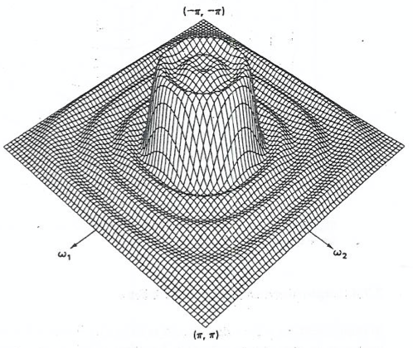
An example frequency response
1-D filter:
2-D filter

Slide 42
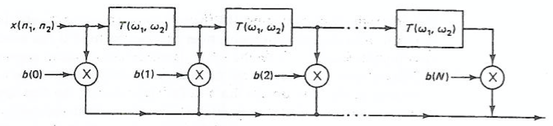
Implementation based on 1-D to 2-D transforms
The transfer function:
Efficient implementation:
Comment: overlap-add, FFTs, etc. can be used here as well

Slide 43
Summary: filter design
We reviewed FIR filter design using the three methods discussed in 18-491:
  Window design with separable or rotation-invariant Kaiser windows
  Frequency-sampling design, varying symmetric points together
  Parks-McClellan design, using the McClellan 1-D to 2-D transformation
  The McClellan transformation implies its own efficient implementation

