Slide 1
INTRODUCTION TO 18-792
ADVANCED DIGITAL SIGNAL PROCESSING
Richard M. Stern
18-491/691 talk
April 14, 2025
Department of Electrical and Computer Engineering
Carnegie Mellon University
Pittsburgh, Pennsylvania 15213

Slide 2
What is 18-792 Advanced DSP?
One of several courses that extend and apply the topics discussed in 18-491/691
Focus is on one-dimensional signals, primarily speech and music
Much of the course will discuss optimal solutions based on probabilistic/stochastic signal representations

Slide 3
Why take 18-792?
ADSP is THE most interesting ECE grad course this fall
ADSP is great fun
  (at least most of the time)
You will be implementing algorithms that are fundamental to signal processing today

Slide 4
Advanced digital signal processing: major application issues
Signal representation
Signal modeling
Signal enhancement
Signal separation

Slide 5
18-792: major topic areas
Multi-rate DSP
Short-time Fourier analysis
Overview of important properties of stochastic processes
Traditional and modern spectral analysis
Linear prediction
Adaptive filtering
Adaptive array processing
Additional topics and applications
Notes:
Orange headings refer to deterministic topics

Slide 6
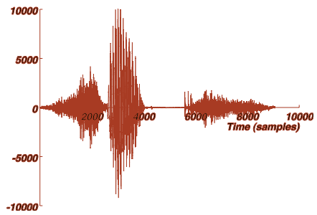
Signal representation: why perform signal processing?
A look at the time-domain waveform of “six”:
It’s hard to infer much from the time-domain waveform

Slide 7
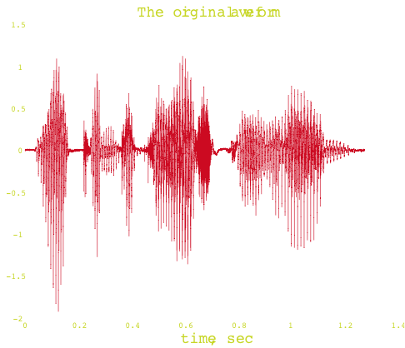

Signal representation: why perform signal processing?
A speech waveform in time:
“Welcome to DSP I”

Slide 8
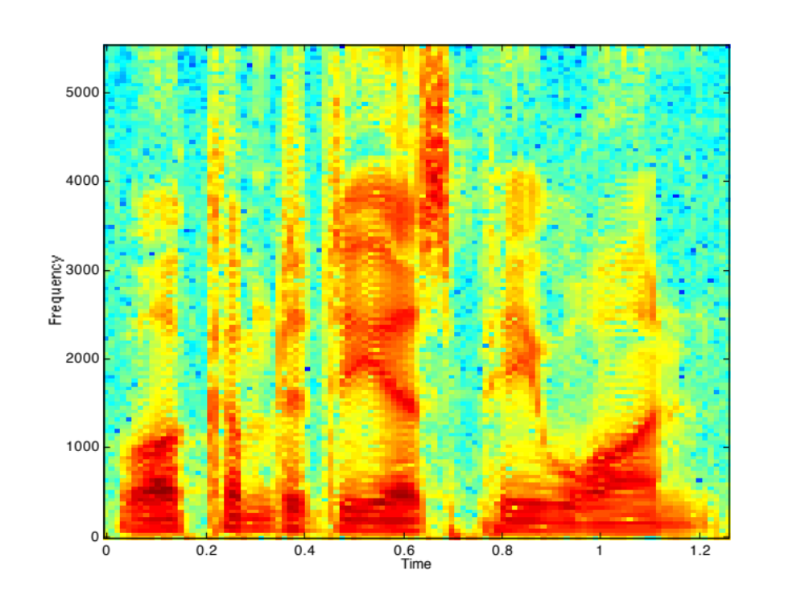
A time-frequency representation of “welcome” is much more informative
[Implemented
In Problem Set 4]

Slide 9
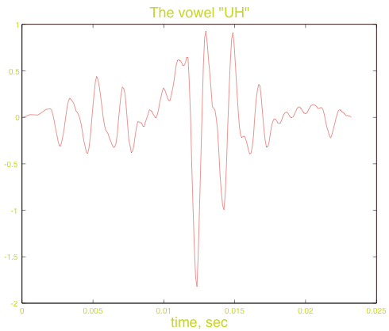
Signal modeling: let’s consider the “uh” in “welcome:”

Slide 10
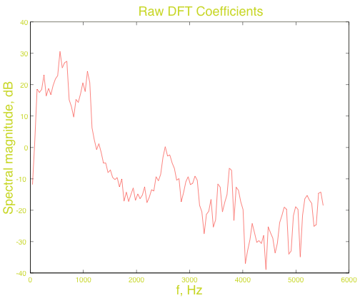
The raw spectrum

Slide 11
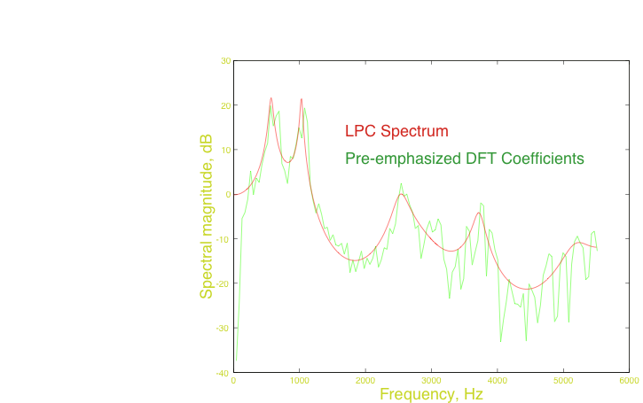
All-pole modeling: the LPC spectrum

Slide 12
The source-filter model of speech
A useful model for representing the generation of speech sounds:
Pitch
Amplitude
Pulse train source
p[n]
Vocal tract model
Noise source

Slide 13
Some examples of homework projects: separating vocal tract excitation and and filter
Original speech:
Speech with 75-Hz excitation:
Speech with 150 Hz excitation:
Speech with noise excitation:
Comment:: this is a major technique used in speech coding
[Implemented
In Problem Set 9]
Notes:
Welcome16
Welcome 75
Welcome 150
Welcome 0

Slide 14
Classical signal enhancement: compensation of speech for noise and filtering
Approach of Acero, Liu, Moreno, et al. (1990-1997)…
Compensation achieved by estimating parameters of noise and filter and applying inverse operations
“Clean” speech
Degraded speech
x[m]
h[m]
z[m]
Linear filtering
n[m]
Additive noise

Slide 15
Compensating for the combined effects of additive noise and linear filtering in ASR
Threshold shifts by ~7 dB
Accuracy still poor for low SNRs
Complete retraining
–7 dB 13 dB Clean
VTS (1997)
Original
CDCN (1990)
“Recovered”
CMN (baseline)
Notes:
out_pre0_norm out_new_pre20 out
out_post0_norm out_new_post20

Slide 16
Signal separation: speech is quite intelligible, even when presented only in fragments
Procedure:
  Determine which time-frequency time-frequency components appear to be dominated by the desired signal
  Reconstruct signal based on “good” components
A Monaural example:
  Mixed signals -
  Separated signals -
[Implemented
In Problem Set 4]
Notes:
5_spk
1st_spk 2nd_spk 3rd_spk 4th_spk 5th_spk

Slide 17
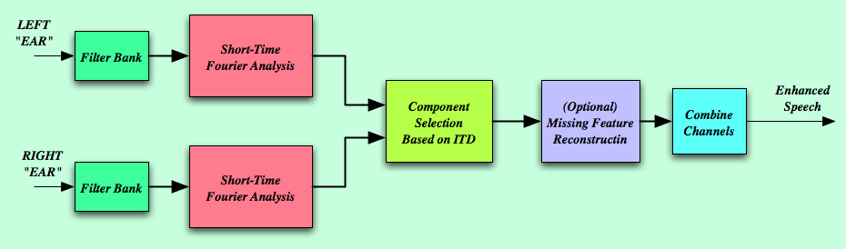
Practical signal separation: Audio samples using selective reconstruction based on ITD
RT60 (ms) 0 300
No Proc
Delay-sum
ZCAE-bin
ZCAE-cont
[Implemented
In Problem Set 5]
Notes:
Brian-Ba-R0I0 Brian-Ba-R3I0
Brian-DS-R0I0 Brian-DS-R3I0
Brian-ZB-R0I0 Brian-ZB-R3I0
Brian-ZC-R0I0 Brian-ZC-R3I0

Slide 18
Phase vocoding: changing time scale and pitch
Changing the time scale:
  Original speech
  Faster by 4:3
  Slower by 1:2
Transposing pitch:
  Original music
  After phase vocoding
  Transposing up by a major third
  Transposing down by a major third
Comment: this is one of the techniques used to perform autotuning
Comment: this is how autotuning is done
[Implemented
In Problem Set 6]
Notes:
Welcome16
Welcome 75
Welcome 150
Welcome 0

Slide 19
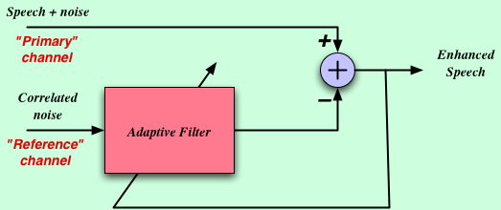
Another type of signal enhancement: adaptive noise cancellation
SupP
Speech + noise enters primary channel, correlated noise enters reference channel
Adaptive filter attempts to convert noise in secondary channel to best resemble noise in primary channel and subtracts
Performance degrades when speech leaks into reference channel and in reverberation
Original:
Processed:
[Implemented
In Problem Set 10]
Notes:
Push-to-talk will make life MUCH easier!!

Slide 20
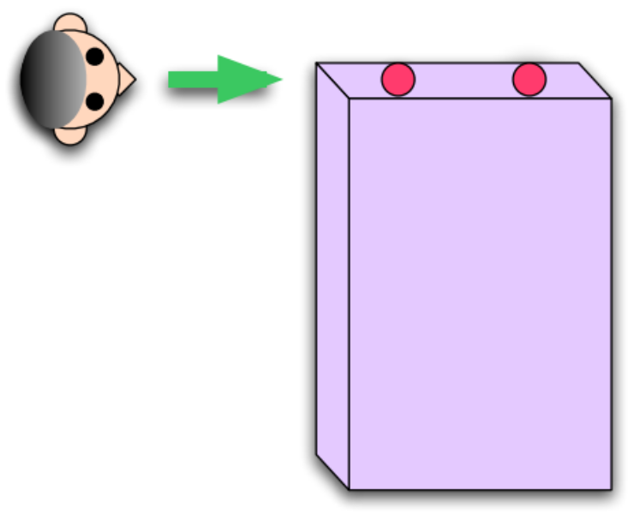
Noise cancellation for a PDA using two mics in “endfire” configuration
Speech in cafeteria noise, no noise cancellation
Speech with noise cancellation
But …. simulation assumed no reverb
[Implemented
In Problem Set 10]
Notes:
ANC_base
ANC_cancel

Slide 21
Summary
Lots of interesting topics that extend core material from DSP
Greater emphasis on implementation and applications
Greater emphasis on statistically-optimal signal processing
I hope that you have as much fun with this material as I have had!

Slide 22
And for more info about coverage …
Check out the ADSP class notes …
  http://www.ece.cmu.edu/~ece792/handouts/Notes_ADSP.pdf

