Slide 1
Some Filter Design Examples
Richard M. Stern
18-491/691
April 19, 2021
Department of Electrical and Computer Engineering
Carnegie Mellon University
Pittsburgh, Pennsylvania 15213

Slide 2
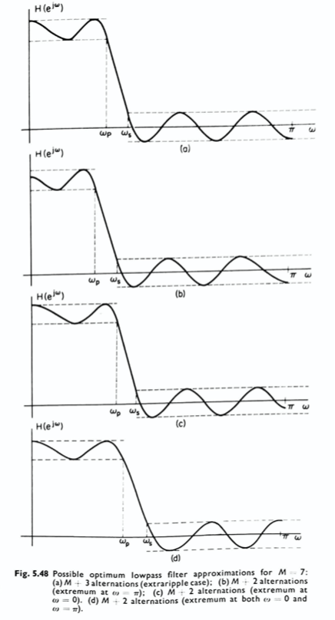
Possible ripple locations for FIR filters

Slide 3
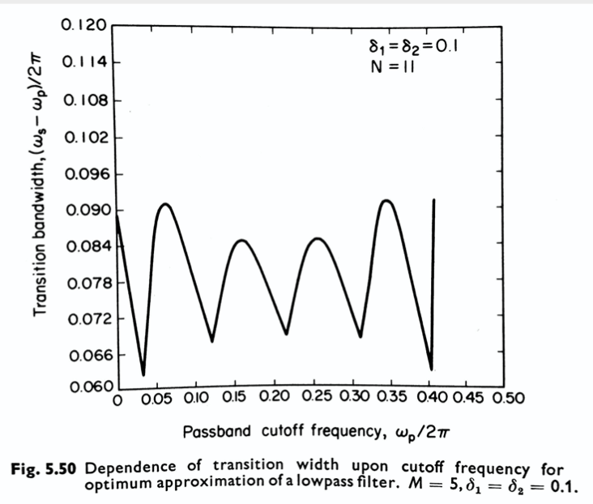
Performance of “extra ripple” filters

Slide 4
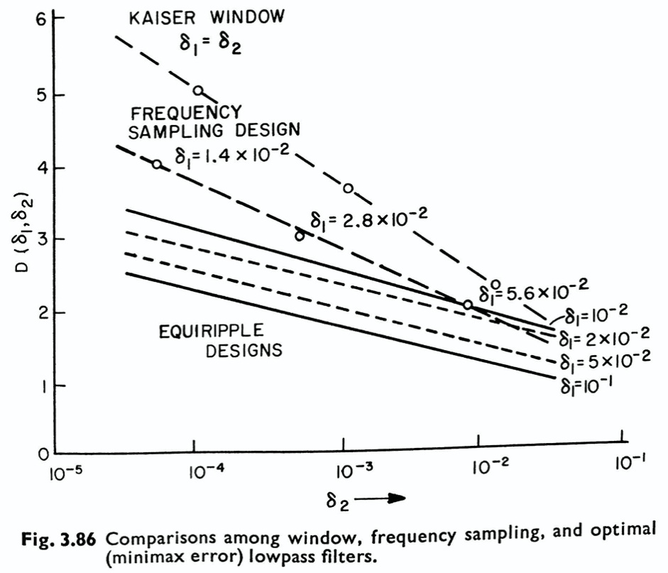
Comparison of performance of FIR designs

Slide 5
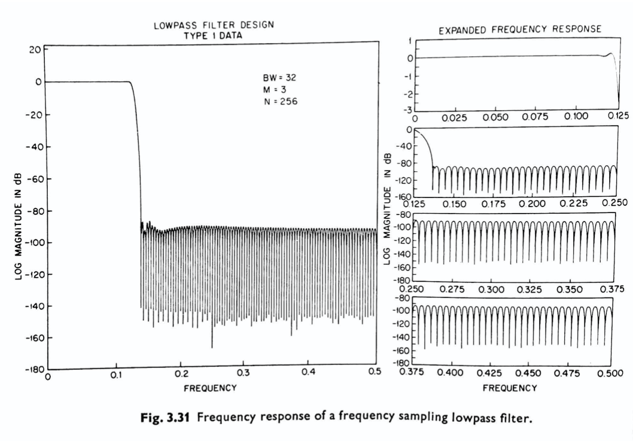
Frequency-sampling filter example

Slide 6
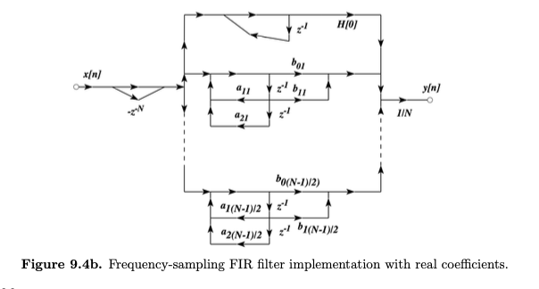
Frequency-sampling filter structure

