Slide 1
18-491/691 Lecture #16
INTRODUCTION TO THE
FAST FOURIER TRANSFORM ALGORITHM
Richard M. Stern
Department of Electrical and Computer Engineering
Carnegie Mellon University
Pittsburgh, Pennsylvania 15213
Phone: +1 (412) 268-2535
FAX: +1 (412) 268-3890
rms@cs.cmu.edu
http://www.ece.cmu.edu/~rms
March 16, 2023
[OSYP 9.2]

Slide 2
Introduction
Today we will begin our discussion of the family of algorithms known as “Fast Fourier Transforms,” which have revolutionized digital signal processing
What is the FFT?
  A collection of “tricks” that exploit the symmetry of the DFT calculation to make its execution much faster
  Speedup increases with DFT size
Today - will outline the basic workings of the simplest formulation, the radix-2 decimation-in-time algorithm
Monday - will discuss some of the variations and extensions
  Alternate structures
  Non-radix 2 formulations

Slide 3
Introduction, continued
Some dates:
  ~1880 - algorithm first described by Gauss
  1965 - algorithm rediscovered (not for the first time) by Cooley and Tukey
In 1967 (spring of my freshman year), calculation of a 8192-point DFT on the top-of-the line IBM 7094 took ….
  ~30 minutes using conventional techniques
  ~5 seconds using FFTs

Slide 4
Measures of computational efficiency
Could consider
  Number of additions
  Number of multiplications
  Amount of memory required
  Scalability and regularity
For the present discussion we’ll focus most on number of multiplications as a measure of computational complexity
  More costly than additions for fixed-point processors
  Same cost as additions for floating-point processors, but number of operations is comparable

Slide 5
Computational Cost of Discrete-Time Filtering
Convolution of an N-point input with an M-point unit sample response ….
Direct convolution:
  Number of multiplys ≈ MN
  For M ≈ N, the number of multiplys is

Slide 6
Computational Cost of Discrete-Time Filtering
Convolution of an N-point input with an M-point unit sample response ….
Using transforms directly:
  Computation of N-point DFTs requires multiplys
  Each convolution requires three DFTs of length N+M-1 plus an additional N+M-1 complex multiplys or
  For , for example, the computation is

Slide 7
The Cooley-Tukey decimation-in-time algorithm
Consider the DFT algorithm for an integer power of 2,
Create separate sums for even and odd values of n:
Letting for n even and for n odd, we obtain

Slide 8
The Cooley-Tukey decimation in time algorithm
Splitting indices in time, we have obtained
But and
So …
N/2-point DFT of x[2r] N/2-point DFT of x[2r+1]
G[k]
H[k]

Slide 9
Savings so far …
We have split the DFT computation into two halves:
Have we gained anything? Consider the nominal number of multiplications for
  Original form produces multiplications
  New form produces multiplications
  So we’re already ahead ….. Let’s keep going!!

Slide 10
Signal flowgraph notation
In generalizing this formulation, it is most convenient to adopt a graphic approach …
Signal flowgraph notation describes the three basic DSP operations:
  Addition
  Multiplication by a constant
  Delay
x[n]
x[n]+y[n]
y[n]
a
x[n]
ax[n]
z⁻¹
x[n]
x[n-1]

Slide 11
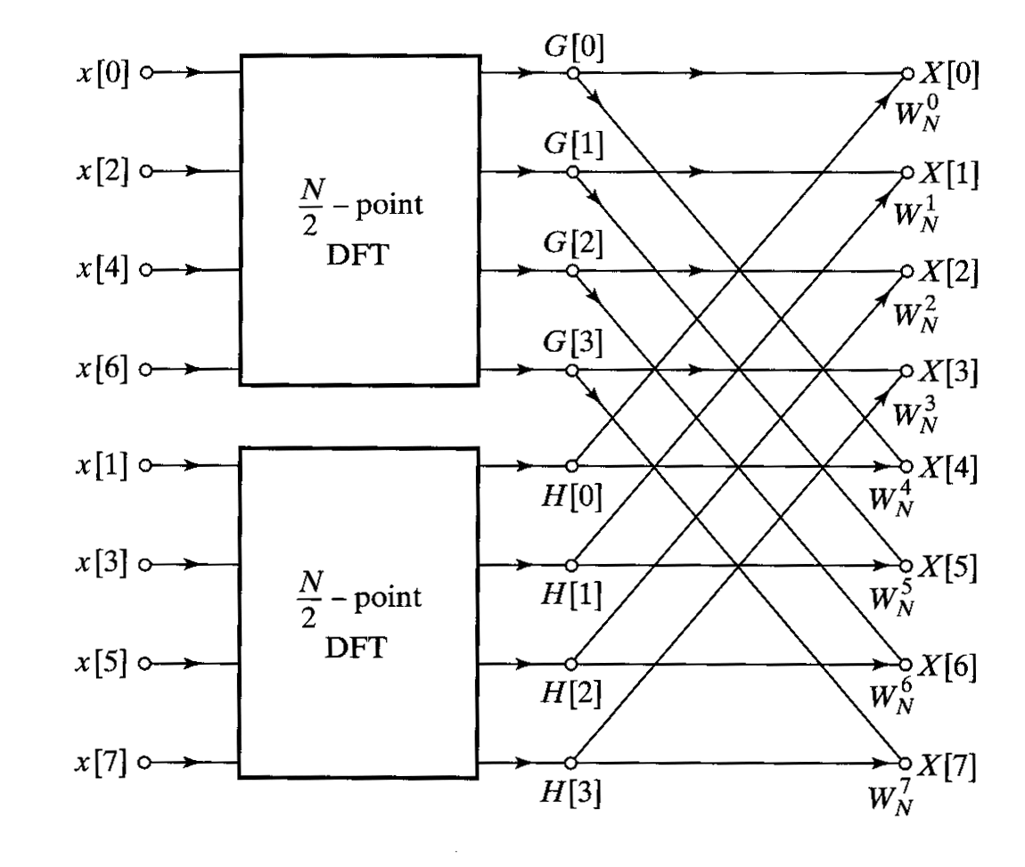
Signal flowgraph representation of 8-point DFT
Recall that the DFT is now of the form
The DFT in (partial) flowgraph notation:

Slide 12
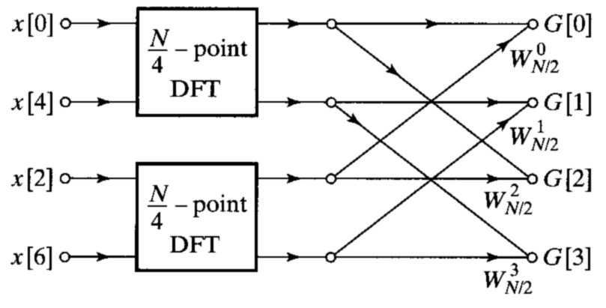
Continuing with the decomposition …
So why not break up into additional DFTs? Let’s take the upper 4-point DFT and break it up into two 2-point DFTs:

Slide 13
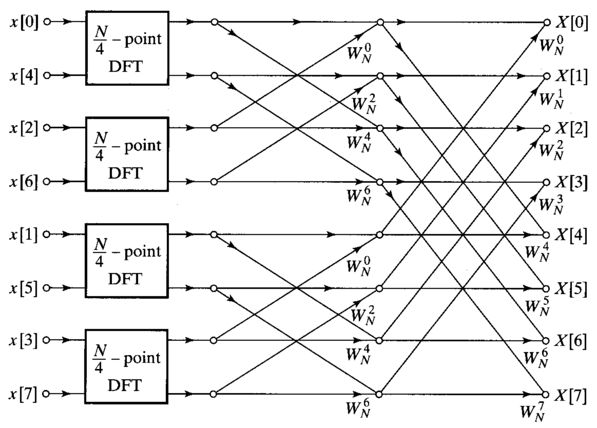
The complete decomposition into 2-point DFTs

Slide 14
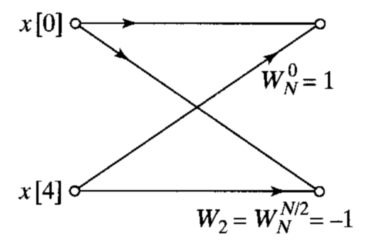
Now let’s take a closer look at the 2-point DFT
The expression for the 2-point DFT is:
Evaluating for we obtain
which in signal flowgraph notation looks like ...
This topology is referred to as the
basic butterfly

Slide 15
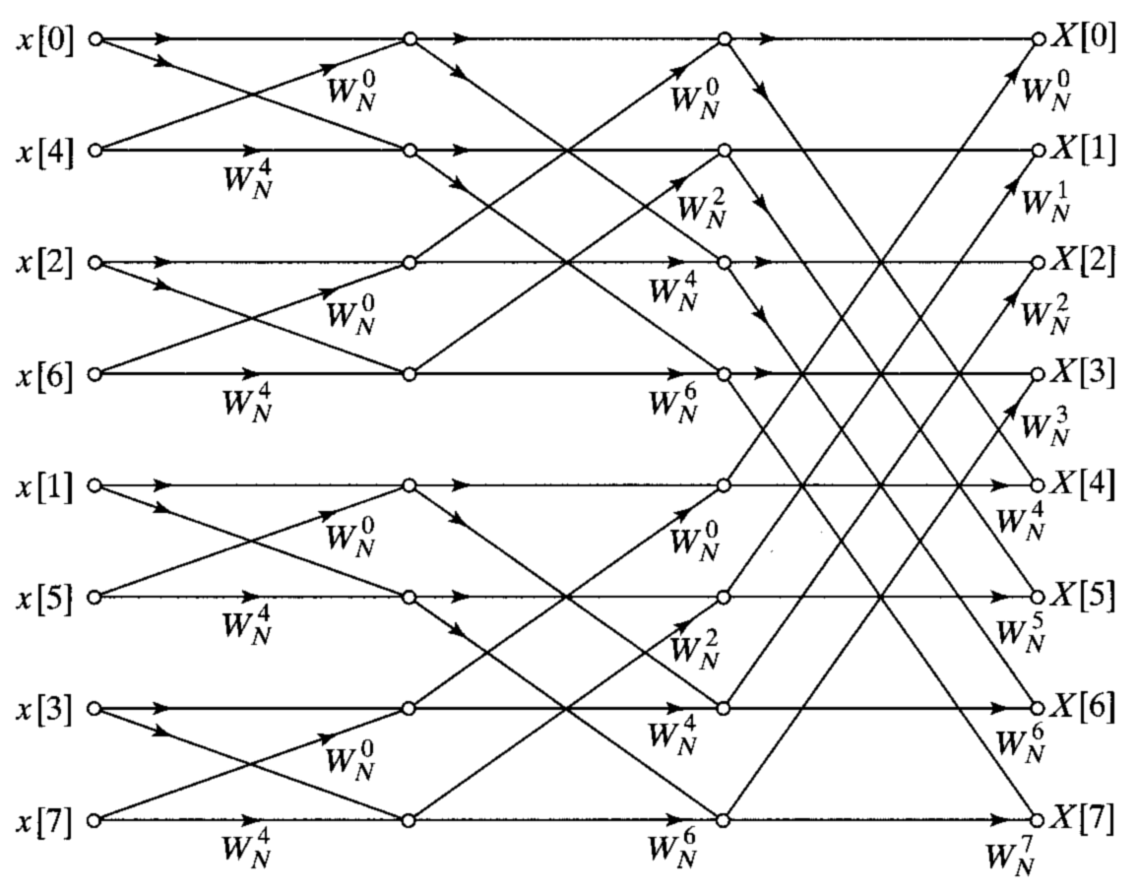
The complete 8-point decimation-in-time FFT

Slide 16
Number of multiplys for N-point FFTs
Let
(log₂(N) columns)(N/2 butterflys/column)(2 mults/butterfly)
or ~ multiplys

Slide 17
Comparing processing with and without FFTs
“Slow” DFT requires N² mults; FFT requires N log₂(N) mults
Filtering using FFTs requires 3(N log₂(N))+N mults
Let
N α₁ α₂
16 .25 .8124
32 .156 .50
64 .0935 .297
128 .055 .171
256 .031 .097
1024 .0097 .0302
Note: 1024-point FFTs
accomplish speedups of 100
for DFTs, 30 for filtering!

Slide 18
Additional timesavers: reducing multiplications in the basic butterfly
As we derived it, the basic butterfly is of the form
Since we can reduce computation by 2 by premultiplying by

Slide 19
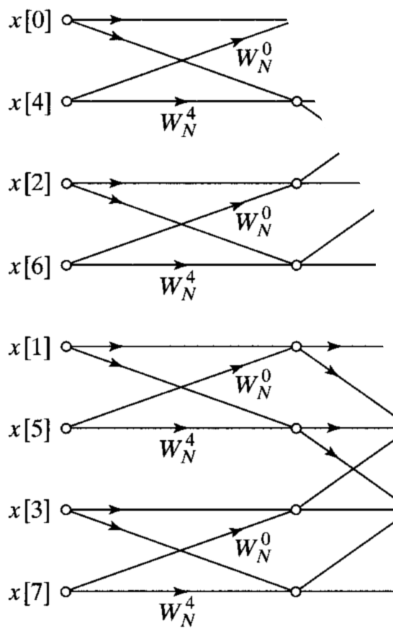
Bit reversal of the input
Recall the first stages of the 8-point FFT:
Consider the binary representation of the
indices of the input:
0 000
4 100
2 010
6 110
1 001
5 101
3 011
7 111
If these binary indices are
time reversed, we get the
binary sequence representing
0,1,2,3,4,5,6,7
Hence the indices of the FFT
inputs are said to be in
bit-reversed order

Slide 20
Some comments on bit reversal
In the implementation of the FFT that we discussed, the input is bit reversed and the output is developed in natural order
Some other implementations of the FFT have the input in natural order and the output bit reversed (to be described Monday)
In some situations it is convenient to implement filtering applications by
  Use FFTs with input in natural order, output in bit-reversed order
  Multiply frequency coefficients together (in bit-reversed order)
  Use inverse FFTs with input in bit-reversed order, output in natural order
Computing in this fashion means we never have to compute bit reversal explicitly

Slide 21
Using FFTs for inverse DFTs
We’ve always been talking about forward DFTs in our discussion about FFTs …. what about the inverse FFT?
One way to modify FFT algorithm for the inverse DFT computation is:
  Replace by wherever it appears
  Multiply final output by
This method has the disadvantage that it requires modifying the internal code in the FFT subroutine

Slide 22
A better way to modify FFT code for inverse DFTs
Taking the complex conjugate of both sides of the IDFT equation and multiplying by N:
This suggests that we can modify the FFT algorithm for the inverse DFT computation by the following:
  Complex conjugate the input DFT coefficients
  Compute the forward FFT
  Complex conjugate the output of the FFT and multiply by
This method has the advantage that the internal FFT code is undisturbed; it is widely used.

Slide 23
Summary
We developed the structure of the basic decimation-in-time FFT
Use of the FFT algorithm reduces the number of multiplys required to perform the DFT by a factor of more than 100 for 1024-point DFTs, with the advantage increasing with increasing DFT size
We can use the same structure to compute inverse FFTs
On Monday we will consider alternate forms of the FFT, and FFTs for values of DFT sizes that are not an integer power of 2

