Slide 1
18-491/691 Lecture #9 (First half)
FREQUENCY RESPONSE OF LSI SYSTEMS
Richard M. Stern
Department of Electrical and Computer Engineering
Carnegie Mellon University
Pittsburgh, Pennsylvania 15213
Phone: +1 (412) 268-2535
FAX: +1 (412) 268-3890
rms@cs.cmu.edu
http://www.ece.cmu.edu/~rms
February 5, 2025

Slide 2
Introduction
Last week we discussed the Z-transform at length, including the unit sample response, ROC, inverse Z-transforms and comparison to the DTFT and difference equations
Today we will discuss the frequency response of LSI systems and how it relates to the system function in Z-transform form
Specifically we will …
  Relate magnitude and phase of DTFT to locations of poles and zeros in z-plane
  Discuss several important special cases:
    All-pass systems
    Minimum/maximum-phase systems
    Linear phase systems

Slide 3
Review - Difference equations and Z-transforms characterizing LSI systems
x[n]
h[n]
y[n]
Many LSI systems are characterized by difference equations of the form
They produce system functions of the form
Comment: This notation is a little different from last week’s (but consistent with the text in Chap, 5)

Slide 4
Difference equations and Z-transforms characterizing LSI systems (cont.)
Comments:
  LSI systems characterized by difference equations produce z-transforms that are ratios of polynomials in z or z⁻¹
  The zeros are the values of z that cause the numerator to equal zero, and the poles are the values of z that cause the denominator polynomial to equal zero

Slide 5
Discrete-time Fourier transforms and the
Z-transform
Recall that the DTFT is obtained by evaluating the z-transform along the contour
The DTFT is generally complex and typically characterized by its magnitude and phase:

Slide 6
Obtaining the magnitude and phase of the DTFT by factoring the z-transform
Factoring the z-transform:
Comment: The constants and are the zeros and poles of the system respectively

Slide 7
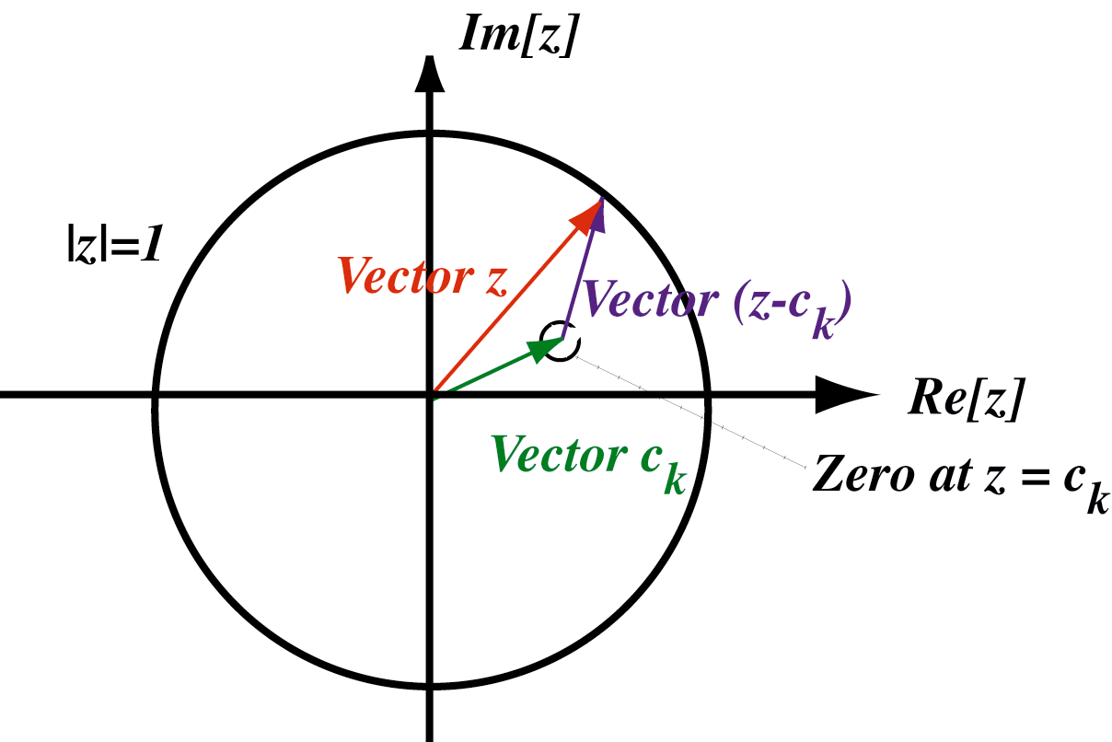
So what do those terms mean, anyway?
Convert into a polynomial in z by multiplying numerator and denominator by largest power of z:
Now consider one of the numerator terms,
Note that the vector (z-c_{k}) is the length of line from the zero to the current value of z or the distance from the zero to the unit circle.

Slide 8
Finding the magnitude of the DTFT
Magnitude:
Comment: The magnitude is the product of magnitudes from zeros divided by product of magnitudes from poles

Slide 9
Finding the phase of the DTFT
Phase:
Comment: The magnitude is the sum of the angles from the zeros minus the sums of the angles from the poles

Slide 10
Example 1: Unit time delay
Pole-zero pattern: Frequency response:

Slide 11
Example 2: Decaying exponential sample response
Pole-zero pattern: Frequency response:

Slide 12
Example 3: Notch filter
Pole-zero pattern: Frequency response:

Slide 13
Summary (first half)
The DTFT is obtained by evaluating the z-transform along the unit circle
As we walk along the unit circle,
  The magnitude of the DTFT is proportional of the product of the distances from the zeros divided by the product of the distances from the poles
  The phase of the DTFT is (within additive constants) the sum of the angles from the zeros minus the sum of the angles from the poles
After the break:
  Allpass systems
  Minimum-phase and maximum-phase systems
  Linear-phase systems

Slide 14
Special types of LSI systems
We can get additional insight about the frequency-response behavior of LSI systems by considering three special cases:
  Allpass systems
  Systems with minimum or maximum phase
  Linear-phase systems

Slide 15
All-pass systems
Consider an LSI system with system function
with α complex …..
Let
  Then there is a pole at
  And a zero at
Comment: We refer to this configuration as “mirror image” poles and zeros

Slide 16
Frequency response of all-pass systems
Obtaining magnitude of frequency response directly:

Slide 17
Frequency response of all-pass systems
All-pass systems have mirror-image
sets of poles and zeros
All-pass systems have a frequency
response with constant magnitude

Slide 18
System functions with the same magnitude can have more than one phase function
Consider two systems:
System 1: pole at .75, zero at .5 System 2: pole at .75, zero at 2
Comment: System 2 can be obtained by cascading System 1 with an all-pass system with a pole at .5 and a zero at 2. Hence the two systems have the same magnitude.

Slide 19
But what about the two phase responses?
Response of System 1: Response of System 2:
Comment: Systems have same magnitude, but System 2 has much greater phase shift

Slide 20
General comments on phase responses
System 1 has much less phase shift than System 2; this is generally considered to be good
System 1 has its zero inside unit circle; System 2 has zero its zero outside the unit circle
A system is considered to be of “minimum phase” if all of its zeros and all poles lie inside the unit circle
A system is considered to be of “maximum phase” if all of its zeros and all poles lie outside the unit circle
Systems with more than one zero might have neither minimum nor maximum phase

Slide 21
A digression: Symmetry properties of DTFTs
Recall from DTFT properties:
If
then
and ...

Slide 22
Consequences of Hermitian symmetry
If
Then
And

Slide 23
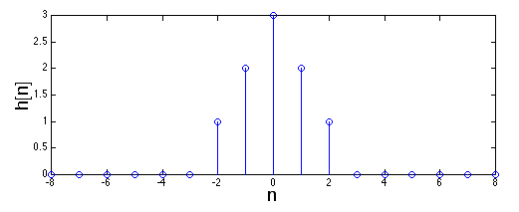
Zero phase systems
Consider an LSI system with an even unit sample response:
DTFT is
Comments:
  Frequency response is real, so system has “zero” phase shift
  This is to be expected since unit sample response is real and even

Slide 24
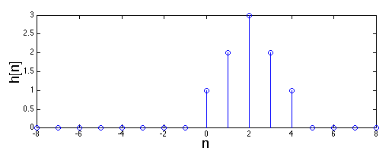
Linear phase systems
Now delay the system’s sample response to make it causal:
DTFT is now
Comment:
  Frequency response now exhibits linear phase shift

Slide 25
An additional comment or two
The system on the previous page exhibits linear phase shift
This is also reasonable, since the corresponding sample response can be thought of as a zero-phase sample response that undergoes a time shift by two samples (producing a linear phase shift in the frequency domain)
Another way to think about this is as a sample response that is even symmetric about the sample n=2
Linear phase is generally considered to be more desirable than non-linear phase shift
If a linear-phase system is causal, it must be finite in duration. (The current example has only 5 nonzero samples.)

Slide 26
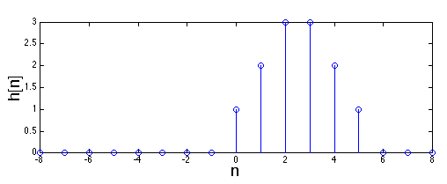
Another example of a linear phase systems
Now let’s consider a similar system but with an even number of sample points:
DTFT is

Slide 27
Comments on the last system
The system on the previous page also exhibits linear phase shift
In this case the corresponding sample response can be thought of as a zero-phase sample response that undergoes a time shift by 2.5 samples
In this case the unit sample response is symmetric about the “point” n=2.5
This type of system exhibits “generalized linear phase”, because the unit sample response is symmetric about a location that is between two integers

Slide 28
Zeros of linear phase systems
Let us now consider again the z-transform of the system of Slide 24:
Zeros are obtained easily by solving:
Multiplying both sides by z⁻⁴ produces
Note that if z₀ is a zero of H(z), z₀⁻¹ is as well. These are conjugate reciprocal locations:

Slide 29
Possible zero locations for linear-phase systems

Slide 30
Four types of linear-phase systems
Oppenheim and Schafer refer to four types systems with generalized linear phase. All have sample points that are symmetric about its midpoint.
  Type I: Odd number of samples, even symmetry
  Type II: Even number of samples, even symmetry
  Type III: Odd number of samples, odd symmetry
  Type IV: Even number of samples, odd symmetry

Slide 31
Summary of second half of lecture
All-pass systems have poles and zeros in “mirror-image” pairs
Minimum phase causal and stable systems have all zeros (as well as all poles) inside the unit circle
Maximum phase causal and stable systems have all zeros and all poles outside the unit circle
Linear phase systems have unit sample responses that are symmetric about their midpoint (which may lie between two sample points

