Slide 1
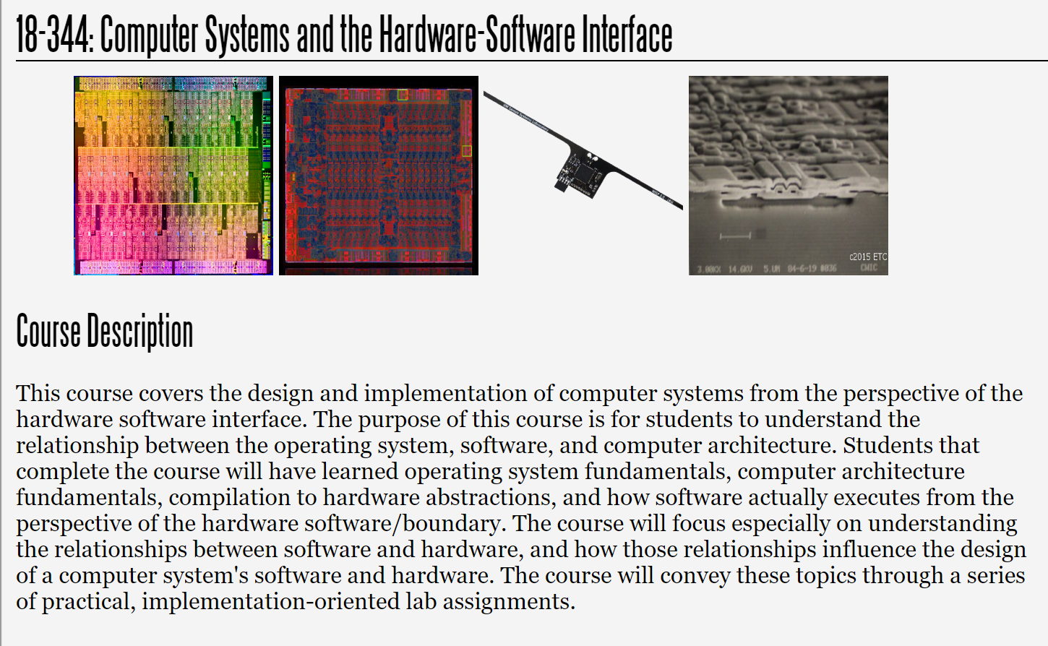
Fall 2025
Lecture 8: Cache Replacement Policies and Enhancements
Credit: Brandon Lucia

Slide 2
Replacement Policies

Slide 3
Replacement Policies
lb x6 0x7fff0053
Byte M
0011
Way 0
Way 1
Way 2
Way 3
fset
9
L3$
Set 0
Line
. . .
Which block in the set should we evict
32 Byte Block
@ 0x7fff0000
to make space for the new block?
Set 1
ache ontroller
Set 2
0,0,0x7fff00,…
1,0,0x7fff10,…
1,0,0x000000,…
1,1,0x001e00,…
. . .
Byte 2
Byte 1
Byte 0
Set 3

Slide 4
Replacement Policies – Round Robin
lb x6 0x7fff0053
Byte M
0011
Way 0
Way 1
Way 2
Way 3
fset
9
L3$
Set 0
Line
. . .
32 Byte Block
@ 0x7fff0000
Set 1
Evict
ache ontroller
Next
Set 2
0,0,0x7fff00,…
1,0,0x7fff10,…
1,0,0x000000,…
1,1,0x001e00,…
. . .
Byte 2
Byte 1
Byte 0
Set 3

Slide 5
Replacement Policies – Round Robin
lb x6 0x7fff0053
Byte M
0011
Way 0
Way 1
Way 2
Way 3
fset
9
L3$
Set 0
Line
. . .
32 Byte Block
@ 0x7fff0000
Set 1
Evict
ache ontroller
Next
Set 2
0,0,0x7fff00,…
1,0,0x7fff10,…
1,0,0x000000,…
1,1,0x001e00,…
. . .
Byte 2
Byte 1
Byte 0
Set 3

Slide 6
Replacement Policies – Round Robin
lb x6 0x7fff0053
Byte M
0011
Way 0
Way 1
Way 2
Way 3
fset
9
L3$
Set 0
Line
. . .
32 Byte Block
@ 0x7fff0000
Set 1
Evict
ache ontroller
Next
Set 2
0,0,0x7fff00,…
1,0,0x7fff10,…
1,0,0x000000,…
1,1,0x001e00,…
. . .
Byte 2
Byte 1
Byte 0
Set 3

Slide 7
Replacement Policies – Round Robin
lb x6 0x7fff0053
Byte M
0011
Way 0
Way 1
Way 2
Way 3
fset
9
L3$
Set 0
Line
. . .
32 Byte Block
@ 0x7fff0000
Set 1
Evict
ache ontroller
Next
Set 2
0,0,0x7fff00,…
1,0,0x7fff10,…
1,0,0x000000,…
1,1,0x001e00,…
. . .
Byte 2
Byte 1
Byte 0
Set 3

Slide 8
Replacement Policies – Round Robin
lb x6 0x7fff0053
Byte M
0011
Way 0
Way 1
Way 2
Way 3
fset
9
L3$
Set 0
Line
. . .
32 Byte Block
@ 0x7fff0000
Set 1
Evict
ache ontroller
NNeexxtt
Set 2
0,0,0x7fff00,…
1,0,0x7fff10,…
1,0,0x000000,…
1,1,0x001e00,…
. . .
Byte 2
Byte 1
Byte 0
Set 3

Slide 9

Replacement Policies – Round-Robin Analysis
lb | x6 | 0xe
lb | x6 | 0xb
lb | x6 | 0xc
lb | x6 | 0xd
lb | x6 | 0xa
Evict Next
Set 0
a
b
c
d
Advantage: Simple to implement and understand
Disadvantage: Hopefully the next to evict isn’t going to be the next to be accessed…

Slide 10

Replacement Policies – Round-Robin Analysis
lb | x6 | 0xe
lb | x6 | 0xb
lb | x6 | 0xc
lb | x6 | 0xd
lb | x6 | 0xa
Evict
Next
Set 0
a
e
c
d
Advantage: Simple to implement and understand
Disadvantage: Hopefully the next to evict isn’t going to be the next to be accessed…

Slide 11

Replacement Policies – Round-Robin Analysis
lb | x6 | 0xe
lb | x6 | 0xb
lb | x6 | 0xc
lb | x6 | 0xd
lb | x6 | 0xa
Evict
Next
Set 0
a
e
b
d
Advantage: Simple to implement and understand
Disadvantage: Hopefully the next to evict isn’t going to be the next to be accessed…

Slide 12

Replacement Policies – Round-Robin Analysis
lb | x6 | 0xe
lb | x6 | 0xb
lb | x6 | 0xc
lb | x6 | 0xd
lb | x6 | 0xa
Evict Next
Set 0
a
e
b
c
Advantage: Simple to implement and understand
Disadvantage: Hopefully the next to evict isn’t going to be the next to be accessed…

Slide 13

Replacement Policies – Round-Robin Analysis
lb | x6 | 0xe
lb | x6 | 0xb
lb | x6 | 0xc
lb | x6 | 0xd
lb | x6 | 0xa
Evict Next
Set 0
d
e
b
c
Advantage: Simple to implement and understand
Disadvantage: Hopefully the next to evict isn’t going to be the next to be accessed…

Slide 14
Replacement Policies – Round-Robin Analysis
lb | x6 | 0xe
lb | x6 | 0xb
lb | x6 | 0xc
lb | x6 | 0xd
lb | x6 | 0xa
Evict
Next
Set 0
d
a
b
c
Advantage: Simple to implement and understand
Disadvantage: Hopefully the next to evict isn’t going to be the next to be accessed…

Slide 15
Minimum Number of Misses?
lb | x6 | 0xe
lb | x6 | 0xb
lb | x6 | 0xc
lb | x6 | 0xd
lb | x6 | 0xa
Set 0
a
b
c
d
What is the best replacement strategy to minimize misses & why?

Slide 16
Minimum Number of Misses?
lb | x6 | 0xe
lb | x6 | 0xb
lb | x6 | 0xc
lb | x6 | 0xd
lb | x6 | 0xa
Evict
Next
Set 0
a
b
c
d

Slide 17
When are we going to re-use cached data?
lb | x6 | 0xe
lb | x6 | 0xb
lb | x6 | 0xc
lb | x6 | 0xd
lb | x6 | 0xa
Miss Hit
Hit
Hit Miss
Set 0
e
b
c
d
Replacement decisions must be informed by the next reuse of a block of data.
Think: what is an optimal policy? How far in the future is something going to be used again?

Slide 18
When are we going to re-use cached data?
lb | x6 | 0xe
lb | x6 | 0xb
lb | x6 | 0xc
lb | x6 | 0xd
lb | x6 | 0xa
Miss Hit
Hit
Hit Miss
Set 0
d
a
b
c
What defines optimality for a cache replacement algorithm?

Slide 19
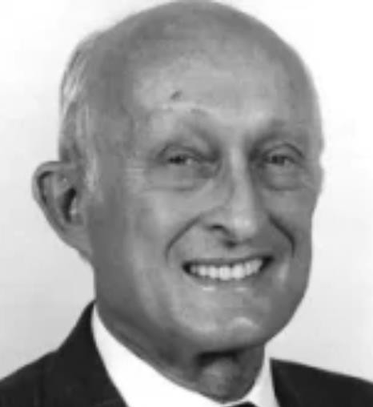
Belady’s MIN Algorithm for Optimal Replacement
lb | x6 | 0xe
lb | x6 | 0xb
lb | x6 | 0xc
lb | x6 | 0xd
lb | x6 | 0xa
Miss Hit
Hit
Hit Miss
Set 0
d
a
b
c
Bélády László:
“What defines optimality for a cache replacement algorithm?”
Evict the cached element that will be used furthest in the future.

Slide 20

Belady’s MIN Algorithm for Optimal Replacement
lb | x6 | 0xe
lb | x6 | 0xa
lb | x6 | 0xb
lb | x6 | 0xa
lb | x6 | 0xc
lb | x6 | 0xa
lb | x6 | 0xd
lb | x6 | 0xa
lb | x6 | 0xe
lb | x6 | 0xa
lb | x6 | 0xf
lb | x6 | 0xe
Set 0
d
a
b
c

Slide 21
Belady’s MIN Algorithm for Optimal Replacement
lb | x6 | 0xe
lb | x6 | 0xa
lb | x6 | 0xb
lb | x6 | 0xa
lb | x6 | 0xc
lb | x6 | 0xa
lb | x6 | 0xd
lb lb | x6 x6 | 0xa 0xe
lb | x6 | 0xa
lb | x6 | 0xf
lb | x6 | 0xe
Set 0
d
a
b
c
reuse distance: 6 reuse distance: 1 reuse distance: 2 reuse distance: 4

Slide 22
Belady’s MIN Algorithm for Optimal Replacement
lb | x6 | 0xe
lb | x6 | 0xa
lb | x6 | 0xb
lb | x6 | 0xa
lb | x6 | 0xc
lb | x6 | 0xa
lb | x6 | 0xd
lb lb | x6 x6 | 0xa 0xe
lb | x6 | 0xa
lb | x6 | 0xf
lb | x6 | 0xe
Evict Next
Set 0
d
a
b
c
reuse distance: 6 reuse distance: 1 reuse distance: 2 reuse distance: 4

Slide 23
Belady’s MIN Algorithm for Optimal Replacement
lb | x6 | 0xe
lb | x6 | 0xa
lb | x6 | 0xb
lb | x6 | 0xa
lb | x6 | 0xc
lb | x6 | 0xa
lb | x6 | 0xd
lb lb | x6 x6 | 0xa 0xe
lb | x6 | 0xa
lb | x6 | 0xb
lb | x6 | 0xa
Set 0
e
a
b
c
reuse distance: 2 reuse distance: 1 reuse distance: 4 reuse distance: ∞

Slide 24
Belady’s MIN Algorithm for Optimal Replacement
lb | x6 | 0xe
lb | x6 | 0xa
lb | x6 | 0xb
lb | x6 | 0xa
lb | x6 | 0xc
lb | x6 | 0xa
lb | x6 | 0xd
lb lb | x6 x6 | 0xa 0xe
lb | x6 | 0xa
lb | x6 | 0xb
lb | x6 | 0xa
Evict Next
Set 0
e
a
b
c
reuse distance: 2 reuse distance: 1 reuse distance: 4 reuse distance: ∞

Slide 25
Belady’s MIN Algorithm for Optimal Replacement
findBlockMIN(){
0://init reuse distances 1:for each block in cache, b:
2: RD[b] = 0; RD_done[b] = false;
3://look forward in the execution trace
4:for each access, a, forward in execution trace: 5://increment reuse distance for each block not already seen
6:
7:
8:
9:
for each block in cache, b:
if RD_done[b] == false:
RD[b]++;
RD_done[a.block] = true
10://MIN finds the block with maximum RD 11:return argmax(b,RD[b])
MIN results in the MINimum number of replacements in a cache for an execution trace.

Slide 26
Belady’s MIN Algorithm for Optimal Replacement
findBlockMIN(){
0://init reuse distances 1:for each block in cache, b:
2: RD[b] = 0; RD_done[b] = false;
3://look forward in the execution trace
4:for each access, a, forward in execution trace: 5://increment reuse distance for each block not already seen
6:
7:
8:
9:
for each block in cache, b:
if RD_done[b] == false:
RD[b]++;
RD_done[a.block] = true
10://MIN finds the block with maximum RD 11:return argmax(b,RD[b])
See any limitations of the MIN algorithm for cache replacement?

Slide 27
Belady’s MIN Algorithm for Optimal Replacement
findBlockMIN(){
0://init reuse distances 1:for each block in cache, b:
2: RD[b] = 0; RD_done[b] = false;
3://look forward in the execution trace
4:for each access, a, forward in execution trace:
5://increment reuse distance for each block not already seen
6:
7:
8:
9:
for each block in cache, b:
if RD_done[b] == false:
RD[b]++;
RD_done[a.block] = true
10://MIN finds the block with maximum RD 11:return argmax(b,RD[b])
Need omniscient future knowledge of the execution trace of your program! MIN is optimal, but not practically implementable

Slide 28
Practical Replacement Algorithms
General idea: Assume the near future is similar to the recent past
lb | x6 | 0xe
lb | x6 | 0xa
lb | x6 | 0xb
lb | x6 | 0xa
lb | x6 | 0xc
lb | x6 | 0xa
lb | x6 | 0xd
lb | x6 | 0xa
lb | x6 | 0xe
lb | x6 | 0xa
lb | x6 | 0xb
lb | x6 | 0xe
knowable
Set 0
e
a
b
c
guessable
If a block was used recently, it will be used again soon

Slide 29
Least-Recently Used (LRU) Replacement
Evict the block that was used the furthest in the execution’s past
lb | x6 | 0xe
lb | x6 | 0xa
lb | x6 | 0xb
lb | x6 | 0xa
lb | x6 | 0xc
lb | x6 | 0xa
lb | x6 | 0xd
lb | x6 | 0xa
lb | x6 | 0xe
lb | x6 | 0xa
lb | x6 | 0xb
lb | x6 | 0xe
knowable
Set 0
e
a
b
c
guessable
If a block was not used recently, it will not be used again soon

Slide 30
Least-Recently Used (LRU) Replacement
Evict the block that was used the furthest in the execution’s past
lb | x6 | 0xe
lb | x6 | 0xa
lb | x6 | 0xb
lb | x6 | 0xa
lb | x6 | 0xc
lb | x6 | 0xa
lb | x6 | 0xd
lb | x6 | 0xa
lb | x6 | 0xe
lb | x6 | 0xa
lb | x6 | 0xb
lb | x6 | 0xe
knowable
Evict
Next
Set 0
e
a
b
c
last use: -6 last use: -1 last use: -4 last use: -2
LRU’s Gamble: “Haven’t used block 0xe for longest, probably won’t use it again any time soon, either”
If a block was not used recently, it will not be used again soon
guessable

Slide 31
Least-Recently Used (LRU) Replacement
Evict the block that was used the furthest in the execution’s past
lb | x6 | 0xe
lb | x6 | 0xa
lb | x6 | 0xb
lb | x6 | 0xa
lb | x6 | 0xc
lb | x6 | 0xa
lb | x6 | 0xd
lb | x6 | 0xa
lb | x6 | 0xe
lb | x6 | 0xa
lb | x6 | 0xb
lb | x6 | 0xe
knowable
LRU
Evicts
MIN
Evicts
Set 0
e
a
b
c
last use: -6 last use: -1 last use: -4 last use: -2
Caveat: LRU is wrong if past does not predict future
Caveat to caveat: past usually predicts future well
If a block was not used recently, it will not be used again soon
guessable

Slide 32
(Naïve) LRU Algorithm & Implementability
accessCacheLRU(access a){ for each block in cache, b:
if b != a.block: LRU_Age[b]++
LRU_Age[b] = 0
}
findBlockLRU(){
return argmax(b,LRU_Age)
}
Implementability and limitations of LRU?

Slide 33
(Naïve) LRU Algorithm & Implementability
accessCacheLRU(access a){ for each block in cache, b:
if b != a.block: LRU_Age[b]++
LRU_Age[b] = 0
}
findBlockLRU(){
return argmax(b,LRU_Age)
}
Implementability! Does not require unknowable information about future of execution Limitation! Requires accessing metadata for every block on each access to any block.
Time & energy cost to update ages. Area & power cost to store age values.
Does not scale beyond about 4 way set associativity.

Slide 34
Bit-Pseudo-Least-Recently Used (Bit-PLRU)
Evict a block that was definitely not most recently used
lb | x6 | 0xe
lb | x6 | 0xa
lb | x6 | 0xb
lb | x6 | 0xa
lb | x6 | 0xc
lb | x6 | 0xa
lb | x6 | 0xd
lb | x6 | 0xa
lb | x6 | 0xe
lb | x6 | 0xa
lb | x6 | 0xb
lb | x6 | 0xe
knowable
Set 0
e
a
b
c
MRU: 0
MRU: 1
MRU: 0
MRU: 0
guessable
Set MRU bit when block is used (most recently), clear all MRU bits when all MRU bits are set, evict the left-most block with unset MRU bit

Slide 35
Bit-Pseudo-Least-Recently Used (Bit-PLRU)
Evict a block that was definitely not most recently used
lb | x6 | 0xe
lb | x6 | 0xa
lb | x6 | 0xb
lb | x6 | 0xa
lb | x6 | 0xc
lb | x6 | 0xa
lb | x6 | 0xd
lb | x6 | 0xa
lb | x6 | 0xe
lb | x6 | 0xa
lb | x6 | 0xb
lb | x6 | 0xe
knowable
Bit-PLRU
Evicts
Set 0
e
a
b
c
MRU: 0
MRU: 1
MRU: 0
MRU: 0
guessable
Set MRU bit when block is used (most recently), clear all MRU bits when all MRU bits are set, evict the left-most block with unset MRU bit

Slide 36
Bit-Pseudo-Least-Recently Used (Bit-PLRU)
Evict a block that was definitely not most recently used
LRU
Evicts
lb x6 0xe lb x6 0xa
lb | x6 | 0xb
lb | x6 | 0xa
lb | x6 | 0xc
lb | x6 | 0xa
lb | x6 | 0xd
lb | x6 | 0xa
lb | x6 | 0xe
lb | x6 | 0xa
lb | x6 | 0xb
lb | x6 | 0xe
knowable
Bit-PLRU
Evicts
MIN
Evicts
Set 0
e
a
b
c
MRU: 0
MRU: 1
MRU: 0
MRU: 0
guessable
Bit-PLRU is a decent approximation of LRU

Slide 37
Bit-PLRU Algorithm & Implementability
accessCachePLRU(access a){
MRU_Bit[a.block] = 1
if ++MRU_BitSum == setSize: for each block in cache, b:
MRU_Bit[b] = 0
MRU_BitSum = 0
}
findBlockLRU(){
for i in 0..setSize: if !MRU_Bit[i]:
return block(i);
}
Implementability and limitations of Bit-PLRU?

Slide 38
Bit-PLRU Algorithm & Implementability
accessCachePLRU(access a){
MRU_Bit[a.block] = 1
if ++MRU_BitSum == setSize: for each block in cache, b:
MRU_Bit[b] = 0
MRU_BitSum = 0
}
findBlockLRU(){
for i in 0..setSize: if !MRU_Bit[i]:
return block(i);
}
Implementability! No future knowledge, 1 bit/block overhead, block-local metadata updates on access (no O(n) aging operation)
Limitation! Approximates LRU, which approximates MIN by guessing based on history…

Slide 39
Replacement Policies – Performance & Complexity Cost/Benefit Analysis
RR: log(set size) bits per set to track next to evict, no action on access
Notional Plot: not real data (You measure these in Lab 2!)
Bit-PLRU: 1 MRU bit per block + log(set size) bits per set (or equivalent logic) to detect all set,
Clear bits on access if all bits set
Misses per Kilo
Instruction (MPKI)
LRU: 1 age per block + logic to track max. Update (set size - 1) ages on any access
RR
Bit- PLRU
LRU
MIN
MIN: unimplementable, requires future knowledge of execution trace.

Slide 40
More cache-related optimizations
Way 0
Way 1
Way 2
Way 3
L3$
Set 0
Line
Set 1
Set 2
Set 3

Slide 41
Recall a Set Associative Caches
What type of miss can be addressed by cache design?
Cold?
Capacity?
Conflict?
What can we do to address those misses without doing the impractical:
Increasing cache size significantly(costly)
Increasing associativity (slower)
Address the most glaring misses caused by partitioning, i.e. conflict misses
But how?
Way 0
Way 1
Way 2
Way 3
L3$
Set 0
Line
Set 1
Set 2
Set 3

Slide 42
Miss Cache
Set associative
Probably write-through (Why?)
L1
Just a few lines, i.e. 2 – 4, but fully associative
Miss Cache
The most recent few reads brought into L1 from L2 also hang out for a very short time in the “Miss Cache” which is fully associative. L1 misses that is satisfied by the “Miss Cache” very low penalty.
L2

Slide 43
Miss Cache
L1
But, most of the time, the miss cache stores values that are already stored in the L1 cache, as they were just read into both L1 and the miss cache from the L2 cache, which is a waste of space.
What can we do about that?
Miss Cache
L2

Slide 44
Victim Caches/Buffers
LL33$$ |  | Way 0 | Way 1 | Way 2 | Way 3
 | Set 0 | Line
 | Set 1
 | Set 2
 | Set 3
Only store things into the cache upon eviction – then the only copy is in the small cache between L1 and L2, now called victim buffer.
Block evicted from cache goes into (usually
fully associative, small) victim buffer.
Victim Cache

Slide 45
Victim Caches/Buffers
LL33$$ |  | Way 0 | Way 1 | Way 2 | Way 3
 | Set 0 | Line
 | Set 1
 | Set 2
 | Set 3
Block evicted from cache goes into (usually fully associative, small) victim buffer.
On next access, “victim” can be re-cached
without going down the hierarchy.
Victim Cache

Slide 46
Victim Caches/Buffers
LL33$$ |  | Way 0 | Way 1 | Way 2 | Way 3
 | Set 0 | Line
 | Set 1
 | Set 2
 | Set 3
Block evicted from cache goes into (usually fully associative, small) victim buffer.
On next access, “victim” can be re-cached
without going down the hierarchy.
What problem does a victim cache solve?
Victim Cache

Slide 47
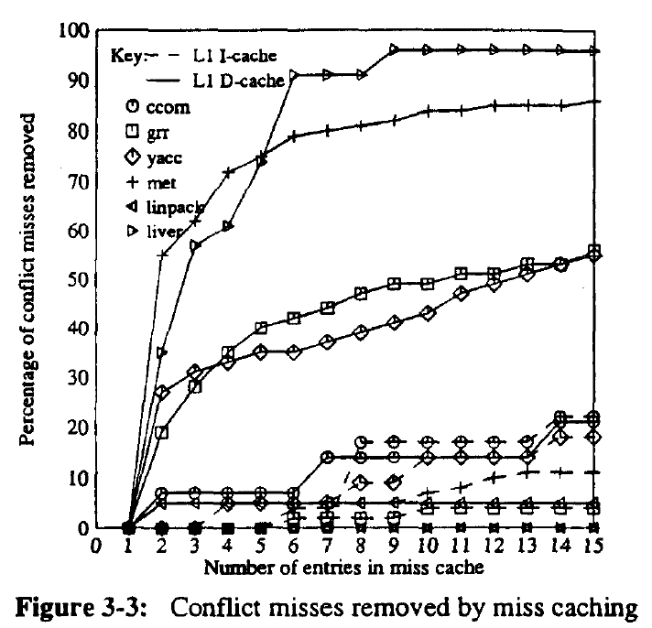
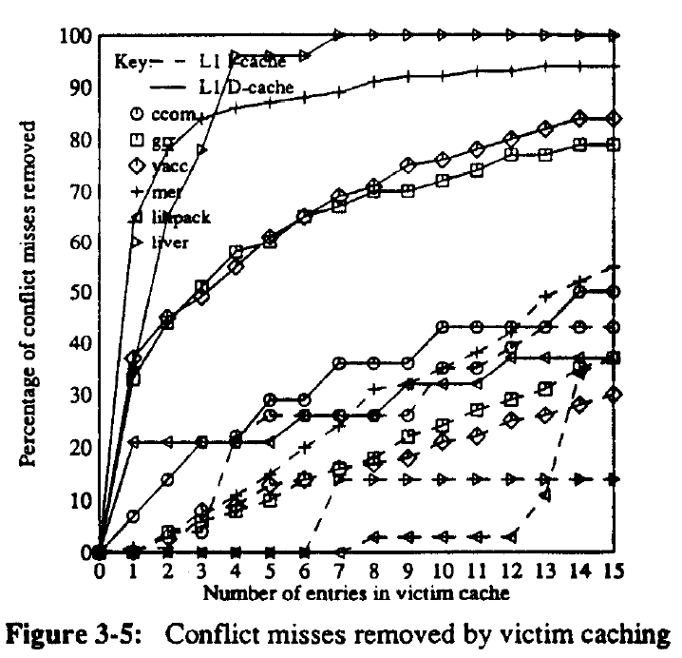
Miss Caching vs Victim Caching
Norman P. Jouppi. 1990. Improving direct-mapped cache performance by the addition of a small fully-associative cache and prefetch buffers. SIGARCH Computer Architecture News 18(3):388-397.
Victim Caches better than Miss Caches
But, butter for d-Caches than i-Caches. Why? (Think about locality and distance)

Slide 48
Stream Buffer
L1
Benefits i-caches
Upon miss, prefetch next n instructions
Gets back ahead after jumps
Stream Buffer
L2

Slide 49
Non-blocking Writes & Write Buffering
sw 0xc $1000
Byte M
WB/Mem Fwd
Mem/Mem Fwd Addr Reg A
WB/Mem Fwd
Mem/Mem Fwd
Data Reg B
Write Buffer Entry (e.g.)
Write Buffer
WB drains to…
. . .
MUX
MUX
…cache if
write-back
…memory, if write-through (why WB important for write-through caches?)
MUX
Read Data C
Byte 0xF Byte 0xE Byte 0xD Byte 0xC
Cont. Sigs.: Op. Select
Memory Unit
Memory unit can read from write buffer
[Ld/St]
. . .
Memory
Byte 2
Byte 1
Byte 0
Cache
Write buffer: single cycle to add write op to write buffer What problem does a write buffer solve?
What are key challenges associated with a write buffer?

Slide 50
Non-blocking Writes & Write Buffering
sw 0xc $1000
Byte M
WB/Mem Fwd
Mem/Mem Fwd Addr Reg A
WB/Mem Fwd
Mem/Mem Fwd
Data Reg B
Write Buffer Entry (e.g.)
Write Buffer
WB drains to…
. . .
MUX
MUX
…cache if
write-back
…memory, if write-through (why WB important for write-through caches?)
MUX
Read Data C
Byte 0xF Byte 0xE Byte 0xD Byte 0xC
Cont. Sigs.: Op. Select
Memory Unit
Memory unit can read from write buffer
[Ld/St]
. . .
Memory
Byte 2
Byte 1
Byte 0
Cache
Completed memory operations’ effects not yet in memory (complicated stuff,
later in the semester…)
What is the latency of a write if it ends up buffered?
Unpredictable write completion latency. Need ordering logic.

Slide 51
Non-temporal/Streaming Stores
Byte M
In x86: movntdq r15, 0xC
Write Buffer
WB drains to…
WB/Mem Fwd
Mem/Mem Fwd Addr Reg A
WB/Mem Fwd
Mem/Mem Fwd
Data Reg B
. . .
MUX
MUX
…cache if write-back
& not non-temporal
…memory, if write-through
or non-temporal instruction
MUX
Read Data C
Byte 0xF Byte 0xE Byte 0xD Byte 0xC
Cont. Sigs.: Op. Select
Memory Unit
Memory unit can read from write buffer
[Ld/St]
. . .
Memory
Byte 2
Byte 1
Byte 0
Cache
Non-temporal Store: Acts like no-write-allocate+write-through even if write-allocate+write-back for rest of cache.
When would you use a non-temporal store instruction?

Slide 52
Non-temporal/Streaming Stores
Byte M
In x86: movntdq r15, 0xC
Write Buffer
WB drains to…
WB/Mem Fwd
Mem/Mem Fwd Addr Reg A
WB/Mem Fwd
Mem/Mem Fwd
Data Reg B
. . .
MUX
MUX
…cache if write-back
& not non-temporal
…memory, if write-through
or non-temporal instruction
MUX
Read Data C
Byte 0xF Byte 0xE Byte 0xD Byte 0xC
Cont. Sigs.: Op. Select
Memory Unit
Memory unit can read from write buffer
[Ld/St]
. . .
Memory
Byte 2
Byte 1
Byte 0
Cache
When would you use a non-temporal store instruction?
Data streaming, accesses that are sure to have no locality

Slide 53
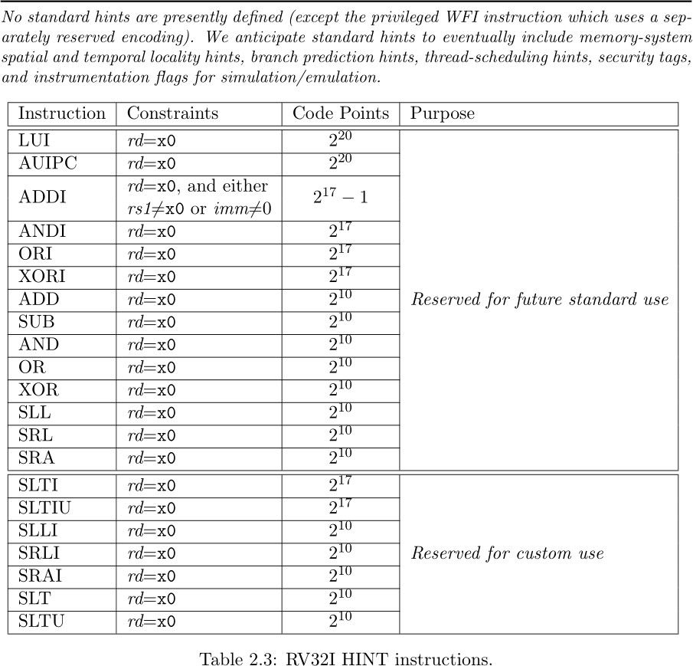
Not in RISCV (yet)!
RISCV Specification:
“RV32I reserves a large encoding space for HINT instructions, which are usually used to communicate performance hints to the microarchitecture. HINTs are encoded as integer computational instructions with rd=x0. Hence, like the NOP instruction, HINTs do not change any architecturally visible state, except for advancing the pc and any applicable performance counters.
Implementations are always allowed to
ignore the encoded hints.”

Slide 54
Scratchpad Memories
Memory unit can load from and
store to SP separately from Mem
Byte S.0
Byte S.N
BByyttee MM
WB/Mem Fwd
Mem/Mem Fwd Addr Reg A
WB/Mem Fwd
Mem/Mem Fwd
Data Reg B
Memory Unit controls loading data from memory to SP
Write Buffer
WB drains to…
. . .
MUX
MUX
…cache if write-back
& not non-temporal
MUX
Read Data C
…memory, if write-through
or non-temporal instruction
Byte 0xF Byte 0xE Byte 0xD Byte 0xC
Cont. Sigs.: Op. Select
Memory Unit
Memory unit can read from write buffer
[Ld/St]
. . .
Memory
Byte 2
Byte 1
Byte 0
Cache
Scratchpad Memory: Software controlled memory with
explicit, scratch-pad-private physical memory space

Slide 55
Scratchpad Memories
Memory unit can load from and
store to SP separately from Mem
Byte S.0
Byte S.N
BByyttee MM
WB/Mem Fwd
Mem/Mem Fwd Addr Reg A
WB/Mem Fwd
Mem/Mem Fwd
Data Reg B
Memory Unit controls loading data from memory to SP
Write Buffer
WB drains to…
. . .
MUX
MUX
…cache if write-back
& not non-temporal
MUX
Read Data C
…memory, if write-through
or non-temporal instruction
Byte 0xF Byte 0xE Byte 0xD Byte 0xC
Cont. Sigs.: Op. Select
Memory Unit
Memory unit can read from write buffer
[Ld/St]
. . .
Memory
Byte 2
Byte 1
Byte 0
Cache
Why would you use a scratchpad when a cache makes
everything transparent to software and automatic???

Slide 56
Scratchpad Memories
Most often manipulated by accessing special range of addresses mapped to SP
Byte S.0
Byte S.N
BByyttee MM
WB/Mem Fwd
Mem/Mem Fwd Addr Reg A
WB/Mem Fwd
Mem/Mem Fwd
Data Reg B
Memory Unit controls loading data from memory to SP
Write Buffer
WB drains to…
. . .
MUX
MUX
…cache if write-back
& not non-temporal
MUX
Read Data C
…memory, if write-through
or non-temporal instruction
Byte 0xF Byte 0xE Byte 0xD Byte 0xC
Cont. Sigs.: Op. Select
Memory Unit
Memory unit can read from write buffer
[Ld/St]
. . .
Memory
Byte 2
Byte 1
Byte 0
Cache
Most important thing about scratchpads:
Software control is as good (or bad) as the programmer.

Slide 57
Review Questions to Ponder: The Memory Hierarchy and the Hardware Software Boundary
Part of the architecture: Cache? Scratchpad? Replacement policy?
Part of the HW/SW boundary: Cache? Scratchpad? Replacement policy?
What does a programmer need to know about how the cache works?
What does the architect need to know about how the machine will be used?

Slide 58
What did we just learn?
Replacement is a one of the key dimensions of cache design
Different replacement algorithms present different design trade offs
Optimal replacement is infeasible, practical replacement is non-optimal
Many microarchitectural and architectural choices make up a memory hierarchy and the architect and programmer need to share information

Slide 59
What to think about next?
Performance Evaluation (next time)
Design spaces, Pareto Frontiers, and design space exploration
Miscellaneous (micro)architectural tricks & optimizations (future)
Vector processors, SIMD/SIMT, dataflow

Slide 60
What to think about next?
Caches as a microarchitectural optimization (next time)
Implementation of cache hierarchies
Cache design tradeoffs
Performance Evaluation (next next time)
Design spaces, Pareto Frontiers, and design space exploration
Miscellaneous (micro)architectural tricks & optimizations (future)
Vector processors, SIMD/SIMT, dataflow

