Slide 1
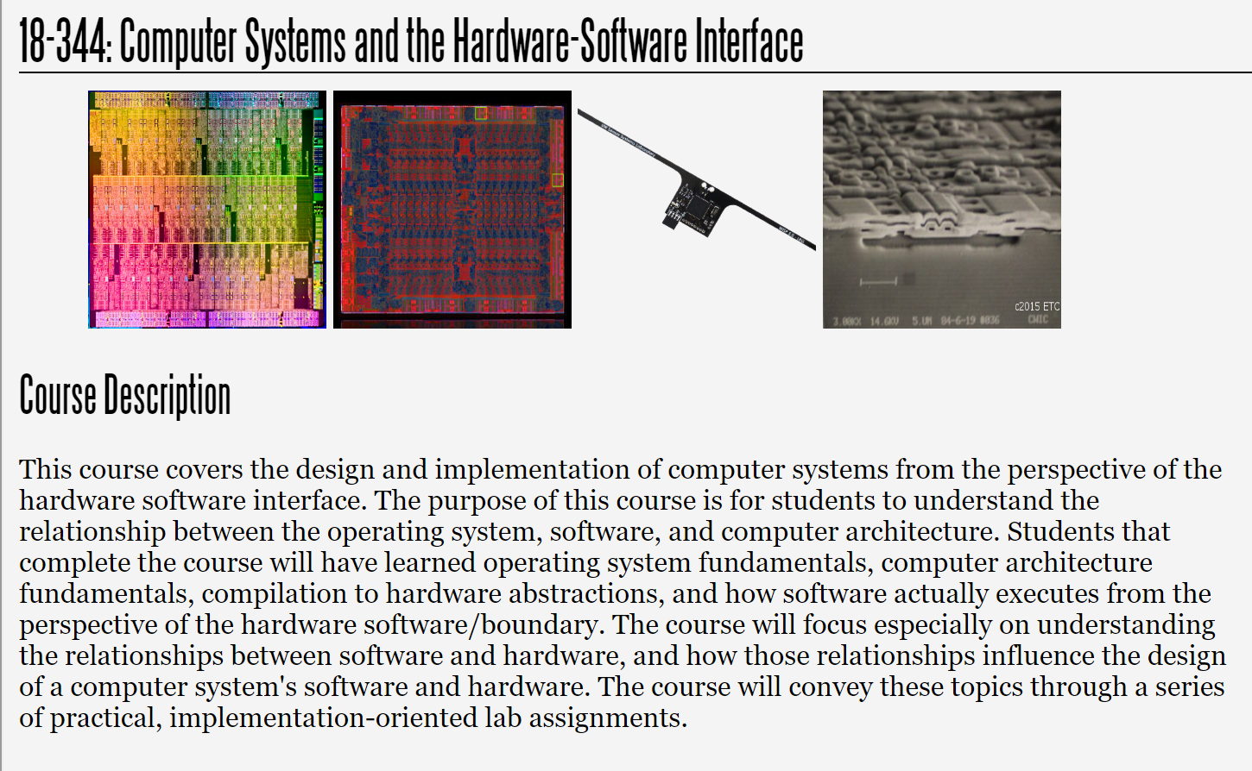
Fall 2025
Lecture 7: Caches and the Memory Hierarchy
Credit: Brandon Lucia

Slide 2
Today: Caches and the Memory Hierarchy
Introduction to caches and cache organization
Caches in the memory hierarchy
Cache implementation choices
Cache hardware optimizations
Software-managed caches & scratchpad memories

Slide 3
Memory is a big list of M bytes
Byte M
lw x6 0xC
. . .
Fetch
Decode
Execute
Memory
Register Write-Back
Byte 0xF Byte 0xE Byte 0xD Byte 0xC
. . .
Byte 2
Byte 1
Byte 0

Slide 4
Memory is conceptually far away from CPU
lw x6 0xC
Byte M
WB/Mem Fwd
Mem/Mem Fwd Addr Reg A
WB/Mem Fwd
Mem/Mem Fwd
Data Reg B
. . .
MUX
MUX
MUX
What does this “distance” entail for a
hardware / software interface?
Read Data C
Byte 0xF Byte 0xE Byte 0xD Byte 0xC
Cont. Sigs.: Op. Select [Ld/St]
Memory
Unit
. . .
Memory
Byte 2
Byte 1
Byte 0

Slide 5
Memory is conceptually far away from CPU
lw x6 0xC
Byte M
WB/Mem Fwd
Mem/Mem Fwd Addr Reg A
WB/Mem Fwd
Mem/Mem Fwd
Data Reg B
What does this “distance” entail for a hardware / software
interface?
Need to be judicious with lw & sw
Compiler & programmer must carefully lay out memory
Worth spending hardware resources to optimize
Need hardware and software to co-optimize data re-use
Data movement is a fundamental limit on speed & energy
. . .
MUX
MUX
MUX
Read Data C
Byte 0xF Byte 0xE Byte 0xD Byte 0xC
Cont. Sigs.: Op. Select [Ld/St]
Memory
Unit
. . .
Memory
Byte 2
Byte 1
Byte 0

Slide 6
Memory hierarchy: large & slow vs. small & fast
lw x6 0xC
Byte M
LL11II$$
WB/Mem Fwd
Mem/Mem Fwd Addr Reg A
Byte I1
WB/Mem Fwd
Mem/Mem Fwd
Data Reg B
L3$
Byte M3
L2$
. . .
MUX
MUX
MUX
Byte M2
Read Data C
Byte 0xF Byte 0xE Byte 0xD Byte 0xC
Cont. Sigs.: Op. Select
Memory
Unit
L1D$
Byte M1
[Ld/St]
. . .
Memory
Byte 2
Byte 1
Byte 0
Capacity inversely proportional to access cost
M > M3 > M2 > M1

Slide 7
Recall: Memory Hierarchy from 18x13
L0:
Regs
CPU registers hold words retrieved from the L1 cache.
Smaller,
faster,
and
costlier
(per byte)
storage
devices
L1:
L1 cache
(SRAM)
L1 cache holds cache lines retrieved from the L2 cache.
L2:
L2 cache
(SRAM)
L2 cache holds cache lines
retrieved from L3 cache.
L3:
L3 cache
(SRAM)
L3 cache holds cache lines
retrieved from main memory.
Larger,
slower,
and
cheaper
(per byte)
storage
devices
L4:
Main memory
(DRAM)
Main memory holds disk blocks retrieved from local disks.
L5:
Local secondary storage
(SSD/Disk)
Local disks hold files retrieved from disks
on remote servers.
L6:
Remote secondary storage
(e.g., Web servers)

Slide 8
Recall from 18x13: The Working Set
The data that is presently being use is called the Working Set.
Imagine you are working on 18x13. Your working set might include:
The lab handout
A terminal window for editing
A terminal window for debugging
A browser window for looking up man pages
If you changed tasks, you’d probably hide those windows and open new ones
The data computer programs use works the same way.

Slide 9
Recall from 18x13: Guesstimating the Working Set
How does the memory system (cache logic) know the working set?
This is tricky. There is no way it can really know what data the program needs or will need soon.
It could even be totally dynamic, based upon input.
It approximates it using a simple heuristic called locality:
Temporal locality: Data used recently is likely to be used again in the near future (local in time).
Spatial locality: Data near the data used recently is likely to be used soon (local in space, e.g. address space).
The memory system will bring and keep the Most Recently Used (MRU) data and data near it in memory to the higher layers while evicting the Least Recently Used (LRU) data to the lower layers.

Slide 10
What’s New Since 18x13?
We want to think about a cache built natively in real hardware vs a software simulation of a cache
The 18x13 cache was a software simulation of a somewhat ideal LRU cache
Consider how you built an LRU cache simulator in 18x13:
A linked list- based queue?
A copy-to-shift array-based queue?
Time for the “18-240 Thinking Cap”: Consider the implementation of LRU in hardware
Can the 18x13 approach be translated to real hardware in a practical way?

Slide 11
Locality is the key to cache performance
Spatial Locality
Temporal Locality
Why do we see locality? What are some examples of each?

Slide 12
Memory hierarchy: Unified vs. Split ICache & DCache
lw x6 0xC
Byte M
LL11II$$
WB/Mem Fwd
Mem/Mem Fwd Addr Reg A
Byte I1
WB/Mem Fwd
Mem/Mem Fwd
Data Reg B
L3$
Byte M3
L2$
. . .
MUX
MUX
MUX
Byte M2
Read Data C
Byte 0xF Byte 0xE Byte 0xD Byte 0xC
Cont. Sigs.: Op. Select
Memory
Unit
L1D$
Byte M1
[Ld/St]
. . .
Memory
Byte 2
Byte 1
Byte 0
L1 Instruction & L1 Data cache often separate (why?)
Lower levels of cache are unified (why?)

Slide 13
Review: Anatomy of a set-associative cache
L3$ |  | Way 0 | Way 1 | Way 2 | Way 3
 | Set 0 | Line
 | Set 1
 | Set 2
 | Set 3
Typical Parameters
Line contains 16-64 bytes of data
1-8 number of sets
1 set contains all lines? All sets contain 1 line? Total size varies by level: L1: 1kB – 32kB
L3: a few kB – 48MB
Valid | Dirty | Tag | B bytes data
Anatomy of a Line

Slide 14
Review: Accessing the cache
L3$ |  | Way 0 | Way 1 | Way 2 | Way 3
 | Set 0 | Line
 | Set 1
 | Set 2
 | Set 3
Step 1: Partitioning the address
lb x6 0x7fff0053
set index
0x01111111111111110000000001010011
tag bits
block offset
Valid | Dirty | Tag | 32 bytes data
Total cache size = 32B x 4 sets x 4 ways = 512B

Slide 15
Review: Accessing the cache
lb x6 0x7fff0053
L3$ |  | Way 0 | Way 1 | Way 2 | Way 3
 | Set 0 | Line
 | Set 1
 | Set 2
 | Set 3
Step 2: Select the set
set index
0x01111111111111110000000001010011
tag bits
block offset
set 2

Slide 16
Review: Accessing the cache - Hit
lb x6 0x7fff0053
Way 0 Way 1 Way 2 Way 3
Line
L3$L3$
Step 3: Check valid, compare tags
Set 1 Set 0
Tag match, valid
set index
0x01111111111111110000000001010011
tag bits
block offset
Set 2
1,0,0x7fff10,…
1,0,0x000000,…
1,1,0x001e00,…
1,1,0x7fff00,…
Set 3
Valid | Dirty | Tag | 32 bytes data

Slide 17
Review: Accessing the cache - Hit
lb x6 0x7fff0053
Step 4: Fetch cache block for memory unit via cache controller
0x01111111111111110000000001010011
Way 0
Way 1
Way 2
Way 3
block offset
= byte 19
LL33$$
Cache
Controller
Set 0
Line
WB/Mem Fwd
WB/Mem Fwd
Addr Reg A
Data Reg B
lb
Set 1
MUX
MUX
MUX
Cont. Sigs.: Op. Select
Memory Unit
Read Data C
Set 2
1,0,0x7fff10,…
1,0,0x000000,…
1,1,0x001e00,…
1,1,0x7fff00,…
[Ld/St]
Single Byte of Data @ 0x7fff0053
Set 3
Memory

Slide 18
Review: Accessing the cache - Miss
lb x6 0x7fff0053
Way 0 Way 1 Way 2 Way 3
Line
L3$L3$
Step 3: Check valid, compare tags
Set 1 Set 0
No tag match, or invalid
set index
0x01111111111111110000000001010011
tag bits
block offset
Set 2
1,0,0x7fff10,…
1,0,0x000000,…
1,1,0x001e00,…
0,1,0x7fff00,…
Set 3
Valid | Dirty | Tag | 32 bytes data

Slide 19
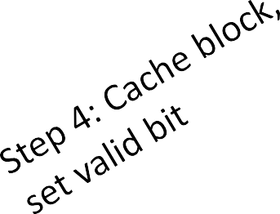
Review: Accessing the cache - Miss
lb x6 0x7fff0053
Byte M
0011
Way 0
Way 1
Way 2
Way 3
fset
9
L3$
Set 0
Line
. . .
32 Byte Block
@ 0x7fff0000
Set 1
ache ontroller
Set 2
1,0,0x7fff10,…
1,0,0x000000,…
1,1,0x001e00,…
1,0,0x7fff00,…
. . .
Byte 2
Byte 1
Byte 0
Set 3

Slide 20
Review: Accessing the cache - Miss
lb x6 0x7fff0053
Step 5: Fetch cache block for memory unit via cache controller
0x01111111111111110000000001010011
Way 0
Way 1
Way 2
Way 3
block offset
= byte 19
LL33$$
Cache
Controller
Set 0
Line
WB/Mem Fwd
WB/Mem Fwd
Addr Reg A
Data Reg B
lb
Set 1
MUX
MUX
MUX
Cont. Sigs.: Op. Select
Memory Unit
Read Data C
Set 2
1,0,0x7fff10,…
1,0,0x000000,…
1,1,0x001e00,…
1,0,0x7fff00,…
[Ld/St]
Single Byte of Data @ 0x7fff0053
Set 3
Memory

Slide 21
Why do we miss in the cache?

Slide 22
Why do we miss in the cache?
The 3 C’s of misses
Compulsory
Conflict
Capacity

Slide 23
Why miss? Compulsory misses
First access to any block of memory is always a miss; these misses are compulsory

Slide 24
Why miss? Capacity misses
Working set of program contains more data than can be cached at one time.
By the pigeonhole principle caching all data requires missing at least once

Slide 25
Why miss? Conflict misses
Multiple blocks of memory map to the same location in the cache and conflict, even if there is still some empty space in the cache
L3$

Slide 26
How many bits in tag/index/offset?
L3$ |  | Way 0 | Way 1 | Way 2 | Way 3
 | Set 0 | Line
 | Set 1
 | Set 2
 | Set 3
lb x6 0x7fff0053
set index
0x01111111111111110000000001010011
tag bits
block offset
Why these numbers of bits?
Valid | Dirty | Tag | 32 bytes data
Total cache size = 32B x 4 sets x 4 ways = 512B

Slide 27
How many bits in tag/index/offset?
L3$ |  | Way 0 | Way 1 | Way 2 | Way 3
 | Set 0 | Line
 | Set 1
 | Set 2
 | Set 3
lb x6 0x7fff0053
set index
0x01111111111111110000000001010011
tag bits
block offset
Enough block offset bits to count block bytes Enough set index bits to count the sets
All left-over bits are tag bits
Question: what do tag bits mean?
Valid | Dirty | Tag | 32 bytes data
Total cache size = 32B x 4 sets x 4 ways = 512B

Slide 28
How many sets should your cache have?
Way 0 Way 1 Way 2 Way 3
Line
L3$L3$
Set 1 Set 0
#Ways parallel tag matches per lookup
Set Associative Cache Design Procedure
Select total cache size
Select implementable #ways
cache size = #sets x #ways x #block_bytes
4.#sets = cache size / (#ways x #block_bytes)
Set 2
1,0,0x7fff10,…
1,0,0x000000,…
1,1,0x001e00,…
0,1,0x7fff00,…
What is an implementable # of ways?
Set 3

Slide 29
What is an implementable # ways?
Way 0 Way 1 Way 2 Way 3
Line
L3$L3$
Set 1 Set 0
n-way set associative cache:
Need n parallel comparators for tag match
Set 2
1,0,0x7fff10,…
1,0,0x000000,…
1,1,0x001e00,…
0,1,0x7fff00,…
Set 3

Slide 30
What is an implementable # ways?
Fully-associative cache:
# comparators = # lines in entire cache
L3$
Line
1,0,0x7fff10,…
1,0,0x000000,…
1,1,0x001e00,…
0,1,0x7fff00,…

Slide 31
What is an implementable # ways?
L3$
Direct mapped cache:
1 comparator because each set
contains a single line
1,0,0x7fff10,…
1,0,0x000000,…
1,1,0x001e00,…
0,1,0x7fff00,…

Slide 32
Physical implementation separates data & tags
set index
0x01111111111111110000000000010011
L3$ |  | Way 0 | Way 1 | Way 2 | Way 3
 | Set 0 | Line
 | Set 1
 | Set 2
 | Set 3
tag bits
block offset
Way 0
Way 1
Way 2
Way 3
L3$
Set 0
tag 0
tag 1
tag 2
tag 3
Set 1
Set 2
Set 3
Cache Data Array
Cache Tag Array

Slide 33
Sequential Tag Lookup & Data Lookup
set index
0x01111111111111110000000000010011
Way 0
Way 1
Way 2
Way 3
tag bits
block offset
L3$
2-bit set
select
2-bit set
select
Set 0
Line
4-bit block select
2-bit way select
Set 1
Way 2
Way 0
Way 1
Way 3
L3$
Set 0
tag 0
tag 1
tag 2
tag 3
Set 2
Set 1
Sequentially access tag array first, then access the data array using the result of the tag lookup.
Question: Can you think of an alternative scheme to optimize tag/data lookup?
Set 3
Set 3 Set 2
Cache Data Array
Cache Tag Array

Slide 34
Parallel Tag Lookup & Data Lookup
set index
0x01111111111111110000000000010011
Way 0
Block Select
Way 3
tag bits
block offset
L3$
2-bit way
select
2-bit set select
Set 0
Line
Set 1
Way 2
Way 0
Way 1
Way 3
L3$
Set 0
tag 0
tag 1
tag 2
tag 3
Set 2
Set 1
Fetch all ways in set in parallel with tag matching and use the way index of tag to select the one data block that was fetched.
Question: Pros & cons of parallel lookup?
Set 3
Set 3 Set 2
Cache Data Array
Cache Tag Array

Slide 35
Way Prediction: Cost Like Sequential, Performance
Like Parallel Tag Lookup
Prediction validator
set index
?
0
x01111111111111110000000000010011
Way 0 Way 2 Way 3
tag bits
block offset
Way 1
L3$
way
predictor
2-bit set select
2-bit set
select
Set 0
Line
4-bit block select
Set 1
Way 2
2-bit
Way 0
Way 1
Way 3
L3$
way
select
Set 0
tag 0
tag 1
tag 2
tag 3
Set 2
Set 1
Send some tag bits and set index bits to fast way predictor, output of which is 4-bit block select, like in sequential. Fetch way of matched tag and send to prediction validation logic. If correct predict: use block. If incorrect predict: discard block and refetch.
Cache Tag Array
Set 3
Set 3 Set 2
Cache Data Array

Slide 36
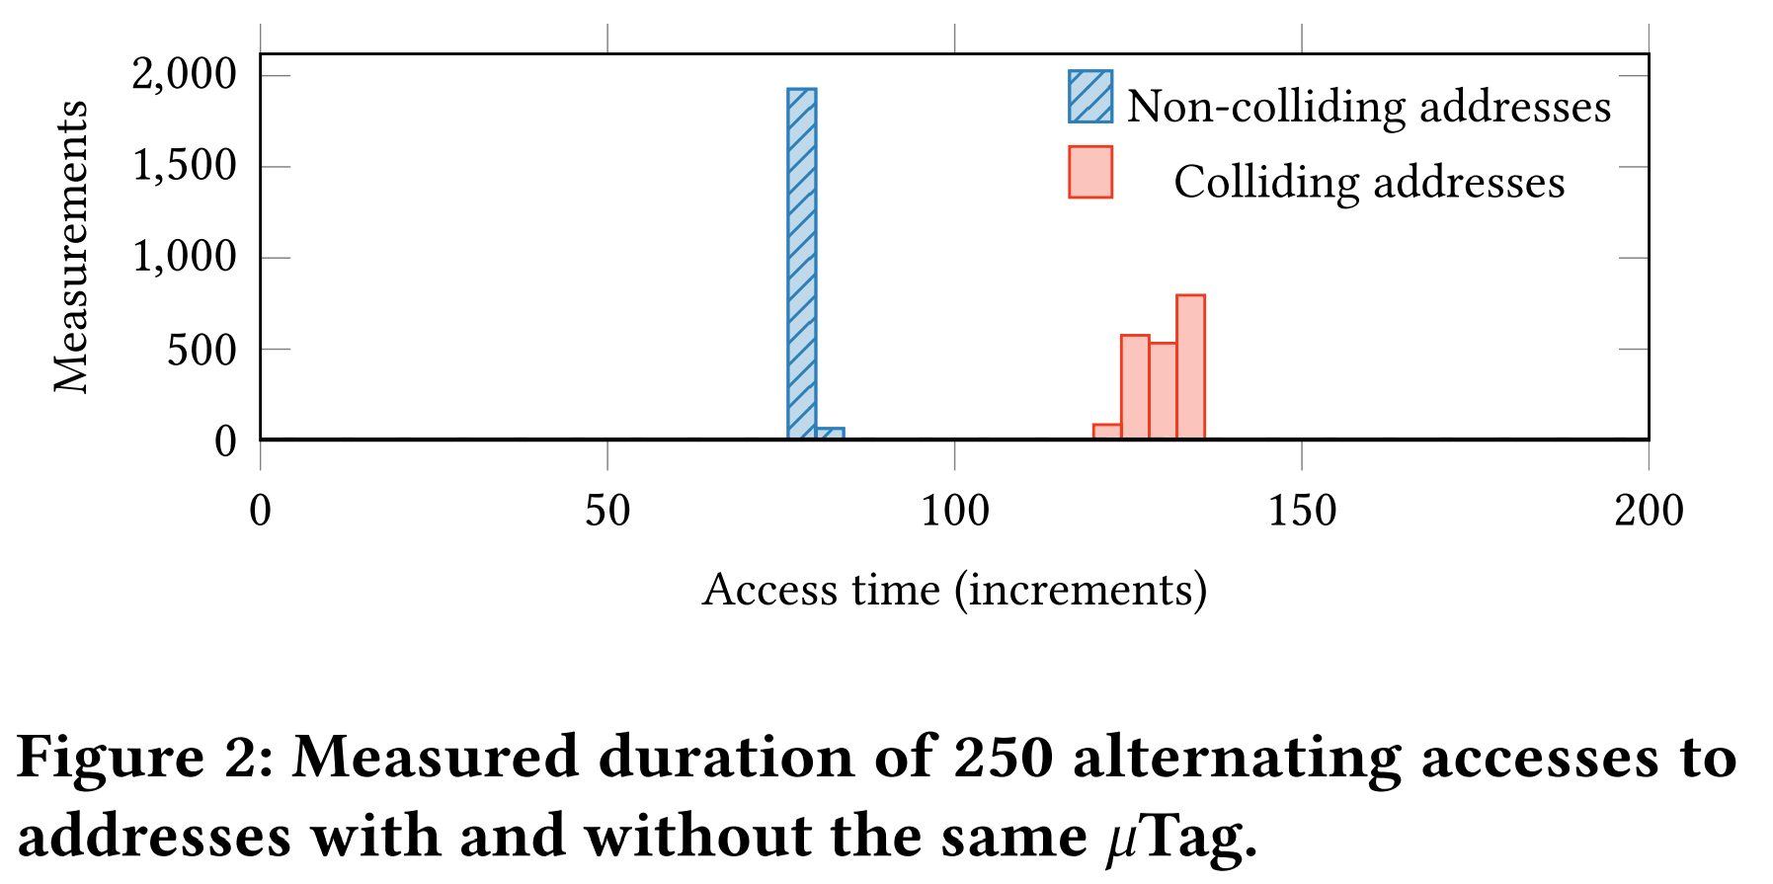
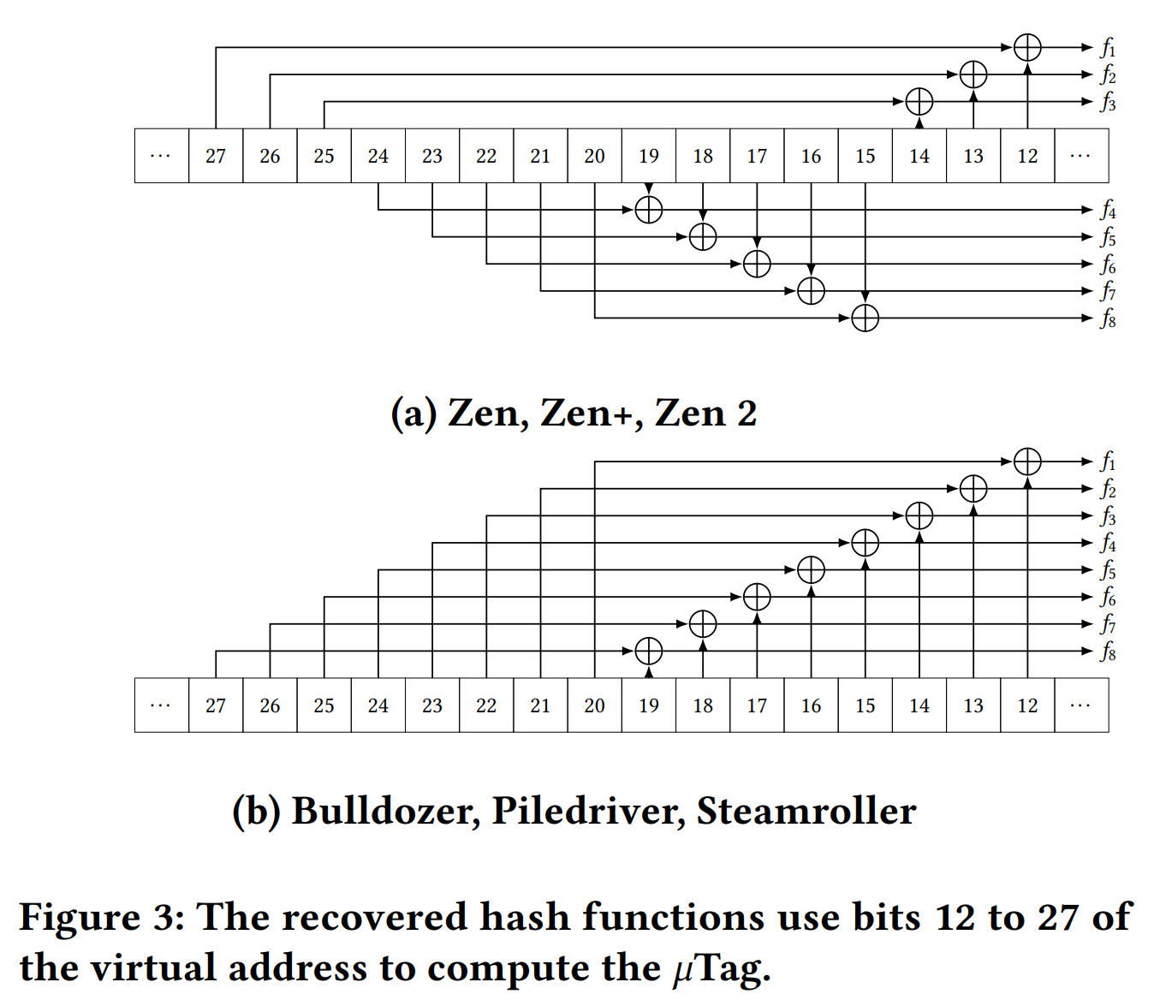
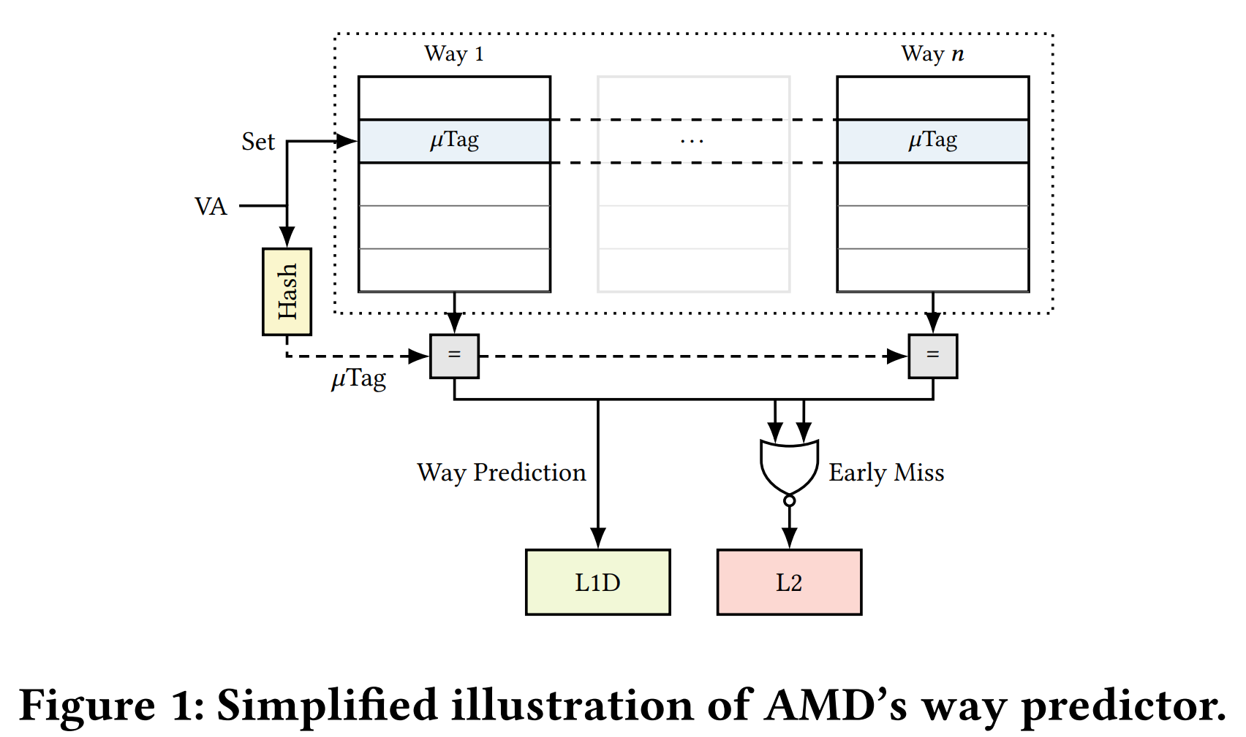
Moritz Lipp, Vedad Hadžić, Michael Schwarz, Arthur Perais, Clémentine Maurice, and Daniel Gruss. 2020. Take A Way: Exploring the Security Implications of AMD's Cache Way Predictors. In Proceedings of the 15th ACM Asia Conference on Computer and Communications Security (ASIA CCS '20). Association for Computing Machinery, New York, NY, USA, 813–825. https://doi.org/10.1145/3320269.3384746

Slide 37
Cost of Associativity
512 Bytes, 256-bit (32B) lines, 1-way
512 Bytes, 256-bit (32B) lines, 4-way
$ ./destiny config/SRAM_512_1_256.cfg
$ ./destiny config/SRAM_512_4_256.cfg
Read Latency = 55.4943ps Tag Read Latency = 277.84ps Write Latency = 54.7831ps
Tag Write Latency = 212.575ps
Read Latency = 83.4307ps
Tag Read Latency = 293.516ps Write Latency = 83.1343ps
Tag Write Latency = 226.518ps
Read Bandwidth = 674.493GB/s Write Bandwidth = 633.944GB/s
Read Bandwidth = 480.942GB/s Write Bandwidth = 500.715GB/s
Tag Read Dynamic Energy = 0.281324pJ Tag Write Dynamic Energy = 0.222833pJ
Tag Read Dynamic Energy = 1.01651pJ Tag Write Dynamic Energy = 0.758075pJ
Higher associativity avoids conflict misses at an additional cost in hit latency & energy

Slide 38
Write-Allocate: Stores go to cache
Write-No-Allocate: Stores do not go to cache
Write Policies - Allocation
Way 0
Way 1
Way 2
Way 3
Byte M
LL33$$
sb x6 0x7fff0053
Set 0
Line
WB/Mem Fwd
WB/Mem Fwd
Addr Reg A
Data Reg B
. . . . . .
MUX
MUX
Set 1
MUX
Cont. Sigs.: Op. Select
Memory
Unit
Read
Data C
Set 2
[Ld/St]
Byte 2
Byte 1
Byte 0
Set 3
Memory
?

Slide 39
Write Policies - Propagation
Write-Back: Wait until line evicted to writeback Write-Through: Writeback immediately on store
LL33$$ |  | Way 0 | Way 1 | Way 2 | Way 3
 | Set 0 | Line
 | Set 1
 | Set 2
 | Set 3
Byte M
sb x6 0x7fff0053
WB/Mem Fwd
WB/Mem Fwd
Addr Reg A
Data Reg B
. . . . . .
When?
MUX
MUX
MUX
Cont. Sigs.: Op. Select [Ld/St]
Read
Data C
Memory
Unit
Byte 2
Byte 1
Byte 0
Memory

Slide 40
Recall 18x13: Snoopy Caches
int a = 1;
int b = 100;
Tag each cache block with state
Invalid Cannot use value
Shared Readable copy
Exclusive Writeable copy
Thread1:
Wa: a = 2;
Rb: print(b);
Thread2:
Wb: b = 200;
Ra: print(a);
Thread1 Cache
Thread2 Cache
E
a: 2
E
b:200
Main Memory
a:1
b:100

Slide 41
Recall 18x13: Snoopy Caches
int a = 1;
int b = 100;
Tag each cache block with state
Invalid Cannot use value
Shared Readable copy
Exclusive Writeable copy
Thread1:
Wa: a = 2;
Rb: print(b);
Thread2:
Wb: b = 200;
Ra: print(a);
Thread1 Cache
Thread2 Cache
E
S
a: 2
a: 2
S
a:2
print 2
S
b:200
E
S
b:200
b:200
print 200
Main Memory
When cache sees request for one of its E-tagged blocks
Supply value from cache (Note: value in memory may be stale)
Set tag to S
a:1
b:100

Slide 42
Recall 18x13: Typical Multicore Processor
Core 0
Core n-1
Regs
Regs
L1
d-cache
L1
i-cache
…
L1
d-cache
L1
i-cache
Propagation Policy v. Multicore Cache Coherency
What is required for a snooping?
How does propagation policy facilitate or impede this?
What does this suggest about cache policy by level?
L2 unified cache
L2 unified cache
L3 unified cache
(shared by all cores)
Main memory

Slide 43
Cache Hierarchy Performance Measurement

Slide 44
Average Memory Access Time (AMAT):
Measuring the performance of a memory hierarchy
lw x6 0xC
Byte M
LL11II$$
WB/Mem Fwd
Mem/Mem Fwd Addr Reg A
Byte I1
WB/Mem Fwd
Mem/Mem Fwd
Data Reg B
L3$
Byte M3
L2$
. . .
MUX
MUX
MUX
Byte M2
Read Data C
Byte 0xF Byte 0xE Byte 0xD Byte 0xC
Cont. Sigs.: Op. Select
Memory
Unit
L1D$
Byte M1
[Ld/St]
. . .
Memory
Byte 2
Byte 1
Byte 0
Compute the time taken by the average access based on miss rate, hit latency, and miss penalty at each level

Slide 45
Average Memory Access Time (AMAT):
Measuring the performance of a memory hierarchy
lw x6 0xC
Miss rate = 0.01 Hit time = 1.28ns Miss time = 485ps
7.5ns
Latency
WB/Mem Fwd
Mem/Mem Fwd Addr Reg A
WB/Mem Fwd
Mem/Mem Fwd
Data Reg B
Miss rate = 0.02 Access time = 461ps Miss time = 395ps
L3$
Miss rate = 0.1 Access time = 322ps Miss time = 305ps
. . .
MUX
MUX
MUX
L2$
Read Data C
Byte 0xF Byte 0xE Byte 0xD Byte 0xC
Cont. Sigs.: Op. Select [Ld/St]
Memory
Unit
L1$
4kB,
4way
. . .
Memory
64kB,
8way
Byte 2
Compute the time taken by the average access based on miss rate, hit latency, and miss penalty at each level
Byte 1
Byte 0
1MB,
8way

Slide 46
Average Memory Access Time (AMAT):
Measuring the performance of a memory hierarchy
lw x6 0xC
Miss rate = 0.01 Hit time = 1.28ns Miss time = 485ps
7.5ns
Latency
WB/Mem Fwd
Mem/Mem Fwd Addr Reg A
WB/Mem Fwd
Mem/Mem Fwd
Data Reg B
Miss rate = 0.02 Access time = 461ps Miss time = 395ps
L3$
Miss rate = 0.1 Access time = 322ps Miss time = 305ps
. . .
MUX
MUX
MUX
L2$
Read Data C
Byte 0xF Byte 0xE Byte 0xD Byte 0xC
Cont. Sigs.: Op. Select [Ld/St]
Memory
Unit
L1$
4kB,
4way
64kB,
8way
. . .
Memory
Byte 2
AMAT = L1HitRate x L1AccTime + L1MissRate x ( L1MissTime + L2HitRate x L2AccTime + L2MissRate x ( L2MissTime + L3HitRate x L3AccTime + L3MissRate x ( L3MissTime +
DRAM Latency ) ) )
Byte 1
Byte 0
1MB,
8way

Slide 47
Computing the AMAT 1/2/4/23 90% hits
Miss rate = 0.1 Access time = 322ps (1 cycle @ 3GHz) Miss time = 305ps
Miss rate = 0.02 Access time = 461ps (2 cycles @ 3GHz) Miss time = 395ps
Miss rate = 0.01 Hit time = 1.28ns (4 cycles @ 3GHz) Miss time = 485ps
DRAM Latency
7.5ns (CAS latency) (23 cycles @ 3GHz)
0.322ns x 0.9 + 0.1 x (0.305ns +
0.461ns x 0.98 + 0.02 x (0.395ns +
1.28ns x 0.99 + 0.01 x (0.485ns +
7.5ns) ) )
AMAT in Seconds
1 x 0.9 + 0.1 x (1 +
2 x 0.98 + 0.02 x (2 +
4 x 0.99 + 0.01 x (2 +
AMAT in Cycles
23) ) )

Slide 48
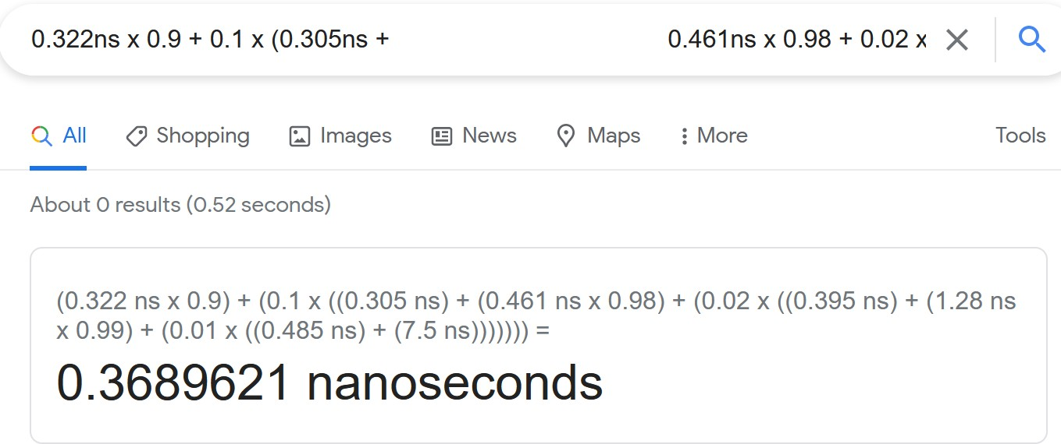
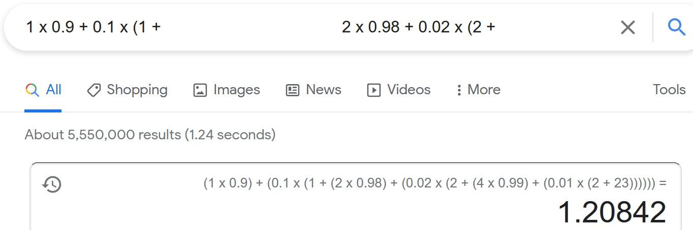
Computing the AMAT
Miss rate = 0.1 Access time = 322ps Miss time = 305ps
Miss rate = 0.02 Access time = 461ps Miss time = 395ps
Miss rate = 0.01 Hit time = 1.28ns Miss time = 485ps
DRAM Latency
7.5ns (CAS latency)
cycles

Slide 49
Computing the AMAT – 2/5/10/30 90% hits
Miss rate = 0.1
Access time = 2 cycles Miss time = 2 cycles
Miss rate = 0.02 Access time = 5 cycles Miss time = 5 cycles
Miss rate = 0.01
Hit time = 10 cycles Miss time = 10 cycles
DRAM Latency
30 cycles
2 x 0.9 + 0.1 x (2 +
5 x 0.98 + 0.02 x (5 +
AMAT in cycles
10 x 0.99 + 0.01 x (10 +
30) ) ) = 2.52 cycles = 3 cycles

Slide 50
Computing the AMAT – 2/5/10/30 80% hits
Miss rate = 0.2
Access time = 2 cycles Miss time = 2 cycles
Miss rate = 0.02 Access time = 5 cycles Miss time = 5 cycles
Miss rate = 0.01
Hit time = 10 cycles Miss time = 10 cycles
DRAM Latency
30 cycles
2 x 0.8 + 0.2 x (2 +
5 x 0.98 + 0.02 x (5 +
AMAT in cycles
10 x 0.99 + 0.01 x (10 +
30) ) ) = 3.04 cycles = 4 cycles = 2 x L1 latency!

Slide 51
The ABCs of Optimizing a Cache

Slide 52
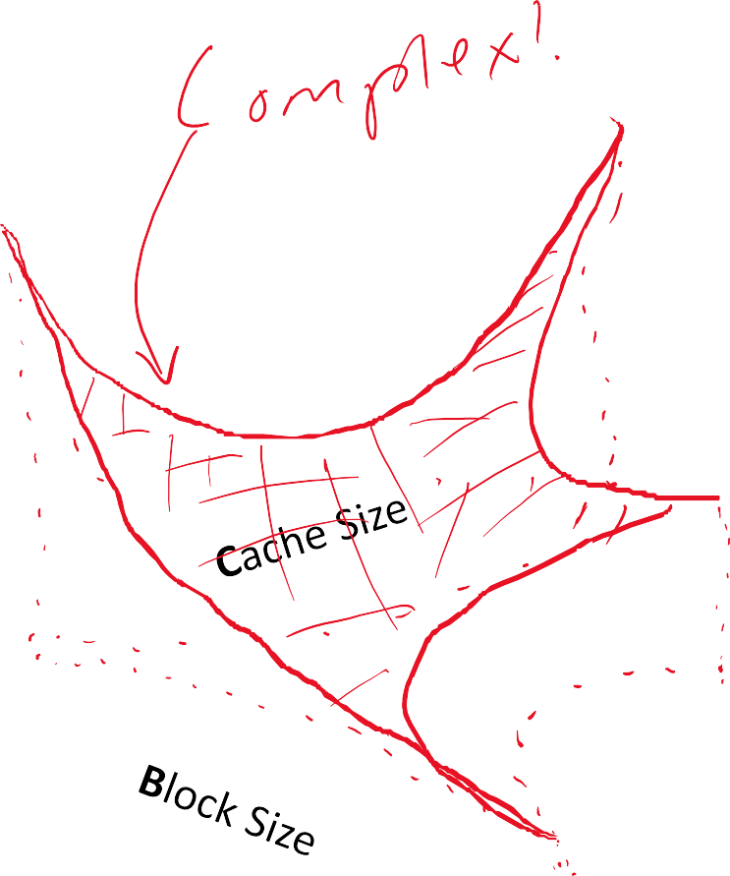
Associativity vs. Block Size vs Cache Size
Many complex inter-dependent factors determine cache performance
Associativity
Block Size
Cache Size
Replacement Policy
Write allocation policy
Write propagation policy
Best option depends on workload!
Factors will sometimes work against one another, where improving degrades another. (we will study this next week)
Associativity

Slide 53
Replacement Policies

Slide 54
Replacement Policies
lb x6 0x7fff0053
Byte M
0011
Way 0
Way 1
Way 2
Way 3
fset
9
L3$
Set 0
Line
. . .
Which block in the set should we
evict
32 Byte Block
@ 0x7fff0000
to make space for the new block?
Set 1
ache ontroller
Set 2
0,0,0x7fff00,…
1,0,0x7fff10,…
1,0,0x000000,…
1,1,0x001e00,…
. . .
Byte 2
Byte 1
Byte 0
Set 3

Slide 55
Replacement Policies – Round Robin
lb x6 0x7fff0053
Byte M
0011
Way 0
Way 1
Way 2
Way 3
fset
9
L3$
Set 0
Line
. . .
32 Byte Block
@ 0x7fff0000
Set 1
Evict
ache ontroller
Next
Set 2
0,0,0x7fff00,…
1,0,0x7fff10,…
1,0,0x000000,…
1,1,0x001e00,…
. . .
Byte 2
Byte 1
Byte 0
Set 3

Slide 56
Replacement Policies – Round Robin
lb x6 0x7fff0053
Byte M
0011
Way 0
Way 1
Way 2
Way 3
fset
9
L3$
Set 0
Line
. . .
32 Byte Block
@ 0x7fff0000
Set 1
Evict
ache ontroller
Next
Set 2
0,0,0x7fff00,…
1,0,0x7fff10,…
1,0,0x000000,…
1,1,0x001e00,…
. . .
Byte 2
Byte 1
Byte 0
Set 3

Slide 57
Replacement Policies – Round Robin
lb x6 0x7fff0053
Byte M
0011
Way 0
Way 1
Way 2
Way 3
fset
9
L3$
Set 0
Line
. . .
32 Byte Block
@ 0x7fff0000
Set 1
Evict
ache ontroller
Next
Set 2
0,0,0x7fff00,…
1,0,0x7fff10,…
1,0,0x000000,…
1,1,0x001e00,…
. . .
Byte 2
Byte 1
Byte 0
Set 3

Slide 58
Replacement Policies – Round Robin
lb x6 0x7fff0053
Byte M
0011
Way 0
Way 1
Way 2
Way 3
fset
9
L3$
Set 0
Line
. . .
32 Byte Block
@ 0x7fff0000
Set 1
Evict
ache ontroller
Next
Set 2
0,0,0x7fff00,…
1,0,0x7fff10,…
1,0,0x000000,…
1,1,0x001e00,…
. . .
Byte 2
Byte 1
Byte 0
Set 3

Slide 59
Replacement Policies – Round Robin
lb x6 0x7fff0053
Byte M
0011
Way 0
Way 1
Way 2
Way 3
fset
9
L3$
Set 0
Line
. . .
32 Byte Block
@ 0x7fff0000
Set 1
Evict
ache ontroller
NNeexxtt
Set 2
0,0,0x7fff00,…
1,0,0x7fff10,…
1,0,0x000000,…
1,1,0x001e00,…
. . .
Byte 2
Byte 1
Byte 0
Set 3

Slide 60

Replacement Policies – Round-Robin Analysis
lb | x6 | 0xe
lb | x6 | 0xb
lb | x6 | 0xc
lb | x6 | 0xd
lb | x6 | 0xa
Evict Next
Set 0
a
b
c
d
Advantage: Simple to implement and understand
Disadvantage: Hopefully the next to evict isn’t going to be the next to be accessed…

Slide 61

Replacement Policies – Round-Robin Analysis
lb | x6 | 0xe
lb | x6 | 0xb
lb | x6 | 0xc
lb | x6 | 0xd
lb | x6 | 0xa
Evict
Next
Set 0
a
e
c
d
Advantage: Simple to implement and understand
Disadvantage: Hopefully the next to evict isn’t going to be the next to be accessed…

Slide 62

Replacement Policies – Round-Robin Analysis
lb | x6 | 0xe
lb | x6 | 0xb
lb | x6 | 0xc
lb | x6 | 0xd
lb | x6 | 0xa
Evict
Next
Set 0
a
e
b
d
Advantage: Simple to implement and understand
Disadvantage: Hopefully the next to evict isn’t going to be the next to be accessed…

Slide 63

Replacement Policies – Round-Robin Analysis
lb | x6 | 0xe
lb | x6 | 0xb
lb | x6 | 0xc
lb | x6 | 0xd
lb | x6 | 0xa
Evict Next
Set 0
a
e
b
c
Advantage: Simple to implement and understand
Disadvantage: Hopefully the next to evict isn’t going to be the next to be accessed…

Slide 64

Replacement Policies – Round-Robin Analysis
lb | x6 | 0xe
lb | x6 | 0xb
lb | x6 | 0xc
lb | x6 | 0xd
lb | x6 | 0xa
Evict Next
Set 0
d
e
b
c
Advantage: Simple to implement and understand
Disadvantage: Hopefully the next to evict isn’t going to be the next to be accessed…

Slide 65
Replacement Policies – Round-Robin Analysis
lb | x6 | 0xe
lb | x6 | 0xb
lb | x6 | 0xc
lb | x6 | 0xd
lb | x6 | 0xa
Evict
Next
Set 0
d
a
b
c
Advantage: Simple to implement and understand
Disadvantage: Hopefully the next to evict isn’t going to be the next to be accessed…

Slide 66
Minimum Number of Misses?
lb | x6 | 0xe
lb | x6 | 0xb
lb | x6 | 0xc
lb | x6 | 0xd
lb | x6 | 0xa
Set 0
a
b
c
d
What is the best replacement strategy to minimize misses & why?

Slide 67
Minimum Number of Misses?
lb | x6 | 0xe
lb | x6 | 0xb
lb | x6 | 0xc
lb | x6 | 0xd
lb | x6 | 0xa
Evict
Next
Set 0
a
b
c
d

Slide 68
When are we going to re-use cached data?
lb | x6 | 0xe
lb | x6 | 0xb
lb | x6 | 0xc
lb | x6 | 0xd
lb | x6 | 0xa
Miss Hit
Hit
Hit Miss
Set 0
e
b
c
d
Replacement decisions must be informed by the next reuse of a block of data.
Think: what is an optimal policy? How far in the future is something going to be used again?

Slide 69
What did we just learn?
Memory has a high access cost; memory hierarchy mitigates that cost
Caches make locality exploitable to optimize for data reuse
Review of the basics of cache operation, address decomposition, set associative caches
Miss types
The costs of associativity & tag storage arrays
What to do about writes?
The replacement problem

Slide 70
What to think about next?
More caches (next time)
Replacement from the ground up
Caching optimizations: victim caches, write buffers & lockup-free caches, prefetching, way partitioning, banking & bank conflicts
Scratchpads vs. Caches & their relation to the HW/SW interface
Performance Evaluation (next next time)
Design spaces, Pareto Frontiers, and design space exploration
Miscellaneous (micro)architectural tricks & optimizations (future)
Vector processors, SIMD/SIMT, dataflow

Slide 71
What to think about next?
Caches as a microarchitectural optimization (next time)
Implementation of cache hierarchies
Cache design tradeoffs
Performance Evaluation (next next time)
Design spaces, Pareto Frontiers, and design space exploration
Miscellaneous (micro)architectural tricks & optimizations (future)
Vector processors, SIMD/SIMT, dataflow

