Slide 1
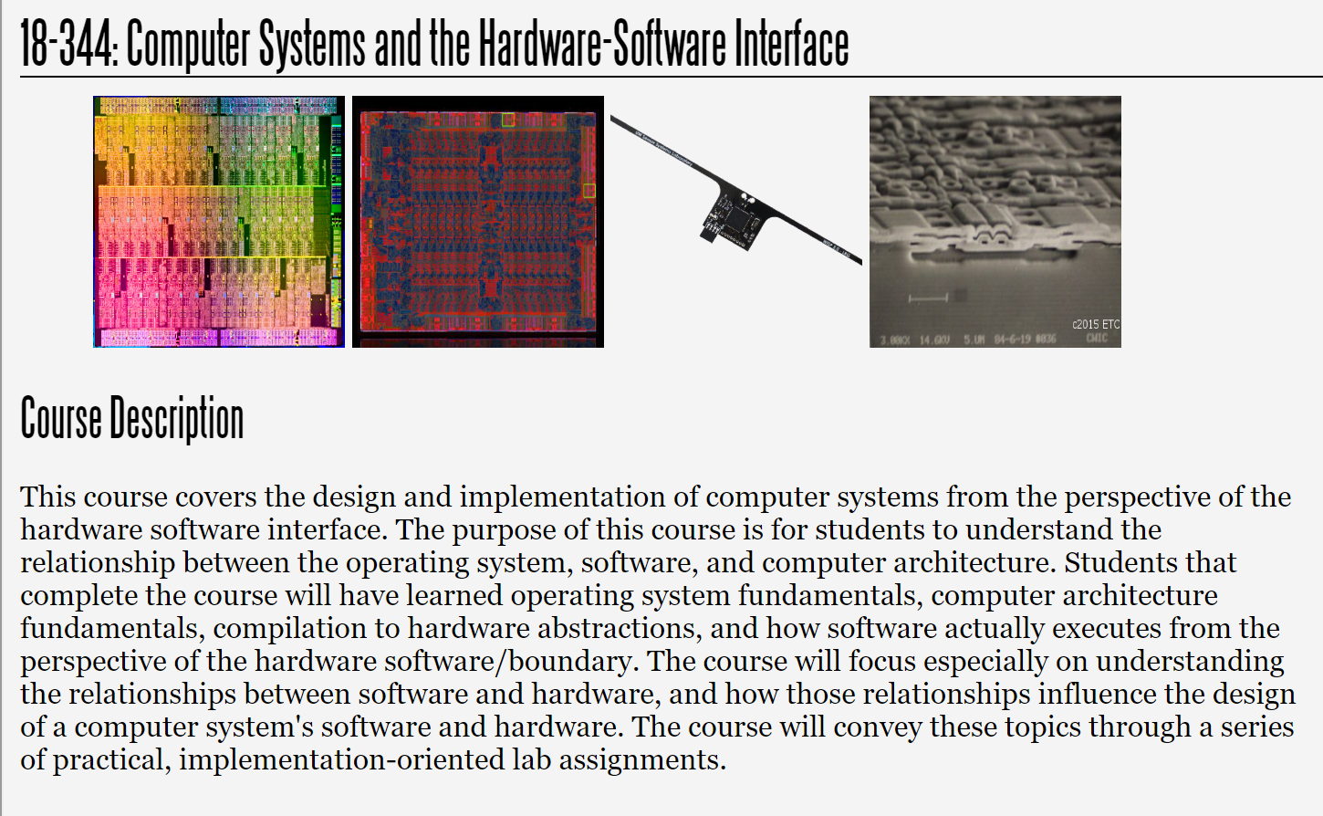
Fall 2025
Lecture 6: Control Hazards and Branch Prediction
Credit: Brandon Lucia

Slide 2
Recap: Pipelined Datapath Microarchitecture
Understanding pipelining as a general microarchitectural optimization
Data hazards and their effect on the pipelined microarchitectural datapath
Forwarding as a mitigation for data hazards in a pipelined architecture

Slide 3
A Simple Pipelined Processor Datapath
Instruction PC+4 Branch Target
PC Source Select (1 if branch taken)
Read Data C (Ld Only)
PC
Branch Target Offset
Instruction PC + 4
4
AAddddrr Reg A
Data Reg B
(Ld Only)
Output/Read Reg C Data
Output/Read Reg Select
Branch Target
Control Signals
+
Branch Target
+
MUX
Cont. Sigs.: Op. Select [Ld/St]
Memory
Unit
Register
Writeback
PC Source Select
RReeaadd DDaattaa CC
Read Register A & B Select
Input Read Reg A
Input Read Reg B
Instruction Fetch
Data
Memory
Write Reg C Data
Write Reg C Select
Reg 1
Reg 2
Reg 3
Reg 4
Control Signals:
Op select
op = [+, -, x, /]
ALU
Instruction Memory
ALU: output C data Memop: Effective Addr. Branch: PC Source Select
Instruction Fetch
Instr. Decode Execute
Read Regs A & B Data Write Register C Select
Write Register C Data
Memory
Register Write-Back
Write Reg C Data

Slide 4
Types of Data Hazards
sub x6 x5 x4 lw x16 0xabc
sub x8 x16 x4
lw x6 0xabc
add x16 x6 x14 sub x6 x5 x4
add x12 x6 x14 lw
x16 0xabc
add x12 x6 x14
Read-After-Write (RAW) Write-After-Read (WAR)
Write-After-Write (WAW)
Only Read-After-Write (RAW) hazards are possible in our simple pipeline

Slide 5
Example: Pipelined Execution w/ RAW Hazard
add x12 x6 x14 reads the value of x6 sub x6 x5 x4
add x12 x6 x14 lw x16 0xabc
from
x6 gets written back here 2 cycles later!
sub x6 x5 x4
Fetch
Decode
Memory
Register Write-Back
Execute
Read-After-Write (RAW) Hazard:
Input register does not contain updated data during register read cycle due to yet-to-be-completed register writeback from older instruction

Slide 6
Example: Pipelined Execution w/ RAW Hazard
add x12 x6 x14
sub x6 x5 x4
Fetch
Decode
Memory
Register Write-Back
Execute

Slide 7
Example: Pipelined Execution w/ RAW Hazard
add x12 x6 x14 sub x6 x5 x4
Fetch
Decode
Memory
Register Write-Back
Execute

Slide 8
Example: Pipelined Execution w/ RAW Hazard
stall
add x12 x6 x14
sub x6 x5 x4
Fetch
Decode
Memory
Register Write-Back
Execute

Slide 9
Example: Pipelined Execution w/ RAW Hazard
stall
stall
add x12 x6 x14
sub x6 x5 x4
Fetch
Decode
Memory
Register Write-Back
Execute

Slide 10
Example: Pipelined Execution w/ RAW Hazard
stall
stall
add x12 x6 x14
Fetch
Decode
Memory
Register Write-Back
Execute

Slide 11
Example: Pipelined Execution w/ RAW Hazard
stall
add x12 x6 x14
Fetch
Decode
Memory
Register Write-Back
Execute

Slide 12
Example: Pipelined Execution w/ RAW Hazard
add x12 x6 x14
Fetch
Decode
Memory
Register Write-Back
Execute

Slide 13
How do we avoid the stall cycles?
stall
stall
add x12 x6 x14
sub x6 x5 x4
Fetch
Decode
Memory
Register Write-Back
Execute

Slide 14
Example: Pipelined Execution w/ RAW Hazard
add x12 x6 x14
sub x6 x5 x4
Fetch
Decode
Memory
Register Write-Back
Execute
Value of x6 is available after sub Executes
We can forward the value to the add!

Slide 15
Forwarding to avoid a pipeline RAW Hazard
Value of x6 is available from EX/MEM pipeline register!
add x12 x6 x14 sub x6 x5 x4
Fetch
Decode
Memory
Register Write-Back
Execute
“x6”
We can forward the value in the EX/MEM pipeline register from the sub back to Execute to act as the input operand for the add

Slide 16
Forwarding to avoid a pipeline RAW Hazard
Can also forward if there are intervening instructions
add x12 x6 x14 add x9 x8 x7 sub x6 x5 x4
Fetch
Decode
Register Write-Back
Execute Memory
“x6”
Can forward the value in the MEM/WB pipeline register from the sub back to Execute for the add (going around the unrelated operation now in the memory stage)

Slide 17
Immediately preceding & dependent on load = stall
lw x6 0xabc add x12 x6 x14
Value of x6 is available from Memory!
stall
add x12 x6 x14
lw x6 0xabc
Fetch
Decode
Register Write-Back
Execute
Memory
We can forward the value in Memory’s pipeline register
from the lw back to Execute’s input for the add
(Still requires stalling…)

Slide 18
Adding Forwarding Support
Instruction PC+4 Branch Target
PC Source Select (1 if branch taken)
Mem/WB to Exec Forward
Ex/Mem to Exec
Forward
PC
Branch Target Offset
Instruction PC + 4
WB/Mem Fwd
Mem/Mem Fwd Addr Reg A
WB/Mem Fwd
Mem/Mem Fwd
Data Reg B
4
Output/Read Reg C Data
Output/Read Reg Select
Branch Target
Control Signals
+
Branch Target
+
WB/Ex Fwd
Ex/Ex Fwd Mem/Ex Fwd
WB/Ex Fwd
Ex/Ex Fwd Mem/Ex Fwd
Register
Writeback
MUX
PC Source Select
Input Read Reg A
Input Read Reg B
Read Register A & B Select
MUX
MUX
MUX
Instruction Fetch
Read
Data C
MUX
MUX
Cont. Sigs.: Op. Select
Memory
Unit
Write Reg C Data
Write Reg C Select
Reg 1
Reg 2
Reg 3
Reg 4
Control Signals:
Op select
op = [+, -, x, /]
ALU
[Ld/St]
Data Memory
Instruction Memory
ALU: output C data Branch: PC Source Select
Instruction Fetch
Instr. Decode Execute
Read Regs A & B Data Write Register C Select
Write Register C Data
Memory
Register Write-Back
Read Data C (Ld)
Write Reg C Data

Slide 19
Exception Handling
Exception!
sw x6 (x14)
invalid ins
sw x0 (x13)
lw x12 (x15) add x7 x8 x9
Fetch
Decode
Memory
Register Write-Back
Execute
Basic Exception Idea: Nuke everything that started after the current instruction, finish everything that started before the current instruction, jump to exception handler

Slide 20
Today: More Pipelined Microarchitecture
Quick recap of pipeline mechanics
Introduction to structural hazards
Introduction to control hazards on branches
Simple approaches to handling control hazards
Branch prediction for handling control hazards

Slide 21
Pipeline Control Signals

Slide 22
Control signals also pipelined through stages
PC Source Select (1 if branch taken)
Instruction PC+4 Branch Target
Write Reg C Data Mem
PC
Branch Target Offset
4
Addr
Wr Data
Output/Read Reg C Data
Output/Read Reg Select
Branch Target
Control Signals
+
Branch Target
+
I
P
r
O
o
nstruction C + 4
MUX
Memory
Unit
Register
Writeback
PC Source Select
RReeaadd DDaattaa CC
Read
Input Read Reg A
Input Read Reg B
Instruction Fetch
IF/
Registe
ID/
EX
EX/ Mem
Mem
/WB Write Reg C Data
ID
A & B Select
Data
Memory
Write Reg C Select
Reg 1
Control Signals:
ALU
Reg 2
p select
p = [+, -, x, /]
MemRead/ MemWrite
Instruction Memory
Reg 3
ALU: output C data
Reg 4
Branch: PC Source Select
Register Write-Back
Instruction Fetch
Instr. Decode Execute
Memory
Read Regs A & B Data Write Register C Select
Write Register C Data
Write Reg C Data ALU

Slide 23


Which pipeline control signals get set where?
PC Source Select (1 if branch taken)
Instruction PC+4 Branch Target
Write Reg C Data Mem
PC
Branch
4
^{Target} AAddddrr Data
^{Offset} Branch Target RReegg AA Reg B ^{ontrol} nstruction ⁺ _{(Ld Only)}
gnals C + 4
^{Cont.} Memory
_{ead} ^{Sigs.:} _{Unit} RReeaadd
_{egiste} Input Input ^{Op.} DaDattaa CC
ID/ EX/ Select
_{& B} Read Read _{[Ld/St]}
_{elect} EX Reg A Reg B Mem _{Data}
Memory
Control Signals:
p select ^{ALU}
p = [+, -, x, /]
ALU: output C data Branch: PC Source Select
Output/Read Reg C Data
Output/Read Reg Select
+
Branch Target
C
Si
I
P
r
O
o
MUX
Register
Writeback
PC Source Select
Instruction Fetch:
R R A S
Instruction Fetch
IF/
Instruction memory read control always asserted
Mem
/WB Write Reg C Data
ID
PC write enable always asserted
no special control signal pipelining here
Write Reg C Select
Reg 1
Instruction Memory
Reg 2
Reg 3
Reg 4
Instruction Fetch
Instr. Decode Execute
Memory
Register Write-Back
Read Regs A & B Data Write Register C Select
Write Register C Data
Write Reg C Data ALU

Slide 24


Which pipeline control signals get set where?
PC Source Select (1 if branch taken)
Instruction PC+4 Branch Target
Write Reg C Data Mem
PC
Branch Target Offset
4
AAddddrr Data Output/Read O
^{Branch Target} RReegg AA Reg B Reg C Data Re (Ld Only)
^{Cont. Memory} Registe
Sigs.:
Op. ^{Unit RReeaadd} Writeb
put Input _{EX/ Select} DaDattaa CC
^{ad Read} [Ld/St] ^{Mem}
g A Reg B Mem _{Data /WB Write}
Memory ^{Reg C}
_{s:} Data
ALU
ALU: output C data Branch: PC Source Select
utput/Read
Control Signals
+
g Select
+
Branch Target
I
P
r
O
o
nstruction C + 4
MUX
PC Source Select
r
ack
Read
Instruction Decode ( / Register Read):
Instruction Fetch
IF/
Registe
ID/
EX
In Re Re
In RISCV, source registers always in same location in all
ID
A & B Select
instruction formats.
No special control signal pipelining here either.
Write Reg C Select
Reg 1
Control Signal
Reg 2
p select
p = [+, -, x, /]
Instruction Memory
Reg 3
Reg 4
Register Write-Back
Instruction Fetch
Instr. Decode Execute
Memory
Read Regs A & B Data Write Register C Select
Write Register C Data
Write Reg C Data ALU

Slide 25
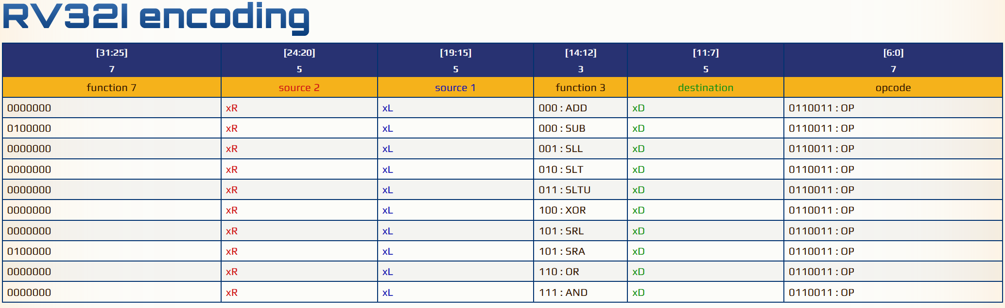
Recall: R-type Arithmetic Operations
https://metalcode.eu/2019-12-06-rv32i.html
Func 7 = 32
reg x5
reg x6
SUB reg x7
OP
x7 = x5 - x6
0100000 | 00101 | 00110 | 000 | 00111 | 0110011

Slide 26
Which pipeline control signals get set where?
PC Source Select (1 if branch taken)
Instruction PC+4 Branch Target
Write Reg C Data Mem
PC
Branch Target Offset
4
AAddddrr Data Output/Read Output/Read
RReegg AA Reg B Reg C Data Reg Select (Ld Only)
^{Cont. Memory} Register
Sigs.:
Op. ^{Unit RReeaadd} Writeback
DaDattaa CC
Select
_{m} [Ld/St] ^{Mem}
Data /WB Write Write
Memory ^{Reg C Reg C}
Data Select
Branch Target
Control Signals
+
Branch Target
+
I
P
r
Instruction C + 4
Immed.
Execute / Address Generation:
MUX
PC Source Select
Input Read Reg B
ALU Src
Sign Extend
Read
Input Read Reg A
ALU Op Select: selects the ALU operation
Instruction Fetch
IF/
Registe
ID/
EX
EX/ Me
ID
A & B Select
Select
ALU Src Select: (previously omitted, added here)
Control Signals:
selects between read register B and a sign-extended
Reg 1
Op select
op = [+, -, x, /]
ALU
immediate extracted from the bits of the instruction
Instruction Memory
Reg 2
Reg 3
ALU: output C data
Reg 4
Branch: PC Source Select
Register Write-Back
Instruction Fetch
Instr. Decode Execute
Memory
Read Regs A & B Data Write Register C Select
Write Register C Data
Write Reg C Data ALU

Slide 27
Which pipeline control signals get set where?
PC Source Select
Instruction PC+4 Branch Target
Write Reg C Data Mem
PC
Branch
4
Target
^{Offset} Branch Target
Branch ^{Control} nstruction ⁺ _{Imme}
Target Signals C + 4
X PC Source _{Input Sign}
^{Select} Read Read ^{Extend}
_{IF/} Registe ID/ ^{Input} Reg B
uction A & B Read _{ALU Src}
_{h} ID Select ^{EX Reg A} _{Select}
Control Signals:
^{Reg 1} p select ^{ALU}
_{uction} Reg 2 p = [+, -, x, /]
mory ^{Reg 3} ALU: output C dat
AAddddrr
Wr Data
Output/Read Reg C Data
Output/Read Reg Select
Memory ( / Branch Resolution):
+
I
P
r
O
o
d.
MU PC Source Select: Set to 1 if instruction is a branch and
Memory
Unit
Register
Writeback
branch taken (e.g., if ALU output is 0)
RReeaadd DDaattaa CC
Instr Fetc
EX/ Mem
Mem
/WB Write Reg C Data
MemRead: Use incoming address from Ex stage as a
Data
Memory
Write Reg C Select
read address
Instr Me
MemWrite: Use incoming address from Ex stage as a
write address
MemRead/ MemWrite
a
Reg 4
Instr. Decode Execute
Read Regs A & B Data Write Register C Select
Write Register C Data
Branch: PC Source Select
Instruction Fetch
Memory
Register Write-Back
Write Reg C Data ALU

Slide 28
Which pipeline control signals get set where?
PC Source Select
Instruction PC+4 Branch Target
Write Reg C Data Mem
PC
Branch
4
Target
^{Offset} Branch Target
Branch ^{Control} nstruction ⁺ _{Imme}
Target Signals C + 4
X PC Source _{Input Sign}
^{Select} Read Read ^{Extend}
_{IF/} Registe ID/ ^{Input} Reg B
uction A & B Read _{ALU Src}
_{h} ID Select ^{EX Reg A} _{Select}
Control Signals:
^{Reg 1} p select ^{ALU}
_{uction} Reg 2 p = [+, -, x, /]
mory ^{Reg 3} ALU: output C dat
Writeback:
AAddddrr
Wr Data
Output/Read Reg C Data
Output/Read Reg Select
+
I
P
r
O
o
d.
MemOrALU: Select whether ALU result (from Ex) or
Register
Writeback
MU
Memory
Unit
RReeaadd DDaattaa CC
data from memory (from Mem) writes to register file
Instr Fetc
EX/ Mem
Mem
/WB Write Reg C Data
Data
Memory
RegWrite: Enables register file write
Write Reg C Select
Write Reg Select: Use instruction bits to choose write
register
MemRead/ MemWrite
Instr Me
a
Reg 4
Instr. Decode Execute
Read Regs A & B Data Write Register C Select
Write Register C Data
Branch: PC Source Select
Instruction Fetch
Memory
Register Write-Back
Write Reg C Data ALU

Slide 29
Which pipeline control signals get set where?
PC Source Select
Instruction PC+4 Branch Target
Write Reg C Data Mem
PC
Branch Target Offset
4
AAddddrr
Wr Data
Output/Read Reg C Data
Output/Read Reg Select
Branch Target
Control
+
Branch Target
+
I
nstruction
Signal
Immed.
s PC + 4
_{Input Sign} Memory
Read ^{Extend} Unit ^{RRee} er ID/ ^{Input} Reg B EX/ ^{DaDa}
Read
EX Reg A ^{ALU Src} Mem _{Data}
Select
Memory
Control Signals:
Op select ^{ALU} MemRead/
op = [+, -, x, /] MemWrite
Takeaway point on pipeline control:
Register
Writeback
MUX
PC Source Select
Need to route signals to a pipeline stage (from the
aadd ttaa CC
Read
decoded instruction, or from an earlier stage)
Instruction Fetch
IF/
Regist
Mem
/WB Write Reg C Data
ID
A & B
and
Select
need to have sufficient signals available to control
Write Reg C Select
Reg 1
units in a pipeline stage.
Instruction
Reg 2
Memory
Reg 3
ALU: output C data Branch: PC Source Select
Reg 4
Instr. Decode Execute
Read Regs A & B Data Write Register C Select
Write Register C Data
Instruction Fetch
Memory
Register Write-Back
Write Reg C Data ALU

Slide 30
More on Pipeline Hazards
Structural Hazards Control Hazards

Slide 31
Structural Hazards
PC Source Select (1 if branch taken)
Instruction PC+4 Branch Target
Write Reg C Data Mem
PC
Branch
Target
^{Offset} Branch Target
^{Control} nstruction ⁺
Signals C + 4
e
Read
_{IF/ Registe ID/} Input Input _{EX/}
_{A & B} Read Read
ID _{Select} EX Reg A Reg B Mem
Control Signals:
^{Reg 1} p select ^{ALU}
Reg 2 p = [+, -, x, /]
Output/Read Reg C Data
Output/Read Reg Select
4
Addr
Wr Data
+
Branch Target
I
P
r
O
o
MUX
Observation:
Memory
Unit
Register
Writeback
PC Sourc
RReeaadd DDaattaa CC
Select
We have two memories, one for data, one for
Instruction Fetch
instructions.
Data
Memory
Mem
/WB Write Reg C Data
Write Reg C Select
MemRead/ MemWrite
Instruction
Memory
Reg 3
ALU: output C data Branch: PC Source Select
Reg 4
Instr. Decode Execute
Read Regs A & B Data Write Register C Select
Write Register C Data
Instruction Fetch
Memory
Register Write-Back
Write Reg C Data ALU

Slide 32
Structural Hazards
What happens when we make
this small change?
PC Source Select (1 if branch taken)
Instruction PC+4 Branch Target
Write Reg C Data Mem
PC
Branch Target Offset
4
Addr
Wr Data
Output/Read Reg C Data
Output/Read Reg Select
Branch Target
Control Signals
+
Branch Target
+
I
P
r
O
o
nstruction C + 4
MUX
Memory
Unit
Register
Writeback
PC Source Select
RReeaadd DDaattaa CC
Read
Input Read Reg A
Input Read Reg B
Instruction Fetch
IF/
Registe
ID/
EX
EX/ Mem
Mem
/WB Write Reg C Data
ID
A & B Select
Write Reg C Select
Reg 1
Control Signals:
ALU
Reg 2
p select
p = [+, -, x, /]
Reg 3
ALU: output C data
Reg 4
Instr. Decode Execute
Read Regs A & B Data Write Register C Select
Write Register C Data
Branch: PC Source Select
Instruction Fetch
Memory
Register Write-Back
Unified Memory 1 rd / 1wr
Write Reg C Data ALU

Slide 33
Structural Hazards
No software or clever architectural mitigation. Need two memories or two memory ports.
stall
sw x6 (x14)
sub x6 x5 x4 sw x0 (x13)
lw x12 (x15) add x7 x8 x9
Fetch
Decode
Memory
Register Write-Back
Execute
Fetch is blocked with no access to read port
Load occupies unified memory read port

Slide 34
Control Hazards
beq | x16 | x12 PC+12
sub | x6 | x5 x4
add | x12 | x6 x14
add | x12 | x7 x9
Branch-induced Control Hazard

Slide 35


Example: Pipelined Execution w/ Branch
beq x16 x12 PC+12
sub x6 x5 x4 add x12 x6 x14 add x12 x7 x9
Problem: What to fetch next?
?
beq x16 x12 PC+12
Fetch
Decode
Memory
Register Write-Back
Execute

Slide 36
Example: Pipelined Execution w/ Branch
Option #1: Stall on Branch
stall
stall
beq x16 x12 PC+12
Fetch
Decode
Memory
Register Write-Back
Execute
Proposal: We know the next PC only after beq finishes Ex (What signals do we need to determine next PC? )

Slide 37
Determining the Next PC in the Pipeline
PC Source Select (1 if branch taken)
Instruction PC+4 Branch Target
Write Reg C Data Mem
PC
Branch
Target
^{Offset} Branch Target nstruction ⁺
C + 4
Output/Read Reg C Data
Output/Read Reg Select
4
Addr
Wr Data
+
Branch Target
I
P
O
o
MUX
Memory
Unit
Register
Writeback
PC Source Select
RReeaadd DDaattaa CC
IF/
ID/
Input Read Reg A
Input Read Reg B
EX/ Mem
Mem
/WB Write Reg C Data
Instruction Fetch
Read
Data
Memory
ID
Register EX
A & B
Write Reg C Select
Control
Signals
Select
Reg 1
Control Signals:
ALU
Reg 2
p select
p = [+, -, x, /]
MemRead/ MemWrite
Instruction Memory
Reg 3
ALU: output C data
Reg 4
Branch: PC Source Select
Register Write-Back
Instruction Fetch
Instr. Decode Execute
Memory
Read Regs A & B Data Write Register C Select
Write Register C Data
Write Reg C Data ALU

Slide 38
Example: Pipelined Execution w/ Branch
Option #1: Stall on Branch
stall
stall
sub x6 x5 x4
beq x16 x12 PC+12
Fetch
Decode
Memory
Register Write-Back
Execute
2 pipeline bubbles per branch!

Slide 39
Example: Pipelined Execution w/ Branch
Option #1: Stall on Branch
stall
stall
sub x6 x5 x4
beq x16 x12 PC+12
Fetch
Decode
Memory
Register Write-Back
Execute
2 pipeline bubbles per branch!
Can we do better than 2 bubbles?

Slide 40
Proposal: Resolve the branch target and branch taken/not taken outcome earlier than beq in Mem.
Early Branch Resolution
PC Source Select (1 if branch taken)
Instruction PC+4 Branch Target
Write Reg C Data Mem
PC
Branch
Target
^{Offset} Branch Target nstruction ⁺
C + 4
Output/Read Reg C Data
Output/Read Reg Select
4
Addr
Wr Data
+
Branch Target
I
P
O
o
MUX
Memory
Unit
Register
Writeback
PC Source Select
RReeaadd DDaattaa CC
IF/
ID/
Input Read Reg A
Input Read Reg B
EX/ Mem
Mem
/WB Write Reg C Data
Instruction Fetch
Read
Data
Memory
ID
Register EX
A & B
Write Reg C Select
Control
Signals
Select
Reg 1
Control Signals:
ALU
Reg 2
p select
p = [+, -, x, /]
MemRead/ MemWrite
Instruction Memory
Reg 3
ALU: output C data
Reg 4
Branch: PC Source Select
Register Write-Back
Instruction Fetch
Instr. Decode Execute
Memory
Read Regs A & B Data Write Register C Select
Write Register C Data
Write Reg C Data ALU

Slide 41
Early Branch Resolution
Key Idea: Move Branch Target logic to ID and add forwarding path for PC Source
Instruction PC+4
Branch Target
Select from Ex for IF to use in same cycle.
Write Reg C Data Mem
PC Source Select (1 if branch taken)
PC
Branch
Target Offset
Instruction ⁺
PC + 4
4
Addr
Wr Data
Output/Read Reg C Data
Output/Read Reg Select
+
Branch Target
Branch
MUX
Target
Memory
Unit
Register
Writeback
PC Source Select
RReeaadd DDaattaa CC
IF/
ID/
Input
Input
EX/ Mem
Mem
/WB Write Reg C Data
Instruction Fetch
Read
Read Reg A
Read
Reg B
Data
Memory
ID
Register EX
A & B
Write Reg C Select
Control
Signals
Select
Reg 1
Control Signals:
ALU
Reg 2
O
o
p select
p = [+, -, x, /]
MemRead/ MemWrite
Instruction Memory
Reg 3
ALU: output C data
Reg 4
Instr. Decode Execute
Read Regs A & B Data Write Register C Select
Write Register C Data
Instruction Fetch
Memory
Register Write-Back
Fairly aggressive optimization in MIPS: resolve branch in EX in first half of cycle, use PC Src Select in second half of cycle in IF to fetch the correct instruction. Could limit clock frequency…
Write Reg C Data ALU

Slide 42
Example: Pipelined Execution w/ Early Resolution
beq | x16 | x12 PC+12
sub | x6 | x5 x4
add | x12 | x6 x14
add | x12 | x7 x9
Problem: What to fetch next?
?
beq x16 x12 PC+12
Fetch
Decode
Memory
Register Write-Back
Execute

Slide 43
Example: Pipelined Execution w/ Early Resolution
stall
beq x16 x12 PC+12
Fetch
Decode
Memory
Register Write-Back
Execute
We know the next PC when beq is in Ex

Slide 44
Example: Pipelined Execution w/ Early Resolution
stall
beq x16 x12 PC+12
sub x6 x5 x4
Fetch
Decode
Memory
Register Write-Back
Execute
1 pipeline bubble per branch!

Slide 45
Example: Pipelined Execution w/ Early Resolution
stall
beq x16 x12 PC+12
sub x6 x5 x4
Fetch
Decode
Memory
Register Write-Back
Execute
Can we do even better than 1 stall per branch?

Slide 46
MIPS-style Delayed Branch Execution
Branch Delay Slot
sub x6 x5 x4
stall
beq x16 x12 PC+12
Fetch
Decode
Memory
Register Write-Back
Execute
Branch takes an extra cycle to resolve, so how about just fetching some instruction in the “delay slot”?

Slide 47
Filling Branch Delay Slots
beq x16 x12 PC+12 sub x6 x5 x4
add x12 x6 x14 add x12 x7 x9
Branch Delay Slot filled w/ not-taken instruction
sub x6 x5 x4
beq x16 x12 PC+12
Fetch
Decode
Memory
Register Write-Back
Execute
Only useful if branch ends up resolving not-taken Otherwise, need to erase the effects of the sub when branch finally resolves

Slide 48
Filling Branch Delay Slots
beq x16 x12 PC+12 sub x6 x5 x4
add x12 x6 x14 add x12 x7 x9
Branch Delay Slot filled w/ taken instruction
add x12 x7 x9
beq x16 x12 PC+12
Fetch
Decode
Memory
Register Write-Back
Execute
Only useful if branch ends up resolving taken Otherwise, need to erase the effects of the add when branch finally resolves

Slide 49
Filling Branch Delay Slots
mul x8 x15 x1 beq x16 x12 PC+12 sub x6 x5 x4
beq x16 x12 PC+12 mul x8 x15 x1 sub x6 x5 x4
add x12 x6 x14
Branch Delay Slot filled w/ other independent insn
mul x8 x15 x1
add x12 x6 x14
add x12 x7 x9 add x12 x7 x9
Compiler reorders code to fill slot
beq x16 x12 PC+12
Fetch
Decode
Memory
Register Write-Back
Execute
Why is it OK for the compiler to reorder the mul and the beq in this instance?

Slide 50
Filling Branch Delay Slots
Compiler reorders code to fill slot
beq x16 x12 PC+12
mul x8 x15 x1 beq x16 x12 PC+12 sub x6 x5 x4
mul x8 x15 x1 sub x6 x5 x4 add x12 x6 x14 add x12 x7 x9
Branch Delay Slot filled w/ other independent insn
mul x8 x15 x1
add x12 x6 x14
add x12 x7 x9
beq x16 x12 PC+12
Fetch
Decode
Memory
Register Write-Back
Execute
Why is it OK for the compiler to reorder the mul and the beq in this instance?
Data-independent and control-equivalent
We will come back to compiler reordering in a few lectures
Compiler knows about branch delay slot (it is architectural)

Slide 51
Filling Branch Delay Slots
beq | x16 | x12 PC+12
nop
sub | x6 | x5 x4
add | x12 | x6 x14
add beq x16 x12 PC+12 | x12 | x7 x9
Branch Delay Slot
filled w/ nop
nop
Fetch
Decode
Memory
Register Write-Back
Execute
Not really sure what to put in the delay slot. Cannot (or do not want to) slot in taken/not-taken conditional next instructions… No data-independent, control-equivalent ops to put in slot

Slide 52
RISCV does not have/allow/require delay slots
Branch Delay Slot
sub x6 x5 x4
stall
beq x16 x12 PC+12
Fetch
Decode
Memory
Register Write-Back
Execute
From the RISCV RV32I Spec: “Control transfer instructions in RV32I do not have architecturally visible delay slots.”
What is “architecturally visible”?
Why do they ban delayed branches at the ISA level?

Slide 53
Why do they ban delayed branches at the ISA level?
“For their first microprocessor with a 5-stage pipeline, this indecision could have caused a one clock-cycle stall of the pipeline. MIPS-32 solved this problem by redefining branch to occur in the instruction after the next one. Thus, the following instruction is always executed. The job of the programmer or compiler writer was to put something useful into the delay slot. Alas, this “solution” didn’t help later MIPS-32 processors with many more pipeline stages (hence many more instructions fetched before the branch outcome is computed), but it made life harder for MIPS-32 programmers, compiler writers, and processor designers ever after, since incremental ISAs demand backwards compatibility (see Section 1.2). In addition, it makes the MIPS-32 code much harder to understand (see Figure 2.10 on page 29 ). While architects shouldn’t put features that help just one implementation at a point in time, they also shouldn’t put in features that hinder some implementations.”
The RISC-V Reader: An Open Architecture Atlas [Beta edition, 0.0.1] 099924910X, 9780999249109
https://dokumen.pub/the-risc-v-reader-an-open-architecture-atlas-beta-edition-001-099924910x-9780999249109.html

Slide 54


Branch Prediction to avoid control hazards
beq | x16 | x12 PC+12
sub | x6 | x5 x4
add | x12 | x6 x14
add | x12 | x7 x9
Fetch the best guess if we know which way is most likely
?
beq x16 x12 PC+12
Fetch
Decode
Memory
Register Write-Back
Execute

Slide 55
Branch Prediction to avoid control hazards
beq | x16 | x12 PC+12
sub | x6 | x5 x4
add | x12 | x6 x14
add | x12 | x7 x9
Fetch the best guess if we know which way is most likely
?
beq x16 x12 PC+12
Fetch
Decode
Memory
Register Write-Back
Execute
How to guess about which way
a branch is most likely to resolve?

Slide 56
There is “typical” branch behavior
beq x16 x12 PC+12 sub x6 x5 x4
add x12 x6 x14
add x12 x7 x9
sub x6 x5 x4 add x12 x6 x14 add x12 x7 x9
beq x16 x12 PC-12
What will these programs tend to do?

Slide 57
There is “typical” branch behavior
Most branch instructions jump forward
Backward branch: 80% taken
beq x16 x12 PC+12 sub x6 x5 x4
add x12 x6 x14
add x12 x7 x9
sub x6 x5 x4 add x12 x6 x14 add x12 x7 x9
beq x16 x12 PC-12
Forward and backward branches have different characteristics
2/3 of all branches are taken in general

Slide 58
Statically defined hints about branches?
beq.t90 x16 x12 PC+12 sub x6 x5 x4
add x12 x6 x14
add x12 x7 x9
From the RISCV RV32I Spec:
“We considered but did not include static branch hints in the instruction encoding. These can reduce the pressure on dynamic predictors, but require more instruction encoding space and software profiling for best results, and can result in poor performance if
production runs do not match profiling runs.”
sub x6 x5 x4 add x12 x6 x14 add x12 x7 x9
beq.nt90 x16 x12 PC-12
From the Intel's manual:
"Branch hint prefixes (2EH, 3EH) allow a program to give a hint to the processor about the most likely code path for a branch. Use these prefixes only with conditional branch instructions (Jcc).“ From the internet:
“gcc is right to not generate the prefix, as they have no effect for all processors since the Pentium 4.”

Slide 59
Dynamically predicting branch behavior
Outcome: taken
Branch Predictor
Target: 0x10C
0x100: beq x16 x12 PC+0xC
Fetch
Decode
Memory
Register Write-Back
Execute

Slide 60
Dynamically predicting branch behavior
Outcome:
Target:
Fetch the predicted instruction (sub,
here) and start executing with no delay.
Branch Predictor
0x10C: sub x6 x5 x4
0x100: beq x16 x12 PC+0xC
Fetch
Decode
Memory
Register Write-Back
Execute
A dynamic branch predictor is a circuit that learns the likely outcome of a branch and keeps a record of its past target computations
Guess what happens after the current instruction and run speculatively.

Slide 61
Speculation entails guessing about what’s next
Outcome:
Target:
Branch Predictor
Fetch more…
0x110
lw x6 0xabc
Predicted taken
0x10C
Resolved not taken
0x100
sub x6 x5 x4 beq x16 x12 PC+0xC
Fetch
Decode
Memory
Register Write-Back
Execute
Question: What do we do on a misprediction (also known as a branch mis-speculation)?

Slide 62
Recovering from branch misprediction
Outcome:
Target:
Branch Predictor
Incorrectly predicted taken
nop nop
Resolved not taken
0x100
beq x16 x12 PC+0xC
Fetch
Decode
Memory
Register Write-Back
Execute
Recovery: Zero all control signals (nop) & reset PC to PC+4 of beq
Recovery from mis-speculation entails wasted work in the pipeline. What about other state? Register file? Anything else might end up corrupted by speculative execution? Main cost? How cost scales?

Slide 63
Dynamically predicting branch behavior
Outcome:
Target:
Branch Predictor
0x10C: sub x6 x5 x4
0x100: beq x16 x12 PC+0xC
Fetch
Decode
Memory
Register Write-Back
Execute
Question: where does the branch predictor live in our pipeline?

Slide 64
Branch Predictor in the pipeline
Key Idea: Add predictor to fetch stage, allowing continuous fetch
Instruction PC+4 Branch Target
PC Source Select (1 if branch taken)
Write Reg C Data Mem
PC
Branch
Target Offset
Instruction ⁺
PC + 4
4
Addr
Wr Data
Output/Read Reg C Data
Output/Read Reg Select
+
Branch Target
Branch
MUX
Target
Memory
Unit
Register
Writeback
PC Source Select
RReeaadd DDaattaa CC
IF/
ID/
Input
Input
EX/ Mem
Mem
/WB Write Reg C Data
Instruction Fetch
Read
Read Reg A
Read
Reg B
Data
Memory
ID
Register EX
A & B
Write Reg C Select
Control
Signals
Select
Reg 1
Control Signals:
ALU
Reg 2
O
o
p select
p = [+, -, x, /]
MemRead/ MemWrite
Instruction Memory
Reg 3
ALU: output C data
Reg 4
Instr. Decode Execute
Read Regs A & B Data Write Register C Select
Write Register C Data
Instruction Fetch
Memory
Register Write-Back
Outcome:
Branch Target:
Branch
Predictor
Branch Predictor
Write Reg C Data ALU

Slide 65
Dynamically predicting branch behavior
Predictors learn from past behavior
Outcome:
Target:
Need to predict branch outcome: 0/1
Need to “predict” branch target: PC
Need to validate prediction
Need to update predictor
Branch Predictor
Many different types of predictor
Branch Address

Slide 66
Predicting Branch Outcomes
What info do we have?
Outcome: taken
Branch Predictor
0x100: beq x16 x12 PC+0xC
Branch Address

Slide 67
Predicting Branch Outcomes
What info do we have?
History of prior branch outcomes
Outcome: taken
Branch Predictor
0x100: beq x16 x12 PC+0xC
Branch Address
0x100: 111111111011111111101111111110…

Slide 68
Predicting Branch Outcomes
What info do we have?
Outcome: taken
History of prior branch outcomes
For every branch in the program
Hardware idea: keep history in table and choose most likely outcome
Branch Predictor
0x100: beq x16 x12 PC+0xC
0x100: 111111111011111111101111111110…
0x10E: 111001111011111111101100000110…
0x200: 000000000011111111100000000000…
0x210: 100011111011110001101111000110…
0x214: 000000000000000000000000000000…
0x220: 111000000010000000001000000000…
Branch Address

Slide 69
Proposal: Store predictor state in fetch stage with prediction logic
Branch Predictor in the pipeline
Instruction PC+4 Branch Target
PC Source Select (1 if branch taken)
Write Reg C Data Mem
PC
Branch
Target Offset
Instruction ⁺
PC + 4
4
Addr
Wr Data
Output/Read Reg C Data
Output/Read Reg Select
+
Branch Target
Branch
MUX
Target
Memory
Unit
Register
Writeback
PC Source Select
RReeaadd DDaattaa CC
IF/
ID/
Input
Input
EX/ Mem
Mem
/WB Write Reg C Data
Instruction Fetch
Read
Read Reg A
Read
Reg B
Data
Memory
ID
Register EX
A & B
Write Reg C Select
Control
Signals
Select
Reg 1
Control Signals:
ALU
Reg 2
O
o
p select
p = [+, -, x, /]
MemRead/ MemWrite
Instruction Memory
Reg 3
ALU: output C data
Reg 4
Instr. Decode Execute
Read Regs A & B Data Write Register C Select
Write Register C Data
Instruction Fetch
Memory
Register Write-Back
0x100: 111111111011111O1u11t10c1o11m11e1:1110…
0x10E: _{B}1_{r}1_{a}10_{n}0_{c}1_{h}111011111111101100000110…
0x200: 000000000011111B1r11a10n0c00h0000000…
0x210:Pr1e00d0i1c1t1o1r1011110_{T}0_{a}01_{r}10_{g}1_{e}11_{t}10:00110…
0x214: 000000000000000000000000000000…
0x220: 111000000010000000001000000000…
Branch Predictor
Write Reg C Data ALU
Problems with this design?

Slide 70
Predicting Branch Outcomes
Making branch history implementable
Idea 1: Hash table from PC to entry
Eliminates table size = #branch insns.
Outcome: taken
Branch Predictor
Branch History Table (BHT)
Branch Address
hash()
Branch PC
0x100

Slide 71
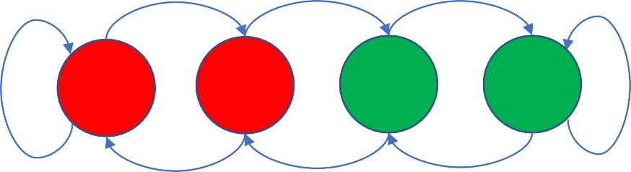
Predicting Branch Outcomes
Making branch history implementable
Idea 2: Concise history of outcomes
Eliminates entry size = #branch executions
Predicted Outcome: T/NT
Branch Predictor
Two-bit saturating counter branch predictor
T T T
Branch History Table (BHT)
hash()
10
00
00
11
NT
Branch Address
Branch PC
0x100
00
01
10
11
NT
NT
NT
T

Slide 72
Bimodal BHT Branch Predictor (Lab 1)
Making branch history implementable
Idea 2: Concise history of outcomes
Eliminates entry size = #branch executions
Predicted Outcome: T/NT
Branch Predictor
Two-bit saturating counter branch predictor
T T T
Branch History Table (BHT)
hash()
10
00
00
11
NT
Branch Address
Branch PC
0x100
00
01
10
11
NT NT NT
Example history - 0x100: 1010110110110110…
T

Slide 73
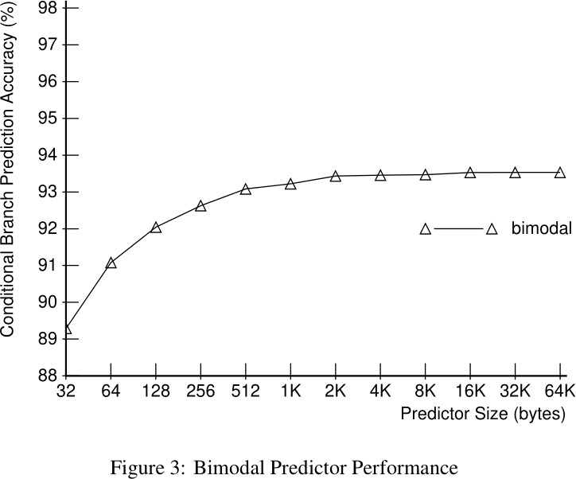
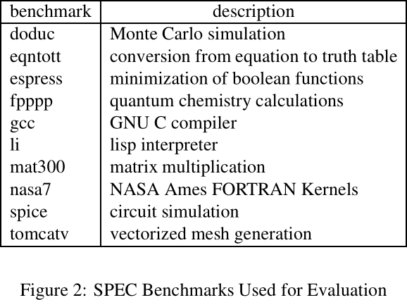
Bimodal BHT Branch Predictor
[“Combining Branch Predictors”, McFarling ’93]

Slide 74

Predicting Branch Outcomes
Two-bit saturating counter branch predictor
T T T
Branch History Table (BHT)
hash()
10
00
00
11
NT
Branch PC
0x100
00
01
10
11
NT NT NT
Example history - 0x100: 1010110110110110…
T
Limitations of 2-bit BHT branch prediction
Limitation 1: branch interference due to hash table collisions
Limitation 2: single-branch decision making misses correlation How to handle each of these problems?

Slide 75
Avoiding collisions
Branch History Table (BHT)
10
Two-bit saturating counter branch predictor
T T T
hash()
00
16k Entries
NT
Branch PC
0x100
. . .
00
01
10
11
00
11
NT NT NT
T
Example history - 0x100: 1010110110110110…
Large table size (e.g., 16k entries) avoids collisions
Each entry is small, making total cost tolerable (e.g., 32kb)
Large enough table and collisions do not limit prediction accuracy

Slide 76
Catching correlated branches
Branch History Table (BHT)
10
if(a | == | 1){ | a=0 | }
if(b | == | 1){ | b=0 | }
if(a | != | b){ | ... | }
hash()
00
16k Entries
Branch PC
0x100
. . .
00
11
There are correlation of the outcomes of consecutive branches
The outcome of the third branch is correlated with the first two
Our per-branch predictor cannot capture this common pattern

Slide 77
Two-Level Branch Predictor (Option for Lab 1): GAp (Global Adaptive w/ per-address table)
Branch PC
0x100
hash()
10 | 00
00 | 00
11
Global History Table
if(a | == | 1){ | a=0 | }
if(b | == | 1){ | b=0 | }
if(a | != | b){ | ... | }
10010110
11
16k Entries
. . .
. . .
00 | 00
11 | 11
00
11
Track history of outcomes of all branches executed in GHT
Per-address “pattern history table”
Use PC to select which PHT to use
Use global pattern history to index into PHT
Use PHT entry’s 2-bit counter to predict outcome
After each branch resolves, updated predictor in per-address
pattern history table & shift its outcome (T=1, NT=0) into GHT

Slide 78
Global Index Sharing Predictor
Branch History Table (BHT)
Global History Table
10
10010110
00
if(a | == | 1){ | a=0 | }
if(b | == | 1){ | b=0 | }
if(a | != | b){ | ... | }
16k Entries
xor
. . .
00
0x100
11
Branch PC
Index sharing predictor tracks local history in global context concisely
XOR GHT with branch PC to select BHT
Use 2-bit counter in BHT to make prediction for branch in GHT context
XOR maps branches & contexts that matter to different BHTs
Gshare combining addr bits with history bits often better

Slide 79
Local/Global Correlating Predictor (Optional for Lab 1): PAg (Per-Address Adaptive global history table)
log n bits
(8 bits here)
Global Pattern History Table
10010110
11
if(a == 1){ a=0 }
if(b == 1){ b=0 } if(a != b){ ... }
hash()
10010110
11
Branch PC
n entries
(256 entries here)
0x100
. . .
. . .
10010110
00
10010110
11
Per-PC Branch History Table
Use per-branch history to index into a global, shared table of
predictors. Per-PC branch history table stores history for that branch only, not global history.
Use PC to select which BHT to use
Use branch history to index into global PHT
Use PHT entry’s 2-bit counter to predict outcome

Slide 80
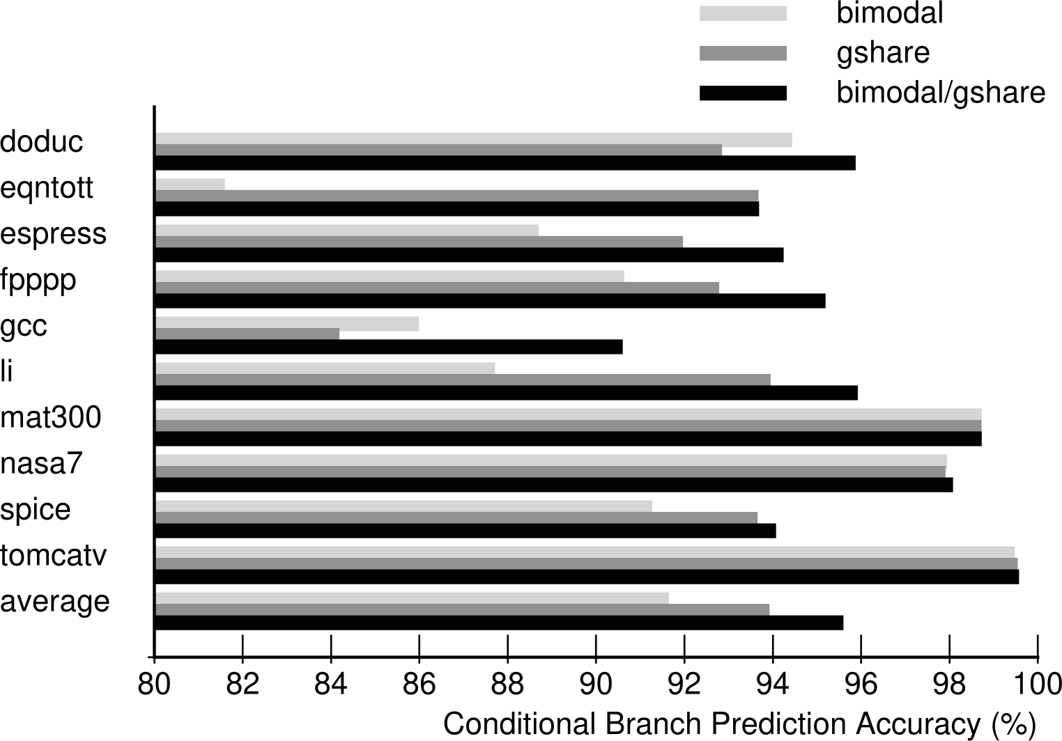
Quantifying Predictor Accuracy
(Choose best option)

Slide 81
Dynamically predicting branch behavior
Branch Predictor
Target: 0x10C
0x100: beq x16 x12 PC+0xC
Fetch
Decode
Memory
Register Write-Back
Execute
Need to predict branch target
Target gets resolved only in Decode, which leads to 1-cycle stall
Predict outcome and target both in Fetch & avoid all stalls

Slide 82
Branch Target Buffer Implementation
Branch Target Buffer
hash()
1a2ABC
BranchID
1A2
1A210C
Target: 0x1A210C
0x1a2100
Branch Tag
1A22EE
Branch PC = Tag + ID
1A2112
Tag
Target
Branch Target Buffer (BTB) logs branch target
BTB is associative memory table indexed by branch PC low order bits
Need tag because some PCs do not point to branches
Associative memory can be set-, fully-associative or direct-mapped

Slide 83
Putting it all together:
A Gshare branch predictor + BTB
Branch History Table (BHT)
Global History Table
10
Branch predictors resolve branches in the fetch stage avoiding stalls
10010110
00
16k Entries
Need misprediction detection logic added to decode stage
Need logic to flush instructions on predicted path after misprediction
Flushed instructions are effectively stalls in the pipeline, but worse: wasted work.
xor
. . .
00
0x100
11
Outcome: Taken
Branch PC
Branch Target Buffer
hash()
1a2ABC
BranchID
1A2
1A210C
Target: 0x1A210C
0x1a2100
Branch Tag
1A22EE
1A2112
Tag
Target

Slide 84

Branch Predictor in the pipeline
Instruction PC+4 Branch Target
PC Source Select (1 if branch taken)
Write Reg C Data Mem
PC
Branch
Target Offset
Instruction ⁺
PC + 4
4
Addr
Wr Data
Output/Read Reg C Data
Output/Read Reg Select
+
Branch Target
Branch
MUX
Target
Memory
Unit
Register
Writeback
PC Source Select
RReeaadd DDaattaa CC
IF/
ID/
Input
Input
EX/ Mem
Mem
/WB Write Reg C Data
Instruction Fetch
Read
Read Reg A
Read
Reg B
Data
Memory
ID
Register EX
A & B
Write Reg C Select
Control
Signals
Select
Reg 1
Control Signals:
ALU
Reg 2
O
o
p select
p = [+, -, x, /]
MemRead/ MemWrite
Instruction Memory
Reg 3
ALU: output C data
Reg 4
Instr. Decode Execute
Read Regs A & B Data Write Register C Select
Write Register C Data
Instruction Fetch
Memory
Register Write-Back
Branch Predictor
.
.
.
Write Reg C Data ALU

Slide 85
What did we just learn?
Control hazards introduce stalls because on a branch the pipeline
doesn’t know what to fetch next
Single stall cycle with early branch resolution (in Decode)
Branch delay slots and static prediction do OK, but still need stalls and nops often
Dynamic Branch Prediction uses per-branch information and global branch outcome history information to predict outcomes and targets
Branch predictor accuracies are in the 90+% in a lot of cases (you will see these figures in Lab 1)

Slide 86
What to think about next?
Caches as a microarchitectural optimization (next time)
Implementation of cache hierarchies
Cache design tradeoffs
Performance Evaluation (next next time)
Design spaces, Pareto Frontiers, and design space exploration

