Slide 1
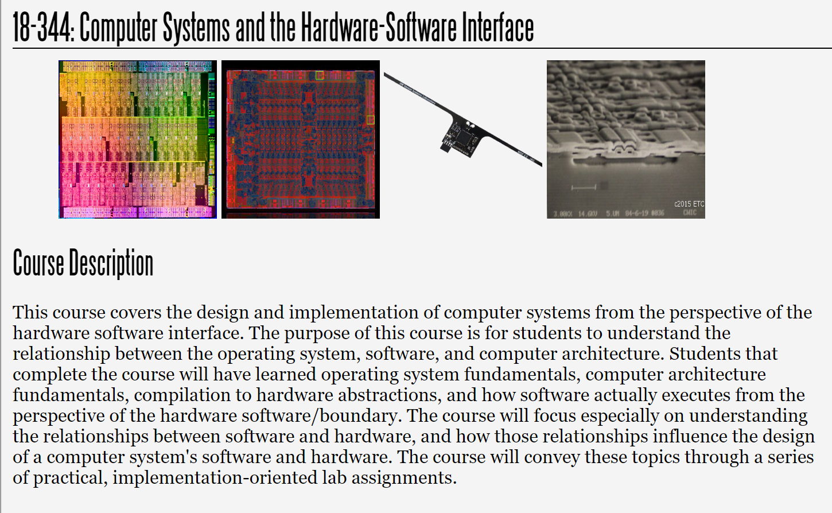
Fall 2023
Lecture 3: Computer Architecture Basics
Credit: Brandon Lucia

Slide 2
What did we talk about last time?
Hardware vs. software tradeoffs
von Neumann vs. Harvard architecture and the beginnings of a design space
An optimization exercise by example
Amdahl’s Law (and Gustafson’s Law, by contrast)

Slide 3
What is a Computer Architecture?
Building up to our first architecture
Defining the ISA: Architecture vs. Microarchitecture
RISC vs. CISC ISAs
RISCV ISA

Slide 4
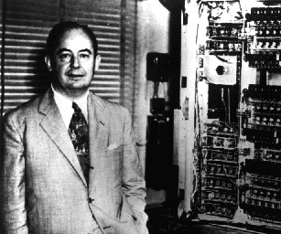
Recall:
The Von Neumann Computing Model
CPU
Control & Instruction
Sequencing (“Control”)
John von Neumann’s Big Idea:
Programs are data.
Arithmetic, Logic, and Data
Manipulation (“ALU”)
Unified Bus
Memory
Program
Data

Slide 5
Recall: the Harvard Architecture
CPU
Control & Instruction
Sequencing (“Control”)
Arithmetic, Logic, and Data
Manipulation (“ALU”)
Split bus architecture provides simultaneous access to program and to data
Instruction Bus
Data Bus
Memory
Program
Data

Slide 6
Either Way:
Our CPU from last time is incomplete
CPU
Control & Instruction
Sequencing (“Control”)
Arithmetic, Logic, and Data
Manipulation (“ALU”)
What’s missing?

Slide 7
Basic Architecture: State + processing elements
ALU/processing
state
Process (combinational logic)
Maintain State (sequential logic)
control

Slide 8
Building up to our first architecture: ALU
Input A
Input B
Opcode selector
op = [+, -, x, /]
ALU
Output: A op B

Slide 9
Building up to our first architecture: ALU
Input A
Input B
Opcode selector
op = [+, -, x, /]
ALU
Output: A op B
Design choice – what operations do we support here?

Slide 10
Basic Architecture: State + processing elements
ALU/processing
state
Input B
Output:
A op B
Maintain State (sequential logic)
ALU
Input A
Opcode selector
op = [+, -, x, /]
control

Slide 11
Basic Architecture: State + processing elements
ALU/processing
Register File
state
Input B
Output:
A op B
Reg 1
Reg 2
Reg 3
Reg 4
ALU
Input A
Opcode selector
op = [+, -, x, /]
control

Slide 12
Building up to our first architecture: ALU + Registers
Input A
Input B Register Control
Register
Control
Input A register select Input B register select
Register File
Input A
Input B
Reg 1
ALU
Output C
Reg 2
Opcode select
op = [+, -, x, /]
Reg 3
Output register select
Reg 4
Output Register Control

Slide 13
Building up to our first architecture: ALU + Registers
Input A
Input B Register Control
Register
Control
Input A register select Input B register select
Register File
Input A
Input B
Reg 1
ALU
Output C
Reg 2
Opcode select
op = [+, -, x, /]
Reg 3
Output register select
Reg 4
Output Register Control
Stateful Elements plus control required to access them, providing inputs to operations and storing outputs of operations

Slide 14
Building up to our first architecture: ALU + Registers
Input A
Input B Register Control
Register
Control
Input A register select Input B register select
Need to activate control logic to select right register for a particular operation. How?
Register File
Input A
Input B
Reg 1
ALU
Output C
Reg 2
Opcode select
op = [+, -, x, /]
Reg 3
Output register select
Reg 4
Output Register Control
Registers are named & explicit. Implication of explicit names?
Design choice – how many stateful elements / registers do we support?

Slide 15
Building up to our first architecture: Control
+
Input A Register
Input B Register Control
4
Control
Instruction
Fetch
Instruction Decode
In A reg select In B reg select
Program Counter(PC)
Register File
Input A
Input B
Reg 1
Reg 2
Instruction
Memory
Op select
ALU
Output C
Reg 3
Out reg select
Reg 4
Output Register Control
Instruction gets decoded into signals that control the other parts of the system (more on encoding / decoding in a few slides)

Slide 16
Building up to our first architecture: Control
+
Input A Register
Input B Register Control
4
Control
Instruction
Fetch
Instruction Decode
In A reg select In B reg select
Program Counter(PC)
Register File
Input A
Input B
Reg 1
Reg 2
Instruction
Memory
Op select
ALU
Output C
Reg 3
Out reg select
Reg 4
Output Register Control
Instruction memory holds all of the bits of all of the instructions that we might ever use to control other units.
Design choice: Need to think about where we put this memory (and its hierarchy of caches)

Slide 17
Building up to our first architecture: Control
+
Input A Register
Input B Register Control
4
Control
Instruction
Fetch
Instruction Decode
In A reg select In B reg select
Program Counter(PC)
Register File
Input A
Input B
Reg 1
Reg 2
Instruction
Memory
Op select
ALU
Output C
Reg 3
Out reg select
Reg 4
Output Register Control
Instruction fetch logic refers to PC, loads instruction from instruction memory and sends to decode.
Design choices: how much to fetch at once?
What to fetch next (not always obvious)?

Slide 18
Building up to our first architecture: Control
+
Input A Register
Input B Register Control
4
Control
Instruction
Fetch
Instruction Decode
In A reg select In B reg select
Program Counter(PC)
Register File
Input A
Input B
Reg 1
Reg 2
Instruction
Memory
Op select
ALU
Output C
Reg 3
Out reg select
Reg 4
Output Register Control
Remember our fetch optimization from last time? That would go here. Specialized instruction memory access logic. (Physical memory may be the same, though)

Slide 19
Building up to our first architecture: Control
+
Input A Register
Input B Register Control
4
Control
Instruction
Fetch
Instruction Decode
In A reg select In B reg select
Program Counter(PC)
Register File
Input A
Input B
Reg 1
Reg 2
Instruction
Memory
Op select
ALU
Output C
Reg 3
Out reg select
Reg 4
Output Register Control
Sequential Control:
Each cycle, update the PC by adding 4.
Implication for software of our current design?

Slide 20
Building up to our first architecture: Control
Decoding a fetched operation breaks it from a blob of bits into a set of signals that we can use to configure the rest of the units in this diagram
+
Input A Register
Input B Register Control
4
Control
Instruction
Fetch
Instruction Decode
In A reg select In B reg select
Program Counter(PC)
Register File
Input A
Input B
Reg 1
Reg 2
Instruction
Memory
Op select
ALU
Output C
Reg 3
Out reg select
Reg 4
Output Register Control
Key Idea: What we encode here has implications for other units and software layers above the instruction definition level.
Mechanism of decoding and content of encoded/decoded instructions are orthogonal concepts. How? vs what?.

Slide 21
Building up to our first architecture: Memory
+
Input A Register Control
Input B Register Control
4
Instruction
Fetch
Instruction Decode
In A reg select In B reg select
Program Counter(PC)
Register File
Input A
Input B
Reg 1
Reg 2
Reg 3
Reg 4
Reg 1
Instruction
Memory
ALU
ALU: output C
Output Register Control
Reg 2
Op select
op = [+, -, x, /]
Reg 3
Out reg select
Reg 4
Memory Unit
ld: data
Op select
op = [ld,st]
Memory
Unit
st: data
ld/st: address
Data Memory
Data
Memory

Slide 22
Building up to our first architecture: Memory
+
Input A Register Control
Input B Register Control
4
Instruction
Fetch
Instruction Decode
In A reg select In B reg select
Program Counter(PC)
Register File
Input A
Input B
Reg 1
Reg 2
Instruction
Memory
ALU
ALU: output C
Output Register
Op select
op = [+, -, x, /]
Control
Reg 3
Out reg select
Reg 4
Op select
op = [ld,st]
Memory Unit
ld: data
st: data
ld/st: address
Decoded instruction now needs to select: ALU op or Mem op?
Data Memory

Slide 23
Building up to our first architecture: Memory
+
Input A Register Control
Input B Register Control
4
Instruction
Fetch
Instruction Decode
In A reg select In B reg select
Program Counter(PC)
Register File
Input A
Input B
Reg 1
Reg 2
Instruction
Memory
ALU
ALU: output C
Output Register
Op select
op = [+, -, x, /]
Control
Reg 3
Out reg select
Reg 4
Op select
op = [ld,st]
Memory Unit
ld: data
st: data
ld/st: address
Data Memory
Here: address assumed to come from register directly

Slide 24
Building up to our first architecture: Memory
+
Input A Register Control
Input B Register Control
4
Instruction
Fetch
Instruction Decode
In A reg select In B reg select
Program Counter(PC)
Register File
Address mode bits from decoded instruction
Input A
Input B
Reg 1
Reg 2
Instruction
Memory
ALU
ALU: output C
Output Register
Op select
op = [+, -, x, /]
Control
Reg 3
Out reg select
Reg 4
Op select
op = [ld,st]
Memory Unit
ld: data
st: data
ld/st: address
Address bits from register
Data Memory
Reality: ALU may crunch reg vals to generate address

Slide 25
Building up to our first architecture: Memory
+
Input A Register Control
Input B Register Control
4
Instruction
Fetch
Instruction Decode
In A reg select In B reg select
Program Counter(PC)
Register File
Address mode bits from decoded instruction
Input A
Input B
Reg 1
Reg 2
Instruction
Memory
ALU
ALU: output C
Output Register
Op select
op = [+, -, x, /]
Control
Reg 3
Out reg select
Reg 4
Op select
op = [ld,st]
Memory Unit
ld: data
st: data
ld/st: address
Address bits from register
Data Memory
Design choice:
How many ways do we have to compute an address? How many ways should we have?
Guess at implications of more ways?

Slide 26
Building up to our first architecture: Memory
+
Input A Register Control
Input B Register Control
4
Instruction
Fetch
Instruction Decode
In A reg select In B reg select
Program Counter(PC)
Register File
Input A
Input B
Reg 1
Reg 2
Instruction
Memory
ALU
ALU: output C
Output Register
Op select
op = [+, -, x, /]
Control
Reg 3
Out reg select
Reg 4
Op select
op = [ld,st]
Memory Unit
ld: data
st: data
ld/st: address
Data Memory
state

Slide 27
Building up to our first architecture: Memory
+
Input A Register Control
Input B Register Control
4
Instruction
Fetch
Instruction Decode
In A reg select In B reg select
Program Counter(PC)
Register File
Input A
Input B
Reg 1
Reg 2
Instruction
Memory
ALU
ALU: output C
Output Register
Op select
op = [+, -, x, /]
Control
Reg 3
Out reg select
Reg 4
Op select
op = [ld,st]
Memory Unit
ld: data
st: data
ld/st: address
Data Memory
Are register files and memory two varieties of the same basic thing?

Slide 28
Building up to our first architecture: Branching
PC+4
+
Input A Register Control
Input B Register Control
4
Instruction
Instruction Decode
In A reg select In B reg select
+
MUX
Program Counter(PC)
Fetch
Register File
PC Source Select
Input A
Input B
Reg 1
Instruction
Memory
Output Register
Reg 2
Op select
op = [+, -, x, /]
ALU
ALU: output C
Control
Reg 3
Out reg select
Reg 4
Branch Target Address Offset
Op select
op = [ld,st]
Memory Unit
ld: data
st: data
ld/st: address
Data Memory

Slide 29
Building up to our first architecture: Branching
PC+4
+
Input A _{Input B}
Register _{Register}
Control _{Control}
In A reg select In B reg select
Register File
Input A Input B Reg 1
Output _{Reg 2}
Op select Register
op = [+, -, x, /] ^{ALU} Control Reg 3
Out reg select ^{ALU: output C} Reg 4
Op select Memory ^{ld: data} _{st: data}
^{op = [ld,st]} Unit ld/st: address
Data Memory
4
Instruction
Instruction Decode
PC
+
Fetch
If PC Source Select not asserted PC=PC+4
Program
Memory
MUX
Program Counter(PC)
PC Source Select
Instruction
Memory
If PC Source Select asserted PC=PC+off
Branch Target Address Offset

Slide 30
Building up to our first architecture: Branching
PC+4
+
Input A Register Control
Input B Register Control
4
Instruction
Instruction Decode
In A reg select In B reg select
+
MUX
Program Counter(PC)
Fetch
Register File
PC Source Select
Input A
Input B
Reg 1
Instruction
Memory
Output Register
Reg 2
Op select
op = [+, -, x, /]
ALU
ALU: output C
Control
Reg 3
Out reg select
Reg 4
Branch Target Address Offset
Op select
op = [ld,st]
Memory Unit
ld: data
st: data
ld/st: address
Data Memory
Where does our branch target offset originate?
Alternative design choices? How are each of those used in code?

Slide 31
Building up to our first architecture: Branching
PC+4
+
Input A Register Control
Input B Register Control
4
Instruction
Instruction Decode
In A reg select In B reg select
+
MUX
Program Counter(PC)
Fetch
Register File
PC Source Select
Input A
Input B
Reg 1
Output Register
Reg 2
Instruction
Memory
Op select
op = [+, -, x, /]
ALU
ALU: output C
Control
Reg 3
Out reg select
Reg 4
Branch Target Address Offset
Op select
op = [ld,st]
Memory Unit
ld: data
st: data
ld/st: address
Data Memory
How do we decide taken vs. not
taken via PC Source Select?

Slide 32
Building up to our first architecture: Branching
PC+4
+
Input A Register Control
Input B Register Control
4
Instruction
Instruction Decode
In A reg select In B reg select
+
MUX
Program Counter(PC)
Fetch
Register File
Input A
Input B
Reg 1
Instruction
Memory
Output Register
Reg 2
Op select
op = [+, -, x, /]
ALU
ALU: output C
Control
Reg 3
Out reg select
Reg 4
Branch: PC Source Select
Branch Target Address Offset
Op select
op = [ld,st]
Memory Unit
ld: data
st: data
ld/st: address
Design Choice:
ALU output determines PC source select when branch condition evaluates Alternative Design?
Data Memory

Slide 33
A Complete (but slightly messy) RISCV-ish Datapath
PC+4
+
Input A Register Control
Input B Register Control
4
Instruction
Instruction Decode
In A reg select In B reg select
+
MUX
Program Counter(PC)
Fetch
Register File
Input A
Input B
Reg 1
Instruction
Memory
Output Register
Reg 2
Op select
op = [+, -, x, /]
ALU
ALU: output C
Control
Reg 3
Out reg select
Reg 4
Branch: PC Source Select
Branch Target Address Offset
Op select
op = [ld,st]
Memory Unit
ld: data
st: data
ld/st: address
Data Memory

Slide 34
A “single-cycle” design
Clock
PC+4
+
Input A Register Control
Input B Register Control
4
Instruction
Instruction Decode
In A reg select In B reg select
+
MUX
Program Counter(PC)
Fetch
Register File
Input A
Input B
Reg 1
Instruction
Memory
Output Register
Reg 2
Reg 3
Op select
op = [+, -, x, /]
ALU
ALU: output C
Control
Out reg select
Reg 4
Branch: PC Source Select
Branch Target Address Offset
Op select
op = [ld,st]
Memory Unit
ld: data
st: data
ld/st: address
Data Memory

Slide 35
A “single-cycle” design
Clock
PC+4
+
Input A Register Control
Input B Register Control
4
Instruction
Instruction Decode
In A reg select In B reg select
+
MUX
Program Counter(PC)
Fetch
Register File
Input A
Input B
Reg 1
Instruction
Memory
Output Register
Reg 2
Reg 3
Op select
op = [+, -, x, /]
ALU
ALU: output C
Control
Out reg select
Reg 4
Branch: PC Source Select
Branch Target Address Offset
Op select
op = [ld,st]
Memory Unit
ld: data
st: data
ld/st: address
Key Idea:
Single-cycle design goes from reading an instruction out of memory all the way to writing results back to registers before the next clock edge.
Data Memory

Slide 36
Thinking about latency: ALU Operations
PC+4
+
Input A Register Control
Input B Register Control
4
Instruction
Instruction Decode
In A reg select In B reg select
+
MUX
Program Counter(PC)
Fetch
Register File
Address mode bits from decoded instruction
Input A
Input B
Reg 1
Instruction
Memory
ALU
ALU: output C
Output Register
Reg 2
Op select
op = [+, -, x, /]
Control
Reg 3
Out reg select
Reg 4
Branch: PC Source Select
Branch Target Address Offset
Op select
op = [ld,st]
Memory Unit
ld: data
st: data
ld/st: address
Address bits from register
ALU Operation Latency:
Circuit delay of ALU operations is (mostly) low.
Why?
Data Memory

Slide 37
Thinking about latency: ALU Operations
PC+4
+
Input A Register Control
Input B Register Control
4
Instruction
Instruction Decode
In A reg select In B reg select
+
MUX
Program Counter(PC)
Fetch
Register File
Address mode bits from decoded instruction
Input A
Input B
Reg 1
Instruction
Memory
ALU
ALU: output C
Output Register
Reg 2
Op select
op = [+, -, x, /]
Control
Reg 3
Out reg select
Reg 4
Branch: PC Source Select
Branch Target Address Offset
Op select
op = [ld,st]
Memory Unit
ld: data
st: data
ld/st: address
Address bits from register
ALU Operation Latency:
Circuit delay of ALU operations is (mostly) low.
Sum of delay of 5 or 6 units depending on impl.
Need to fetch, decode, register access (in 1), reg access (in 2), ALU function, register writeback
Data Memory

Slide 38
Thinking about latency: Memory
PC+4
+
Input A Register Control
Input B Register Control
4
Instruction
Instruction Decode
In A reg select In B reg select
+
MUX
Program Counter(PC)
Fetch
Register File
Address mode bits from decoded instruction
Input A
Input B
Reg 1
Instruction
Memory
ALU
ALU: output C
Output Register
Reg 2
Op select
op = [+, -, x, /]
Control
Reg 3
Out reg select
Reg 4
Branch: PC Source Select
Branch Target Address Offset
Op select
op = [ld,st]
Memory Unit
ld: data
st: data
ld/st: address
Address bits from register
Memory Latency:
Memory accesses are pretty slow. Why?
Data Memory

Slide 39
Thinking about latency: Memory
PC+4
+
Input A Register Control
Input B Register Control
4
Instruction
Instruction Decode
In A reg select In B reg select
+
MUX
Program Counter(PC)
Fetch
Register File
Address mode bits from decoded instruction
Input A
Input B
Reg 1
Instruction
Memory
ALU
ALU: output C
Output Register
Reg 2
Op select
op = [+, -, x, /]
Control
Reg 3
Out reg select
Reg 4
Branch: PC Source Select
Branch Target Address Offset
Memory Latency – Critical Path:
Memory accesses are pretty slow in our datapath.
Op select
op = [ld,st]
Memory Unit
ld: data
st: data
ld/st: address
Address bits from register
Data Memory
Sum of delay of 7 or 8 units depending on counting Need to fetch, decode, register access (addr part 1), reg access (addr part 2), alu (addr gen), memory unit, memory bank, register write

Slide 40
Implication of operation latencies?
Single-cycle design means that the cycle time for the system is
defined by the latency of the longest-latency operation
In our case, that would be the memory latency (and ALU latency has some slack from the cycle time)
If every operation is not a memory operation, then we have over- provisioned the cycle time of the system

Slide 41
Where is the HW/SW Interface in the Datapath?
PC+4
+
Input A Register Control
Input B Register Control
4
Instruction
Instruction Decode
In A reg select In B reg select
+
MUX
Program Counter(PC)
Fetch
Register File
Input A
Input B
Reg 1
Instruction
Memory
Output Register
Reg 2
Op select
op = [+, -, x, /]
ALU
ALU: output C
Control
Reg 3
Out reg select
Reg 4
Branch: PC Source Select
Branch Target Address Offset
Op select
op = [ld,st]
Memory Unit
ld: data
st: data
ld/st: address
Data Memory

Slide 42
Where is the HW/SW Interface?
PC+4
This is where software begins!
+
Input A Register Control
Input B Register Control
4
Instruction
Instruction Decode
In A reg select In B reg select
+
MUX
Program Counter(PC)
Fetch
Register File
Input A
Input B
Reg 1
Instruction
Memory
Output Register
Reg 2
Op select
op = [+, -, x, /]
ALU
ALU: output C
Control
Reg 3
Out reg select
Reg 4
Branch: PC Source Select
Branch Target Address Offset
Op select
op = [ld,st]
Memory Unit
ld: data
st: data
ld/st: address
Data Memory

Slide 43
Instruction memory holds software
Instruction
Fetch
Instruction
Decode
???

Slide 44
Big Idea: Instruction Bits are Control Signals
Input Register 1
Instruction
Fetch
Instruction
Decode
Input Register 2
Operation Type
Output Register
PC Source Select
Jump Target
…

Slide 45
Big Idea: Instruction Bits are Control Signals
Instruction
Fetch
Instruction
Decode
Input Register 1 | Input Register 2 | Output Register | Operation Type
00000100 | 00001000 | 00001001 | 00000001

Slide 46
Big Idea: Instruction Bits are Control Signals
Instruction
Fetch
Instruction
Decode
Input Register 1 | Input Register 2 | Output Register | Operation Type
00000100 | 00000011 | 00000010 | 00000001
Binary encoded: signals
directly interface to datapath
Register r4 | Register r3 | Register r2 | Multiply
Reg 1
Reg 2
Reg 3
x
Reg 4

Slide 47
Instruction Set Architecture
The ISA defines the architecture of the machine
Any implementation of the architecture must support the features exposed through the ISA (why?)
Instruction
Fetch
Instruction
Decode
Input Register 1 | Input Register 2 | Output Register | Operation Type
00000100 | 00000011 | 00000010 | 00000001
Binary encoded: signals
directly interface to datapath
Register r4 | Register r3 | Register r2 | Multiply
Reg 1
Reg 2
Reg 3
x
Reg 4

Slide 48
Architecture vs. Microarchitecture
The ISA defines the architecture of the machine
A microarchitecture implements the features of the architecture
Instruction
Fetch
Instruction
Decode
Input Register 1 | Input Register 2 | Output Register | Operation Type
00000100 | 00000011 | 00000010 | 00000001
Register r4 | Register r3 | Register r2 | Multiply
Reg 1
Reg 2
Reg 3
x
Reg 4

Slide 49
Architecture vs. Microarchitecture
The ISA defines the architecture of the machine
A microarchitecture implements the features of the architecture
Input Register 1 | Input Register 2 | Output Register | Operation Type
00000100 | 00000011 | 00000010 | 00000001
Architecture:
Register-register ALU ops, registers numbering 0-4
Register r4 | Register r3 | Register r2 | Multiply
x
Reg 1
Reg 2
Reg 3
ALU
x
Microarchitecture:
One ALU containing a multiplier,
physical register file with registers numbering 0-3
Reg 4

Slide 50
Architecture vs. Microarchitecture
For a given architecture there are many perfectly good microarchitectural implementations
Input Register 1 | Input Register 2 | Output Register | Operation Type
00000100 | 00000011 | 00000010 | 00000001
Architecture:
Register-register ALU ops, registers numbering 0-4
Register r4 | Register r3 | Register r2 | Multiply
x
Microarchitecture:
One ALU containing an adder; multiply w/ iterated addition, physical register file with registers numbering 0-3
Reg 1
Reg 2
Reg 3
ALU
+
Reg 4

Slide 51
Architecture vs. Microarchitecture
For a given architecture there are many perfectly good microarchitectural implementations
Architecture:
Sequentially-numbered, general-purpose registers
Input Register 1 | Input Register 2 | Output Register | Operation Type
00000100 | 00000011 | 00000010 | 00000001
Architecture:
Register-register ALU ops, registers numbering 0-4
Register r4 | Register r3 | Register r2 | Multiply
x
Microarchitecture:
One ALU containing an adder; multiply w/ iterated addition, physical register file with registers numbering 0-3
Register File
ALU
SRAM Bank #1 SRAM Bank #2
+
Reg 1
Reg 3
Reg 2
Reg 4
Microarchitecture:
Two SRAM banks storing regs based on parity

Slide 52
Instruction Set Architecture
The ISA is the vocabulary of the machine
The ISA/vocabulary determines the types of programs/sentences that it is possible to write
Instruction
Fetch
Instruction
Decode
Input Register 1 | Input Register 2 | Output Register | Operation Type
00000100 | 00000011 | 00000010 | 00000001
Binary encoded: signals
directly interface to datapath
Register r4 | Register r3 | Register r2 | Multiply
Reg 1
Reg 2
Reg 3
x
Reg 4

Slide 53

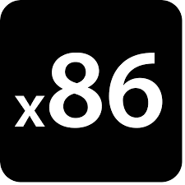

What should go in the ISA?
Reduced Instruction Set Computer
Simple primitives:
Let software compose complex operations
Register operands:
Decouple functionality from memory accesses
Few total operations:
Usually only one way to do something
Complex Instruction Set Computer
Simple & complex operations:
Hardware provides complex functionality
Many operations:
Often several ways to do the same thing
Register and memory operands:
Operations may directly manipulate memory

Slide 54
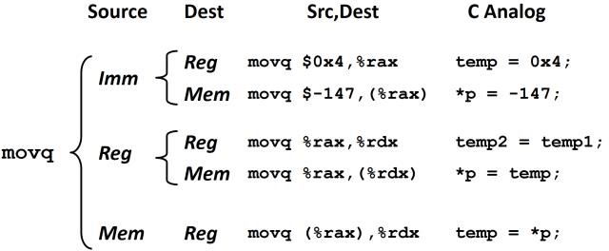

What should go in the ISA?
Reduced Instruction Set Computer
Simple primitives:
Let software compose complex operations
Complex Instruction Set Computer
Simple & complex operations:
Hardware must support complex functionality
Register operands:
Decouple functionality from memory accesses
Many operations:
Often several ways to do the same thing
Few total operations:
Usually only one way to do something
Register and memory operands:
Operations may directly manipulate memory
Few cases to map to control signals in microarchitecture
Many cases to map to control signals in microarchitecture
rd = M[imm] rd = M[reg]
rd = M[reg + imm] rd = M[PC + imm]
Plus all of these combinations

Slide 55
What should go in the ISA?
Reduced Instruction Set Computer
Complex Instruction Set Computer
Simple primitives:
Let software compose complex operations
Simple & complex operations:
Hardware must support complex functionality
Register operands:
Decouple functionality from memory accesses
Register and memory operands:
Operations may directly manipulate memory
Few total operations:
Usually only one way to do something
Many operations:
Often several ways to do the same thing
What are the pros and cons of each?
How does RISC vs. CISC affect the microarchitecture,
compiler, program, programmer?

Slide 56
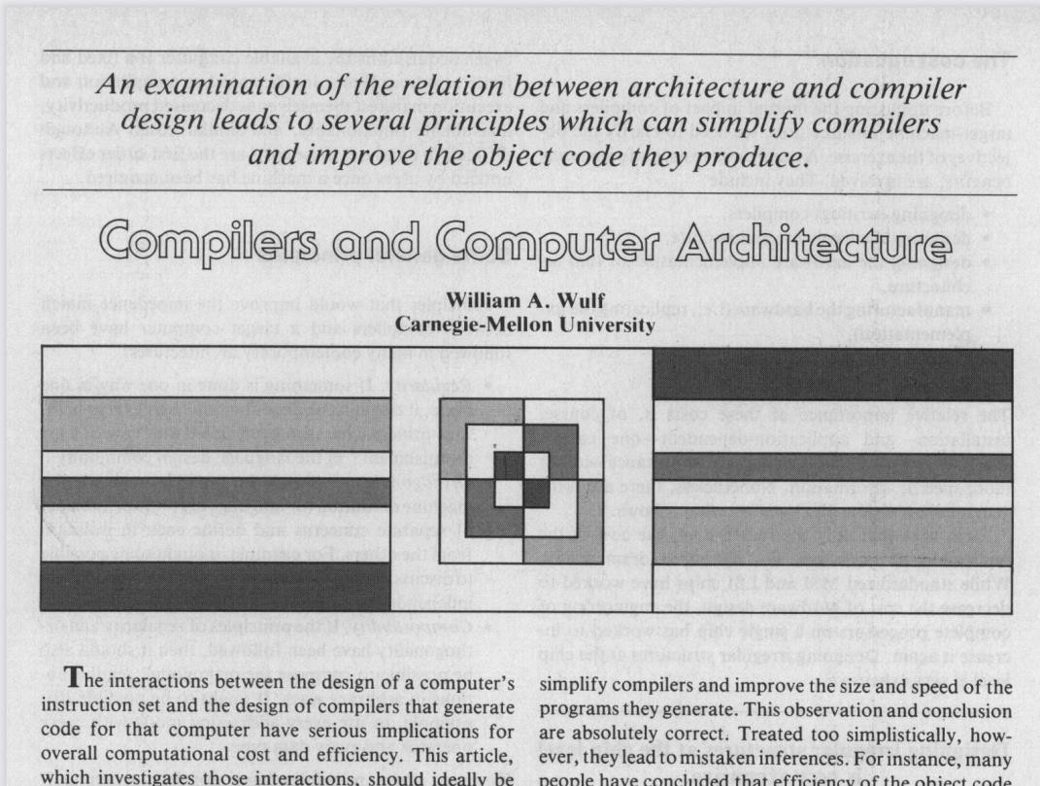
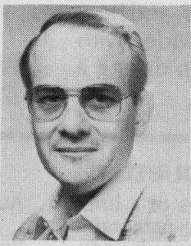
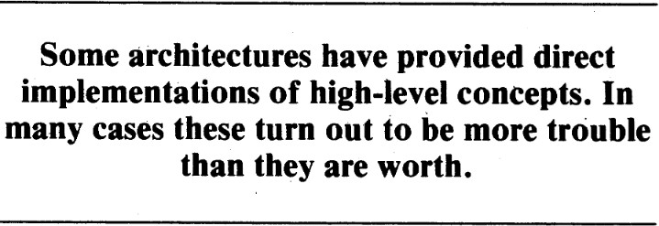
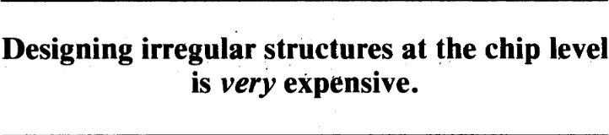
Principles of ISA Design
General Principles
Regularity – “Law of least astonishment”
Orthogonality – keep separable concerns separate Composability – regular, orthogonal ops combine easily
Specific Principles
One vs. All – precisely one way to do it, or all ways should be possible
Primitives, not solutions – solve by coding, compiling, & synthesizing
“Blatant opinions” (matters of taste)
Addressing – not limited to simple arrays, etc.
Environment Support – exceptions, processes, debugging, etc
Deviations – deviate from these rules only in implementation-specific ways

Slide 57
What did we just learn?
Computer architectures define the HW/SW interface through the ISA
There is a difference between architecture and microarchitecture
Many valid microarch. implementations of an architecture exist
RISC vs. CISC architectures are extrema on a spectrum
Principles of ISA design (Wulf)

Slide 58
What to think about next?
The basics of the RISCV-RV32I ISA and some other hw/sw interfaces
More microarchitectural concepts
  Pipelining our microarchitecture & instruction-level parallelism
  Control hazards & branch prediction

