Slide 1
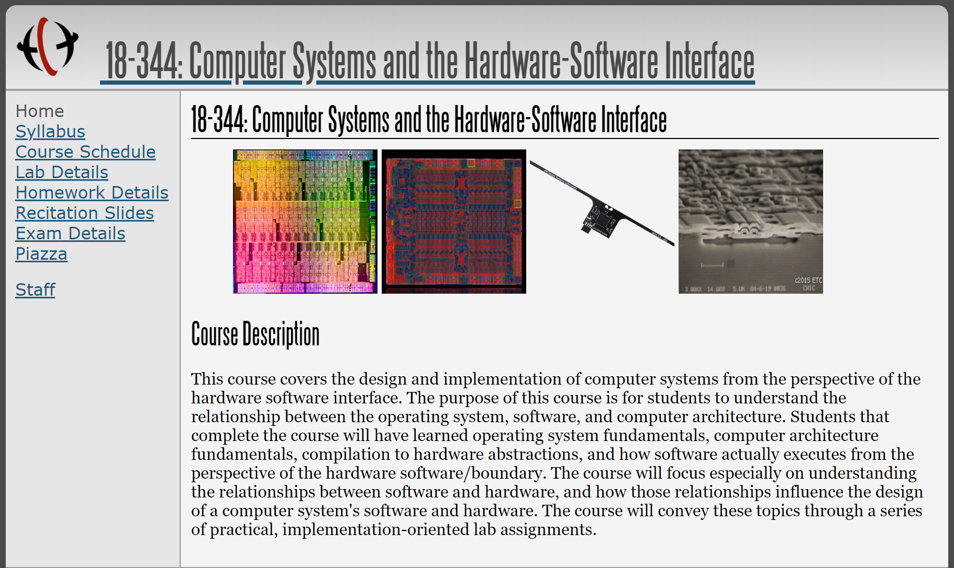
CMU 18-344: Computer Systems and the Hardware/Software Interface
(Fall 2025 Lecture 2)
Fall 2023
LECTURE 2

Slide 2
What is the hardware/software boundary?
An ISA or Computer Architecture?
A division of labor between Computer Engineers and Programmers?
A split between what you can change and what you cannot change?
Python vs. Verilog?

Slide 3
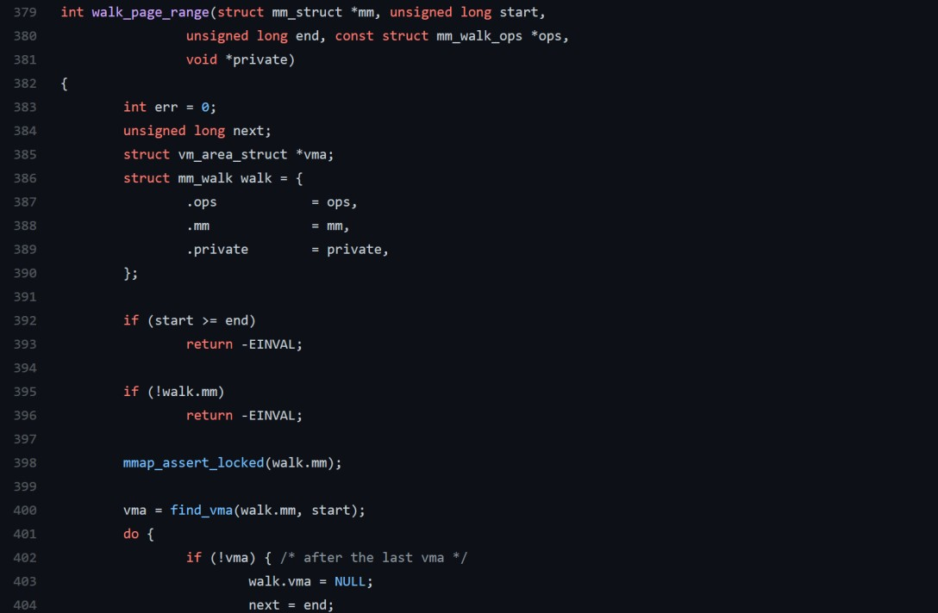


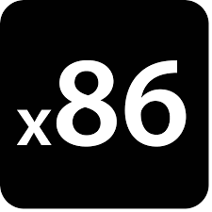
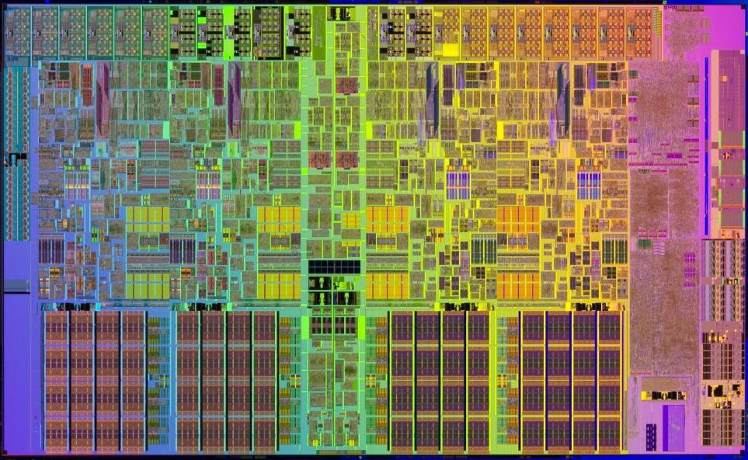
The 213 view of the world
ISA is the immutable
foundation of the system
High-level language compiles to ISA
Linux (or other) OS provides important low-level services
Low-level optimization: know HW structure to make smart code changes

Slide 4
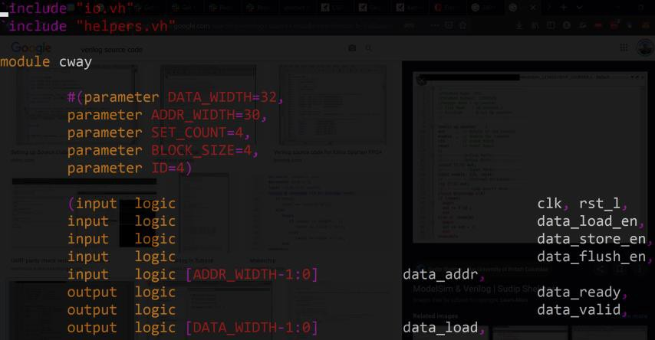
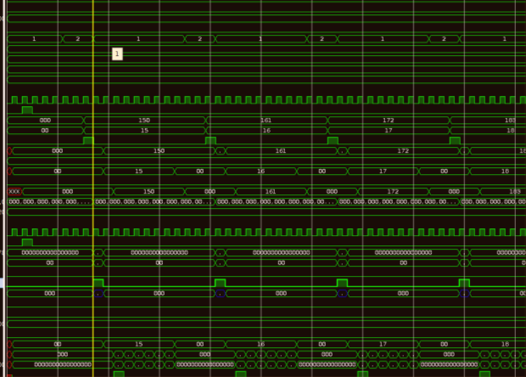



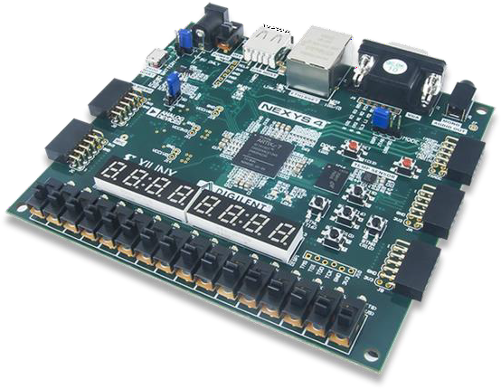
The 240 view of the world
What’s an ISA? (RISC-240 not withstanding)
SystemVerilog describes your hardware
What’s an OS? What is
*software* even?
Implement through simulation, ASIC fabrication or FPGA configuration

Slide 5
Relative Mutability/Non-Recurring Eng. (NRE) Cost?

Slide 6
Relative Observability?

Slide 7
Relative Optimizability?

Slide 8

Today: Thinking Like a Computer Architect

Slide 9
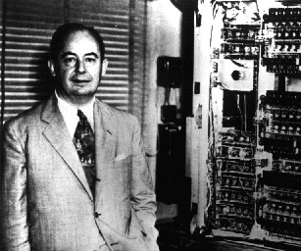
Our first hw/sw interface:
The Von Neumann Computing Model
CPU
Control & Instruction
Sequencing (“Control”)
John von Neumann’s Big Idea:
Programs are data.
Arithmetic, Logic, and Data
Manipulation (“ALU”)
Unified Bus
Memory
Program
Data

Slide 10
The Von Neumann / Stored-Program Computing Model
CPU
Control & Instruction
Sequencing (“Control”)
Arithmetic, Logic, and Data
Manipulation (“ALU”)
Let’s optimize! Where is there a bottleneck in the Von Neumann abstract machine?
Unified Bus
Memory
Program
Data

Slide 11
The Von Neumann / Stored-Program Computing Model
CPU
Control & Instruction
Sequencing (“Control”)
Arithmetic, Logic, and Data
Manipulation (“ALU”)
Data & Program share a bus into the CPU. Need to time multiplex access to the bus.
Unified Bus
Memory
Program
Data

Slide 12
The Von Neumann / Stored-Program Computing Model
CPU
Control & Instruction
Sequencing (“Control”)
Arithmetic, Logic, and Data
Manipulation (“ALU”)
I1: | x | = | y | + | z
I2: | a | = | b | * | c
I3: | r | = | s | + | t
Unified Bus
Memory
Program
Data

Slide 13
The Von Neumann / Stored-Program Computing Model
CPU
64bits
Control & Instruction
Sequencing (“Control”)
32bits
Arithmetic, Logic, and Data
Manipulation (“ALU”)
I1:
x
=
y
+
z
I2: a = b * c
I3: r = s + t
Unified Bus
Need to
write 8 bytes output data, read 16 bytes bits input data, read 4 bytes instruction
per arithmetic operation
Memory
Program
Data

Slide 14
The Von Neumann / Stored-Program Computing Model
CPU
64bits
Control & Instruction
Sequencing (“Control”)
32bits
Arithmetic, Logic, and Data
Manipulation (“ALU”)
I1:
x
=
y
+
z
I2: a = b * c
I3: r = s + t
8 byte unified bus
With a one word (8 byte) bus:
1 data write cycle,
2 data read cycles,
1 instruction read cycle
per arithmetic operation
Memory
Program
Data
4 cycles per instruction!

Slide 15
Alternative to von Neumann: the Harvard Architecture
CPU
Control & Instruction
Sequencing (“Control”)
Arithmetic, Logic, and Data
Manipulation (“ALU”)
Split bus architecture provides simultaneous access to program and to data
Instruction Bus
Data Bus
Memory
Program
Data

Slide 16
Alternative to von Neumann: the Harvard Architecture
CPU
64bits
Control & Instruction
Sequencing (“Control”)
32bits
Arithmetic, Logic, and Data
Manipulation (“ALU”)
I1:
x
=
y
+
z
I2: a = b * c
I3: r = s + t
Instruction Bus
Data Bus
With a one word (8 byte) bus:
data write cycle,
data read cycles, simultaneous with 1 instruction read cycle
per arithmetic operation
Memory
Program
Data
3 cycles per instruction!

Slide 17
Optimizing our Harvard Architecture
CPU
64bits
Control & Instruction
Sequencing (“Control”)
32bits
Arithmetic, Logic, and Data
Manipulation (“ALU”)
I1:
x
=
y
+
z
I2: a = b * c
I3: r = s + t
Instruction Bus
Dual-ported Data Bus
(1 read port, 1 write port)
With a one word (8 byte) bus:
1 data write cycle simultaneous with 2 data read cycles simultaneous with 1 instruction read cycle
per arithmetic operation
Memory
Program
Data
2 cycles per instruction!

Slide 18
Optimizing our Harvard Architecture
CPU
64bits
Control & Instruction
Sequencing (“Control”)
32bits
Arithmetic, Logic, and Data
Manipulation (“ALU”)
I1:
x
=
y
+
z
I2: a = b * c
I3: r = s + t
Instruction Bus
(32-bit read)
Dual-ported Data Bus
(2x64-bit read, 64-bit write port)
With a one word (8 byte) bus:
1 data write cycle simultaneous with 1 data read cycles simultaneous with 1 instruction read cycle
per arithmetic operation
Memory
Program
Data
1 cycle per instruction!

Slide 19
Thinking about the costs of HW optimization
CPU
Arithmetic, Logic, and Data Manipulation (“ALU”)
Control & Instruction
Sequencing (“Control”)
Control & Instruction
Sequencing (“Control”)
Is this free?
Arithmetic, Logic, and Data
Manipulation (“ALU”)
Unified Bus
Instruction Bus
(32-bit read)
Dual-ported Data Bus
(2x64-bit read, 64-bit write port)
Memory
Memory
Program
Data
Program
Data

Slide 20
$ ./destiny config/SRAM_128_1_32.cfg
$ ./destiny config/SRAM_128_1_128.cfg
4-byte Memory Interface: Read Latency = 0.289ns Write Latency = 0.212ns
16-byte Memory Interface: Read Latency = 0.289ns Write Latency = 0.212ns
CPU
Arithmetic, Logic, and Data Manipulation (“ALU”)
Control & Instruction
Sequencing (“Control”)
Control & Instruction
Sequencing (“Control”)
Free Lunch!
Arithmetic, Logic, and Data
Manipulation (“ALU”)
Unified Bus
Instruction Bus
(32-bit read)
Dual-ported Data Bus
(2x64-bit read, 64-bit write port)
Memory
Memory
Program
Data
Program
Data

Slide 21
$ ./destiny config/SRAM_128_1_32.cfg
$ ./destiny config/SRAM_128_1_128.cfg
4-byte Memory Interface: Read Energy = 0.836pJ Write Energy = 0.738pJ
16-byte Memory Interface:
Read Energy = 1.51pJ
Write Energy = 1.30pJ
CPU
Arithmetic, Logic, and Data Manipulation (“ALU”)
Control & Instruction
Sequencing (“Control”)
Control & Instruction
Sequencing (“Control”)
There is No Free Lunch!
Arithmetic, Logic, and Data
Manipulation (“ALU”)
Unified Bus
Instruction Bus
(32-bit read)
Dual-ported Data Bus
(2x64-bit read, 64-bit write port)
Memory
Memory
Program
Data
Program
Data

Slide 22
How about optimizing instruction supply?
CPU
Control & Instruction
Sequencing (“Control”)
128bits
Arithmetic, Logic, and Data
Manipulation (“ALU”)
I1: | x | = | y | + | z
I2: | a | = | b | * | c
I3: | r | = | s | + | t
I4: | q | = | n | + | m
Instruction Bus
(32-bit read)
Dual-ported Data Bus
(2x64-bit read, 64-bit write port)
These four instructions take four cycles to fetch sequentially on our instruction bus
Memory
Program
Data

Slide 23
How about optimizing instruction supply?
CPU
Control & Instruction
Sequencing (“Control”)
128bits
Arithmetic, Logic, and Data
Manipulation (“ALU”)
I1: | x | = | y | + | z
I2: | a | = | b | * | c
I3: | r | = | s | + | t
I4: | q | = | n | + | m
Instruction Bus
(128-bit read)
Dual-ported Data Bus
(2x64-bit read, 64-bit write port)
16 byte instruction bus:
1 instruction read cycle every 4 operations
Memory
Program
Data

Slide 24
Is this optimization a good tradeoff?
CPU
Control & Instruction
Sequencing (“Control”)
128bits
Arithmetic, Logic, and Data
Manipulation (“ALU”)
I1: | x | = | y | + | z
I2: | a | = | b | * | c
I3: | r | = | s | + | t
I4: | q | = | n | + | m
Instruction Bus
(128-bit read)
Dual-ported Data Bus
(2x64-bit read, 64-bit write port)
16 byte instruction bus:
1 instruction read cycle every 4 operations
4B Read Energy = 0.836pJ 16B Read Energy = 1.51pJ
Memory
Program
Data

Slide 25
Is this optimization a good tradeoff?
E_old = n x EpF
CPU
E_new = (n/4) x (EpF x 2) = ½(n x EpF)
2x savings in total instruction fetch energy!
Control & Instruction
Sequencing (“Control”)
128bits
Arithmetic, Logic, and Data
Manipulation (“ALU”)
I1:
I2:
I3:
I4:
x = y + z a = b * c r = s + t q = n + m
Instruction Bus
(128-bit read)
Dual-ported Data Bus
(2x64-bit read, 64-bit write port)
16 byte instruction bus:
1 instruction read cycle every 4 operations
4x fewer instruction fetches
4B Read Energy = 0.836pJ
16B Read Energy = 1.51pJ
~2x more energy / fetch
Memory
Program
Data

Slide 26
Is this optimization a good tradeoff?
CPU
When might this optimization *not* pay off?
Control & Instruction
Sequencing (“Control”)
128bits
Arithmetic, Logic, and Data
Manipulation (“ALU”)
I1: | x | = | y | + | z
I2: | a | = | b | * | c
I3: | r | = | s | + | t
I4: | q | = | n | + | m
Instruction Bus
(128-bit read)
Dual-ported Data Bus
(2x64-bit read, 64-bit write port)
16 byte instruction bus:
1 instruction read cycle every 4 operations
4x fewer instruction fetches
4B Read Energy = 0.836pJ
16B Read Energy = 1.51pJ
~2x more energy / fetch
Memory
Program
Data

Slide 27
Is this optimization always a good tradeoff?
CPU
Control & Instruction
Sequencing (“Control”)
128bits
Arithmetic, Logic, and Data
Manipulation (“ALU”)
I1:
I2:
I3:
I4:
if (x==0) a = b * c y = z + w q = n + m
Instruction Bus
(128-bit read)
Dual-ported Data Bus
(2x64-bit read, 64-bit write port)
1 instruction read cycle every 4 operations
4x fewer reads, if we execute the operations!
OR: 4x more useless fetching if x!=0
(more on this branching topic in a future lecture)
4B Read Energy = 0.836pJ
16B Read Energy = 1.51pJ
~2x more energy / fetch
Memory
Program
Data

Slide 28
How about changing the code?
I1:
I2:
I3:
I4:
if (x==0) a = b * 2 y = z + w q = n + m
CPU
I1:
I2:
I3:
I4:
I5:
I6:
I7:
I8:
y = z + w q = n + m if (x==0) a = b * 2
//else
a = b * 4
//other
//stuff
Control & Instruction
Sequencing (“Control”)
I5: //else
Compiler!
Arithmetic, Logic, and Data
Manipulation (“ALU”)
I6: a = b * 4 I7: y = z + w I8: q = n + m
Instruction Bus
(128-bit read)
Dual-ported Data Bus
(2x64-bit read, 64-bit write port)
Restructure code, increase likelihood to execute
Avoid needless fetch of non-executing code
Q: What if x is most often non-zero?
Memory
Program
Data

Slide 29
A key Law of the HW/SW Universe

Slide 30
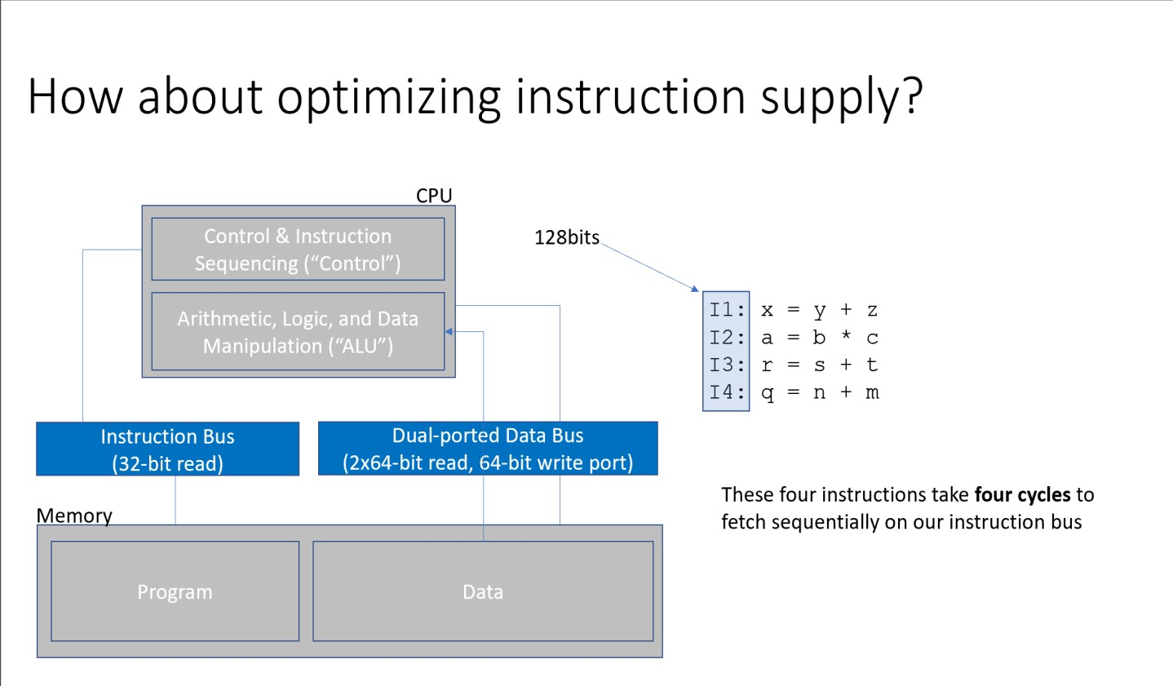
Amdahl’s Law
Let’s revisit the proposition that we should optimize instruction supply
How do we decide if this part of the system is really worth optimizing?

Slide 31
Amdahl’s Law
100% of execution time

Slide 32
Amdahl’s Law
Imagine we have a perfectly precise measurement
tool to break down execution time…
100% of execution time
45% - Memory Accesses
20% - Control Flow
17.5% - Integer
12.5% - Fetch
What can we say about optimizing instruction supply (fetch) if this is our situation?
5% - Floating
Point

Slide 33
Amdahl’s Law
What if we make fetch 4x faster?
100% of execution time
10 seconds
45% - Memory Accesses
20% - Control Flow
17.5% - Integer
12.5% - Fetch
We have 45% + 20% + 17.5% + 5% = 87.5% of the execution running at its original speed (ie 87.5% of 10 seconds = 8.75s)
5% - Floating
Point
We have 12.5% of the execution running 4x faster. Originally, we had 12.5% of 10 units of time = 1.25s. If 4x faster, fetch takes 0.31s. Savings of 0.94s

Slide 34
Amdahl’s Law
What if we make fetch 4x faster?
100% of execution time
45% - Memory Accesses
20% - Control Flow
17.5% - Integer
12.5% - Fetch
(0.875 x 10)/1 + (0.125 x 10)/4 = 9.06
5% - Floating
Point
What does 0.906 mean?

Slide 35
Amdahl’s Law
What if we make fetch 4x faster?
<10% improvement overall, despite 4x improvement on one part of the system!
100% of execution time
45% - Memory Accesses
20% - Control Flow
17.5% - Integer
12.5% - Fetch
4x improvement in fetch means execution takes 9.0625s instead of 10s Saved 0.94s overall. 0.94s / 10s * 100 = 9.4% time savings
5% - Floating
Point

Slide 36
Amdahl’s Law
What if we make memory accesses 4x faster?
100% of execution time
45% - Memory Accesses
20% - Control Flow
17.5% - Integer
12.5% - Fetch
5% - Floating
Point

Slide 37
Amdahl’s Law
What if we make memory accesses 4x faster?
100% of execution time
45% - Memory Accesses
20% - Control Flow
17.5% - Integer
12.5% - Fetch
55% of 10s + (45% of 10s) / 4 = 6.625s
5% - Floating
Point
Evidently, we should optimize the memory part before fetch!

Slide 38
Amdahl’s Law
100% of execution time
45% - Memory Accesses 20% - Control Flow 17.5% - Integer
Amdahl’s Law:
if fraction p can be optimized:
Optimized Time = [ (1-p) * t / 1 ] + [ (p * t) / speedup ]
12.5% - Fetch
5% - Floating
Point

Slide 39
Amdahl’s Law
100% of execution time
45% - Memory Accesses
Amdahl’s Law:
Overall Speedup = ?
20% - Control Flow
17.5% - Integer
12.5% - Fetch
5% - Floating
Point

Slide 40
Amdahl’s Law
100% of execution time
45% - Memory Accesses
Amdahl’s Law:
20% - Control Flow
17.5% - Integer
12.5% - Fetch
Overall Speedup = T_orig / T_opt
Overall Speedup = 1 / (1 – p + p / s)
5% - Floating
Point

Slide 41
Amdahl’s Law
By how much do we have to improve the memory part of the system to get a 2x total speedup?
100% of execution time
45% - Memory Accesses
20% - Control Flow
17.5% - Integer
12.5% - Fetch
5% - Floating
Point

Slide 42
Amdahl’s Law
By how much do we have to improve the memory part of the system to get a 2x total speedup?
100% of execution time
45% - Memory Accesses 20% - Control Flow
0.55 x 10s + (0.45 x 10s)/speedup = 10s / 2 = 5s
4.5s / speedup = 5s – 5.5s speedup = -9x
Well that’s a strange amount by which to speed up
a program… conclusion?
17.5% - Integer
12.5% - Fetch
5% - Floating
Point

Slide 43
Limit Cases for Amdahl’s Law
100% of execution time
45% - Memory Accesses
20% - Control Flow
17.5% - Integer
12.5% - Fetch
Let’s try again:
What if we completely optimize away the optimizable part?
5% - Floating
Point

Slide 44
Limit Cases for Amdahl’s Law
100% of original execution time
IIddeeaallllyy ooppttiimmiizzeedd eexeex ccuuttiioonn ttiimmee
45% - Memory Accesses
20% - Control Flow
17.5% - Integer
0% - Fetch
5% - Floating Point
What if we completely optimize away the optimizable part? (How much is left over here?)

Slide 45
Limit Cases for Amdahl’s Law
100% of original execution time
IIddeeaallllyy ooppttiimmiizzeedd eexeex ccuuttiioonn ttiimmee
45% - Memory Accesses
20% - Control Flow
17.5% - Integer
0% - Fetch
5% - Floating Point
What if we completely optimize away the optimizable part?
8.75s optimized execution time

Slide 46
Limit Cases for Amdahl’s Law
100% of original execution time
Ideally optimized execution time
20% - Control Flow 17.5% - Integer 12.5% - Fetch
5% - Floating Point
0% - Memory Accesses
What if we completely optimize away the memory part?
5.5s optimized execution time

Slide 47
Limit Cases for Amdahl’s Law
100% of original execution time
Ideally optimized execution time
45% - Memory Accesses 20% - Control Flow 17.5% - Integer
Amdahl’s Law:
optimized time = [ 1-p x time / 1.0 ] + [ p x time / s ] Overall speedup = 1 / (1 - p + p / s)
0% - Fetch
5% - Floating Point

Slide 48
Limit Cases for Amdahl’s Law
100% of original execution time
Ideally optimized execution time
45% - Memory Accesses 20% - Control Flow 17.5% - Integer
0% - Fetch
5% - Floating Point
Amdahl’s Law with infinite speedup:
optimized time with infinite speedup of p = [ 1-p x time / 1.0 ] Overall speedup with infinite speedup of p = 1 / (1 - p)

Slide 49
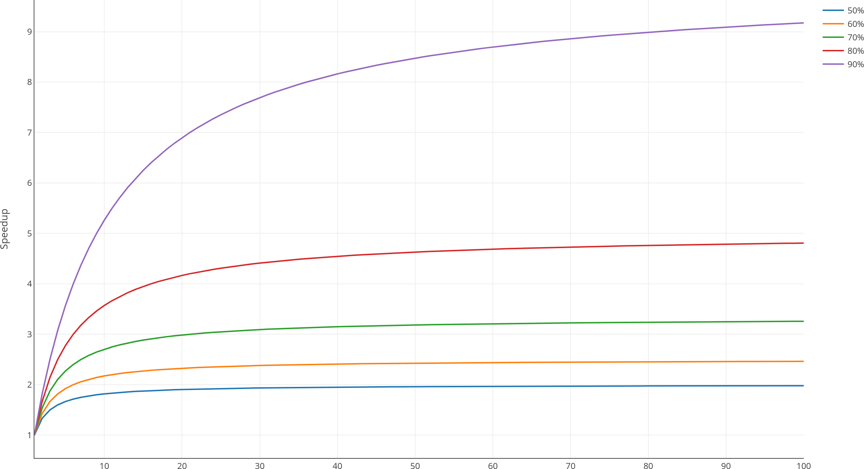
Amdahl’s Law Speedup
optimizable
part (p)
>100x
optimized part speedup?
80%
optimizable? max speedup 5x!
Optimized speedup for optimizable part

Slide 50
Amdahl’s Law is Extremely Versatile
100% of execution energy
45% - Memory Accesses
20% - Control Flow
17.5% - Integer
12.5% - Fetch
Works for any optimization problem and goal. Always
focus on the biggest slice & the rest doesn’t matter.
5% - Floating
Point

Slide 51
Using Amdahl’s Law to push the bottleneck
around
100% of execution energy
45% - Memory Accesses
20% - Control Flow
17.5% - Integer
12.5% - Fetch
Bottleneck: memory accesses
5% - Floating
Point

Slide 52
Using Amdahl’s Law to push the bottleneck
around
100% of execution energy
Memory Accesses
Control Flow
Integer
Fetch
Floating Point
New bottleneck: control flow

Slide 53
Using Amdahl’s Law to push the bottleneck
around
100% of execution energy
Memory Accesses
Control Flow
Integer
Fetch
Floating
Point
New bottleneck: memory accesses (again!)

Slide 54
Using Amdahl’s Law to push the bottleneck
around
100% of execution energy
Memory Accesses
Control Flow
Integer
Fetch
Floating
Point
Remember: Amdahl tells us to optimize the biggest slice

Slide 55
Another view of the world: Gustafson’s Law
Intuition:
Work tends to be time limited, and as we all know, work tends to fill the time.
So, for many problems, the amount of work we do grows alongside our ability to do it.
We need to judge the real-world impact by what we will do, not what we once did.
85% - Memory Accesses
“The speedup we experience is equal to the amount of parallelization, except for the percentage of the problem which isn’t parallelizable and needs to be done sequentially”.
Gustafson’s Law says the scaled speedup S with P processors is:
S(P)=P−α⋅(P−1)
Where:
P = number of processors
α = fraction of time spent on the part of the program that is inherently sequential (cannot be parallelized)

Slide 56
Another view of the world: Gustafson’s Law
Gustafson’s Law: Sequential part does not grow as optimizable part grows. Can always add more optimizable part and make sequential part matter less
Assume that we can scale up # of parallel memory accesses, N
Assume we can scale input up to use all N parallel accesses
data_size = 10 data[data_size] = {…} if(…){ }
…//18 more of these conditionals if(…){ }
data_size = 100000 data[data_size] = {…} if(…){ }
…//18 more of these conditionals if(…){ }
#parallel[N=1000]
for d in 0..data_size{ d++ }
Gustafson!
for d in 0..data_size{ d++ }

Slide 57
Another view of the world:
Scale parallel memory accesses, N, up to 1000? Scaled Speedup = 1-p + 1000p = 999p + 1 Scaled Speedup = 999 * 0.85 + 1 = 850x
85% - Memory Accesses
Gustafson’s Law for overall speedup with speedup factor of N:
(assume) Optimized time = T = 1
Unoptimized time = T’ = (1-p)T + pT*N = (1-p) + pN
Scaled Speedup = T’ / T = (1-p) + pN

Slide 58
Amdahl’s Law vs Gustafson’s Law
Amdahl’s Law
Hold work constant
Scale time
Original Situation
1=1/4*4
4=1*4
What before took 8 units of time now takes 5 units of time
8/5x speedup = 1.6x speedup
4x
Parallelizable
1x (Not)
Parallelizable
Gustafson’s Law
8 units of time, 8 units of work
P=50%, NP=50%
Hold time constant
Scale work
16=4*4 units of work
4 units of work
Before we could do 8 units of work in 8 units of time
Now we can do 20 units of work in 8 units of time.
20/8x speedup – 2.5x speedup

Slide 59
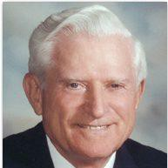
What did we just learn?
Two high-level architectural models
Identify performance bottlenecks
Develop optimizations to mitigate bottlenecks
Analyze resulting improvement from mitigating bottlenecks
Identifying persistent performance limiters (e.g., branches)
Optimize in software or hardware
(Almost) never bet against Gene Amdahl in an optimization contest!

Slide 60
What to think about next?
What is a computer architecture?
What matters when defining a HW/SW interface?
What is above the ISA and what is below the ISA?
What is hidden from the programmer and what is exposed?

