Slide 1
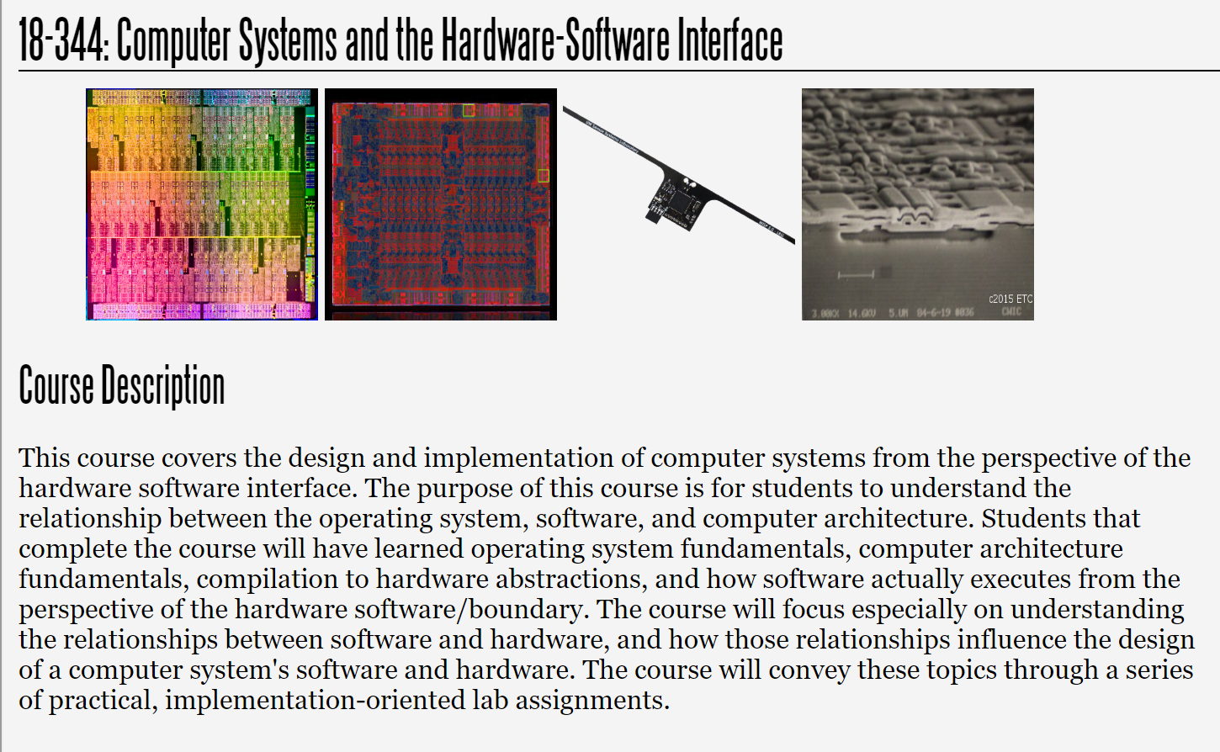
Fall 2025
Lecture 14: The Compiler Is Here To Help
Credit: Brandon Lucia

Slide 2
Today: The Compiler is Here to Help
Next we will look to how the compiler represents and reasons about a program
We will learn about compiler optimizations and how they get defined and applied
Note: This lecture was intended to fall after VLIW and vector machines and before VM in the schedule, but was bumped back by one lecture to give you more time on the VM lab.
When studying later, you may want to review it at that point in your flow.

Slide 3
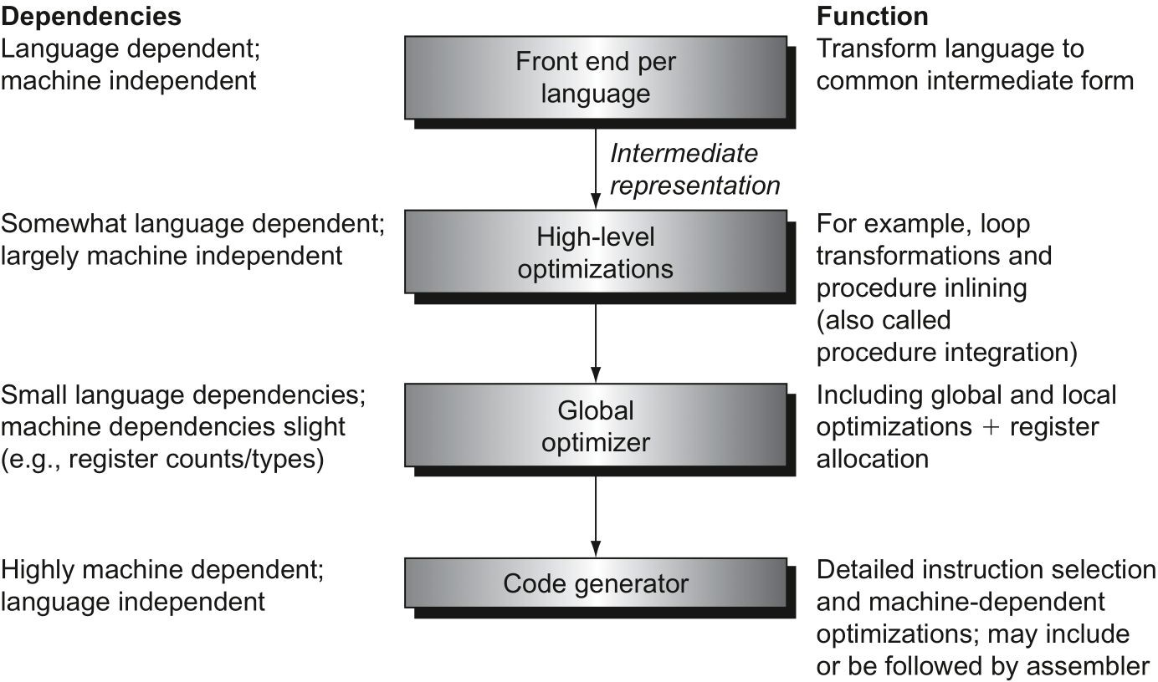
Purpose & Operation of a Compiler
Compilers process high-level language code to (eventually) produce machine code
Organized into a front-end, “middle-end”, and back-end.
Middle-end analyzes/transforms program represented as an “Intermediate Representation”

Slide 4
Front-end Phases in the Compiler
Input: High-level Language / C Program
Scanning / Lexing
Parsing
Semantic Analysis
Generation of Intermediate Representation (IR)
Output: IR to process in middle-end

Slide 5

Scanning / Lexing: Reading in raw characters
Process input string from code file into characters
Use finite state machine to process characters into lexemes to match tokens
Maximal Munch Rule: Always match longest available lexeme to token
Output: series of tokens identified by a (string) name that can be parsed to give semantic meaning
“while (save[i] == k): i += 1;”
‘w’ ‘h’ ‘i’ ‘l’ ‘e’ ‘(‘
‘s’ ‘a’ ‘v’ ‘e’ ‘[‘ ‘I’
‘]’ ‘=‘ ‘=‘ ‘k’ ‘)’ ‘:’
‘i’ ‘+’ ‘=‘ ‘1’ ‘;’
A “scanner” or “lexer” processes text into tokens
“while” “(“ “save” “[“
“]” “i” “==“ “k” “)”
“i” “+=“ “1” “;”

Slide 6
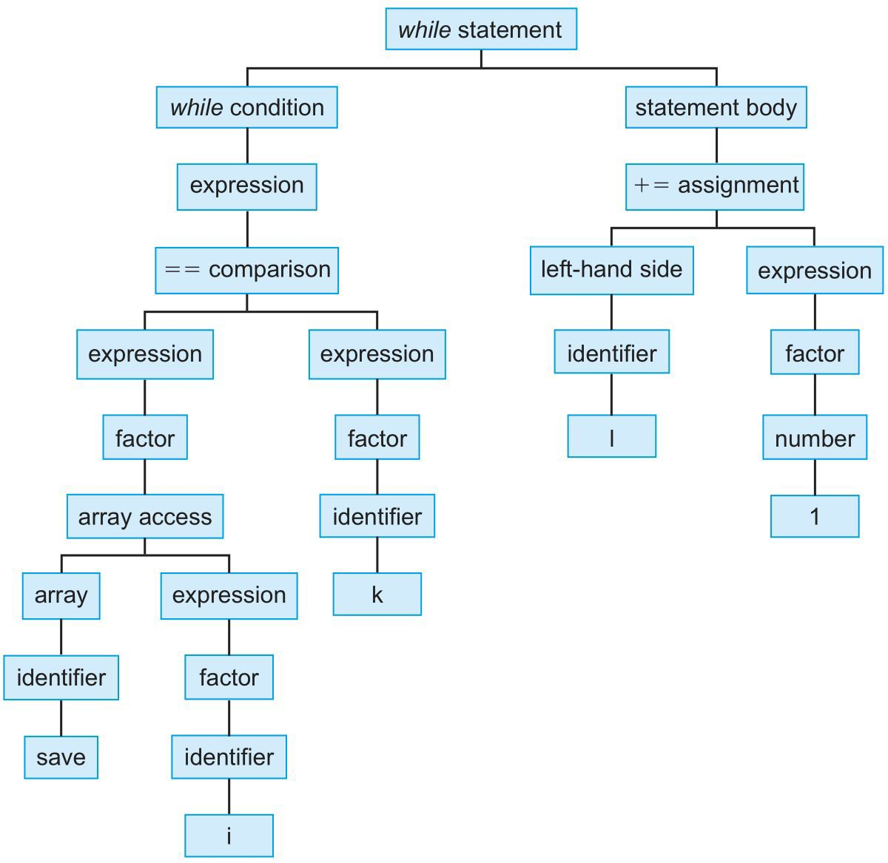
Parsing tokens
Assemble tokens into an abstract syntax tree (AST) that represents the syntactic structure of the program
Tree represents recursive substructure of program
Includes sufficient information to assign semantics to components of the tree for analysis, optimization, and mapping to machine instructions

Slide 7
Semantic Checking & Analysis
Programmatically examine the AST to find a broad class of common errors
Creates a symbol table mapping names & types in program
Type checking (most): make sure
computations only applied to correct kinds of values
Type: (integer, integer)
Ownership/Borrow Checking (some): make sure only zero or one writable reference to a memory location
Data-race checking (some): make sure that no code allows data races
Security / data integrity checking: make sure that non-trustworthy operations to do not see secret data
Type: integer
Type: integer

Slide 8
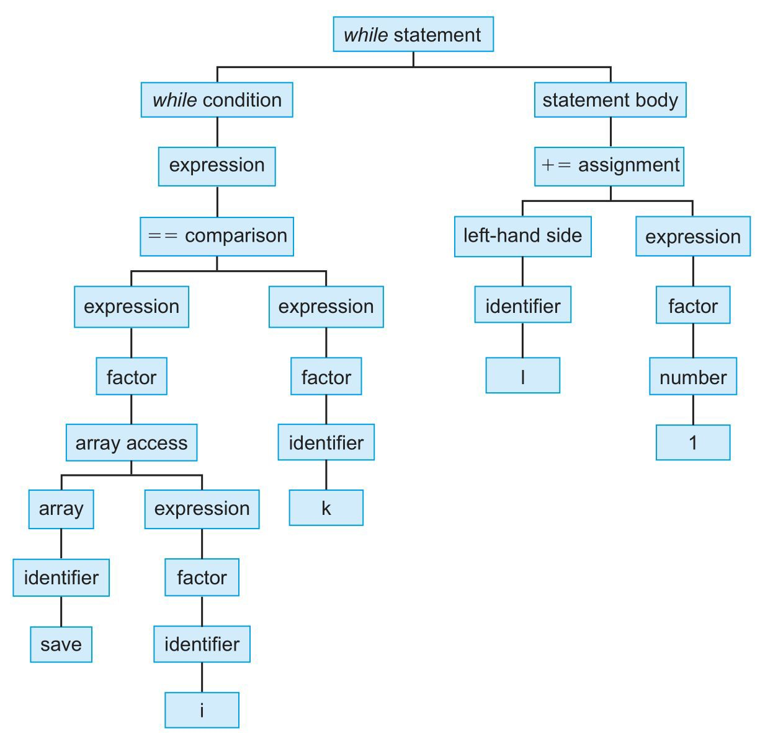
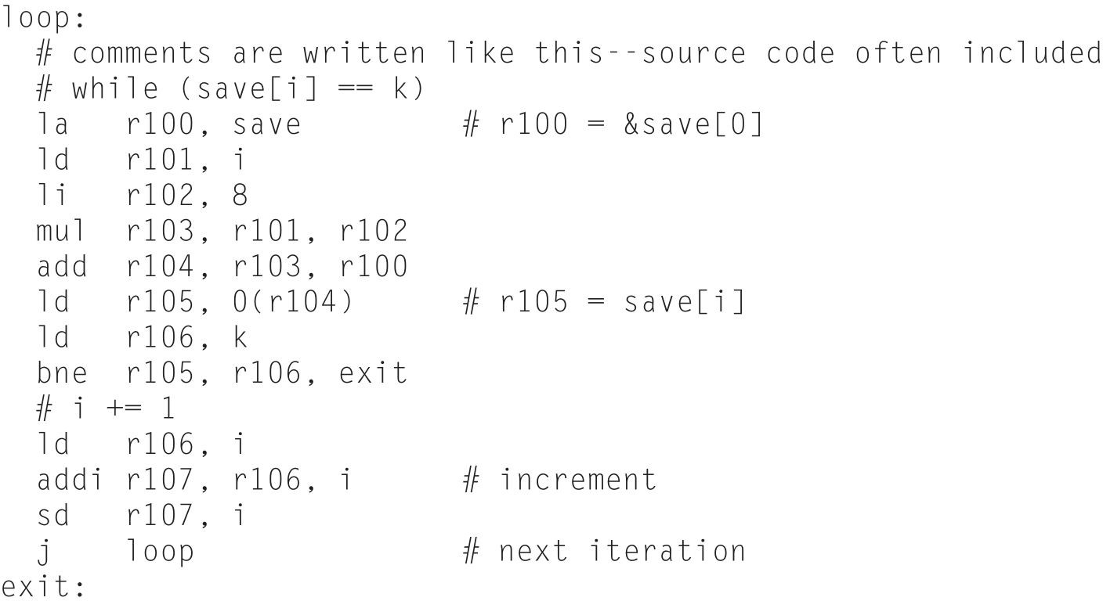
Converting to Intermediate Representation (IR)
Purpose of IR: simple set of semi-universal, language- and
machine-independent operations to which to apply analysis & optimizations
Structure of IR: varies depending on the IR model used by compiler, usually looks assembly-ish & has hierarchical structure (functions, blocks, instructions)

Slide 9
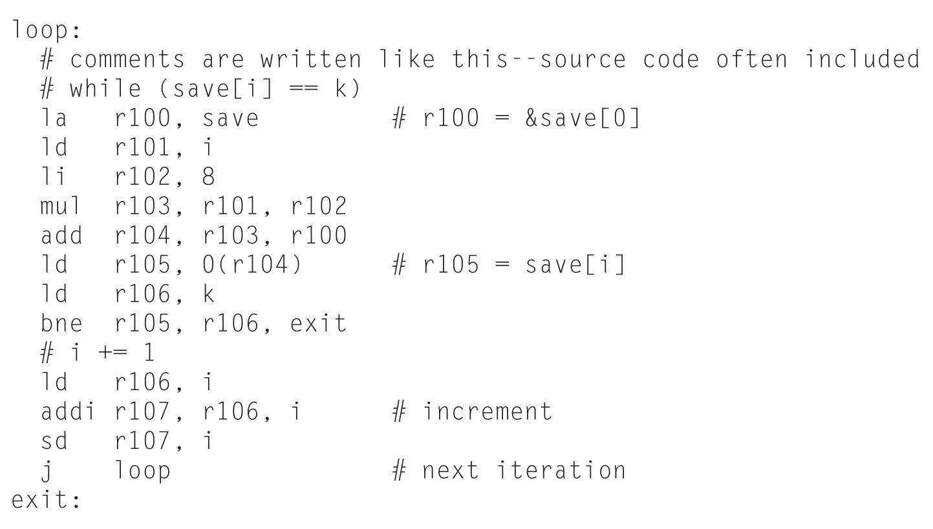
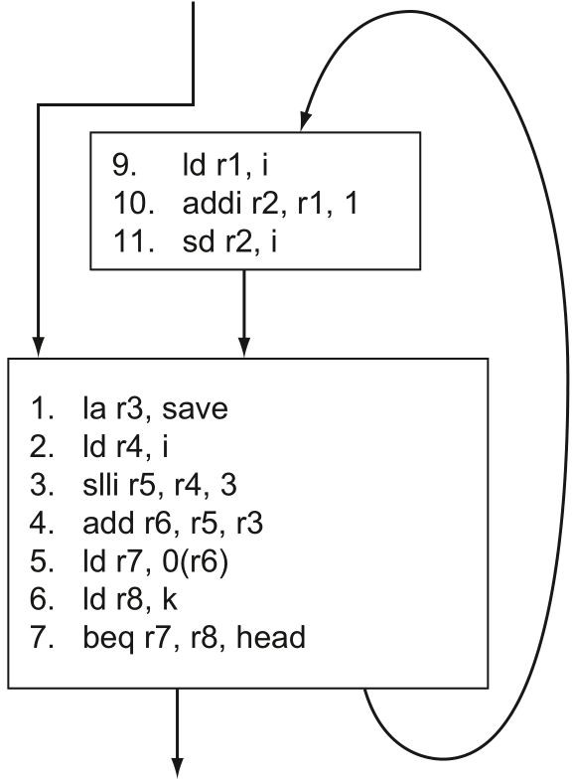
IR: Linear View vs. Control-flow Graph View
Linear: Directly maps to high-level code, no recursive/hierarchical sub-structure
Control-flow Graph: Break code into basic blocks (linear, single entry point, single exit point) with arcs describing possible control flows

Slide 10
Single Static Assignment (SSA)
All registers in IR are “fresh” virtual registers, assigned to exactly once anywhere in the code.
These registers do not correspond to any machine.
Why?

Slide 11
SSA Makes Dependence Chains Easy
Definition – Use Chains (or Def-Use Chains) emerge directly from analysis of virtual register assignments and uses

Slide 12
Φ –nodes: Handling Control-flow Divergence
When control paths diverge, need to re-converge eventually
If single variable conditionally assigned on both sides of branch, how to decide its value?
x = 0;
if(cond){x+=1} else{x+=2};
y = x + 1;
r100 = 0
If cond
r101 = r100+1
r102 = r100+2
without Φ, what value would we assign to r103?
r103 = Φ
(r101,r102)
r104 = r103+1

Slide 13
Compiler Optimizations
Local Optimization: optimize operations within a single basic block; “cleanup” before global optimizations
Global Optimization: optimization across basic blocks
Global register allocation: Register mapping pass required for making code fast

Slide 14
Optimization Example: Dead Code Elimination
x = 0;
if(x>0){x+=1}
else{x+=2}; y = x + 1;
Why would you have a program with weird code like this in it?
x = 0;
x += 2;
y = x+1;

Slide 15
Optimization Example: Constant / Copy Propagation
x = 0;
if(x>0){x+=1}
x=0 x+=2
y = x+1
Significantly simplified from our original code by applying a sequence of optimizations
else{x+=2}; y = x + 1;
y = 3;

Slide 16
Optimization Example: Common Subexpression Elimination
x[i] = x[i] + 4
// x[i] + 4
// x[i] + 4
la r100,x
ld r101,i
mul r102,r101,8 add r103,r100,r102
la r100,x
ld r101,i
slli r102,r101,3 add r103,r100,r102
ld r104, 0(r103)
//
addi r105, r104,4
ld r104, 0(r103)
// x[i] is in r104 addi r105, r104,4 sd r105, 0(r103)
la r106,x
ld r107,I
mul r108,r107,8 add r109,r106,r107
sd r105,0(r109)

Slide 17
Optimization Example: Strength Reduction
x[i] = x[i] + 4
// x[i] + 4 la r100,x ld r101,i
// x[i] + 4 la r100,x ld r101,i
mul r102,r101,8
slli r102,r101,3
add r103,r100,r102 ld r104, 0(r103)
//
addi r105, r104,4 la r106,x
ld r107,I
add r103,r100,r102 ld r104, 0(r103)
// x[i] is in r104 addi r105, r104,4 sd r105, 0(r103)
mul r108,r107,8
add r109,r106,r107 sd r105,0(r109)

Slide 18
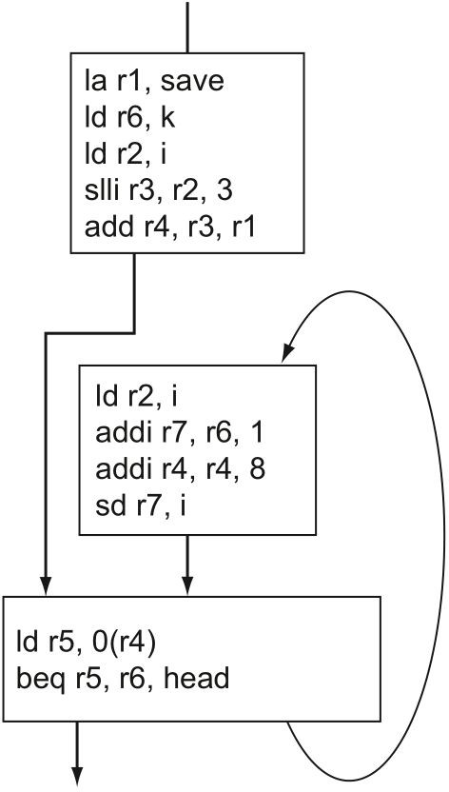

Global Optimization Example:
Code Motion / Induction Variable Elimination
“while (save[i] == k): i += 1;”
Code Motion: hoisted outside of the loop
Induction Variable Elimination: Re-write induction variable update & address computation directly
add 1 to I
addr = save + i*8 via
ld slli addi
add 1 to I add 8 to addr
ld k every time around the loop
Global optimizations tend to be more complex and involve reasoning that is more difficult to prove correct

Slide 19
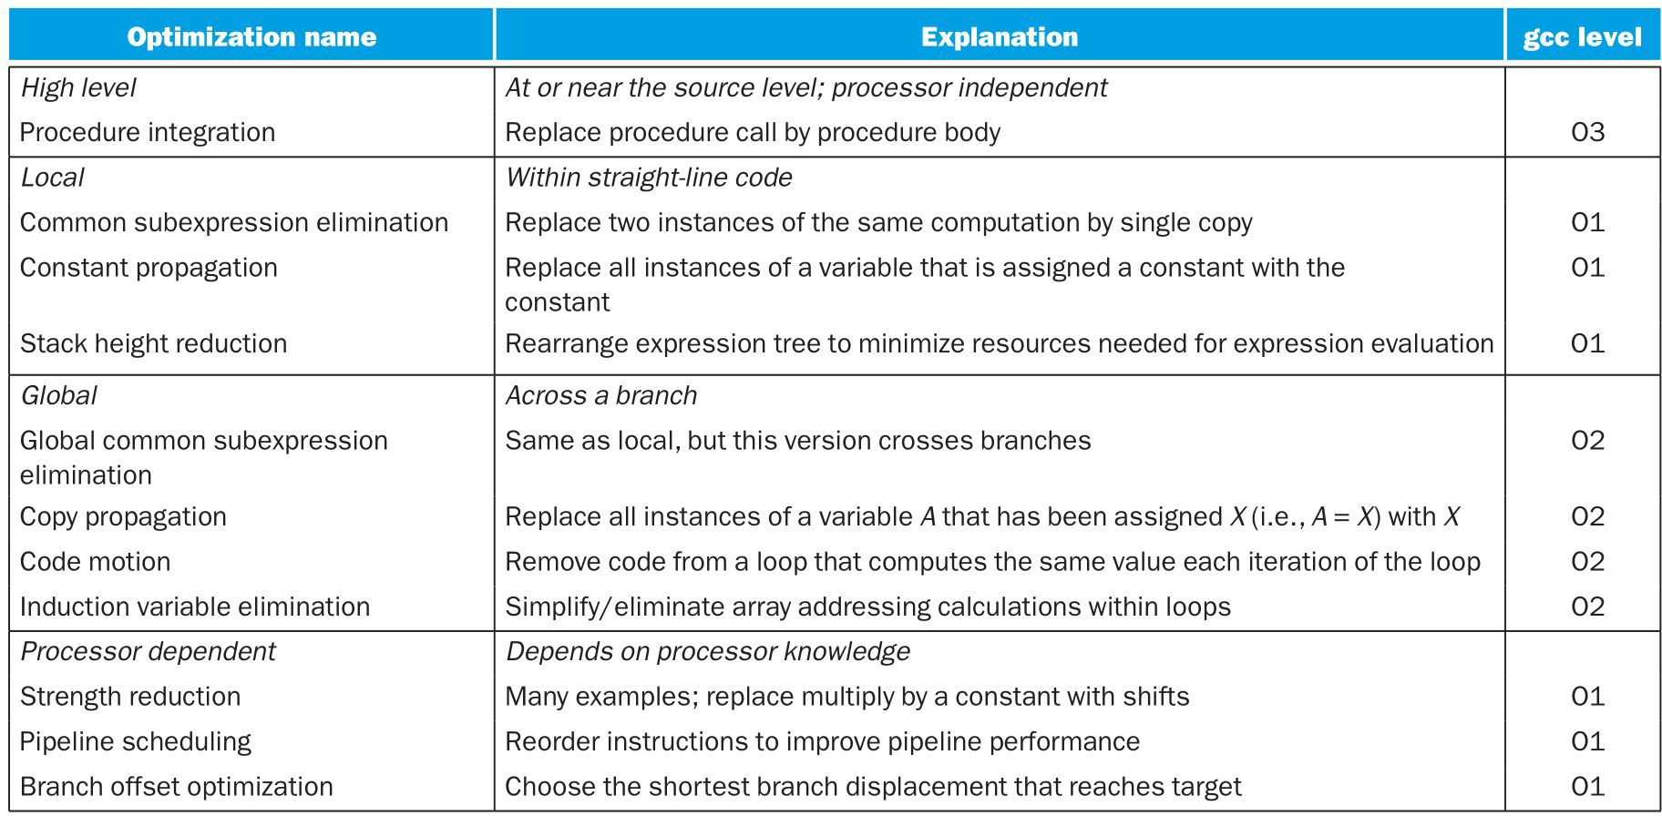
Optimization Summary

Slide 20
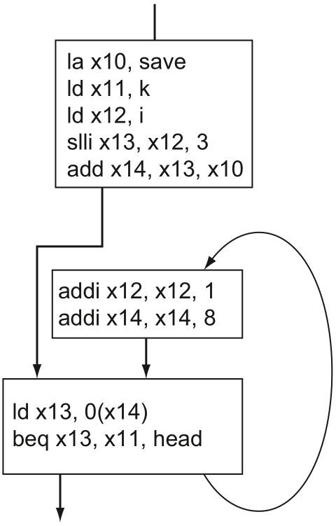
Register Allocation: Eliminating Memory Loads and Stores
Register Allocation: Map to assembly/ machine registers
Load/Store temp variables before/after use
Load/Store Elimination: Remove loads from/stores to memory for vars in regs

Slide 21
Register Allocation: Algorithmically
Region-based Register Allocation – Finding Regions:
Choose a variable definition, d (assignment); add its basic block to region, R
Find uses, u_i of the definition d in other basic blocks, add those basic blocks to R; add any block on a path between a definition’s block and the use’s block to R too.
Find any other definitions that could affect u_i and add the blocks containing those definitions to R
Repeat steps 2 and 3 until you do not add any more regions to R.
Property of resulting set of blocks: if the variable subject to definition d is allocated in register in these blocks, then there is no need to load and store the variable after its initial load/definition
Proof Intuition: definitions flow through these and only these blocks along reachable paths to all possible uses. If all uses and defs use the same register name, no need to write to/read from memory).

Slide 22
Register Allocation: Algorithmically
Region-based Register Allocation – Mapping to machine registers:
Compute regions for each virtual/IR register in program
Construct region interference graph,
G=(V,E): V = {regions}, E = { (r1,r2) | r1 and r2 include a basic block in common}
Run graphColor(G) to assign a color to each region such that no adjacent vertices in G have the same color
If #colors <= #machine registers, assign one machine register per color and register allocate variables in regions.
If #colors > #machine registers, need to spill register to memory with load/store pair, essentially splitting regions until #colors <= #machine registers
Key property: regions that do not include overlapping basic blocks can use the same register for a different value/definition

Slide 23
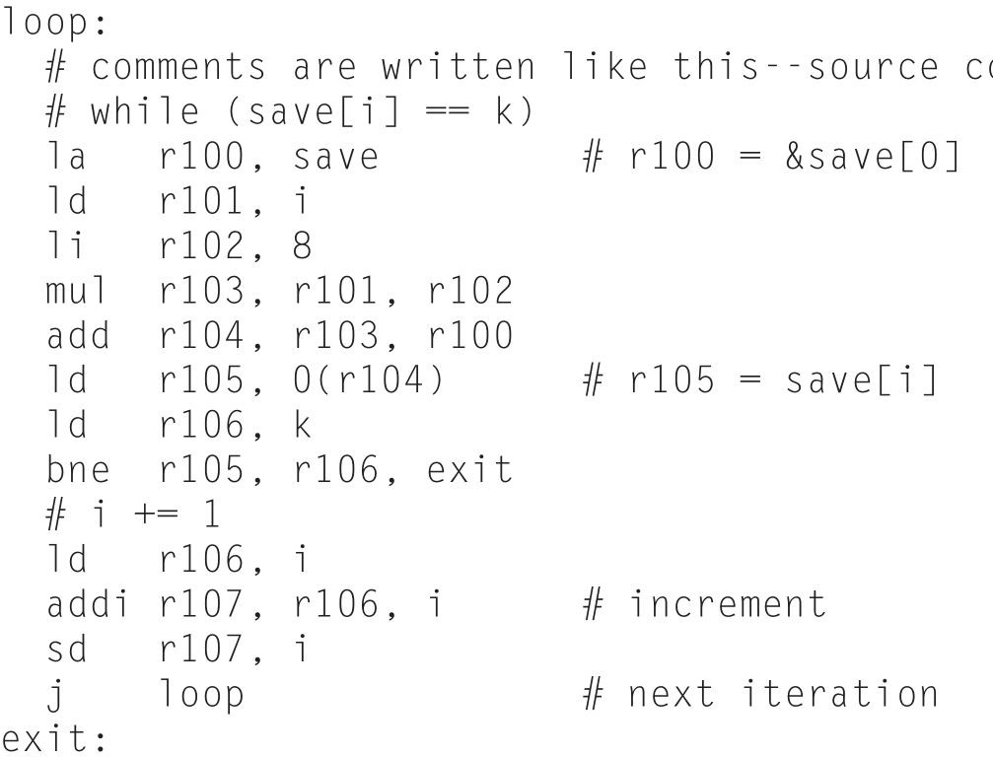
Is the code you write the code you run?
while(save[i] == k]): x[i] = x[i] + 4
Key idea: optimize the inner loop automatically!
Inner loop in initial IR representation is 12 instructions long including 7 mem ops (long time if not cache hits). Inner loop in optimized version is 5 instructions including 1 mem op.

Slide 24
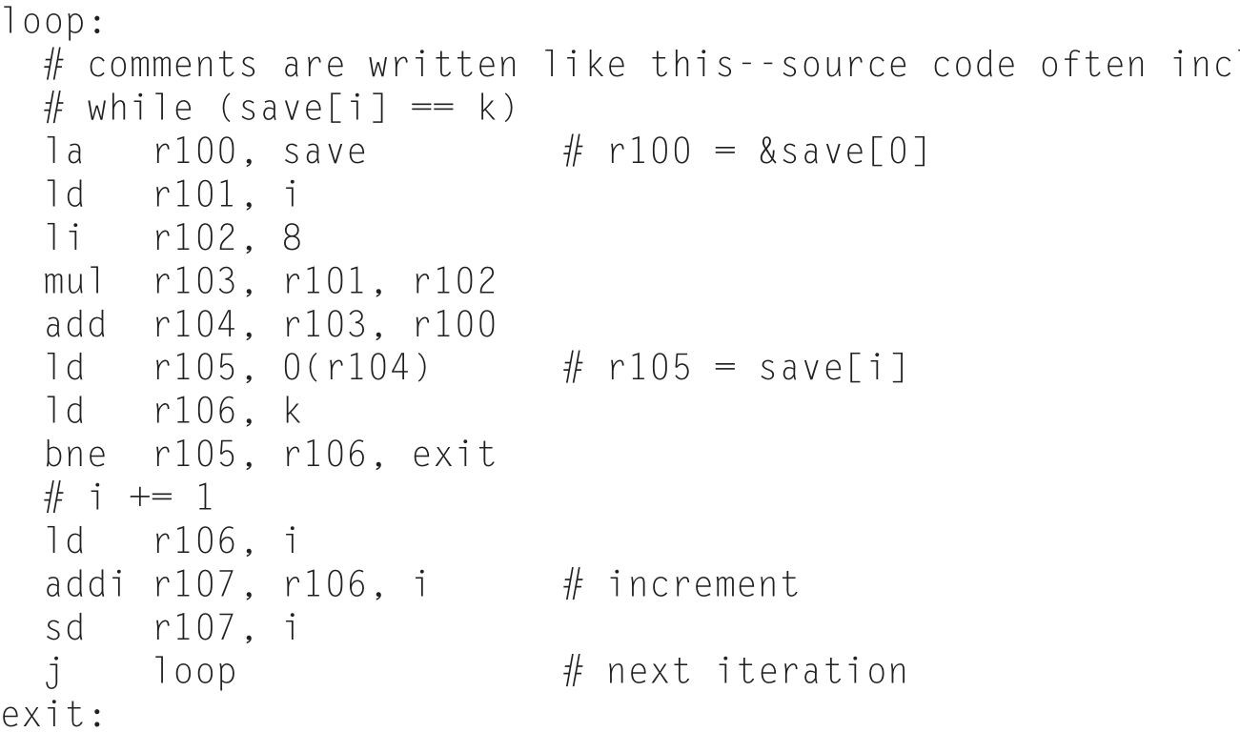
Intermediate Representation Design
What properties are desirable in an IR? (what properties are undesirable in an IR?)
How to select an IR if you are a compiler writer?
What aspects of the IR do you care about if you’re a programmer?
What aspects of the IR do you care about if you’re an architect?

Slide 25


Enter: LLVM the “new” great IR ca. 2004
Designed to support transparent
program analysis and transformation for arbitrary programs
Provide high-level information to
compiler at compile-time, link-time (and run-time); always have a CFG
Language-independent type system
Explicit support for typed address arithmetic
Uniform abstraction for
exception-handling (setjmp / longjmp)
Code representation based on Single
Static Assignment (SSA) with explicit phi nodes

Slide 26

Enter: LLVM the “new” great IR ca. 2004
LLVM has remained the industry and research standard IR for making custom compilers for nearly two decades
GCC, which you’re very familiar with also, is less extensible, but more robust and with a longer lifetime of community support
Recently, new players with applications changing dramatically
what an awful logo!

Slide 27

Do we need a better IR?MLIR the Multi-Level Intermediate
Representation
“The MLIR project is a novel approach to building reusable and extensible compiler infrastructure. MLIR aims to address software fragmentation, improve compilation for heterogeneous hardware, significantly reduce the cost of building domain specific compilers, and aid in connecting existing compilers together.”
Features:
  Ability to represent dataflows directly (including TensorFlow for ML)
  Optimization over dataflow graphs directly
  high-performance-computing-style optimizations across compute kernels
  Hardware dependent features: DMA insertion, cache management, memory tiling mapping to vector hardware primitives
  Hardware accelerator specific operations
Interesting to see where this project goes in the next year or two

Slide 28


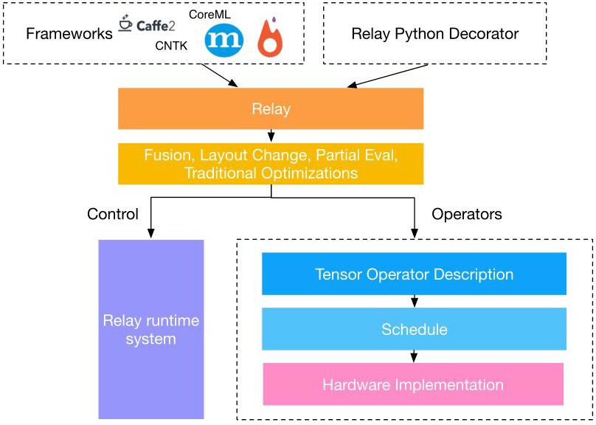
Do we need an IR specifically made for machine learning computations?
Relay IR for Machine Learning / Tensor processing frameworks
Map from any high-level ML framework to IR
Generate orthogonal control (runtime code) and scheduling / hardware mapping (data layout + operators)
Highly specialized for ML & Tensor-specific optimization

Slide 29
What else can compilers do for you?
Compilers do more than just map to machines and optimize for you
Support for debugging and profiling instrumentation
Analysis to check security properties

Slide 30
Compiling to profile (like gprof)
Insert code that tracks transitions into every basic block
  (reality: track at path granularity to cut down on tracking code)
Runtime: randomly sample using a timer which block active & make histogram
  More frequent block in histogram
== hot code/inner loop
Here1!
Here2!
Here3!

Slide 31
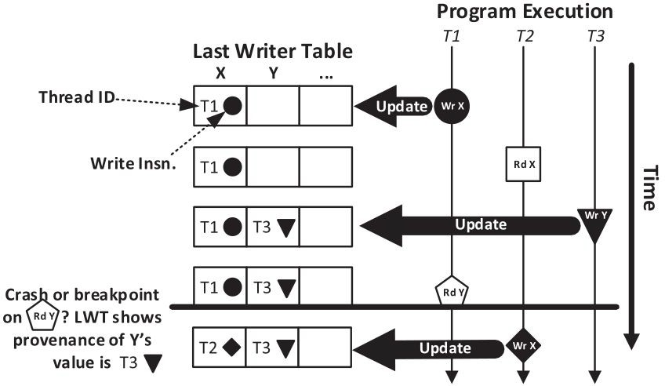
Compiling to help with debugging: Concurrent Data Provenance Tracking
Compiler inserts code on every write operation to dynamically track the last writer instruction and thread ID of a variable
On crash or breakpoint, last writer table helps understand provenance of value in crash/op
Useful for concurrency bug debugging
https://github.com/blucia0a/CTraps-gcc

Slide 32
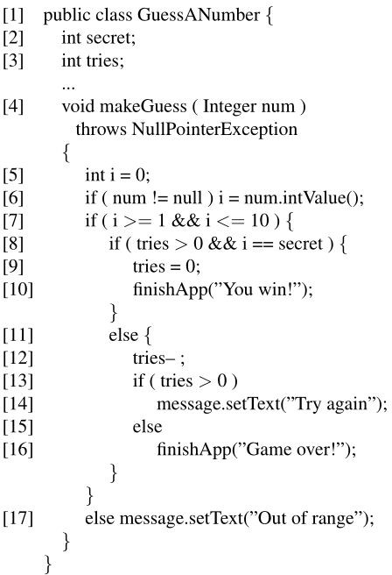
Information Flow Control Analysis for Security
Non-privileged operations not allowed to access/be influenced by secret data
Secret number should never flow to any operation unless we trust that operation with the secret (i.e., correct guess)
Compiler uses “taint propagation” analysis to tag data and operations
Rule: untrusted op never directly or indirectly affected by confidential data
Equivalent rule: High-assurance op never directly or indirectly affected by untrusted data

Slide 33
What did we just learn?
A whirlwind tour of compilers and their design and purpose
Compilers analyze and translate code you write to be code you run
Many types of optimization get applied to your code
Register allocation (and other steps that we omitted) map your code down to the machine
Compilers are good for a host of other interesting analysis
Learning LLVM or another compiler-building framework is like a low-grade super-power. Very worth the effort!

Slide 34
What to think about next?
Next up: Sparse problem optimization
Further along: Parallelism/concurrency
REMINDER:
Today’s lecture logically falls after the advanced architecture lectures, including VLIW and Vector Machines, which we covered before break.
We intentionally misplaced it to let us cover VM and start the VM project earlier, just to give you a little more time on the project.

