Slide 1
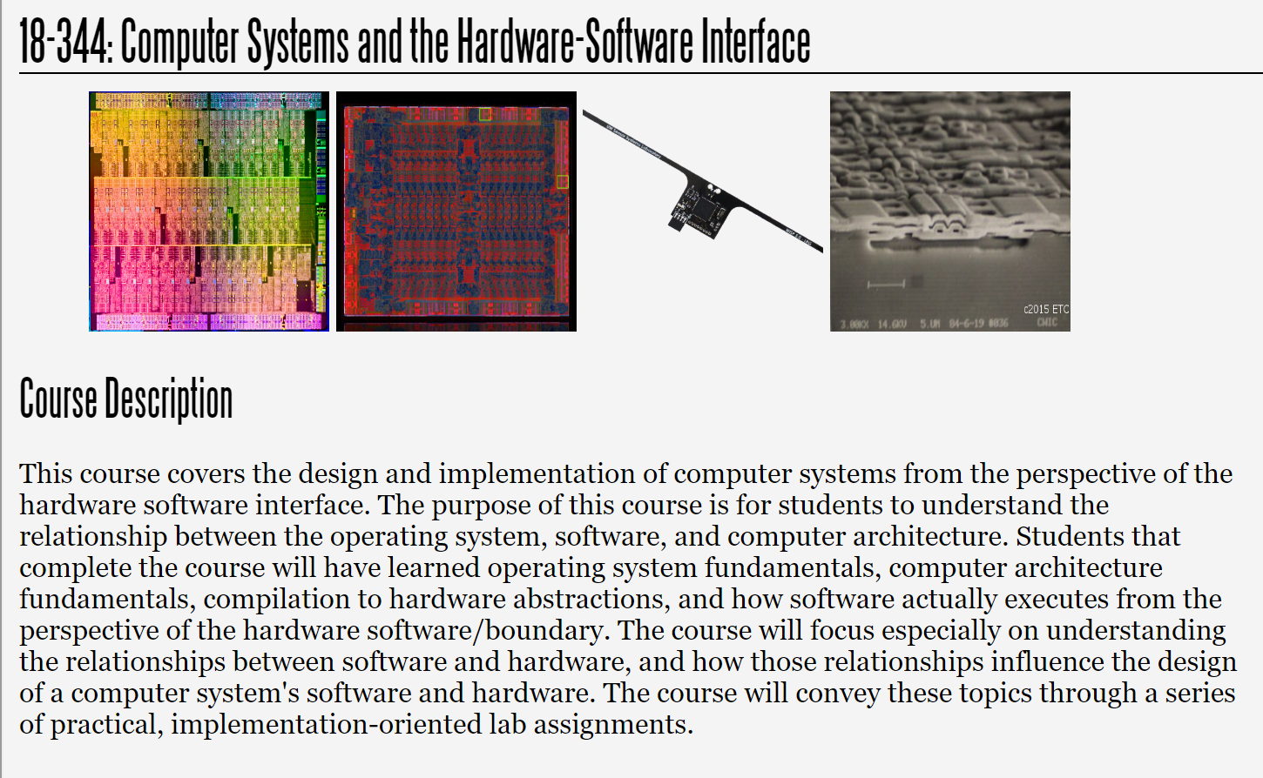
Fall 2025
Lecture 13: Virtual Memory
Credit: Brandon Lucia

Slide 2
Today (& Next Time): Virtual Memory
Basic dimensions of a virtual memory system: paging, protections, process isolation, address mapping
Working through operation of a virtual memory system example, including page fault handling and page table walking
Start looking at hardware support for virtual memory (TLB)

Slide 3

What is virtualization?

Slide 4
Virtualization - Purpose
Expose abstraction of abundant resource despite limited resource
Expose abstraction of uniform resource despite heterogeneity of resource
Expose abstraction of isolated resource despite sharing of resource

Slide 5
Virtualization – What resources?
Entire machines (VMMs)
Storage (Disk controllers / Flash controllers)
Memory (Virtual Memory)
Network connectivity / bandwidth (Software-defined Networks)

Slide 6
Memory Virtualization

Slide 7
Virtual Memory – Abstraction of Abundance
0xFFFF
X
0xFFFF 0xFFFF
X
X
X
Entire Address Range Available
Entire Address Range Available
Entire Address Range Available
0x0000
0x0000
0x0000
Process 1
Process 2
Process 3

Slide 8
Virtual Memory – Abstraction of Uniformity
0xFFFF
0xFFFF 0xFFFF
X X
Contiguous Address Range Available
Contiguous Address Range Available
Contiguous Address Range Available
0x0000
0x0000
0x0000
Process 1
Process 2
Process 3

Slide 9
Virtual Memory – Abstraction of Isolation*
0xFFFF
0xFFFF 0xFFFF
Address Range Available
X
Address Range Available
Address Range Available
X
Unshared
Unshared
Unshared
0x0000
0x0000
0x0000
Process 1
Process 2
Process 3

Slide 10
Virtual Memory – Thinking about mechanism
0xFFFF
0xFFFF
First obvious problem:
Two processes access same location
violates isolation abstraction
sw 0xEFFF
sw 0xEFFF
0x0000
0x0000
Process 1
Process 2

Slide 11
Virtual Memory – Thinking about Mechanism
0xFFFF
0xFFFF
First obvious problem:
sw 0xFFFF
…
sw 0x1000
Two processes access same location
violates isolation abstraction
sw 0xEFFF
…
sw 0x0000
Second obvious problem:
Two processes access #bytes > total memory size
violates abundance abstraction (and isolation)
0x0000
0x0000
Process 1
Process 2

Slide 12
First Attempt: Static Partitioning [Opal, SASOS, bare-metal micros]
0xFFFF
Process 1
stack
0xFFFF
Statically partitioning the address space
violates abundance and uniformity (but not isolation)
Process 2
stack
Process 1
code
Process 2 code
Process 2 heap
Process 2 heap
0x0000
0x0000
Process 1
Process 2

Slide 13
First Attempt: Static Partitioning
0xFFFF
Process 1
stack
0xFFFF
Statically partitioning the address space
violates abundance and uniformity
Also need to be sure that neither process will go and
mess around with the other process’ address ranges
Process 2
stack
Process 1
code
Process 2 code
Process 2 heap
Process 2 heap
0x0000
0x0000
Process 2
Process 1

Slide 14
First Attempt: Static Partitioning
0xFFFF 0xFFFF
Statically partitioning the address space
Need to be sure that neither process will go and mess around with the other process’ address ranges (isolation)
Need to use increasingly tiny partitions per process (abundance)
Need to know where your tiny partition starts so you
can use it (uniformity)
. . .
0x0000
0x0000
cess 1
Process n-1
Process n

Slide 15
First Attempt: Static Partitioning
0xFFFF 0xFFFF
Statically partitioning the address space
Need to be sure that neither process will go and mess around with the other process’ address ranges (isolation)
Need to use increasingly tiny partitions per process (abundance)
Need to know where your tiny partition starts so you
can use it (uniformity).
Machine code can never refer to an address without knowing mix of other programs running on machine & where process loaded (uniformity, isolation)
. . .
0x0000
0x0000
cess 1
Process n-1
Process n

Slide 16
Second Attempt: Segmented Memory [8086, IBM AS/400]
0x7FFF
Process 1
stack
0x7FFF
Process 1 stack
Segment 0
Segment 1
Process 1
code
Process 1
code
Process 2 heap
Process 2 heap
0/1
Active Segment
0x0000
0x0000
Process 1
Process 2

Slide 17
Second Attempt: Segmented Memory
0x7FFF
Segment up the memory address space and switch
segments
Process 1 stack
Segment 1
Benefit: Limited address size can address more memory (switch segment, another 16b space). Abstraction of abundance.
Benefit: Processes can choose a segment and use predictable addresses off of that segment. Abstraction of uniformity.
Process 1 code
Benefit: If processes use independent segments, no interference.
Process 2
heap
0/1
Caveat: 8086 & others did not check permissions,
segments could overlap. (isolation, abundance…)
e Segment
0x0000
Caveat: need to select segment; how to choose
which? (uniformity)
Process 2

Slide 18
Second Attempt: Segmented Memory
Abstraction of abundance, uniformity in segment relative
0xFFFF
Process 1 stack
addressing, and the ability to address a very large address space is a key advantage of segmentation in memory
Segment 0 Segment 1 Segment 2 Segment 3 Segment 4
. . .
Process 1 code
Process 2
heap
2^16 segs
Each segment only needs 16bit addresses, combined with a single 16bit segment reg, have 4GB addressed.
Active Segment
0x0000
Why did they not just use 32bit addresses instead?
Process 1

Slide 19
Virtual Memory: Software Dynamic Address Translation (and Permission Checking)
0x7FFF
Process 1
stack
0x7FFF
Permissions Check
Translate
Process 1 stack
Process 1 code
Process 1 code
Process 2 heap
Process 2 heap
0x0000
0x0000
Process 1
Physical Memory
Process 2

Slide 20
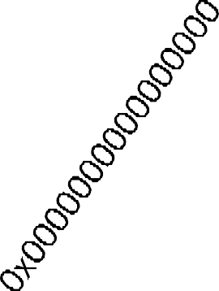
Virtual Memory: Software Dynamic Address Translation and Permission Checking
Key ideas behind virtual memory:
Physical memory acts like a cache of data that are mapped into process address space
Accesses always refer to VAs and VM translates them to usable physical addresses
Mapping makes a virtual address range accessible & unmapped regions are inaccessible
Virtual memory happens at granularity of pages
(i.e., 4kB chunks of memory)
Page table entry per page contains: (1) is it in physical memory? (2) at what address? (3) with what access permissions?
Physical Memory
Process

Slide 21
Virtual Memory: Software Dynamic Address Translation and Permission Checking
On every memory access, translate memory address from virtual address to physical address
Benefit: Arbitrary hierarchy of memories / storage can back program data Abstraction of abundance.
Benefit: All processes have identical linear virtual address space that can use predictable addresses always. Abstraction of uniformity.
Benefit: Per-process address space are private by
default. Abstraction of isolation.
Caveat: need mechanism for mapping data in
Caveat: translation & permissions are dynamic
Caveat: translation granularity (i.e., page size) is a system-wide parameter
Physical Memory
Process

Slide 22
Mapping Data Into Virtual Address Space

Slide 23
Virtual Memory: Mapping Data into Virtual
Address Space
64-bit Address
Space 0xFFFFFFFFFFFFFFFF
0xFFFFFFFF
Define a new operation map(data, size, mode)
a.out
Hard Drive / Backing Storage
Data: ID of file on disk to map into address space (or “anonymous” for blank memory) Size: How many bytes in the address space to map
Mode: Readable, writeable, executable
Semantics of map: Mapped addresses in virtual address space become accessible and if file-
backed, correspond to file’s data
0x00000000
4GB of
What does it mean to “become accessible”?
Physical Memory
0x0000000000000000
Process

Slide 24
Virtual Memory: Mapping Data into Virtual
Address Space
64-bit Address
Space 0xFFFFFFFFFFFFFFFF
Define a new operation
map(addr, data, size, mode)
0xFFFFFFFF
a.out
Hard Drive / Backing Storage
Data: file descriptor to map into address space
(or “anonymous” for just memory)
Size: How many bytes to map
Mode: Readable, writeable, executable
Semantics of map: Mapped addresses in virtual
address space become accessible and if file-
backed, correspond to file’s data
What does it mean to “become accessible”? executing memory access to address in range is no longer illegal; corresponds to data, either file or anonymous buffer
0x00000000
4GB of
Physical Memory
0x0000000000000000
Process

Slide 25


Virtual Memory: Mapping Data into Virtual
Address Space
64-bit Address
Space 0xFFFFFFFFFFFFFFFF
unmapped
mapped (a.out)
unmapped
0xFFFFFFFF
0x1000
a.out
int fd; open(/foo/bar/baz/a.out);
Map(0x1000, fd, 7500 Bytes, RWX)
Permissions Check
0x3000
Update translation function
Update permissions entry
Reserve virtual address range
DO NOT move data anywhere
Translate
Hard Drive /
Backing Storage
0x00000000
4GB of
Physical Memory
0x0000000000000000
Process

Slide 26
Virtual Memory: Accessing Data Mapped into the Virtual Address Space
0xFFFFFFFFFFFFFFFF
unmapped
Access to unmapped region:
0xFFFFFFFF
Attempt to translate address
Find unmapped: Segmentation Fault.
0x1000
a.out
Access to mapped region:
mapped (a.out)
Attempt to translate address, find mapped
Check permissions
Locate data
Permissions Check
0x3000
Translate
segfault
sw 0x2500
Hard Drive /
unmapped
Backing Storage
0x00000000
4GB of
Physical Memory
sw 0x3500
0x0000000000000000
Process

Slide 27
Virtual Memory: Shared Mapping of File-backed Data into Address Space by Multiple Processes
0xFFFFFFFFFFFFFFFF
0xFFFFFFFFFFFFFFFF
unmapped
unmapped
0xFFFFFFFF
0x1000
mapped (a.out)
int fd; open(/foo/bar/baz/a.out);
Map(0x1000, fd, 7500 Bytes, RX)
a.out
Permissions Check
0x2500
0x3000
int fd; open(/foo/bar/baz/a.out);
Translate
unmapped
Map(0x2500, fd, 7500 Bytes, RX)
mapped
(a.out)
0x4500
STILL DO NOT move data! (shared read mapping)
Hard Drive / Backing Storage
unmapped
0x00000000
4GB of
Physical Memory
0x0000000000000000
Process 1
0x0000000000000000
Process 2

Slide 28
Virtual Memory: Shared Mapping of Anonymous Data into Address Space by Multiple Processes
0xFFFFFFFFFFFFFFFF
0xFFFFFFFFFFFFFFFF
Permissions Check
Translate
unmapped
unmapped
0xFFFFFFFF
0x1000
mapped (anon)
int fd = memfd_create(/usr/mem, …)
Map(0x1000, fd, 7500 Bytes, RX)
a.out
Hard Drive / Backing Storage
0x2500
mapped
(anon)
0x3000
int fd = memfd_create(/usr/mem);
unmapped
Map(0x2500, fd, 7500 Bytes, RX)
0x4500
Can share non-file-backed memory w/ memfd_create; all refs close? mem disappears
unmapped
0x00000000
4GB of
Physical Memory
0x0000000000000000
Process 1
0x0000000000000000
Process 2

Slide 29
Page Granularity for Translation (& Permissions)

Slide 30
Virtual Memory: Translation & Permissions at Page Granularity
0xFFFFFFFFFFFFFFFF
unmapped
Page 0x1000 mapped
(a.out) Page 0x2000
unmapped
Still not talking about getting actual data yet; first need to translate (we will talk about how data moves in a few slides)
0xFFFFFFFF
0x1000
a.out
Translation happens at page granularity
0x2000
Permissions Check
Pages are usually 2^12 = 4096 bytes
0x3000
Memory access:
Translate
Look up translation for page virtual address
Find & fetch data after translation
Hard Drive / Backing Storage
0x00000000
4GB of
Physical Memory
0x0000000000000000
Process

Slide 31


Virtual Memory: Translation and Finding Data Outcome #1: Page Not in Physical Memory
0xFFFFFFFFFFFFFFFF
Permissions Check
unmapped
0xFFFFFFFF
“Translate Virtual Page Number
0x2000, please!” ^{0x1000}
a.out
Page 0x1000 mapped
0x2000
(a.out) Page 0x2000
0x3000
Translate
Hard Drive /
Backing Storage
unmapped
lw 0x2500
0x00000000
4GB of
Physical Memory
0x0000000000000000
Process
Virtual Memory

Slide 32
Virtual Memory: Translation and Finding Data Outcome #1: Page Not in Physical Memory
0xFFFFFFFFFFFFFFFF
unmapped
0xFFFFFFFF
VM:
“Mapped, but not in physical memory!”
“Translate Virtual Page Number
0x2000, please!” ^{0x1000}
a.out
Page 0x1000 mapped
?
0x2000
Permissions Check
(a.out) Page 0x2000
0x3000
Translate
Hard Drive /
Backing Storage
unmapped
lw 0x2500
0x00000000
4GB of
Physical Memory
0x0000000000000000
Process
Virtual Memory

Slide 33
Virtual Memory: Translation and Finding Data Outcome #1: Page Not in Physical Memory
0xFFFFFFFFFFFFFFFF
unmapped
0xFFFFFFFF
VM:
“Page Fault.
Try again.”
VM:
“Translation updated. Page in memory for future accesses.
0x1000
a.out
Page 0x1000 mapped
0x2000
Permissions Check
(a.out) Page 0x2000
Move page from disk into memory on access:
“demand paging”
0x3000
Translate
Hard Drive / Backing Storage
unmapped
lw 0x2500
0x00000000
4GB of
Physical Memory
0x0000000000000000
Process
Virtual Memory
“Demand Paging” – bring into physical memory on first access

Slide 34
Virtual Memory: Translation and Finding Data Outcome #2: Page in Physical Memory
0xFFFFFFFFFFFFFFFF
Permissions Check
unmapped
0xFFFFFFFF
“Translate Virtual Page Number
0x2000, please!” ^{0x1000}
a.out
Page 0x1000 mapped
0x2000
(a.out) Page 0x2000
0x3000
Translate
Hard Drive /
Backing Storage
unmapped
lw 0x2500
0x00000000
4GB of
Physical Memory
0x0000000000000000
Process
Virtual Memory

Slide 35
Virtual Memory: Translation and Finding Data Outcome #2: Page in Physical Memory
0xFFFFFFFFFFFFFFFF
unmapped
0xFFFFFFFF
VM:
“Virtual 0x2000 corresponds to Physical Page Number 0xF000”
VM:
“Translated:
0x2000 =>
0xF000”
0x1000
a.out
Page 0x1000 mapped
0x2000
Permissions Check
(a.out) Page 0x2000
0x3000
Translate
Hard Drive /
Backing Storage
unmapped
lw 0x2500
0x00000000
4GB of
Physical Memory
0x0000000000000000
Process
Virtual Memory

Slide 36
Virtual Memory: Translation and Finding Data Outcome #2: Page in Physical Memory
0xFFFFFFFFFFFFFFFF
unmapped
0xFFFFFFFF
0x1000
Page 0x1000 mapped
a.out
Hard Drive / Backing Storage
0x2000
Permissions Check
(a.out) Page 0x2000
0x3000
Translate
0xF000
CPU Memory Unit: “Data at physical page number 0xF000, physical page offset
lw 0x2500
MEM:
lw 0xF500
0xF500
unmapped
0x00000000
4GB of
Physical Memory
0x500, please”
0x0000000000000000
Process
Virtual Memory

Slide 37
Virtual Memory: Translation and Finding Data Outcome #2: Page in Physical Memory
0xFFFFFFFFFFFFFFFF
unmapped
0xFFFFFFFF
0x1000
Page 0x1000 mapped
a.out
Hard Drive / Backing Storage
0x2000
Permissions Check
(a.out) Page 0x2000
0x3000
Memory Hierarchy:
“Data at 0xF500:
<data>”
Translate
lw 0x2500
MEM:
lw 0xF500
unmapped
0x00000000
4GB of
Physical Memory
0x0000000000000000
Process
Virtual Memory

Slide 38
The Translation Function & Its Use

Slide 39



Virtual Memory: The Translation Function Page Table Stores Translation for Paged-In Data
0xFFFFFFFFFFFFFFFF
Page Table
unmapped
0xFFFFFFFF
VPN
PPN
Page
0x1000
a.out
Hard Drive / Backing Storage
Page 0x1000 mapped
Table
0x2000
0xF000
Entry
0x2000
Permissions Check
(a.out) Page 0x2000
0x3000
Translate
sw 0x2500
unmapped
0x00000000
4GB of
Physical Memory
PPN: Physical Page Number VPN: Virtual Page Number
0x0000000000000000
Process
Virtual Memory

Slide 40
Virtual Memory: The Translation Function
Page Table Holds Disk Location for Paged-Out Data
0xFFFFFFFFFFFFFFFF
Page Table
VPN PPN
unmapped
0xFFFFFFFF
Page
0x1000
a.out
Hard Drive /
Page 0x1000 mapped
Table
0x2000
Paged Out:
/swap/a.out
Entry
0x2000
Permissions Check
(a.out) Page 0x2000
0x3000
Translate
sw 0x2500
unmapped
Backing Storage
0x00000000
4GB of
Physical Memory
0x0000000000000000
Process
Virtual Memory

Slide 41
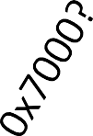
Virtual Memory: The Translation Function Page Table Holds No Entry for Unmapped Data
0xFFFFFFFFFFFFFFFF
Page Table
unmapped
0xFFFFFFFF
VPN
PPN
Page Table Entry
0x1000
a.out
Hard Drive /
Page 0x1000 mapped
0x2000
Paged Out:
/swap/a.out
0x2000
Permissions Check
(a.out) Page 0x2000
0x3000
No Entry!
Translate
0x7000
???????
SegFault delivered to program
sw 0x7522
unmapped
Backing Storage
0x00000000
4GB of
Physical Memory
0x0000000000000000
Process
Virtual Memory

Slide 42
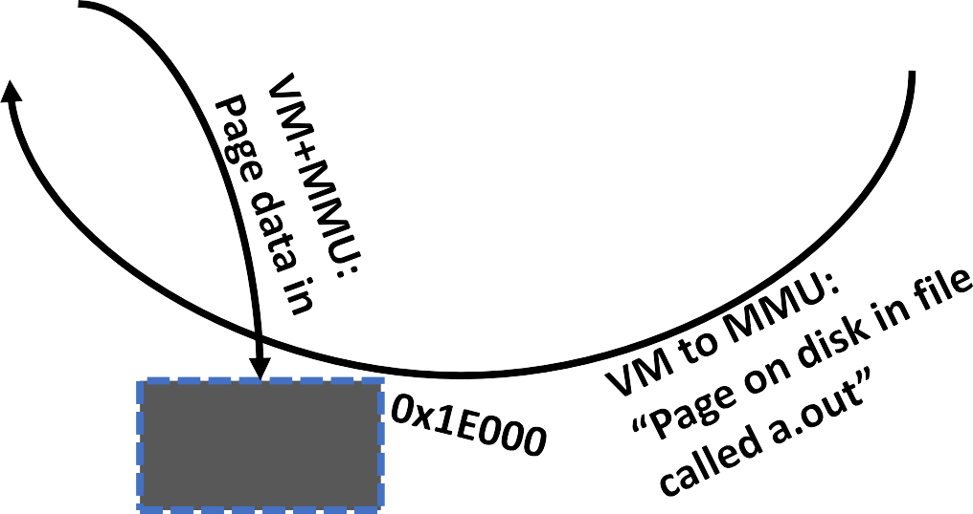
Physical Memory as a Cache of Data on Disk: Cache Miss Means Page Fault (1/2)
0xFFFFFFFFFFFFFFFF
Page Table
VPN PPN
unmapped
Page 0x1000 mapped
(a.out) Page 0x2000
unmapped
0xFFFFFFFF
Page
0x1000
a.out
Table
0x2000
Paged Out:
/swap/a.out
Entry
0x2000
Permissions Check
0x3000
Translate
sw 0x2522
Hard Drive /
Backing Storage
0x00000000
4GB of
Physical Memory
“Demand Paging” – bring into physical memory on first access
0x0000000000000000
Process
Virtual Memory

Slide 43
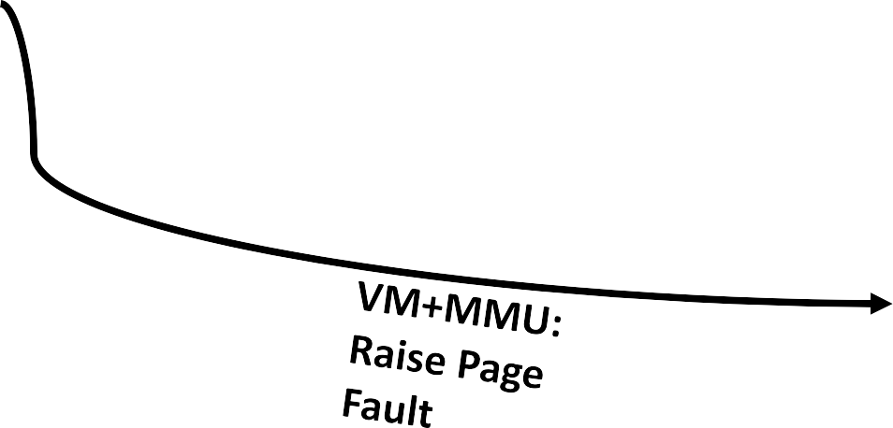
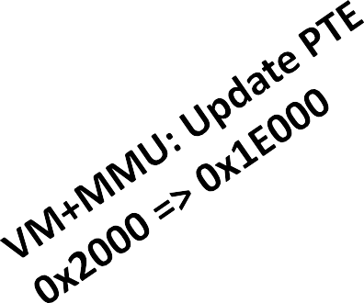
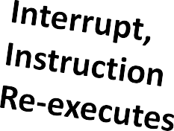
Physical Memory as a Cache of Data on Disk: Cache Miss Means Page Fault (2/2)
0xFFFFFFFFFFFFFFFF
Page Table
VPN PPN
unmapped
0xFFFFFFFF
Page
0x1000
a.out
Hard Drive /
Page 0x1000 mapped
Table
0x2000
0x1E000
Entry
0x2000
Permissions Check
(a.out) Page 0x2000
0x3000
Translate
sw 0x2522
0x1E000
unmapped
Backing Storage
0x00000000
4GB of
Physical Memory
0x0000000000000000
Process
Virtual Memory

Slide 44
Virtual Memory Translation Algorithmically
vmTranslate(vaddr){
//Compute Virtual Page Number & Virtual Page Offset
//from vaddr assuming 2^12 page size
(VPN,VPO) = (vaddr[63:12],vaddr[11:0])
PPN = PT.lookup(VPN)
if PPN == UNMAPPED:
kill(SIGSEGV)
else if PPN == PAGEDOUT@<diskloc>: MMU.pageIn(VPN,PPN,<diskloc>) // move diskloc data to
// phys @ PPN, update PTE for VPN
MMU.raiseInterrupt(PAGE_FAULT, …)
//Semantics of interrupt: replay instruction that caused interrupt
//In Lab 3 emulation: page data in, record page fault
else
return PPN //PTE contained usable VPN; hooray! MMU tells CPU the PPN
}

Slide 45
Permissions Checking

Slide 46
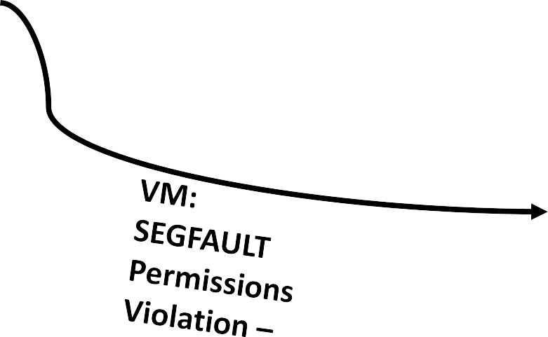

Permissions Checking Happens with Page Translation (Compare access type to permissions)
0xFFFFFFFFFFFFFFFF
Page Table
VPN PPN
unmapped
0xFFFFFFFF
Perms
0x1000
a.out
Hard Drive / Backing Storage
Page 0x1000 mapped
0x2000
0x1E000
R
0x2000
Permissions Check
(a.out) Page 0x2000
0x3000
Translate
sw 0x2522
0x1E000
unmapped
0x00000000
4GB of
Physical Memory
0x0000000000000000
Process
Virtual Memory

Slide 47
Page Cache Placement / Replacement

Slide 48
Physical Memory as a Cache of Data on Disk: Cache Placement / Replacement Policy
0xFFFFFFFF
Placement Policy? Where to put a new page?
a.out
?
Hard Drive /
Backing Storage
0x00000000
4GB of
Physical Memory
Acts as cache for disk

Slide 49
Physical Memory as a Cache of Data on Disk: Cache Placement / Replacement Policy
0xFFFFFFFF
Placement Policy:
Fully associative – need flexibility to put any page anywhere in physical memory via arbitrary mapping function. Next available location works fine.
a.out
Fully Associative
Replacement Policy?
Hard Drive /
Backing Storage
0x00000000
4GB of
Physical Memory
Acts as cache for disk

Slide 50
Physical Memory as a Cache of Data on Disk: Cache Placement / Replacement Policy
0xFFFFFFFF
Placement Policy:
Fully associative – need flexibility to put any page anywhere in physical memory via arbitrary mapping function. Next available location works fine.
a.out
?
Replacement Policy?
Hard Drive /
Backing Storage
0x00000000
4GB of
Physical Memory
Acts as cache for disk

Slide 51
Physical Memory as a Cache of Data on Disk: Cache Placement / Replacement Policy
0xFFFFFFFF
Placement Policy:
Fully associative – need flexibility to put any page anywhere in physical memory via arbitrary mapping function. Next available location works fine.
a.out
?
Replacement Policy:
Can be complicated…
Variants of LRU & approximations
Not Recently Used (like Bit-PLRU)
Not Frequently Used
Re-reference-Distance-Based Policies
Hard Drive / Backing Storage
0x00000000
4GB of
In Lab 3 we handle placement & replacement
Physical Memory
Acts as cache for disk
so you can focus on translation & mapping

Slide 52
Page Tables: Another Look at the Translation Function

Slide 53
Page Translation and Its Implementation
48-bit Virtual Address (like AMD)
36 bits 12 bits
Page Table
VPN
VPO
 |  |  |  |  | PPN |  | Perms/Flags
 |  |  | VPN
 |  |  | 0x2000 |  | 0x123000 |  |  | RW
 |  |  | 0x3000 |  | Paged Out: /swap/a.out |  |  | RWX
 |  |  | …
 |  |  | 0xF000 |  | 0xFFF0F000 |  |  |  | RW
 |  |  | …
 | 0x |  | 126F000 |  | 0x11212000 |  |  |  | R
 |  |  | …
0xFFFFFFF |  |  | FF000 |  | 0x45454000 |  |  |  | R / COW
Translate
Table stores 2^36 entries in it for virtual pages 0x000000000000 up to 0xFFFFFFFFF000
which span the entire
48-bit address space.
PPN
PPO
36 bits
12 bits
Page Table Entry – 6 Bytes
PPN
Perms/Flags
Implementation Issues?
36 bits
12 bits
Q: Why can store flags in
lower 12 bits of PTE?

Slide 54
Page Translation and Its Implementation
48-bit Virtual Address (like AMD)
36 bits 12 bits
Page Table
VPN
VPO
 |  |  |  |  | PPN |  | Perms/Flags
 |  |  | VPN
 |  |  | 0x2000 |  | 0x123000 |  |  | RW
 |  |  | 0x3000 |  | Paged Out: /swap/a.out |  |  | RWX
 |  |  | …
 |  |  | 0xF000 |  | 0xFFF0F000 |  |  |  | RW
 |  |  | …
 | 0x |  | 126F000 |  | 0x11212000 |  |  |  | R
 |  |  | …
0xFFFFFFF |  |  | FF000 |  | 0x45454000 |  |  |  | R / COW
Translate
Table stores 2^36 entries in it for virtual pages 0x000000000000 up to 0xFFFFFFFFF000
which span the entire
48-bit address space.
PPN
PPO
36 bits
12 bits
Page Table Entry – 6 Bytes
PPN
Perms/Flags
Dense, linear table stores 2^36 * 6B PTEs: 550.8GB of Page Tables
36 bits
12 bits
Most PTEs Empty!!!

Slide 55
Hierarchical Page Tables
…
PTAddr
…
PPN
…
2^9 PTEs
PTAddr
…
PTAddr
PTAddr
PTAddr
…
…
PTAddr
…
…
PTAddr
PTAddr
…
2^9 PTEs
2^9 PTEs
2^9 PTEs
PPN
…
…
…
…
Page Table Entry – 6 Bytes
Page Table Addr or PPN
Perms/Flags
PTAddr
2^9 PTEs
…
…
2^9 PTEs
36 bits
12 bits
…
PTAddr
…
Multi-level / hierarchical page tables are enormously more space efficient. If an entire sub-tree of addresses in hierarchy of tables contain no mapped VAs, then entire tables not stored anywhere in memory!
PPN

Slide 56
Translation Using Hierarchical Page Tables
48-bit Virtual Address
L1 PT Offset | L2 PT Offset | L3 PT Offset | L4 PT Offset | VPO
9 bits
9 bits
9 bits
9 bits
12 bits
PTAddr
…
PTAddr
PTAddr
PTAddr
…
…
PTAddr
…
PPN
…
PPN
PPO
L1 PTab
L2 PTab
L3 PTab
L4 PTab
Register CR3 Page Table Base

Slide 57
Mapping Using Hierarchical Page Tables
48-bit Virtual Address
L1 PT Offset | L2 PT Offset | L3 PT Offset | L4 PT Offset | VPO
9 bits
9 bits
9 bits
9 bits
12 bits
PTAddr
…
PTAddr
PTAddr
PTAddr
…
…
PTAddr
…
Paged Out
…
Initialize PPN to show paged out.
L1 PTab
L2 PTab
L3 PTab
L4 PTab
Register CR3 Page Table Base
L1 Table Always Exists
Table not allocated? Create & fill entry

Slide 58
(New) Intel 57-bit Virtual, 52-bit Physical, 5-level Translation Using Hierarchical Page Tables (2019)
57-bit Virtual Address
Reserved | L0 PT Offset | L1 PT Offset | L2 PT Offset | L3 PT Offset | L4 PT Offset | VPO
7 bits
9 bits
9 bits
9 bits
9 bits
9 bits
12 bits
PTAddr
…
PTAddr
PTAddr
…
PTAddr
PTAddr
PTAddr
…
…
PTAddr
…
PPN
…
PPN
PPO
L0 PTab
L1 PTab
L2 PTab L3 PTab
Why not do something with those top 7 bits?
L4 PTab
Register CR3 Page Table Base

Slide 59
(New) Intel 57-bit Virtual, 52-bit Physical, 5-level Translation Using Hierarchical Page Tables (2019)
57-bit Virtual Address
Reserved | L0 PT Offset | L1 PT Offset | L2 PT Offset | L3 PT Offset | L4 PT Offset | VPO
7 bits
9 bits
9 bits
9 bits
9 bits
9 bits
12 bits
PTAddr
…
PTAddr
PTAddr
…
PTAddr
PTAddr
PTAddr
…
…
PTAddr
…
PPN
…
PPN
PPO
L0 PTab
L1 PTab L2 PTab L3 PTab L4 PTab
Register CR3 Page Table Base
Why not do something with those top 7 bits?
Intel checks that addresses are “canonical”, meaning sign extended to 64 bits & if not, then
SEGFAULT. Allows future architecturs to use 64b addrs if they want to!

Slide 60

What part of the pipeline manipulates the page tables?
WB/Exec Forward
Instruction PC+4
Mem/Exec Forward
WB/Mem Forward
Branch Target
PC Source Select (1 if branch taken)
Exec/Exec Forward
Mem/Mem Forward
PC
Branch
Target
WB/Mem Fwd
Mem/Mem Fwd Addr Reg A
WB/Mem Fwd
Mem/Mem Fwd
Data Reg B
4
Offset
Instruction PC + 4
Branch
Output/Read Reg C Data
Output/Read Reg Select
Branch Target
+
Target
+
Reg A Reg B
PC
Source Select
WB/Ex Fwd
Ex/Ex Fwd Mem/Ex Fwd
WB/Ex Fwd
Ex/Ex Fwd Mem/Ex Fwd
Register
Writeback
MUX
PC Source Select
Branch
Outcome Logic
Input Read Reg A
Input Read Reg B
MUX
MUX
MUX
Instruction Fetch
Read Register A & B Select
Read
Data C
MUX
MUX
Cont. Sigs.: Op. Select
Memory
Unit
Write Reg C Data
Write Reg C Select
Control
Signals
Reg 1
Reg 2
Reg 3
Reg 4
Control Signals:
Op select
op = [+, -, x, /]
ALU
[Ld/St]
Data Memory
Instruction Memory
ALU: output C data
Instr. Decode Execute
Read Regs A & B Data Write Register C Select
Write Register C Data
Memory
Register Write-Back
Branch Predictor
Outcome
Target
.
.
.
Read Data C (Ld)
Write Reg C Data
Instruction Fetch

Slide 61
MMU has fast access to memory and TLB for translation
WB/Exec Forward
Instruction PC+4
Mem/Exec Forward
WB/Mem Forward
Branch Target
PC Source Select (1 if branch taken)
Exec/Exec Forward
Mem/Mem Forward
PC
Branch
Target
WB/Mem Fwd
Mem/Mem Fwd Addr Reg A
WB/Mem Fwd
Mem/Mem Fwd
Data Reg B
4
Offset
Instruction PC + 4
Branch
Output/Read Reg C Data
Output/Read Reg Select
Branch Target
+
Target
+
Reg A Reg B
PC
Source Select
WB/Ex Fwd
Ex/Ex Fwd Mem/Ex Fwd
WB/Ex Fwd
Ex/Ex Fwd Mem/Ex Fwd
Register
Writeback
MUX
PC Source Select
Branch
Outcome Logic
Input Read Reg A
Input Read Reg B
MUX
MUX
MUX
Instruction Fetch
Read Register A & B Select
Read
Data C
MUX
MUX
Cont. Sigs.: Op. Select
Memory
Unit
Write Reg C Data
Write Reg C Select
Control
Signals
Reg 1
Reg 2
Reg 3
Reg 4
Control Signals:
Op select
op = [+, -, x, /]
ALU
Instruction Memory
[Ld/St]
Data
Memory
MMU
+ TLB
ALU: output C data
Instr. Decode Execute
Read Regs A & B Data Write Register C Select
Write Register C Data
Memory
Register Write-Back
Branch Predictor
Outcome
Target
.
.
.
Read Data C (Ld)
Key idea: page table walk entails extra memory operations not extra memory instructions
Write Reg C Data
Instruction Fetch

Slide 62
Performance and Storage Overhead Analysis of Translation with Page Tables

Slide 63

Page Tables Stored in Virtual Memory and Paged in and out Like Other Data
0xFFFFFFFF
First level page table always in physical memory at address in Register CR3. Other levels of page table can be paged out to make space for other data.
PTAddr
Register CR3
PTAddr
…
…
PPTTAAddddrr
All paged & page table data moves through cache hierarchy like any other data
Question: How much space overhead to store hierarchical vs. linear page tables?
…
…
P P N
…
P T A
d d r
2
^ 9
P T
Es
P T A
d d r
P T A
d d
rP T A
d d r
P
T A
d d r
P T A
d d
…
…
…
2
^ 9
P T
Es
2
^ 9
P T
Es
P T A
d d r
2
^ 9
P T
Es
P P N
…
P T A
d d r
…
…
r
…
…
…
PTAddr
Question: How much time overhead to access hierarchical vs. linear page tables?
…
PTAddr
Perm s/Fla gs
P T A
d d r
2
^ 9
P T
Es
…
2
^ 9
P T
Es
…
…
1
2
b i t s
…
P T A
d d r
…
P P N
… …
PTAddr
0x00000000
4GB of
Physical Memory
Acts as cache for disk

Slide 64
Space Overhead Analysis of Page Tables
4 Levels of Page Tables
How much space for tables vs. mapped data? Compared to linear?
8bytes / PTE (sign extend to 64-bit word size)
…
PTAddr
…
PPN
…
2^9 PTEs
PTAddr
…
PTAddr
PTAddr
PTAddr
…
…
PTAddr
…
…
PTAddr
PTAddr
512^{sETP^92}
…
PTEs
2^9 PTEs
2^9 PTEs
PPN
…
…
…
…
PTAddr
…
PTAddr
…
PTAddr
2^9 PTEs
2^9 PTEs
…
12 bits
PPN
…
PPN

Slide 65
Space Overhead Analysis of Page Tables
4 Levels of Page Tables
Table Size = Page Size
2^3 bytes / PTE * 2^9 PTEs / Table = 2^12 = 4kB / Table
8bytes / PTE (sign extend to 64-bit word size)
…
PTAddr
…
PPN
…
2^9 PTEs
Pictured Example page tables size:
9 * 4kB = 36kB of page tables
PTAddr
…
PTAddr
PTAddr
PTAddr
…
…
PTAddr
…
…
PTAddr
PTAddr
512^{sETP^92}
Possible to map every page in last level PT:
4 last level tables exist * 512 entries * 4kB / page = 2^23B mappable with just these page tables
…
PTEs
2^9 PTEs
2^9 PTEs
PPN
…
…
…
…
PTAddr
…
PTAddr
…
PTAddr
2^9 PTEs
2^9 PTEs
…
Overhead:
36kB / 2^23B = 36kB / 2^13kB = 0.004x overhead
12 bits
PPN
…
Linear page tables:
550GB of page tables
With 2^23B of data to map, 65565x overhead
PPN

Slide 66
Performance Analysis of Page Tables
What is the time cost per memory access to use a hierarchical page table structure?
sw 0x2000
…
PTAddr
…
PPN
…
2^9 PTEs
PTAddr
…
PTAddr
PTAddr
PTAddr
…
…
PTAddr
…
…
PTAddr
PTAddr
…
2^9 PTEs
2^9 PTEs
2^9 PTEs
PPN
…
…
…
…
PTAddr
…
PTAddr
…
PTAddr
2^9 PTEs
2^9 PTEs
…
12 bits
PPN
…
PPN

Slide 67
Performance Analysis of Page Tables
What is the time cost per memory access to use a hierarchical
page table structure?
sw 0x2000
Plus four more memory accesses:
one memory access per page table level
three of which levels may be swapped out / page fault
all of which can be a cache miss
…
PTAddr
…
PPN
…
2^9 PTEs
PTAddr
…
PTAddr
PTAddr
PTAddr
…
…
PTAddr
…
…
PTAddr
PTAddr
…
2^9 PTEs
2^9 PTEs
2^9 PTEs
PPN
Worst case time overhead:
Word at 0x2000 is an L1 cache hit, all page table data except first level table misses in cache & page faults
1 cycle L1 hit becomes 3 cache misses & 3 page faults (DRAM
~20 cycles) = 60-100 (or more) cycles overhead on 1 cycle L1 hit
…
…
…
…
PTAddr
…
PTAddr
…
PTAddr
2^9 PTEs
2^9 PTEs
…
12 bits
PPN
…
Minimum(-ish) Overhead:
Access to word at 0x2000 (L1 miss, say), all page table accesses
hit in cache & no page faults
3 cycle L1 miss becomes 3 cache hits and a cache miss (1 cycle cache hits) = 3 cycles overhead on 3 cycle L1 miss
Time Overhead Summary: Worst: >60-100x overhead Best: ~2x overhead
PPN

Slide 68
Hierarchical Page Tables Trade Time to Save Space
…
PTAddr
…
PPN
…
2^9 PTEs
Time overhead:
From 2x constant time overhead to a variable overhead that can be upwards of 100x!
PTAddr
…
PTAddr
PTAddr
PTAddr
…
…
PTAddr
…
…
Space Savings:
From 65565x space overhead
to a 0.001x space overhead
PTAddr
PTAddr
…
2^9 PTEs
2^9 PTEs
2^9 PTEs
PPN
…
…
…
…
PTAddr
…
PTAddr
…
PTAddr
2^9 PTEs
2^9 PTEs
…
12 bits
PPN
…
Key Insight:
Use microarchitectural support in the form of a Translation Lookaside Buffer to eliminate the time cost of most translations
PPN

Slide 69
Translation Lookaside Buffers: Hardware Support for Caching Page Address Translations

Slide 70

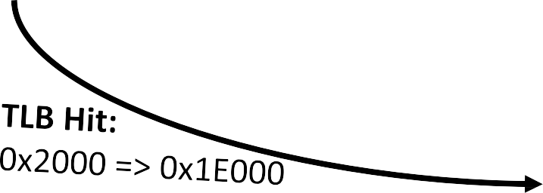

Translation Lookaside Buffer: Basic Idea (Hit)
0xFFFFFFFFFFFFFFFF
Page Table
unmapped
0xFFFFFFFF
Permissions Check
Translate
TLB: On-core Hardware
Cache of Translations
VPN
PPN
0x1000
Page 0x1000 mapped
t
e /
rage
0x2000
0x1E000
0x2000
(a.out) Page 0x2000
0x3000
sw 0x2522
0x1E000
unmapped
0x00000000
4GB of Physical Memory
0x0000000000000000
Process
Virtual Memory

Slide 71
Translation Lookaside Buffer: Basic Idea (Hit)
0xFFFFFFFFFFFFFFFF
unmapped
Page Table
VPN PPN
0x2000 0x1E000
0x1E000
Virtual Memor
0xFFFFFFFF
t
e /
rage
0x00000000
4GB of Physical Memory
TLB: On-core Hardware
Cache of Translations
0x1000
Page 0x1000 mapped
0x2000
Awesome property of the TLB:
(a.out) Page 0x2000
Permissions Check
Translate
On a TLB Hit, no need to run translation function, access
0x3000
page tables, traverse page table hierarchy, experience a page
fault, access the page table again, and return a translation
sw 0x2522
Translation stays core-local, zero extra memory accesses
unmapped
0x0000000000000000
Process
y

Slide 72

Translation Lookaside Buffer: Basic Idea
TLB Miss (4): cache
0x2000 => 0x1E000 in TLB
0xFFFFFFFFFFFFFFFF
Page Table
unmapped
0xFFFFFFFF
VPN
PPN
0x1000
t
e /
rage
TLB: Translation
Page 0x1000 mapped
0x2000
0x1E000
Cache
0x2000
(a.out) Page 0x2000
Permissions Check
0x3000
Translate
sw 0x2522
0x1E000
unmapped
0x00000000
4GB of Physical Memory
0x0000000000000000
Process
Virtual Memory

Slide 73
Translation Lookaside Buffer: Basic Idea (Hit)
0xFFFFFFFFFFFFFFFF
unmapped
Page Table
VPN PPN
0x2000 0x1E000
0x1E000
Virtual Memor
0xFFFFFFFF
t
e /
rage
0x00000000
4GB of Physical Memory
TLB: On-core Hardware
Cache of Translations
0x1000
Page 0x1000 mapped
0x2000
On the next access to same page:
(a.out) Page 0x2000
Permissions Check
Translate
TLB Hit! Subsequent accesses to
0x3000
same page amortize cost of page
sw 0x2522
table “walk”
unmapped
0x0000000000000000
Process
y

Slide 74
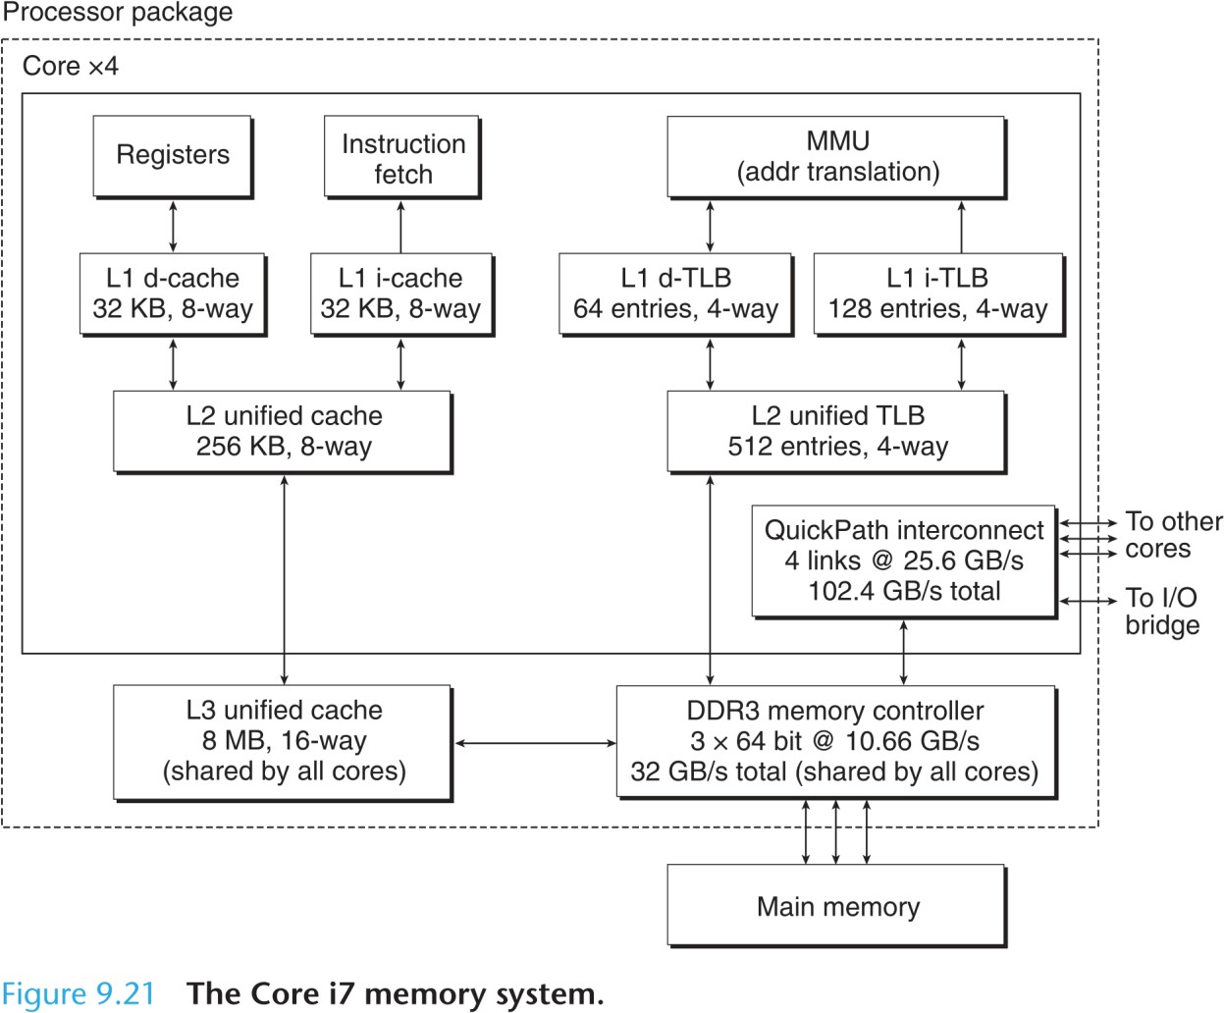
Hardware Support for Virtual Memory: Translation Lookaside Buffers in Intel Core i7
Separate L1 data & instruction (L1) TLB
Size? Reach? Why i-TLB larger?
Unified (L2) TLB
512 entries: total size? total reach?

Slide 75
Hardware Support for Virtual Memory: Translation Lookaside Buffers in Intel Core i7
Separate L1 data & instruction (L1) TLB
Size: 64 * 8B = 512B; 128 * 8B = 1024B
Data Reach: 64 * 4kB = 256kB data Code Reach: 128 * 4kB = 512kB code
Unified (L2) TLB
Size: 512 * 8B = 4kB
Reach: 512 * 4kB = 2^21 = 2MB code+data
Awesome Property of the TLB:
With a 3MB-ish working set of data + code, can run
without ever running virtual memory translation

Slide 76
Hardware Support for Virtual Memory: Translation Lookaside Buffers in Intel Core i7
Separate L1 data & instruction (L1) TLB
Size: 64 * 8B = 512B; 128 * 8B = 1024B
Data Reach: 64 * 4kB = 256kB data Code Reach: 128 * 4kB = 512kB code
Unified (L2) TLB
Size: 512 * 8B = 4kB
Reach: 512 * 4kB = 2^21 = 2MB code+data
Awesome Property of the TLB?
What if my working set is, like, 58GB?
Question: How do we increase TLB Reach?

Slide 77
Revisiting the Assumption of Page Granularity
0xFFFFFFFFFFFFFFFF
unmapped
Page 0x40000000
0xFFFFFFFF
0x40000000
a.out
Permissions Check
1GB of data
What if a page were large (2MB) or huge (1GB)?
Translate
0x80000000
Hard Drive / Backing Storage
0x00000000
4GB of
Physical Memory
0x0000000000000000
Process

Slide 78
Hardware Support for Virtual Memory: Translation Lookaside Buffers in Intel Core i7
Separate L1 data & instruction (L1) TLB
Size: 64 * 8B = 512B; 128 * 8B = 1024B
Max Data Reach: 64 * 1GB = 64GB data Code Reach: 128 * 4kB = 512kB code Implication of this TLB organization
Unified (L2) TLB
Size: 512 * 8B = 4kB
Max Reach: 512 * 1GB = 512GB code+data
Awesome Property of the TLB!
Huge pages make reach of L1TLB be 64GB!

Slide 79
Increasing Page Size to Increase TLB Reach
0xFFFFFFFFFFFFFFFF
Moder Oses support large pages and huge pages via mmap (& other ways).
unmapped
Page 0x40000000
0xFFFFFFFF
0x40000000
a.out
IA-64 (Itanium) had 8 page
sizes 4kB – 256MB
Permissions Check
1GB of data
Can mix different page sizes
w/ hardware support
Translate
0x80000000
mmap((void*)0x0,
round_to_huge_page_size(n * sizeof(T)),
PROT_READ | PROT_WRITE,
MAP_PRIVATE | MAP_ANONYMOUS |MAP_HUGETLB,
Hard Drive / Backing Storage
0x00000000
4GB of
-1, 0));
Physical Memory
0x0000000000000000
Process

Slide 80
Increasing Page Size to Increase TLB Reach
0xFFFFFFFFFFFFFFFF
unmapped
Page 0x40000000
“Transparent” huge pages allow the OS to promote a normal page to HUGE status
0xFFFFFFFF
0x40000000
a.out
Permissions Check
1GB of data
madvise(..., MADV_HUGEPAGE);
Translate
Not guaranteed to Huge-ify.
If aligned more likely to be huge
0x80000000
Hard Drive / Backing Storage
int posix_memalign(void **memptr,
size_t alignment, size_t size);
0x00000000
4GB of
Physical Memory
0x0000000000000000
Process

Slide 81
Increasing Page Size to Increase TLB Reach
0xFFFFFFFFFFFFFFFF
unmapped
Page 0x40000000
0xFFFFFFFF
Risks / Costs of Increasing Page Size?
0x40000000
a.out
Permissions Check
1GB of data
Translate
0x80000000
Hard Drive /
Backing Storage
0x00000000
4GB of
Physical Memory
0x0000000000000000
Process

Slide 82
Increasing Page Size to Increase TLB Reach
0xFFFFFFFFFFFFFFFF
unmapped
Page 0x40000000
Risks / Costs of Increasing Page
Size?
0xFFFFFFFF
High cost to page in/out on page fault (eek!)
Wasting memory if hugeness is useless
Internal page fragmentation
Need HW to track page sizes
Potential for programmer error w/ changing sizes
High cost to zero a page
0x40000000
a.out
Permissions Check
1GB of data
Translate
0x80000000
Hard Drive / Backing Storage
0x00000000
4GB of
Physical Memory
Use at your own risk! Try it out!
0x0000000000000000
Process

Slide 83
How Do Virtual Memory and Caching Interact?

Slide 84
Recall:
Physically separate cache data & tags
set index
0x01111111111111110000000001010011
L3$ |  | Way 0 | Way 1 | Way 2 | Way 3
 | Set 0 | Line
 | Set 1
 | Set 2
 | Set 3
tag bits
block offset
Way 0
Way 1
Way 2
Way 3
L3$
Set 0
tag 0
tag 1
tag 2
tag 3
Set 1
Set 2
Set 3
Cache Data Array
Cache Tag Array

Slide 85
Recall:
Question: Virtual or Physical Address?
Physically separate cache data & tags
set index
0x01111111111111110000000001010011
L3$ |  | Way 0 | Way 1 | Way 2 | Way 3
 | Set 0 | Line
 | Set 1
 | Set 2
 | Set 3
tag bits
block offset
Way 0
Way 1
Way 2
Way 3
L3$
Set 0
tag 0
tag 1
tag 2
tag 3
Set 1
Set 2
Set 3
Cache Data Array
Cache Tag Array

Slide 86


Physical Cache: Translate First Then Access Cache
Tag bits change with translation b/c cache uses physical addresses but page offset bits stay same
VPN
VPO
Virtual Address 0x01111111111111110000000001010011
PPN PPO
0x01100001111011100001001101010011
Physical Address
tag
Way 0
Way 1
Way 2
Way 3
…
…
P P N
…
L3
P T A
d d r
2
^ 9
P T
Es
$
P T A
d d
P T A
d d
rP T A
d d r
P
T A
d d r
P T A
d d
… …
…
Set 0
r
2
^ 9
P T
Es
2
^ 9
P T
Es
P T A
d d
2
^ 9
P T
Es
P P N
…
r
Line
…
P T A
d d r
… …
r
…
…
…
Perm s/Fla gs
P T A
d d r
2
^ 9
P T
Es
…
2
^ 9
P T
Es
…
Set 1
1
2
b i t s
…
P T A
d d r
…
L
W
ay
W
ay
W
ay
W
ay
P P N
3
0
ta¹g 1
ta²g 2
ta³g 3
Translate
3
$
S
e t
0
Set 2
$
S
e t
1
Set 3
S
e t 2
Issues with the physical cache approach?
S
e t
3
Cache Data Array
Cache Tag Array

Slide 87
Physical Cache: Translate First Then Access Cache (PIPT: Physically Indexed, Physically Tagged)
Tag bits change with translation b/c cache uses physical addresses but page offset bits stay same
VPN
VPO
Virtual Address 0x01111111111111110000000001010011
PPN PPO
0x01100001111011100001001101010011
Physical Address
tag
Way 0
Way 1
Way 2
Way 3
…
…
P P N
…
L3
P T A
d d r
2
^ 9
P T
Es
$
P T A
d d r
P T A
d d
rP T A
d d r
P
T A
d d r
P T A
d d
… …
…
Set 0
…
2
^ 9
P T
Es
2
^ 9
P T
Es
P T A
d d r
2
^ 9
P T
Es
P P N
Line
…
P T A
d d r
… …
r
…
…
…
Perm s/Fla gs
P T A
d d r
2
^ 9
P T
Es
…
2
^ 9
P T
Es
…
Set 1
1
2
b i t s
…
P T A
d d r
…
L
W
ay
W
ay
W
ay
W
ay
P P N
3
0
ta¹g 1
ta²g 2
ta³g 3
Translate
3
$
S
e t
0
Set 2
$
S
e t
1
Issues with the physical cache approach?
Set 3
S
e t 2
Translation is on the L1 critical path!
Even w/ TLB hit, increases L1 hit time
Limits cycle time & performance
S
e t
3
Cache Data Array
Cache Tag Array

Slide 88
Virtual Cache: Access Cache Then Translate (VIVT: Virtually Indexed, Virtually Tagged)
Benefits of the virtual cache approach?
Parallelize cache lookup & translate Costs of the virtual cache approach?
Synonyms & homonyms
VPN
VPO
Virtual Address 0x01111111111111110000000001010011
tag
Way 0
Way 1
Way 2
Way 3
…
…
P P N
…
L3
P T A
d d r
2
^ 9
P T
Es
$
P T A
d d r
P T A
d d
rP T A
d d r
P
T A
d d r
P T A
d d
… …
…
Set 0
…
2
^ 9
P T
Es
2
^ 9
P T
Es
P T A
d d r
2
^ 9
P T
Es
P P N
Line
…
P T A
d d r
… …
r
…
…
…
Perm s/Fla gs
P T A
d d r
2
^ 9
P T
Es
…
2
^ 9
P T
Es
…
Set 1
1
2
b i t s
…
P T A
d d r
…
L
W
ay
W
ay
W
ay
W
ay
P P N
3
0
ta¹g 1
ta²g 2
ta³g 3
Translate
3
$
S
e t
0
Set 2
$
S
e t
1
Physical Address
S
e t 2
PPN PPO
Set 3
0x01100001111011100001001101010011
S
e t
3
Cache Data Array
Cache Tag Array
To: lower caches & memory

Slide 89
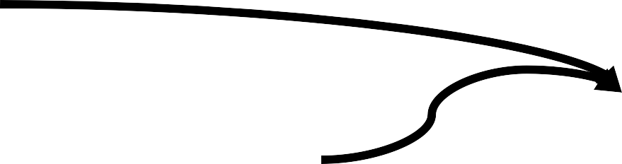
Virtual Caches: The Synonym Problem
Problem: two VAs refer to the same PA. Cached
Process 1:
separately, in memory as a single block.
Virtual Address 1 VPN VPO
0x01111111111111110000111000010010
Process 2:
Virtual Address 1 VPN
VPO
0x01111111111111110000000000110011
Way 0
Way 1
Way 2
Way 3
…
…
P P N
…
L3
P T A
d d r
2
^ 9
P T
Es
$
P T A
d d
P T A
d d
rP T A
d d r
P
T A
d d r
P T A
d d
… …
…
Set 0
r
2
^ 9
P T
Es
2
^ 9
P T
Es
P T A
d d
2
^ 9
P T
Es
P P N
…
r
Line
…
P T A
d d r
… …
r
…
…
…
Perm s/Fla gs
P T A
d d r
2
^ 9
P T
Es
…
2
^ 9
P T
Es
…
Set 1
1
2
b i t s
…
P T A
d d r
…
L
W
ay
W
ay
W
ay
W
ay
P P N
3
0
ta¹g 1
ta²g 2
ta³g 3
Translate
3
$
S
e t
0
Set 2
$
S
e t
1
Physical Address
S
e t 2
PPN PPO
Set 3
0x01100001111011100001001101010011
S
e t
3
Cache Data Array
Cache Tag Array
To: lower caches & memory

Slide 90
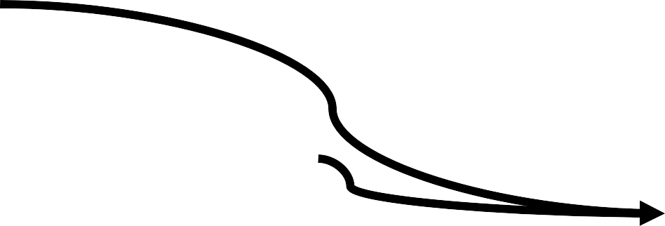
Virtual Caches: The Homonym Problem
Problem: Same VA refers to two different PAs. Same
Process 1:
block in cache, but distinct in memory.
Virtual Address 1 VPN VPO
0x01111111111111110000011000010011
Process 2:
Virtual Address 2 VPN
VPO
0x01111111111111110000000000110011
…
…
P P N
…
P T A
d d r
2
^ 9
P T
Es
P T A
d d r
P T A
d d
rP T A
d d r
P
T A
d d r
P T A
d d
…
…
2
^ 9
P T
Es
2
^ 9
P T
Es
P T A
d d
2
^ 9
P T
Es
P P N
…
r
…
Way 0
Way 1
Way 2
Way 3
P T A
d d rr
… …
…
…
…
…
L3
Perm s/Fla gs
P T A
d d r
2
^ 9
P T
Es
…
2
^ 9
P T
Es
…
$
1
2
b i t s
…
P T A
d d r
…
Set 0
Line
P P N
Translate
Set 1
W
W
W
W
L
ay
ay
ay
ay
3
ta³g 3
Physical Address 1
3
$
0
ta¹g 1
ta²g 2
S
e t
0
Set 2
$
S
e t
1
0x01100001111011100001001101010011
Physical Address 2
0x0100000011111000001001101010011
Set 3
S
e t 2
S
e t
3
Cache Data Array
Cache Tag Array
To: lower caches & memory

Slide 91

Virtually Indexed, Physically Tagged Caches
Use index bits from VPO and
VPN
VPO
use tag bits from PPN. Overlap set indexing w/ translation
Virtual Address 0x01111111111111110000000001010011
PPN PPO
0x01100001111011100001001101010011
Physical Address
tag
Way 0
Way 1
Way 2
Way 3
…
…
P P N
…
L3
P T A
d d r
2
^ 9
P T
Es
$
P T A
d d
P T A
d d
rP T A
d d r
P
T A
d d r
P T A
d d
… …
…
Set 0
r
2
^ 9
P T
Es
2
^ 9
P T
Es
P T A
d d
2
^ 9
P T
Es
P P N
…
r
Line
…
P T A
d d r
… …
r
…
…
…
Perm s/Fla gs
P T A
d d r
2
^ 9
P T
Es
…
2
^ 9
P T
Es
…
Set 1
1
2
b i t s
…
P T A
d d r
…
L
W
ay
W
ay
W
ay
W
ay
P P N
3
0
ta¹g 1
ta²g 2
ta³g 3
Translate
3
$
S
e t
0
Set 2
$
S
e t
1
Set 3
S
e t 2
For what cache organizations does VIPT work?
S
e t
3
Cache Data Array
Cache Tag Array

Slide 92
Virtually Indexed, Physically Tagged Caches
Use index bits from VPO and
VPN
VPO
use tag bits from PPN. Overlap set indexing w/ translation
Virtual Address 0x01111111111111110000000001010011
PPN PPO
0x01100001111011100001000001010011
Physical Address
tag
Way 0
Way 1
Way 2
Way 3
…
…
P P N
…
L3
P T A
d d r
2
^ 9
P T
Es
$
P T A
d d
P T A
d d
rP T A
d d r
P
T A
d d r
P T A
d d
… …
…
Set 0
r
2
^ 9
P T
Es
2
^ 9
P T
Es
P T A
d d
2
^ 9
P T
Es
P P N
…
r
Line
…
P T A
d d r
… …
r
…
…
…
Perm s/Fla gs
P T A
d d r
2
^ 9
P T
Es
…
2
^ 9
P T
Es
…
Set 1
1
2
b i t s
…
P T A
d d r
…
L
W
ay
W
ay
W
ay
W
ay
P P N
3
0
ta¹g 1
ta²g 2
ta³g 3
Translate
3
$
S
e t
0
Set 2
$
S
e t
1
Cache geometries compatible with VIPT:
S
e t 2
Requires #VPO bits > #cache block offset + #cache set index bits (why?)
Page size > block size * (cachesize / assoc = #sets)
Set 3
S
e t
3
Cache Data Array
Cache Tag Array

Slide 93
Virtual Caches vs. Physical Caches
Virtual Cache: uses virtual address to do cache lookups
Physical Cache: uses physical address to do cache lookups
Virtually-Indexed, Physically-Tagged (VIPT): uses virtual set index bits to do set lookup, uses physical tag bits to do tag comparison

Slide 94
What did we just learn?
Virtual memory, from the ground up
Partitioning & segmentation: partial solutions
Dynamic, software mapping, translation, and permissions checking
Page tables & hierarchical page tables
TLBs for accelerating translation
Caches & VM together

