Slide 1
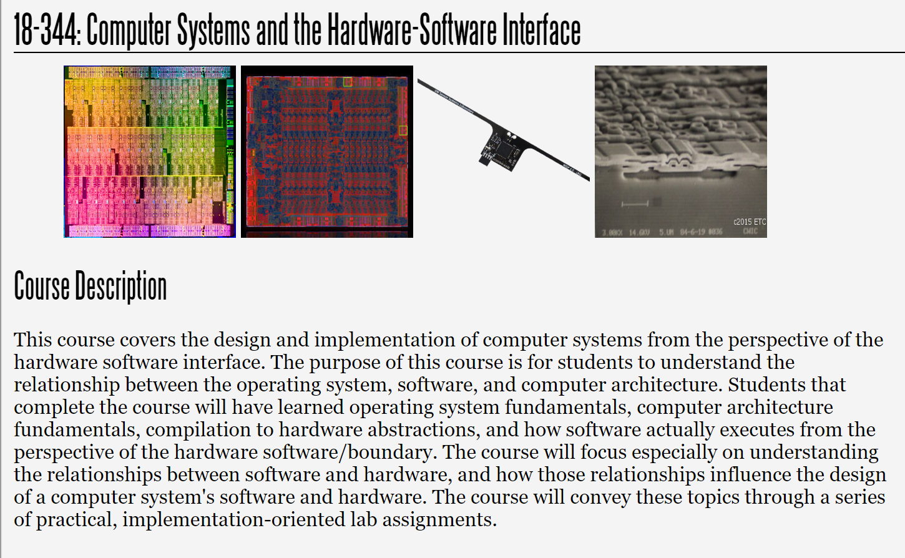
Fall 2025
Lecture 11: Design Space Exploration
Credit: Brandon Lucia

Slide 2
Today: Design Space Exploration
Defining the design space of a hardware or software system
Pareto Frontiers and optimizing within a design space
Applied Performance Evaluation
Finding the best performing design under constraints

Slide 3

Defining a design space
A design space is a set of possible incarnations of a system
A design space is defined over a set of parameters
A point in the design space is a concrete system with a concrete value for each of the design space’s parameters
Design spaces exist to allow systematic exploration of a collection of possible designs, like architectures.

Slide 4
Example: Branch Predictor Design Space
Branch History Table (BHT)
Global History Table
10
What are the parameters /
10010110
00
16k Entries
xor
. . .
dimensions of this branch predictor’s design?
00
0x100
11
Outcome: Taken
Branch PC
Branch Target Buffer
hash()
1a2ABC
BranchID
1A2
1A210C
Target: 0x1A210C
0x1a2100
Branch Tag
1A22EE
1A2112
Tag
Target

Slide 5
Example: Branch Predictor Design Space
Branch History Table (BHT)
GHT size
BHT # entries GHT/PC hash func BHT entry size BranchID hash BTB # entries
BTB assoc
Global History Table
10
10010110
00
16k Entries
xor
. . .
00
0x100
11
Outcome: Taken
Branch PC
Branch Target Buffer
hash()
1a2ABC
BranchID
1A2
1A210C
Target: 0x1A210C
0x1a2100
Branch Tag
1A22EE
1A2112
Tag
Target

Slide 6
These parameters are the dimensions of a design space vector
GHT size
BHT # entries GHT/PC hash func BHT entry size BranchID hash BTB # entries
BTB assoc
Sg Nb Hp Sb Hb Nt At

Slide 7
Example: Branch Predictor Design Space
Branch History Table (BHT)
10
8
16k
xor()
2
hash()
4
1
Sg Nb Hp Sb Hb Nt At
Global History Table
10010110
00
16k Entries
xor
. . .
00
0x100
11
Outcome: Taken
Branch PC
Branch Target Buffer
hash()
1a2ABC
BranchID
1A2
1A210C
Target: 0x1A210C
0x1a2100
Branch Tag
1A22EE
1A2112
Tag
Target

Slide 8
Example: Branch Predictor Design Space
Branch History Table (BHT)
10
16
1k
xor()
2
hash()
8
2
Sg Nb Hp Sb Hb Nt At
Global History Table
1001011001000111
00
1k Entries
xor
. . .
00
0x100
11
Outcome: Taken
Branch PC
Branch Target Buffer
hash()
1a2ABC
BranchID
1A2
1A210C
Target: 0x1A210C
0x1a2100
Branch Tag
1A22EE
1A2112
Tag
Target
Tag
Target

Slide 9
Can find a good design by measuring points in the design space
7s
Run Time (s)
3s
8
16k xor() 2
hash()
4
1
16
1k xor() 2
hash() 8
2
Faster design!

Slide 10
Can find a good design by measuring points in the design space
7s
Run Energy (J)
5J
Side Q: Why might this particular
Run Time (s)
design have lower energy?
3s
2J
8
16k xor() 2
hash() 4
1
16
1k xor() 2
hash()
8
2
8
16k xor()
16
1k xor() 2
hash() 8
2
Faster design!
Low² er energy
hash()
4
1

Slide 11
Is one of these better?
7s
Run Energy (J)
5J
Run Time (s)
3s
2J
8
16k xor() 2
hash() 4
1
16
1k xor() 2
hash()
8
2
8
16k xor()
16
1k xor() 2
hash() 8
2
Faster design!
Low² er energy
hash()
4
1

Slide 12
Plotting the design space:
Geometric view of design dimensions
8
16k xor() 2
hash() 4
1
Sg Nb Hp Sb Hb Nt At
Sg
16
1k xor() 2
hash()
8
2
Nb
Nt

Slide 13
Plotting the design space:
Geometric view of design dimensions
8
16k xor() 2
hash() 4
1
Sg Nb Hp Sb Hb Nt At
Sg
16
1k xor() 2
hash()
8
2
Nb
Nt
Limited medium: too many dimensions to render visually Limited interpretability: what does position mean?
Can be helpful for clustering designs if non-obvious

Slide 14
Plotting the design space: Geometric view of figures of merit
16
1k xor() 2
hash() 8
2
Time Energy
Time
8
16k xor() 2
hash() 4
1
Simple medium: can easily render multiple FoMs & designs Limited view of designs: points do not show design info Benefit: allows comparing designs in multiple dimensions
Energy
FoM = “Feature of Merit”, i.e. an attribute we care about.

Slide 15
Plotting many designs to study a tradeoff
What can we learn from this plot?
16
1k xor() 2
hash()
8
2
Time
8
16k xor() 2
hash() 4
1
Energy

Slide 16
Plotting many designs to study a tradeoff
Time
Time
More energy,
same time
More time,
same energy
Energy
Energy

Slide 17
Which points in this plot are optimal?
Time
Time
More energy,
same time
More time,
same energy
Energy
Energy

Slide 18
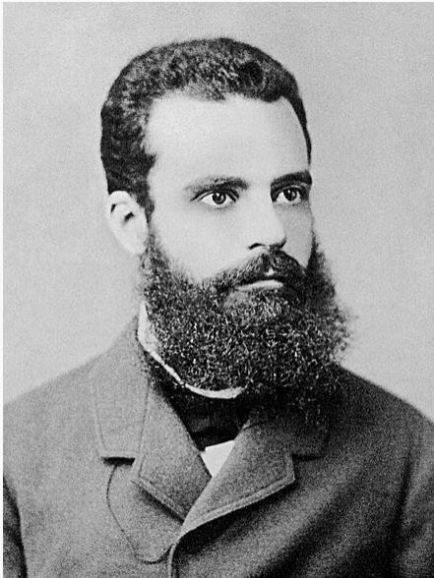
Pareto Optimality of Design Alternatives
Pareto Optimality:
A design is optimal if no change leads to improvement in one dimension without a loss in at least one other dimension
Vilfredo Pareto
Time
Energy

Slide 19
Pareto Optimality of Design Alternatives
All other points offer a level of performance in one dimension which can be had, or more, at a lower cost in the other dimension.
Time
Time
Energy
Energy

Slide 20
Design Consequence of Pareto Optimality
Never select designs other than at the frontier, at least without motivation outside of plot.
Any design anywhere other than at the frontier can achieve the same or better performance at a lower cost w.r.t. the plotted dimensions.
This level of energy efficiency can be had at a lower cost along the frontier
Time
This point is strictly better, right?
Energy

Slide 21
Design Consequence of Pareto Optimality
How do we choose from between
these Pareto Optimal alternatives?
Time
Time
Energy
Energy

Slide 22
Worthwhile Options Are Along the Pareto Frontier
Need low energy (battery powered maybe?)
How do we choose from between these Pareto Optimal alternatives?
Need to decide what matters to you!
Want to strike a balance of performance and
energy consumption (not make anyone too mad)
Need high performance (for latency requirement)
Energy
Time

Slide 23
Design Space Exploration
Applied Performance Evaluation to find the best feasible system
Define a system’s important design parameters
Define a system’s figure(s) of merit
Define a set of constraints on the feasibility of a binding of design parameters
Choose a feasible parameter setting and measure its merit
Iterate until satisfied:
If this system is better than the last one, keep it. If worse, discard it.
Choose a parameter and change it

Slide 24
Design Space Exploration
Applied Performance Evaluation to find the best feasible system
Define a system’s important design parameters
Define a system’s figure(s) of merit
Define a set of constraints on the feasibility of a binding of design parameters
Choose a feasible parameter setting and measure its merit
Iterate until satisfied:
If this system is better than the last one, keep it. If worse, discard it.
Choose a parameter and change it

Slide 25
Constraining your design space
Branch History Table (BHT)
Physical design constraints Max BP power = 4mW
Max BTB associativity = 2
Max memory (BTB+BHT) = 20kB
Global History Table
10
10010110
00
16k Entries
xor
. . .
00
0x100
11
Outcome: Taken
Branch PC
Branch Target Buffer
hash()
1a2ABC
Designs candidates are often described as needing to “Make PPA”:
Power
Performance
Area
BranchID
1A2
1A210C
Target: 0x1A210C
0x1a2100
Branch Tag
1A22EE
1A2112
Tag
Target

Slide 26
Design Space Exploration
Applied Performance Evaluation to find the best feasible system
Define a system’s important design parameters
Define a system’s figure(s) of merit
Define a set of constraints on the feasibility of a binding of design parameters
Choose a feasible parameter setting and measure its merit
Iterate until satisfied:
If this system is better than the last one, keep it. If worse, discard it.
Choose a parameter and change it
Random restarts to search different sub-spaces

Slide 27

Systematically fill out your design space
8
4k xor() 2
hash() 4
1
8
88kk xor() 22
hash() 4
1
8
12k xor() 2
hash()
4
1
Time
8
16k xor() 2
hash()
4
1
Energy
Choose a dimension to start exploring Experiments to get time/energy (or other FoM) Change dimensions when way off frontier

Slide 28
Systematically fill out your design space
8
4k xor() 2
hash() 4
1
8
88kk xor() 22
hash() 4
1
8
12k xor() 2
hash()
4
1
Time
8
16k xor() 2
hash()
4
1
Energy
As you start plotting different designs’ points, you will discover which dimensions matter to your space (What do we learn from these labeled points?)

Slide 29
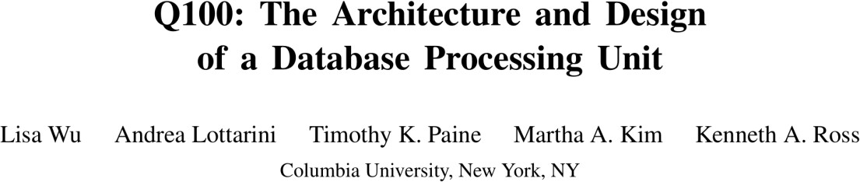
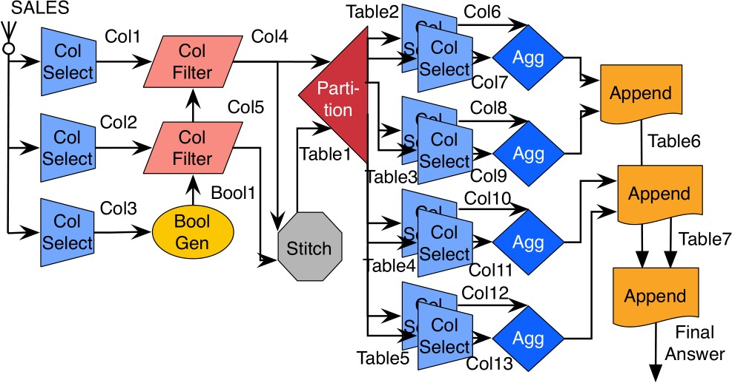
Example of Design Space Optimization
The Q100 Database Acceleration Architecture
Cutting edge database query hardware accelerator
“GPU for SQL & Database operations”
Architecture built up of a collection of special computing tiles in hardware
Each tile runs a particular kind of database operation
Tiles connected by configurable wires that can be set up to make circuits to do a database query
(Includes one of the best design space
explorations I’ve encountered in a research paper)

Slide 30
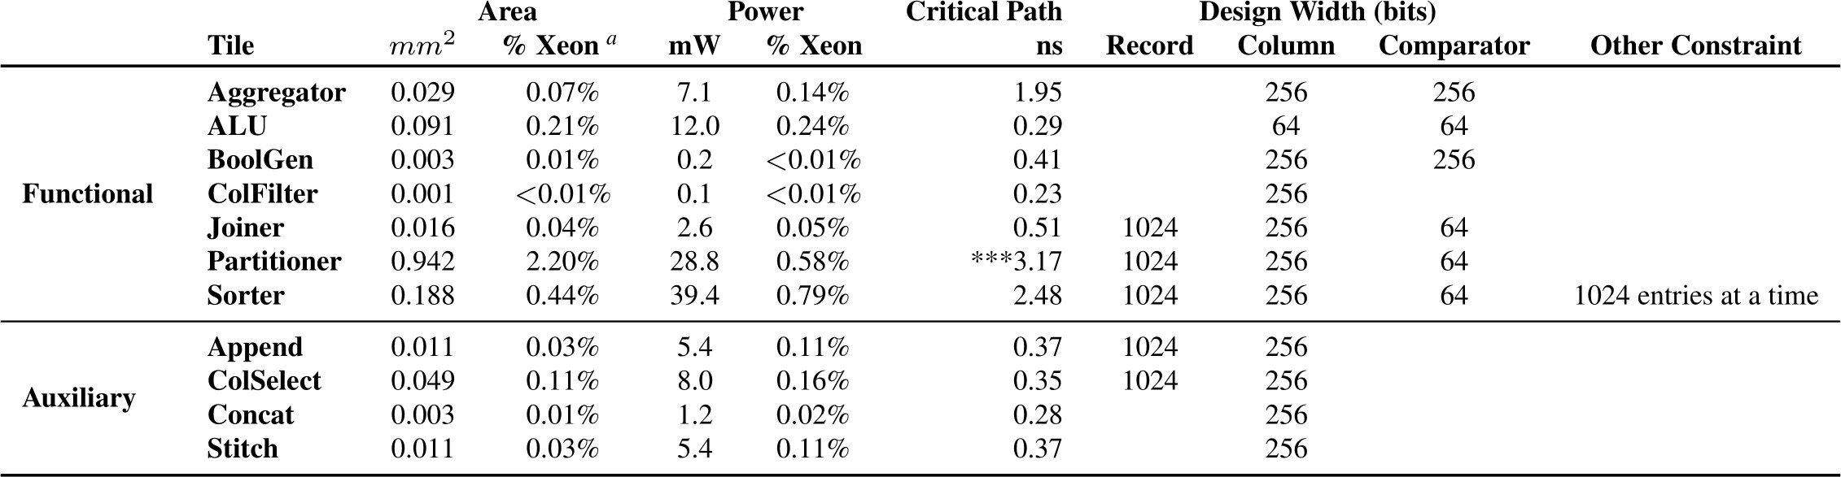
Design Space Constraints
The Q100 Database Acceleration Architecture
Design space optimization problem statement:
Choose the right mixture of tiles to have the best performance and power without using too much area or limiting frequency

Slide 31
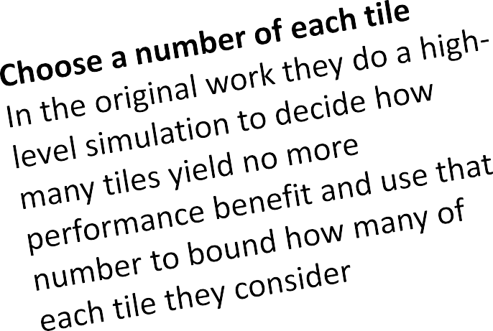
Design Space Constraints
The Q100 Database Acceleration Architecture
Design space optimization problem statement:
Choose the right mixture of tiles to have the best performance and power without using too much area or limiting frequency

Slide 32
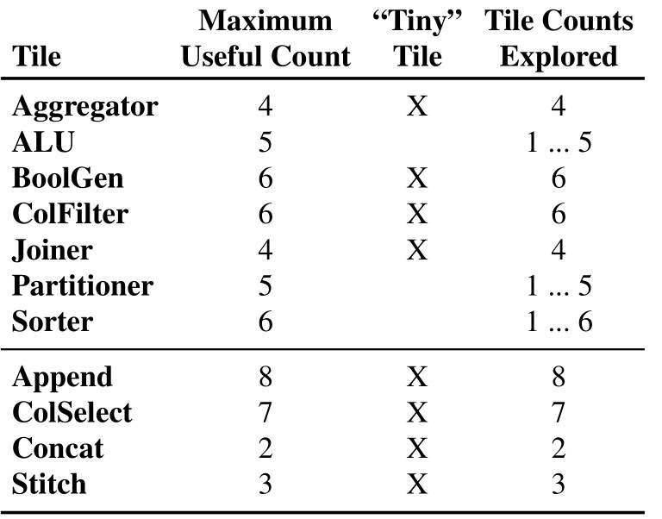
Design Space Constraints
The Q100 Database Acceleration Architecture
Design space optimization problem statement:
Choose the right mixture of tiles to have the best performance and power without using too much area or limiting frequency

Slide 33
Design Space Constraints
The Q100 Database Acceleration Architecture
Estimate area w.r.t. a reasonable baseline.
In the original work, they compared to a contemporary server processor, the Intel E5620 Xeon. The comparison included all of the connecting wires, buffers, etc.
Design space optimization problem statement:
Choose the right mixture of tiles to have the best performance and power without using too much area or limiting frequency

Slide 34
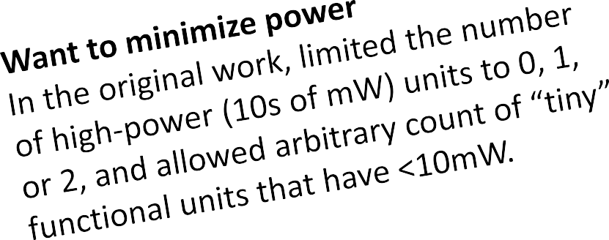
Design Space Constraints
The Q100 Database Acceleration Architecture
Design space optimization problem statement:
Choose the right mixture of tiles to have the best performance and power without using too much area or limiting frequency

Slide 35
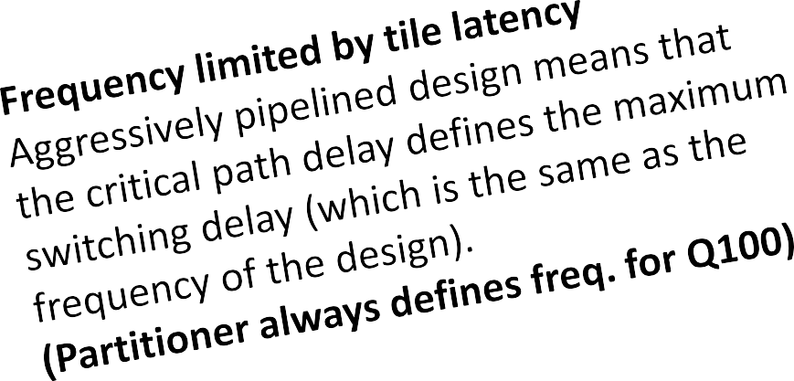
Design Space Constraints
The Q100 Database Acceleration Architecture
Design space optimization problem statement:
Choose the right mixture of tiles to have the best performance and power without using too much area or limiting frequency

Slide 36
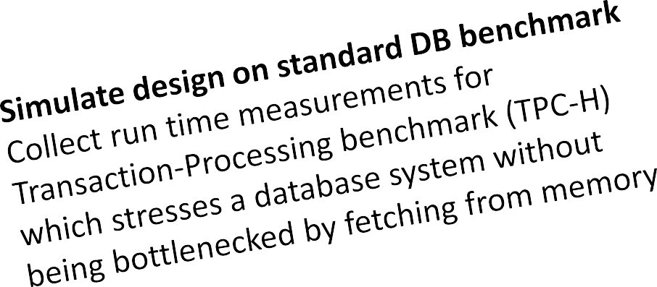
Design Space Constraints
The Q100 Database Acceleration Architecture
Design space optimization problem statement:
Choose the right mixture of tiles to have the best performance and power without using too much area or limiting frequency

Slide 37
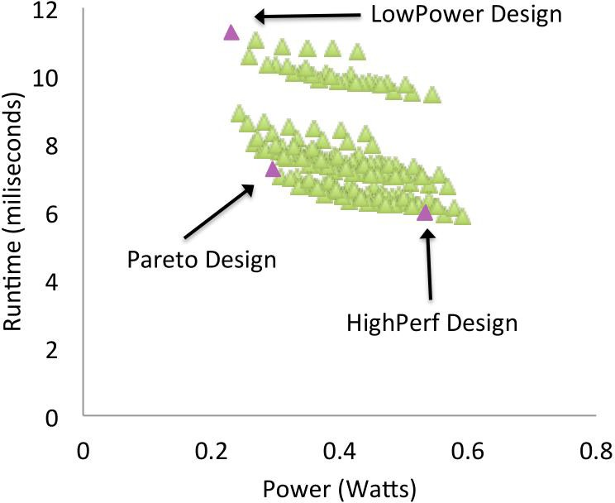
Q100 Pareto Frontier
Pareto plot from a research paper on the Q100 Database accelerator by Wu et al, ASPLOS 2014
How did they select magenta points?
What other points might they have selected?
What is the value in seeing all these points?
“Pareto Design” as used in the paper means the design that maximizes (runtime) performance per watt.
Although there were designs with nominally better runtime, the goal of the paper was to select three options for further study. The two options with a nominally better runtime were only negligibly better but at a much higher cost in terms of energy, rendering them less interesting to the authors.

Slide 38
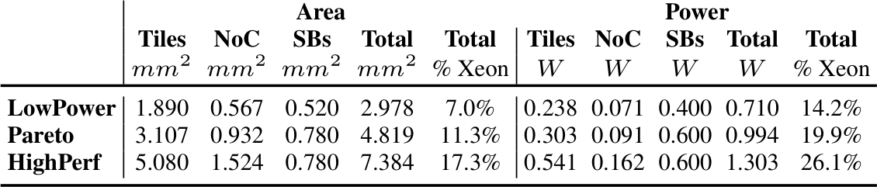
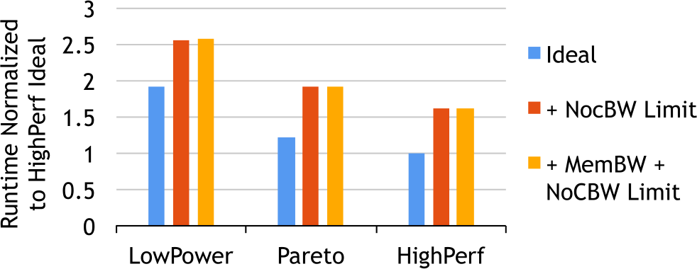
Results of Design Space Exploration
Final results show idealized design and results that include adding in costs related to the on-chip network and memory access bandwidth

Slide 39
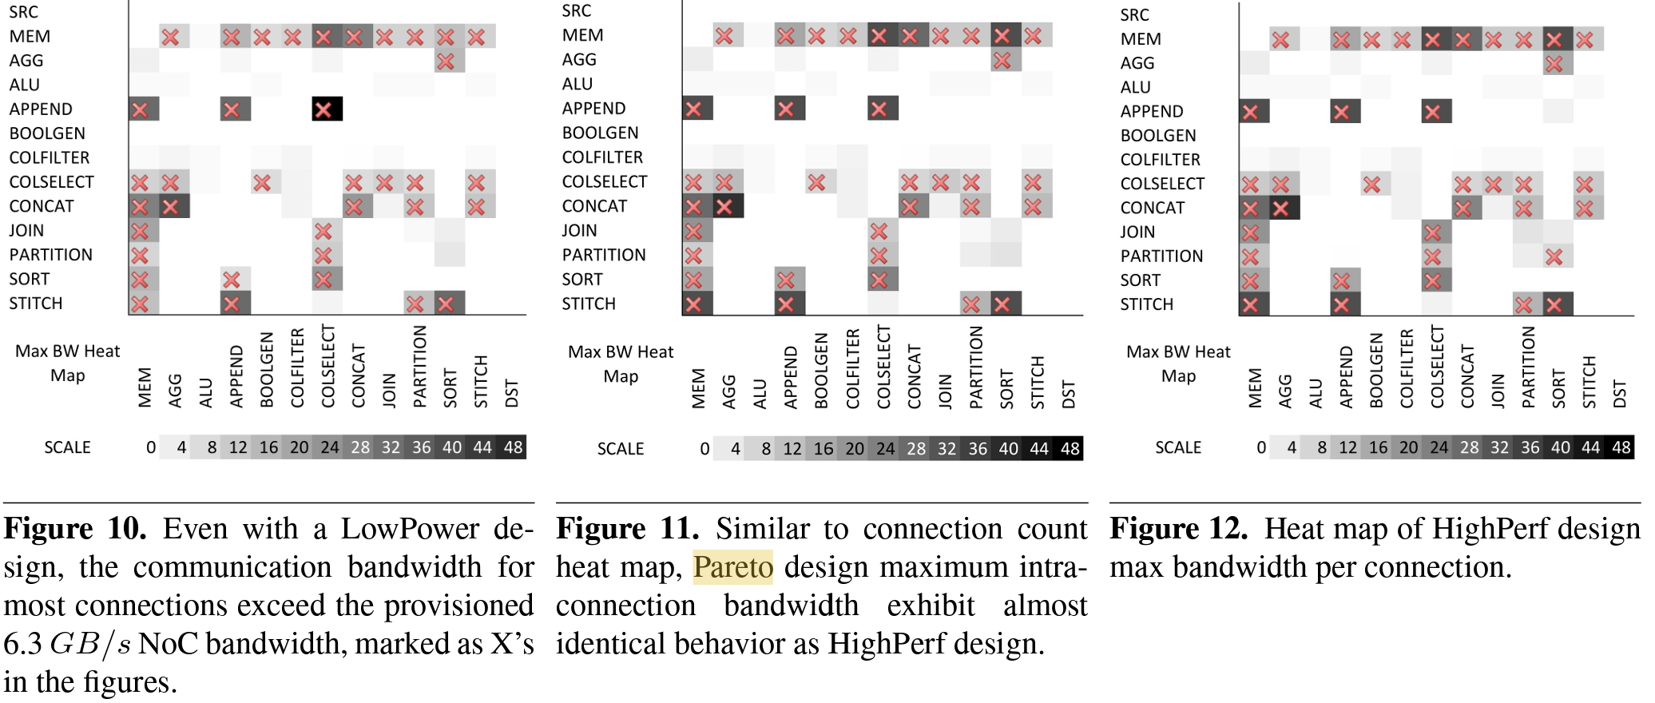
Heat Plots Can Be Used to Explore 2D Space
Here heat plots are used to show the communication bandwidth needed between tiles and which design elements exceed a reference threshold.

Slide 40
Q100 Takeaways / What did we just learn
Practical application of design space exploration
Defined design space based on tiles and connections between tiles
Defined constraints and optimization goals based on power, area, frequency
Runs experiments to produce Pareto Frontier with performance and power as main design dimension
Final designs come from Pareto Frontier – fast, balanced, low-power
Compare design to characteristics of known baseline (Xeon)

Slide 41
What to think about next?
Miscellaneous (micro)architectural tricks & optimizations (future)
Super-scalar Out-of-Order
VLIW
Vector processors / SIMD
SIMT/GPU

