Slide 1
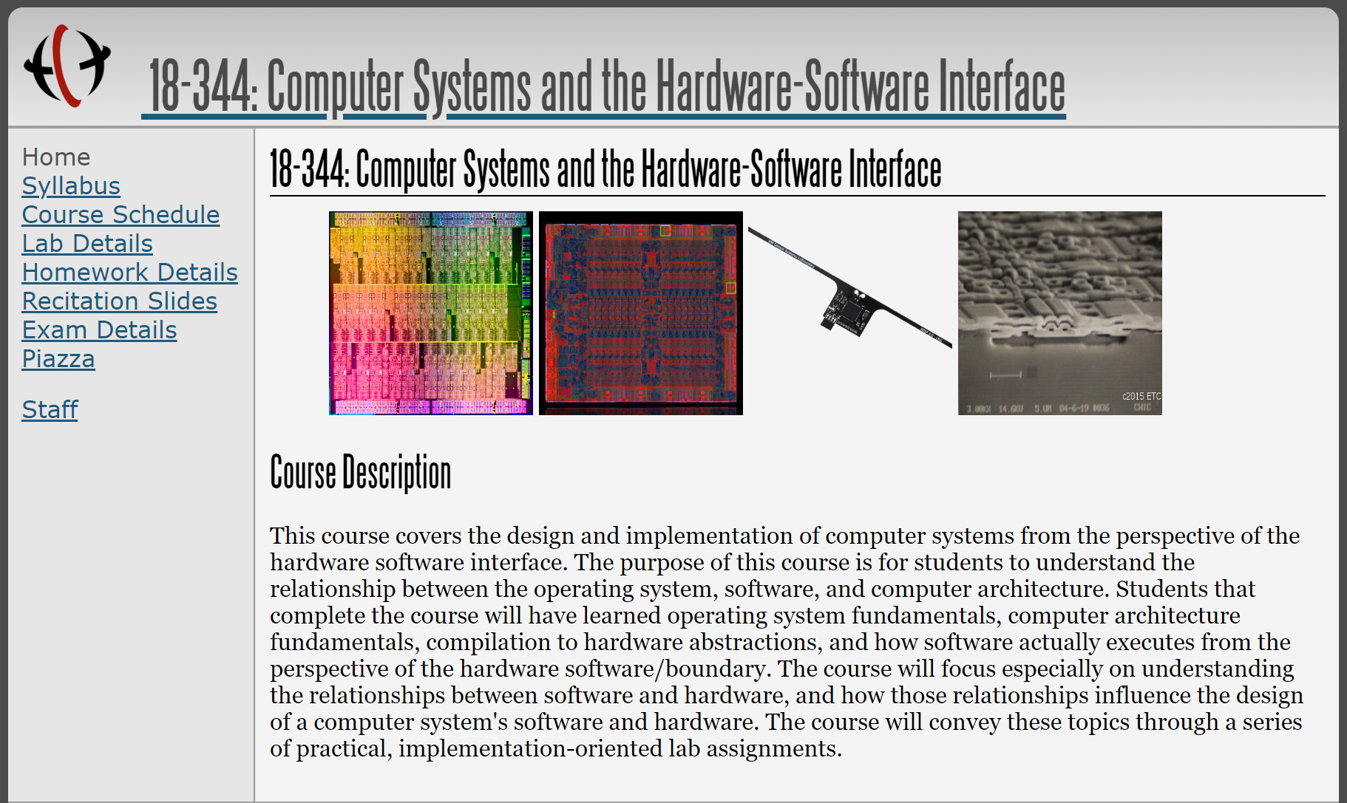
CMU 18-344: Computer Systems and the Hardware/Software Interface
(Fall 2023)
Fall 2023

Slide 2
Course Staff & Logistics
Prof. Greg Kesden
  (412) 818-7813
  HH A205
  https://www.andrew.cmu.edu/~gkesden/schedule.html
Teaching Assistants (18-344 Veterans):
  Ashira Johara
  Fiona Fisher
  Jaehyun Lim
  Yufei Shi
Lecture: Mondays and Wednesdays, 3:30 – 4:20pm in WeH 5421
  Some lectures are designed to run short, some to run long. We may leave early, we may spill into next week.
Recitation: Friday, 10-10:50am in WeH 5421
  Project focused + Reinforcement
Office Hours (per website, TBD)
5 Labs (more later) + (Attendance/Homework | Exams)
Gradescope (primarily for handin), Slack (Ephemeral questions) ,& Piazza (for continuous Q&A)
Late policy: -10% for each day late. If you need schedule adjustments, please work it out with us well in advance.

Slide 3
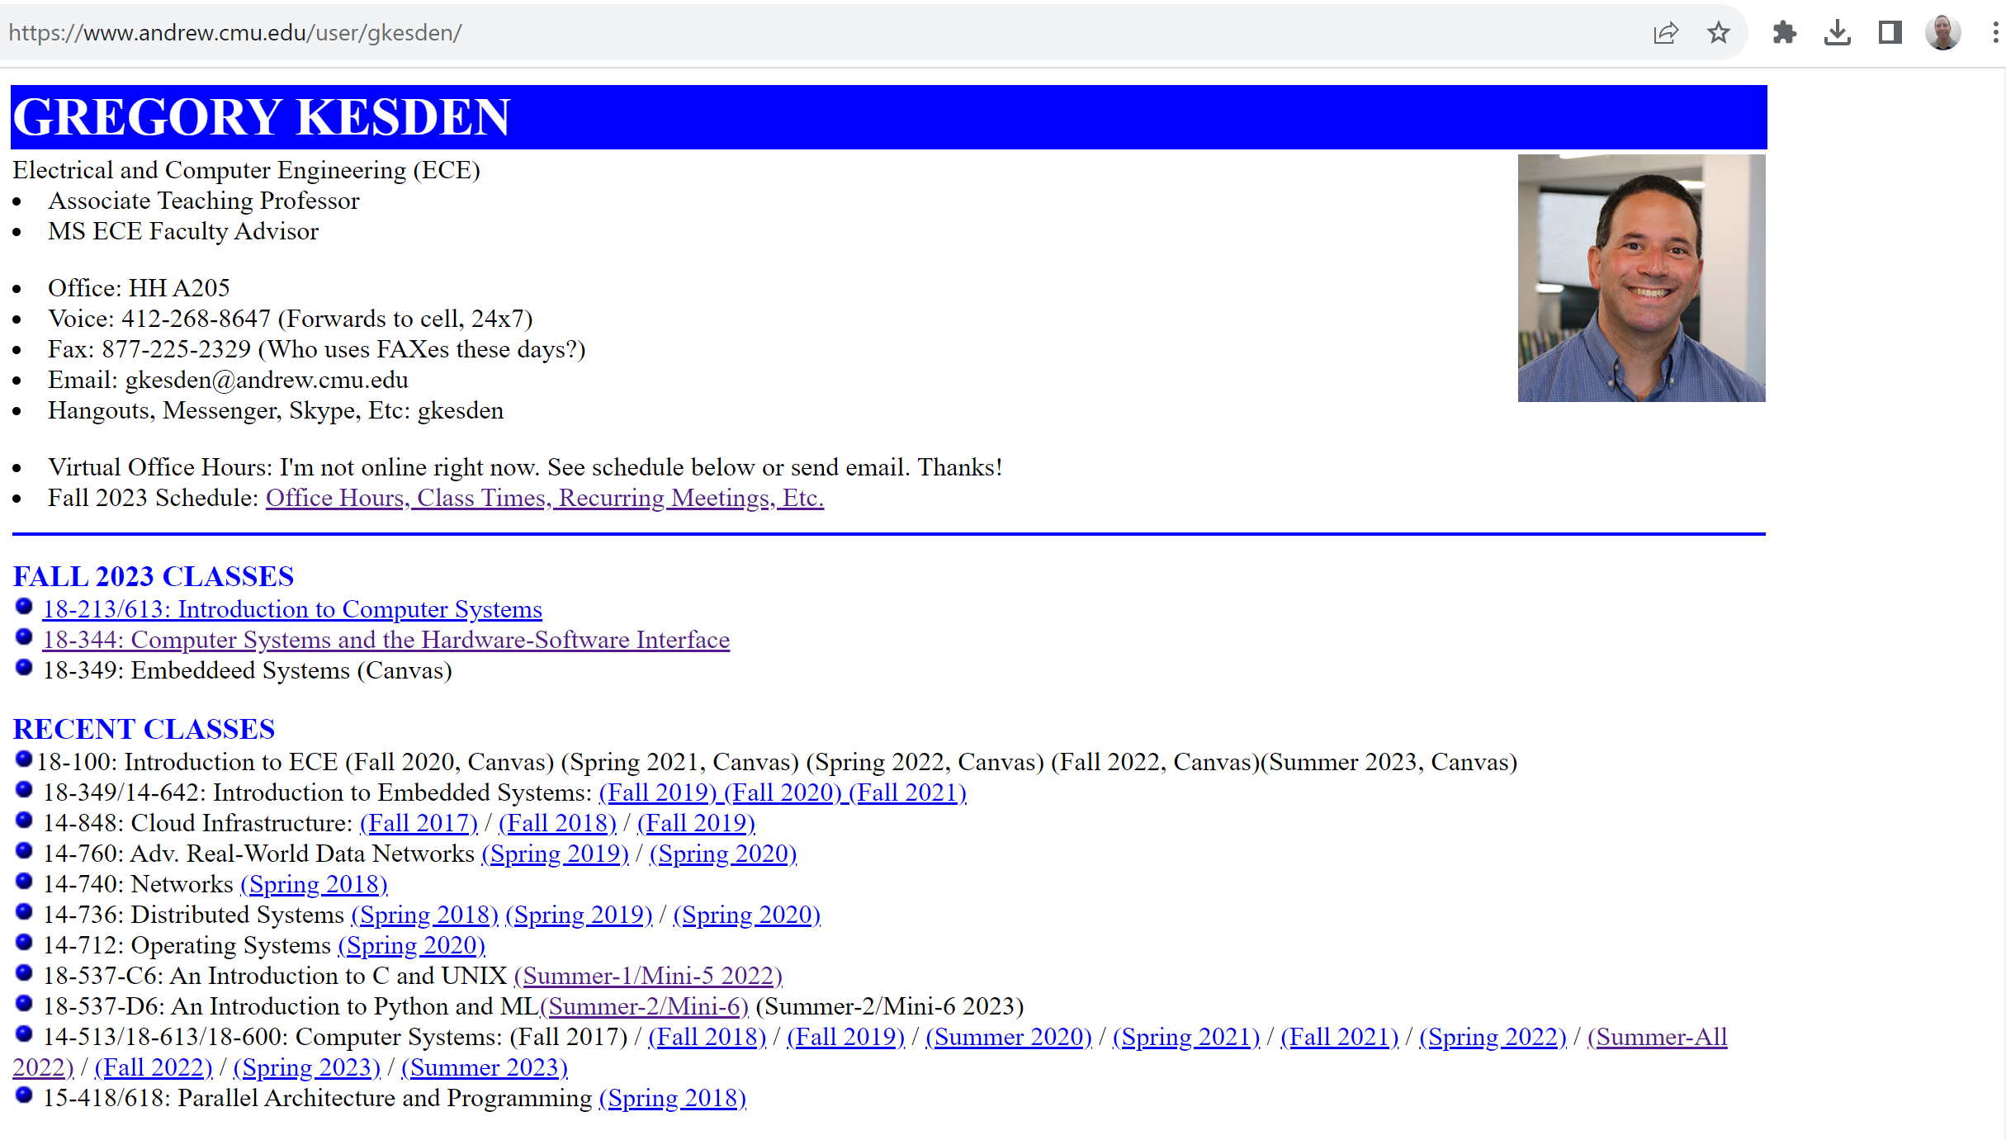
Who am I?

Slide 4
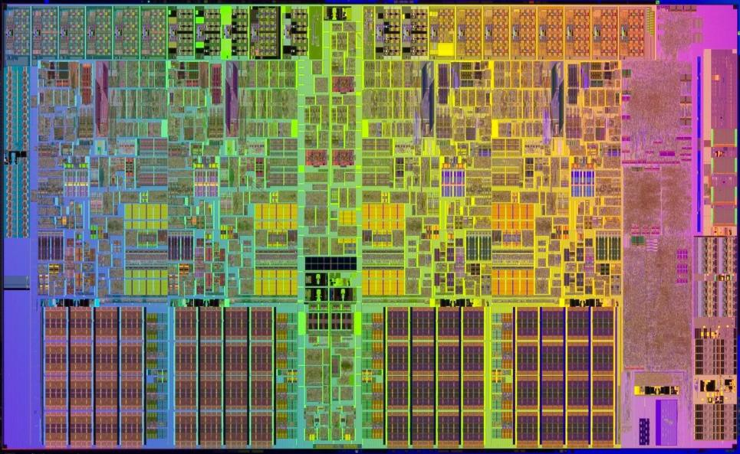
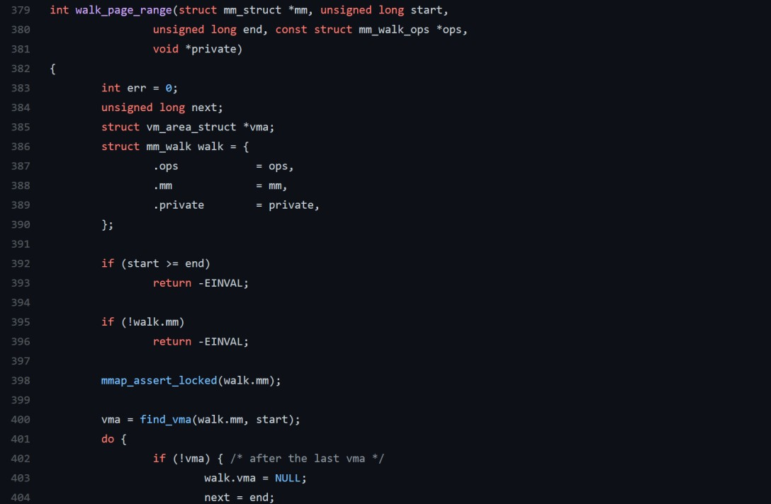
What is this course about?

Slide 5






What is the hardware software boundary?

Slide 6
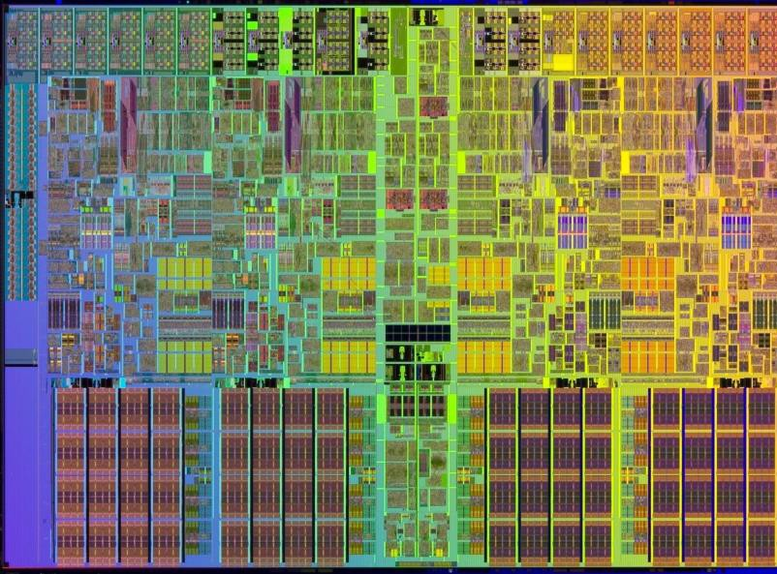
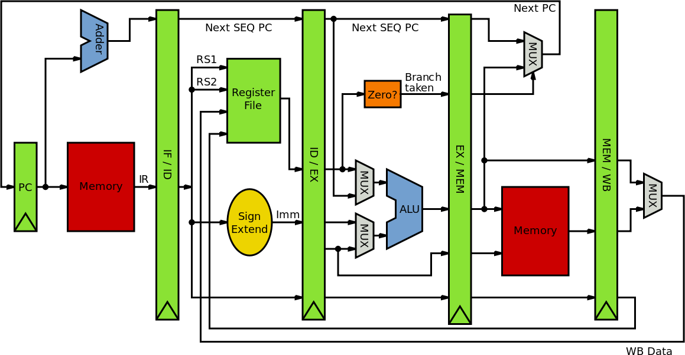
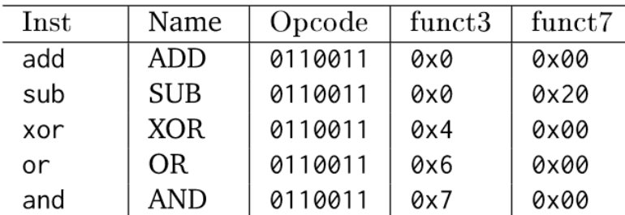
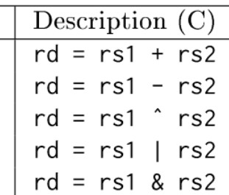
What is computer (μ)architecture?

Slide 7
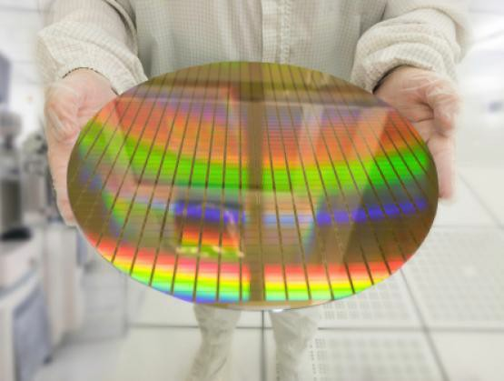
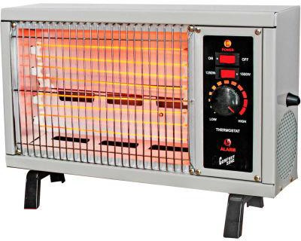
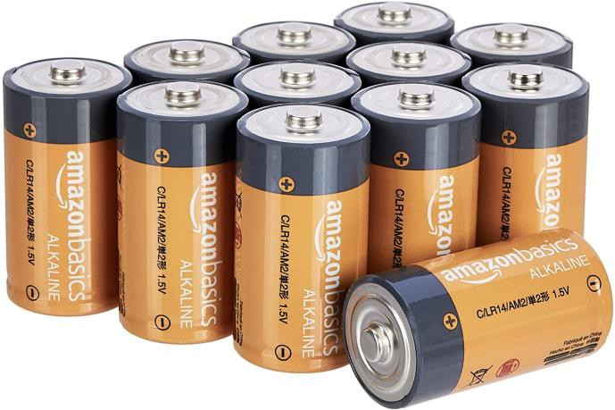
What constrains a computer system?

Slide 8
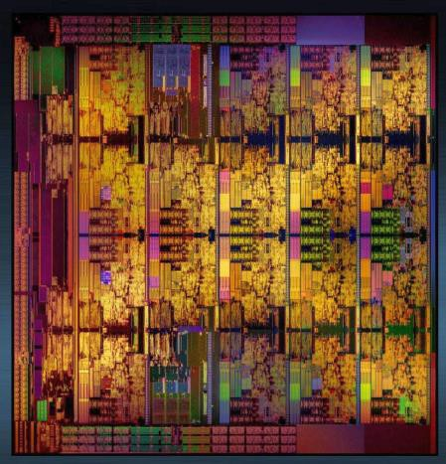
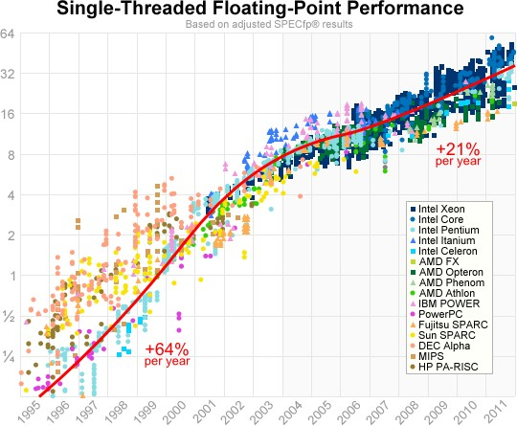
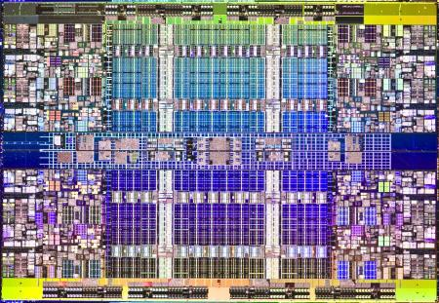
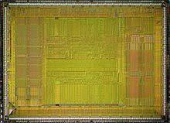
Why are these processors different?

Slide 9
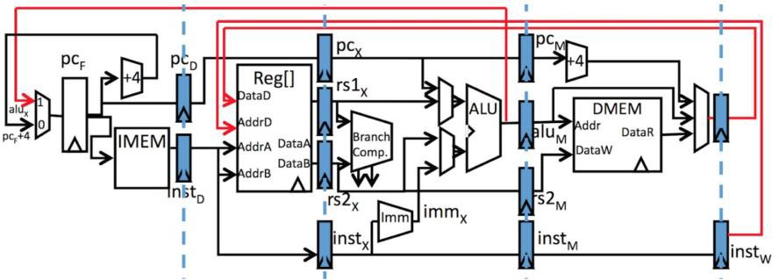
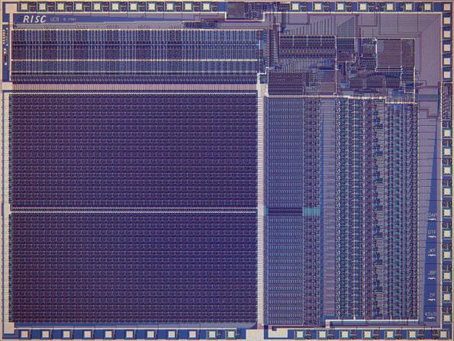
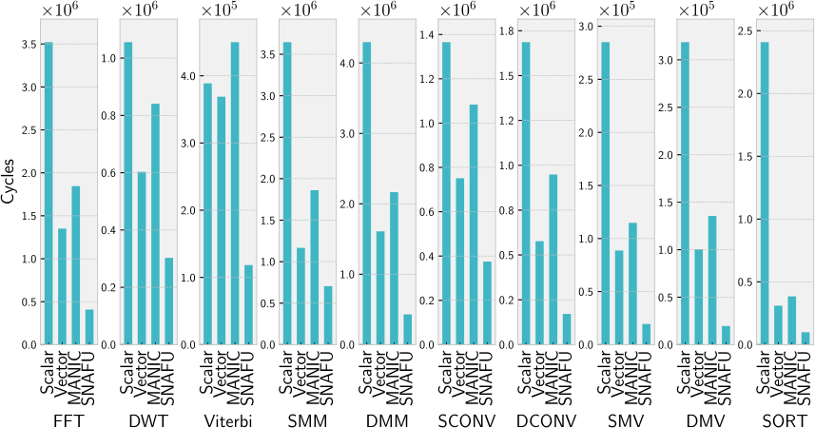
How do you measure a computer’s performance?

Slide 10
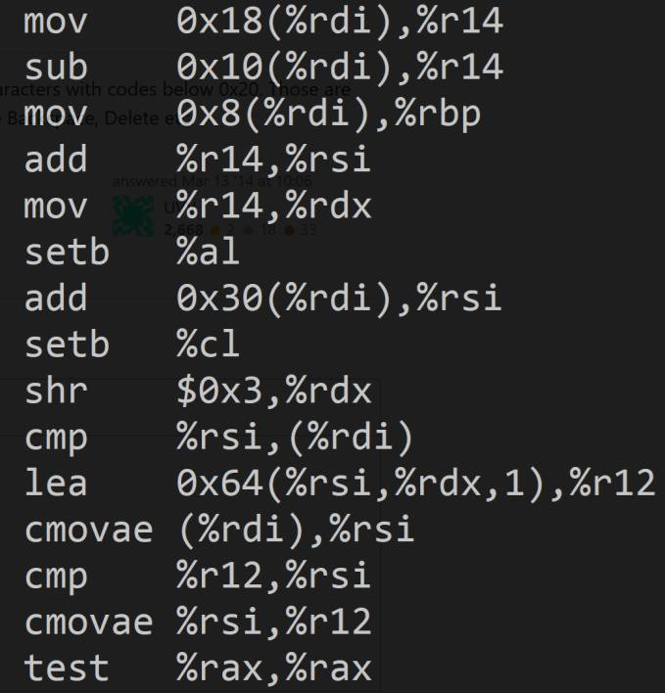
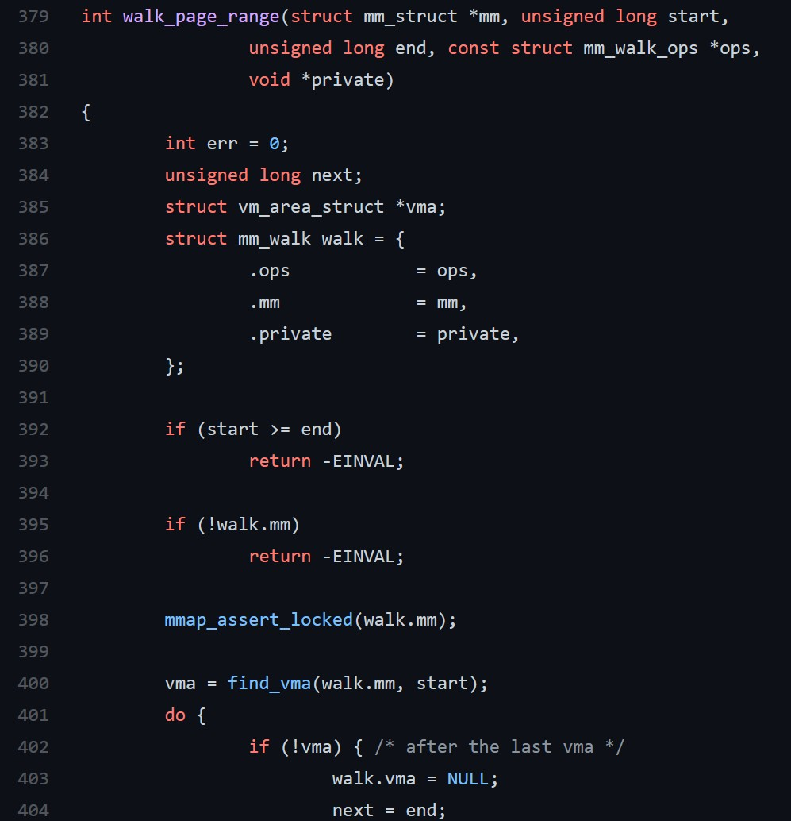
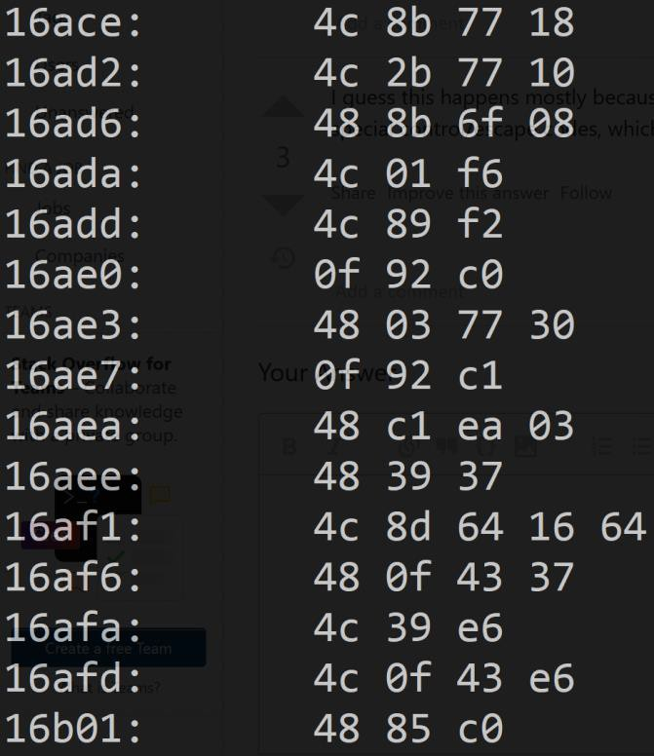
What makes software runnable?

Slide 11
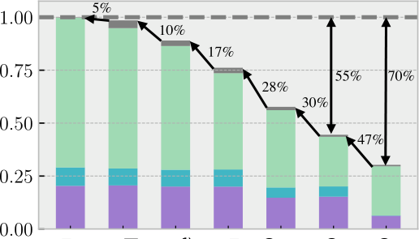
How do you improve software’s performance?
X
=

Slide 12
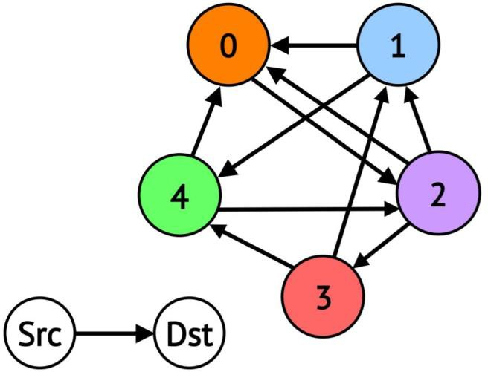
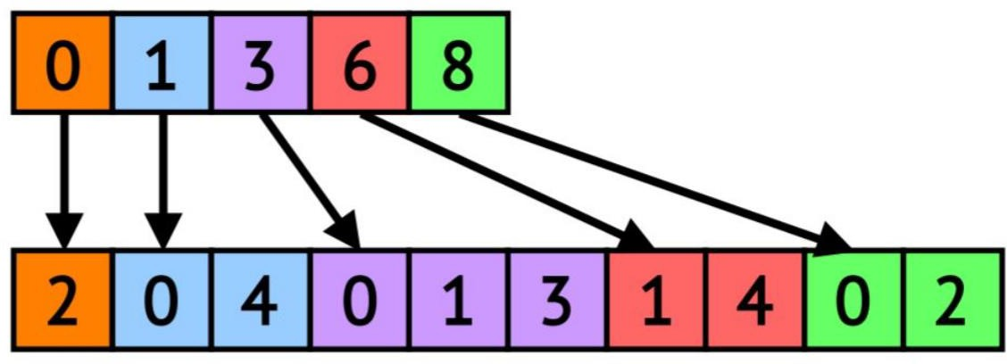
Are some programs intrinsically slow?

Slide 13
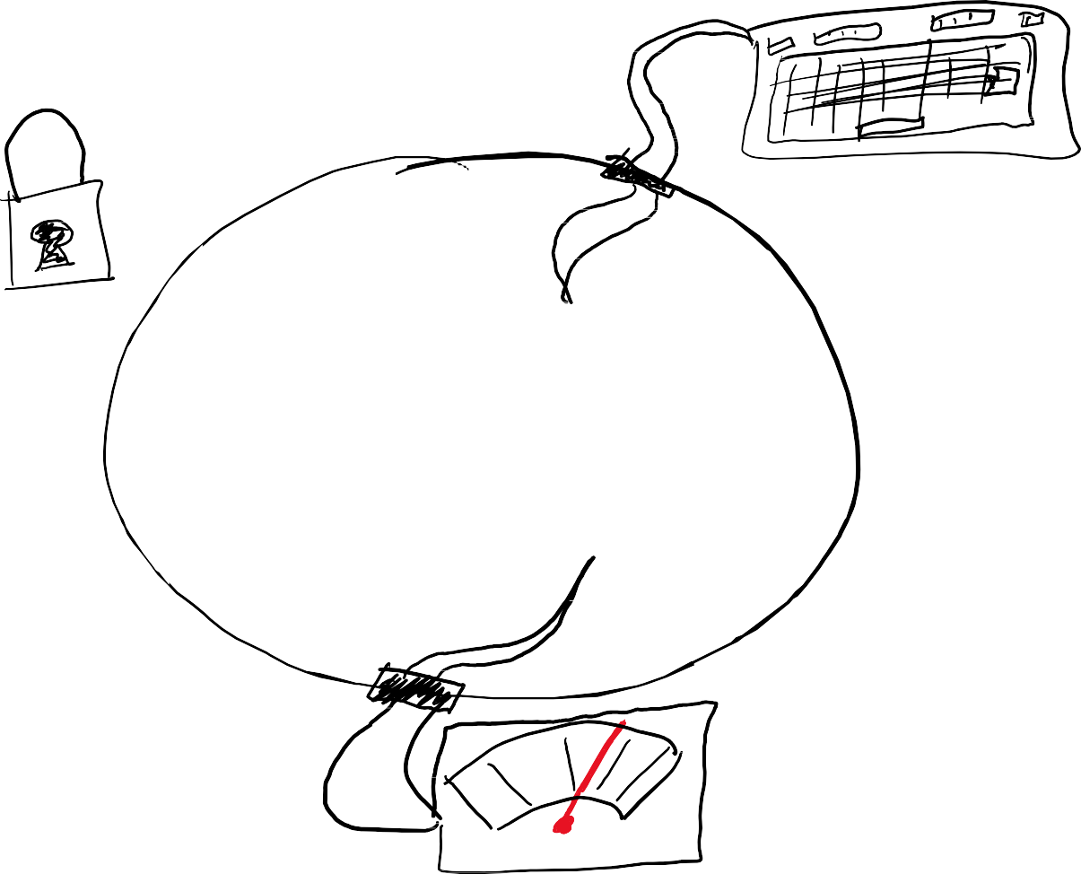
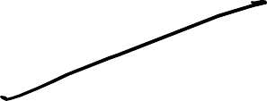
What are the lower-extremities of software?

Slide 14
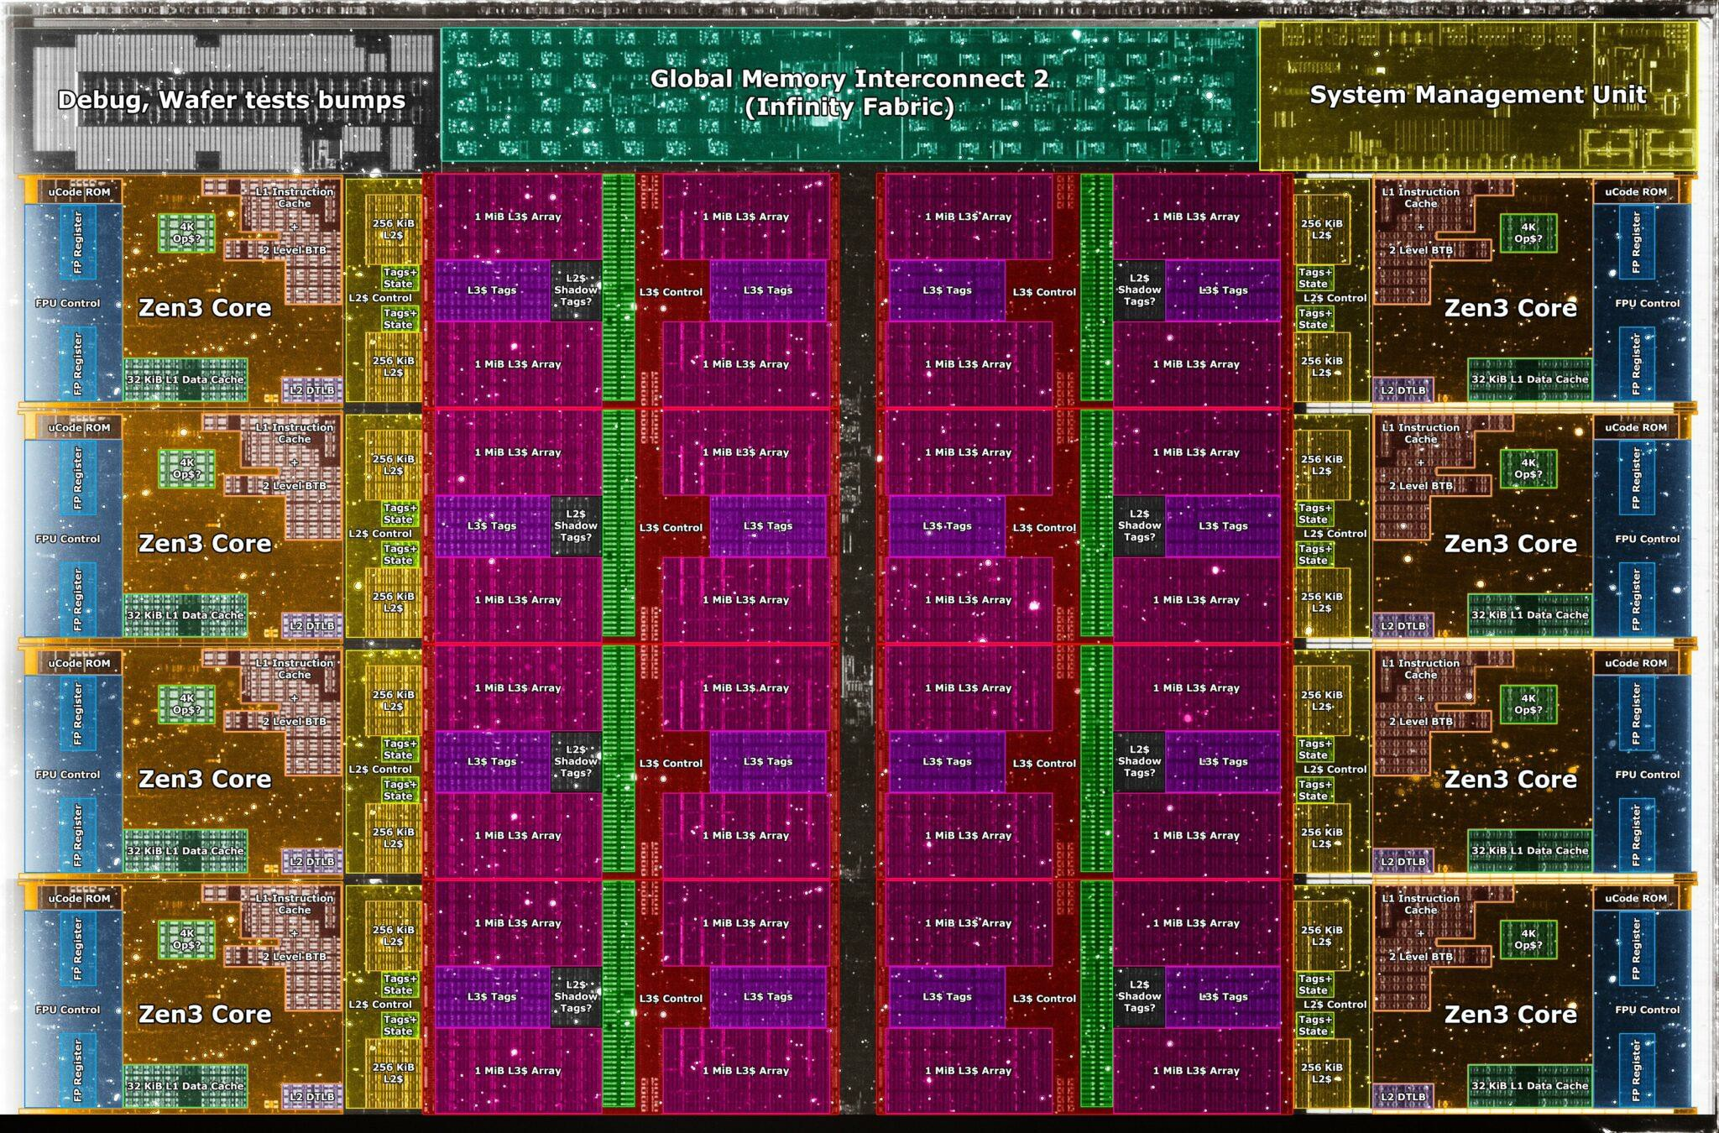
How (& why?) to do two things at the same time?

Slide 15
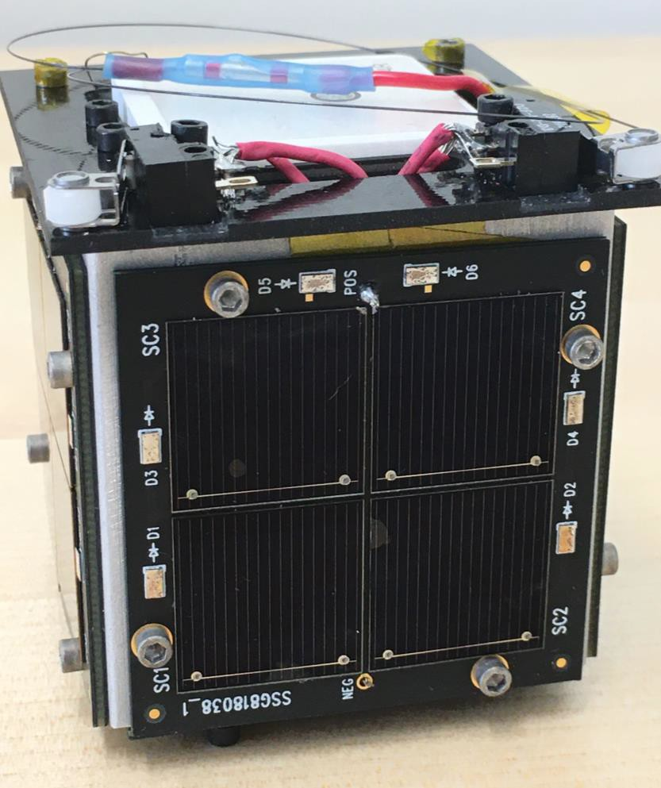
How does it all fit together in real systems?
Tartan-Artibeus-1 Batteryless Energy- harvesting Nanosatellite System

Slide 16
What are we doing this semester?
Series of labs (Lab 0 – “bootstrapping” goes out today, due in 1 week)
  Do all labs except lab 0 in pairs. The point is not to make you code or experiment for the rest of your life. We want you to learn by doing.
Labs released via AFS: /afs/ece.cmu.edu/class/ece344/assign
  For each lab, handout.txt is your main reference & documentation. READ IT CAREFULLY because it will tell you what you need to know to complete the lab
Labs are not just “code & submit”. Instead, you’ll be building,
studying, measuring, and evaluating systems. Coding it up is step 1.

Slide 17
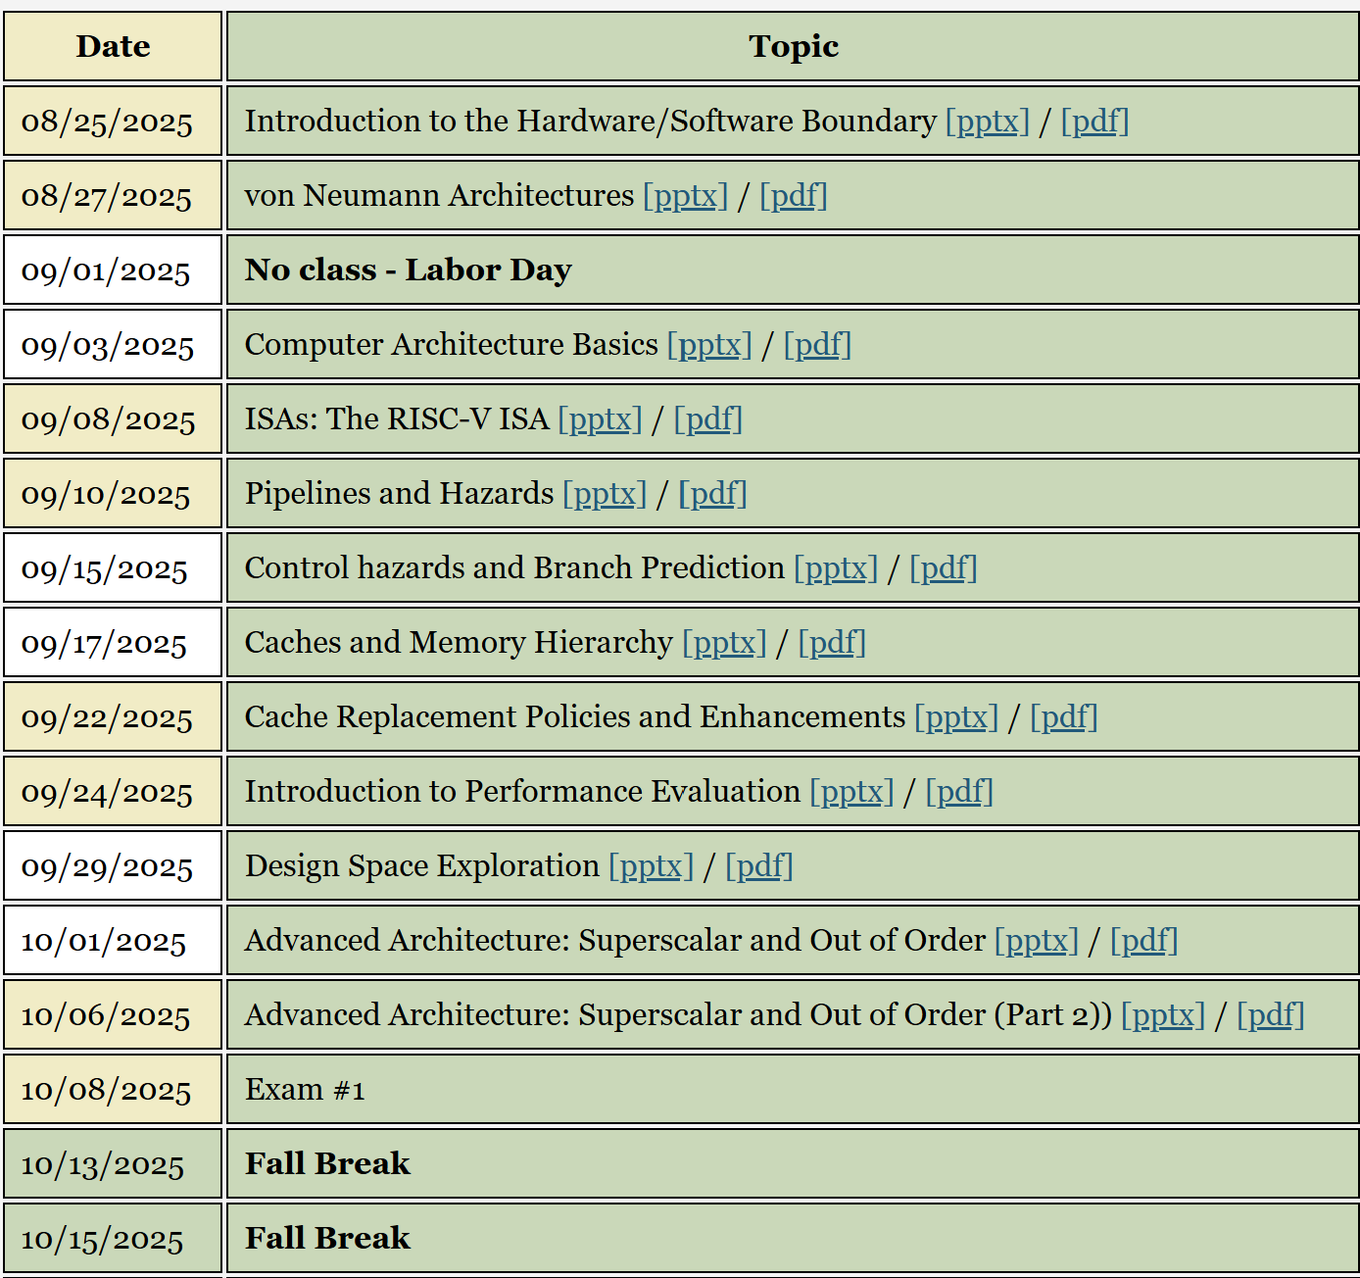
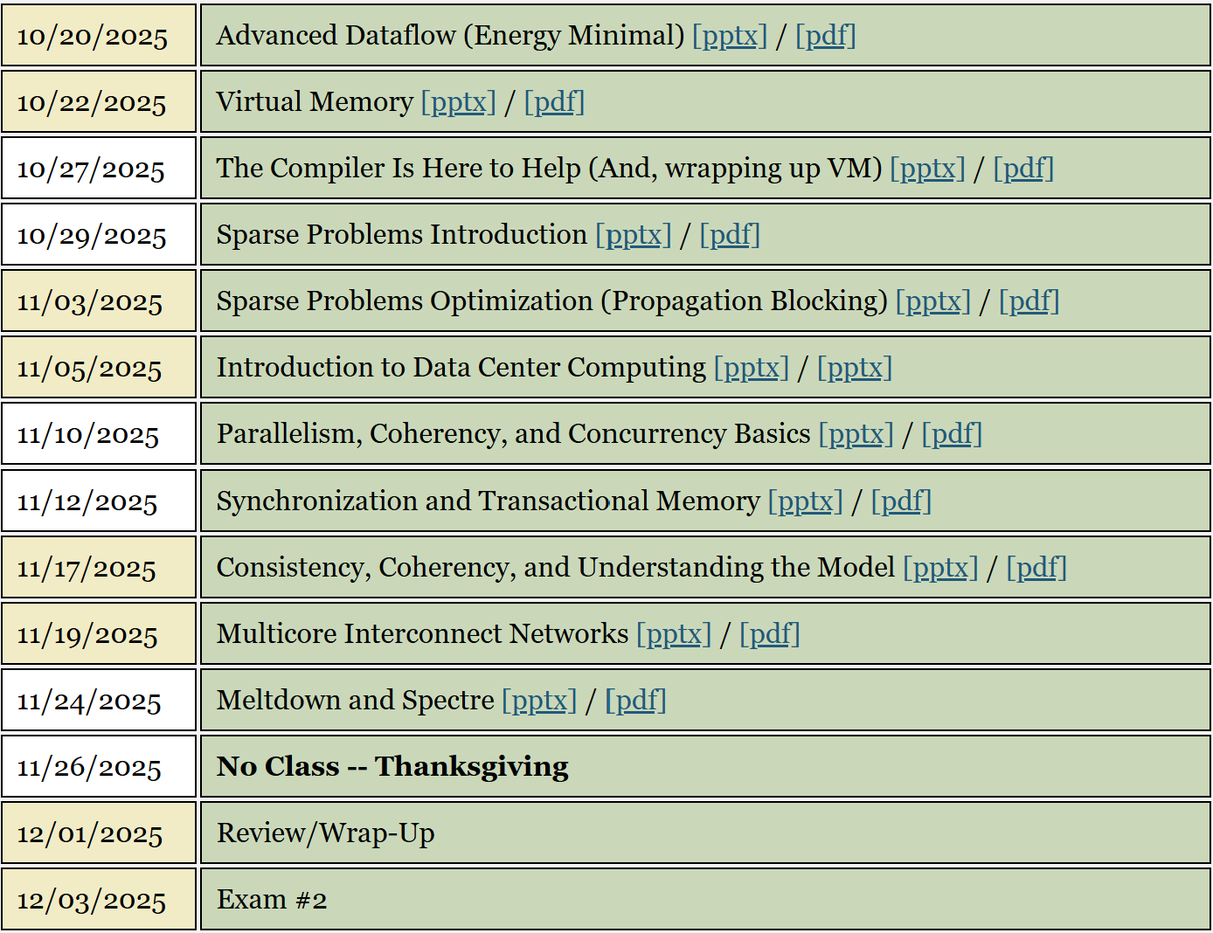
Course Calendar

Slide 18
Diving into Computer Architecture
Broad introduction to computer architecture, understanding the architecture / microarchitecture distinction, what is an ISA?, what limits computer performance?, how to think about hardware
using abstractions, Amdahl’s Law

Slide 19
ILP & Dealing with Hazards
Introduction to ILP, pipelining and what gets in its way, how control flow happens at execution time, branch prediction

Slide 20
Caches & Memory Hierarchies
Memory is the real problem! Caches, memory hierarchies: an architect’s view, cache replacement and other cache optimizations

Slide 21
Principled Performance Analysis
Measuring a system in a meaningful way, understanding performance measurement pitfalls, Pareto analysis, design space iteration & exploration, Amdahl’s Law (again)

Slide 22
Microarchitectural Optimizations
Going beyond IPC=1, advanced ILP techniques, superscalar & out-of- order execution, vector processors, Very Large Instruction Word processors, other more exotic architectures

Slide 23
Midterm Exam
The midterm covers everything from the start of the course up to this point. The labs & homeworks will evaluate what you learn during the second half of the course.

Slide 24
Virtual Memory
Virtual Memory, virtualization basics, bad ways to do VM, hardware/software co-design for virtualization, VM advanced topics, huge pages, TLB design

Slide 25
Sparse Computation
Introduction to sparsity, what is a sparse problem and why is one difficult?, understanding the performance limiters, sparse problem optimization strategies, open problems

Slide 26
Parallelism & Concurrency
Parallel computation, parallel architectures concurrency, memory consistency models, synchronization, atomics, transactional memory networks on chip

Slide 27
End of semester: computer architecture today
(Subject to change) What is happening in the field of computer architecture and systems today?
What are the exciting new ideas? Reconfigurable dataflow machines, encrypted computing, energy- harvesting computers, open-ended Q/A

Slide 28
Lab 0: Bootstrapping
18-344 has lots of moving parts. Lab 0 is about figuring them all out
  You’ll be using each of them again in subsequent labs.
SPEC2017: collection of benchmark programs designed for evaluating computer architectures
  Needlessly complex and very difficult to change infrastructure. SPEC will be a pain, but will give you the Real Computer Systems Experience.
Pin: binary instrumentation tool used to insert code into program binaries to implement computer architecture simulators
Destiny: memory modeling tool useful for evaluating the time & energy to access different cache/memory designs

Slide 29
Lab 1: Branch Prediction
As you will learn, (and as you may recall from 213) microarchitectures predict the outcome of their branch instructions
Write a branch predictor simulator
Evaluate different implementations
  Cost, accuracy, implementation feasibility
Write-up in English prose characterizing and explaining your design,
and with quantitative evaluation of your design’s performance.

Slide 30
Lab 2: Memory Hierarchy Design Space
Cache hierarchies are big complex microarchitectural components
Which is best for a given set of programs?
You will start by writing a cache, and then a whole memory hierarchy.
Then you will run a design space exploration process to optimize your memory hierarchy implementation, subject to physical constraints and performance & efficiency goals
You will explore different replacement policies
Write-up in English prose summarizing your design space exploration and conclusions, including quantitative evaluation.

Slide 31
Lab 3: Virtual Memory
Virtual memory provides process isolation and access control using paging and some hardware support
You will implement an emulation of a page table and the basic functions that you will use to manipulate the page table
You will implement simulated hardware to accelerate translate of virtual to physical addresses and evaluate its impact on system performance
You will study your implementation and quantitatively analyze your page table and hardware support
Write-up describing your design, including quantitative evaluation of your system and its performance

Slide 32
Lab 4: Sparse Workload Optimization
Sparse workloads are programs that work on datasets that have sparse structure, like graphs that have lots of vertices and far fewer edges (sparse adjacency matrix). Sparse workloads are hard to cache.
Given a simple unoptimized sparse workload implementation, you will use a highly specialized optimization called Propagation Blocking to optimize, yielding a much higher performance implementation
You will study your optimized version, and quantitatively analyze your design choices.
Write-up including description of your implementation and summary of quantitative results

Slide 33
Lab 5: Synchronization for Parallel Code
Parallel programs require synchronizing to avoid confusing interactions between threads.
There are many ways to implement synchronization
You will implement different synchronization mechanisms (from spin locks to transactional memory) for two performance-sensitive test programs
You will quantitatively study your implementations and their performance on the two test programs
Write-up including description of your synchronization alternatives and a quantitative analysis of performance

