Slide 1
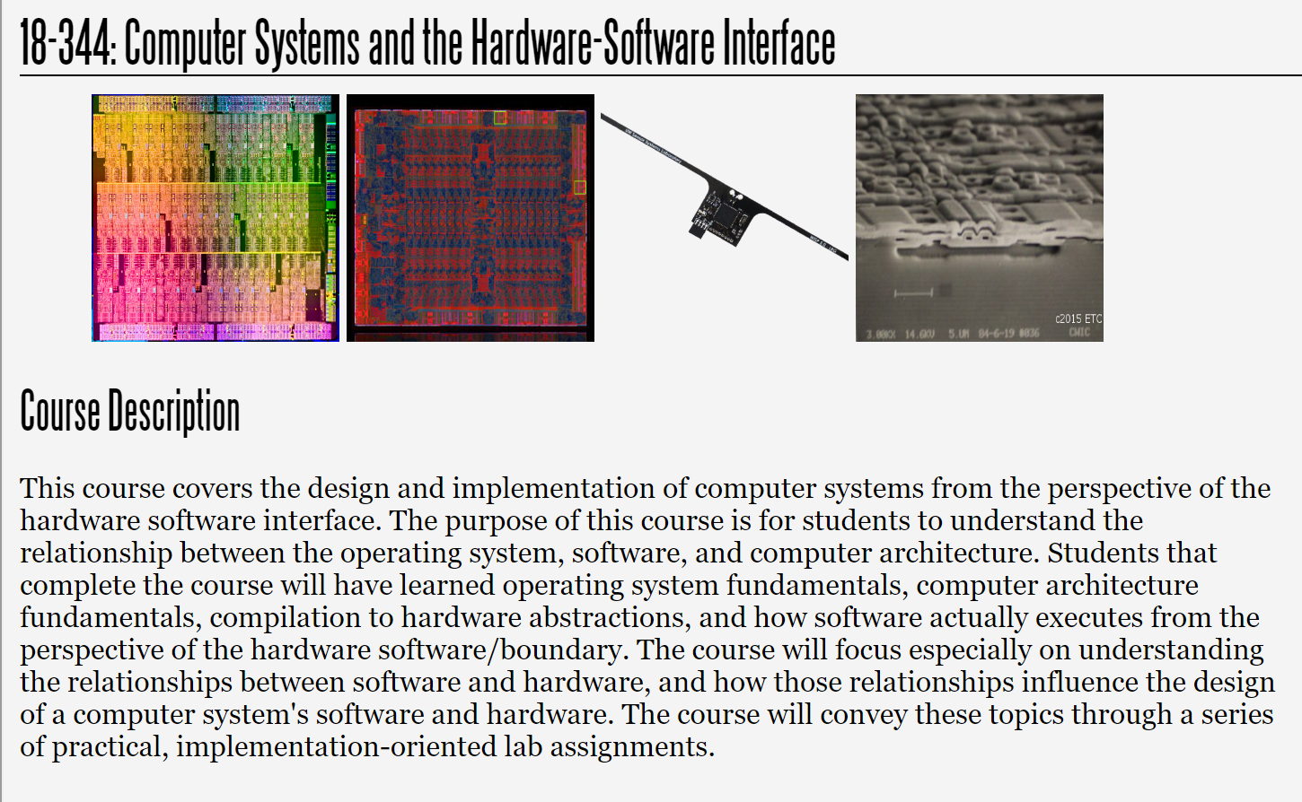
Fall 2023
Lecture 9: Introduction to Performance Evaluation
Credit: Brandon Lucia

Slide 2
Today: Performance Evaluation
Performance evaluation basics: metrics, measurement, comparisons
Benchmarks and benchmarking
The curse of averages: means, variance, distributions
Selecting the right metric along which to compare two systems
Defining a design space
Pareto Frontiers and Pareto Optimality of a design
Design space exploration and design iteration

Slide 3

How good is this architecture?
WB/Exec Forward
Instruction PC+4
Mem/Exec Forward
WB/Mem Forward
Branch Target
PC Source Select (1 if branch taken)
Exec/Exec Forward
Mem/Mem Forward
PC
Branch
Target
WB/Mem Fwd
Mem/Mem Fwd Addr Reg A
WB/Mem Fwd
Mem/Mem Fwd
Data Reg B
4
Offset
Instruction PC + 4
Branch
Output/Read Reg C Data
Output/Read Reg Select
Branch Target
+
Target
+
Reg A Reg B
PC
Source Select
WB/Ex Fwd
Ex/Ex Fwd Mem/Ex Fwd
WB/Ex Fwd
Ex/Ex Fwd Mem/Ex Fwd
Register
Writeback
MUX
PC Source Select
Branch
Outcome Logic
Input Read Reg A
Input Read Reg B
MUX
MUX
MUX
Instruction Fetch
Read Register A & B Select
Read
Data C
MUX
MUX
Cont. Sigs.: Op. Select
Memory
Unit
Write Reg C Data
Write Reg C Select
Control
Signals
Reg 1
Reg 2
Reg 3
Reg 4
Control Signals:
Op select
op = [+, -, x, /]
ALU
[Ld/St]
Data Memory
Instruction Memory
ALU: output C data
Instr. Decode Execute
Read Regs A & B Data Write Register C Select
Write Register C Data
Memory
Register Write-Back
Branch Predictor
Outcome
Target
.
.
.
Read Data C (Ld)
Write Reg C Data
Instruction Fetch

Slide 4
How good is this architecture?
WB/Exec Forward
Instruction PC+4
Mem/Exec Forward
WB/Mem Forward
Branch Target
PC Source Select (1 if branch taken)
Exec/Exec Forward
Mem/Mem Forward
PC
Branch
Target
WB/Mem Fwd
Mem/Mem Fwd Addr Reg A
WB/Mem Fwd
Mem/Mem Fwd
Data Reg B
4
Offset
Instruction PC + 4
Branch
Output/Read Reg C Data
Output/Read Reg Select
Branch Target
+
Target
+
Reg A Reg B
PC
Source Select
WB/Ex Fwd
Ex/Ex Fwd Mem/Ex Fwd
WB/Ex Fwd
Ex/Ex Fwd Mem/Ex Fwd
Register
Writeback
MUX
PC Source Select
Branch
Outcome Logic
Input Read Reg A
Input Read Reg B
MUX
MUX
MUX
Instruction Fetch
Read Register A & B Select
Read
Data C
MUX
MUX
Cont. Sigs.: Op. Select
Memory
Unit
Write Reg C Data
Write Reg C Select
Control
Signals
Reg 1
Reg 2
Reg 3
Reg 4
Control Signals:
Op select
op = [+, -, x, /]
ALU
[Ld/St]
Data Memory
Instruction Memory
ALU: output C data
Instr. Decode Execute
Read Regs A & B Data
Memory
Register Write-Back
Branch Predictor
Outcome
Target
.
.
.
Wr Writ
Read Data C (Ld)
ite Register C Select
e Register C Data
Write Reg C Data
Key Question: Good relative to what?
Instruction Fetch

Slide 5
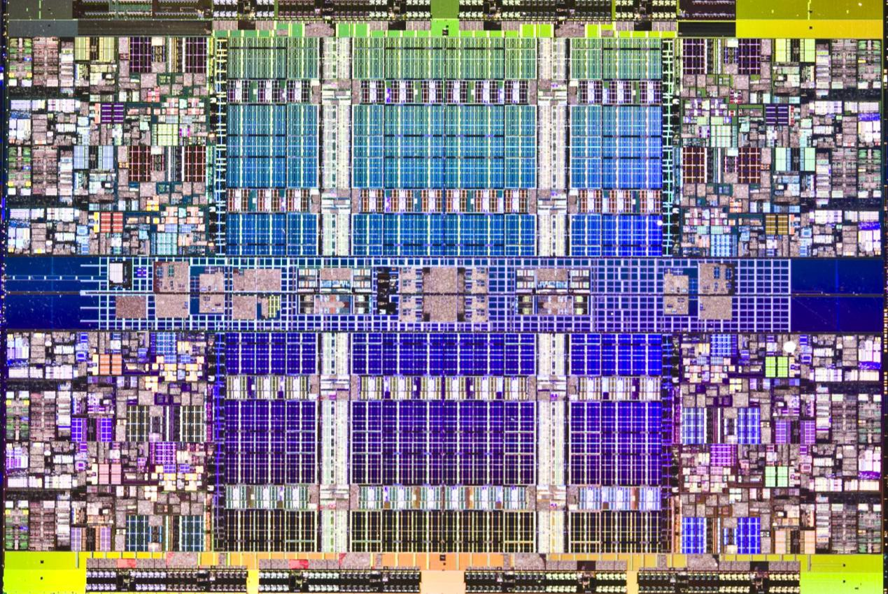
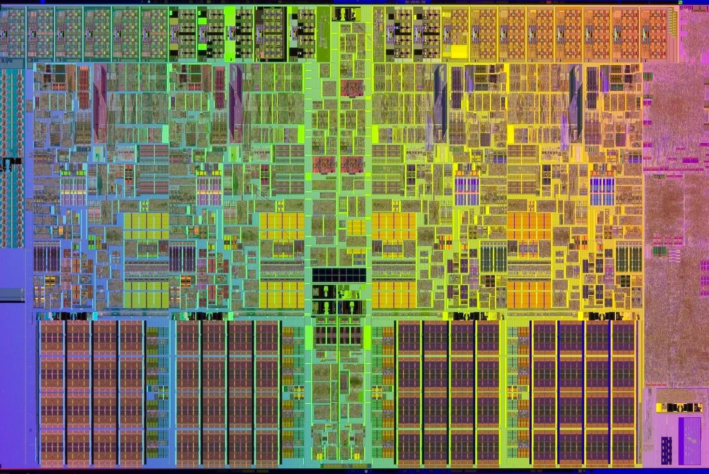
Which architecture is better?

Slide 6
Which architecture is better?
Key Question: What defines “good”?

Slide 7
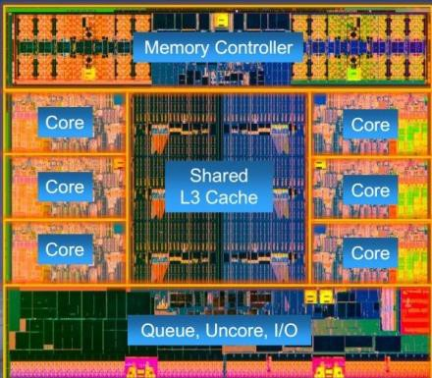
Intel Core i7-4960X
Area: 257 mm^2 22nm process tech. 3.6GHz
15mm
17.1mm

Slide 8
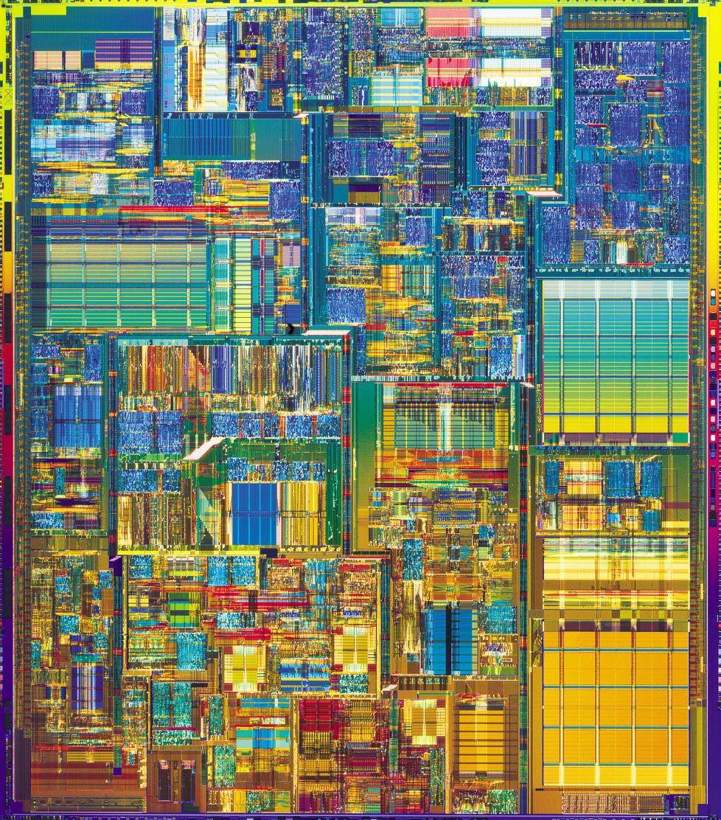
Intel Pentium 4
Area: 1225 mm^2 180nm process tech. 1.8GHz
35mm
35mm

Slide 9
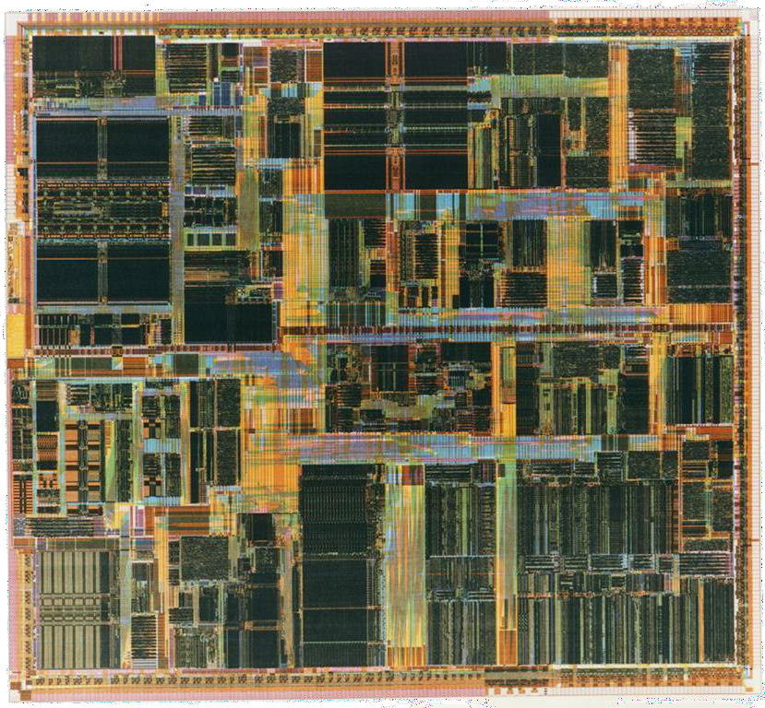
Intel Pentium Pro / Klamath Falls
Area: 194.8 mm^2 280nm process tech. 0.3GHz
14mm
14mm

Slide 10
Comparing Processor Designs
1225
Area
(mm^2)
257
194
257
194
Area: 194.8 mm²
280nm tech
0.3GHz
Area: 1225 mm²
180nm tech
1.8GHz
Area: 257 mm² 22nm process tech. 3.6GHz
What do we learn from this comparison?

Slide 11
Comparing Processor Designs
Process normalization example:
180nm / 22nm = ~8x
257
Process
Normalized Area (mm^2)
35mm / 8x = 4.375 // 1225 = 35*35
4.375 * 4.375 = 19.14 //half-square dim.
19.14
1.21
Area: 194.8 mm²
280nm tech
0.3GHz
Area: 1225 mm²
180nm tech
1.8GHz
Area: 257 mm² 22nm process tech. 3.6GHz
Now what do we learn? What did we change?

Slide 12
Comparing Processor Designs
Process normalization example:
180nm / 22nm = ~8x
257
Process
Normalized Area (mm^2)
35mm / 8x = 4.375
4.375 * 4.375 = 19.14 //half-square dim.
19.14
1.21
Area: 194.8 mm²
280nm tech
0.3GHz
Area: 1225 mm²
180nm tech
1.8GHz
Area: 257 mm² 22nm process tech. 3.6GHz
The metric you use should suit the comparison

Slide 13
Comparing Processor Designs
212.4x
Normalized
Process- Normalized Area (mm^2)
Normalize the results to the most logical
option in your data set
15.8x
Wow! 212.4x more complexity
than a Pentium Pro!
1.0x
7.5M Transistors 42M Transistors
1.9B Transistors
Area: 194.8 mm²
280nm tech
0.3GHz
Area: 1225 mm²
180nm tech
1.8GHz
Area: 257 mm² 22nm process tech. 3.6GHz
The relative value is most important in comparisons

Slide 14
There are lots of metrics to choose from
Performance:
  Run time or “latency” (seconds to get a result)
  Throughput (results per second)
  Instructions per Cycle (IPC) or Cycles per Instruction (CPI)
Energy:
  Total energy
  Power (avg. or peak) [we will come back to this one….]
  Area (absolute or normalized)
Efficiency:
  Performance per power (GigaOperations Per Second Per Watt: GOPS/W)
  Operations per Joule (1W = 1J/s, so multiply by J/s, then by 1s)
  Throughput per unit area (results per second per mm²)

Slide 15

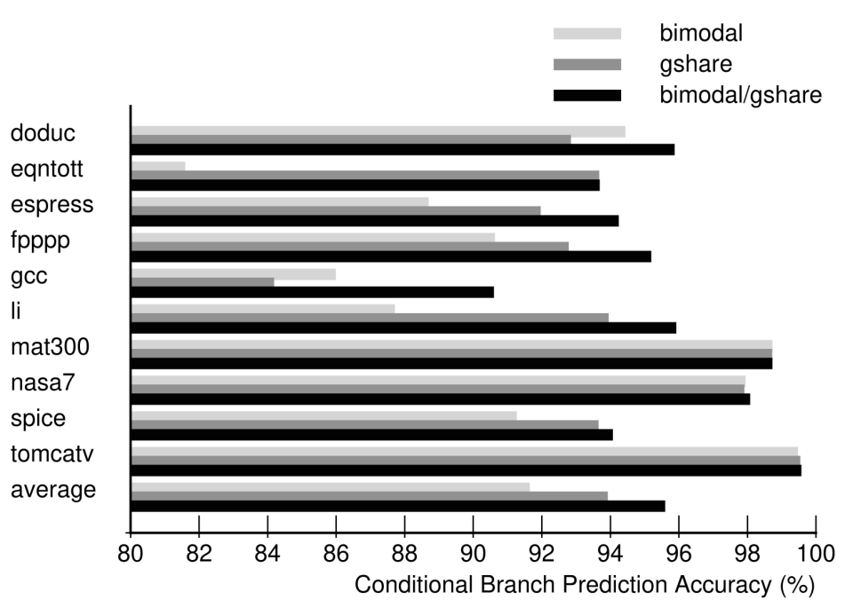
There are lots of metrics to choose from
Cache-specific:
  Cache Misses per Kilo-Instruction
  Cache Misses per Kilo-Memory-Instruction
  Cache Misses per Cache Access
  Average Memory Access Time
Control-specific:
  Branch prediction accuracy
  Branch Mispredictions per Kilo-Instruction
Memory-specific:
  Data throughput (GB/s)
  Memory Latency (seconds per random byte)

Slide 16

Measuring a System’s Performance
Get a system that you want to measure and clean it up and isolate it from everything else in the world
Find a workload that you can run on your system and
that will produce a meaningful result
Choose an appropriate baseline system to which to
compare your results to understand their relative merit

Slide 17
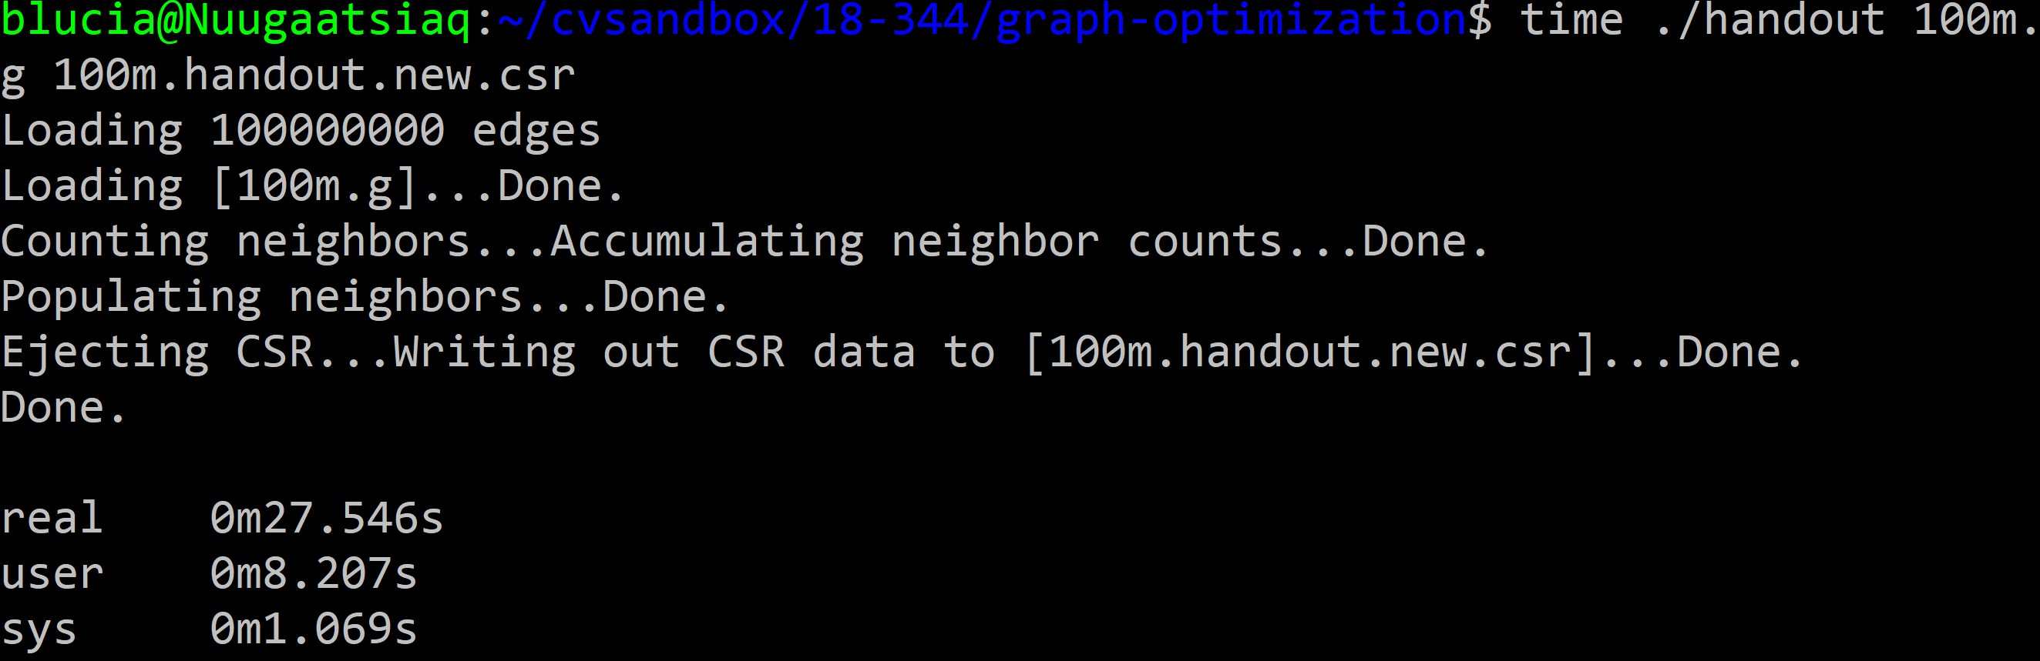
Measure your baseline…

Slide 18
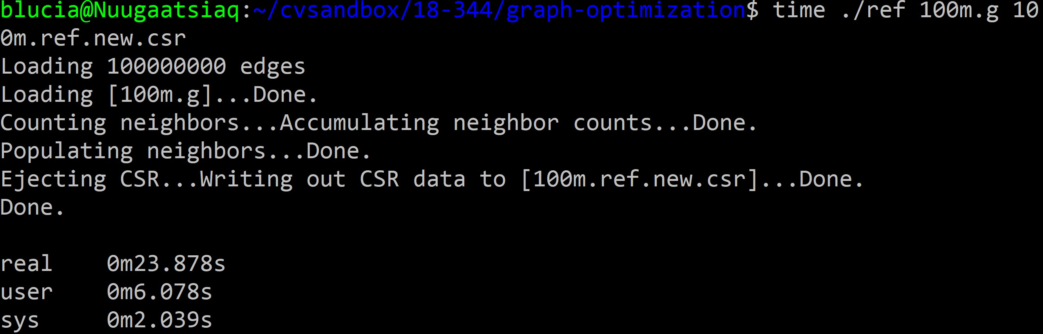
…measure your system…

Slide 19
…and compare the results
Normalized Run Time
Run Time (s)
8.2s
1.0x
Speedup
1.36x
6.0s
0.74x
1.0x
baseline ref baseline ref ref baseline
These are equivalent results, with different presentations

Slide 20
Choosing your measurement workload
The “Benchmark Problem”

Slide 21

What are we looking for in a benchmark program?
Representative of typical workloads for system
Runs long enough to measure precisely
Runs in reasonable time for repeated trials
Runs with deterministic metric values
Runs w/ no excessively large inputs or I/O
Runs with no human intervention

Slide 22

Benchmark Suites
The Standard Performance Evaluation Corporation
Founded 1988 by workstation computer manufacturers
Goal: eliminate hype misinformation, replace hype with hard data,
eliminate “apples-to-oranges” comparison of computer systems
Methodology: provide standardized suite of source code that a benchmarker (a human) can compile for their system, tune for best results, and run for an official benchmark performance score comparable to others.
Updates benchmark suite periodically to keep it in line with the market, i.e. the workloads driving the sales.

Slide 23
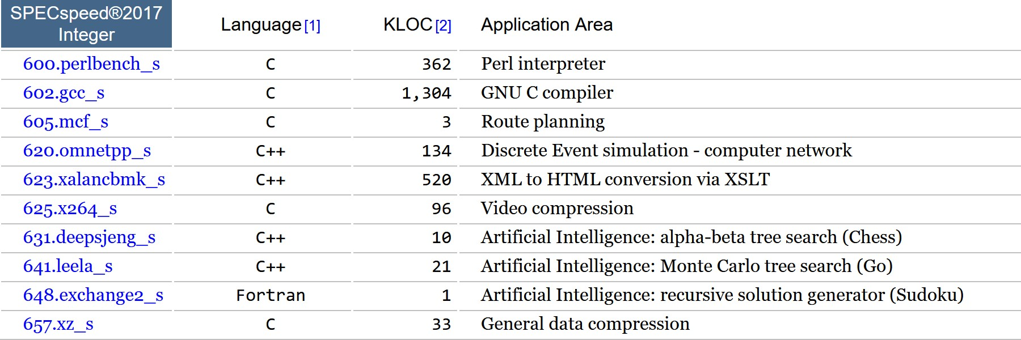
What are these benchmark programs?

Slide 24
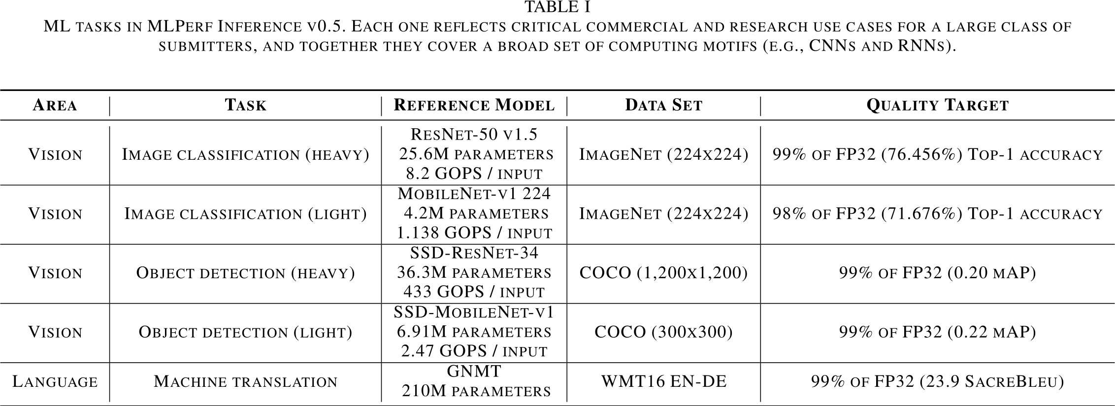
MLPerf (“MLCommons”) Benchmarks

Slide 25
What are these benchmark programs?

Slide 26
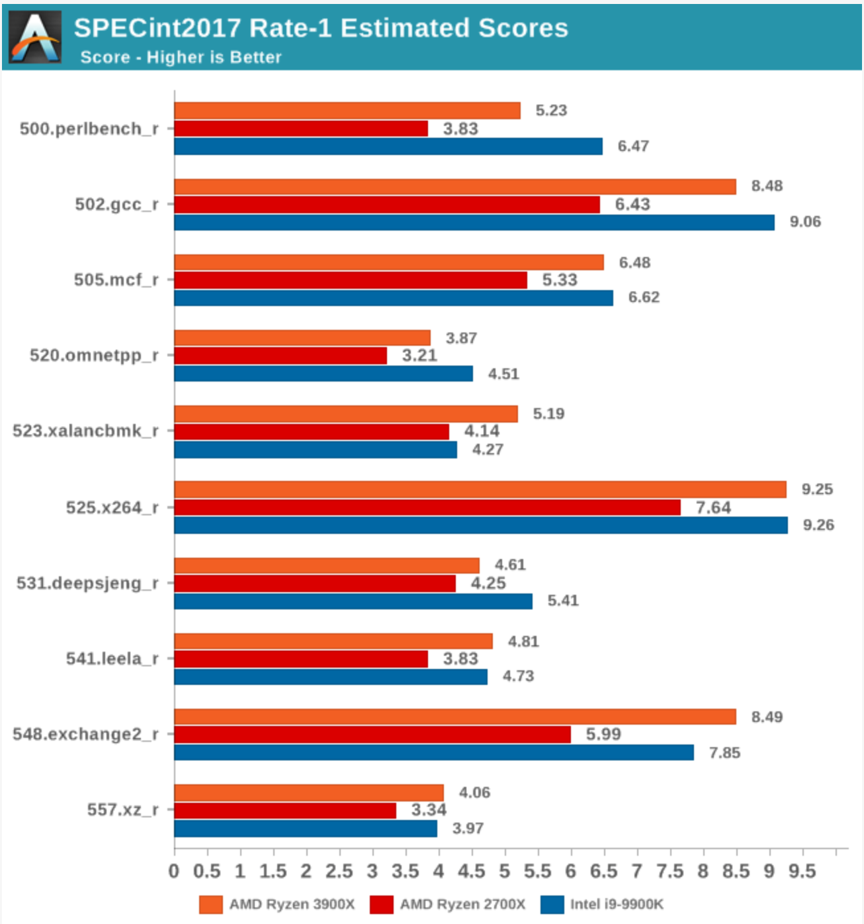
Allows us to compare different machines?
What is this axis showing?

Slide 27
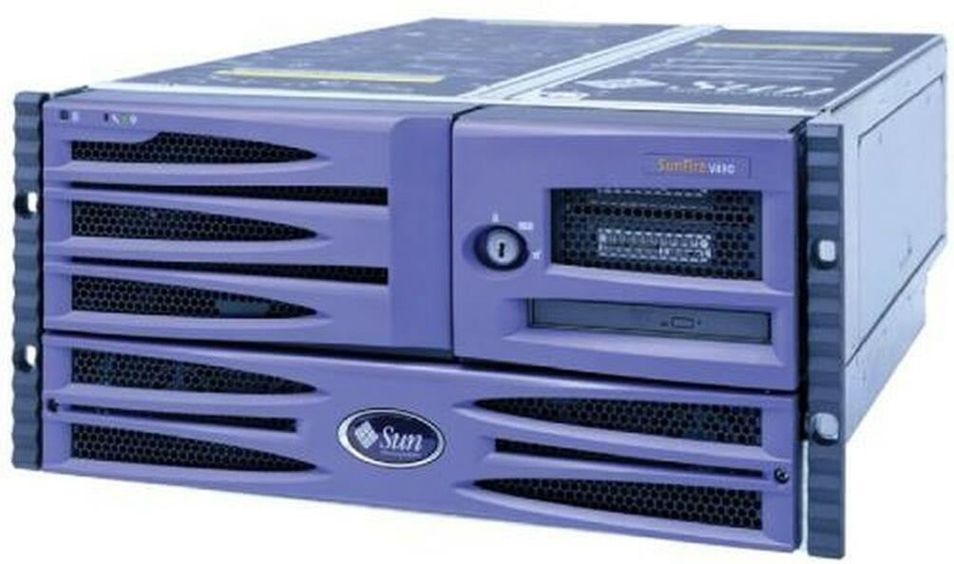
SPEC Baselines to a Reference Machine
Oracle Sun Fire V490
Competitive 2000s-era server
4-Socket UltraSPARC IV architecture 64GB Max Memory Capacity
Last shipped April 2009
For SPEC2017, this machine represents 1.0 SPECMarks Why compare to some random machine from 2001?

Slide 28
Allows us to compare arbitrary machines!
SPECMarks: Normalized throughput relative to Sun Fire V490
Oracle Sun Fire V490
Competitive 2000s-era server
4

Slide 29
The SPEC Reference Machine Challenge
A current competitor won’t fly
  It is an industry benchmark.
  Do you want your machine to be the slow 1.0?
  Do you want everyone talking about a competitor’s product as if it is the current gold standard
An unfamiliar machine is an unintuitive metric
An imaginary machine is worse
An older machine may be poorly suited for current workloads
  It isn’t just ops/sec.
  Consider a modern large working set workload run on an older machine with a smaller cache. How does one compare?
A recent “venerable workhorse” may be the best option

Slide 30
A Few Other Presently Relevant Benchmarks
Cloudsuite
  Data center works (may be a little less relevant than a few years ago)
MLPerf
  Cloud-based training and inference performance
GAP Code (Berkeley)
  Data center works (may be a little less relevant than a few years ago)
It is sometimes appropriate to propose a new benchmark tuned to emerging concerns, but results are typically also reported for well-accepted benchmark(s) until the research community understands the proposed benchmark, observes a critical mass of research data based upon it, and accepts its relevance.

Slide 31
Lies, Damned Lies, and Statistics (Twain/Diraeli)
Comparing to the wrong thing can make anything look good
  Comparing an improvement of a feature to the absence of a feature, e.g. a new branch predictor to none at all vs comparing it to a well-accepted best-of-class
Comparing in a nonsensical environment can make anything look good
  Workload too large for cache on reference machine
  Comparing single core to multicore and letting bus traffic interfere
Choosing a benchmark not relevant to the audience or problem
  E.g., just a SPEC benchmark, when the use case is a novel workload for which the chosen benchmark, though well accepted for other purposes, is not relevant.
Managing the data
  Cherry-picking runs (when there is environmental interference)
  Not excluding outliers (when there is environmental interference)
  Averaging or otherwise summarizing inappropriately

Slide 32
Practical Normalized Performance Measurement
Userspace Run Time (s)
8.2s
6.0s
Choose appropriate baseline system
  Not going to use Oracle Sun Fire V490 unless you’re
submitting to SPEC
Select a highly optimized baseline
  Avoid “Straw Man” comparisons
Select a comparable baseline
  Avoid “apples-to-oranges” comparisons
baseline
ref
Speedup
1.36x
1.0x
ref
baseline

Slide 33
Single Number Performance Summaries
What is the meaning of this bar over here?
Speedup
perlbench
gcc
mcf
omnetpp
xalan
x264
deepsjeng
leela
SPEC2017
Average

Slide 34


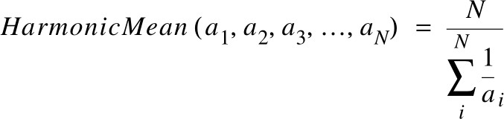
On Computing Averages: Options

Slide 35
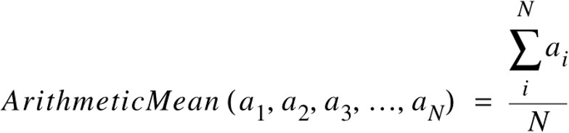
Amean – Good for averaging times
Averages all data points equally. Sums them up and divides by number of fata points
Good for times.

Slide 36
Geometric Mean – good for speedups
Program 1: 0.5x speedup Program 2: 2.0x speedup
Average speedup: 1.0 (one is half as fast, one is twice as fast)
Amean(0.5,2.0) = (0.5+2.0) / 2 = 2.5 / 2 = 1.25x
Gmean(0.5,2.0) = sqrt(0.5 * 2.0) = Sqrt(1.0) = 1.0
See the problem?

Slide 37

Harmonic Mean – Good for rates
F() has N instructions
N instructions at 60GOPS
N same instructions at 20GOPS
Total time = N/60 + N/20 = N/15; N=60 -> 4s.
Amean: (60GOPS + 20 GOPS) / 2 = 40GOPS
Total time using Amean: 2N / 40; N = 60 -> 120/40 = 3s (incorrect)
Hmean: Avg GOPS = Total Instructions / Sum of per-call times =
2N / (N/60 + N/20) = 2 / (1/60 + 1/20) = 2 / (1 / 15) = 30 GOPS
Total time using Hmean: 2N / 30; N = 60 -> 120/30 = 4s (correct)

Slide 38
The problem with single-number performance summaries by example
12s
600s
Benchmark #1 Userspace
Run Time (s)
Benchmark #2 Userspace
Run Time (s)
3s
300s
baseline
ref
baseline
ref

Slide 39
Thinking in ratios
12s
600s
Benchmark #1 Userspace
Run Time (s)
Benchmark #2 Userspace
Run Time (s)
3s
300s
baseline ref
Speedup = 12s / 3s = 4x
baseline ref
Speedup = 600s / 300s = 2x
Unweighted Average Speedup (gmean of speedups) = sqrt(4x * 2x) = 2.82x (No benchmark is more important or prevalent than any other in the wild despite differences in time during tests – unweighted average.)
Time-weighted Average Speedup (amean of times) = 612s / 303s = 2.02x (Runtime of each test indicates its
prevalence/importance in the wild. Tests that run longer count for more – weighted average. This only makes sense if workloads balance out in this proportion in the wild. Otherwise can weight by prevalence, etc. )

Slide 40
Isolating your measurement environment

Slide 41
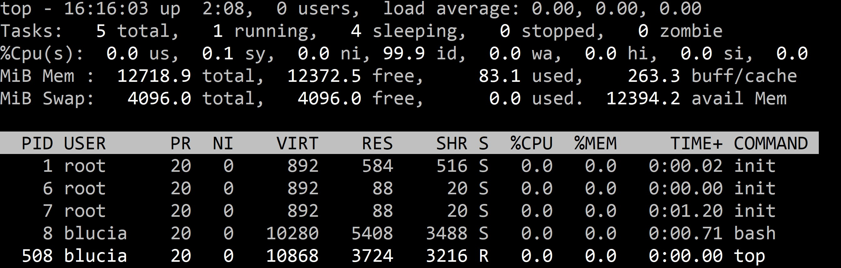
Isolating your measurement environment
First check the basics (like no one is gamin’ on the rig)

Slide 42
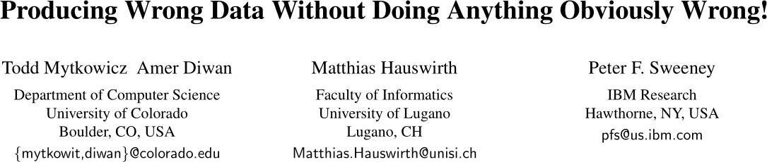
Unintuitive Sources of Performance Interference

Slide 43
blucia@Nuugaatsiaq:~$ env SHELL=/bin/bash
PINPATH=/home/blucia/cvsandbox/pin/pin-3.18-98332-gaebd7b1e6-gcc-linux
WSL_DISTRO_NAME=Ubuntu-20.04
NAME=Nuugaatsiaq PWD=/home/blucia LOGNAME=blucia MOTD_SHOWN=update-motd HOME=/home/blucia LANG=C.UTF-8
WSL_INTEROP=/run/WSL/632_interop
LS_COLORS=rs=0:di=01;34:ln=01;36:mh=00:pi=40;33:so=01;35:do=01;35:bd=40;33;01:cd=40;33;01:or=40;31;01:mi=00:su=37;41:sg=30;43:ca=30;41:tw=30;42:ow=34;42:st=3
7;44:ex=01;32:*.tar=01;31:*.tgz=01;31:*.arc=01;31:*.arj=01;31:*.taz=01;31:*.lha=01;31:*.lz4=01;31:*.lzh=01;31:*.lzma=01;31:*.tlz=01;31:*.txz=01;31:*.tzo=01;3
1:*.t7z=01;31:*.zip=01;31:*.z=01;31:*.dz=01;31:*.gz=01;31:*.lrz=01;31:*.lz=01;31:*.lzo=01;31:*.xz=01;31:*.zst=01;31:*.tzst=01;31:*.bz2=01;31:*.bz=01;31:*.tbz
=01;31:*.tbz2=01;31:*.tz=01;31:*.deb=01;31:*.rpm=01;31:*.jar=01;31:*.war=01;31:*.ear=01;31:*.sar=01;31:*.rar=01;31:*.alz=01;31:*.ace=01;31:*.zoo=01;31:*.cpio
=01;31:*.7z=01;31:*.rz=01;31:*.cab=01;31:*.wim=01;31:*.swm=01;31:*.dwm=01;31:*.esd=01;31:*.jpg=01;35:*.jpeg=01;35:*.mjpg=01;35:*.mjpeg=01;35:*.gif=01;35:*.bm p=01;35:*.pbm=01;35:*.pgm=01;35:*.ppm=01;35:*.tga=01;35:*.xbm=01;35:*.xpm=01;35:*.tif=01;35:*.tiff=01;35:*.png=01;35:*.svg=01;35:*.svgz=01;35:*.mng=01;35:*.p cx=01;35:*.mov=01;35:*.mpg=01;35:*.mpeg=01;35:*.m2v=01;35:*.mkv=01;35:*.webm=01;35:*.ogm=01;35:*.mp4=01;35:*.m4v=01;35:*.mp4v=01;35:*.vob=01;35:*.qt=01;35:*. nuv=01;35:*.wmv=01;35:*.asf=01;35:*.rm=01;35:*.rmvb=01;35:*.flc=01;35:*.avi=01;35:*.fli=01;35:*.flv=01;35:*.gl=01;35:*.dl=01;35:*.xcf=01;35:*.xwd=01;35:*.yuv
=01;35:*.cgm=01;35:*.emf=01;35:*.ogv=01;35:*.ogx=01;35:*.aac=00;36:*.au=00;36:*.flac=00;36:*.m4a=00;36:*.mid=00;36:*.midi=00;36:*.mka=00;36:*.mp3=00;36:*.mpc
=00;36:*.ogg=00;36:*.ra=00;36:*.wav=00;36:*.oga=00;36:*.opus=00;36:*.spx=00;36:*.xspf=00;36: PIN_ROOT=/home/blucia/cvsandbox/pin/pin-3.18-98332-gaebd7b1e6-gcc-linux PIN_HOME=/home/blucia/cvsandbox/pin/pin-3.18-98332-gaebd7b1e6-gcc-linux LESSCLOSE=/usr/bin/lesspipe %s %s
TERM=xterm-256color
LESSOPEN=| /usr/bin/lesspipe %s USER=blucia DISPLAY=172.17.80.1:0
SHLVL=1 WSLENV=
XDG_DATA_DIRS=/usr/local/share:/usr/share:/var/lib/snapd/desktop PROJECT_ROOT=/home/blucia/cvsandbox/panic PATH=/home/blucia/.local/bin:/home/blucia/cvsandbox/pin/pin-3.18-98332-gaebd7b1e6-gcc-
linux:/home/blucia/.local/bin/:/usr/local/sbin:/usr/local/bin:/usr/sbin:/usr/bin:/sbin:/bin:/usr/games:/usr/local/games:/mnt/c/Program Files/WindowsApps/CanonicalGroupLimited.Ubuntu20.04onWindows_2004.2021.610.0_x64 79rhkp1fndgsc:/mnt/c/WINDOWS/system32:/mnt/c/WINDOWS:/mnt/c/WINDOWS/System3 2/Wbem:/mnt/c/WINDOWS/System32/WindowsPowerShell/v1.0/:/mnt/c/WINDOWS/System32/OpenSSH/:/mnt/c/Program Files (x86)/PDFtk Server/bin/:/mnt/c/Program Files/MIT/Kerberos/bin:/mnt/c/Program Files/OpenAFS/Common:/mnt/c/Program Files/OpenAFS/Client/Program:/mnt/c/Users/bluci/AppData/Local/Microsoft/WindowsApps:/snap/bin
HOSTTYPE=x86_64
RISCV=/home/blucia/cvsandbox/panic-riscv-tools/riscv-tools
_=/usr/bin/env blucia@Nuugaatsiaq:~$

Slide 44
blucia@Nuugaatsiaq:~$ env SHELL=/bin/bash
PINPATH=/home/blucia/cvsandbox/pin/pin-3.18-98332-gaebd7b1e6-gcc-linux
WSL_DISTRO_NAME=Ubuntu-20.04
NAME=Nuugaatsiaq PWD=/home/blucia LOGNAME=blucia MOTD_SHOWN=update-motd HOME=/home/blucia LANG=C.UTF-8
WSL_INTEROP=/run/WSL/632_interop
LS_COLORS=rs=0:di=01;34:ln=01;36:mh=00:pi=40;33:so=01;35:do=01;35:bd=40;33;01:cd=40;33;01:or=40;31;01:mi=00:su=37;41:sg=30;43:ca=30;41:tw=30;42:ow=34;42:st=3
7;44:ex=01;32:*.tar=01;31:*.tgz=01;31:*.arc=01;31:*.arj=01;31:*.taz=01;31:*.lha=01;31:*.lz4=01;31:*.lzh=01;31:*.lzma=01;31:*.tlz=01;31:*.txz=01;31:*.tzo=01;3
1:*.t7z=01;31:*.zip=01;31:*.z=01;31:*.dz=01;31:*.gz=01;31:*.lrz=01;31:*.lz=01;31:*.lzo=01;31:*.xz=01;31:*.zst=01;31:*.tzst=01;31:*.bz2=01;31:*.bz=01;31:*.tbz
=01;31:*.tbz2=01;31:*.tz=01;31:*.deb=01;31:*.rpm=01;31:*.jar=01;31:*.war=01;31:*.ear=01;31:*.sar=01;31:*.rar=01;31:*.alz=01;31:*.ace=01;31:*.zoo=01;31:*.cpio
=01;31:*.7z=01;31:*.r .gif=01;35:*.bm
int execvpe(const char *file, char *const argv[], char *const envp[]);
p=01;35:*.pbm=01;35:
z=01;31:*.cab=01;31:*.wim=01;31:*.swm=01;31:*.dwm=01;31:*.esd=01;31:*.jpg=01;35:*.jpeg=01;35:*.mjpg=01;35:*.mjpeg=01;35:*
*.pgm=01;35:*.ppm=01;35:*.tga=01;35:*.xbm=01;35:*.xpm=01;35:*.tif=01;35:*.tiff=01;35:*.png=01;35:*.svg=01;35:*.svgz=01;35:
*.mng=01;35:*.p
cx=01;35:*.mov=01;35:*.mpg=01;35:*.mpeg=01;35:*.m2v=01;35:*.mkv=01;35:*.webm=01;35:*.ogm=01;35:*.mp4=01;35:*.m4v=01;35:*.mp4v=01;35:*.vob=01;35:*.qt=01;35:*. nuv=01;35:*.wmv=01;35:*.asf=01;35:*.rm=01;35:*.rmvb=01;35:*.flc=01;35:*.avi=01;35:*.fli=01;35:*.flv=01;35:*.gl=01;35:*.dl=01;35:*.xcf=01;35:*.xwd=01;35:*.yuv
=01;35:*.cgm=01;35:*.emf=01;35:*.ogv=01;35:*.ogx=01;35:*.aac=00;36:*.au=00;36:*.flac=00;36:*.m4a=00;36:*.mid=00;36:*.midi=00;36:*.mka=00;36:*.mp3=00;36:*.mpc
=00;36:*.ogg=00;36:*.ra=00;36:*.wav=00;36:*.oga=00;36:*.opus=00;36:*.spx=00;36:*.xspf=00;36: PIN_ROOT=/home/blucia/cvsandbox/pin/pin-3.18-98332-gaebd7b1e6-gcc-linux PIN_HOME=/home/blucia/cvsandbox/pin/pin-3.18-98332-gaebd7b1e6-gcc-linux LESSCLOSE=/usr/bin/lesspipe %s %s
TERM=xterm-256color
^{LESSOPEN=| /usr/bin/l} Every process includes an environment that takes up some memory in its address space
USER=blucia
esspipe %s
DISPLAY=172.17.80.1:0
SHLVL=1 WSLENV=
XDG_DATA_DIRS=/usr/local/share:/usr/share:/var/lib/snapd/desktop PROJECT_ROOT=/home/blucia/cvsandbox/panic PATH=/home/blucia/.local/bin:/home/blucia/cvsandbox/pin/pin-3.18-98332-gaebd7b1e6-gcc-
linux:/home/blucia/.local/bin/:/usr/local/sbin:/usr/local/bin:/usr/sbin:/usr/bin:/sbin:/bin:/usr/games:/usr/local/games:/mnt/c/Program Files/WindowsApps/CanonicalGroupLimited.Ubuntu20.04onWindows_2004.2021.610.0_x64 79rhkp1fndgsc:/mnt/c/WINDOWS/system32:/mnt/c/WINDOWS:/mnt/c/WINDOWS/System3 2/Wbem:/mnt/c/WINDOWS/System32/WindowsPowerShell/v1.0/:/mnt/c/WINDOWS/System32/OpenSSH/:/mnt/c/Program Files (x86)/PDFtk Server/bin/:/mnt/c/Program Files/MIT/Kerberos/bin:/mnt/c/Program Files/OpenAFS/Common:/mnt/c/Program Files/OpenAFS/Client/Program:/mnt/c/Users/bluci/AppData/Local/Microsoft/WindowsApps:/snap/bin
HOSTTYPE=x86_64
RISCV=/home/blucia/cvsandbox/panic-riscv-tools/riscv-tools
_=/usr/bin/env blucia@Nuugaatsiaq:~$

Slide 45
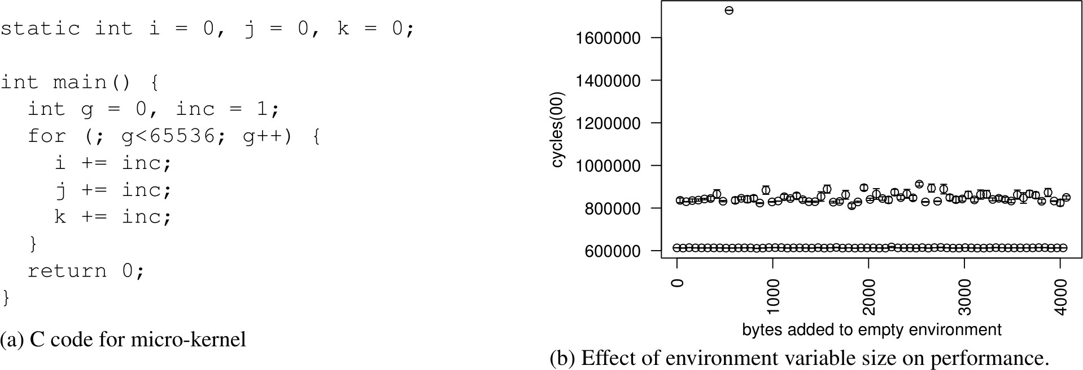
The size of your Unix environment can bias your measurements!
(It can change alignment of data on the stack, changing cache conflicts, etc.)

Slide 46
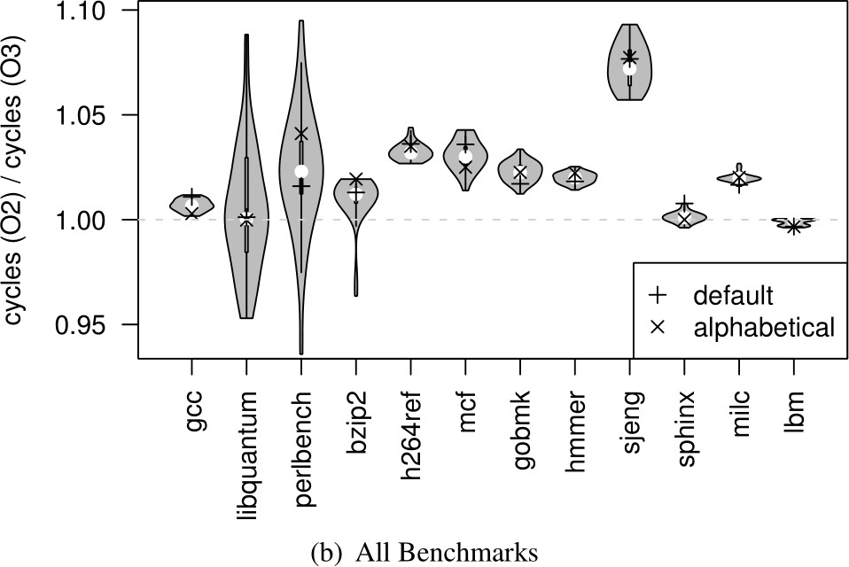
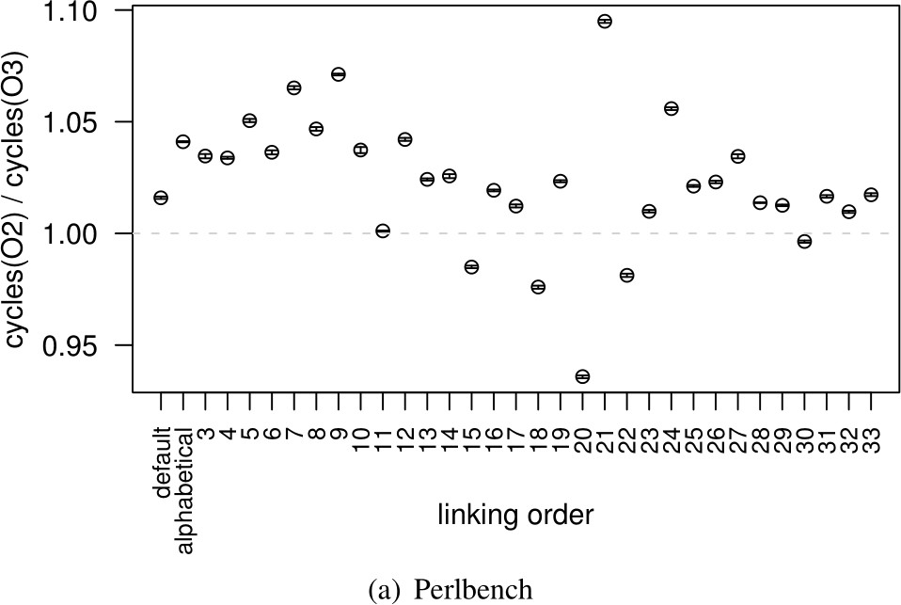
The order in which you link libraries affects optimizability (O2 vs. O3)
(Changing locations changes alignment w.r.t. cache conflicts, as very nuanced things such as branch prediction, alignment within buffers/queues, etc.)

Slide 47
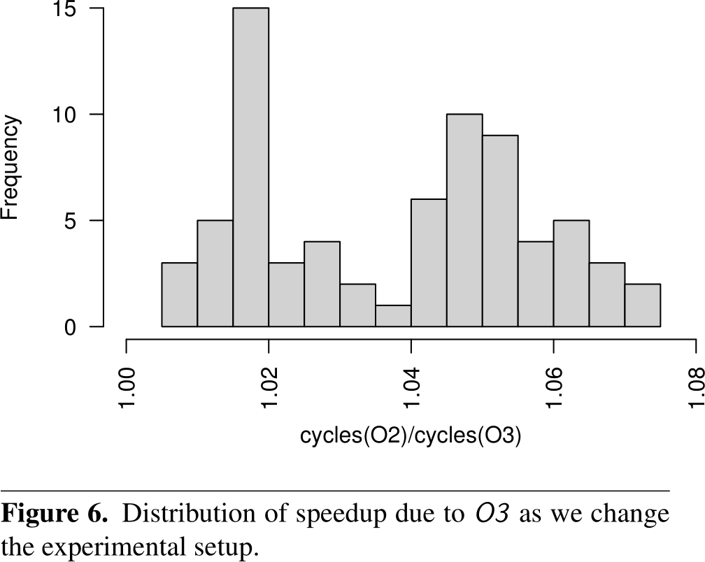
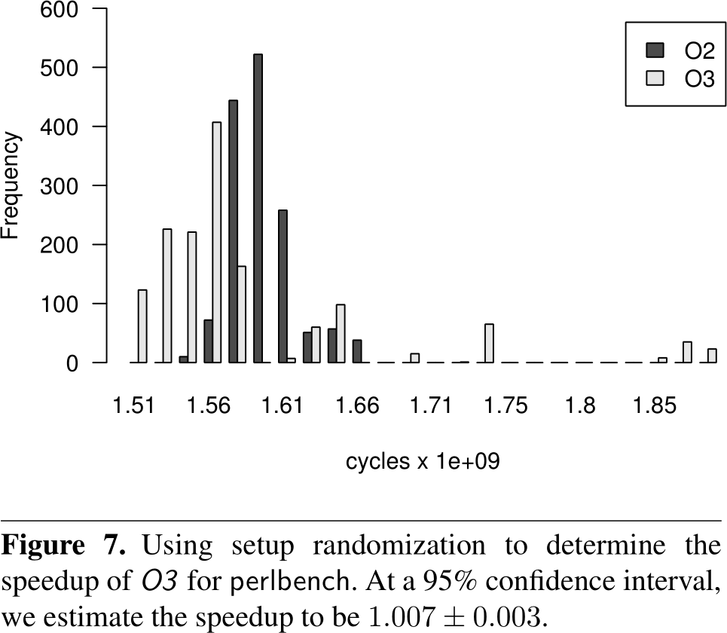
Measurement bias effects may exceed the scale of actual effects
Setup randomization: Semi-systematic randomization of address layout, environment, and other factors

Slide 48
It may be impossible to entirely isolate
Real world benchmarking is most relevant to the real world
It is also most subject to environmental interference
One can’t eliminate every aspect of environment, e.g. OS activity
It may be that the best one can do is to clean up as much as possible and then exclude outliers.
Even comparing only user time ignores the impact of side-effects

Slide 49
What did we just learn?
Performance Evaluation
  What does it mean to evaluate a system?
  How to compare two systems?
  How to do a performance experiment?
  Measurement pitfalls & metrics
  Single-number performance summaries
  Averages
  Measurement bias sources

Slide 50
What to think about next?
Performance Evaluation (next time)
  Design spaces, Pareto Frontiers, and design space exploration
Miscellaneous (micro)architectural tricks & optimizations (future)
  Vector processors, SIMD/SIMT, dataflow

