Slide 1
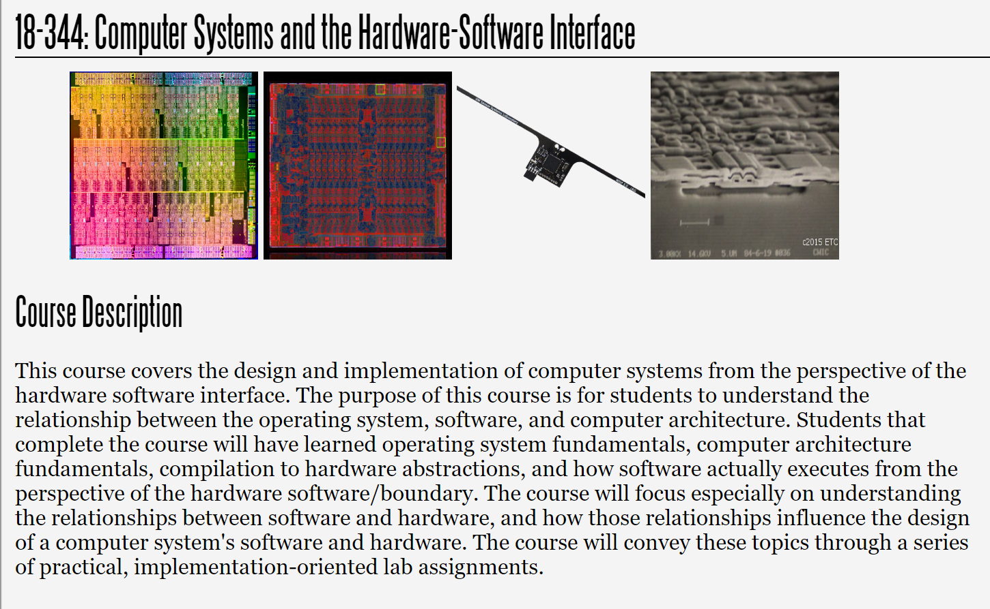
Fall 2023
Lecture 20: On-Chip Interconnect
Credit: Lightly updated from Phillip Gibbons and Omar Multu, 15-740-F18

Slide 2
On-chip Interconnect

Slide 3
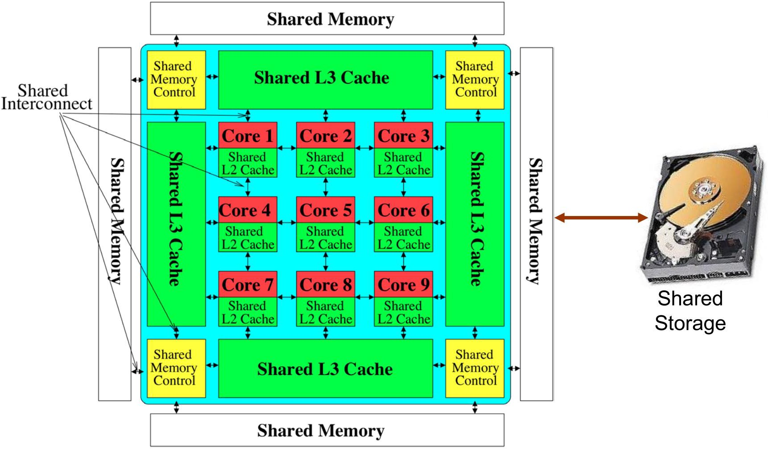
On-chip interconnect in a multicore

Slide 4
Where is interconnect used?
To connect components
Processor-to-processor Processor-to-cache Cache-to-cache
Cache-to-memory I/O-to-memory Etc.

Slide 5
Why is interconnect important?
Affects scalability of the system
How large a system can you build?
How easily can you add more processors/caches?
Affects performance & energy efficiency
How fast can processors, caches, memories communicate? (longer than cache access)
How much energy is spent on communication? (10-35%)

Slide 6
Interconnect basics
Topology
How switches are wired to each other
Affects routing, reliability, throughput, latency, cost
Routing (algorithm)
How does a message get from source to destination?
Static vs adaptive
Buffering and flow control
What do we store within the network? (Packets, headers, …?)
How do we throttle when oversubscribed?
Tightly coupled with routing

Slide 7
Interconnect topologies
Bus (simplest)
Point-to-point (ideal and most costly)
Crossbar (less costly)
Ring Mesh Tree Omega
Hypercube Torus Butterfly
…

Slide 8
Interconnect metrics
Cost (area)
Latency (hops, cycles, nanoseconds) Contention
Energy
Bandwidth (“bisection” b/w)
End-to-end system performance

Slide 9
Bus
+ Simple
+ Cost-effective for small number of nodes
+ Easy to implement coherence (global broadcast)
Poor scalability (electrical limitations)
High contention
Core
Core
Core
Core
LLC
LLC
LLC
LLC

Slide 10
Point-to-point
Every node connected directly to every other
+ Lowest contention
+ Lowest latency (maybe—wire length, wasted area)
+ Ideal except for cost
Highest cost
  𝑂(𝑁²) links
Not scalable
Physical layout??
Core
Core
Core
Core
LLC
LLC
LLC
LLC

Slide 11
Crossbar
Every node connected to every other, but only one at a time Concurrent communication to different destinations
Good with few nodes
+ Low latency & high throughput
Expensive
Doesn’t scale -- 𝑂 𝑁² switches
Difficult to arbitrate with many nodes
Used in many designs (e.g., Sun UltraSPARC T1)

Slide 12
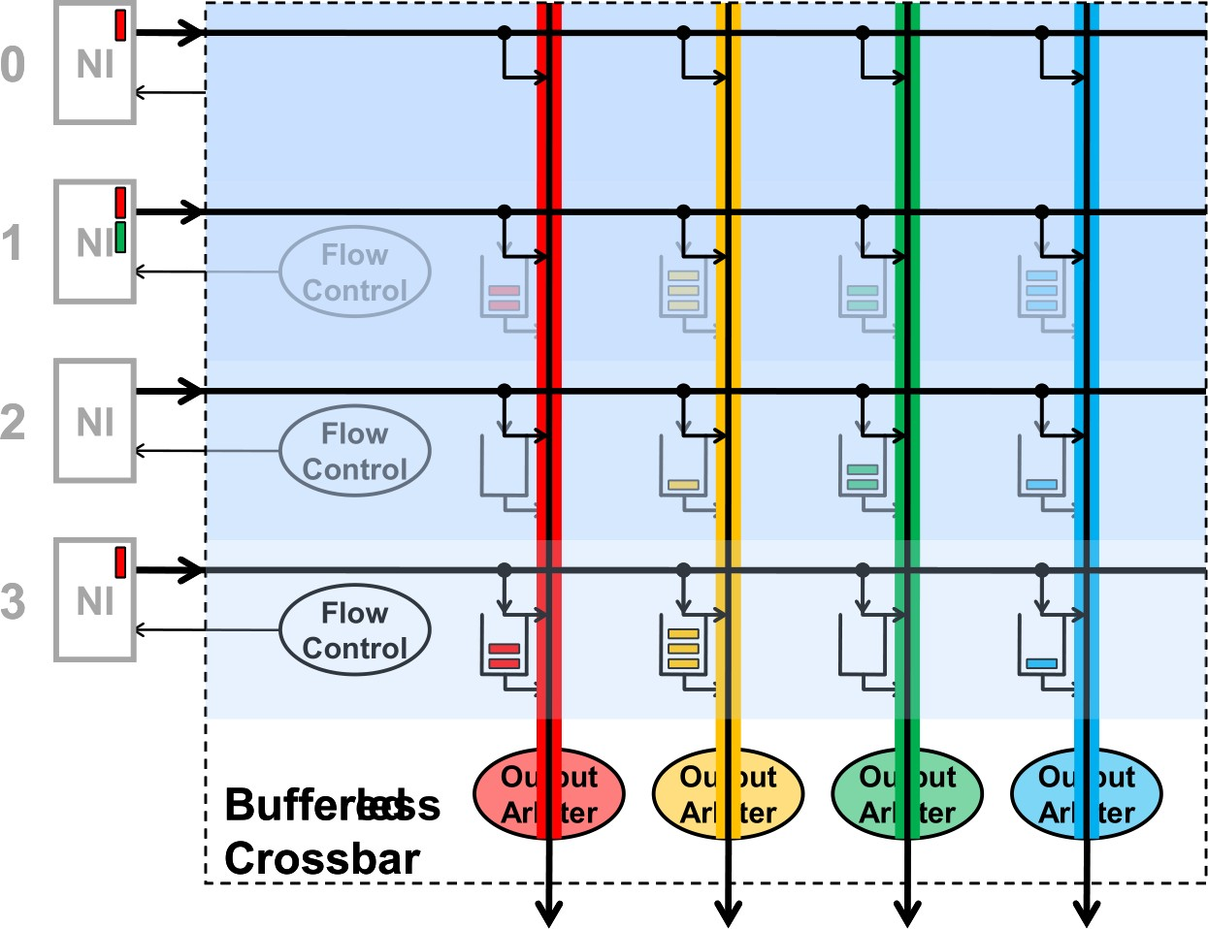
Buffered crossbar
+ Simpler arbitration & scheduling
+ Efficient support for variable sized packets
- Requires 𝑂(𝑁²) buffers
Can we scale the interconnect without contention?

Slide 13
Multistage networks
Idea: log 𝑁 switches between nodes
+ Cost 𝑂 𝑁 log 𝑁
Many variations (Omega, Butterfly, Benes, Banyan, …)
Each switch is a 2x2 crossbar
000
001
010
011
100
101
110
111
000
001
010
011
100
101
110
111
CONTENTION!

Slide 14
Handling contention
Two packets try to use same link at the same time
What do you do?
Buffer one
Drop one
Misroute one (deflection)
Let’s assume buffering for now
Core
Core
Core
Core
LLC
LLC
LLC
LLC

Slide 15
Ring
Unidirectional or bidirectional
+ Cheap 𝑂(𝑁) switches
+ Simple switches ➔ Low hop latency
High latency 𝑂(𝑁)
Not scalable; bisection bandwidth is constant
Used in many commercial systems today;
recently Intel switched to “ring of rings”
topology
Core
Core
Core
Core
LLC
LLC
LLC
LLC
Core
Core
Core
Core
LLC
LLC
LLC
LLC

Slide 16
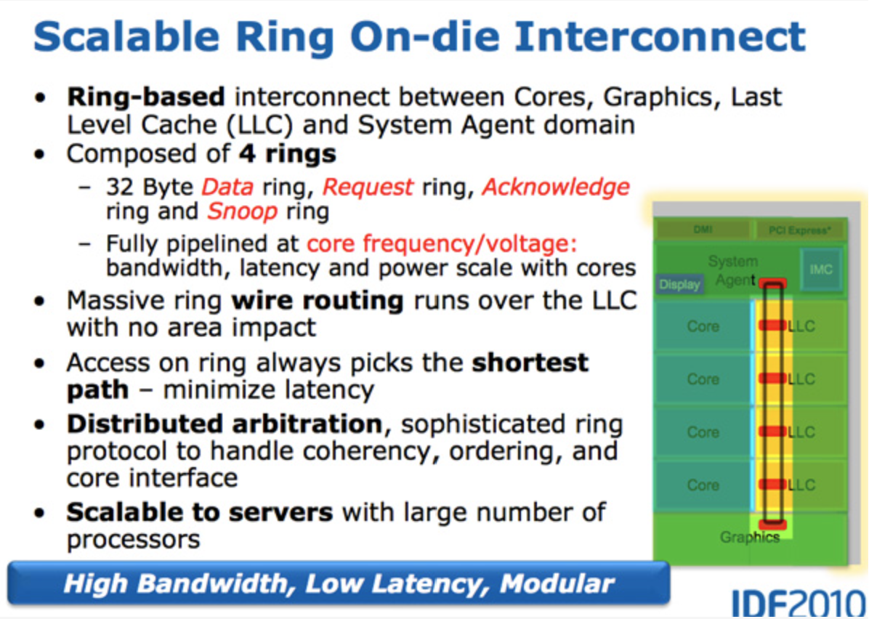
Credit: https://www.anandtech.com/show/3922/intels-sandy-bridge-architecture-exposed/4

Slide 17
2D Mesh
+ 𝑂(𝑁) cost
+ 𝑂( 𝑁) average latency
+ Natural physical layout
+ Path diversity: Many routes between most sources & destinations
Potentially lower contention
+ Decent bisection bandwidth
- More complex routers ➔ Higher hop latency
Used in Tilera 100-core chip & most research prototypes

Slide 18
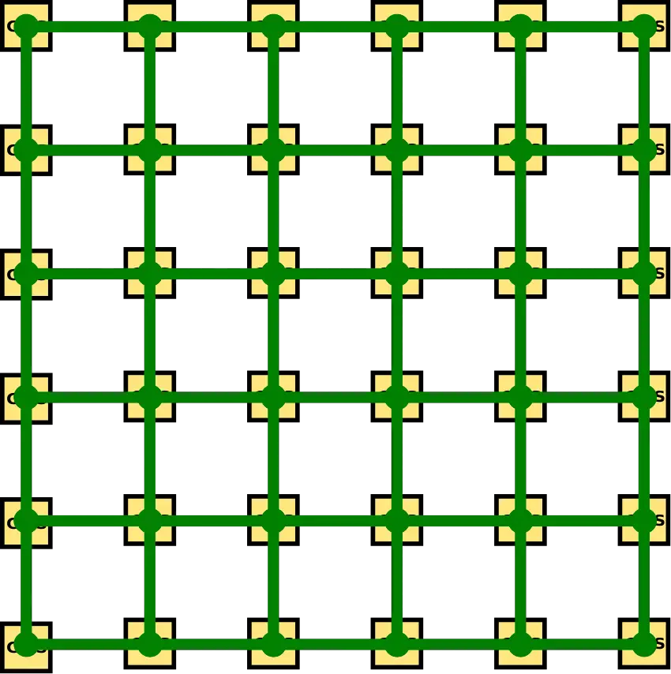
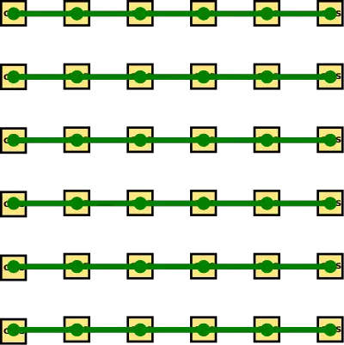
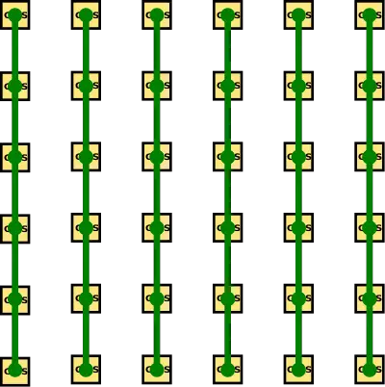
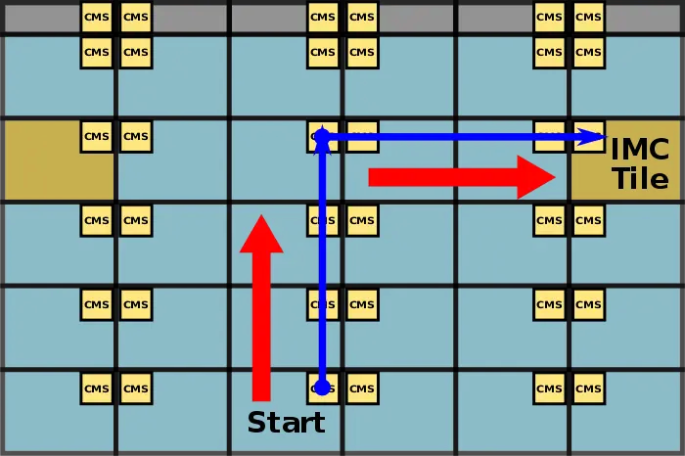
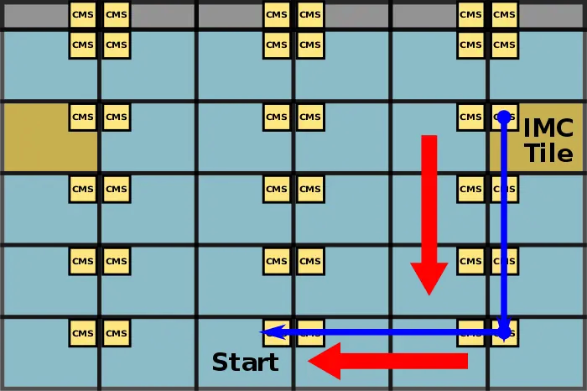
Intel Xeon Phi / Skylake Server
Vertical and horizontal half rings
Route first vertically, then horizontally
Return path may be different
Credit: https://en.wikichip.org/wiki/intel/mesh_interconnect_architecture

Slide 19
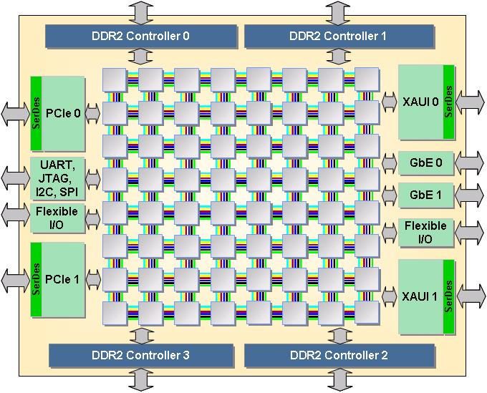
Tilera Pro Mesh Interconnect
Credit: https://en.wikipedia.org/wiki/TILEPro64

Slide 20
Trees
Planar, hierarchical topology
+ 𝑂(log 𝑁) latency
+ 𝑂(𝑁) cost
+ Easy to layout
Root is bottleneck; constant bisection bandwidth
Trees common for local communication; e.g., banks of single cache
Bisection bandwidth mitigated by “fat trees”, at add’l cost
  Idea: Make bandwidth at the top “fatter”
  Idea: Replicate root node, randomize routing (Used in Thinking Machines CM-5 circa 1991)

Slide 21
Flow control methods
Circuit switching
Packet switching
Store and forward
Virtual cut-through
Wormhole

Slide 22
Circuit switching
Pre-allocate resources across multiple switches
Requires “probe” ahead of message
+ No need for buffering
+ No contention (after circuit established)
+ Handles arbitrary message sizes
Low link utilization
Delay to set up circuit

Slide 23
Store and forward
Copy entire packet between switches
+ Simple
High per-packet latency
Requires big buffers / small messages

Slide 24
Virtual cut-through
Start forwarding as soon as header is received
+ Dramatic reduction in latency vs store and forward
- Still buffers entire message in worst case: requires large buffers / small messages

Slide 25
Wormhole
Break packets into much smaller “flits”
Pipeline delivery: Each flit (“flow control digit”) follows its predecessor through network
If head is blocked, rest of packet waits in earlier switches
+ No large buffering in network
+ Latency independent of distance for large messages
- Head-of-line blocking

Slide 26
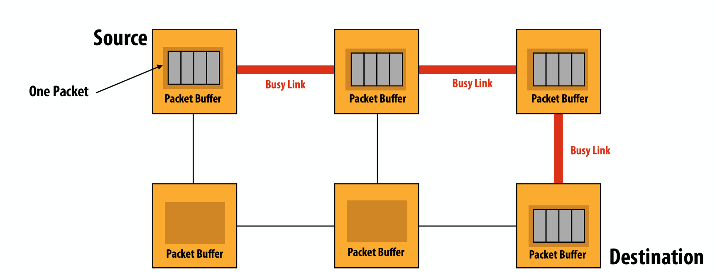
Wormhole
Credit: 15-418, Spring 2023, Lecture 14

Slide 27
Routing algorithms
Deterministic: Simplest, high contention
Dimension-order (e.g., XY)
Deadlock-free
Oblivious: Simple, mitigates contention
Valiant’s algorithm: Route deterministically via a random node
Balances network load, adds latency
Optimization: Use only at high load
Adaptive: Complex, most efficient
Minimal adaptive: Always route closer to destination on least-contended port
Fully adaptive: “Misroute” packets to optimize overall network load
  Must guard against livelock
  How to coordinate overall network state?

