Slide 1
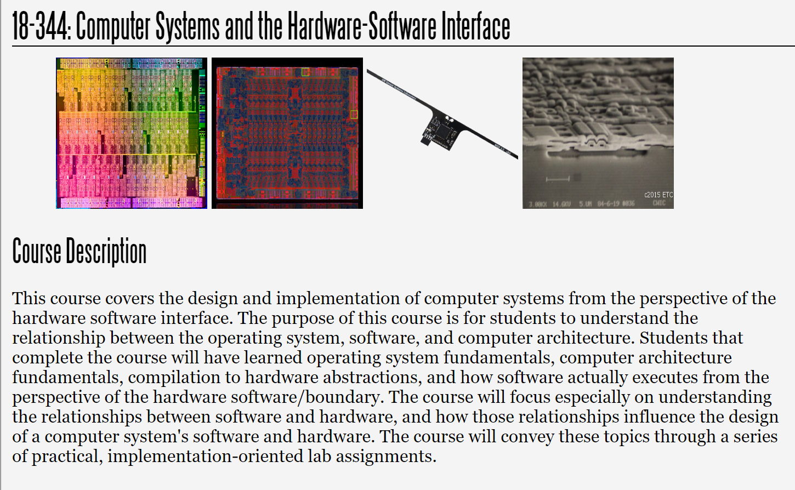
Fall 2023
Lecture 4: ISAs: The RISC-V ISA
Credit: Brandon Lucia

Slide 2
What is a Computer Architecture?
Building up to our first architecture
Defining the ISA: Architecture vs. Microarchitecture
RISC vs. CISC ISAs
RISCV ISA

Slide 3
Recap: What is a Computer Architecture?
Building up to our first architecture
Defining the ISA: Architecture vs. Microarchitecture
RISC vs. CISC ISAs
RISCV ISA

Slide 4
Basic Architecture: State + processing elements
ALU/processing
state
Process (combinational logic)
Maintain State (sequential logic)
control

Slide 5
Building up to our first architecture: ALU
Input A
Input B
Opcode selector
op = [+, -, x, /]
ALU
Output: A op B

Slide 6
A “single-cycle” design
Clock
PC+4
+
Input A Register Control
Input B Register Control
4
Instruction
Instruction Decode
In A reg select In B reg select
+
MUX
Program Counter(PC)
Fetch
Register File
Input A
Input B
Reg 1
Instruction
Memory
Output Register
Reg 2
Reg 3
Op select
op = [+, -, x, /]
ALU
ALU: output C
Control
Out reg select
Reg 4
Branch: PC Source Select
Branch Target Address Offset
Op select
op = [ld,st]
Memory Unit
ld: data
st: data
ld/st: address
Key Idea:
Single-cycle design goes from reading an instruction out of memory all the way to writing results back to registers before the next clock edge.
Data Memory

Slide 7
Where is the HW/SW Interface?
PC+4
+
Input A Register Control
Input B Register Control
4
Instruction
Instruction Decode
In A reg select In B reg select
+
MUX
Program Counter(PC)
Fetch
Register File
Input A
Input B
Reg 1
Instruction
Memory
Output Register
Reg 2
Op select
op = [+, -, x, /]
ALU
ALU: output C
Control
Reg 3
Out reg select
Reg 4
Branch: PC Source Select
Branch Target Address Offset
Op select
op = [ld,st]
Memory Unit
ld: data
st: data
ld/st: address
Data Memory

Slide 8
Big Idea: Instruction Bits are Control Signals
Instruction
Fetch
Instruction
Decode
Input Register 1 | Input Register 2 | Output Register | Operation Type
00000100 | 00000011 | 00000010 | 00000001
Binary encoded: signals
directly interface to datapath
Register r4 | Register r3 | Register r2 | Multiply
Reg 1
Reg 2
Reg 3
x
Reg 4

Slide 9
Architecture vs. Microarchitecture
The ISA defines the architecture of the machine
A microarchitecture implements the features of the architecture
Instruction
Fetch
Instruction
Decode
Input Register 1 | Input Register 2 | Output Register | Operation Type
00000100 | 00000011 | 00000010 | 00000001
Register r4 | Register r3 | Register r2 | Multiply
Reg 1
Reg 2
Reg 3
x
Reg 4

Slide 10
Architecture vs. Microarchitecture
For a given architecture there are many perfectly good microarchitectural implementations
Architecture:
Sequentially-numbered, general-purpose registers
Input Register 1 | Input Register 2 | Output Register | Operation Type
00000100 | 00000011 | 00000010 | 00000001
Architecture:
Register-register ALU ops, registers numbering 0-4
Register r4 | Register r3 | Register r2 | Multiply
x
Microarchitecture:
One ALU containing an adder; multiply w/ iterated addition, physical register file with registers numbering 0-4
Register File
ALU
SRAM Bank #1 SRAM Bank #2
+
Reg 1
Reg 3
Reg 2
Reg 4
Microarchitecture:
Two SRAM banks storing regs based on parity

Slide 11
ISA Design and Diving into RISCV-RV32I
What makes an ISA?
The basics of the RISCV-RV32I ISA
  A modern ISA engineered with clear goals from first principles
More microarchitectural concepts
  Control hazards & branch prediction
  Pipelining our microarchitecture & instruction-level parallelism

Slide 12

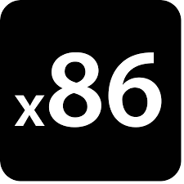

What should go in the ISA?
Reduced Instruction Set Computer
Simple primitives:
Let software compose complex operations
Register operands:
Decouple functionality from memory accesses
Few total operations:
Usually only one way to do something
Complex Instruction Set Computer
Simple & complex operations:
Hardware provides complex functionality
Many operations:
Often several ways to do the same thing
Register and memory operands:
Operations may directly manipulate memory

Slide 13
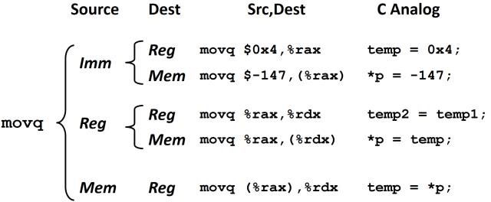

What should go in the ISA?
Reduced Instruction Set Computer
Simple primitives:
Let software compose complex operations
Complex Instruction Set Computer
Simple & complex operations:
Hardware must support complex functionality
Register operands:
Decouple functionality from memory accesses
Many operations:
Often several ways to do the same thing
Few total operations:
Usually only one way to do something
Register and memory operands:
Operations may directly manipulate memory
Few cases to map to control signals in microarchitecture
Many cases to map to control signals in microarchitecture
rd = M[imm] rd = M[reg]
rd = M[reg + imm] rd = M[PC + imm]
Plus all of these combinations

Slide 14
What should go in the ISA?
Reduced Instruction Set Computer
Complex Instruction Set Computer
Simple primitives:
Let software compose complex operations
Simple & complex operations:
Hardware must support complex functionality
Register operands:
Decouple functionality from memory accesses
Register and memory operands:
Operations may directly manipulate memory
Few total operations:
Usually only one way to do something
Many operations:
Often several ways to do the same thing
What are the pros and cons of each?
How does RISC vs. CISC affect the microarchitecture,
compiler, program, programmer?

Slide 15
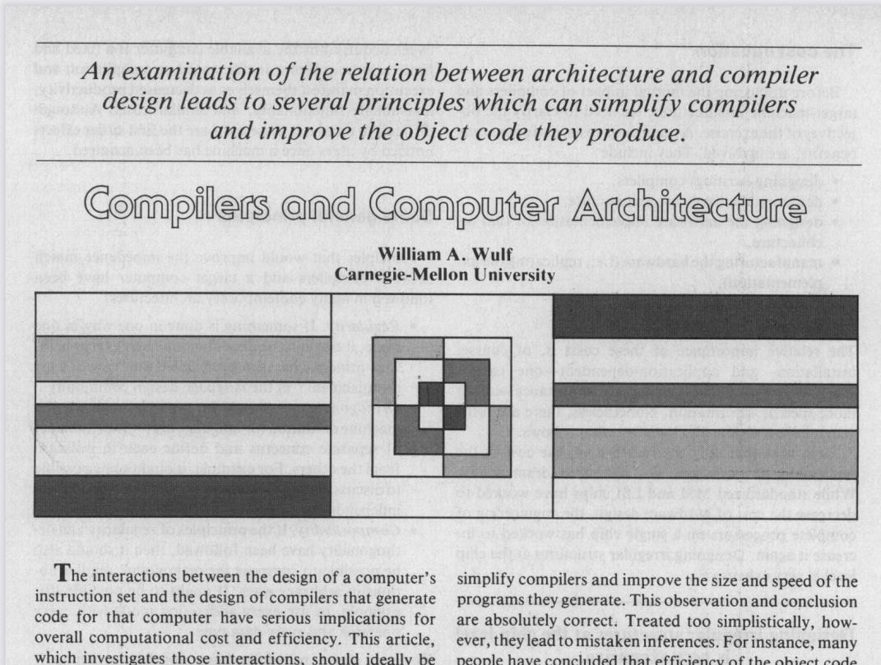
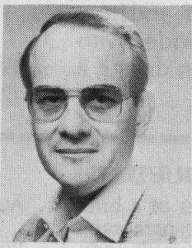
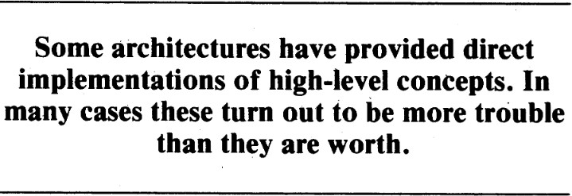
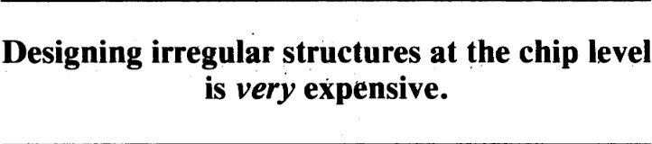
Principles of ISA Design
General Principles
Regularity – “Law of least astonishment”
Orthogonality – keep separable concerns separate Composability – regular, orthogonal ops combine easily
Specific Principles
One vs. All – precisely one way to do it, or all ways should be possible
Primitives, not solutions – solve by coding, compiling, & synthesizing
“Blatant opinions” (matters of taste)
Addressing – not limited to simple arrays, etc.
Environment Support – exceptions, processes, debugging, etc
Deviations – deviate from these rules only in implementation-specific ways

Slide 16
RISCV ISA
We will learn about ISA design by learning about RISCV
Modern, full-featured RISC ISA
Developed in the last decade at UC Berkeley
  The fifth in a sequence of RISC ISAs originating in the 80s
  https://riscv.org/technical/specifications/
  The RISC-V Instruction Set Manual, Volume I: BaseUser-Level ISA, Waterman et al, 2011
Goals
  Open-source
  Free
  Simple, but full-featured; avoids “over-architecting” for a particular uArch style (FPGA, ASIC,…)
  Extensible through extension specifications and variants
  Support heterogeneous & parallel systems efficiently
  Support 32- and 64-bit variants efficiently
  Fully virtualizable
  Supports (but does not require) IEEE 754 Floating Point

Slide 17
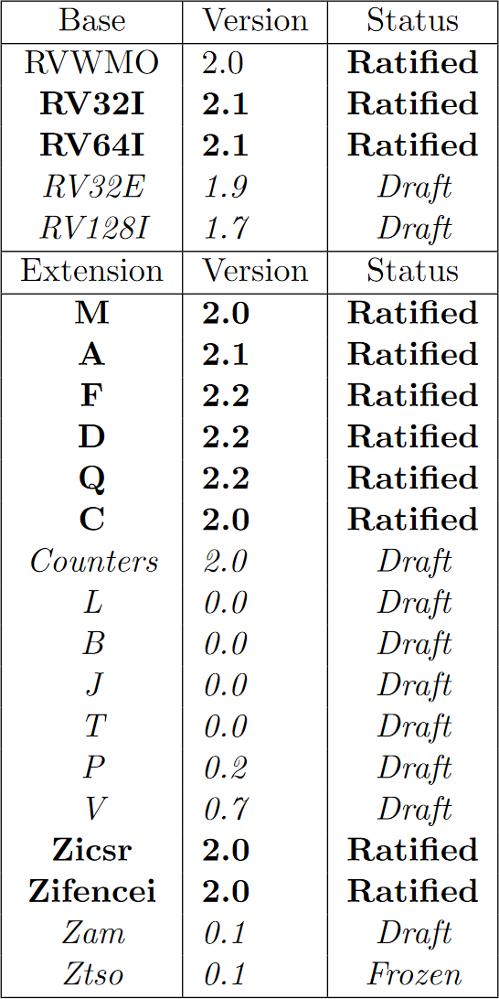
RISCV Variants & extensions
RV32I & RV64I are base integer ISA versions M – Support for HW Multiply & Divide _{Basic Operations}
F – Support for single-precision Float D – Support for double-precision Float Q – Support for quad-precision Float _{Floating Point}
A – Support for Atomic instructions RVWMO – Memory Consistency Model _{Concurrency}
L,B,J,T,P,V – Extra weird stuff (read the spec)

Slide 18
RISCV Variants & extensions
RV32I & RV64I are base integer ISA versions
XLEN: how many bits in a register?
Memory: 2^XLEN bytes
Word: 4B, Doubleword: 8B, Halfword: 2B
32-bit instructions in base encoding
Insn 1
Insn 2
Insn 3
Insn 4
…

Slide 19
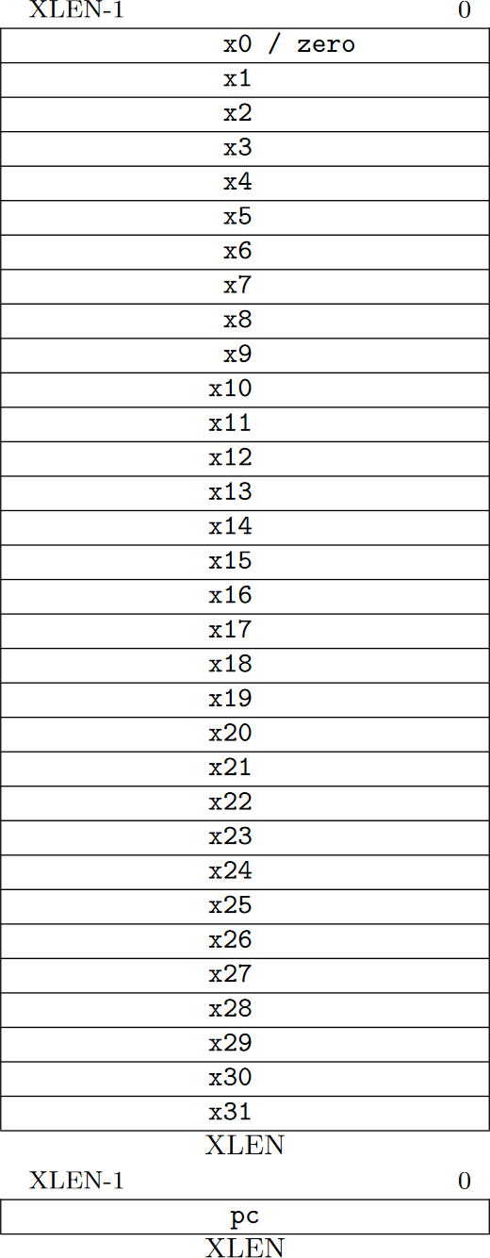
RISCV-RV32I Specification
32 Registers x0-x31 + PC register
x0 is always zero
x1 is the return address (by convention)
x2 is the stack pointer (by convention)
x5 is used as an “alternate link” register (by convention)
  E.g., Implementing exceptions / long jumps in software
(Micro)architectural implications of this ISA choice?

Slide 20
RISCV-RV32I Specification
32 Registers x0-x31 + PC register
x0 is always zero
x1 is the return address (by convention)
x2 is the stack pointer (by convention)
x5 is used as an “alternate link” register (by convention)
  E.g., Implementing exceptions / long jumps in software
(Micro)architectural implications of this ISA choice?
  Why not 16 registers? [RV32-E has 16 regs; why?]
  Why not 16-bit instructions?
  Power / Energy?
  Compilation & optimization?

Slide 21
Exercise: What about variable insn/reg size?
What defines instruction size? Why? What defines register size? Why?
Can we support multiple instruction sizes? Why would we support multiple sizes?
How to support different sizes? Benefits & drawbacks?

Slide 22
Exercise: What about variable insn/reg size?
What defines instruction size? Why? What defines register size? Why?
  ISA defines insn size. Lacking extensions, RV32I & RV64I both 32-bit insn
  ISA variant defines reg size. Programmer must know, datapath must implement; must be ISA-level spec.
Can we support multiple instruction sizes? Why would we support multiple sizes?
  Can we? Yes. Why? Code size optimization, longer constant immediates, longer jumps
How to support different sizes? Benefits & drawbacks?
  Two options. Option 1: RVC (riscv-compressed) – 16-bit ops blowup at decode into 32bit ones.
Code size optimization. Longer jumps possible.
  Option 2: steal some ISA bits to indicate variable width: 11 for 32, 011111 for 48, 0111111 for 64
  Costs? Increased decode complexity. Need to figure out how big instruction word is and where important signals are in the instruction word based on size.

Slide 23
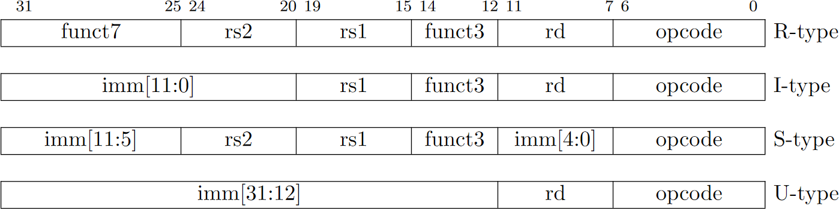
RISCV-RV32I Specification
Four base instruction encoding formats
  R(egister), I(mmediate), S(tore), U(pper Immediate)
  Mnemonics are non-binding and formats get flexibly used

Slide 24
RISCV-RV32I Specification
Four base instruction encoding formats
  R(egister), I(mmediate), S(tore), U(pper Immediate)
  Mnemonics are non-binding and formats get flexibly used
R-Type: 2 register input operands, 1 register output operand, opcode type, and function selection bits

Slide 25
RISCV-RV32I Specification
Four base instruction encoding formats
  R(egister), I(mmediate), S(tore), U(pper Immediate)
  Mnemonics are non-binding and formats get flexibly used
I-Type: 1 register input operands, 1 immediate input operand, 1 register output operand,
opcode type, and function selection bits

Slide 26
RISCV-RV32I Specification
Four base instruction encoding formats
  R(egister), I(mmediate), S(tore), U(pper Immediate)
  Mnemonics are non-binding and formats get flexibly used
S-Type: 2 register input operands, 1 immediate input operand, [0 output operands], Opcode type, and function selection bits

Slide 27
RISCV-RV32I Specification
Four base instruction encoding formats
  R(egister), I(mmediate), S(tore), U(pper immediate)
  Mnemonics are non-binding and formats get flexibly used
U-Type: 1 immediate input operand, 1 register output operand, opcode selection bits

Slide 28
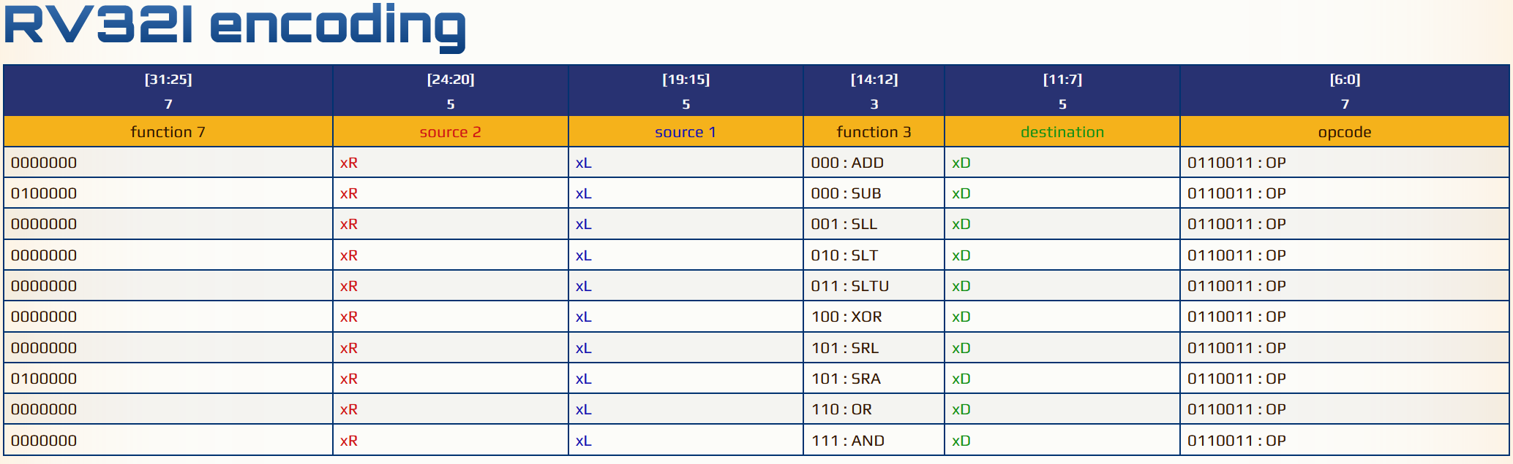
Example: R-type Arithmetic Operations
https://metalcode.eu/2019-12-06-rv32i.html
OP
0000000 | 00101 | 00110 | 000 | 00111 | 0110011

Slide 29
Example: R-type Arithmetic Operations
https://metalcode.eu/2019-12-06-rv32i.html
Func 7 = 0
reg x5
reg x6
ADD reg x7
OP
x7 = x5 + x6
0000000 | 00101 | 00110 | 000 | 00111 | 0110011

Slide 30
Example: R-type Arithmetic Operations
https://metalcode.eu/2019-12-06-rv32i.html
Func 7 = 32
reg x5
reg x6
SUB reg x7
OP
x7 = x5 - x6
0100000 | 00101 | 00110 | 000 | 00111 | 0110011

Slide 31
Example: R-type Arithmetic Operations
https://metalcode.eu/2019-12-06-rv32i.html
Func 7 = 0
reg x5
reg x6
OR reg x7
OP
x7 = x5 | x6
0000000 | 00101 | 00110 | 110 | 00111 | 0110011

Slide 32
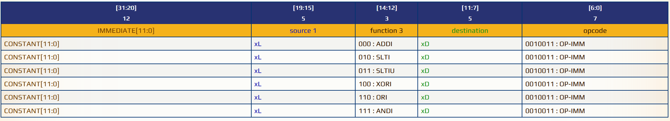
Example: I-type Reg/Imm Arithmetic Operations
Func 7 = 0
reg x6
SLTI
reg x7
OP-IMM
x7 = x5 << 9
0000 0000 1001 | 00110 | 010 | 00111 | 0100011

Slide 33
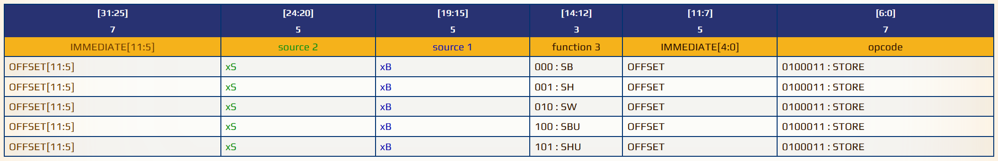
Example: S-type Store Operations
Base + offset: Why? Seem familiar?
imm[11:5]
reg x5
reg x6
width
imm[4:0]
STORE
M[x6 + offset] = x5 (4-bytes stored)
0100000 | 00101 | 00110 | 010 | 00111 | 0100011
offset
value
addr base
word
offset

Slide 34
Example: S-type Store Operations
Base + offset: Why? Seem familiar?
imm[11:5]
reg x5
reg x6
width imm[4:0]
STORE
M[x6 + offset] = x5 (2-bytes stored)
0100000 | 00101 | 00110 | 001 | 00111 | 0100011
offset
value
addr base
half- word
offset

Slide 35
What type are Load instructions?
What information do we need to encode for a load instruction?

Slide 36
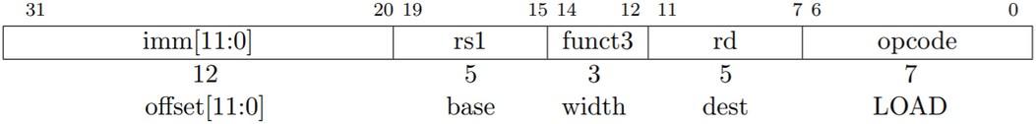
Load operations are I-Type Instructions

Slide 37
Example: U-type Upper Immediate Operations
What in the world is this instruction type used for?
LUI (Load Upper Immediate)
20-bit Upper Immediate
reg x7
x7 = (2303 << 12)
0000 0000 1000 1111 1111 | 00111 | 0110111
= 2303

Slide 38
Example: U-type Upper Immediate Operations
Why bring the PC into the picture?
x7 = PC + (2303 << 12)
AUIPC (Add Upper Imm to PC)
20-bit Upper Immediate
reg x7
0000 0000 1000 1111 1111 | 00111 | 0010111
= 2303

Slide 39
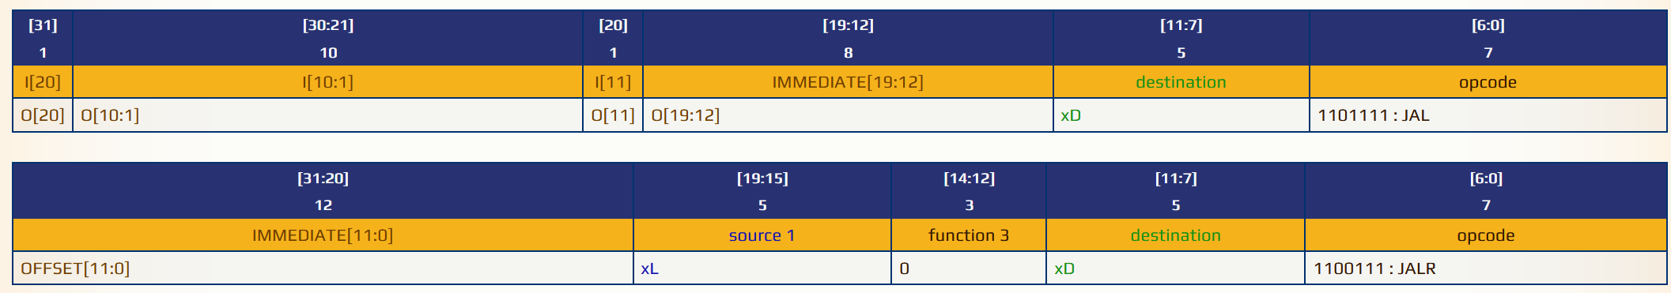
Control Flow: Jump-and-link
x8=PC+4;
jump to ((base+offset) & 0xfffffffe)
Jump & Link (Register)
Immediate
reg x7
reg x8
0000 0000 100 | 00111 | 000 | 01000 | 1100111
offset
base
Save PC+4

Slide 40
Control Flow: Call Jump-and-link
x8=PC+4;
jump to ((base+offset) & 0xfffffffe)
Jump & Link (Register)
Immediate
reg x7
reg x8
0000 0000 100 | 00111 | 000 | 01000 | 1100111
Why the mask?
offset
base
Save PC+4

Slide 41
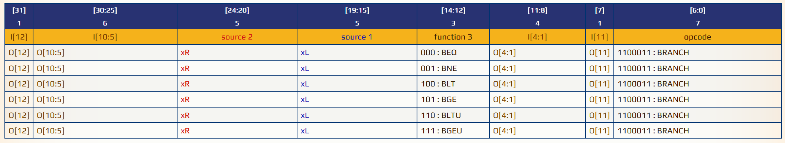
Control Flow: Compare & Branch
Imm[12,10:5]
reg x7
reg x8 BGE
Imm[4:1,11]
Branch
If(x8 >= x7) PC=PC + 16
0 000000 | 00111 | 01000 | 101 | 1000 0 | 1100011
Imm: PC-relative branch target
Where is bit 0?

Slide 42
Design Goals Behind Instruction Encoding
Why are all of the immediate bits all over the place?
Why are the immediates apparently different sizes?
Why are some immediate bits left unspecified?

Slide 43
Design Goals Behind Instruction Encoding
Why are all of the immediate bits all over the place?

Slide 44
Design Goals Behind Instruction Encoding
Why are all of the immediate bits all over the place?
  Instruction decode is expensive & always performance critical
  Registers always in same place makes decoder simpler

Slide 45
Fixed register position, simple decode logic
000001 01010 00011 000 00010 00000001
Instruction
Fetch
Instruction
Decode

Slide 46
Fixed register position, simple decode logic
000001 00100 01111 000 01000 00000001
Instruction
Fetch
Instruction
Decode

Slide 47
Design Goals Behind Instruction Encoding
Why are the immediates apparently different sizes?
12 bits
12 bits
32* bits

Slide 48
Design Goals Behind Instruction Encoding
Why are the immediates apparently different sizes?
  Different immediates have different uses!
  E.g., 12-bits are enough for PC-relative jump targets
12 bits
12 bits
32* bits

Slide 49
Design Goals Behind Instruction Encoding
Why are some immediate bits left unspecified?

Slide 50
Design Goals Behind Instruction Encoding
Why are some immediate bits left unspecified?
  To make large (like, 32-bit) values in a 32-bit insn., need to leave stuff out
  E.g., LUI: store high order bits of a large constant into a register

Slide 51
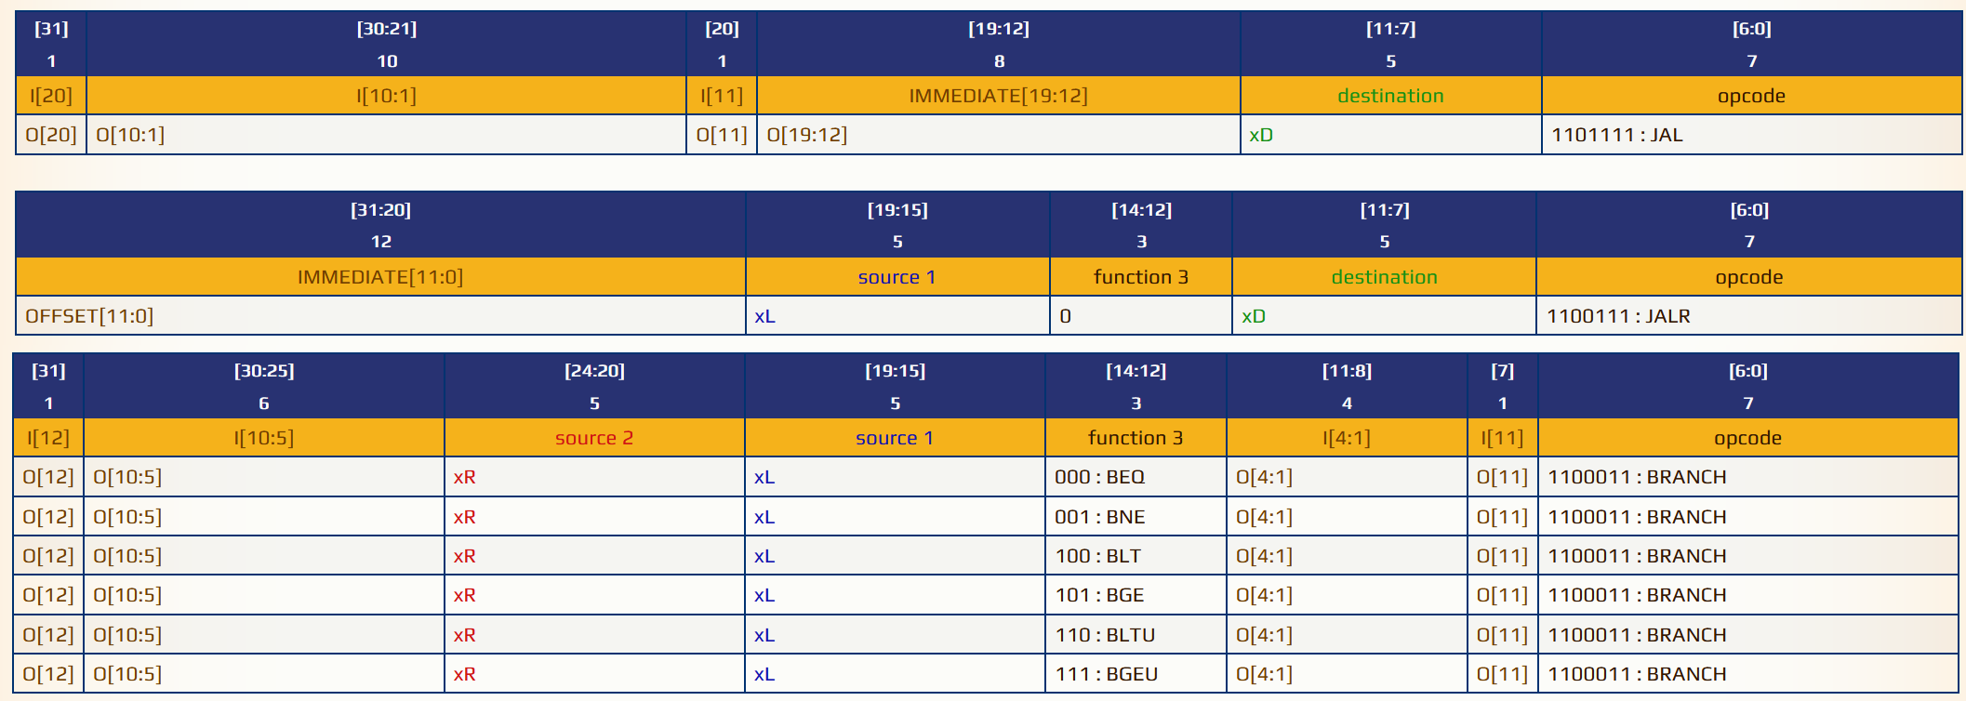
Implications of Control Flow Design
Benefits & limitations of PC-relative offsets?

Slide 52
Implications of Control Flow Design
Benefits & limitations of PC-relative offsets?
  Compact encoding
  Easy to support position independent code (PIC) if all jumps PC-relative
  Limited reach for jump targets

Slide 53
Implications of Control Flow Design
Benefits of combined compare & branch?

Slide 54
Implications of Control Flow Design
Benefits of combined compare & branch?
  No management of implicit (& explicit) condition codes like x86, ARM, SPARC…
  Higher code density, reduced instruction fetch traffic,
  Execution reaches branch sooner in instruction stream allowing earlier prediction

Slide 55
Other Design Dissiderata
Differences from x86 (for better and for worse)
  No complex addressing modes
  No conditional move (like x86 cmov) or predicated execution
  Much smaller basic ISA implementation (http://ref.x86asm.net/coder.html)
Memory Model Considerations (more on this toward end of semester)
  Alignment Issues: “The base ISA supports misaligned accesses, but these might run extremely slowly depending on the implementation. Furthermore, naturally aligned loads and stores are guaranteed to execute atomically, whereas misaligned loads and stores might not, and hence require additional synchronization to ensure
atomicity.”
  Memory Consistency Model: “We chose a relaxed memory model to allow high performance from simple machine implementations, however a completely relaxed memory model is too weak to support programming language memory models and so the memory model is being tightened.” [this point is basically the riscv team apologizing for having punted on concurrency to begin with and walking back to something that makes sense]

Slide 56
What kind of ISA are we studying?
ALU/processing
state
Process (combinational logic)
Maintain State (sequential logic)
control

Slide 57
RISCV is a “Register / Register” ISA
ALU/processing
Register File
state – inputs & outputs are in register file
Input B
Output:
A op B
Reg 1
Reg 2
Reg 3
Reg 4
ALU
Input A
Opcode selector
op = [+, -, x, /]
control

Slide 58
RISCV is a “Register / Register” ISA
Input A Register Control
Input B Register Control
state – inputs & outputs are in register file Register / Register? we have memory tho?
Register File
Input A
Input B
Reg 1
ALU
ALU: output C
Output
Register
Reg 2
Control
Reg 3
Reg 4
Memory
Unit
ld: data
st: data
ld/st: address
Data Memory

Slide 59
Alternative: “Register / Memory” ISA
Input A Register Control
Input B Register Control
state – inputs & outputs are in register file Register / Register? we hhaavvee mmeemmoorryy tho?
Zero or one inputs comes from memory in a R/M architecture
Register File
Input A
Input B
Reg 1
ALU
ALU: output C
Output
Register
Reg 2
Control
Reg 3
Reg 4
Memory
Unit
ld: data
st: data
ld/st: address
Data Memory
Example Register / Memory architectures?

Slide 60
Alternative: Stack Machine Architecture
state – in/out operands from stack only. there are no registers in this architecture!
Input B
Output: A op B
stored at stack top
ALU
Input A
Stack
(Access memory via
ld/st to stack top)
Opcode selector
op = [+, -, x, /]
control
Implicit arguments A & B come from top two stack positions

Slide 61
Alternative: Stack Machine Architecture
state – in/out operands from stack only. there are no registers in this architecture!
push (0xabc) push (0xac0) addw
push (0x123)
push $10 //imm. 10 mulw
addw
pop (0xdeadbeef)
Input B
Output: A op B
stored at stack top
ALU
Input A
Stack
Opcode selector
op = [+, -, x, /]
Memory is weird: push <addr> loads
<addr> and pushes to stack top, pop
<addr> stores stack top to <addr>
control
What does this do?
Implicit arguments A & B come from top two stack positions

Slide 62
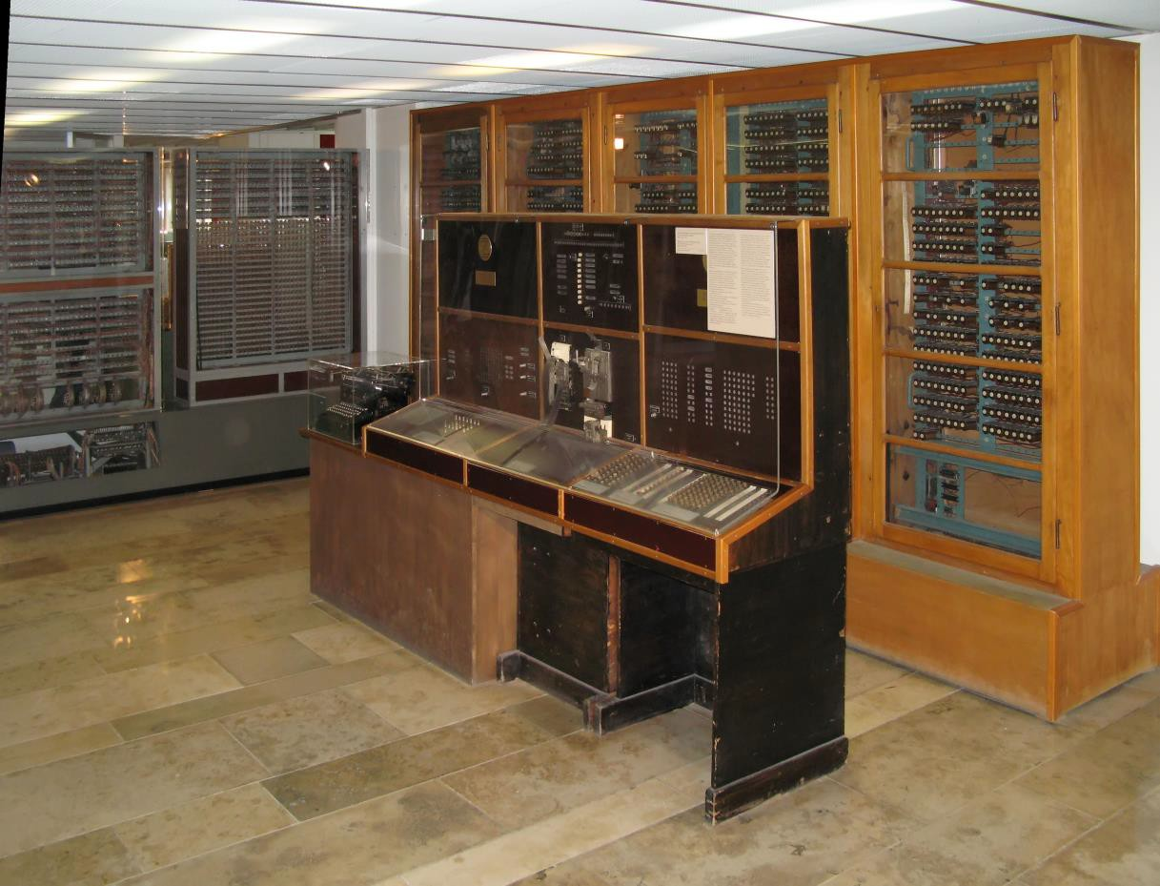
Alternative: Stack Machine Architecture The Z4 digital computer (1942 + later)
state – in/out operands from stack only. there are no registers in this architecture!
push (0xabc) push (0xac0) addw
push (0x123)
push $10 //imm. 10 mulw
addw
pop (0xdeadbeef)
Input B
Output: A op B
stored at stack top
ALU
Input A
Stack
Opcode selector
op = [+, -, x, /]
Memory is weird: push <addr> loads
<addr> and pushes to stack top, pop
<addr> stores stack top to <addr>
control
What does this do?
Implicit arguments A & B come from top two stack positions

Slide 63

Alternative: Stack Machine Architecture The Java Virtual Machine is a stack machine
state – in/out operands from stack only. there are no registers in this architecture!
push (0xabc) push (0xac0) addw
push (0x123)
push $10 //imm. 10 mulw
addw
pop (0xdeadbeef)
Memory is weird: push <addr> loads
<addr> and pushes to stack top, pop
<addr> stores stack top to <addr>
What does this do?

Slide 64
Alternative: Accumulator Machine Architecture
Input B: imm. or mem.
state – no registers, implicit argument is A (the accumulator), other arg is imm. / mem.
load (0xabc) add (0xac0) store (0xf00) load (0x123) mul 10
add (0xf00)
store (0xdeadbeef)
Output: A op B
stored in A
Accumulator
ALU
Input A
Memory is less weird: load (0xabc) puts the contents of 0xabc in A, store (0xabc) puts A into memory at 0xabc
Opcode selector
op = [+, -, x, /]
control
What does this do?
Implicit argument A always comes from accumulator

Slide 65
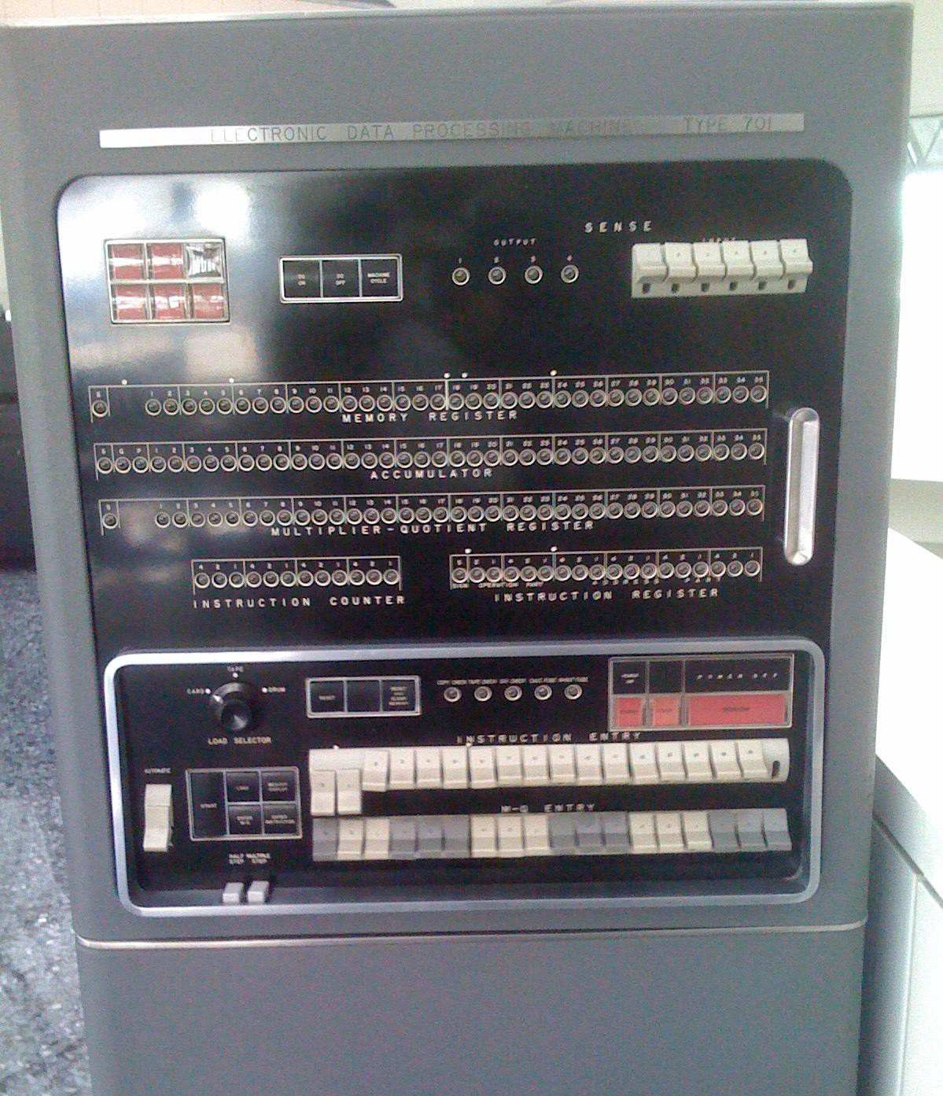
IBM 701 (ca. 1952)
Input B: imm. or mem.
state – no registers,
load (0xabc) add (0xac0) store (0xf00) load (0x123) mul 10
add (0xf00)
store (0xdeadbeef)
Output: A op B
stored in A
Accumulator
implicit argument is A
(the accumulator), other
arg is imm. / mem.
ALU
Input A
Memory is less weird: load (0xabc) puts the contents of 0xabc in A, store (0xabc) puts A into memory at 0xabc
Opcode selector
op = [+, -, x, /]
control
What does this do?
Implicit argument A always comes from accumulator

Slide 66
What did we just learn?
A deep-ish dive into the RISCV ISA as a vehicle for learning about ISA design
A look at how ISA design choices influence other aspects of the
system’s design
How to we cross the hardware/software interface to go from software to hardware

Slide 67
What to think about next?
More microarchitectural concepts (next time)
  Pipelining our microarchitecture & instruction-level parallelism
  Control hazards & branch prediction
Caches as a microarchitectural optimization (next next time)
  Implementation of cache hierarchies
  Cache design tradeoffs
Performance Evaluation (looking forward)
  Design spaces, Pareto Frontiers, and design space exploration

