Slide 1
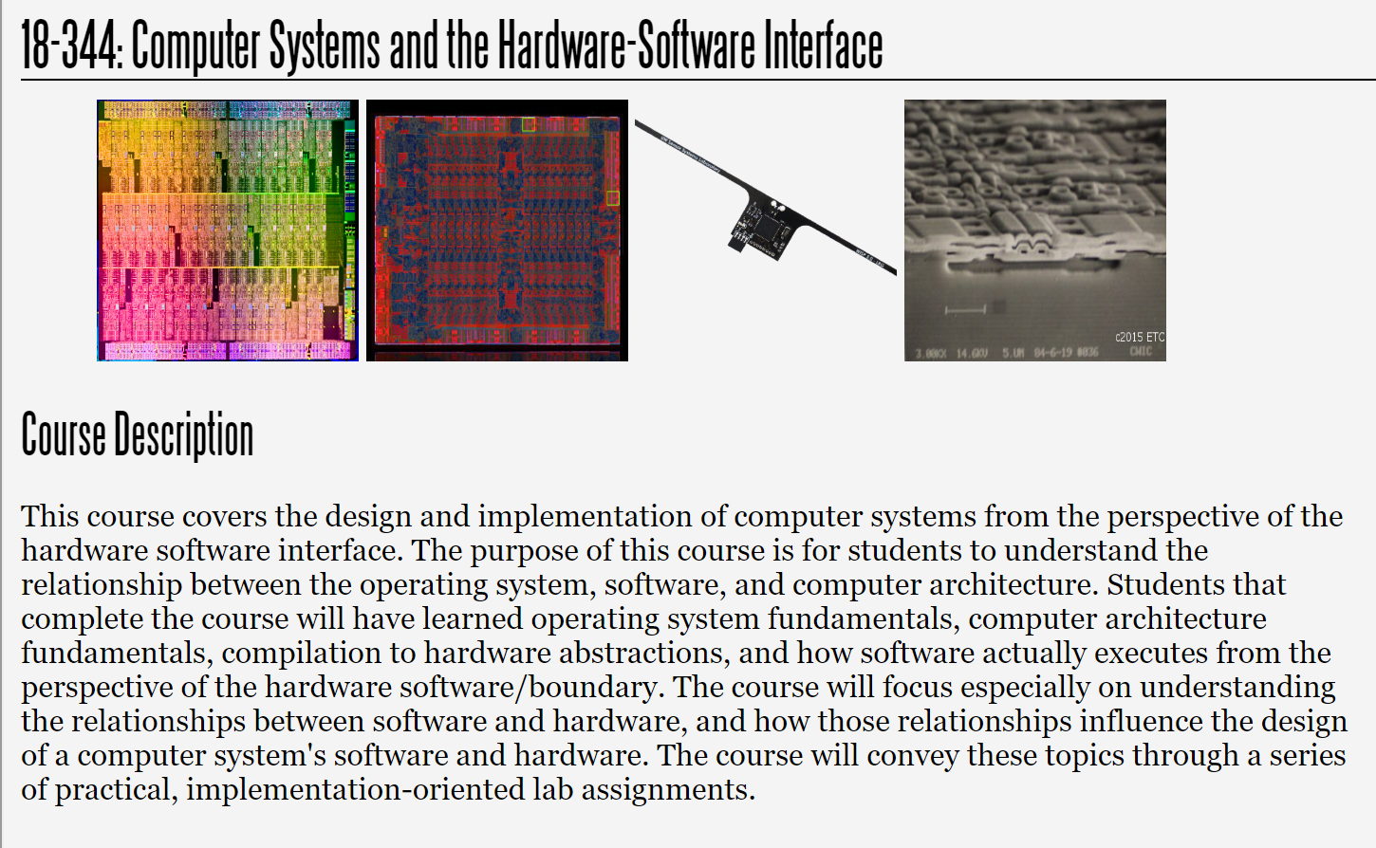
Fall 2023
Lecture 18: Synchronization and Transactional Memory
Credit: Brandon Lucia

Slide 2
Synchronization and its Implementation

Slide 3


Review: Synchronization Can Prevent Operation Reordering
Memory fences are one type of synchronization
r1=Y
Reordering prevented
X=1
Memory Fence
r1=Y
Fence implementation depends on reordering implementation

Slide 4
Review: Synchronization For Real Programmers
Memory fences are wrapped up in locks, etc.
r1=Y
Lock
Reordering prevented
Y=1
Unlock
r1=Y
Direct use of fences can be tricky and you will usually use a library

Slide 5

Data Races
Synchronization imposes happens-before on otherwise unordered operations
Lock Unlock
Y=1
Data race prevented
Lock
r1=Y
Unlock
Data Race: Unordered operations to the same memory location, at least one write.

Slide 6
Fences are for (Preventing Re-)Ordering to Avoid Data Races & Ensure Correct Executions
Thread 0 |  |  | Thread 1
r1=Y X=1 | Fence |  | r2=X ^{Y=1} Fence
r1=Y |  |  | r2=X
We will see later that this program can produce very strange results if not sychronized

Slide 7
Fences are for (Preventing Re-)Ordering to Avoid Data Races & Ensure Correct Executions
Thread 0
r1=X r1++ X=r1
Thread 1
r2=X r2++ X=r2
What happens with this program? Where can we put the fence?
Fence

Slide 8
Fences are for (Preventing Re-)Ordering to Avoid Data Races & Ensure Correct
Executions
Thread 0
r1=X
Thread 1
r2=X
Fence
Fence
How about fences everywhere? Does this fix our problem?
r1++
Fence
r2++
Fence
X=r1
X=r2

Slide 9
Some programs also require atomicity
Defining Atomicity:
Given a critical region that requires atomic execution by multiple different threads, all threads’ executions of the region were atomic if the resulting execution is equivalent to some serialization of the atomic regions.
Thread 0
Thread 1
r1=X r1++ X=r1
r2=X r2++ X=r2
Fences don’t provide atomicity, but we have other primitives that we can use for atomic operations
Fence

Slide 10
Some programs also require atomicity
Serialization #1
Serialization #2
r1=X r1++ X=r1
r2=X r2++ X=r2
Defining Atomicity:
Given a critical region that requires atomic execution by multiple different threads, all threads’ executions of the region were atomic if the resulting execution is equivalent to some serialization of the atomic regions.
r2=X r2++ X=r2
r1=X r1++ X=r1

Slide 11
Mutual exclusion (mutex) locks enforce
atomicity (and ordering)
Lock Behavior:
A thread acquires a lock L, does stuff while holding L, and then releases lock L.
Thread 0
Thread 1
Lock L
Lock L
r1=X r1++ X=r1
r2=X r2++ X=r2
If a thread tries to acquire L while L is held, the thread keeps trying to acquire L until L is unheld, when its attempt to acquire succeeds.
Unlock L
Unlock L

Slide 12
SpinLocks are one implementation of synchronization
Thread 0
Thread 1
Lock L
Lock L
r1=X r1++ X=r1
r2=X r2++ X=r2
Unlock L Unlock L
spinlock(L){
while( sync_bool_compare_and_swap(&L,0,1) == 0 ){
/*do nothing; pause here on some systems*/
}
}
unlock(L){ L = 0; sync_synchronize(); /*mem fence*/ }

Slide 13
SpinLocks are one implementation of synchronization
spinlock(L){
while( sync_bool_compare_and_swap(&L,0,1) == 0 ){
/*do nothing; pause here on some systems*/
}
}
unlock(L){ L = 0; sync_synchronize(); /*mem fence*/ }
Turtles all the way down?

Slide 14
SpinLocks are one implementation of synchronization
spinlock(L){
while( sync_bool_compare_and_swap(&L,0,1) == 0 ){
/*do nothing; pause here on some systems*/
}
}
unlock(L){ L = 0; sync_synchronize(); /*mem fence*/ }
175b: | 48 | 8b | 02 |  |  | mov | (%rdx),%rax //load L into %rax
175e: | 48 | 8d | 48 | 01 |  | lea | 0x1(%rax),%rcx //add 1 to %rax, into %rcx
1762: | f0 | 48 | 0f | b1 | 0a | lock | cmpxchg %rcx,(%rdx) //compare & exchange
1767: | 75 | f2 |  |  |  | jne | 175b //loop to mov if cmpxchg fails

Slide 15
SpinLocks are one implementation of synchronization
spinlock(L){
while( sync_bool_compare_and_swap(&L,0,1) == 0 ){
/*do nothing; pause here on some systems*/
}
}
unlock(L){ L = 0; sync_synchronize(); /*mem fence*/ }
1762: f0 48 0f b1 0a
//if (%rdx) == %rax{
lock cmpxchg %rcx,(%rdx) (%rdx) = %rcx }
Implemented directly in the machine microarchitecture. Even if multiple threads executing, hardware guarantees no inter-thread interactions

Slide 16
SpinLocks are one implementation of synchronization
spinlock(L){
while( sync_bool_compare_and_swap(&L,0,1) == 0 ){
/*do nothing; pause here on some systems*/
}
}
unlock(L){ L = 0; sync_synchronize(); /*mem fence*/ }
mfence Fence
1890:
0f ae f0

Slide 17
Lock ordering matters
Thread 0
Lock LX
Lock LY
Thread 1
Lock LX Lock LY
x++ y++
x++ y++
Lock Ordering:
If you manipulate more than one piece of data in a critical region, you will need to acquire the locks in the same order for all critical regions or face deadlock
Unlock LX Unlock LY
Lock LY Lock LX
Unlock LX Unlock LY
x++ y++
Unlock LY
Unlock LX

Slide 18
Directly Using Compare and Swap
Thread 0
Thread 1
Thread 0
Thread 1
Lock L
Lock L
r1=X r1++ X=r1
r2=X r2++ X=r2
r1 = x + 1
_cas(&x,x,r1)
r2 = x + 1
_cas(&x,x,r2)
Unlock L
Unlock L
How general is a CAS operation for implementing critical regions that need to execute atomically? What are the limitations on a CAS operation?

Slide 19
Fetch and Add – Further Specializing Atomics
sync_fetch_and_add(x,1);
Thread 0
Thread 1
Thread 0
Thread 1
Lock L
Lock L
r1=X r1++ X=r1
r2=X r2++ X=r2
_fna(&x,1)
_fna(&x,1)
Unlock L
Unlock L
1707: f0 48 83 04 d0 01 lock addq $0x1,(%rax,%rdx,8)
How much less general than compare and swap?

Slide 20
Transactional Memory – Further Generalizing
Atomics
Thread 0
Thread 1
Thread 0
Thread 1
Lock L
Lock L
r1=X r1++ X=r1
r2=X r2++ X=r2
r1 = x + 1
_cas(&x,x,r1)
r2 = x + 1
_cas(&x,x,r2)
Unlock L
Unlock L
Limited by single location that can be updated using a CAS. What if we want to update 3 (or n) different locations (without using a lock)?

Slide 21
Transactional Memory – Further Generalizing
Atomics
Thread 0
Lock L
Thread 1 Thread 0 Thread 1
Lock L
r1=X
r1++ X=r1 r2=Y Y++ Y=r2
r3=X
r3++ X=r3 r2=Y Y++ Y=r2
r1 = x + 1
_cas(&x,x,r1) r2 = y + 1
_cas(&y,y,r2)
r3 = x + 1
_cas(&x,x,r3) r4 = y + 1
_cas(&y,y,r4)
Unlock L
Unlock L
How about using multiple CAS operations?

Slide 22
Transactional Memory – Further Generalizing
Atomics
Thread 0
Lock L
Thread 1 Thread 0 Thread 1
Lock L
r1=X
r1++ X=r1 r2=Y Y++ Y=r2
r3=X
r3++ X=r3 r2=Y Y++ Y=r2
r1 = x + 1
_cas(&x,x,r1) r2 = y + 1
_cas(&y,y,r2)
r3 = x + 1
_cas(&x,x,r3) r4 = y + 1
_cas(&y,y,r4)
Unlock L
Unlock L
How about using multiple CAS operations?
Problem: Need atomicity across CAS ops.

Slide 23
Transactional Memory: Atomicity for “n-CAS”
Thread 0
Thread 1
xbegin()
xbegin() starts a transaction xend() ends the transaction started by the most recent xbegin()
xbegin()
r1 = x | + | 1
r2 = y | + | 1
x = r1
y = r2
xend()
r1 = x | + | 1
r2 = y | + | 1
x = r1
y = r2
xend()
Transaction attempts to execute atomically, as if protected by a lock

Slide 24
Transactional Memory: Atomicity for “n-CAS”
Thread 0
Thread 1
xbegin() r1 = x + 1 r2 = y + 1 x = r1
y = r2
ABORT
y = 17
Transaction aborts if another thread accesses a location accessed in transaction (or if explicitly aborted)

Slide 25
Transactional Memory: Atomicity for “n-CAS”
Thread 0
Thread 1
xbegin() r1 = x + 1 r2 = y + 1 x = r1
y = r2
ABORT?
… = y
Transaction aborts if another thread accesses a location accessed in transaction (or if explicitly aborted)

Slide 26
Transactional Memory: Atomicity for “n-CAS”
Thread 0
Thread 1
xbegin() r1 = x + 1 r2 = y + 1 x = r1
y = r2
ABORT?
… = y
Transaction aborts if another thread reads a location written by the transaction or writes a location
accessed by the transaction (“Conflicting” accesses)

Slide 27
Transactional Memory: Atomicity for “n-CAS”
Thread 0
Thread 1
xbegin() r1 = x + 1 r2 = y + 1 x = r1 ABORT
… = y
Reads don’t conflict and
transactions can read-share data

Slide 28
What do we do if we have repeated aborts?
Thread 0
Thread 1
xbegin() r1 = x + 1 r2 = y + 1 x = r1 ABORT
xbegin() r1 = x + 1 r2 = y + 1 x = r1 ABORT
These threads are contending for memory locations causing repeated aborts.
xbegin() r1 = x + 1 r2 = y + 1 x = r1 ABORT
xbegin() r1 = x + 1 r2 = y + 1 x = r1 ABORT
How to deal with contention in a transactional memory system?
xbegin() r1 = x + 1 r2 = y + 1 x = r1
xbegin() r1 = x + 1 r2 = y + 1 x = r1

Slide 29
Lock-based Fallback Path
if(xbegin()==OK){ rlk = read_spinlock(L) r1 = x + 1
r2 = y + 1 x = r1 xend()
}else{
//fallback lock(L) r1 = x+1 r2 = y+1 x = r1
y = r2 unlock(L)
}
Add a fallback path & abort handling code Fallback should use spinlocks, not TM. Why? TM case needs to read spinlock lock word. Why? In fallback, can do arbitrary code.
Can also retry TM version repeatedly before giving up and running fallback. Up to you the programmer what sequence to follow.
Precise Intel TSX syntax is available in the lab handout and tm.h in the lab release files.

Slide 30
What do we do if we have repeated aborts?
Thread 0
Thread 1
xbegin() r1 = x + 1 r2 = y + 1 x = r1 ABORT
xbegin() r1 = x + 1 r2 = y + 1 x = r1 ABORT
These threads are contending for memory locations causing repeated aborts.
Random delay for contention avoidance
xbegin() r1 = x + 1 r2 = y + 1 x = r1
y = r2
xend()
How to deal with contention in a transactional memory system?
xbegin() r1 = x + 1 r2 = y + 1

Slide 31
A Note About Lock-based Fallback Paths
for(i = 0..MAX_TRIES){
if(xbegin()){
…; xend(); goto done;
}//abort code here
}
//Fallback code here
lock(Lx); lock(Ly);
Run your transaction some number of times (MAX_TRIES)
If you commit once, skip past your fallback. Often use ‘goto’…
r1 = x+1 r2 = y+1 x = r1 y = r2
unlock(Lx); unlock(Ly);
Locks are tricky in code like this: which locks do you need to
acquire? Often need to acquire them all before you make accesses associated with locks.
}
done:
//continue

Slide 32
Implementation sketch of TM
LL33$$ |  | Way 0 | Way 1 | Way 2 | Way 3
 |  |  |  |  |  |  |  | Add TM bit to each cache block Blocks accessed in transaction mark bit All transactional state must fit in cache.
 | Set 0 | Line
 | Set 1
 | Set 2
 |  |  |  |  |  |  |  | TM | Valid | Dirty | Tag | 32 bytes data
 | Set 3

Slide 33
Tracking TM conflicts using coherence msgs
CPU 1 CPU 2 CPU 3
X++ Rd X=?
X++
$ $ $
Invalidate X++
An incoming access request for a block with its TM bit set leads to a conflict and a transactional abort

Slide 34
Reasons a transaction might abort
Too many blocks with their TM bits set leaves no room for more TM blocks
Too many defined as “more blocks w/ TM bits set than blocks in a way”
Conflict with another transaction or non-transactional access
identified through incoming coherence traffic
Explicit xabort() instruction when transactional code concludes transaction is not useful
Other, unspecified, but arbitrary conditions left up to the microarchitects
I speculate that these are related to internal buffers of fixed capacity

Slide 35
Why is this reordering situation a problem?
Thread 0 |  |  | Thread 1
r1=Y X=1 | Fence |  | r2=X ^{Y=1} Fence
r1=Y |  |  | r2=X
Reordering independent memory operations that access different locations

Slide 36

“computers execute operations in a different order than is specified by the program. A correct execution is achieved if the results produced are the same as would be produced by executing the program steps in order. For a multiprocessor computer, such a correct execution by each processor does not guarantee the correct execution of the entire program.”
Excerpt from “How to Make a Multiprocessor Computer That Correctly Executes Multiprocess Program”
LESLIE LAMPORT, 1979

Slide 37

“The memory consistency model of a shared-memory system specifies the order in which memory operations will appear to execute to the programmer. The memory consistency model affects the process of writing parallel programs and forms an integral part of the entire system, including the architecture, the compiler, and the programming language.”
Excerpt from “Recent Advances in Memory Consistency Models for Hardware Shared-Memory Systems”
Sarita Adve, et al, 1999

Slide 38
Memory Consistency

Slide 39
Memory Consistency Model
Informal Definition:
“Defines the value a read operation may read at each point during the execution”
“Defines the set of legal observable orders of memory operations during an execution”
“Defines which reorderings of memory operations are permitted”

Slide 40
Coherence is Ordering
Wr X
Wr X
OR
Wr X
Wr X
Coherence defines the set of legal orders of accesses to a single memory location

Slide 41
Consistency is Ordering
Wr X
Wr Y
OR
Wr Y
Wr X
Consistency defines the set of legal orders of accesses to multiple memory locations

Slide 42
Sequential Consistency (SC)
The simplest, most intuitive memory consistency model
Two Invariants to SC:
Invariant #1: Instructions are executed in program order
Invariant #2:
All processors agree on a total order of executed instructions

Slide 43
The SC “Switch”
Wr X
Rd Y
Wr Y
Rd X
Rd X
Execution

Slide 44
The SC “Switch”
Wr X
Rd Y
Wr Y
Rd X
Rd X
Execution
Wr X

Slide 45
The SC “Switch”
Wr X
Rd Y
Wr Y
Rd X
Rd X
Execution
Wr X Rd Y

Slide 46
The SC “Switch”
Wr X
Rd Y
Wr Y
Rd X
Rd X
Execution
Wr X Rd Y Wr Y

Slide 47
The SC “Switch”
Wr X
Rd Y
Wr Y
Rd X
Rd X
Execution
Wr X Rd Y Wr Y Rd X

Slide 48
The SC “Switch”
Wr X
Rd Y
Wr Y
Rd X
Rd X
Execution
Wr X Rd Y Wr Y Rd X Rd X

Slide 49
Why is SC Important?
SC is the most complex model that we can ask
programmers to think about.
Intuitive (SC) Weird (not SC)
Wr X Rd Y Wr Y Rd X Rd X
Rd Y
Wr X
Rd X Rd X Wr Y
Wr X
Wr Y Rd X
Rd Y
Rd X
SC prohibits all reordering of instructions (Invariant 1)

Slide 50
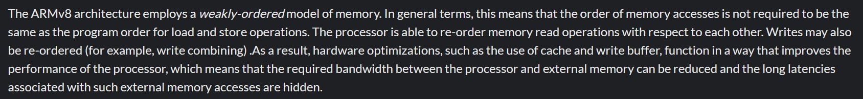
Real hardware does not enforce SC
The ARMv8 Memory Model:
https://developer.arm.com/documentation/den0024/a/Memory-Ordering

Slide 51
Reordering #1: Write Buffers
CPU
 |  | Wri
M
CPU
 |  | Wri
M
CPU can read its write
buffer, but not others’
te Buffer
te Buffer
Coherent
Buffered writes eventually end up in coherent shared memory

Slide 52
Reordering #1: Write Buffers
Program
Initially X == Y == 0
M
X=1
Y=1
r1=Y
r2=X
Is r1==r2==0
a valid result?
M

Slide 53
Reordering #1: Write Buffers
Program Initially X == Y == 0
M
X=1
Y=1
r1=Y
r2=X
Is r1==r2==0
a valid result?
M
r1 == r2 == 0 is not SC, but it can happen with write buffers

Slide 54
Reordering #1: Write Buffers
Program
Initially X == Y == 0
Y=1
X=1
M
M
r1=Y
r2=X
Execution

Slide 55
Reordering #1: Write Buffers
Program
Initially X == Y == 0
X=
 | 1
M
Y=1
M
r1=Y
r2=X
Execution

Slide 56
Reordering #1: Write Buffers
Program
Initially X == Y == 0
X=
 | 1
M
Y=
 | 1
M
r1=Y
r2=X
Execution

Slide 57
Reordering #1: Write Buffers
Program
Initially X == Y == 0
r2=X
Execution
r1=Y
X=
 | 1
M
Y=
 | 1
M

Slide 58
Reordering #1: Write Buffers
Program Initially X == Y == 0
r1=Y
X=
 | 1
M
r2=X
Y=
 | 1
M
Execution

Slide 59
Reordering #1: Write Buffers
Program Initially X == Y == 0
X=
 | 1
M
r2=X
Y=
 | 1
M
Execution
r1=Y [r1 <- 0]

Slide 60
Reordering #1: Write Buffers
Program
Initially X == Y == 0
X=
 | 1
M
Y=
 | 1
M
Execution
r1=Y [r1 <- 0] r2=X [r2 <- 0]

Slide 61
Reordering #1: Write Buffers
Program
Initially X == Y == 0
M
M
Execution
r1=Y [r1 <- 0] r2=X [r2 <- 0]
WBs let reads finish before older writes
^{X=1} (Not SC!)
Y=1

Slide 62
Reordering #2: Write Combining
Program X,Z in same $ line
X=1 Y=1 Z=1
Coalescing Write Buffer
4 word cache line

Slide 63
Reordering #2: Write Combining
Program X,Z in same $ line
X=1 Y=1 Z=1
Coalescing Write Buffer
X=1

Slide 64
Reordering #2: Write Combining
Program X,Z in same $ line
X=1 Y=1 Z=1
Coalescing Write Buffer
X=1
 |  |  | Y=1

Slide 65
Reordering #2: Write Combining
Program X,Z in same $ line
X=1 Y=1 Z=1
Coalescing Write Buffer
X=1
 |  |  | Y=1
 | Z=1

Slide 66
Reordering #2: Write Combining
Coalescing Write Buffer Coalescing Write Buffer
X=1
 |  |  | Y=1
 | Z=1
X=1 | Z=1
 |  |  | Y=1
Combining the write to X & Z saves bandwidth, but reorders Z=1 and Y=1

Slide 67
Reordering #3: Interconnect
Program
X=1 r1=X Y=1
r2=Y
r3=Y
r4=X
X=1
Y=1
Y=1
Execution
X=1
Y=1 r1=X [r1 <- 1] r2=Y [r2 <- 0]
r3=Y [r3 <- 1] r4=X [r4 <- 0]
X=1
Variable time cost traversing routed on-chip network

Slide 68
Reordering #4: Compilers
Hoisted!
X = 0
for (1 .. 100)
X = 1
print X
X = 1
for (1 .. 100)
print X
X = 0
X = 0
The compiler hoists the write out of the loop,
permitting new (non-SC) results (e.g., “1 0 0 0 0 0 0...”)

Slide 69
When is an Execution Not SC?
When a memory operation happens before itself
Execution
r1=Y [r1 <- 0] r2=X [r2 <- 0]
X=1
Y=1
Happens-Before Graph
X=1
Y=1
r1=Y
r2=X

Slide 70
When is an Execution Not SC?
When a memory operation happens before itself
Execution
r1=Y [r1 <- 0] r2=X [r2 <- 0]
X=1
Y=1
Happens-Before Graph
X=1
Y=1
r1=Y
r2=X
Program Order HB Edge

Slide 71




When is an Execution Not SC?
When a memory operation happens before itself
Execution
r1=Y [r1 <- 0] r2=X [r2 <- 0]
X=1 Y=1
Happens-Before Graph
X=1
Y=1
r1=Y
r2=X
Program Order HB Edge Causal Order HB Edge

Slide 72
When is an Execution Not SC?
When a memory operation happens before itself
Execution
r1=Y [r1 <- 0] r2=X [r2 <- 0]
X=1
Y=1
Happens-Before Graph
X=1
Y=1
r1=Y
r2=X
If there is a cycle in the happens-before graph, the execution is not SC

Slide 73



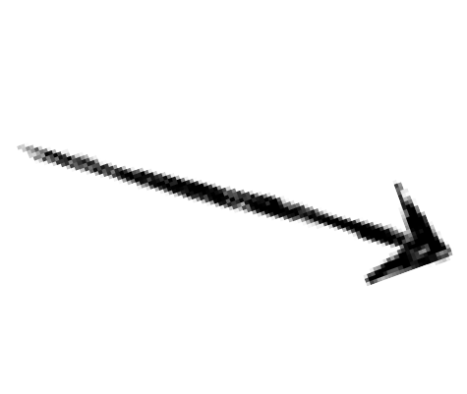








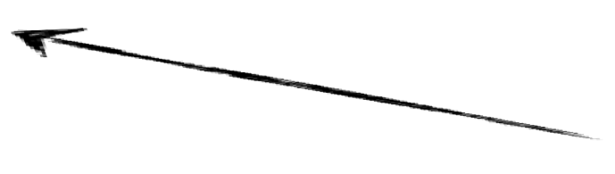


When is an Execution Not SC?
When a memory operation happens before itself
Execution
X=1 Y=1
r1=X [r1 <- 1]
r2=Y [r2 <- 0] r3=Y [r3 <- 1] r4=X [r4 <- 0]
Happens-Before Graph
Y=1 r1=X r3=Y
r2=Y r4=X
X=1
If there is a cycle in the happens-before graph, the execution is not SC

Slide 74
Two Design Constraints at Odds
SC is how programmers think, but restricts all reordering
Reordering allows optimization, but leads to unintuitive non-SC behavior.

Slide 75
Relaxed Memory Consistency
Relaxed Memory Models permit reorderings, unlike SC

Slide 76


x86-TSO (intel x86s)
“The Write Buffer Memory Model”
r1=Y X=1
Relaxes W->R order
r1=Y
Total Store Order - loads may complete before older stores to different locations complete.

Slide 77


PSO(SPARC)
“The Write Combining Memory Model”
X=1 Z=1 Y=1 Z=1
Relaxes W->W order
Partial Store Order - loads and stores may complete before older stores to different locations complete.

Slide 78
In General
r1=Y X=1
r1=Y r2=X
Y=1
r2=X
X=1 Z=1 Y=1 Z=1
r1=Y Y=1
R->R R->W
r1=Y
W->R W->W
Starting with PSO and relaxing R->R and R->W yields Weak Ordering or Release Consistency (alpha)
Depending on the implementation

Slide 79
Implementing Synchronization for Weak Memory Models
What does synchronization have to do to prevent SC violations?
Flush WB, prevent coalescing/bypassing, impose ordering in network, prevent compiler reorderings
What does synchronization have to do to prevent other kinds of problems?
Enforce mutually exclusive execution by different threads of critical region, force threads to wait at barriers, enforce wait/notify discipline

Slide 80
SC and Relaxed Consistency
SC is required for correctness and programmer sanity
+
Reordering is required* for performance
Goal: Ensure SC executions while permitting Relaxed Consistency reorderings
*Usually; MIPS memory model is SC

Slide 81
Memory Models across the System Stack
Language
Compiler
Architecture
Usually very weak for max optimization (lots of reordering)
Java/C++: SC for data-race- free programs
Conservative with reordering when d-r-f can’t be proved
Note: fences from
“above” ensure SC

Slide 82
What did we just learn?
Concurrency and parallelism, from the bottom to the top
Coherence and consistency are both memory ordering principles
Synchronization exists to spare you data-races and non-SC executions
Transactional memory is a powerful sync primitive in many x86 CPUs

