Slide 1
CMU 18-344: Computer Systems and the Hardware/Software Interface
Fall 2021, Prof. Brandon Lucia

Slide 2
Recap: Sparse Problems
What is a sparse problem? Why are they called “sparse”?
What makes sparse problems hard?
Roofline performance modeling
Hardware and software strategies for optimizing sparse problems

Slide 3
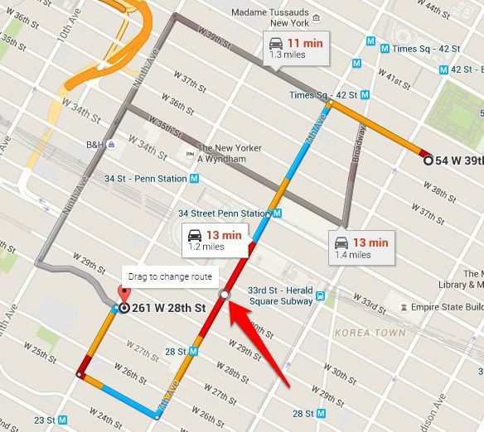
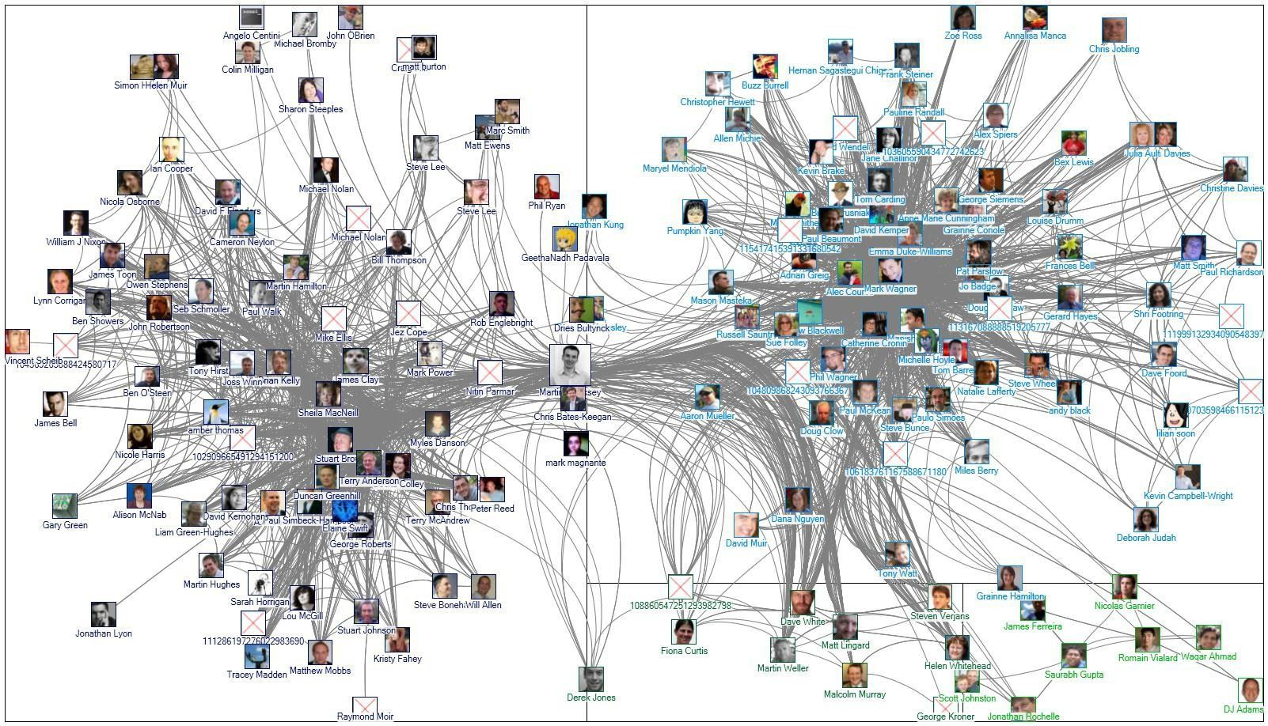

Graph Processing Problems are Sparse Problems
Path Planning
Social network analysis
Protein-Protein Interaction
The canonical examples of sparse problems are graph processing applications.

Slide 4
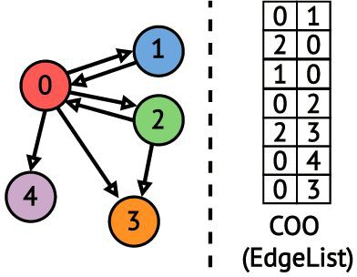

What does a graph processing program look like?
for e in EL: dstData[e.dst] =
f(srcData[e.src],dstData[e.dst])
dstData srcData
stores vertex property information
if srcData == dstData, updating in-place;
often “swap” srcData & dstData from 1 iteration to the next iteration

Slide 5
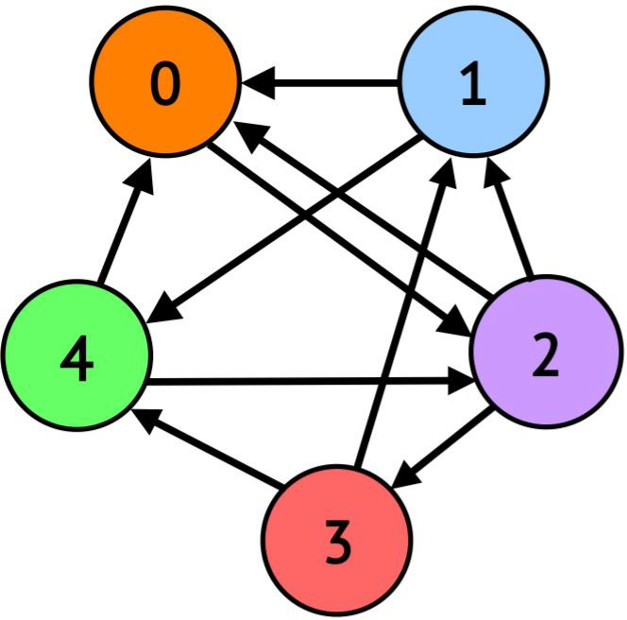
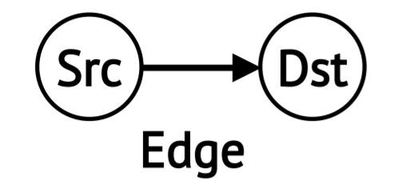
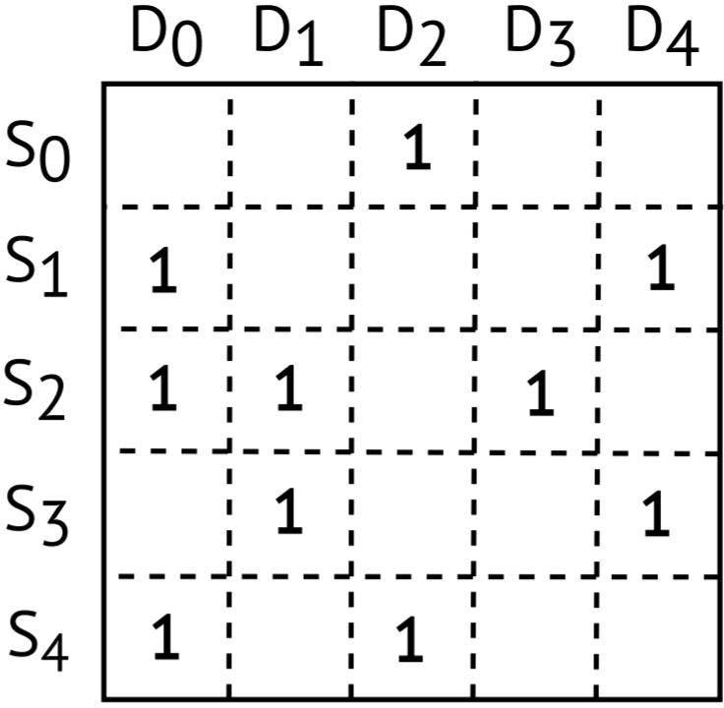
How do graph applications correspond to linear algebra?
Turns out that other graph applications also correspond to roughly this formulation if you change the operations you use (min/+ instead of +/*) or consider weighted edges
A^{T}x = x
i i+1
SSSP, BFS, PageRank, Connected-Components, Betweenness-Centrality, triangle counting… BFS is a representative sparse problem.
1
1
1
1
1
1
1
1
1
1
1
1
Dst
T
x_{i}
^{x}i+1
=
1
1
1
1
Src
=
Search done when no new vertices added (or all visited)
5

Slide 6
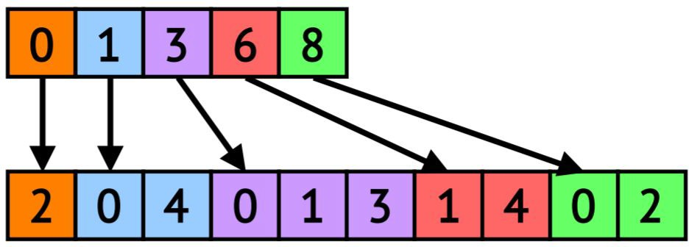
Compressed Sparse Data Structures for Feasible Memory Size
Offsets Array (OA)
Neighbors Array (NA)
Compressed Sparse Row (CSR)
Outgoing Neighbors
Dst
Vertex Property Array i.e., srcData / dstData
2 | 1 | 1 | 2 | 1
Often we will leave the vertex property array implicitly deﬁned when we talk about sparse structures, but it is always there
Src
6

Slide 7
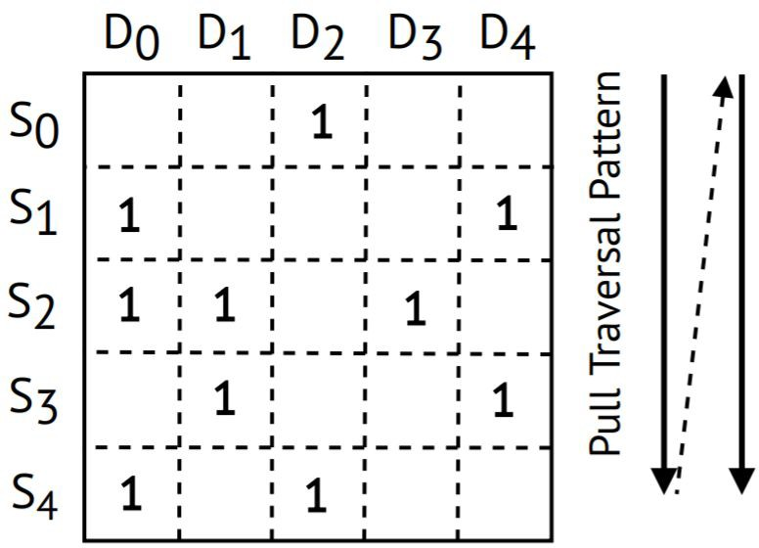
Compressed Representations ⇒ Irregular Memory Accesses
Dst
Push (CSR Traversal)
for src in G:
for dst in out_neighs(src): dstData[dst] += srcData[src]
Src
Push traversal performs irregular write operations that lack locality
i.e., x_{i+1}
dstData
OA
0 1 2 3 4
e.g., current rank of page I, e.g., current shortest path from source vertex
srcData
5 | 20 | 10 | 2 | 1
NA
CSR
7

Slide 8
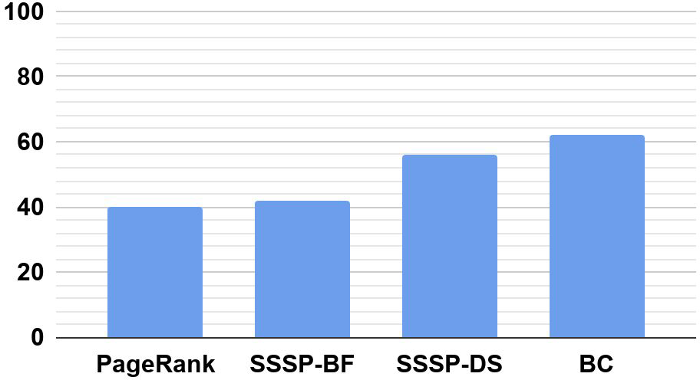
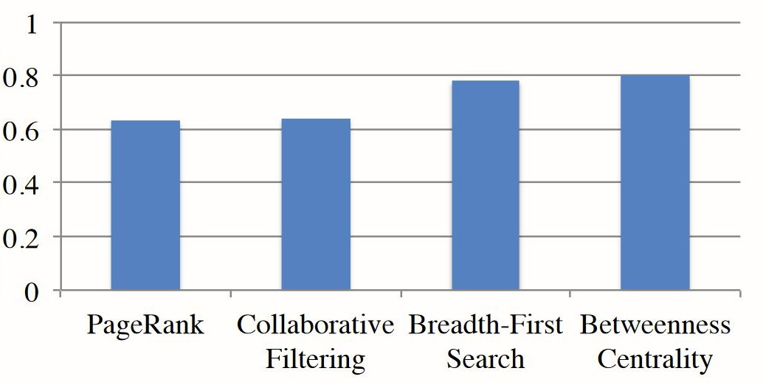
Irregular Accesses Lead to Poor Locality
LLC Miss Rate (%)
Cycles stalled on DRAM / Total Cycles
Problem: Sparse representations make processing large graphs feasible, but graph processing still entails a large working set with poor locality
8
Right Figure from “Optimizing Cache Performance for Graph Analytics” ArXiv v1;

Slide 9
Even Building the CSR / CSC is an Irregular Access Pattern!
for e in EL: neigh_count[e.dst]++; /*e.src*/
2 | 1 | 1 | 2 | 1
neigh_count
Updates to the neigh_count array are to random elements determined by order of edges in edge list

Slide 10
Even Building the CSR / CSC is an Irregular Access Pattern!
for e in EL:
NA[ OA[e.src]++ ] = e.dst
0 | 2 | 3 | 4 | 6
OA
NA
Completed CSC
1 | 2 | 0 | 0 | 0 | 2 | 0
Updates to NA based on EL order & OA[e.src] NA[ OA[e.src]++ ] = e.dst

Slide 11



Graph Applications are Memory-Bound
Memory-Bou nd
Compute-Bo und
Peak FLOPS
Throughput
(GFLOP/s)
DRAM BW utilization in graph apps is ~50%
Peak Mem BW
Why would we have spare BW capacity to go to memory and not use it?
250
Operational Intensity
(FLOPS/Byte)
1/16
11

Slide 12
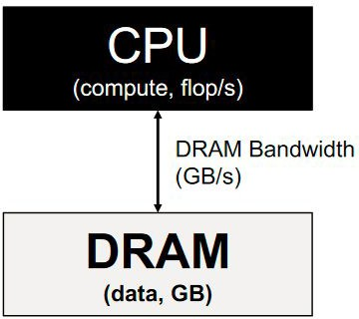
Improving Operational Intensity (OI) by Improving Locality
Memory-Bou nd
Compute-Bo und
Peak FLOPS
Throughput
(GFLOP/s)
Peak Cache BW
Key Question: So how do we improve locality, to reduce data movement from memory, to increase OI, and move to peak performance?
Locality wins: If we can operate out of cache, higher ceiling & more leftward ridge point.
Peak Mem BW
Why is cache BW > DRAM BW?
Smaller SRAM caches much faster.
1/16 1/8
250
Operational Intensity
(FLOPS/Byte)
12

Slide 13
Propagation Blocking: Optimizing Sparse Irregular Writes to Improve Cache Locality

Slide 14
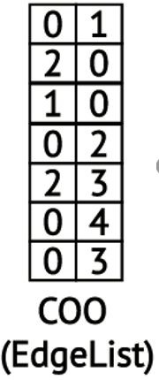
Propagation Blocking: Reorganize Input to Make Memory Being Randomly Written Fit in Cache
Bad for the cache: the size of the domain of vertex data array entries is |V|, but the
|Domain| = |V| = 5 vertices
cache holds only |C| << |V| entries
0 | 0 | 0 | 0 | 0
Recall: irregular accesses into vertex data array based on
e.dst which are essentially random
|Cache| = 2 vertices
14

Slide 15
Propagation Blocking: Reorganize Input to Make Memory Being Randomly Written Fit in Cache
Bad for the cache: the size of the domain of vertex data array entries is |V|, but the
|Domain| = |V| = 5 vertices
cache holds only |C| << |V| entries
0 | 0 | 0 | 0 | 0
Recall: irregular accesses into vertex data array based on
e.dst which are essentially random
|Cache| = 2 vertices
Key idea in propagation blocking: Limit the domain of updates to a sub-space of vertices,
V*, so that |V*| <= |C| and do multiple sub-spaces of V*s, so that all V*s together = V
15

Slide 16



Propagation Blocking: Performance Analysis
Usually save a little space in cache for
Traverse the edge list twice instead of once streaming edge list data. Easy to cache.
Binning
Bin Read
Streaming
2 3
0 3
0 4
0 | 1
2 | 0
1 0
0 2
0
0
0
Random Access, but always in cache
0 | 0 | 0 | 0 | 0
Bin 1:
dst 0-2
Bin 1:
dst 3-5
dstData
Remember: dstData[e.dst] ++
and e.dst is random, from edge list
What about the performance of reading the edge list during binning?
16

Slide 17
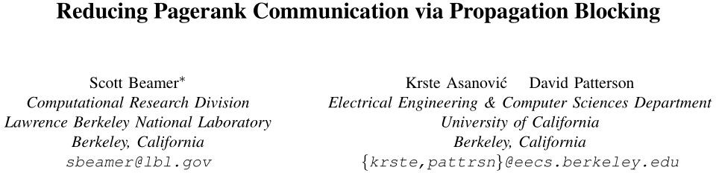
Propagation Blocking
PropagationBlocking_EdgeCount(EdgeList E){
Bins B[];
for edge in E{
add_to_bin( find_bin(edge) )
}
for bin in B{ for e in bin{
dstData[e.dst]++
}
}
}
Application of Propagation Blocking for Graph Applications (Page Rank only, at first) discovered in 2017 (Prior work on “radix partitioning” applied the idea to other domains, but not graphs)

Slide 18
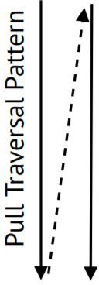


Using The Graph’s Transpose For Optimal Replacement
Dst
Pull Execution (CSC Traversal)
for dst in G:
for src in in_neighs(dst): dstData[dst] += srcData[src]
Src
CurrDs Irregular Data Stream
t_{D0}
D₀ D₀ D₁ D
srcData[S₁]
srcData[S₂]
srcData[S₄]
srcData[S₂]
srcData[S₃]
Which line should we evict?:
Time
srcData[S₁]
srcData[S₁] (nextRef @ D₄)
srcData[S₂] (nextRef @ D₁)
srcData[S₂]
1
18
2-way Set-Associative
. . .

Slide 19
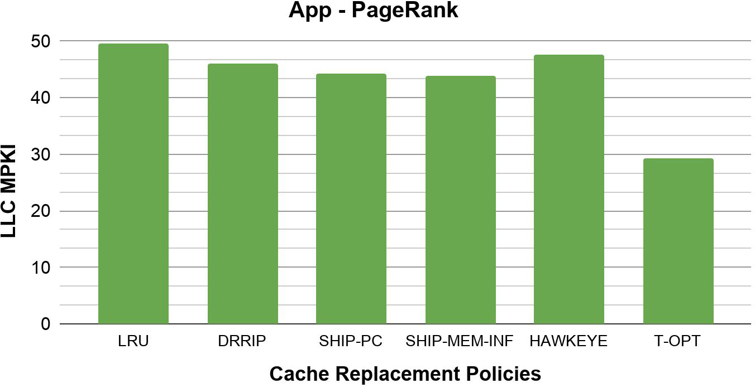

Transpose-based OPT (T-OPT) Provides Large Gains
1.7X
19

Slide 20
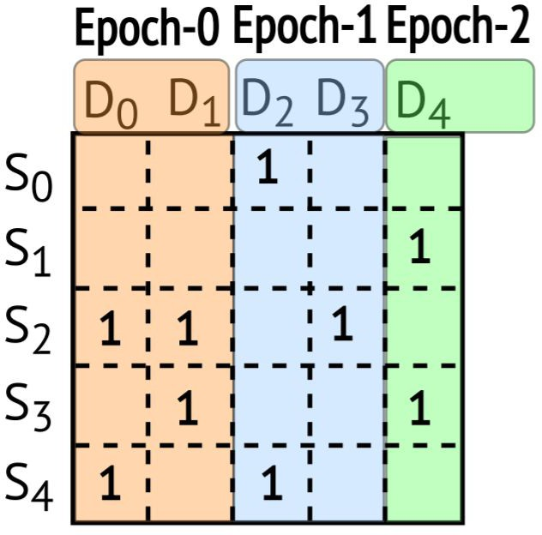

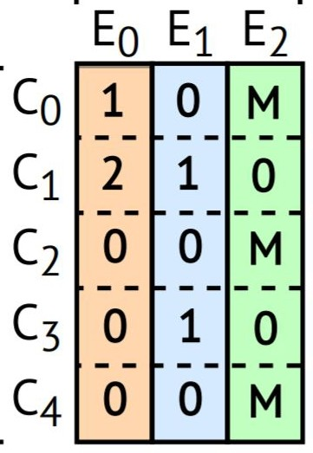
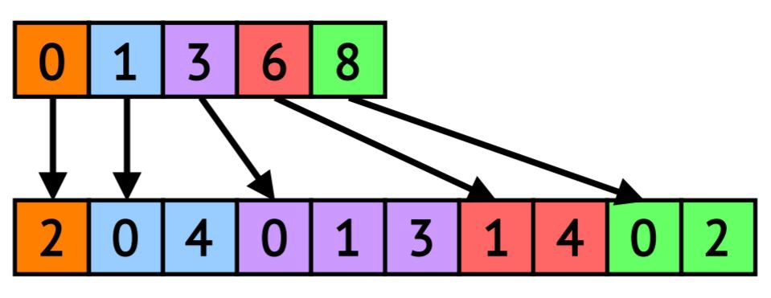
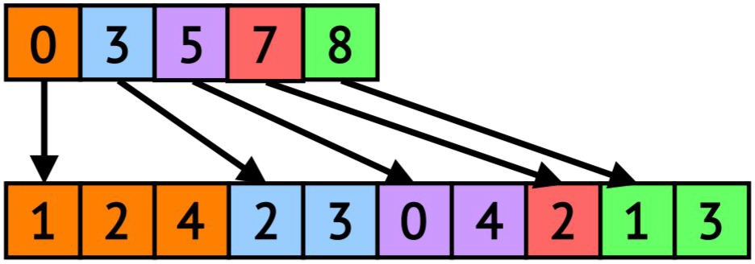
Main Technique: Use Quantization To Compress The Transpose
Dst
Divide execution into coarse-grained epochs
Src
Quantization enables compression of transpose data
OA
NA
CSR
(Transpose)
Rereference Matrix
(Quantized Transpose)
20

Slide 21
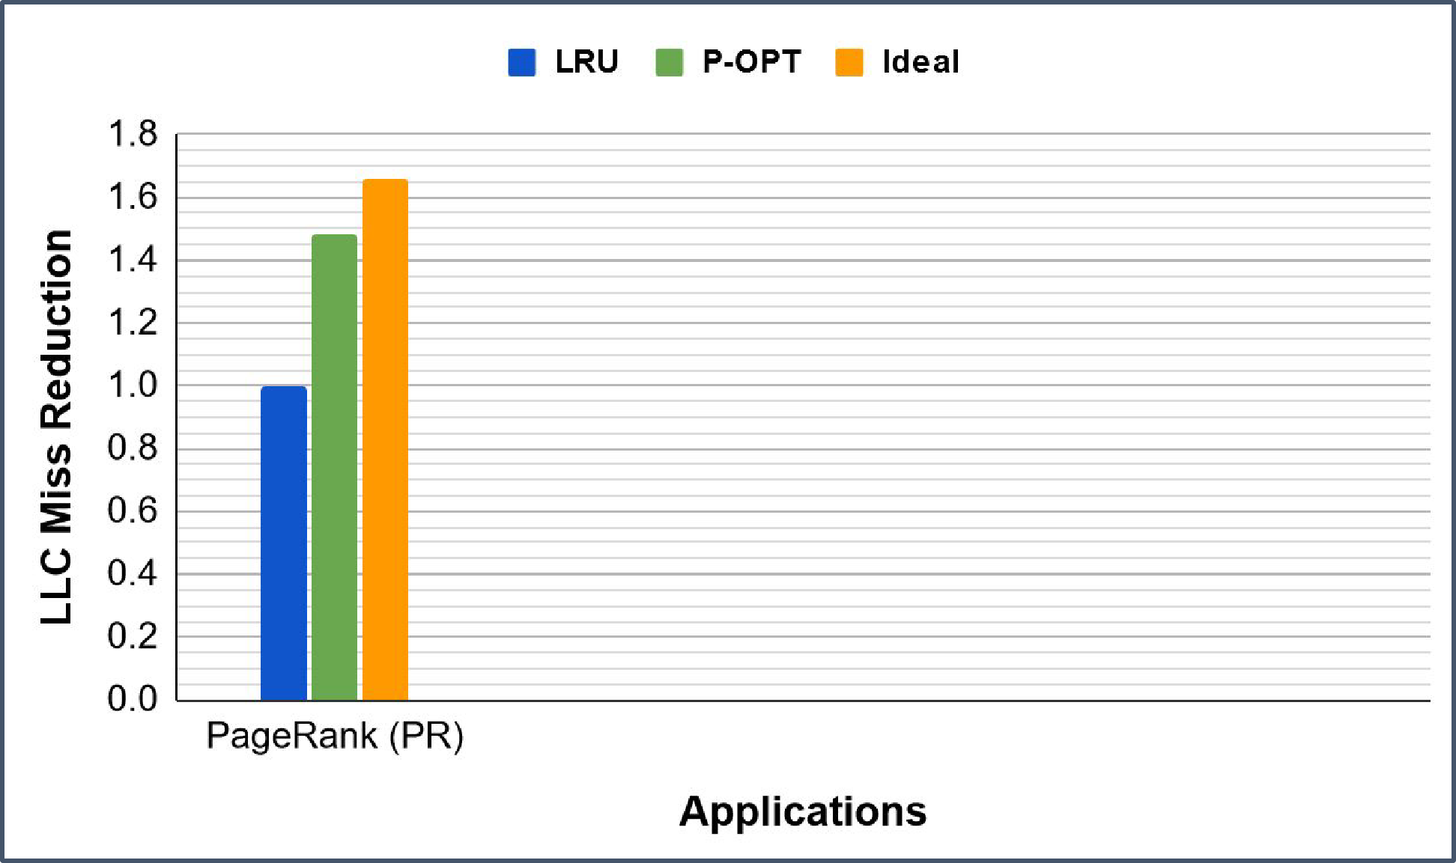
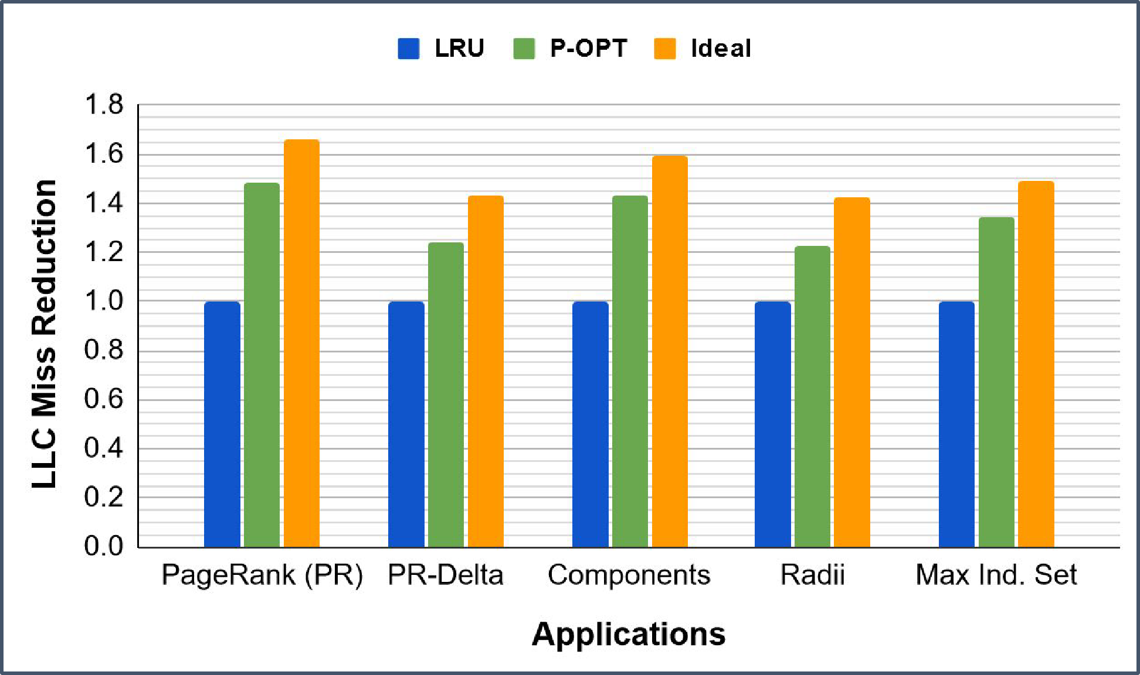
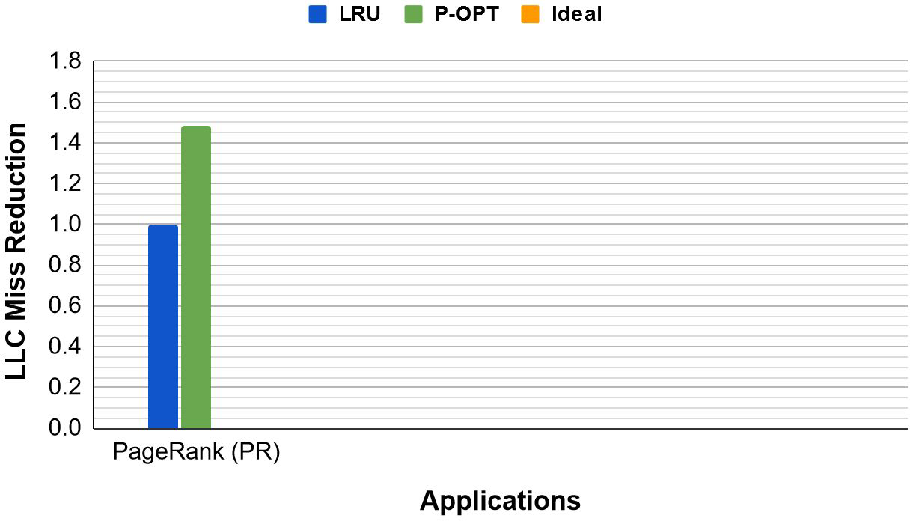
P-OPT Improves Cache Locality
P-OPT results are only 12% away from the Ideal
21

Slide 22
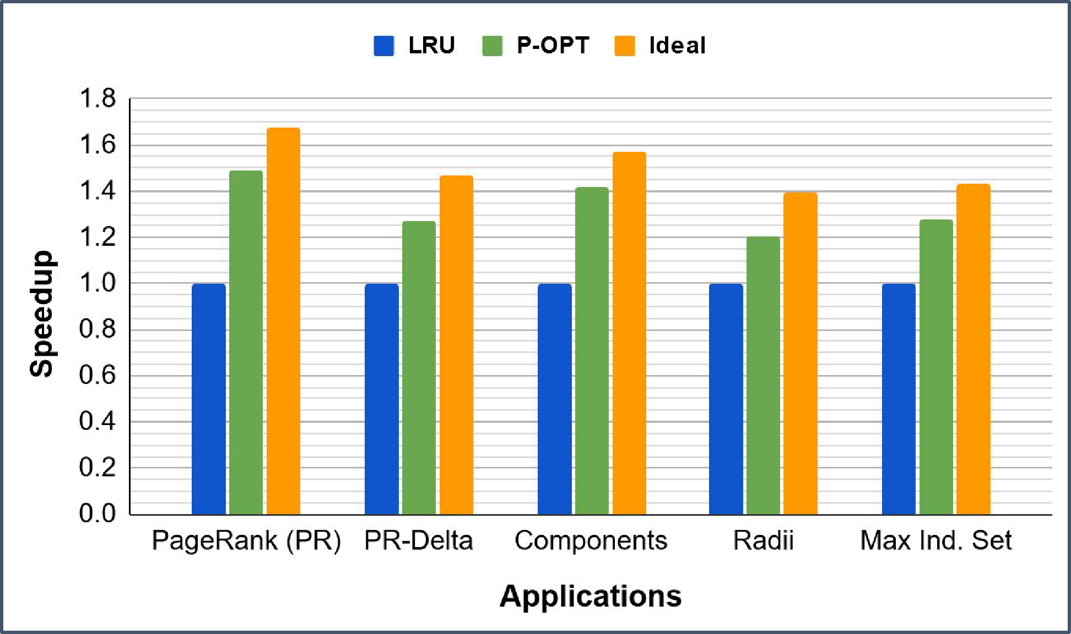
P-OPT’s LLC Miss Reductions Directly Translate To Speedups
P-OPT provides up to 1.56x speedup over LRU
22

Slide 23
Today: Parallel Computer Architectures
Why do we have mainly parallel computers
How do we make caches work with parallelism
Memory consistency models & ordering
Implementing synchronization

Slide 24


Slide 25
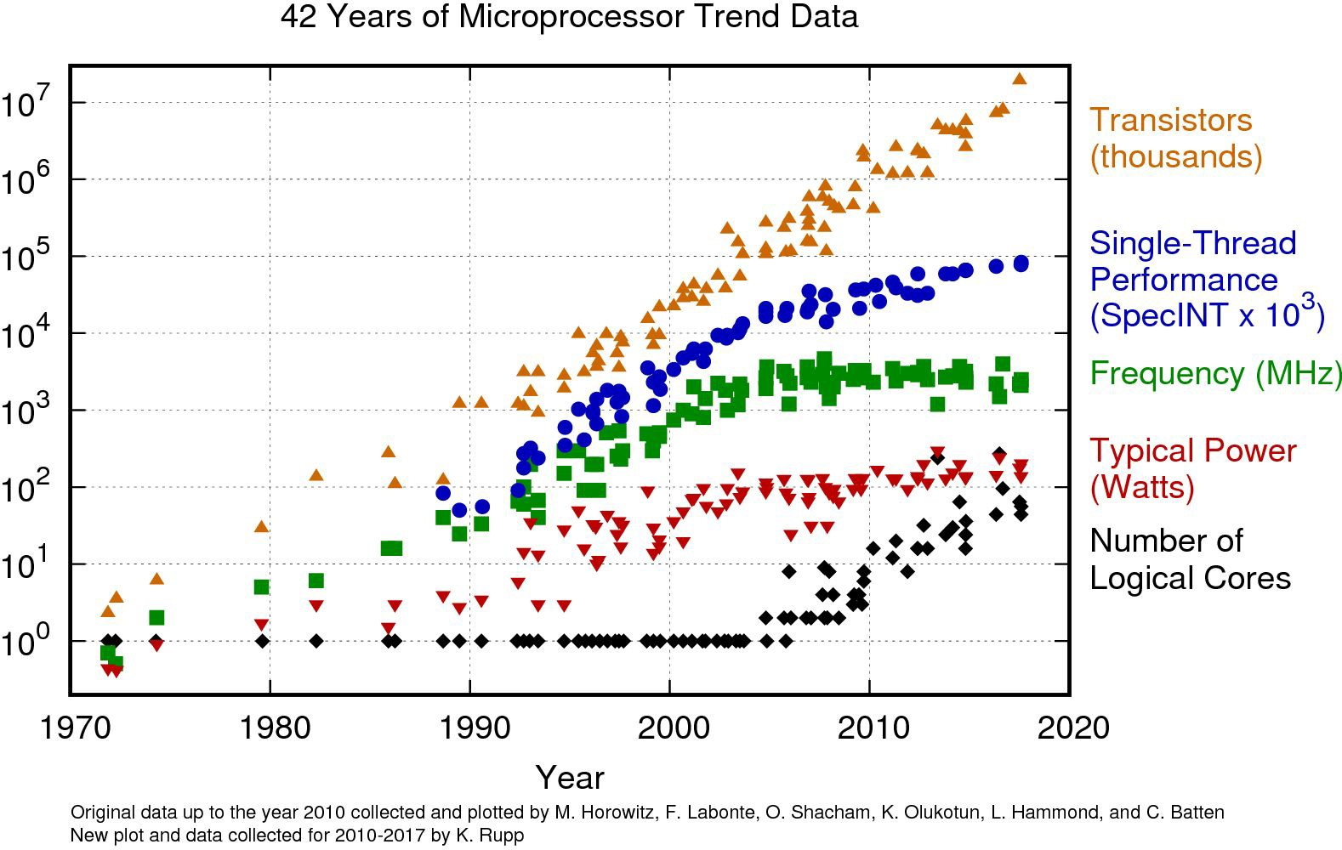

Slide 26
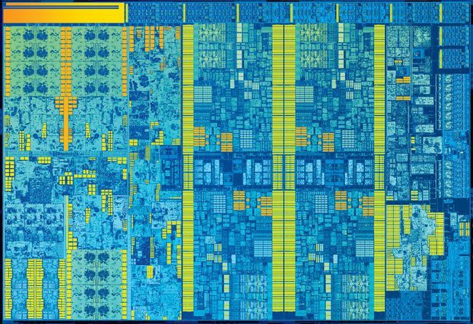
14 nm process
11 metal layers
~1,750,000,000 transistors
~9.19 mm x ~11.08 mm
~101.83 mm² die size
4 CPU cores + 24 GPU EUs

Slide 27
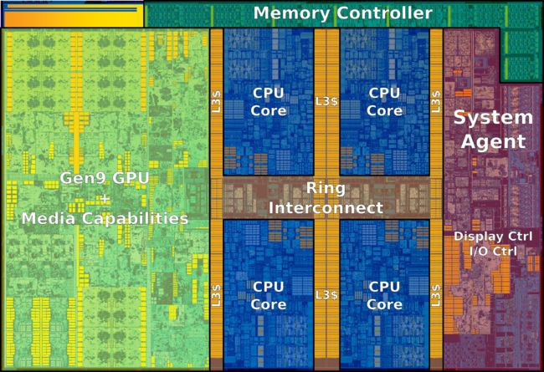
14 nm process
11 metal layers
~1,750,000,000 transistors
~9.19 mm x ~11.08 mm
~101.83 mm² die size
4 CPU cores + 24 GPU EUs
Shared memory multi-threading

Slide 28
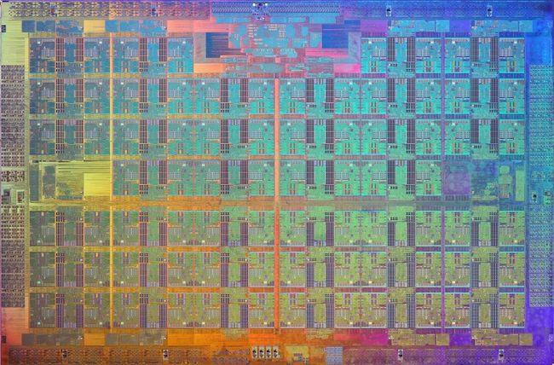
14 nm process
682.6 mm² die size
76 CPU cores
7,100,000,000 transistors

Slide 29
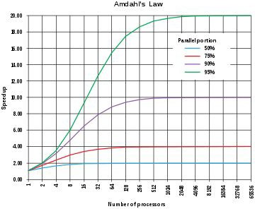
Parallel hardware + parallelizable software are a direct application of
Amdahl’s Law
Multi-core parallelism was the primary way to keep performance scaling alive once single-thread performance hit the
wall
Question: How to we architect a
programmable parallel computer
system?

Slide 30

“Coherence seeks to make the caches of
a shared-memory system as functionally invisible as the caches in a single-core system. Correct coherence ensures that a programmer cannot
determine whether and where a system has caches by analyzing the results of loads and stores.”
Excerpt from “Primer on Memory Consistency and Cache Coherence” Mark Hill, 2011

Slide 31
Cache Coherence

Slide 32
CPU 1
CPU 2
CPU 3
r X=1
$
r X=2
 | $
W
W
Rd X=?
$
What is the behavior of this parallel program? (X initially 0)

Slide 33
CPU 1
CPU 2
CPU 3
r X=1
$
r X=2
 | $
W
W
Rd X=?
$
Wr X=1
Wr X=2
Rd X=2
Wr X=2
Wr X=1
Rd X=1 Rd X=0
Wr X=1
Wr X=2

Slide 34
CPU 1
CPU 2
CPU 3
++
$
++
 | $
X
X
Rd X=?
$
What about this example? (X initially 0)

Slide 35
CPU 1
CPU 2
CPU 3
++
$
++
 | $
X
X
Rd X=?
$
X++
X++
Rd X=2
X++
X++
Rd X=2
X++
Rd X=1
(and the symmetric case)
X++

Slide 36
CPU 1
CPU 2
CPU 3
++
$
++
 | $
X
X
Rd X=?
$
What assumptions are we making about the system to produce the results 0, 1, and 2?

Slide 37
CPU 1
CPU 2
CPU 3
++
$
++
 | $
X
X
Rd X=?
$
We assume the updates see one anothers’ results! (Why wouldn’t they?)

Slide 38
CPU 1
CPU 2
CPU 3
++
=0
++
 | X=0
X
X
Rd X=?
X
$
X++
$[X]=1
X++
Rd X=?
Memory: X=0 CPU1: X=1 CPU2: X=1
Reality: X=2 (?!)
$[X]=1
So what the heck do we do now?

Slide 39
CPU 1
CPU 2
CPU 3
++
=0
++
 | X=0
X
X
Rd X=?
X
$
X++
$[X]=1
X++
Rd X=?
Memory: X=0 CPU1: X=1 CPU2: X=1
Reality: X=2 (?!)
$[X]=1
Never let this happen. Caches should be coherent.
“coherence ensures that a programmer cannot determine whether and where a system has caches by analyzing the results of loads and stores”

Slide 40
Informally Defining Coherence
“Coherence serializes all reads with all updates to the same location by different CPUs/caches, so that each read sees the result of the most recent update by any other”
“Single Writer/Multiple Reader (SWMR) Invariant
+
Data-Value Invariant”

Slide 41
Epoch Model
$[X]=0
Read/Write X++
Epoch for CPU1 ^{$[X]=1}
$[X]=1
Read/WriteX++
Epoch for CPU2^{$[X]=2}
$[X]=2
Read-onlyRd X=?
$[X]=2
Rd X=?
Epoch for all
$[X]=2 $[X]=2
Yay! Corresponds to reality!

Slide 42
Epoch Model
R/W vs. R-O Epochs directly enforce SWMR
$[X]=0
Read/Write X++
Epoch for CPU1 ^{$[X]=1}
$[X]=1
Read/WriteX++
Epoch for CPU2^{$[X]=2}
$[X]=2
Read-onlyRd X=?
$[X]=2
Rd X=?
Epoch for all
$[X]=2 $[X]=2
Yay! Corresponds to reality!
Epoch transitions assume data-value invariant

Slide 43
What do we need to implement the Epoch Model?
Need to add concept of R/W epoch vs. R-O epoch
Need to add gadget that correctly moves data between epochs

Slide 44
Cache Coherence Protocol
Add state to each cache line saying whether it is R-O or R/W
Add protocol actions to move lines from state to state based on (1)local memory operations; and (2)other CPUs’ memory operations
Add support to get data from (1)local cache; (2)a remote cache; or (3)main memory, depending on line’s protocol state

Slide 45
High-level sketch of protocol in action
(1) CPU1 says “I am is writing X”
Others relinquish cached copies of X
and reply “OK go for it” <enter R/W epoch>
$[X]=0
Read/Write X++
Epoch for CPU1 ^{$[X]=1}
(ditto (1) for CPU2)
(2)
CPU3 says “I want to read only”
$[X]=1
Read/WriteX++
Epoch for CPU2^{$[X]=2}
₍₄₎Others reply “OK, we all agree
not to write without saying so”
<enter R-O epoch>
$[X]=2
Read-onlyRd X=?
$[X]=2
Rd X=?
$[X]=2
CPU1 replies “I have X. Use my copy or get it from memory after I write it back”
Epoch for all
$[X]=2
(3)
(ditto (3) for CPU 2) (5)

Slide 46


Cache Coherence Protocol
M
S
Per-line coherence states
I

Slide 47
Cache Coherence Protocol
Modified (R/W)
Shared (R-O)
Invalid (inaccessible)

Slide 48




Cache Coherence Protocol
Local operations perspective
Locally perform a read or write
Locally perform a write
[send invalidations to other CPUs]
Locally perform a read
M
S
Locally perform a write [send invalidations to other CPUs]
Locally perform a read
[send requests to share to other CPUs]
I

Slide 49


Cache Coherence Protocol
Remote operations perspective
Incoming request to share [reply with data or write back]
M
S
Incoming Invalidation [reply with invalidation acknowledgement]
Incoming Invalidation
[reply with invalidation acknowledgement]
I

Slide 50
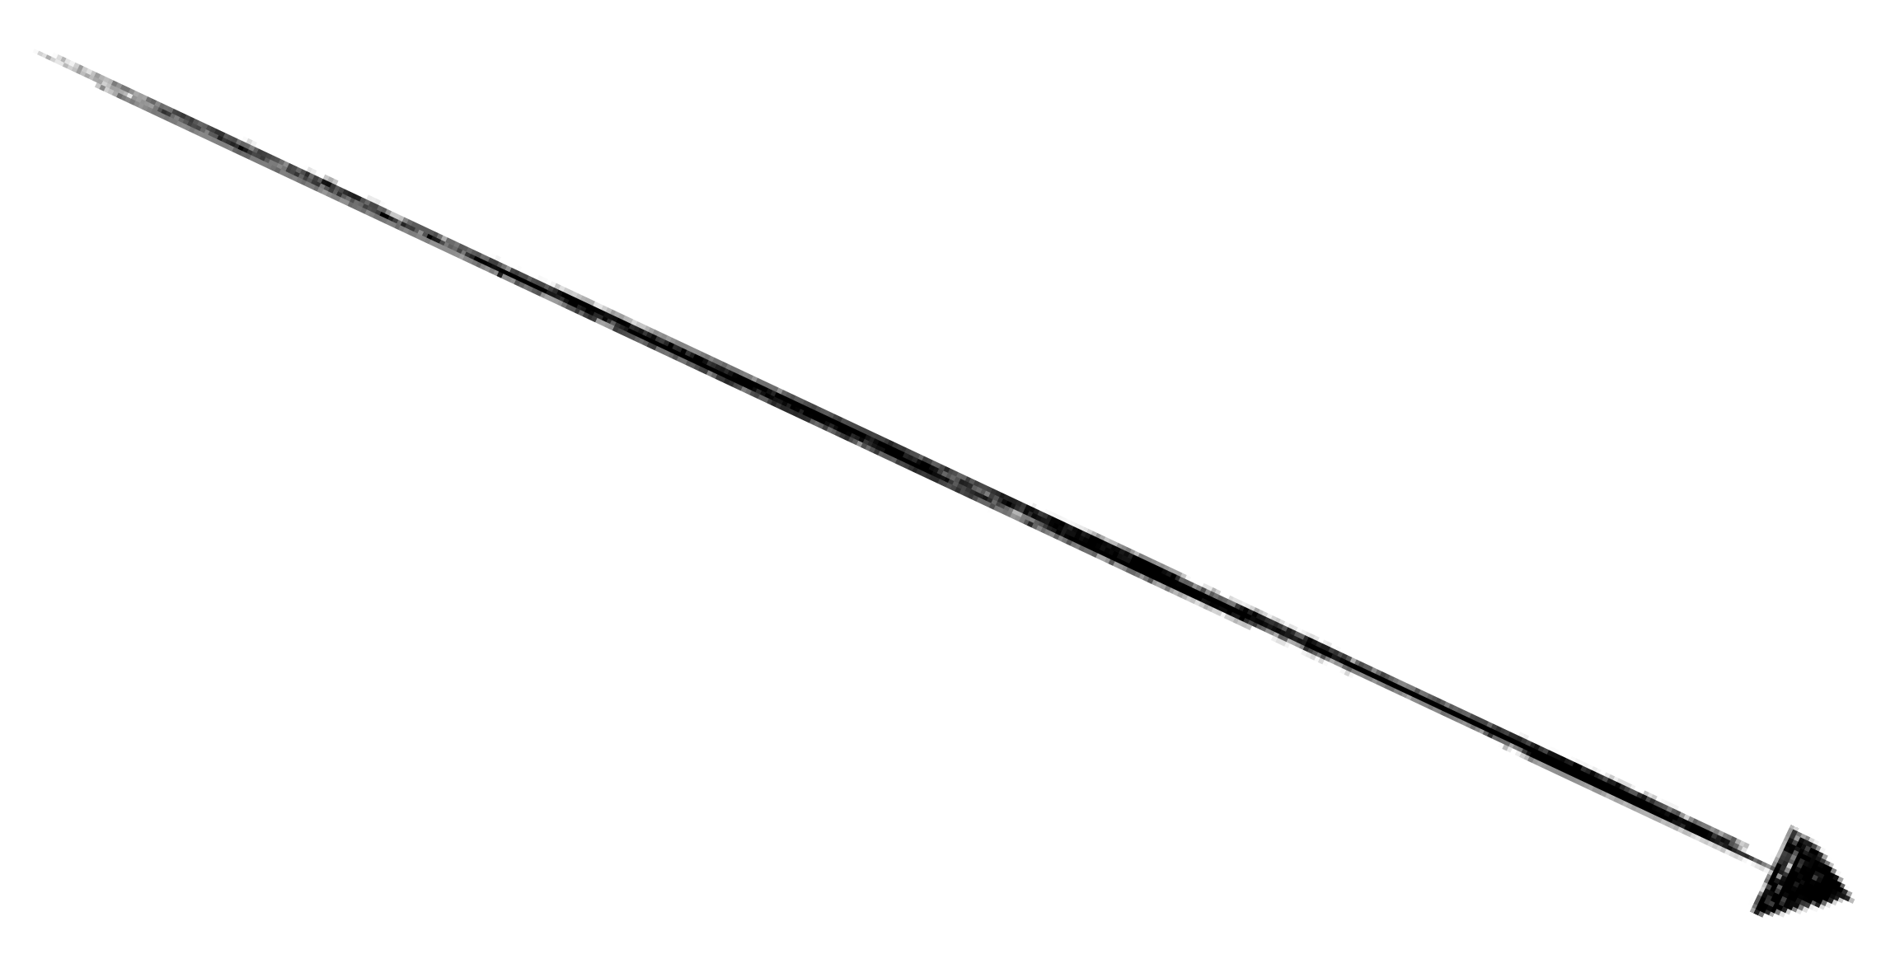
Can we design another state?
M
S
?
I
What should we optimize?

Slide 51
Can we design another state?
M
S
Exclusive Read-only
I
(Benefit: no invalidation required
to transition from E->M, like from S->M)

Slide 52

Implementing the Protocol
CPU 1 CPU 2 CPU 3
++
$
++
 | $
X Rd X=?
X
$
Shared bus for coherence messages
Snoopy Coherence

Slide 53
Implementing the Protocol
CPU 1 CPU 2 CPU 3
++
$
++
 | $
X Rd X=?
X
$
Invalidate X++

Slide 54
Implementing the Protocol
CPU 1 CPU 2 CPU 3
++
$
++
 | $
X Rd X=?
X
$
Ack
Ack
X++

Slide 55
Implementing the Protocol
CPU 1 CPU 2 CPU 3
++
=1
++
 | $
X Rd X=?
X
(M)X
Entering CPU1’s write epoch
$
X++

Slide 56
Implementing the Protocol
CPU 1 CPU 2 CPU 3
++
=1
++
 | $
X Rd X=?
X
(M)X $
RdReq Rd X=?
X++

Slide 57
Implementing the Protocol
CPU 1 CPU 2 CPU 3
++
=1
++
 | $
X Rd X=?
X
(M)X $
Got it: X=1 X++
Don’t have it
Rd X=?

Slide 58
Implementing the Protocol
CPU 1 CPU 2 CPU 3
++
=1
++
 | $
X Rd X=?
X
(S) X (S)
X=1
Entering R-O epoch
X++
Rd X=?

Slide 59

Implementing the Protocol
CPU 1 CPU 2 CPU 3
++
$
++
 | $
X Rd X=?
X
$
What sucks about Snoopy?

Slide 60
Implementing the Protocol
CPU 1 CPU 2 CPU 3
++
$
++
 | $
X Rd X=?
X
$
Shared bus
Bus limits scalability due to congestion and complex message arbitration

Slide 61
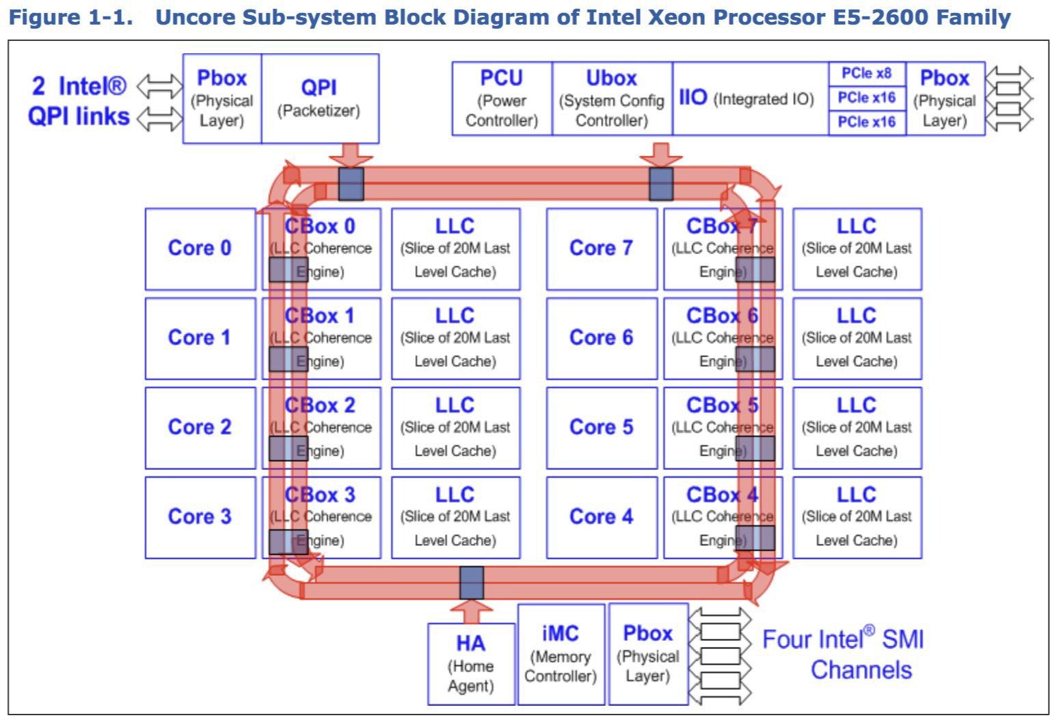
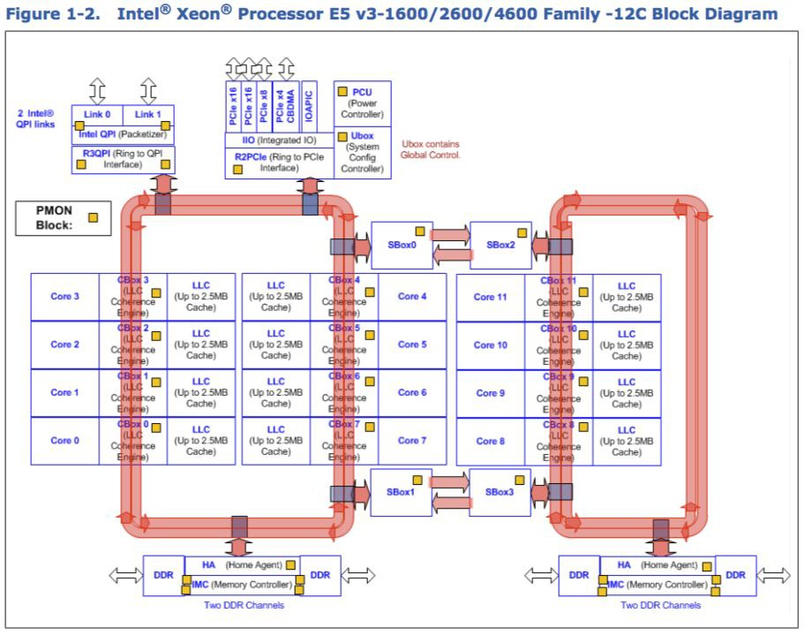
Intel Sandybridge Multiprocessor: bi-directional ring network

Slide 62
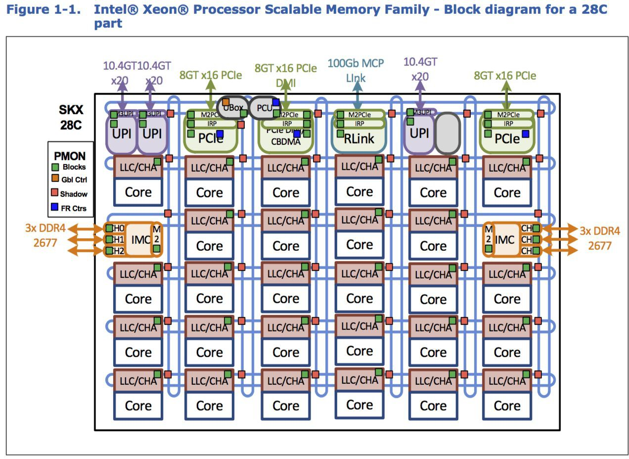
Skylake Xeon 2017 2D mesh

Slide 63
Implementing the Protocol
CPU 1 CPU 2 CPU 3
++
$
++
 | $
X Rd X=?
X
$
(Effectively) Point to Point Links
Sharers of X
Directory-based

Slide 64
Implementing the Protocol
CPU 1 CPU 2 CPU 3
++
$
++
 | $
X Rd X=?
X
$
Sharers of X
Directory-based

Slide 65
Implementing the Protocol
CPU 1 CPU 2 CPU 3
++
$
++
 | $
X Rd X=?
X
$
Who has X?
Sharers of X
X++
Directory-based

Slide 66
Implementing the Protocol
CPU 1 CPU 2 CPU 3
++
$
++
 | $
X Rd X=?
X
$
No one does! Proceed!
Sharers of X
X++
Directory-based

Slide 67
Implementing the Protocol
CPU 1 CPU 2 CPU 3
++
$
++
 | X=1
X Rd X=?
X
X=1
CPUs 2 and 3 do.
Send them Invalidates!
Sharers of X
X++
Rd X=?
X++
Directory-based

Slide 68
Implementing the Protocol
CPU 1 CPU 2 CPU 3
++
=1
++
 | $
X Rd X=?
X
X $
Sharers of X
Benefit: No broadcast on shared bus

Slide 69
Implementing the Protocol
CPU 1 CPU 2 CPU 3
++
=1
++
 | $
X Rd X=?
X
X $
Sharers of X
X++
Drawbacks?

Slide 70
Implementing the Protocol
CPU 1 CPU 2 CPU 3
++
=1
++
 | $
X Rd X=?
X
X $
Sharers of Y
Sharers of X
Centralized directory won’t scale (In Practice: Distribute Directory)

Slide 71
Optimization: Non-binding Prefetch
CPU 1 CPU 2 CPU 3
F X
$
d X
 | X
Rd X
 | X
P
R
Sharers of X
CPU 2
CPU 3
Prefetch instruction preemptively changes coherence state

Slide 72
Optimization: Non-binding Prefetch
CPU 1 CPU 2 CPU 3
P X
…F X =1
=1
d X
 | $
Rd X
 | $
R
X
Owner of X
CPU 2
CPU 3
CPU 1
Benefit?

Slide 73
Optimization: Speculation
CPU 1 CPU 2
CPU 3
i
f(C) BP X=1
X | s
d X
 | $
Rd X
 | $
: taken
R
speculative
Owner of X
CPU 2
CPU 3
CPU 1
Speculative operations that squash behave like non-binding pre-fetch

Slide 74

“computers execute operations in a different order than is specified by the program. A correct execution is achieved if the results produced are the same as would be produced by executing the program steps in order. For a multiprocessor computer, such a correct execution by each processor does not guarantee the correct execution of the entire program.”
Excerpt from “How to Make a Multiprocessor Computer That Correctly Executes Multiprocess Program”
LESLIE LAMPORT, 1979

Slide 75

“The memory consistency model of a shared-memory system specifies the order in which memory operations will appear to execute to the programmer. The memory consistency model affects the process of writing parallel programs and forms an integral part of the entire system, including the architecture, the compiler, and the programming
language.”
Excerpt from “Recent Advances in Memory Consistency Models for Hardware Shared-Memory Systems”
Sarita Adve, et al, 1999

Slide 76
Memory Consistency

Slide 77
Memory Consistency Model
Informal Definition:
“Defines the value a read operation may read at each point during the execution”
“Defines the set of legal observable orders of memory operations during an execution”
“Defines which reorderings of memory operations are permitted”

Slide 78
Coherence is Ordering
Wr X
Wr X
OR
Wr X
Wr X
Coherence defines the set of legal orders of accesses to a single memory location

Slide 79
Consistency is Ordering
Wr X
Wr Y
OR
Wr Y
Wr X
Consistency defines the set of legal orders of accesses to multiple memory locations

Slide 80
Sequential Consistency (SC)
The simplest, most intuitive memory consistency model
Two Invariants to SC:
Invariant #1: Instructions are executed in program order
Invariant #2:
All processors agree on a total order of executed instructions

Slide 81
The SC “Switch”
Wr X
Rd Y
Wr Y
Rd X
Rd X
Execution

Slide 82
The SC “Switch”
Wr X
Rd Y
Wr Y
Rd X
Rd X
Execution
Wr X

Slide 83
The SC “Switch”
Wr X
Rd Y
Wr Y
Rd X
Rd X
Execution
Wr X Rd Y

Slide 84
The SC “Switch”
Wr X
Rd Y
Wr Y
Rd X
Rd X
Execution
Wr X Rd Y Wr Y

Slide 85
The SC “Switch”
Wr X
Rd Y
Wr Y
Rd X
Rd X
Execution
Wr X Rd Y Wr Y Rd X

Slide 86
The SC “Switch”
Wr X
Rd Y
Wr Y
Rd X
Rd X
Execution
Wr X Rd Y Wr Y Rd X Rd X

Slide 87
Why is SC Important?
SC is the most complex model that we can ask
programmers to think about.
Intuitive (SC)Weird (not SC)
Wr X Rd Y Wr Y Rd X Rd X
Rd Y Wr X
Rd X Rd X Wr Y
Wr X
Wr Y Rd X
Rd Y
Rd X
SC prohibits all reordering of instructions (Invariant 1)

Slide 88
Why are Instructions Reordered?
Examples? When does it matter? When does it not matter?

Slide 89
Reordering #1: Write Buffers
CPU
CPU
 |  | Wri
M
CPU can read its write buffer, but not others’
Write Buffer
te Buffer
M
Coherent
Buffered writes eventually end up in coherent shared memory

Slide 90
Reordering #1: Write Buffers
Program Initially X == Y == 0
M
X=1
Y=1
r1=Y
r2=X
Is r1==r2==0
a valid result?
M

Slide 91
Reordering #1: Write Buffers
Program Initially X == Y == 0
M
X=1
Y=1
r1=Y
r2=X
Is r1==r2==0
a valid result?
M
r1 == r2 == 0 is not SC, but it can happen with write buffers

Slide 92
Reordering #1: Write Buffers
Program Initially X == Y == 0
Y=1
X=1
M
M
r1=Y
r2=X
Execution

Slide 93
Reordering #1: Write Buffers
Program Initially X == Y == 0
X=
 | 1
M
Y=1
M
r1=Y
r2=X
Execution

Slide 94
Reordering #1: Write Buffers
Program Initially X == Y == 0
X=
 | 1
M
Y=
 | 1
M
r1=Y
r2=X
Execution

Slide 95
Reordering #1: Write Buffers
Program Initially X == Y == 0
r2=X
Execution
r1=Y
X=
 | 1
M
Y=
 | 1
M

Slide 96
Reordering #1: Write Buffers
Program Initially X == Y == 0
r1=Y
X=
 | 1
M
r2=X
Y=
 | 1
M
Execution

Slide 97
Reordering #1: Write Buffers
Program Initially X == Y == 0
X=
 | 1
M
r2=X
Y=
 | 1
M
Execution
r1=Y [r1 <- 0]

Slide 98
Reordering #1: Write Buffers
Program Initially X == Y == 0
X=
 | 1
M
Y=
 | 1
M
Execution r1=Y [r1 <- 0] r2=X [r2 <- 0]

Slide 99
Reordering #1: Write Buffers
Program Initially X == Y == 0
M
M
Execution r1=Y [r1 <- 0] r2=X [r2 <- 0]
WBs let reads finish before older writes
^{X=1} (Not SC!)
Y=1

Slide 100
Reordering #2: Write Combining
Program X,Z in same $ line
X=1 Y=1 Z=1
Coalescing Write Buffer
4 word cache line

Slide 101
Reordering #2: Write Combining
Program X,Z in same $ line
X=1 Y=1 Z=1
Coalescing Write Buffer
X=1

Slide 102
Reordering #2: Write Combining
Program X,Z in same $ line
X=1 Y=1 Z=1
Coalescing Write Buffer
X=1
Y=1

Slide 103
Reordering #2: Write Combining
Program X,Z in same $ line
X=1 Y=1 Z=1
Coalescing Write Buffer
X=1
Y=1
Z=1

Slide 104
Reordering #2: Write Combining
Coalescing Write Buffer Coalescing Write Buffer
X=1
Y=1
Z=1
X=1 Z=1
Y=1
Combining the write to X & Z saves bandwidth, but reorders Z=1 and Y=1

Slide 105
Reordering #3: Interconnect
Program
X=1 r1=X Y=1 r2=Y
r3=Y r4=X
X=1
Y=1
Y=1
Execution
X=1 Y=1
r1=X [r1 <- 1]
r2=Y [r2 <- 0] r3=Y [r3 <- 1] r4=X [r4 <- 0]
X=1
Variable time cost traversing routed on-chip network

Slide 106
Reordering #4: Compilers
Hoisted!
X = 0
for (1 .. 100)
X = 1
print X
X = 1
for (1 .. 100)
print X
X = 0
X = 0
The compiler hoists the write out of the loop, permitting new (non-SC) results (e.g., “1 0 0 0 0 0 0...”)

Slide 107
When is Reordering a Problem?
When Executions Aren’t SC

Slide 108
When is an Execution Not SC?
When a memory operation happens before itself
Execution r1=Y [r1 <- 0] r2=X [r2 <- 0]
X=1 Y=1
Happens-Before Graph
X=1
Y=1
r1=Y
r2=X

Slide 109
When is an Execution Not SC?
When a memory operation happens before itself
Execution r1=Y [r1 <- 0] r2=X [r2 <- 0]
X=1 Y=1
Happens-Before Graph
X=1
Y=1
r1=Y
r2=X
Program Order HB Edge

Slide 110




When is an Execution Not SC?
When a memory operation happens before itself
Execution r1=Y [r1 <- 0] r2=X [r2 <- 0]
X=1 Y=1
Happens-Before Graph
X=1
Y=1
r1=Y
r2=X
Program Order HB Edge Causal Order HB Edge

Slide 111
When is an Execution Not SC?
When a memory operation happens before itself
Execution r1=Y [r1 <- 0] r2=X [r2 <- 0]
X=1 Y=1
Happens-Before Graph
X=1
Y=1
r1=Y
r2=X
If there is a cycle in the happens-before graph, the execution is not SC

Slide 112



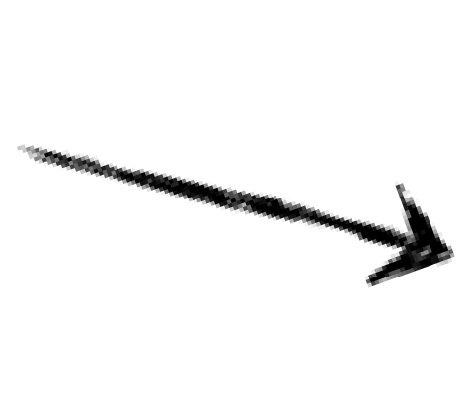








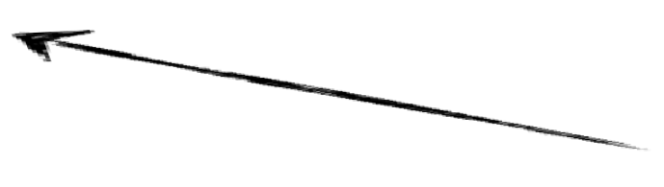


When is an Execution Not SC?
When a memory operation happens before itself
Execution X=1 Y=1
r1=X [r1 <- 1]
r2=Y [r2 <- 0] r3=Y [r3 <- 1] r4=X [r4 <- 0]
Happens-Before Graph
Y=1 r1=X r3=Y
r2=Y r4=X
X=1
If there is a cycle in the happens-before graph, the execution is not SC

Slide 113
So... are Computers Wrong?!
SC is how programmers think.
SC prohibits all reordering of instructions
WBs let reads finish before older writes Combining writes saves bandwidth but reorders writes

Slide 114
Relaxed Memory Consistency
Relaxed Memory Models permit reorderings, unlike SC

Slide 115


x86-TSO (intel x86s)
“The Write Buffer Memory Model”
r1=Y X=1
Relaxes W->R order
r1=Y
Total Store Order - loads may complete before older stores to different locations complete.

Slide 116


PSO(SPARC)
“The Write Combining Memory Model”
X=1 Z=1 Y=1 Z=1
Relaxes W->W order
Partial Store Order - loads and stores may complete before older stores to different locations complete.

Slide 117
In General
r1=Y X=1
r1=Y r2=X
Y=1 r2=X
X=1 Z=1 Y=1 Z=1
r1=Y
R->R
Y=1
R->W
r1=Y
W->R W->W
Starting with PSO and relaxing R->R and R->W yields Weak Ordering or Release Consistency (alpha)
Depending on the implementation

Slide 118
SC and Relaxed Consistency
SC is required for correctness and programmer sanity
+
Reordering is required* for performance
Goal: Ensure SC executions while permitting Relaxed Consistency reorderings
*Usually; the MIPS memory model is SC (surprising!)

Slide 119
How to ensure SC, but permit reordering?

Slide 120


Synchronization Prevents Reordering
Memory fences are another type of synchronization
r1=Y
Reordering prevented
X=1
Memory Fence
r1=Y
Fence implementation depends on reordering implementation
TSO: Stall reads until write buffer is empty

Slide 121
Synchronization For Real Programmers
Memory fences are wrapped up in locks, etc.
r1=Y X=1
Lock Unlock
Reordering prevented
r1=Y
Direct use of fences possible, but inadvisable. USE A LIBRARY.

Slide 122

Data Races
Synchronization imposes happens-before on otherwise unordered operations
Lock Unlock
Y=1
HB Order: Data race prevented
Lock
r1=Y
Unlock
Data Race: Unordered operations to the same memory location, at least one a write

Slide 123
Memory Models across the System Stack
Language
Compiler
Architecture
Java/C++: SC for
data-race-free programs
Usually very weak for max optimization (lots of reordering)
Conservative with reordering when d-r-f can’t be proved
Note: fences from “above” ensure SC

