Slide 1
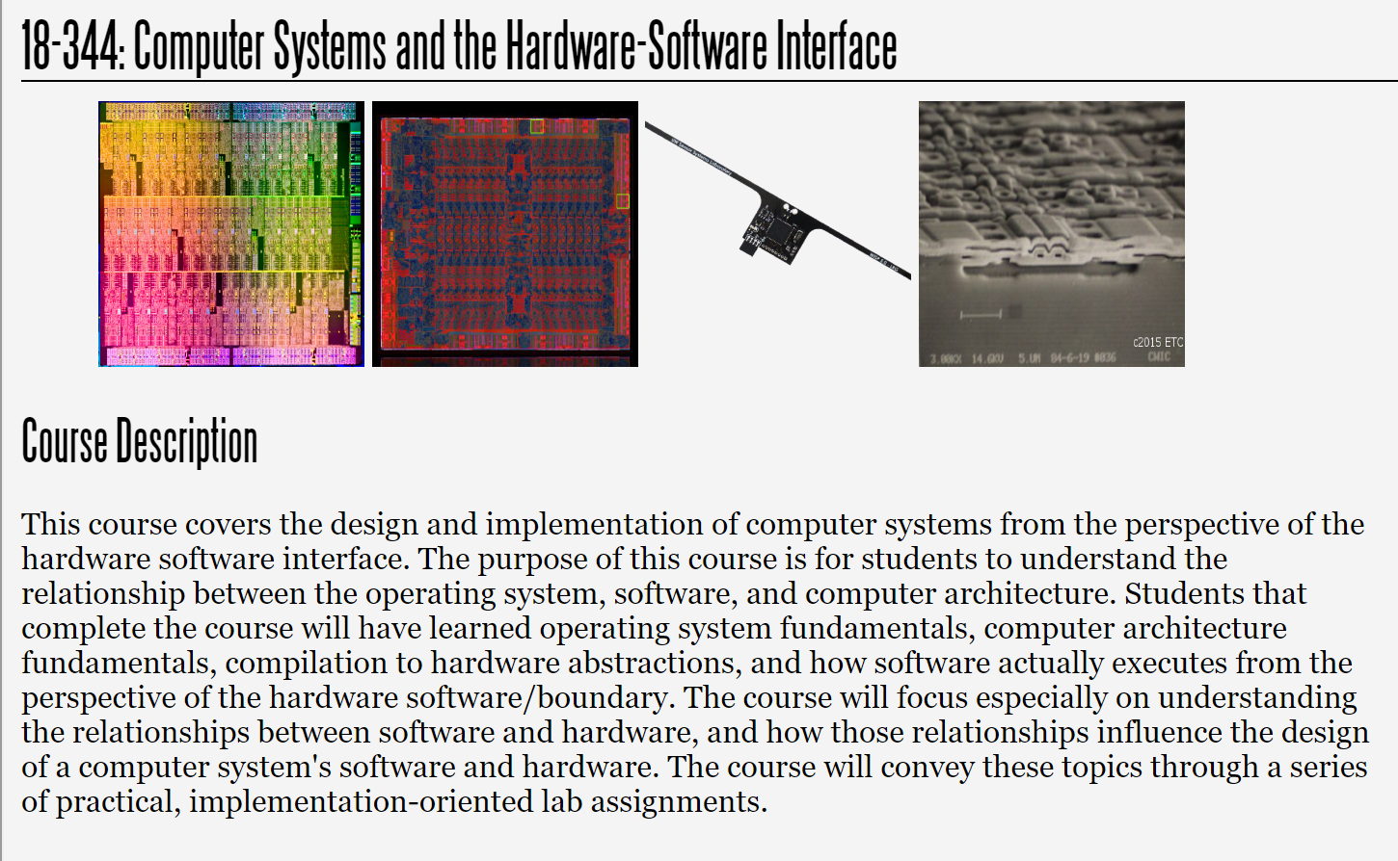
Fall 2023
Lecture 16: Sparsity, cont
Credit: Brandon Lucia

Slide 2
Today: Sparse Problems
Hardware and software strategies for optimizing sparse problems
(with acknowledgements to Vignesh Balaji, CMU ECE PhD 2021, now at Nvidia for contributions to this material)

Slide 3
Propagation Blocking: Optimizing Sparse Irregular Writes to Improve Cache Locality

Slide 4
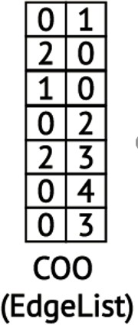
Propagation Blocking: Reorganize Input to Make Memory Being Randomly Written Fit in Cache
Bad for the cache: the size of the domain of vertex data array entries is |V|, but the
|Domain| = |V| = 5 vertices
cache holds only |C| << |V| entries
0 | 0 | 0 | 0 | 0
Recall: irregular accesses into
vertex data array based on
e.dst which are essentially random
|Cache| = 2 vertices
67

Slide 5
Propagation Blocking: Reorganize Input to Make Memory Being Randomly Written Fit in Cache
Bad for the cache: the size of the domain of vertex data array entries is |V|, but the
|Domain| = |V| = 5 vertices
cache holds only |C| << |V| entries
0 | 0 | 0 | 0 | 0
Recall: irregular accesses into
vertex data array based on
e.dst which are essentially random
|Cache| = 2 vertices
Key idea in propagation blocking: Limit the domain of updates to a sub-space of vertices,
V*, so that |V*| <= |C| and do multiple sub-spaces of V*s, so that all V*s together = V
68

Slide 6
Propagation Blocking: Reorganize Input to Make Memory Being Randomly Written Fit in Cache
Create “Bins” that hold input elements (edges
from the edge list)
0 1
0 2
0 4
2 0
2 3
1 0
0 3
0 | 0 | 0 | 0 | 0
Bin 0:
dst 0-1
Bin 1:
dst 2-3
Bin 2:
dst 4-5
dstData
Remember: dstData[e.dst] ++
and e.dst is random, from edge list

Slide 7
Propagation Blocking: Reorganize Input to Make Memory Being Randomly Written Fit in Cache
0 1
0 2
0 4
2 0
2 3
1 0
0 3
0 | 0 | 0 | 0 | 0
Bin 0:
dst 0-1
Bin 1:
dst 2-3
Bin 2:
dst 4-5
dstData
Remember: dstData[e.dst] ++
and e.dst is random, from edge list
Execute the kernel for one bin at a time

Slide 8
Propagation Blocking: Reorganize Input to Make Memory Being Randomly Written Fit in Cache
0 1
0 2
0 4
0
2 0
2 3
1 0
0 3
0 | 0 | 0 | 0 | 0
Bin 0:
dst 0-1
Bin 1:
dst 2-3
Bin 2:
dst 4-5
dstData
Remember: dstData[e.dst] ++
and e.dst is random, from edge list
Execute the kernel for one bin at a time

Slide 9
Propagation Blocking: Reorganize Input to Make Memory Being Randomly Written Fit in Cache
0 1
0 2
0 4
0 0
2 0
2 3
1 0
0 3
0 | 0 | 0 | 0 | 0
Bin 0:
dst 0-1
Bin 1:
dst 2-3
Bin 2:
dst 4-5
dstData
Remember: dstData[e.dst] ++
and e.dst is random, from edge list
Execute the kernel for one bin at a time

Slide 10
Propagation Blocking: Reorganize Input to Make Memory Being Randomly Written Fit in Cache
0 1
0 2
hit
0 4
0 0
2 0
2 3
1 0
0 3
0 | 0 | 0 | 0 | 0
Bin 0:
dst 0-1
Bin 1:
dst 2-3
Bin 2:
dst 4-5
dstData
Remember: dstData[e.dst] ++
and e.dst is random, from edge list
Execute the kernel for one bin at a time

Slide 11
Propagation Blocking: Reorganize Input to Make Memory Being Randomly Written Fit in Cache
0 1
0 2
0 4
0 0
2 0
2 3
1 0
0 3
0 | 0 | 0 | 0 | 0
Bin 0:
dst 0-1
Bin 1:
dst 2-3
Bin 2:
dst 4-5
dstData
Remember: dstData[e.dst] ++
and e.dst is random, from edge list
Execute the kernel for one bin at a time

Slide 12
Propagation Blocking: Reorganize Input to Make Memory Being Randomly Written Fit in Cache
0 1
0 2
0 4
0 0
2 0
2 3
1 0
0 3
0 | 0 | 0 | 0 | 0
Bin 0:
dst 0-1
Bin 1:
dst 2-3
Bin 2:
dst 4-5
dstData
Remember: dstData[e.dst] ++
and e.dst is random, from edge list
Execute the kernel for one bin at a time

Slide 13
Propagation Blocking: Reorganize Input to Make Memory Being Randomly Written Fit in Cache
0 1
0 2
hit
0 4
0 0
2 0
2 3
1 0
0 3
0 | 0 | 0 | 0 | 0
Bin 0:
dst 0-1
Bin 1:
dst 2-3
Bin 2:
dst 4-5
dstData
Remember: dstData[e.dst] ++
and e.dst is random, from edge list
Execute the kernel for one bin at a time

Slide 14
Propagation Blocking: Reorganize Input to Make Memory Being Randomly Written Fit in Cache
0 1
0 2
hit
0 4
0 0
2 0
2 3
1 0
0 3
0 | 0 | 0 | 0 | 0
Bin 0:
dst 0-1
Bin 1:
dst 2-3
Bin 2:
dst 4-5
dstData
Remember: dstData[e.dst] ++
and e.dst is random, from edge list
How to decide how many vertices go in
each of your Propagation Blocker’s bins?

Slide 15
Propagation Blocking: Reorganize Input to Make Memory Being Randomly Written Fit in Cache
0 1
0 2
2 3
hit
0 0 0
2 0
0 3
1 0
0 4
0 | 0 | 0 | 0 | 0
Bin 0:
dst 0-2
Bin 1:
dst 3-5
dstData
Remember: dstData[e.dst] ++
and e.dst is random, from edge list
Match destinations per bin to number of vertices worth of dstData that can fit in cache at one time
78

Slide 16
Propagation Blocking: Performance Analysis
Traverse the edge list twice instead of once
All locations written fit in cache! Compulsory misses on dstData[] only: all the rest hit.
hit
Binning
Bin Read
0 1
2 0
1 0
2 3
0 3
0 4
0 2
0 0 0
0 | 0 | 0 | 0 | 0
Bin 0:
dst 0-2
Bin 1:
dst 3-5
dstData
Remember: dstData[e.dst] ++
and e.dst is random, from edge list
79

Slide 17
Propagation Blocking: Performance Analysis
Traverse the edge list twice instead of once
All locations written fit in cache! Compulsory misses on dstData[] only: all the rest hit.
hit
Binning
Bin Read
0 1
2 0
1 0
2 3
0 3
0 4
0 2
0 0 0
0 | 0 | 0 | 0 | 0
Bin 0:
dst 0-2
Bin 1:
dst 3-5
dstData
Remember: dstData[e.dst] ++
and e.dst is random, from edge list
What about the performance of reading the edge list during binning?
80

Slide 18



Propagation Blocking: Performance Analysis
Usually save a little space in cache for
Traverse the edge list twice instead of once streaming edge list data. Easy to cache.
Binning
Bin Read
Streaming
0 1
2 0
1 0
2 3
0 3
0 4
0 2
0
0
0
Random Access, but always in cache
0 | 0 | 0 | 0 | 0
Bin 0:
dst 0-2
Bin 1:
dst 3-5
dstData
Remember: dstData[e.dst] ++
and e.dst is random, from edge list
What about propagation blocking for irregular reads?
81

Slide 19
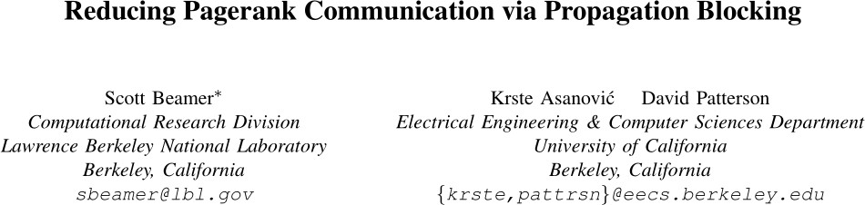
Propagation Blocking
PropagationBlocking_EdgeCount(EdgeList E){
Bins B[];
for edge in E{
add_to_bin( find_bin(edge) )
}
for bin in B{ for e in bin{
dstData[e.dst]++
}
}
}
Application of Propagation Blocking for Graph Applications (Page Rank only, at first) discovered in 2017
(Prior work on “radix partitioning” applied the idea to other domains, but not graphs)

Slide 20
Cache Locality determines Overall Performance What about better replacement policies?
83

Slide 21
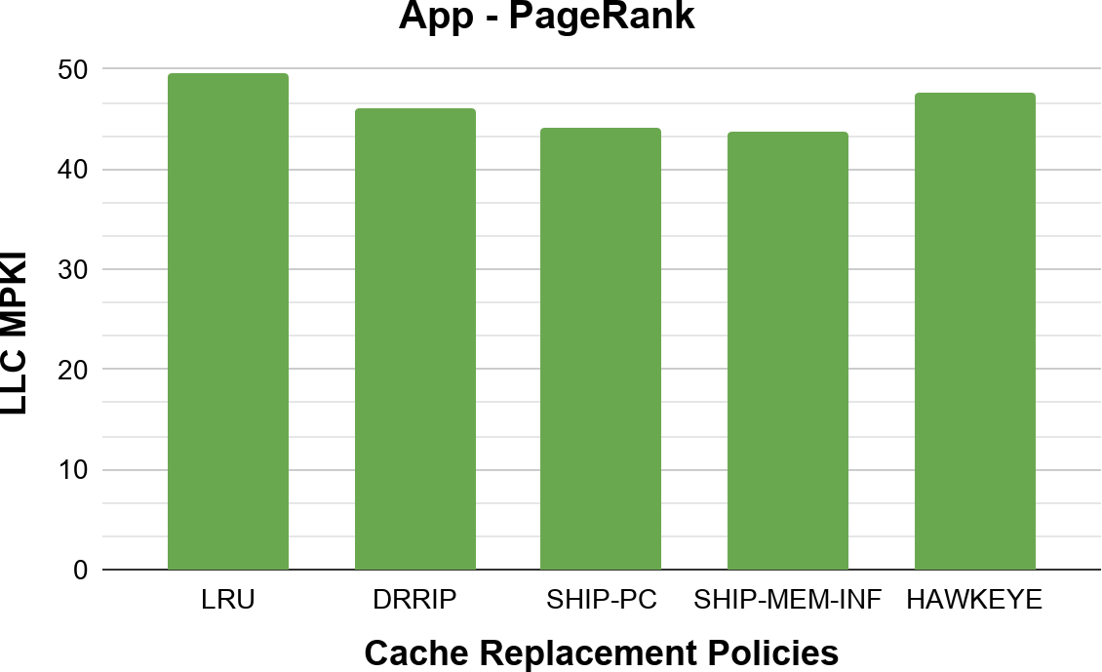
Existing Replacement Policies Are Insufficient
Lower is Better

Slide 22


Existing Replacement Policies Are Insufficient
Lower is Better
State-of-the-Art
Policies

Slide 23
Existing Replacement Policies Are Insufficient
Marginal Benefit over LRU
Lower is Better
State-of-the-Art
Policies

Slide 24
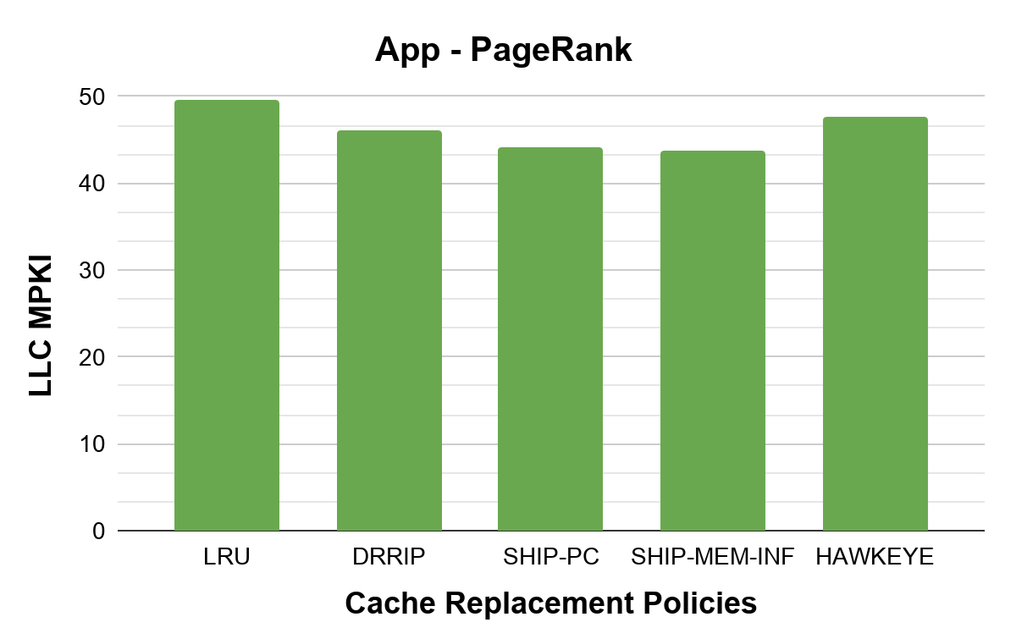

Existing Replacement Policies Are Insufficient
Marginal Benefit over LRU
Lower
^{is} State-of-the-
Better _{Art}
🏆 Policies
87
Problem: Heuristics used by SOTA policies fail to capture the complex reuse patterns of graph data

Slide 25
Is It Possible To Do Better Cache Replacement?
Element To Be Inserted
^{E}new
Belady’s MIN Replacement Policy
E₁
Elements
in Cache
E₂
...
E_{k}

Slide 26
Is It Possible To Do Better Cache Replacement?
Element To Be Inserted
^{E}new
Belady’s MIN Replacement Policy
E₁
Elements
in Cache
E₂
...
E_{k}
Time
Next
References

Slide 27
Is It Possible To Do Better Cache Replacement?
Element To Be Inserted
^{E}new
Belady’s MIN Replacement Policy
E₁
Evict the element accessed furthest in the future
Elements
in Cache
E₂
...
E_{k}
Time
Next
References

Slide 28
Is It Possible To Do Better Cache Replacement?
Element To Be Inserted
^{E}new
Belady’s MIN Replacement Policy
E₁
Evict the element accessed furthest in the future
Elements
in Cache
E₂
...
E_{k}
Recall: Prescience required. Problem?
Time
Next
References

Slide 29
Is It Possible To Do Better Cache Replacement? YES!
Element To Be Inserted
^{E}new
Belady’s MIN Replacement Policy
E₁
Evict the element accessed furthest in the future
Elements
in Cache
E₂
...
E_{k}
Prescience is a flawed requirement: any hope?
Time
Key Observation: The Graph’s Transpose Efficiently Encodes Future Accesses ₉₂

Slide 30
Key Graph Application Property That Enables Belady’s OPT
93

Slide 31
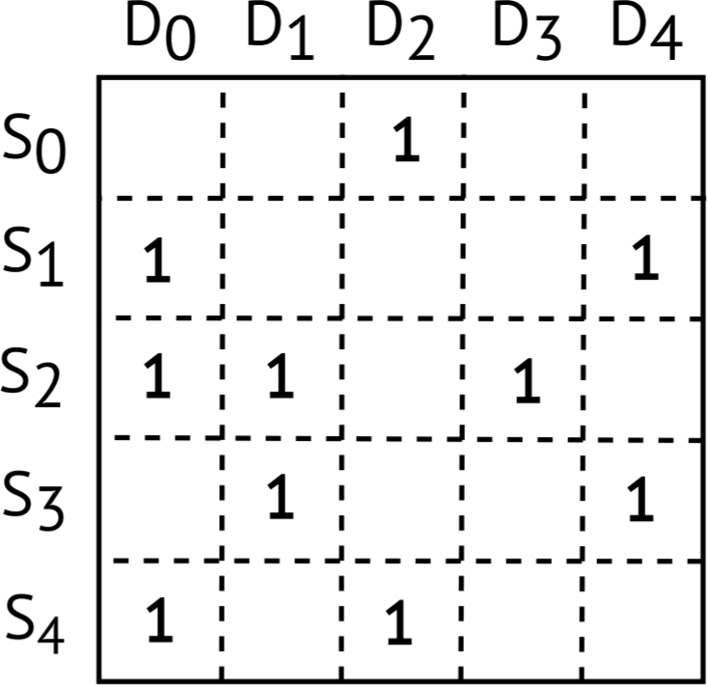
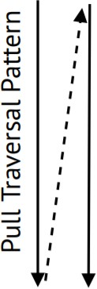
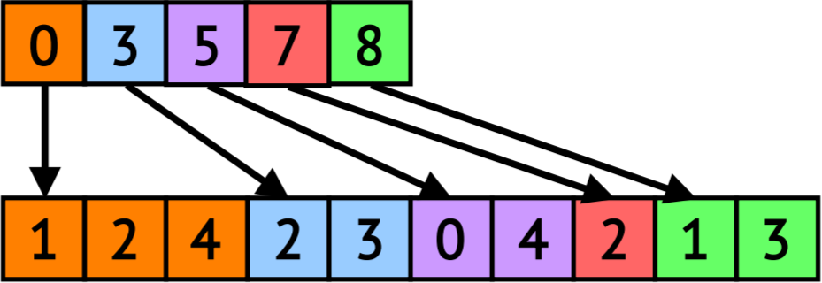
Key Graph Application Property That Enables Belady’s OPT
Dst
Pull Execution (CSC Traversal)
for dst in G:
for src in in_neighs(dst):
dstData[dst] += srcData[src]
Src
OA
NA
CSC
94

Slide 32
Key Graph Application Property That Enables Belady’s OPT
Dst
Pull Execution (CSC Traversal)
for dst in G:
for src in in_neighs(dst):
dstData[dst] += srcData[src]
Src
CurrDs Irregular Data Stream t_{D0}
D₀
srcData[S₁]
srcData[S₂]
srcData[S₄]
srcData[S₂]
srcData[S₃]
OA
Time
D
0
D₁
NA
D₁
CSC
95
. . .

Slide 33
Key Graph Application Property That Enables Belady’s OPT
Dst
Pull Execution (CSC Traversal)
for dst in G:
for src in in_neighs(dst):
dstData[dst] += srcData[src]
Src
CurrDs Irregular Data Stream
t_{D0}
D₀
srcData[S₁]
srcData[S₂]
srcData[S₄]
srcData[S₂]
srcData[S₃]
Key Property: Dst-IDs are like timestamps for irregular accesses
OA
Time
D
0
D₁
NA
D₁
CSC
96
. . .

Slide 34
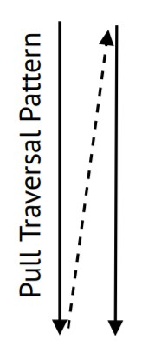
Key Graph Application Property That Enables Belady’s OPT
Dst
Pull Execution (CSC Traversal)
for dst in G:
for src in in_neighs(dst):
dstData[dst] += srcData[src]
Src
CurrDs Irregular Data Stream
t_{D0}
D₀
srcData[S₁]
srcData[S₂]
srcData[S₄]
srcData[S₂]
srcData[S₃]
Key Property: Dst-IDs are like timestamps for irregular accesses
OA
Time
D
0
D₁
NA
D₁
CSC
97
. . .

Slide 35
Key Graph Application Property That Enables Belady’s OPT
Dst
Pull Execution (CSC Traversal)
for dst in G:
for src in in_neighs(dst):
dstData[dst] += srcData[src]
Src
CurrDs Irregular Data Stream
t_{D0}
D₀
srcData[S₁]
srcData[S₂]
srcData[S₄]
srcData[S₂]
srcData[S₃]
Key Property: Dst-IDs are like timestamps for irregular accesses
OA
Time
D
0
D₁
NA
D₁
CSC
98
. . .

Slide 36
Key Graph Application Property That Enables Belady’s OPT
Dst
Pull Execution (CSC Traversal)
for dst in G:
for src in in_neighs(dst):
dstData[dst] += srcData[src]
Src
CurrDs Irregular Data Stream
t_{D0}
D₀
srcData[S₁]
srcData[S₂]
srcData[S₄]
srcData[S₂]
srcData[S₃]
Key Property: Dst-IDs are like timestamps for irregular accesses
OA
Time
D
0
D₁
D₁
NA
srcData[S₂] is accessed at D₀ ⇒ D₁ ⇒ D₃
CSC
. . .

Slide 37
Using The Graph’s Transpose For Optimal Replacement

Slide 38
Using The Graph’s Transpose For Optimal Replacement
Dst
Pull Execution (CSC Traversal)
for dst in G:
for src in in_neighs(dst): dstData[dst] += srcData[src]
Src
CurrDs Irregular Data Stream t_{D0}
D₀ D₀ D₁ D₁
srcData[S₁]
srcData[S₂]
srcData[S₄]
srcData[S₂]
srcData[S₃]
Time
Assumptions:
One srcData elem per line
Only irregular data enters the cache
2-way Set-Associative
. . .

Slide 39
Using The Graph’s Transpose For Optimal Replacement
Dst
Pull Execution (CSC Traversal)
for dst in G:
for src in in_neighs(dst):
dstData[dst] += srcData[src]
Src
CurrDs Irregular Data Stream
t_{D0}
D₀ D₀ D₁ D₁
srcData[S₁]
srcData[S₂]
srcData[S₄]
srcData[S₂]
srcData[S₃]
Time
102
2-way Set-Associative
. . .

Slide 40
Using The Graph’s Transpose For Optimal Replacement
Dst
Pull Execution (CSC Traversal)
for dst in G:
for src in in_neighs(dst):
dstData[dst] += srcData[src]
Src
CurrDs Irregular Data Stream
t_{D0}
D₀ D₀ D₁ D₁
srcData[S₁]
srcData[S₂]
srcData[S₄]
srcData[S₂]
srcData[S₃]
Time
srcData[S₁]
103
2-way Set-Associative
. . .

Slide 41
Using The Graph’s Transpose For Optimal Replacement
Dst
Pull Execution (CSC Traversal)
for dst in G:
for src in in_neighs(dst):
dstData[dst] += srcData[src]
Src
CurrDs Irregular Data Stream
t_{D0}
D₀ D₀ D₁
srcData[S₁]
srcData[S₂]
srcData[S₄]
srcData[S₂]
srcData[S₃]
Time
srcData[S₁]
srcData[S₂]
D
1
104
2-way Set-Associative
. . .

Slide 42
Using The Graph’s Transpose For Optimal Replacement
Dst
Pull Execution (CSC Traversal)
for dst in G:
for src in in_neighs(dst):
dstData[dst] += srcData[src]
Src
CurrDs Irregular Data Stream
t_{D0}
D₀
D₀
srcData[S₁]
srcData[S₂]
srcData[S₄]
srcData[S₂]
srcData[S₃]
Which line should we evict?:
Time
srcData[S₁]
srcData[S₁]
srcData[S₂]
D
srcData[S₂]
1
D
1
105
2-way Set-Associative
. . .

Slide 43
Using The Graph’s Transpose For Optimal Replacement
Dst
Pull Execution (CSC Traversal)
for dst in G:
for src in in_neighs(dst):
dstData[dst] += srcData[src]
Src
CurrDs Irregular Data Stream
t_{D0}
D₀
D₀
srcData[S₁]
srcData[S₂]
srcData[S₄]
srcData[S₂]
srcData[S₃]
Which line should we evict?:
Time
srcData[S₁]
srcData[S₁] (nextRef @ D₄)
srcData[S₂]
D
srcData[S₂]
1
D₀
D₄
D
Out-Neigh(S₁):
CS R
1
106
2-way Set-Associative
. . .

Slide 44

Using The Graph’s Transpose For Optimal Replacement
Dst
Pull Execution (CSC Traversal)
for dst in G:
for src in in_neighs(dst):
dstData[dst] += srcData[src]
Src
CurrDs Irregular Data Stream
t_{D0}
D₀
D₀
srcData[S₁]
srcData[S₂]
srcData[S₄]
srcData[S₂]
srcData[S₃]
Which line should we evict?:
Time
srcData[S₁]
srcData[S₁] (nextRef @ D₄)
srcData[S₂] (nextRef @ D₁)
D
srcData[S₂]
1
D₀ | D₁ | D₃
D
Out-Neigh(S₂):
CS R
1
107
2-way Set-Associative
. . .

Slide 45
Using The Graph’s Transpose For Optimal Replacement
Dst
Pull Execution (CSC Traversal)
for dst in G:
for src in in_neighs(dst):
dstData[dst] += srcData[src]
Src
CurrDs Irregular Data Stream
t_{D0}
D₀
D₀
srcData[S₁]
srcData[S₂]
srcData[S₄]
srcData[S₂]
srcData[S₃]
Which line should we evict?:
srcData[S₁] (nextRef @ D₄) ✔️
srcData[S₂] (nextRef @ D₁)
Time
srcData[S₁]
D
srcData[S₂]
1
D
1
108
2-way Set-Associative
. . .

Slide 46
Using The Graph’s Transpose For Optimal Replacement
Dst
Pull Execution (CSC Traversal)
for dst in G:
for src in in_neighs(dst):
dstData[dst] += srcData[src]
Src
CurrDs Irregular Data Stream
t_{D0}
D₀
D₀
srcData[S₁]
srcData[S₂]
srcData[S₄]
srcData[S₂]
srcData[S₃]
Which line should we evict?:
srcData[S₁] (nextRef @ D₄) ✔️
srcData[S₂] (nextRef @ D₁)
Time
srcData[S₁]
D
srcData[S₂]
1
Key Question: how to query next
D
1
reference while running the program?
109
2-way Set-Associative
. . .

Slide 47
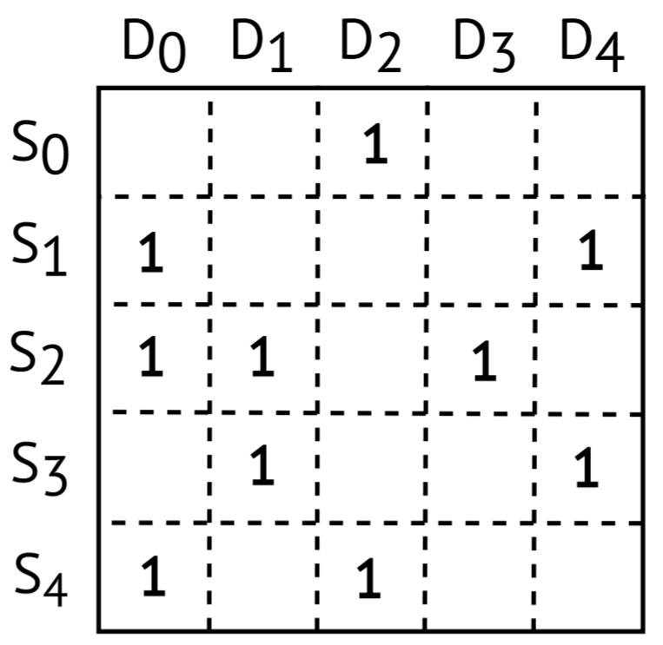
For a pull execution (CSC-traversal), the transpose (CSR) contains all the necessary OPT replacement information
Using The Graph’s Transpose For Optimal Replacement
Pull Execution (CSC Traversal)
CurrDs Irregular Data t Stream
Which line should we evict?: Time
_{srcData[S1]} ● srcData[S₁] (nextRef @ D₄)
✔️
● srcData[S₂] (nextRef @ D₁)
srcData[S₂]
2-way Set-Associative
Dst
for dst in G:
for src in in_neighs(dst):
dstData[dst] +=
Src srcData[src]
D₀ srcData[S₁]
D₀ srcData[S₂]
D₀ srcData[S₄]
D₁ srcData[S₂]
D₁ srcData[S₃]
110
. . .

Slide 48
For a pull execution (CSC-traversal), the transpose (CSR) contains all the necessary OPT replacement information
Using The Graph’s Transpose For Optimal Replacement
Pull Execution (CSC Traversal)
CurrDs Irregular Data t Stream
Which line should we evict?: Time
_{srcData[S1]} ● srcData[S₁] (nextRef @ D₄)
✔️
● srcData[S₂] (nextRef @ D₁)
srcData[S₂]
2-way Set-Associative
Dst
for dst in G:
for src in in_neighs(dst):
dstData[dst] +=
Src srcData[src]
D₀ srcData[S₁]
D₀ srcData[S₂]
D₀ srcData[S₄]
D₁ srcData[S₂]
D₁ srcData[S₃]
111
For a push execution (CSR-traversal), the transpose (CSC) contains all the necessary OPT replacement information
. . .

Slide 49
Transpose-based OPT (T-OPT) Provides Large Gains

Slide 50
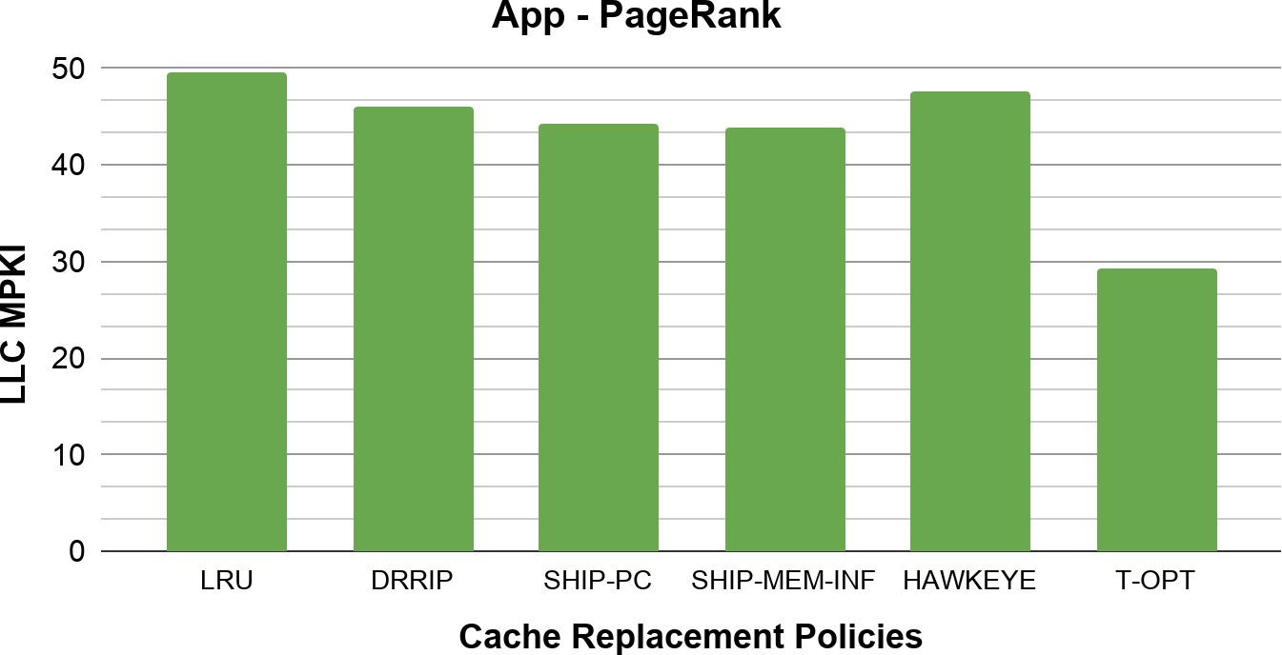
Transpose-based OPT (T-OPT) Provides Large Gains
1.7X
🏆

Slide 51
Transpose-based OPT (T-OPT) Incurs Overheads
Dst
Finding Next References Using The Transpose
Src
SrcData[S₂]
Set-Associative Cache
114

Slide 52
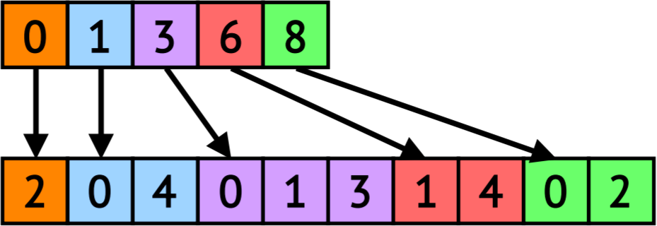
Transpose-based OPT (T-OPT) Incurs Overheads
Dst
Finding Next References Using The Transpose
Src
DRAM Access overhead
SrcData[S₂]
OA
Transpose accesses are irregular
NA
Set-Associative Cache
CSR (Transpose)
115

Slide 53
Transpose-based OPT (T-OPT) Incurs Overheads
Dst
Finding Next References Using The Transpose
Src
DRAM Access overhead
Runtime Traversal overhead
SrcData[S₂]
Out-Neigh(S₂):
D₀
D₁
D₃
OA
NA
CSR (Transpose)
Need to scan neighbors 116
Set-Associative Cache

Slide 54
Transpose-based OPT (T-OPT) Incurs Overheads
Dst
Finding Next References Using The Transpose
Src
DRAM Access overhead
Runtime Traversal overhead
SrcData[S₂]
Question: How do we retrieve the next reference information from the graph’s transpose
without all the cost of traversing the graph?
Set-Associative Cache
117

Slide 55
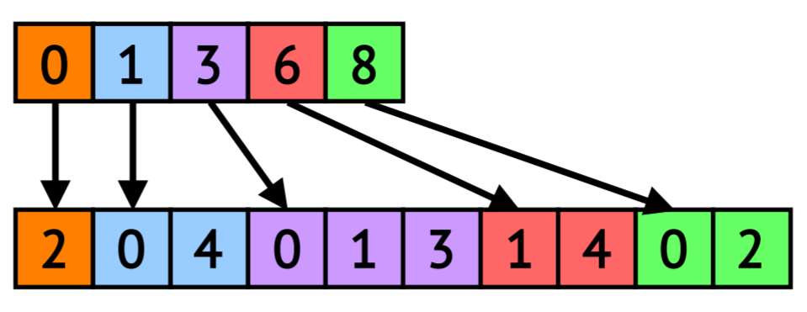
Main Technique: Use Quantization To Compress The Transpose
Dst
Src
srcData[S₂] Accessed at:
D₀ ⇒ D₁ ⇒ D₃
OA
NA
CSR
(Transpose)
118

Slide 56
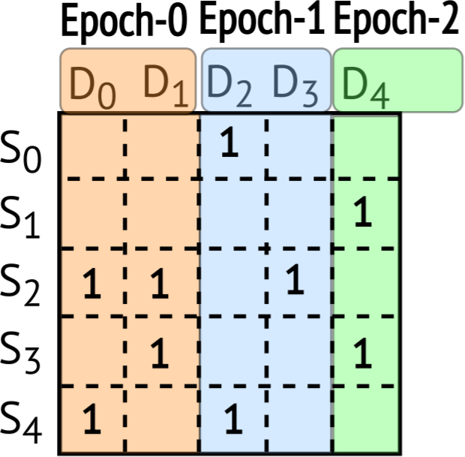

Main Technique: Use Quantization To Compress The Transpose
Dst
Divide execution into coarse-grained epochs
Src
srcData[S₂] Accessed at:
D₀ ⇒ D₁ ⇒ D₃
OA
NA
CSR
(Transpose)
119

Slide 57
Main Technique: Use Quantization To Compress The Transpose
Dst
Divide execution into coarse-grained epochs
Src
srcData[S₂] Accessed at:
D₀ ⇒ D₁ ⇒ D₃
srcData[S₂] Accessed at:
E₀ ⇒ E₁
OA
NA
CSR
(Transpose)
120

Slide 58
Main Technique: Use Quantization To Compress The Transpose
Dst
Divide execution into coarse-grained epochs
Src
srcData[S₂] Accessed at:
D₀ ⇒ D₁ ⇒ D₃
srcData[S₂] Accessed at:
E₀ ⇒ E₁
OA
NA
CSR
(Transpose)
No. of epochs ⬇ ⇒ Next Ref Quantization ⬆
(accuracy vs metadata size trade-off)
121

Slide 59
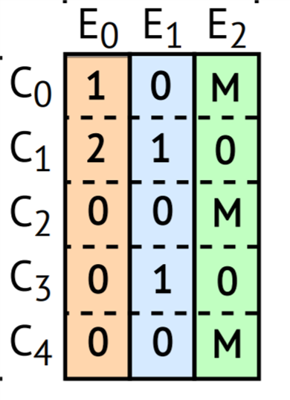
Main Technique: Use Quantization To Compress The Transpose
Dst
Divide execution into coarse-grained epochs
Src
Quantization enables
compression of transpose data
OA
Size the reref matrix to fit in cache!
NA
CSR
(Transpose)
Rereference Matrix
(Quantized Transpose)
122

Slide 60
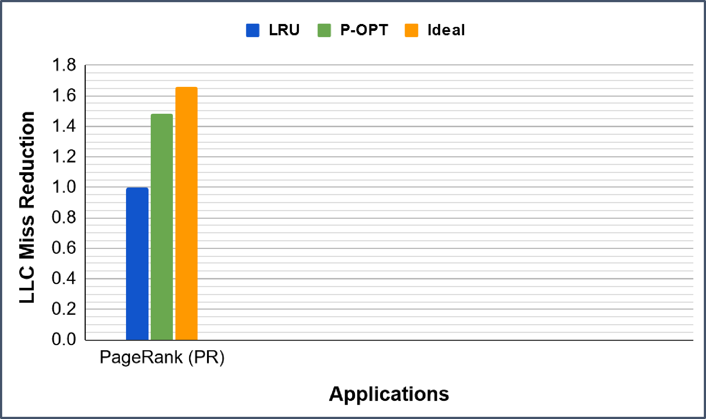
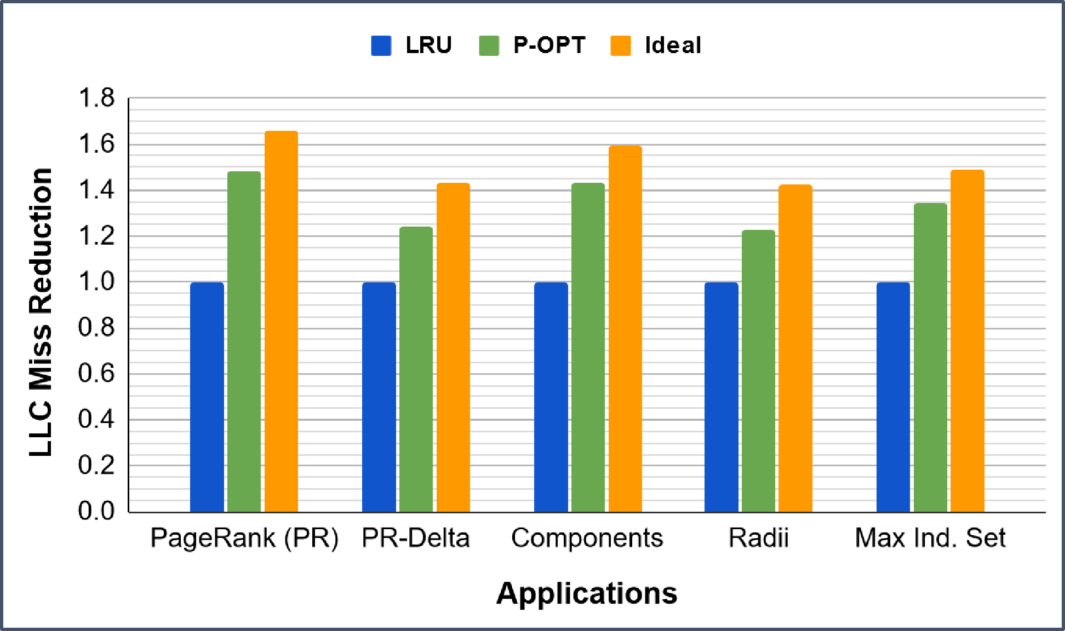
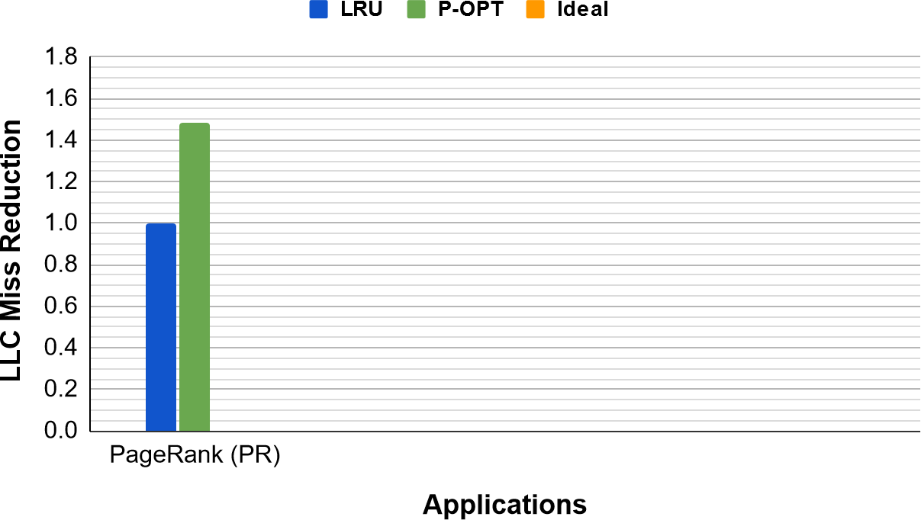
P-OPT Improves Cache Locality

Slide 61
P-OPT Improves Cache Locality
P-OPT results are only 12% away from the Ideal

Slide 62
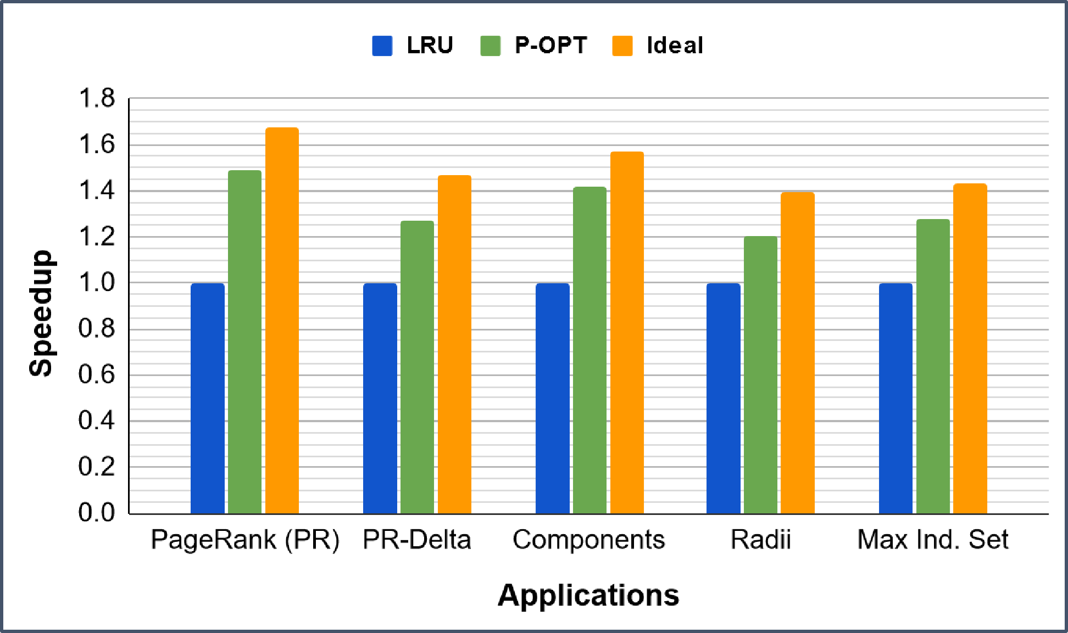
P-OPT’s LLC Miss Reductions Directly Translate To Speedups
P-OPT provides up to 1.56x speedup over LRU. What does this tell us about LRU?
125

Slide 63
What did we just learn?
Sparse problems are ones that manipulate large, mostly-zero matrices
Sparsity makes caching a useful part of the matrix hard
Roofline model shows how close to peak perf. an app is
Propagation blocking bins updates making irregular data fit in cache
P-OPT is a practical implementation of Belady’s OPT for graphs
(with acknowledgements to Vignesh Balaji, CMU ECE PhD 2021, now at Nvidia for contributions to this material)

Slide 64
Takeaways
P-OPT achieves close to ideal performance (quantization can be an effective tool in making a design practical)
    Creative thinking can provide solutions when hardware can be customized, e.g. lossy compression (epochs) and other-than-LRU prediction (transpose)
127

