Slide 1
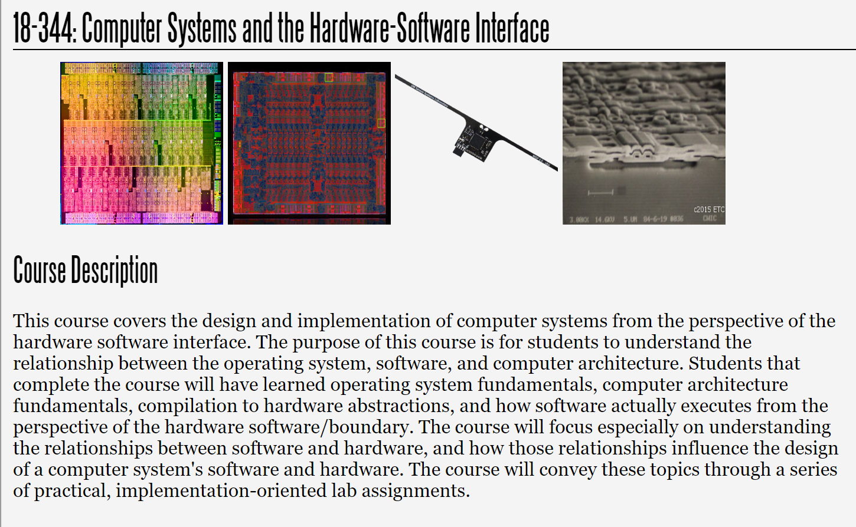
Fall 2023
Lecture 15: Sparsity
Credit: Brandon Lucia

Slide 2
Today: Sparse Problems
What is a sparse problem? Why are they called “sparse”?
What makes sparse problems hard?
Roofline performance modeling
Hardware and software strategies for optimizing sparse problems
(with acknowledgements to Vignesh Balaji, CMU ECE PhD 2021, now at Nvidia for contributions to this material)

Slide 3
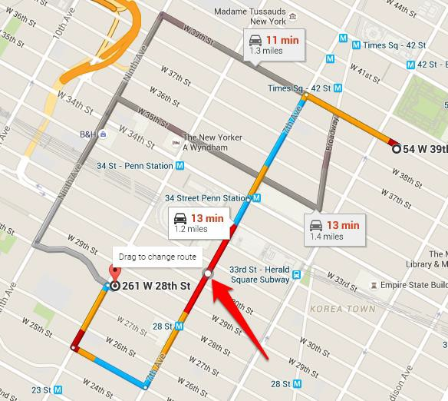
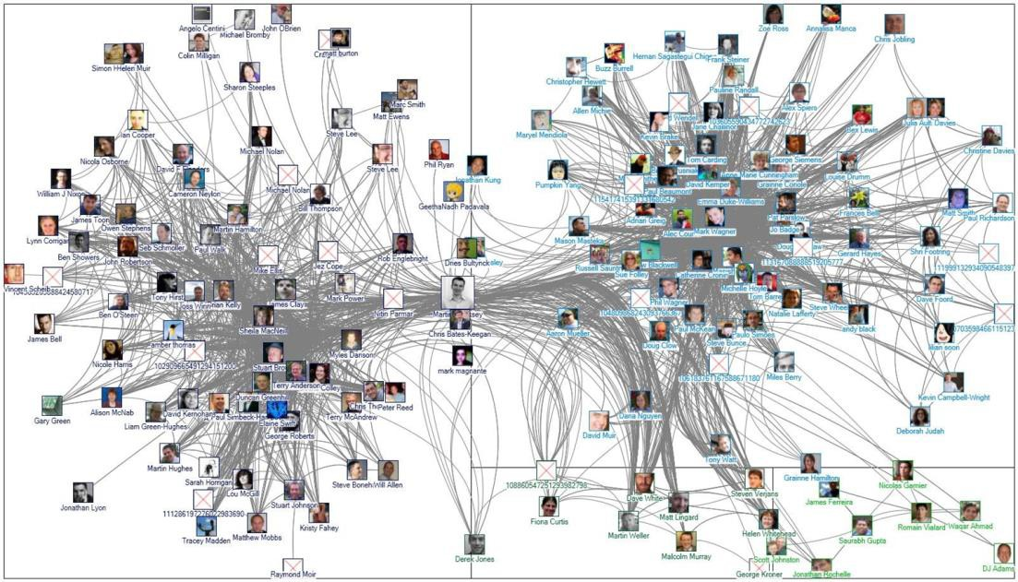
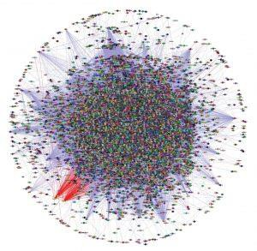
Graph Processing Problems are Sparse Problems
Path Planning
Social network analysis
Protein-Protein Interaction
The canonical examples of sparse problems are graph processing applications.

Slide 4
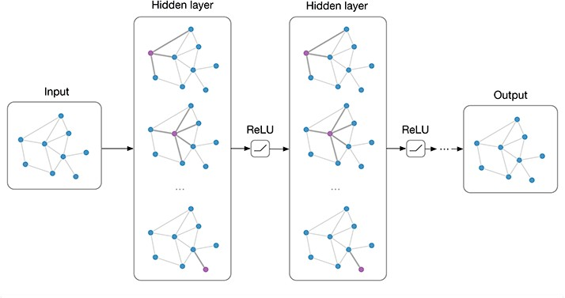
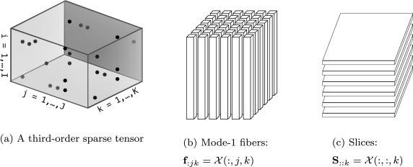
Machine Learning Problems are Sparse Problems
Data Mining
Graph Convolutional Networks

Slide 5
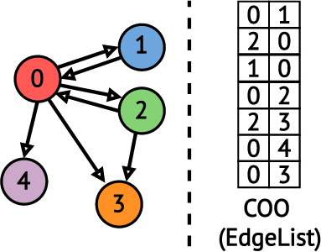

What does a graph processing program look like?
for e in EL: dstData[e.dst] =
f(srcData[e.src],dstData[e.dst])
dstData srcData
stores vertex property information
if srcData == dstData, updating in-place;
often “swap” srcData & dstData from 1 iteration to the next iteration

Slide 6
What does a graph processing program look like?
PageRank(-ish){
for e in EL: rank_n[e.dst] =
rank_nminus1[e.src] + rank_n[e.dst]
}
dstData srcData
rank_n is a webpage’s rank in this iteration,
rank_nminus1 is rank_n from the last iteration

Slide 7

Graph Analytics can be mapped to Sparse Linear Algebra

Slide 8
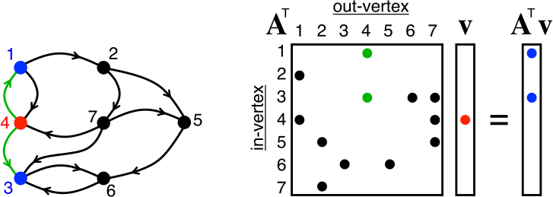
Graph Analytics can be mapped to Sparse Linear Algebra

Slide 9
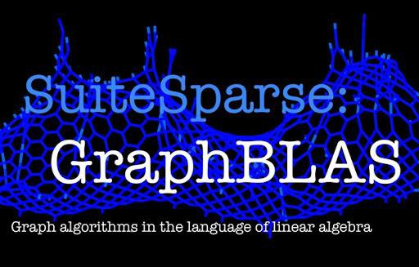
Graph Analytics can be mapped to Sparse Linear Algebra

Slide 10
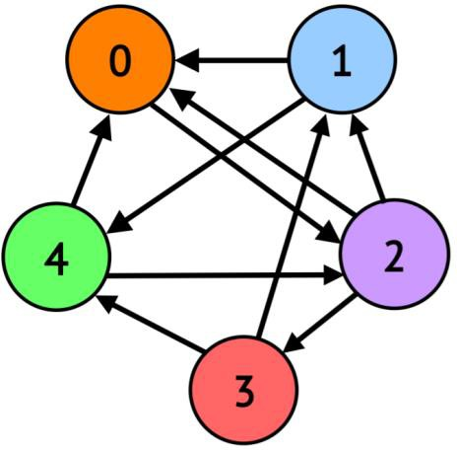
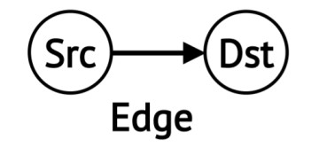
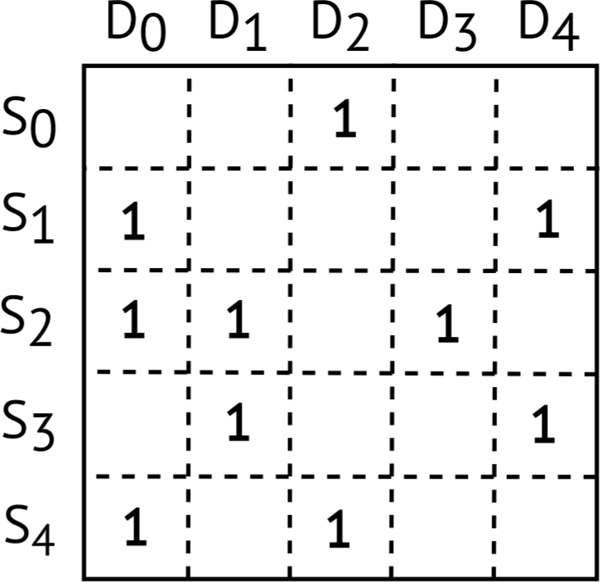
How do graph applications correspond to linear algebra?
Dst
Src

Slide 11
How do graph applications correspond to linear algebra?
Matrix-transpose-vector product is one BFS iteration
A^{T}x_{i} = x_{i+1}
Initial x_{i} vector is starting vertex for BFS.
Dst
T
1
1
Src
=
1

Slide 12
How do graph applications correspond to linear algebra?
Matrix-transpose-vector product is one BFS iteration
A^{T}x_{i} = x_{i+1}
A Transpose
Initial x_{i} vector is starting vertex for BFS.
Dst
T
x_{i}
^{x}i+1
1
1
Initial x_{i+1} is vertices reachable from x_{i}
Src
=
1

Slide 13
How do graph applications correspond to linear algebra?
Matrix transpose vector product is one BFS iteration
A^{T}x_{i} = x_{i+1}
The next iteration is computed by performing the next matrix
transpose vector product
1
1
1
Dst
T
x_{i}
^{x}i+1
1
1
Src
=

Slide 14
How do graph applications correspond to linear algebra?
Matrix transpose vector product is one BFS iteration
A^{T}x_{i} = x_{i+1}
The next iteration is computed by performing the next matrix
transpose vector product
1
1
1
1
Dst
T
x_{i}
^{x}i+1
1
1
1
1
Src
=

Slide 15
How do graph applications correspond to linear algebra?
Matrix transpose vector product is one BFS iteration
A^{T}x_{i} = x_{i+1}
The next iteration is computed by performing the next matrix
transpose vector product
1
1
1
1
1
1
1
1
1
1
1
1
Dst
T
x_{i}
^{x}i+1
=
1
1
1
1
Src
=
Search done when no new vertices added (or all
visited)

Slide 16
How do graph applications correspond to linear algebra?
Turns out that other graph applications also correspond to roughly this formulation if you change the operations you use (min/+ instead of +/*) or consider weighted edges
A^{T}x_{i} = x_{i+1}
SSSP, BFS, PageRank, Connected-Components, Betweenness-Centrality,
triangle counting… BFS is a representative sparse problem.
1
1
1
1
1
1
1
1
1
1
1
1
Dst
T
x_{i}
^{x}i+1
=
1
1
1
1
Src
=
Search done when no new vertices added (or all
visited)

Slide 17
Nobody EVER uses the adjacency matrix!
Dst
Why would the Adjacency Matrix not be used?
Src

Slide 18
Nobody EVER uses the adjacency matrix!
Dst
Reasons Adjacency Matrix is never used:
Sparsity: % of Non-Zero Entries ~ 10⁻⁵
Total Size: 32M nodes => (32M * 32M) = 1PB
Src

Slide 19
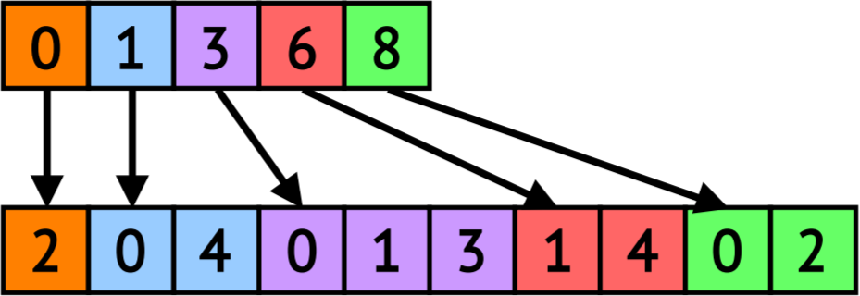
Compressed Sparse Data Structures for Feasible Memory Size
Offsets Array (OA)
Neighbors Array (NA)
Compressed Sparse Row (CSR)
Outgoing Neighbors
Dst
Vertex Property Array i.e., srcData / dstData
2 | 1 | 1 | 2 | 1
Often we will leave the vertex property array implicitly defined when we talk about sparse structures, but it is always there
Src

Slide 20
Compressed Sparse Data Structures for Feasible Memory Size
Offsets Array (OA)
index is src id
Neighbors Array (NA)
EdgeList sorted by SrcIDs
Compressed Sparse Row (CSR)
Outgoing Neighbors
Dst
OA indexed by vertex ID of src of edge Value in OA is offset into NA
start index for edges w/ src == vertex i = OA[i]
#edges with src == vertex i = OA[i+1] – OA[i]
Src
Dense encoding of sparse structure
20

Slide 21
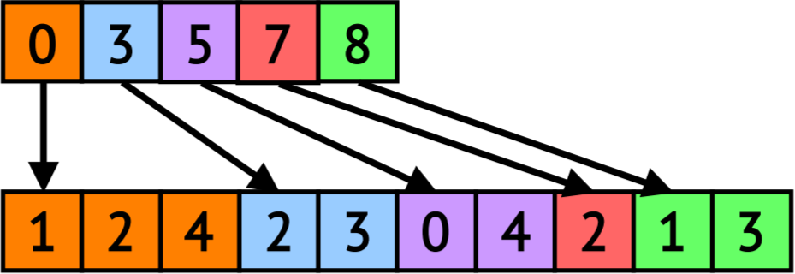
Compressed Sparse Data Structures for Feasible Memory Size
Offsets Array (OA)
Neighbors Array (NA)
EdgeList sorted by SrcIDs
Compressed Sparse Row (CSR)
Outgoing Neighbors
Dst
The CSC is the transpose of the CSR
Offsets Array (OA)
Src
Neighbors Array (NA)
EdgeList sorted by DstIDs
Compressed Sparse Column (CSC)
Incoming Neighbors
21

Slide 22
Building the CSR / CSC from a Graph’s Edge List
for e in EL: neigh_count[e.dst]++; /*e.src*/
2 | 1 | 1 | 2 | 1
neigh_count

Slide 23
Building the CSR / CSC from a Graph’s Edge List
for e in EL: neigh_count[e.dst]++; /*e.src*/
2 | 1 | 1 | 2 | 1
neigh_count
neigh_count_dup
2 | 1 | 1 | 2 | 1
sum = 0
for i in 0 .. |V|: tmp = neigh_count[i]
neigh_count[i] = sum; neigh_count_dup[i] = sum; sum += tmp

Slide 24
Building the CSR / CSC from a Graph’s Edge List
for e in EL: neigh_count[e.dst]++; /*e.src*/
2 | 1 | 1 | 2 | 1
neigh_count
sum = 0
for i in 0 .. |V|: tmp = neigh_count[i]
neigh_count[i] = sum; //OA neigh_count_dup[i] = sum; sum += tmp
0 | 2 | 3 | 4 | 6
OA (also OA_dup)

Slide 25
Building the CSR / CSC from a Graph’s Edge List
0 | 2 | 3 | 4 | 6
OA (also OA_dup)
for e in EL:
neigh_ind = OA[e.src] NA[neigh_ind] = e.dst OA[e.src]++ /*sacrificial OA*/
//i.e., NA[ OA[e.src]++ ] = e.dst
0 | 2 | 3 | 4 | 6
OA_dup
NA
Completed CSC
1 | 2 | 0 | 0 | 0 | 2 | 0

Slide 26
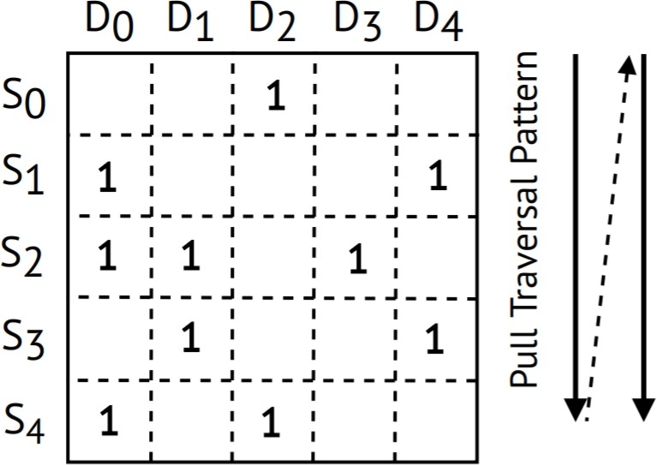
Compressed Representations ⇒ Irregular Memory Accesses
Dst
Pull (CSC Traversal)
for dst in G:
for src in in_neighs(dst):
dstData[dst] += srcData[src]
Src
Pull traversal performs irregular read operations that lack locality
i.e., x_{i+1}
dstData
OA
0 1 2 3 4
e.g., current rank of page I,
e.g., current shortest path
srcData
5 | 20 | 10 | 2 | 1
NA
CSC
26
from source vertex

Slide 27
Compressed Representations ⇒ Irregular Memory Accesses
Dst
Push (CSR Traversal)
for src in G:
for dst in out_neighs(src):
dstData[dst] += srcData[src]
Src
Push traversal performs irregular write operations that lack locality
i.e., x_{i+1}
dstData
OA
0 1 2 3 4
e.g., current rank of page I,
srcData
5 | 20 | 10 | 2 | 1
NA
CSR
e.g., current shortest path
from source vertex

Slide 28
Compressed Representations ⇒ Irregular Memory Accesses
Dst
Push (CSR Traversal)
for src in G:
for dst in out_neighs(src):
dstData[dst] += srcData[src]
Src
Push traversal performs irregular write operations that lack locality
i.e., x_{i+1}
0 1 2 3 4
srcData 5 20 10 2 1
e.g., current rank of page I,
dstData
OA
e.g., current shortest path
from source vertex
NA
CSR
Irregular Data Footprint >> LLC Size
Size of srcData ~ 256MB (32M vertices * 8B)

Slide 29
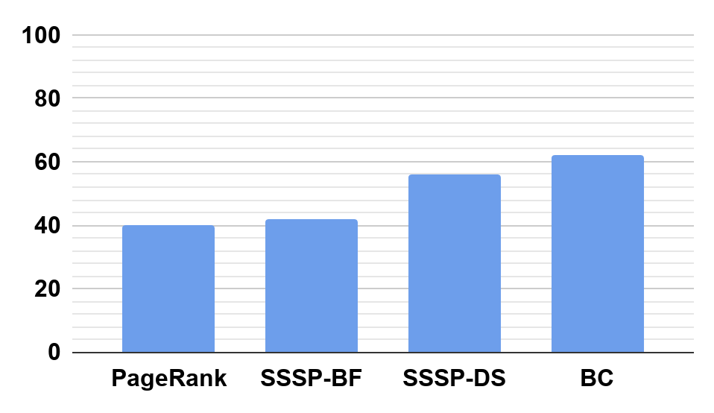
Irregular Accesses Lead to Poor Locality
LLC Miss Rate (%)
Why such bleak cache performance? Consequence of bleak cache performance?
Running on RMAT27 Graph w/ 35MB LLC
Right Figure from “Optimizing Cache Performance for Graph Analytics” ArXiv v1;

Slide 30
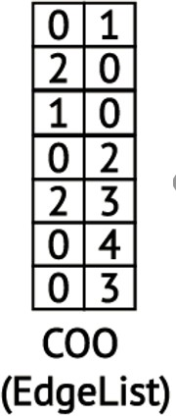

Irregular Accesses Lead to Poor Locality
Dst coordinate of edge is index in dstData:
LLC Miss Rate (%)
totally input dependent & random!!!
0 | 0 | 0 | 0 | 0
Running on RMAT27
Graph w/ 35MB LLC
dstData
Remember: dstData[e.dst] ++
and e.dst is random, from edge list
Right Figure from “Optimizing Cache Performance for Graph Analytics” ArXiv v1;

Slide 31
Irregular Accesses Lead to Poor Locality
Dst coordinate of edge is index in dstData:
LLC Miss Rate (%)
totally input dependent & random!!!
miss
0
0 | 0 | 0 | 0 | 0
Running on RMAT27
Graph w/ 35MB LLC
dstData
Remember: dstData[e.dst] ++
and e.dst is random, from edge list
Right Figure from “Optimizing Cache Performance for Graph Analytics” ArXiv v1;

Slide 32
Irregular Accesses Lead to Poor Locality
Dst coordinate of edge is index in dstData:
LLC Miss Rate (%)
totally input dependent & random!!!
miss
0 0
0 | 0 | 0 | 0 | 0
Running on RMAT27
Graph w/ 35MB LLC
dstData
Remember: dstData[e.dst] ++
and e.dst is random, from edge list
Right Figure from “Optimizing Cache Performance for Graph Analytics” ArXiv v1;

Slide 33
Irregular Accesses Lead to Poor Locality
Dst coordinate of edge is index in dstData:
LLC Miss Rate (%)
totally input dependent & random!!!
(You get lucky sometimes)
hit
0 0
0 | 0 | 0 | 0 | 0
Running on RMAT27
Graph w/ 35MB LLC
dstData
Remember: dstData[e.dst] ++
and e.dst is random, from edge list
Right Figure from “Optimizing Cache Performance for Graph Analytics” ArXiv v1;

Slide 34
Irregular Accesses Lead to Poor Locality
Dst coordinate of edge is index in dstData:
LLC Miss Rate (%)
totally input dependent & random!!!
miss
0
0
0 | 0 | 0 | 0 | 0
Running on RMAT27
Graph w/ 35MB LLC
dstData
Remember: dstData[e.dst] ++
and e.dst is random, from edge list
Right Figure from “Optimizing Cache Performance for Graph Analytics” ArXiv v1;

Slide 35
Irregular Accesses Lead to Poor Locality
Dst coordinate of edge is index in dstData:
LLC Miss Rate (%)
totally input dependent & random!!!
miss
0
0
0 | 0 | 0 | 0 | 0
Running on RMAT27
Graph w/ 35MB LLC
dstData
Remember: dstData[e.dst] ++
and e.dst is random, from edge list
Right Figure from “Optimizing Cache Performance for Graph Analytics” ArXiv v1;

Slide 36

Irregular Accesses Lead to Poor Locality
Dst coordinate of edge is index in dstData:
LLC Miss Rate (%)
totally input dependent & random!!!
miss
0 0
0 | 0 | 0 | 0 | 0
Running on RMAT27
Graph w/ 35MB LLC
dstData
Remember: dstData[e.dst] ++
and e.dst is random, from edge list
Right Figure from “Optimizing Cache Performance for Graph Analytics” ArXiv v1;

Slide 37
Irregular Accesses Lead to Poor Locality
Dst coordinate of edge is index in dstData:
LLC Miss Rate (%)
totally input dependent & random!!!
miss
0 0
0 | 0 | 0 | 0 | 0
Running on RMAT27
Graph w/ 35MB LLC
dstData
Remember: dstData[e.dst] ++
and e.dst is random, from edge list
Right Figure from “Optimizing Cache Performance for Graph Analytics” ArXiv v1;

Slide 38
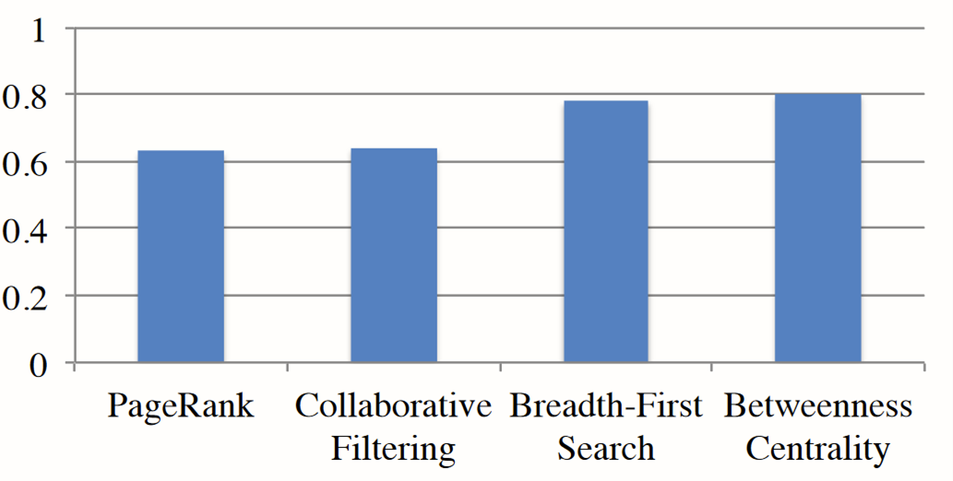
Irregular Accesses Lead to Poor Locality
LLC Miss Rate (%)
Cycles stalled on DRAM / Total Cycles
Cache miss latency cannot be hidden by anything else in the program. Each miss incurs DRAM latency!
Right Figure from “Optimizing Cache Performance for Graph Analytics” ArXiv v1;

Slide 39
Irregular Accesses Lead to Poor Locality
LLC Miss Rate (%)
Cycles stalled on DRAM / Total Cycles
Problem: Sparse representations make processing large graphs feasible, but
graph processing still entails a large working set with poor locality
Right Figure from “Optimizing Cache Performance for Graph Analytics” ArXiv v1;

Slide 40
Even Building the CSR / CSC is an Irregular Access Pattern!
for e in EL: neigh_count[e.dst]++;
2 | 1 | 1 | 2 | 1
neigh_count
Why is this irregular?

Slide 41
Even Building the CSR / CSC is an Irregular Access Pattern!
for e in EL: neigh_count[e.dst]++; /*e.src*/
2 | 1 | 1 | 2 | 1
neigh_count
Updates to the neigh_count array are to random elements determined by order of edges in edge list

Slide 42
Even Building the CSR / CSC is an Irregular Access Pattern!
for e in EL:
NA[ OA[e.src]++ ] = e.dst
0 | 2 | 3 | 4 | 6
OA
NA
Completed CSC
1 | 2 | 0 | 0 | 0 | 2 | 0
Why is the NA update part irregular?

Slide 43
Even Building the CSR / CSC is an Irregular Access Pattern!
for e in EL:
NA[ OA[e.src]++ ] = e.dst
0 | 2 | 3 | 4 | 6
OA
NA
Completed CSC
1 | 2 | 0 | 0 | 0 | 2 | 0
Updates to NA based on EL order & OA[e.src] NA[ OA[e.src]++ ] = e.dst

Slide 44
Roofline Performance Analysis of Graph Applications
44

Slide 45
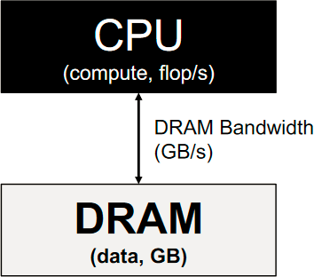

The Roofline Model
Memory-
Bound
Compute-
Bound
Peak ops/s
Throughput (operations per second)
GFLOPS = Giga-Floating
Point Operations Per Second
Yes, this is not a proper acronym
Operational Intensity
(operations per byte)
45

Slide 46



The Roofline Model
Memory-
Bound
Compute-
Bound
Peak FLOPS
Throughput
(GFLOP/s)
App 2
App 1
What does Roofline help us understand about a program?
Operational Intensity
(FLOPS/Byte)
46

Slide 47
The Roofline Model
Memory-
Bound
Compute-
Bound
Peak FLOPS
Throughput
(GFLOP/s)
App 2
App 1
What does Roofline help us
understand about a program?
Tell us what limits performance & how close to peak an app is.
Operational Intensity
(FLOPS/Byte)

Slide 48
The Roofline Model
Memory-
Bound
Compute-
Bound
Peak FLOPS
Throughput
(GFLOP/s)
App 2
“Ridge point” is a property of a particular machine
App 1
What does Roofline help us
understand about a program?
Tell us what limits performance & how close to peak an app is.
Operational Intensity
(FLOPS/Byte)

Slide 49
The Roofline Model
Memory-
Bound
Compute-
Bound
Peak FLOPS
Throughput
(GFLOP/s)
App 2
“Ridge point” is a property of a particular machine
App 1
As a program does more operations per byte, memory has more time to deliver next byte, relieving Mem BW pressure & increasing compute pressure
Operational Intensity
(FLOPS/Byte)
49

Slide 50

The Roofline Model
Memory-
Bound
Compute-
Bound
Peak FLOPS
Throughput
(GFLOP/s)
App 2
“Ridge point” is a property of a particular machine
As a program does more operations per byte, memory has more time to deliver next byte, relieving Mem BW pressure & increasing compute pressure
App 1
What is this point?
Operational Intensity
(FLOPS/Byte)
50

Slide 51
The Roofline Model
Memory-
Bound
Compute-
Bound
Peak FLOPS
Throughput
(GFLOP/s)
App 2
Compare App1 and App2. What are they doing differently from one another?
As a program does more operations per byte, memory has more time to deliver next byte, relieving Mem BW pressure & increasing compute pressure
App 1
What is this point?
Operational Intensity
(FLOPS/Byte)
51

Slide 52

Operational Intensity of Irregular Graph Applications
for e in EL:
dstData[e.dst] += srcData[e.src]
What is the operational intensity of a random update kernel like this one?

Slide 53
Operational Intensity of Irregular Graph Applications
for e in EL:
dstData[e.dst] += srcData[e.src]
What is the operational intensity of a random update kernel like this one?
Operations per byte:

Slide 54
Operational Intensity of Irregular Graph Applications
for e in EL:
dstData[e.dst] += srcData[e.src]
What is the operational intensity of a random
update kernel like this one?
Operations per byte:
Operations: 1 addition
Bytes to Load: 8B for edge, 4B srcData, 4B dstData
Operational Intensity = 1 / (8+4+4) = 1/16

Slide 55
Graph Applications are Memory-Bound
Memory- Bound
Compute- Bound
Peak FLOPS
Throughput
(GFLOP/s)
1/16
250
Operational Intensity
(FLOPS/Byte)

Slide 56
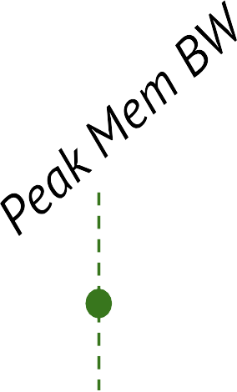
Graph Applications are Memory-Bound
Memory- Bound
Compute- Bound
Peak FLOPS
Throughput
(GFLOP/s)
DRAM BW utilization in graph apps is ~50%
Why would we have spare BW capacity to go to memory and not use it?
1/16
250
Operational Intensity
(FLOPS/Byte)

Slide 57
Graph Applications are Memory-Bound
DRAM BW utilization in graph apps is ~50%
Memory- Bound
Compute- Bound
Peak FLOPS
Why would we have spare BW capacity to go to memory and not use it?
Throughput
(GFLOP/s)
Don’t know what to fetch
next (no temporal
locality), can’t use extra stuff we fetch (no spatial locality). Limited ability to send more memory requests (limited mem. parallelism).
250
Operational Intensity
(FLOPS/Byte)
1/16
57

Slide 58
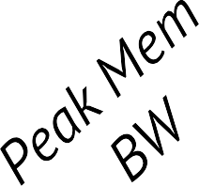

Graph Applications are Memory-Bound
Memory- Bound
Compute- Bound
Peak FLOPS
Throughput
(GFLOP/s)
Option #1: Improve Locality →
Reduce Bytes moved → Improve OI
How to improve BW utilization?
250
Operational Intensity
(FLOPS/Byte)
1/16
58

Slide 59
Graph Applications are Memory-Bound
Memory- Bound
Compute- Bound
Peak
Throughput
(GFLOP/s)
FLOPS
Option #2: Improve Memory to handle more parallel requests
Option #1: Improve Locality →
Reduce Bytes moved → Improve OI
How to improve BW utilization?
250
Operational Intensity
(FLOPS/Byte)
1/16
59

Slide 60
Operational Intensity of Irregular Graph Applications
for e in EL:
dstData[e.dst] += srcData[e.src]
Ideal Best Possible Operational Intensity?
Operations per byte: Operations: 1 addition Bytes to Load: Operational Intensity =

Slide 61
Ideal Operational Intensity of Irregular Graph Applications
for e in EL:
dstData[e.dst] += srcData[e.src]
Ideal Best Possible Operational Intensity?
Operations per byte:
Operations: 1 addition
Bytes to Load: 8B for edge, 0B srcData, 0B dstData
Operational Intensity = 1 / (8+0+0) = 1/8

Slide 62
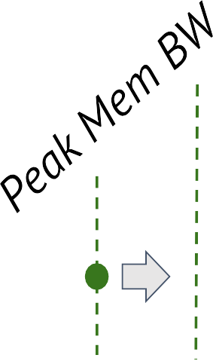
Improving Operational Intensity (OI) by Improving Locality
Memory- Bound
Compute- Bound
Peak FLOPS
Throughput
(GFLOP/s)
1/16 1/8
250
Operational Intensity
(FLOPS/Byte)

Slide 63
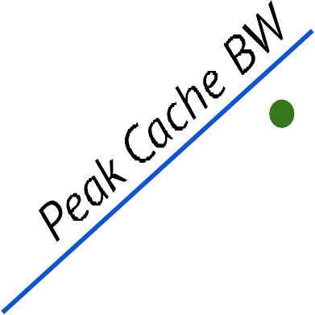
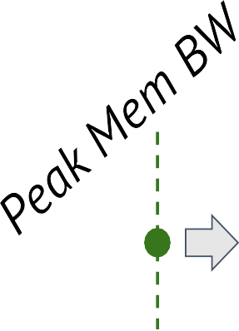
Improving Operational Intensity (OI) by Improving Locality
Memory- Bound
Compute- Bound
Peak FLOPS
Throughput
(GFLOP/s)
Locality wins: If we can operate out of cache, higher ceiling & more leftward ridge point.
Why is cache BW > DRAM BW?
1/16 1/8
250
Operational Intensity
(FLOPS/Byte)

Slide 64
Improving Operational Intensity (OI) by Improving Locality
Memory- Bound
Compute- Bound
Peak FLOPS
Throughput
(GFLOP/s)
Locality wins: If we can operate out of cache, higher ceiling & more leftward ridge point.
Why is cache BW > DRAM BW?
Smaller SRAM caches much faster.
1/16
1/8
250
Operational Intensity
(FLOPS/Byte)

Slide 65
Improving Operational Intensity (OI) by Improving Locality
Memory- Bound
Compute- Bound
Peak FLOPS
Throughput
(GFLOP/s)
Key Question: So how do we improve locality, to reduce data movement from memory, to increase OI, and move to peak performance?
Locality wins: If we can operate out of cache, higher ceiling & more leftward ridge point.
Why is cache BW > DRAM BW?
Smaller SRAM caches much faster.
1/16
1/8
250
Operational Intensity
(FLOPS/Byte)

Slide 66
What did we just learn?
Sparse problems are ones that manipulate large, mostly-zero matrices
Sparsity makes caching a useful part of the matrix hard
Roofline model shows how close to peak perf. an app is
(with acknowledgements to Vignesh Balaji, CMU ECE PhD 2021, now at Nvidia for contributions to this material)

