Slide 1
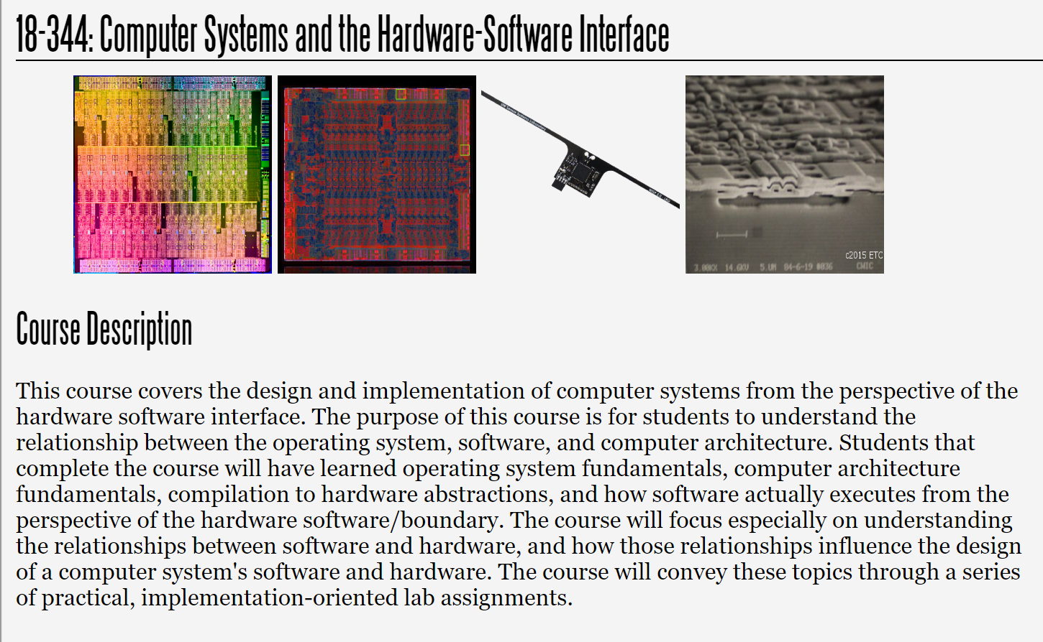
Fall 2023
Lecture 12: Adv. Architecture: Superscalar and Out of Order, cont.
Credit: Brandon Lucia

Slide 2
Today: More Advanced Architecture Concepts
(more) VLIW
Vector machines & SIMD
Dataflow as a hardware/software boundary design problem
Systolic Array Architectures (if time)

Slide 3
Very Large Instruction Word (VLIW) and the EPIC Architecture (Explicit Parallel Instruction Computer)
Change the ISA! In VLIW, the ISA exposes issue width architecturally. Each fetch / issue is on a bundle of instructions that are independent
Insn1 (41b)
Insn2 (41b)
Insn3 (41b)
Type
(5b)
EPIC/IA-64 bundles up to 3 instructions with a type that says
whether & how they’re dependent or parallelizable
sw lw
sw
lw
lw
Memory
Register
Write-Back
Type:
Mem, Float,
Int, Long Imm.
Branch e.g.,
MMI, IIF, MMI MM/I, M/MI
ALU (non-
mul)
Issue Width
ALU (non- mul)
“/” indicates a ”stop”, break parallelism.
Issue
Reg. Read
mul0 mul1mul2
Issue Time

Slide 4
Very Large Instruction Word (VLIW) and the EPIC Architecture (Explicit Parallel Instruction Computer)
What do we rely on for VLIW to work? What assumptions do we depend on for VLIW to work and be efficient?
Insn1 (41b)
Insn2 (41b)
Insn3 (41b)
Type
(5b)
EPIC/IA-64 bundles up to 3 instructions with a type that says
whether & how they’re dependent or parallelizable
sw lw
sw
lw
lw
Memory
Register
Write-Back
Type:
Mem, Float,
Int, Long Imm.
Branch e.g.,
MMI, IIF, MMI MM/I, M/MI
ALU (non-
mul)
Issue Width
ALU (non- mul)
“/” indicates a ”stop”, break parallelism.
Issue
Reg. Read
mul0 mul1mul2
Issue Time

Slide 5
Very Large Instruction Word (VLIW) and the EPIC Architecture (Explicit Parallel Instruction Computer)
Software-constructed (compiler-constructed) bundles of instructions can come from anywhere
EPIC assumes in-order execution (static scheduling) and presence of ILP exploiting features, e.g., branch pred., load speculation
Issue Width
Issue Width
Issue Width
Issue Time
Issue Time
Issue Time
Like single-issue scalar execution
Like multi-issue superscalar execution
Like SMT superscalar, exploiting thread-level parallelism in prog.

Slide 6
Superscalar OoO is great at finding ILP to reduce CPI, but EPIC eliminates dynamic scheduling. Why?
Question: how can static scheduling be good enough to
justify eliminating dynamic scheduling & SS/OoO?
Issue
Goal for static & dynamic scheduling: Find instructions to
keep the issue window full at all times.
Issue Width
ld x11 (x8) add x2 x3 x4 mul x4 x10 x11 mul x10 x8 x9 st x10 (x8)
add | x6 | x8 x11
mul | x9 | x6 x13
add | x6 | x12 x14
Issue Time

Slide 7
Dynamic Scheduling vs. Static VLIW
Question: how can static scheduling be good enough to
justify eliminating dynamic scheduling & SS/OoO?
Goal for static & dynamic scheduling: Find instructions to keep the issue window full at all times.
Issue
Issue Width
Dynamic scheduling has a limited scope
for analysis and optimization
Short window limits reordering distance
Static scheduling has global scope
for reordering / optimization
Long window allows long reorderings
ld x11 (x8) add x2 x3 x4 mul x4 x10 x11 mul x10 x8 x9
ld x11 (x8) mul t1 x10 x11 mul x10 x8 x9
Latency = t_mul
Issue Time
st x10 (x8) add x6 x8 x11 mul x9 x6 x13 add x6 x12 x14
… //other ops taking t_mul cycles
add x2 x3 x4 st x10 (x8)
At this point, muls are done and we keep rolling, overlapped latency.

Slide 8
Effective scheduling relies on approximately equal execution latency for all instructions
If some instructions in a bundle are long-latency and others short- latency, the longs delay the shorts
Scheduling same-latency ops together keeps the machine moving
What about unpredictable latency instructions like memory operations?
div
add
add
add
add
add

Slide 9
Effective scheduling relies on approximately equal execution latency for all instructions
If some instructions in a bundle are long-latency and others short- latency, the longs delay the shorts
Scheduling same-latency ops together keeps the machine moving
What about unpredictable latency instructions like memory operations?
Unpredictable stalls in the pipeline waiting for memory operations.
Can tolerate latencies by scheduling same-latency operations together, if compiler has an expectation about memory latency, cache structure, and producer / consumer relationships.
This is a very difficult compilers problem!!

Slide 10
Branch instructions in EPIC
EPIC / VLIW does branches differently than in SS/OoO
Option 1: Waste space in a bundle, run branches like in SS/OoO
if taken, grab taken bundle, if not, grab sequentially next bundle
Option 2: Predication
run both sides of branch and commit only insns with true predicate
Predication takes pressure off of control logic & branch prediction (why?)
Do we need a branch predictor?
Costs of predication?
P P P
₁ Insn1 (41b) ₂ Insn2 (41b) ₃ Insn3 (41b)
If !P nullify insn
Type
(5b)

Slide 11
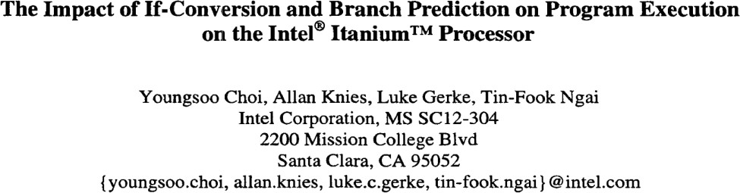
If conversion
If cond
bne cond, pc+12 Add x9 x7 x8 bne cond2 pc+12 Sub x10 x9 x11 Add x9 x10 x14 St x9 (0xabc)
x10 =
X9-x11
x9 = x7+x8
If cond2
x9 =
x10+x14
St x9 (0xabc)

Slide 12
If conversion
If cond
bne | cond, | pc+12
Add | x9 x7 | x8
bne | cond2 | pc+12
!cond
cond || (!cond && cond2)
X9 = x7+x8
X10 =
x9+x11
Sub x10 x9 x11 Add x9 x10 x14 St x9 (0xabc)
cond || (!cond && cond2)
If cond2
X9 =
x10+x14
St x9 (0xabc)
Join:
cond || (!cond && cond2) || (!cond && !cond2) Which is the same as:
cond || !cond, i.e., unconditional

Slide 13
If conversion
If cond
Store predicate results in explicit
predicate registers
P1=!cond P2=cond||(!cond&&cond2) (P1)Add x9 x7 x8 (P2)Sub x10 x9 x11 (P2)Add x9 x10 x14
St x9 (0xabc)
Add explicit predicates to the code that executes. Predicates evaluate dynamically using predicate registers.
bne | cond, | pc+12
Add | x9 x7 | x8
bne | cond2 | pc+12
Sub | x10 x9 x11
Add | x9 x10 x14
!cond
cond || (!cond && cond2)
X9 = x7+x8
X10 =
x9+x11
X9 = x10+x14
cond || (!cond && cond2)
If cond2
St x9 (0xabc)
St x9 (0xabc)
Join:
cond || (!cond && cond2) || (!cond && !cond2)
Which is the same as:
cond || !cond, i.e., unconditional
No branch instructions here! Microarchitectural implication?

Slide 14
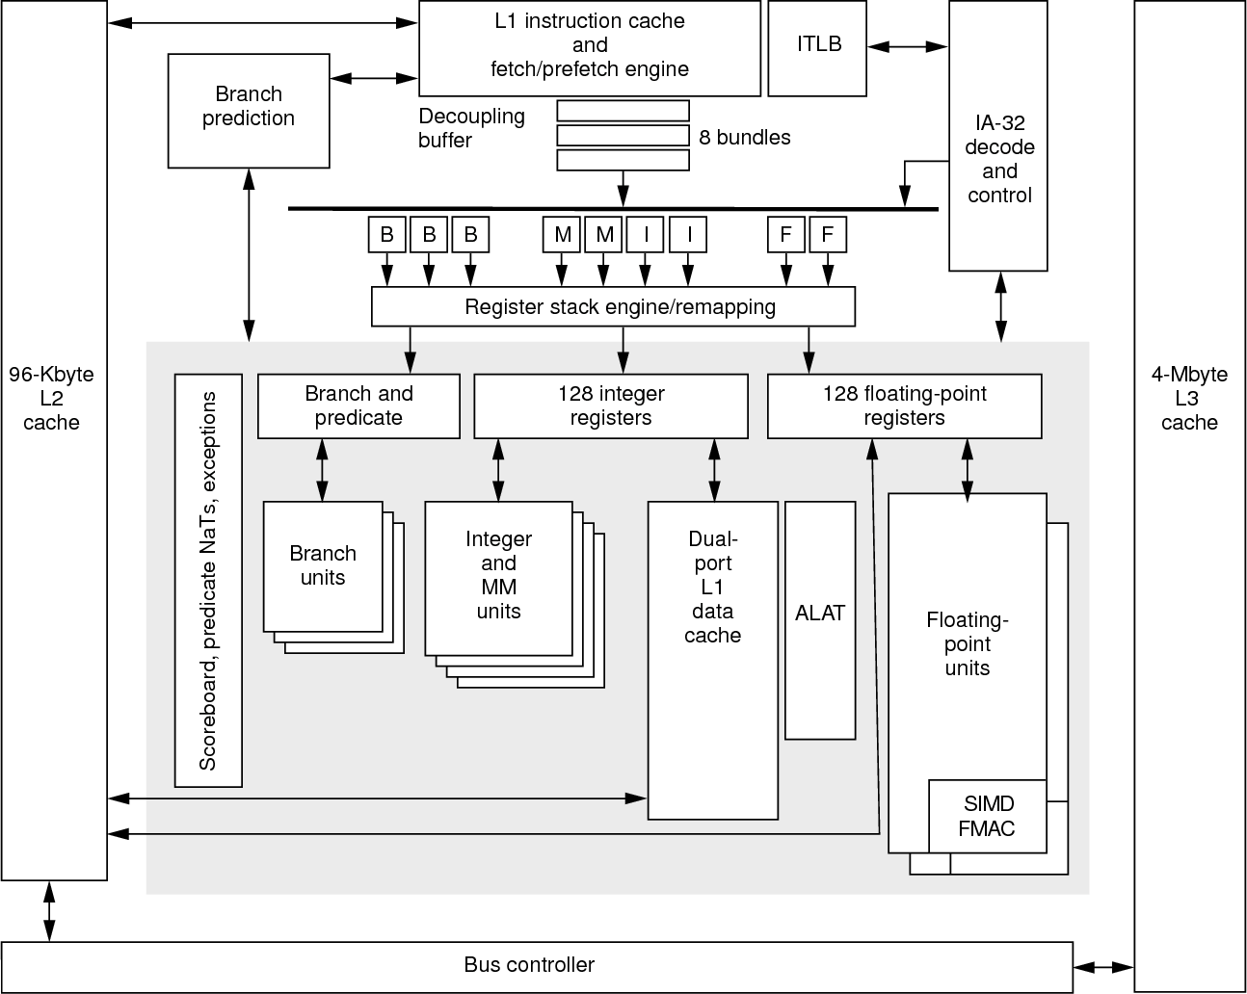
Pipeline Characteristics
Execute 2 bundles (6insns) per cycle
10 stage pipeline
4 Integer Units (2 of which do Ld/St)
2 Floating Point Units
3 Branch Units
Issue in order, execute in order
Simple register dependence tracking
using a “scoreboard”
Control Characteristics
Predication and sophisticated two-level branch predictor (why?)
Instruction queues connect fetch to execute units hiding some fetch bubble latency with execute latency (how?)
Register File
Fairly complex and highly abundant
Separate predicate / branch, int, and FP regs
“Register stack engine” efficiently doles out
physical registers, avoiding structural hazard
Intel Itanium EPIC Architecture

Slide 15
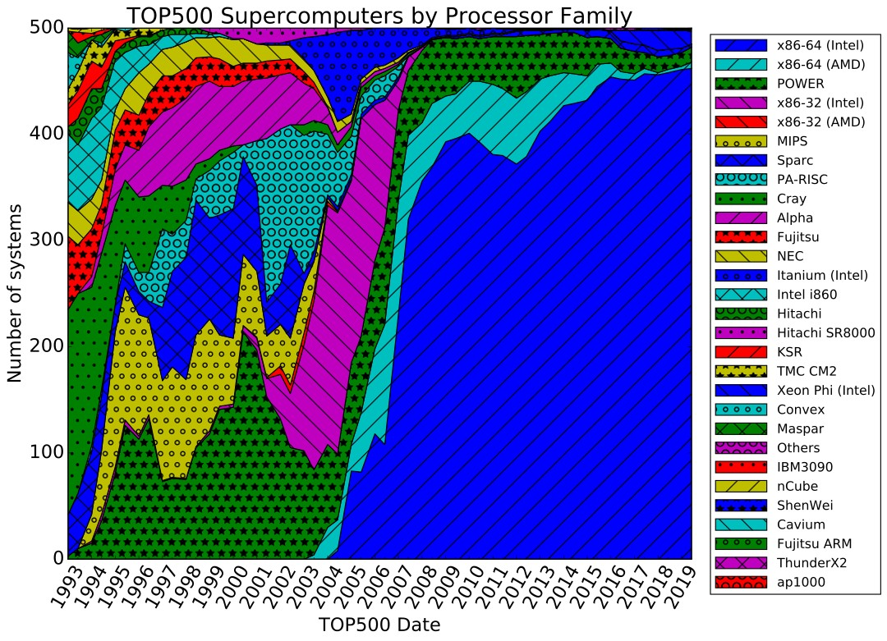
VLIW / EPIC is a Very Cool HW/SW Interface!
Why did Itanium not seize the (any?) market as Intel anticipated?
(In the top500 supercomputers, we mostly have x86-64, not IA64)

Slide 16
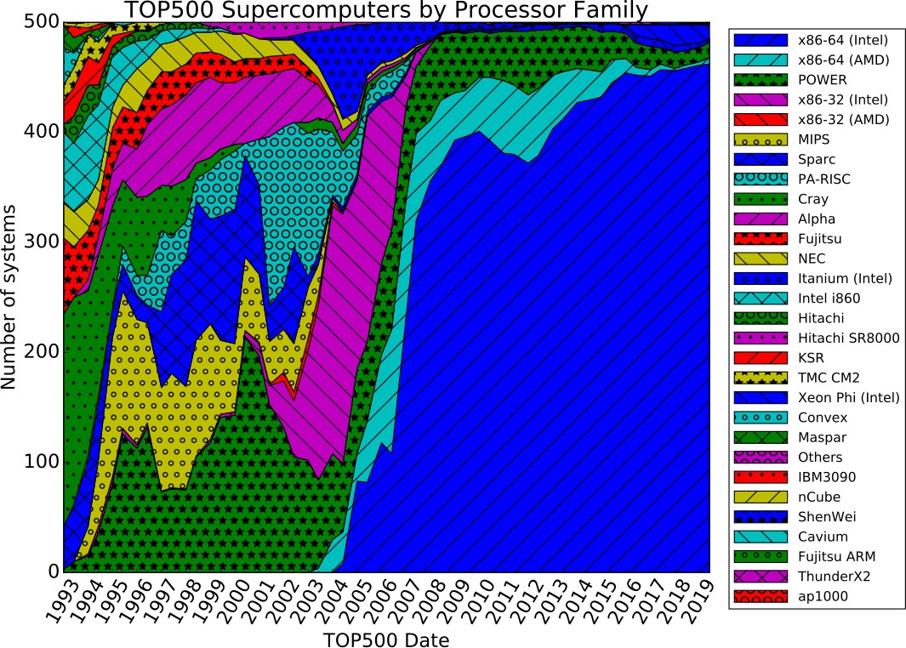

VLIW / EPIC is a Very Cool HW/SW Interface!
Donald Knuth: “the "Itanium" approach [was] supposed to be so terrific—until it turned out that the wished-for compilers were basically impossible to
write”

Slide 17
Parallelism Beyond ILP

Slide 18
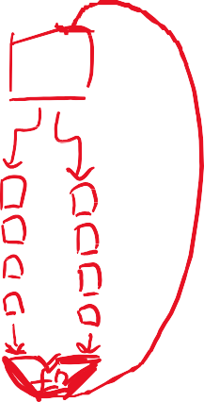
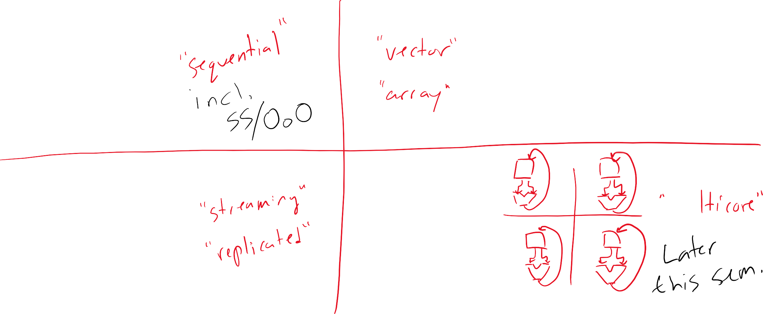

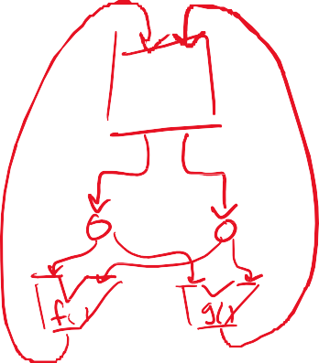

Flynn’s Taxonomy of Parallel Architectures
SISD
SIMD
MISD
MIMD

Slide 19
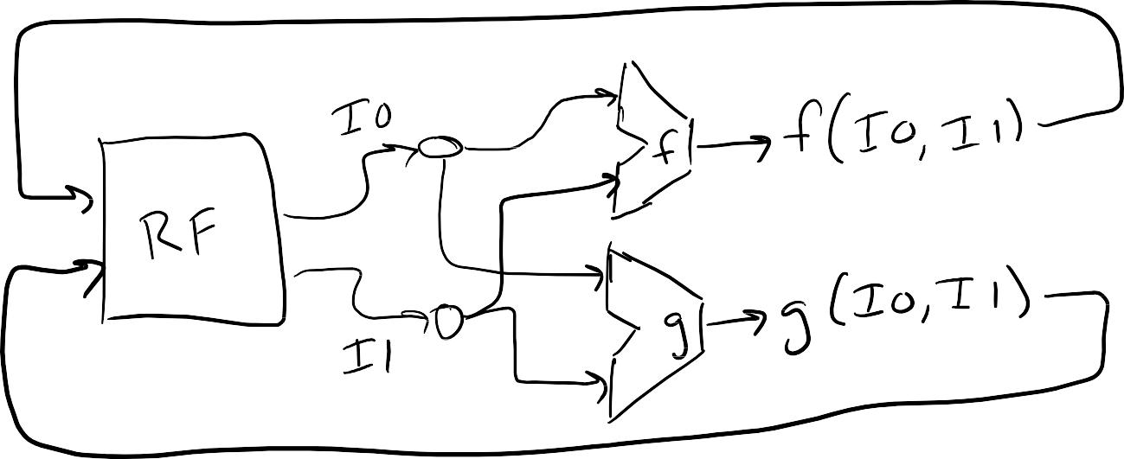
MISD – Multiple Instruction Single Data
Send same inputs (logically) simultaneously to multiple functions
Used for …what?

Slide 20



MISD – Multiple Instruction Single Data
Send same inputs (logically) simultaneously to multiple functions
Rare, sometimes used in DSP, filter signal using multiple programs
Modular redundancy, replicated hardware for execution

Slide 21
SIMD – Single Instruction Multiple Data
Apply instruction to many data: Single instruction (fetched, decoded, etc) applies its operation to a large number of data elements
Amortizes Instruction Costs: Each instruction corresponds to a large number of operations
A Few Flavors: most notable/effective are Vector machines
Also: historically, Array Machines but these are not widely used anymore
Data-oriented, Not Necessarily Parallel: Instructions specify what do to to each element of data, but not how to do it (i.e., parallel, partially parallel, sequential)

Slide 22



Vector Machines
setvl: tell machine length of input vector. Actual in-memory length can be thousands of elements! Machine returns max it can handle in a vector register (varies by implementation, can be tens of elements)
A[4]
B[4]
vld <vector register>, <mem>: load vector of length vl starting at
memory location^{A[0]}<mem>^{[0B ]}
A[3]
B[3]
A[2]
B[2]
vst <vreg>, <mem>: store elems of <vreg> to memory starting from memory location <mem>
A[1]
B[1]
vadd <vreg1> <vreg2>: add element-wise store into vreg1
A[0]
B[0]
Assumes explicit vector register file that can temporarily store vector operands
vector register file (VRF)
+
setvl 5 vld v0, a vld v1, b vadd v0, v1 vst v0, c
v0
A[1] B[1]
A[2] B[2]
A[3] B[3]
A[4]
C [1]
v1
B[4]
C [0]

Slide 23
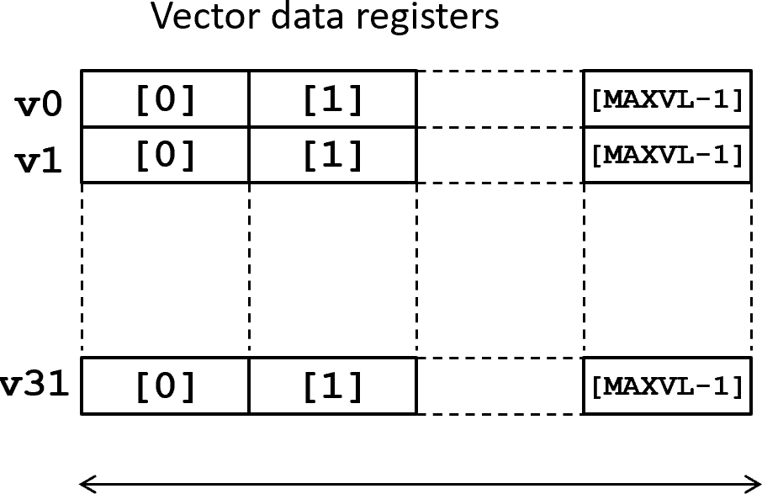
Vector register file
Large, performance-critical structure accessed potentially many times per-cycle during vector operation. How large? How critical?
maxvl is an implementation-dependent parameter. How do we (architects) set maxvl?
If setvl sets vl to greater than maxvl, then vl
gets set to maxvl. HW/SW consequence?
If setvl sets vl to less than maxvl, then the excess vectors get set to 0 during ops

Slide 24
Vector register file
Large, performance-critical structure accessed potentially many times per-cycle during vector operation. How large? How critical?
maxvl is an implementation-dependent parameter. How do we (architects) set maxvl?
If setvl sets vl to greater than maxvl, then vl
gets set to maxvl. HW/SW consequence?
If setvl sets vl to less than maxvl, then the excess vectors get set to 0 during ops
8B / word * 16 words / VRF entry * 32 VRF entries per VRF = 4kB!
Larger than many L1 Caches

Slide 25








Dealing with limited^{A[3]}vect^{][3B} or size is easy in SW
A[2] B[2]
A[4]
B[4]
setvl 8192 //machine says “vl = 5, actually”
for(i = 0…(8192 / vl) ): //loop vl at a time
vld v0, a + i*vl vld v1, b + i*vl vadd v0, v1
vst v0, c + i*vl
A[3]
B[3]
A[2]
B[2]
A[1]
B[1]
A[0]
B[0]
+
v0
A[0] B[0]
A[1] B[1]
A[4] B[4]
C [1]
v1
C [0]
vector register file (VRF)

Slide 26


Vector Machines are Easily Parallelizable
A[4]
B[4]
Lane 0
Lane 1
Abstraction: execute an
instruction’s operation over an
entire vector of data
A[3]
B[3]
A[2]
B[2]
A[4]
B[4]
Implementation: Parallel functional units each process parts of a vector, producing a vector output. Why simple?
A[1]
B[1]
A[2]
B[2]
A[3]
B[3]
A[0]
B[0]
A[0]
B[0]
A[1]
B[1]
+
+
+
C [1]
C [4]
C [3]
C [2]
C [1]
C [0]
C [0]

Slide 27
Vector Machines are Easily Parallelizable
A[4]
B[4]
Lane 0
Lane 1
Simple: Vector instruction operates on v0[i] and v1[i] not v0[i] and elem *v.
A[3]
B[3]
A[2]
B[2]
A[4]
B[4]
Very simple operand matching logic, no need to track complex producer consumer relationships across inputs of operations.
A[1]
B[1]
A[2]
B[2]
A[3]
B[3]
A[0]
B[0]
A[0]
B[0]
A[1]
B[1]
Primary cost?
+
+
+
C [1]
C [4]
C [3]
C [2]
C [1]
C [0]
C [0]

Slide 28


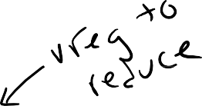




Reduction Operations
A[4]
B[4]
A[3]
B[3]
v0
setvl 5 vld v0, a vld v1, b
vredsum v0, v0, v1, vm
0
A[2]
B[2]
v1
B[0]
B[1]
B[2]
B[3]
B[4]
A[1]
B[1]
A[0]
B[0]
sum
v0
v0[0] =
v0[0] + Σ_i v1[i]
+
v1
B[4]
B[3]
B[2]
B[1]
B[0]
A [0]

Slide 29


Reduction Operations
A[4]
B[4]
A[3]
B[3]
v0
setvl 5 vld v0, a vld v1, b
vredsum v0, v0, v1, vm
0
A[2]
B[2]
v1
B[0]
B[1]
B[2]
B[3]
B[4]
A[1]
B[1]
A[0]
B[0]
sum
v0
v0[0] =
v0[0] + Σ_i v1[i]
+
v1
B[4]
B[3]
B[2]
B[1]
B[0]
A [0]

Slide 30
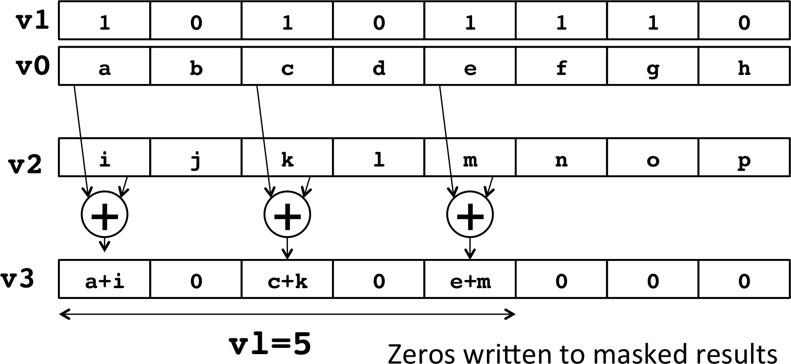
Vector Masking
vadd v3, v0, v2, v1.t
Behavior of a masked vector operation: For elements up to vl in v3, add elements from
v0 and v2 if that element in v1’s LSB is set to 1, set other v3 elems to 0
What high-level programming concept does this get used to implement?

Slide 31
Reduction Operations with a vector mask
A[4]
B[4]0
v0
A[3]
B[3]
v1
setvl 5 vld v0, a vld v1, b
B[0]
B[1]
B[2]
B[3]
B[4]
input vec
A[2]
B[2]
v2
0
1
1
1
0
vredsum v0, v0, v1, v2
A[1]
B[1]
dst init
mask
val
Reduction operations accumulate the result
of an operation on a vector into the first element of a destination vector
Uses for reduction?
A[0]
B[0]
v0
sum
+
v1
B[4]
B[3]
B[2]
B[1]
B[0]
v0[0] =
v0[0] +
v1[1] + v1[2] + v1[3]
A [0]
v2
0
1
1
1
0

Slide 32
Reduction Operations with a vector mask
A[4]
B[4]0
v0
Uses for reduction? Dot product, e.g.,
A[3]
B[3]
v1
B[0]
B[1]
B[2]
B[3]
B[4]
A[2]
B[2]
v2
setvl 5 vld v0, a vld v1, b vmul v0, v1
vredsum v0, v0, v1, v2
1
1
1
1
1
A[1]
B[1]
A[0]
B[0]
v0
sum
+
for( i = 0..len){
v[i] += a[i] * b[i]
}
v1
B[4]
B[3]
B[2]
B[1]
B[0]
A [0]
v2
1
1
1
1
1

Slide 33
Indexed Memory Accesses (Scatter/Gather)
3
4
0
2
1
index
vector
v0
dest
vluxei64 v1, (&B), v0, v2
base
v1
addr
mask
v2
0
1
1
1
0
Indexed memory loads “gather” elements from all over memory into a contiguous vector register.
Indexed memory stores “scatter” elements from a
contiguous vector register into locations all over memory
v0
3
4
0
2
1
2
0
4
3
Uses?
v1
B[4]
B[0]
B[2]
v1[i] = v2[i] ? B[v0[i]] : v1[i]
B[2]
B[0]
B[4]
v2
0
1
1
1
0

Slide 34
Indexed Memory Accesses (Scatter/Gather)
3
4
0
2
1
index
vector
v0
dest
vluxei64 v1, (&B), v0, v2
base
v1
addr
mask
v2
0
1
1
1
0
Common Use: indirect array accesses. Common in graph analytics
for( src in 0 .. n ){
for( dst in 0..ind[src].len() ){ data[ ind[src][dst] ]++;
}
}
v0
3
4
0
2
1
2
0
4
3
v1
B[4]
B[0]
B[2]
v1[i] = v2[i] ? B[v0[i]] : v1[i]
B[2]
B[0]
B[4]
v2
0
1
1
1
0

Slide 35
Summary of Benefits: Vector Architectures
Compared to scalar architectures:
Single instruction performs many operations: one instruction is the equivalent of executing
an entire loop of a program!
Control is simpler: no loops, no branches, no misprediction/misspeculation
Vector interface makes data-independence across vector elements explicit: simplifies implementations and eliminates complex dependence logic
Dependence checking of vectors, not elements: what dependence tracking is required pertains to entire vector registers, not individual elements, amortizing its cost significantly
Easy to express data parallelism: avoids software complexity of multithreading on a
multiprocessor (i.e., MIMD)
Maximize value of memory bandwidth: contiguous/strided vector fetch operations are a good match for highly-banked memories
Energy efficiency: instruction & data fetch amortize costs across vector saving energy
Require vector programming style, which means changing all of your code. Code doesn’t match vector style well? Can’t use the vector architecture without lots of extra work!

Slide 36
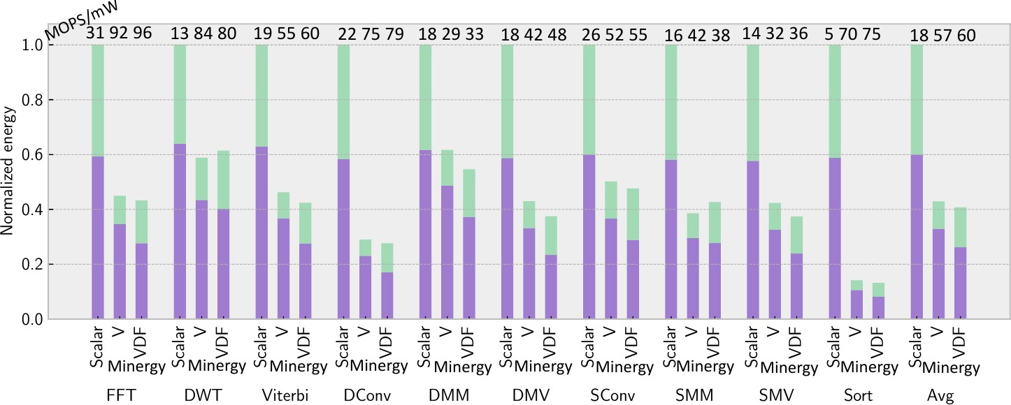
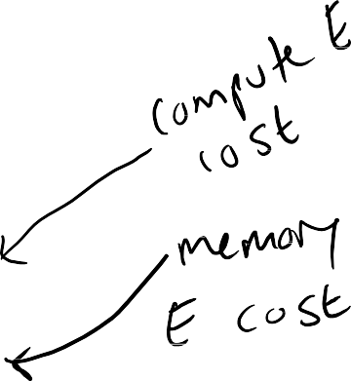
Vector execution model saves energy (and time) over scalar processing
Taken from a very recent research project about optimizing for minimum energy by using a new vector processor (V bars in
the plot) and a customized variant (VDF bars in the plot). V/VDF use RISCV vector insns., scalar plain RISCV insns.
Key take-away: vector processing cuts energy by more than half compared to scalar processing.

Slide 37
What did we just learn?
We learned about how VLIW and Vector processing are two different takes on the hardware software boundary that admit more parallelism than SS/OoO’s ILP focus allows
VLIW did not take over, vector has been a consistent background hum
Both approaches require the programmer and the compiler to make big changes to code to work well with these new hardware/software interfaces.

Slide 38
What to think about next?
Next we look at Virtual Memory as an abstraction
Also look at the underlying mechanisms and options for implementing virtual memory in a modern CPU

