Slide 1
18734: Foundations of Privacy Information Flow Experiments
Amit Datta

Slide 2
Information Flow Experiments Methodology

Slide 3
Personalized Web Advertising
Notes:
1:00 ads are both served by Google, and these may be based on some behavioral model Google creates about the user. The second one is for new mothers.
A user viewing the ad may wonder why he or she may have been served such an ad.

Slide 4
Personalized Web Advertising
Confounding factors:
Other users
Advertisers
Websites
Web Browsing
Ad Ecosystem
Advertisements
Notes:
3:00 We’re interested in finding which flows exist among these entities.
However, it’s a blackbox. This lack of visibility prevents us from drawing conclusions about the interactions inside the system.
Moreover confounding inputs.
What we are still capable of doing is running experiments to detect flows through the system as a whole

Slide 5
Experimental Design
Confounding factors:
Environmental factors
Genetic differences
Drug
Biological System
Surviving Cancer
Notes:
3:00 We’re interested in finding which flows exist among these entities.
However, it’s a blackbox. This lack of visibility prevents us from drawing conclusions about the interactions inside the system.
What we are still capable of doing is running experiments to detect flows through the system as a whole

Slide 6
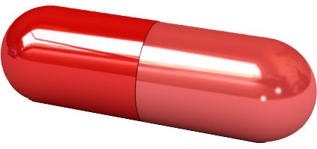
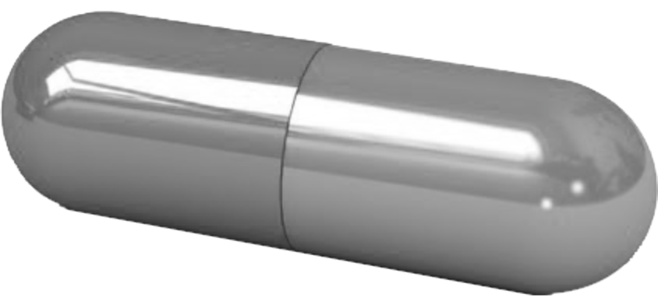
Experimental Design
Drug
Biological System
Surviving Cancer
Confounding factors
Different
Outcome?
Notes:
3:00 We’re interested in finding which flows exist among these entities.
However, it’s a blackbox. This lack of visibility prevents us from drawing conclusions about the interactions inside the system.
What we are still capable of doing is running experiments to detect flows through the system as a whole

Slide 7
Information Flow Experiments
Web Browsing
Ad Ecosystem
Ads
Male
Confounding factors
Different
Outcome?
Female
Notes:
3:00 We’re interested in finding which flows exist among these entities.
However, it’s a blackbox. This lack of visibility prevents us from drawing conclusions about the interactions inside the system.
What we are still capable of doing is running experiments to detect flows through the system as a whole

Slide 8
Information Flow Experiments as Science
Experimental Science | Information Flow
Natural process | System in question
Population of units | Subset of interactions
Treatments | Inputs
Responses | Outputs
… | …
Causation | Information flow
Notes:
But, some key differences: distribution model (weeks after receiving drug is normal/poisson), bunnies are independent of each other.
How do we go about doing the experiments?

Slide 9
Noninterference
[Goguen and Meseguer, 1982]
Different
high
input
High
input
Same
Program
Same
low
output
Program
Low
output
Female
Male
Job ad
Low
inputs
Same
low
inputs

Slide 10
Probabilistic Noninterference
Different
high
input
Same
low
output
distribution
Same
Program
High
input
Program
Low
output
distribution
Female
Male
Low
inputs
Same
low
inputs

Slide 11
We would like to test the following
Null hypothesis
The outputs from the experimental and control units are drawn from the same distribution
Apply a significance test
On the outputs from the two groups
Returns a p-value
Reject the null hypothesis if p-value < 0.05

Slide 12
Mechanism of ad delivery is complex
Notes:
This graph shows how Google ads change over time. One browser collected ads by reloading the breaking news page of the Chicago Tribune ever minute for 200 minutes, with time on the x-axis. We assign each unique ad an id number in the order in which we see them, which we use for the y-axis. Google’s behavior changes over time. This behavior also changes between websites. Thus, any probabilistic model would have to be more complex than those typically used in statistics.

Slide 13
Browser agents may not be independent
Notes:
statistical tests cannot make iid assumptions or assume a distribution of ads

Slide 14
Our Idea:
Use a non-parametric test
Does not require a model for Google
Specifically, a permutation test
Does not require independence among browser instances or assumption that ads are independent and identically distributed

Slide 15
Permutation Test [Good’05]
It is a non-parametric test
No assumptions about ad distributions
It does not require independent samples
Ads served to one browser can affect ads served to another
Assumption: Samples are exchangeable under the null hypothesis
A statistic that discriminates between the null and alternate hypotheses
Observations (x₁, x₂, …, x_{n}) are exchangeable if the probability of any particular joint outcome is the same regardless of the order
P. Good.
Permutation Tests: A Practical Guide to Resampling Methods for Testing Hypotheses. Springer, 2005
Notes:
13:00
No model assumptions – like bernoulli
Samples in our setting are agents, lets see why browser agents may not be independent.
works with a statistic… It is a measure of distance between the two groups.
if this distance is low, it provides evidence towards the validity of the null hypothesis, while if it is high, it does the same for the alternate.

Slide 16
Permutation Test: Example
car-related ads
Notes:
14:00

Slide 17
Permutation Test: Example
=119
car-related ads
is the measurement vector
is the statistic computed over

Slide 18
Permutation Test: Example
=67
car-related ads
is a permutation of
is the statistic computed over

Slide 19
Permutation Test: Example
=67
=119
=7
= 119
count
1
p-value =
=
= 0.004
number of unique permutations
¹⁰ C ₅
Reject null hypothesis
is a permutation of
Notes:
15:30

Slide 20
Information Flow Experiments
Experimental Treatment
(visit car-related sites)
Control Treatment
(idle)
Controlled Environment
Ad Ecosystem
Experimental Group
Control Group
Measurements
(ads)
Ad Ecosystem
Test Statistic
Hypothetical Value
Observed Value
Notes:
13:30 Random assignment breaks any confounding.
The test statistic is a measure of distance/difference between the two groups.
If the observed test statistic is extreme, we can conclude that the treatment had an effect on the ads.
To find whether it is extreme, it is compared with hypothetical values of the statistic under various permutations or browsers across groups.
This form of significance testing is called permutation testing, and no assumptions on the distribution of ads or independence of units.

Slide 21
A rigorous methodology for information flow experiments
Connection between Information Flow and Causal Experiments
Statistical principles for designing Information Flow Experiments
Control for known confounders
Randomize to break unknown confounders
Significance testing with non-parametric statistical tests
Notes:
Compare with prior work

Slide 22
Information Flow Experiments on Personalized Ads and Ad Settings

Slide 23
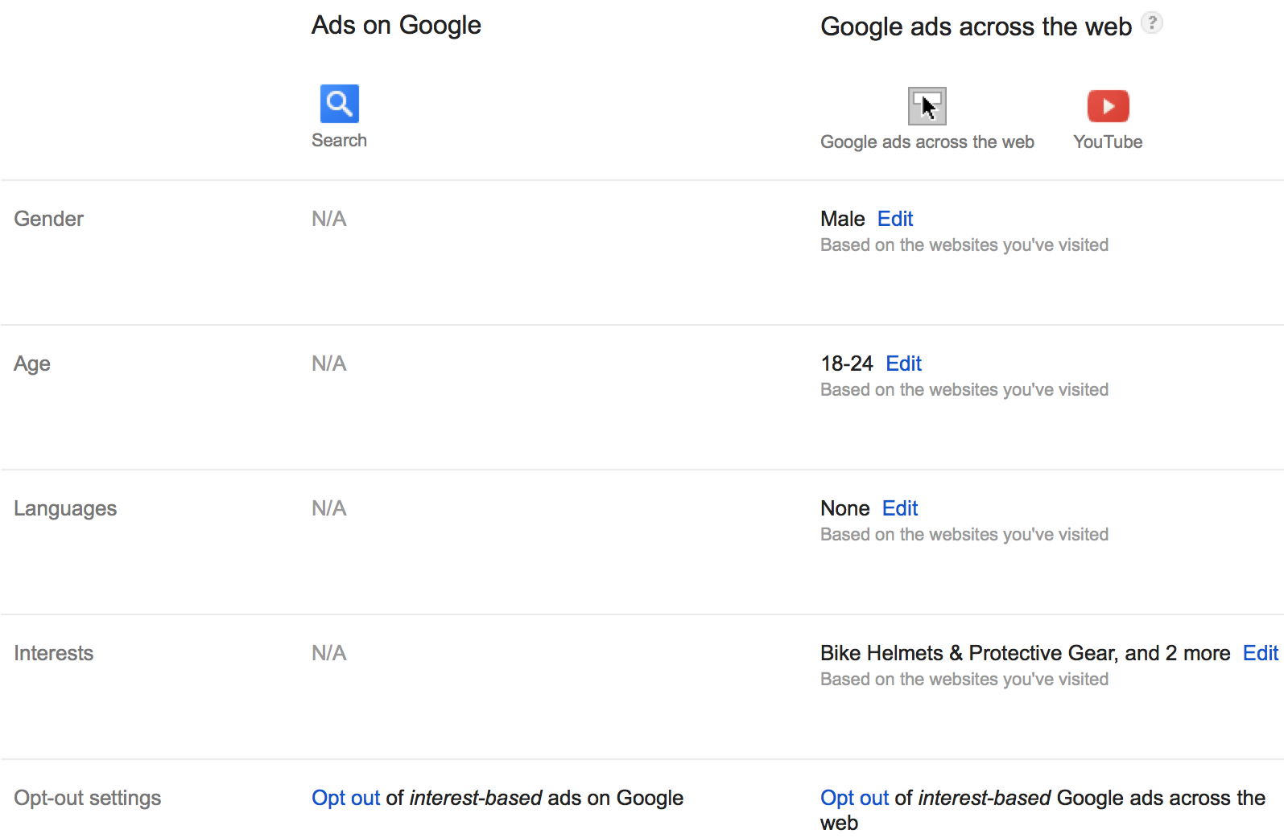
Ad Settings
www.google.com/settings/ads
Notes:
1:30
Screenshot. Transparency, Choice.

Slide 24
Model of Interactions
Web Browsing
Ad Ecosystem
Advertisements
inferences
edits
Ad Settings
Notes:
3:00 We’re interested in finding which flows exist among these entities.
However, it’s a blackbox. This lack of visibility prevents us from drawing conclusions about the interactions inside the system.
What we are still capable of doing is running experiments to detect flows through the system as a whole

Slide 25
Scaling Challenges
Limited samples
Selection of test statistic
Ad Ecosystem
Test Statistic
Notes:
14:00 To maintain a controlled environment, all browsers are run from the same machine. Due to system limitations, we can collect data from a few browsers. This wouldn’t get statistical significance for more subtle changes. So, increase samples, while develop a significance test for it.
gender-jobs experiment, it would be very difficult to guess the coaching services ad would be served more to males.

Slide 26
AdFisher Methodology
Ad Ecosystem
block 1
Ad Ecosystem
block 1
Ad Ecosystem
Ad Ecosystem
block t
Ad Ecosystem
Control Treatment
Experimental Treatment
block n
Training Data
Ad Ecosystem
Machine Learning
Measurements
explanations
Classifier
Measurements
Significance Testing
p-value
Notes:
15:30 One way increase samples is to run browsers over time, but this would add noise. To increase samples without adding too much noise, we use blocking. So, we modify the permutation test to consider only valid permutations.
classifier learns a difference between measurements from the exp and control browsers. Then, a statistical test is performed specialized for the learnt differences. Our initial studies showed that logistic regression performed best, We use accuracy.
A benefit of using a linear classifier - easy to extract the top ads for each group. features with the highest weights.

Slide 27
We study three properties on the Ad Ecosystem
Discrimination
Transparency
Choice

Slide 28
Discrimination
Web Browsing
Ad Ecosystem
Advertisements
Browse websites related to finding jobs
Significant causal effect on ads
(p-value < 0.00003)
Ad Settings
Set gender bit
Notes:
6:00 Two identical users differing in only a sensitive attribute.
1000 = 500+500

Slide 29
Discrimination Explanations
Female Group | Male Group
Jobs (Hiring Now) www.jobsinyourarea.co 45 vs. 8 | $200k+ Jobs - Execs Only careerchange.com 311 vs. 1816
4Runner Parts Service www.westernpatoyotaservice.com 36 vs. 5 | Find Next $200k+ Job careerchange.com 7 vs. 36
Criminal Justice Program www3.mc3.edu/Criminal+Justice 29 vs. 1 | Become a Youth Counselor www.youthcounseling.degreeleap.com 0 vs. 310
Notes:
From a societal standpoint, it is concerning that high paying job opportunities are being targeted towards males.
2 reasons why this may have happened – advertisers, Google. cannot pinpoint.

Slide 30
Transparency
Web Browsing
Ad Ecosystem
Advertisements
Significant causal effect on ads
(p-value < 0.00005)
Visit the top 100 substance abuse sites
Ad Settings
No effect on ad settings
Notes:
9:00 2 flows. Lack of transparency == one exists and another does not. Ad settings doesn’t tip off that certain browsing activities are being used to serve ads

Slide 31
Transparency Explanations
Substance Abuse Visitors | Control Group
The Watershed Rehab www.thewatershed.com/Help 2276 vs. 0 | Alluria Alert www.bestbeautybrand.com 0 vs. 9
Watershed Rehab www.thewatershed.com/Rehab 362 vs. 0 | Best Dividend Stocks dividends.wyattresearch.com 24 vs. 54
The Watershed Rehab (none) 771 vs. 0 | 10 Stocks to Hold Forever www.streetauthority.com 76 vs. 118
Notes:
9:30 2 explanations:
somehow the ‘substance abuse’ interest was learned by Google
second, more likely reason is remarketing
conveyed findings, did not get a clear explanation of how this may have happened.

Slide 32
Additional notice on Ad Settings
Before
After
Notes:
10:00 We cannot say that our findings are the reason behind this notice, but the timing does suggest they might be.

Slide 33
Choice
Web Browsing
Ad Ecosystem
Advertisements
Visit sites related to online dating
Causes significant reduction in dating ads
(p-value < 0.05)
Ad Settings
Remove interests related to online dating
Notes:
11:00 Editing interests does affect ads in a meaningful way
interest: dating & personals
keywords for identifying dating ads: dating, romance, relationship

Slide 34
Choice Explanations
Keep Dating Interest | Remove Dating Interest
Are You Single? www.zoosk.com/Dating 2433 vs. 78 | Car Loans w/ Bad Credit www.car.com/Bad-Credit-Car-Loan 8 vs. 37
Top 5 Online Dating Sites www.consumer-rankings.com/Dating 408 vs. 13 | Individual Health Plans www.individualhealthquotes.com 21 vs. 46
Why can't I find a date? www.gk2gk.com 51 vs. 5 | Crazy New Obama Tax www.endofamerica.com 22 vs. 51
Notes:
All is not bad. Editing interests does affect ads in a meaningful way

Slide 35
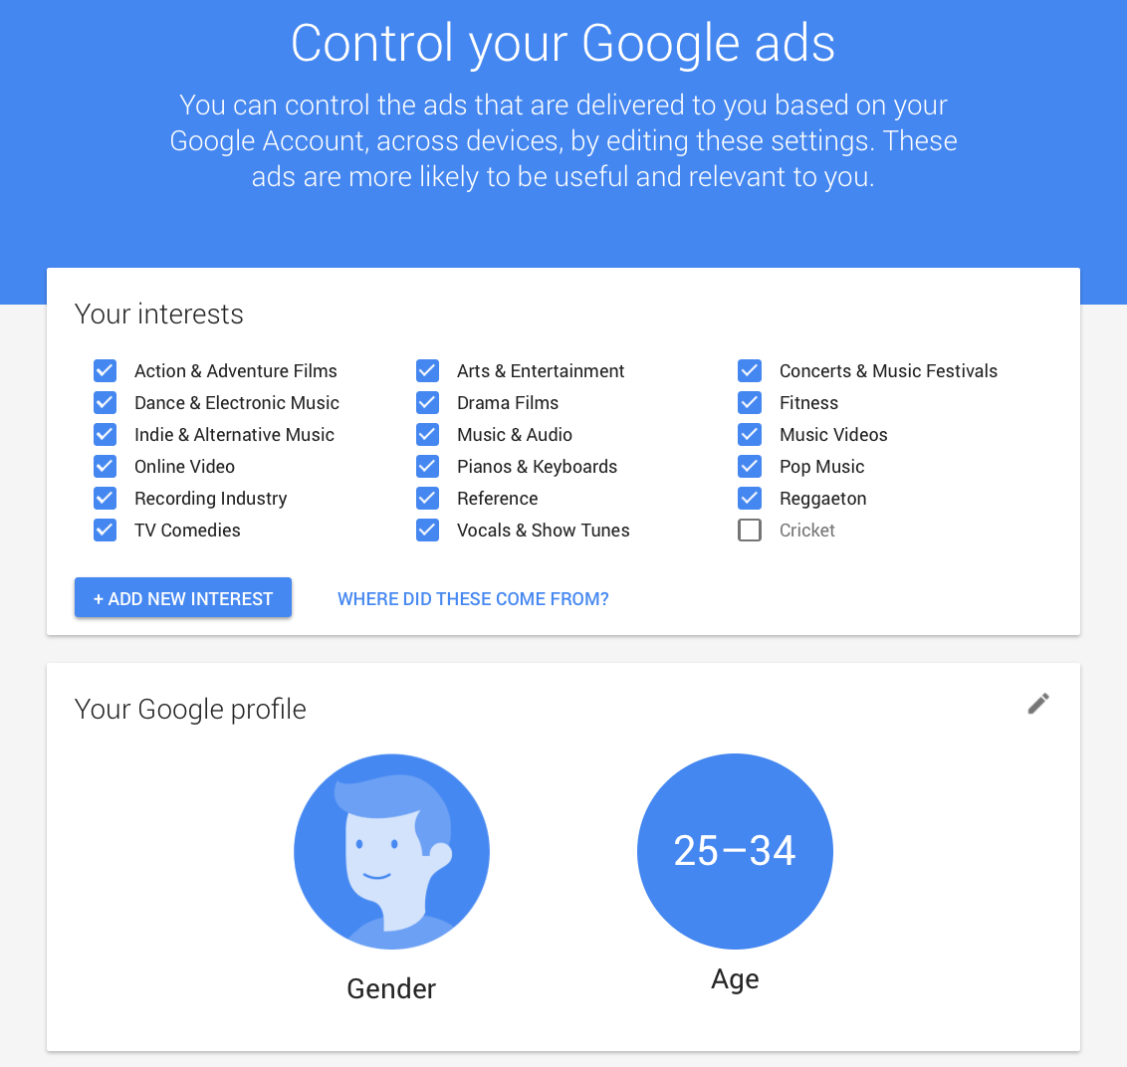
Possible Impact on Ad Settings

Slide 36
Possible Impact on Ad Settings

Slide 37
Conclusions
Findings of discrimination, lack of transparency, and choice.
Scalable methodology
Blocked design
Automated selection of test statistic
AdFisher is freely available online:
github.com/tadatitam/info-flow-experiments
Notes:
16:00

