Slide 1
18734: Foundations of Privacy *coins
Peter Mardziel
(slides by Anupam Datta, Nicolas Christin, Joe Bonneau)
CMU
Fall 2017

Slide 2
Motivation
Recall e-cash lecture
Retain bank
Bank cannot link transactions
Agents cannot double spend their electronic coins
Key novelty in Bitcoin design
No centralized bank

Slide 3
*coins Lectures
Decentralized Cash
Building blocks refresher
Design
Bitcoin
Uses and Implications
Anonymity
Anonymous (and decentralized) Cash

Slide 4
Building blocks refresher

Slide 5
Building blocks refresher
Public-private key crypto for signatures
Hash / “one-way” functions
Design for incentives

Slide 6
Public/private key Signatures
m
Private key sk
Message m
Public key pk
Sign(sk,m)
m,Sign(sk,m)
Public key pk
Bob checks Check(pk, Sign(m))
Notes:
Design special signature schemes for which there exist efficient proofs
- CL signatures based on RSA, gap DH, LRSW
- [BCKL08, BCCKLS09, CK] signatures based on bilinear pairings

Slide 7
Hash functions
“One-way”, “cryptographic hash”
Function f: X → Y
Easy: Given x, compute f(x)
Hard: Given y, compute x s.t. f(x) = y
”Effectively” uniform output.

Slide 8
Design for incentives
Easy vs. hard is relative.
Inverting a hash function is hard.
But not impossible.
Computational effort is a disincentive.
Positive incentives are useful.
Bitcoin will feature several.

Slide 9
Designing Bitcoin

Slide 10
Coin Goals
A coin can:
Belong to Alice
Be paid/transferred to Bob (by Alice)
Be used as a coin subsequently by Bob
A coin cannot:
Be paid paid by someone other than Alice
Be spent more than once
Rely on a central trusted authority

Slide 11
Attempt 1: signed letter of intent
Alice: “I, Alice, am giving Bob one coin”
Alice digitally signs message and announces bits to everyone.
Properties
Establishment of Alice’s intent
Limited protection from forgery
Weakness
Coins are not unique; can be duplicated

Slide 12
Attempt 2: unique serial # on coins
Alice: “I, Alice, am giving Bob one coin, with serial number 8740348”
Alice: “I, Alice, am giving Bob one coin, with serial number 8770431”
Bank issues coins with unique serial numbers, keeps track of who owns coins, verifies transactions
Properties
Establishment of Alice’s intent
Better protection from forgery
Weaknesses
Need trusted bank to issue coins, keep track of who owns coins, verify transactions
Bank can link transactions to identity

Slide 13
Attempt 3: make everyone the bank
Everyone maintains a copy of the public ledger of transactions (keeps track of who owns coins)
Bob uses his copy of the ledger to check that the coin is Alice’s; he broadcasts both Alice’s message and his acceptance of the transaction to the entire network, and everyone updates their copy of the ledger.
Weaknesses
Double-spending: What if Alice gives the same coin to Bob and Charlie at the same time?
Effort required on everyone else.

Slide 14
A Network Verification Design
Bob does not verify Alice’s coin by himself.
Asks everyone on the network to verify
When “enough” people confirm that the coin is indeed Alice’s, Bob accepts and everyone updates their block chain
Weakness:
Sybil attack: Alice creates many fake agents who lie for her; Alice spends the same coin many times

Slide 15
Attempt 4: proof-of-work
Computationally costly for network users to validate transactions
Reward network users for validating transactions
Properties
Sybil attacks disincentivized
Verifiers rewarded with coins for work
Ensure that ledger succinctly maintains history of all transactions

Slide 16
Bitcoin Overview

Slide 17
Bitcoin primer (1/2)
A peer-to-peer digital payment system
Completely decentralized digital currency
No central mint to produce currency
No central bank to verify transactions
Once confirmed, transactions are irreversible
Predictable, capped, currency supply
Key innovation in Bitcoin: coin production and verification is done by network consensus

Slide 18
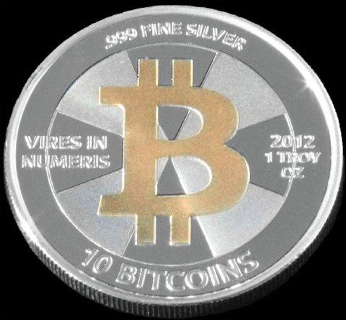
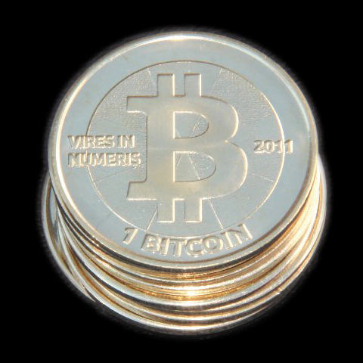
Bitcoin primer (2/2)
No notion of a “coin”
Private Key A
Public Key A
T1: 0.25 BTC → A
T2: 0.75 BTC → A
Wallets are addressed by public keys.
Owner of wallet knows the private key.
Transactions are at the heart of the protocol.
Value of a wallet = the bitcoins transferred to it in the past.

Slide 19
Bitcoin transactions
Alice wants to send 1 BTC to Bob
She picks a transaction (or a group of transactions) that she has previously been the recipient of and that cumulatively contain at least 1 BTC
She then appends Bob’s wallet address to the transaction and digitally signs it
When Bob subsequently wants to spend the 1 BTC, all he has to do is to repeat the operation

Slide 20
Preventing double-spending
Bob now has 1 BTC
He wants to send it to Charlie…
… while keeping it for himself at the same time
To prevent this Bob (and Alice before him) has to broadcast the transaction to everybody in the Bitcoin network
Then other peers can verify that the transaction is not a double-spend
Once this is done, the transaction is embedded forever in a public ledger

Slide 21
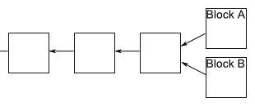
The Block Chain of Transactions

Slide 22
Preventing double spending
Sign_{A}(Transfer X to B)
Sign_{A}(Transfer X to C)
Sign_{A}(Transfer X to B)
Longest chain wins
Slide credit: Joe Bonneau

Slide 23
Bitcoin is transaction-based
...
IN:
scriptSig ...
scriptSig ...
OUT:
scriptPubA, 5.9
IN:
scriptSigA
OUT:
scriptPubB, 5.0
scriptPubA, 0.9
...
IN:
scriptSigA
scriptSigA
OUT:
scriptPubC, 10.0
IN:
scriptSig ...
OUT:
scriptPubA, 9.2
...
Slide credit: Joe Bonneau

Slide 24
A Bitcoin Transaction
{"hash":"7c4025...", //serial number: hash of transaction
"ver":1, // protocol version
"vin_sz":1, // no.of inputs
"vout_sz":1, // no.of outputs
"lock_time":0, // transaction finalized after time
"size":224, // no. of bytes in transaction
"in":[ // input of transaction 7-11
{"prev_out": // input is an output of a previous transact.
{"hash":"2007ae...", // serial number of previous transact.
"n":0}, // output number of previous transact.
"scriptSig":"304502... 042b2d..."}], // signature and pub key of sender
"out":[ // output of transaction 12-14
{"value":"0.31900000", // outputs 0.319 BTC
"scriptPubKey":"OP_DUP OP_HASH160 a7db6f OP_EQUALVERIFY OP_CHECKSIG"}]} // script for verifying transaction

Slide 25
Bitcoin transactions specify scripts
scriptPubKey: OP_DUP OP_HASH160 <pubKeyHash> OP_EQUALVERIFY OP_CHECKSIG
scriptSig: <sig> <pubKey>
IN:
scriptSig ...
scriptSig ...
OUT:
scriptPubA, 5.9
IN:
scriptSigA
OUT:
scriptPubB, 5.0
scriptPubA, 0.9
Redemption script:
<sig> <pubKey> OP_DUP OP_HASH160 <pubKeyHash> OP_EQUALVERIFY OP_CHECKSIG
Slide credit: Joe Bonneau

Slide 26
Bitcoin transactions specify scripts
<pubKeyHash>
<pubKey>
<pubKeyHash>
✓
<pubKey>
<sig>
<sig> <pubKey> OP_DUP OP_HASH160 <pubKeyHash> OP_EQUALVERIFY OP_CHECKSIG
Slide credit: Joe Bonneau

Slide 27
Bitcoin script features
https://en.bitcoin.it/wiki/Script
Notes:
multiple signatures
escrow
time locking
commitment opening
...

Slide 28
Part III: Mining Bitcoin

Slide 29
Coin production
Coin production is embedded in the verification process
Verifiers (“miners”) verify batches of transactions at once
In exchange for which they are allowed to add a “creation” transaction to the batch and give themselves a fixed amount of money
50 BTC originally, 25 BTC now, divided by two every so often
Verification is combined with a “proof-of-work” scheme to ensure
That transactions have proper timestamping
That currency production is rate-limited

Slide 30
More on mining incentives
Miners solve a cryptographic puzzle:
Find x s.t. H(x||l) < y where l is the batch of transactions.
There is no good algorithm to solve this (H is a cryptographically secure hash function)
Brute-force: try x=0, x=1, x=2, x=…
The lower y, the harder the puzzle
Difficulty is tunable and is (by edict) designed to be inversely proportional to the total computational power of the network
The goal is to have one block every ten minutes
Predictable supply of currency (independent of the difficulty)
But this limits how quickly transactions can be verified
At least 10 minutes, usually 60 minutes is recommended

Slide 31
Transaction fees
In addition to the bonus they get for mining, miners get “transaction fees”
Leftover “change” voluntarily left in transactions
Because the bonus is decreasing over time, the expectation is that transaction fees will increase over time to make up for lost mining revenue

Slide 32
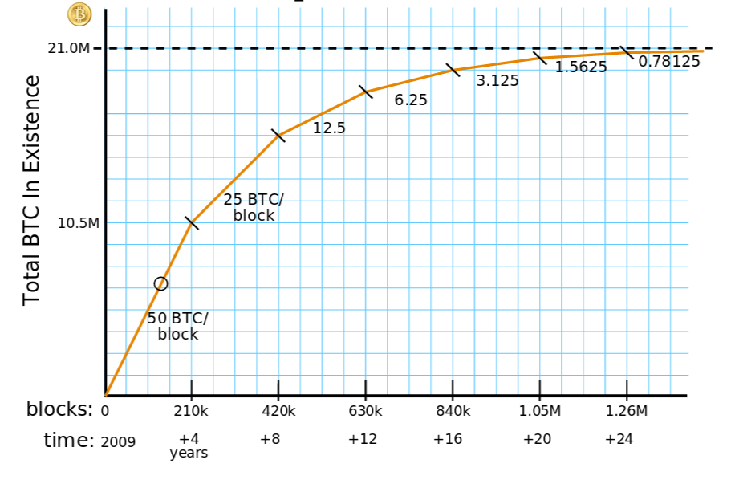
Mining rewards
Courtesy:
Brian Warner

Slide 33
Total network capacity
2⁶⁴ hashes per block (every 10 minutes!)
2⁷⁵ hashes in 2013
In exchange for ~US$250M
Consuming > 100 MW
Slide credit: Joe Bonneau

Slide 34
Uses and Implications

Slide 35
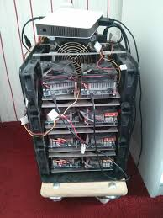
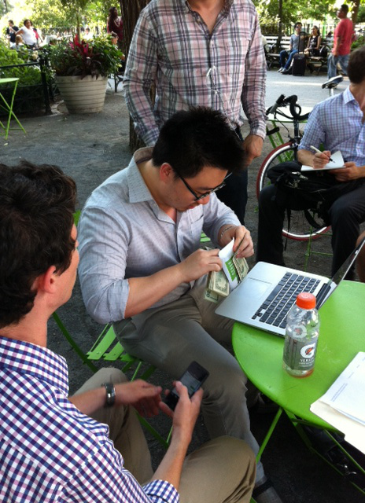
Getting Bitcoin
Become a miner
Nowadays only profitable if dedicated (ASIC) hardware
Buy at an exchange
CampBX, Bitstamp, BTC-e, Coinbase…
(Mt.Gox before they went bankrupt)
Very high concentration on exchanges through which money is exchanged
Exchanges fail pretty often…
Increasingly scrutinized by regulators
Buy from individuals
Satoshi Square in NYC

Slide 36
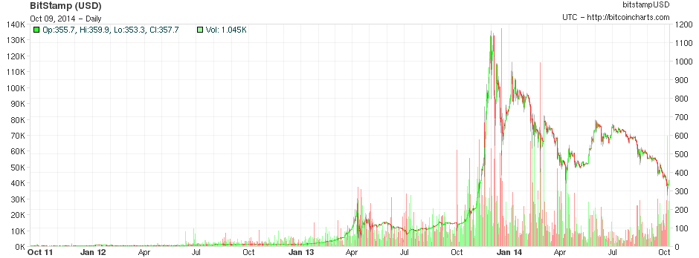
Main Bitcoin uses
As a speculative instrument
People invest in BTC, betting on its rising value
Dominant use thus far

Slide 37
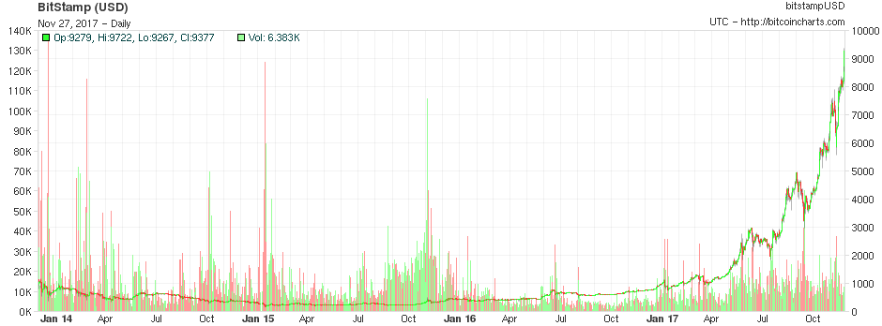
Main Bitcoin uses
As a speculative instrument
People invest in BTC, betting on its rising value
Dominant use thus far

Slide 38
Main Bitcoin uses
As a currency
Only currency accepted on underground marketplaces (Silk Road, Evolution,…)
(Except for LiteCoin, which is a clone of Bitcoin)
Because of its “anonymity properties”
Still relatively modest
Entire Silk Road revenue represented in 1st half of 2012 about $15M/annum
Gambling, poker sites
Large number of transactions, volume not very high
Other uses still in their infancy
Campaign contributions, online stores (e.g., Overstock), etc

Slide 39
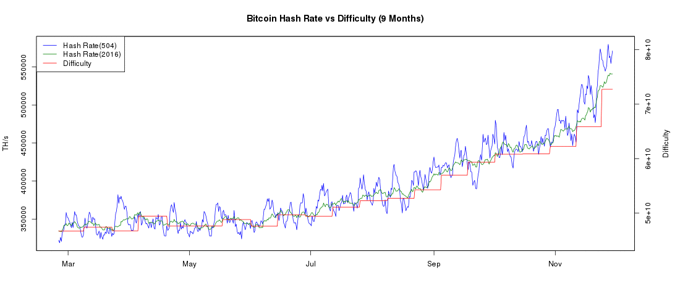
Mining difficulty (2016)
bitcoinwisdom.com
Notes:
> what is the hash rate? Total number of hashes per second produced by the entire Bitcoin network. > how are the green and blue lines different? One is the average hash rate over the past 504 blocks, one is over the past 2016 blocks. > what is "difficulty"? It is a metric used by the whole network as a consensus to determine how hard the cryptopuzzle should be. Essentially -- and very roughly -- it maps to the number of zeros y should start with in solving the equation H(x) < y. The technical explanations are at https://en.bitcoin.it/wiki/Difficulty

Slide 40
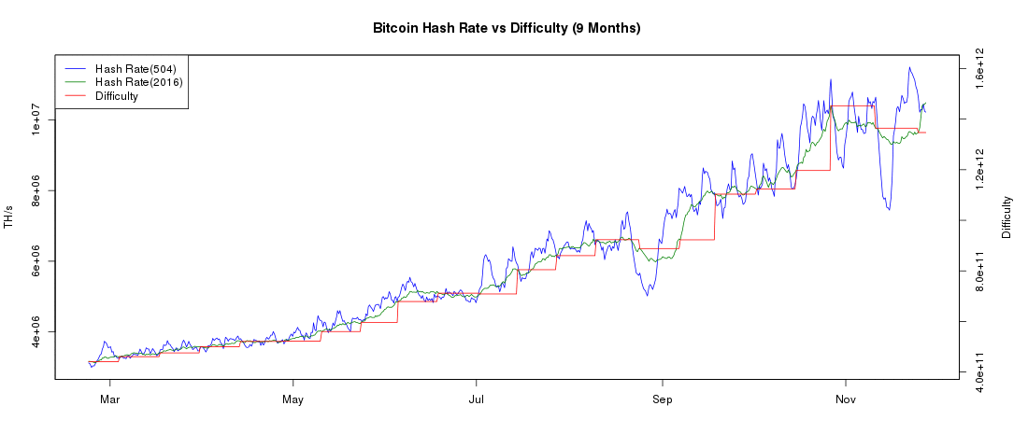
Mining difficulty (2017)
bitcoinwisdom.com
Notes:
> what is the hash rate? Total number of hashes per second produced by the entire Bitcoin network. > how are the green and blue lines different? One is the average hash rate over the past 504 blocks, one is over the past 2016 blocks. > what is "difficulty"? It is a metric used by the whole network as a consensus to determine how hard the cryptopuzzle should be. Essentially -- and very roughly -- it maps to the number of zeros y should start with in solving the equation H(x) < y. The technical explanations are at https://en.bitcoin.it/wiki/Difficulty

Slide 41
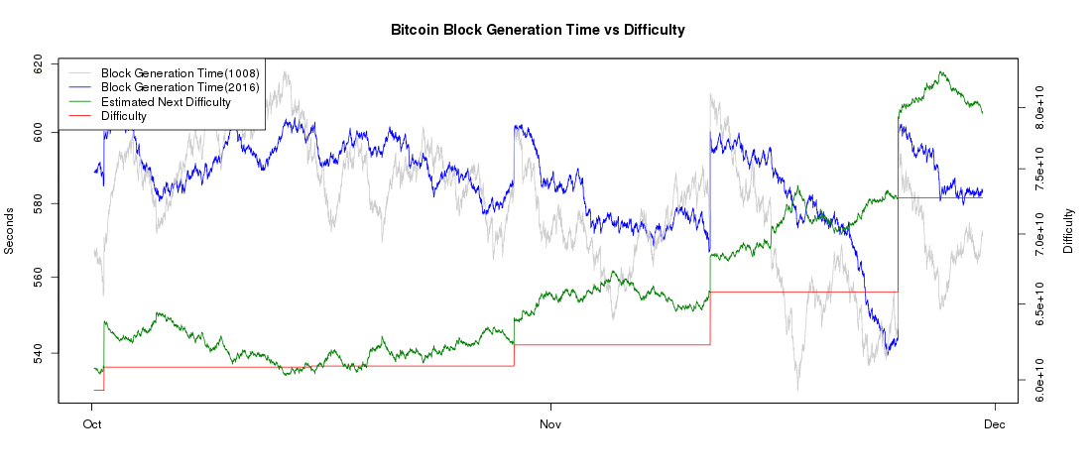
Difficulty adjustment
bitcoinwisdom.com
Notes:
> what is block generation time (1008 vs 2016)? Average generation time for a block (i.e., time needed to solve the cryptopuzzle) over the past 1008 blocks (resp. 2016 blocks). The lower the gray curve below the blue curve the faster the network hash rate is increasing. > what is "estimated next difficulty"? Predicted value "difficulty" will take upon its next assingment. "Difficulty" is re-assigned every two weeks by consensus.

Slide 42
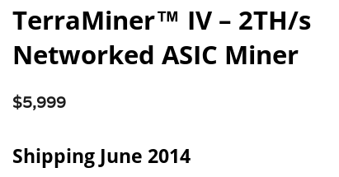
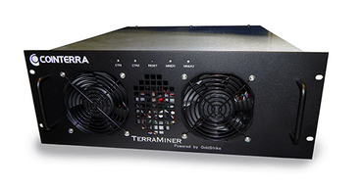
Bitcoin mining hardware
Slide credit: Joe Bonneau

Slide 43
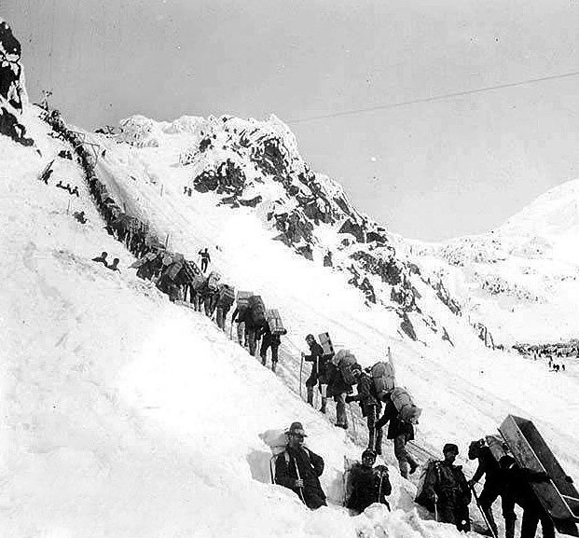
Should I mine bitcoins?
Chilkoot pass, Klondike 1898
Slide credit: Joe Bonneau

Slide 44
Implications: Energy

Slide 45
Implications: Energy

Slide 46
Implications: Illicit purposes

Slide 47
Legality

Slide 48
Anonymity?

Slide 49
Pseudonymity vs anonymity
Wallets are public/private key pairs
Can create as many as you want
Think of them as zero-cost pseudonyms
There is no central authority issuing Bitcoins or vetting transactions
This means Bitcoin is anonymous, right?
NO!

Slide 50
Recall: public ledger
...
IN:
scriptSig ...
scriptSig ...
OUT:
scriptPubA, 5.9
IN:
scriptSigA
OUT:
scriptPubB, 5.0
scriptPubA, 0.9
...
IN:
scriptSigA
scriptSigA
OUT:
scriptPubC, 10.0
IN:
scriptSig ...
OUT:
scriptPubA, 9.2
...
Slide credit: Joe Bonneau

Slide 51
Bitcoin tracing
Anonymity here implies unlinkability of transactions
The entire ledger of all transactions is available, forever
Technically in a compressed form, but transaction chains can all be reconstructed
Even if you add intermediary dummy steps wallets, linking the source and the destination of a transaction may be done by graph analysis…
Something that computer scientists know how to do!
Reid & Harrigan, 2011
Shamir & Ron, 2012
Meiklejohn et al., 2013
Families of wallets can be pooled together as belonging to the same actual user…
…and if somehow you can get the user’s identity, the game is over

Slide 52
Example: early coins
worth close to 6 billion USD

Slide 53
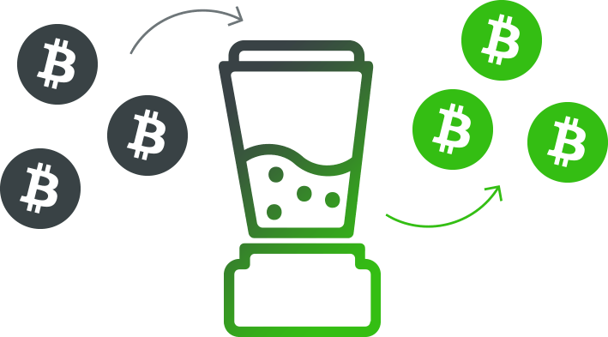
Anonymizing Bitcoin
Mixers

Slide 54
Anonymizing Bitcoin
Mixers
Did Alice give 10 BTC to Charles or Daisy?
10 BTC
Mixer
10 BTC
Alice
Charles
Bob
Daisy
10 BTC
10 BTC

Slide 55
Anonymizing Bitcoin
Mixers in practice
Need to also introduce arbitrary delays
Introduction of change addresses, etc
Mixer can be dishonest!
5 BTC
Mixer (keeps 5%)
4.75 BTC
Alice
Charles
Bob
Daisy
10 BTC
9.5 BTC

Slide 56
Anonymizing Bitcoin
It’s unclear how good existing Bitcoin mixers are
Key difference with message mixing (Tor)
You can’t implement arbitrary “padding” – money has to go somewhere eventually
Recent research suggests existing mixers are not effective or downright dishonest

Slide 57
Zerocoin

Slide 58
Zerocoin overview (1/3)
Miers et al (2013)
Runs on top of the bitcoin blockchain
Mixing as part of protocol
Not adopted
Revised as zerocash

Slide 59
Zerocoin overview (2/3)
Step 1: Mint a “zerocoin”
Spend a non-redeemable bitcoin
Step 2: Spend a zerocoin
Prove that you have minted a zerocoin in the past
ANY zerocoin (not already spent)

Slide 60
Zerocoin overview (3/3)

Slide 61
Zerocoin building blocks
Building blocks
Cryptographic commitments
Cryptographic accumulators
Non-interactive zero-knowledge proofs

Slide 62
Commitments (1/3)
Locked box analogy
Hiding – hard to tell which message is committed to
Binding – there is a unique message corresponding to each commitment
m
m

Slide 63
Commitments (2/3)
Locked box analogy
Hiding – hard to tell which message is committed to
Binding – there is a unique message corresponding to each commitment
f(m)
m
m
Using one-way function f

Slide 64
Commitments (3/3)
Pederson commitment
Hiding – information theoretic protection
Binding – computationally infeasible if discrete log is hard
h^{m} g^{r}
m
m,r
Random r, h and g are group generators.

Slide 65
Accumulators
“One-way membership” function.
For a set X, A = Acc(X)
A(x) iff x ∈ X
A(x) is easy to compute.
Hard to recover X from A.
Example: product of large primes.
p₁^{x} p₂^{y} p₃^{z} ...
Easy to check that a particular prime is a factor.
Hard to determine which primes are factors.

Slide 66
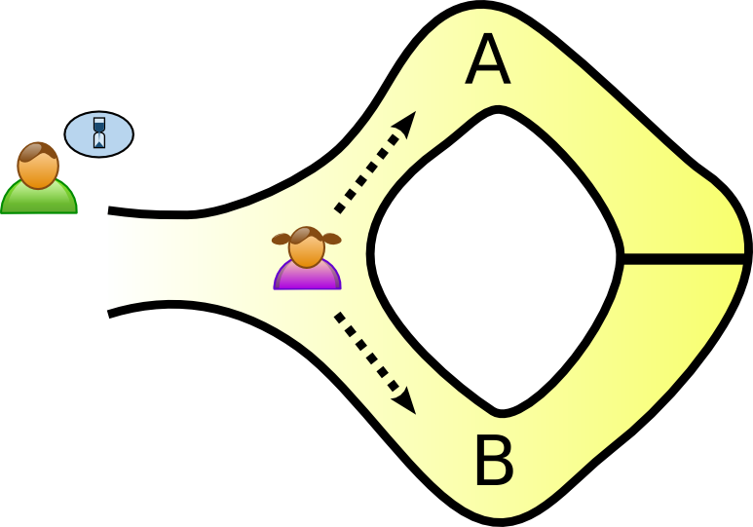
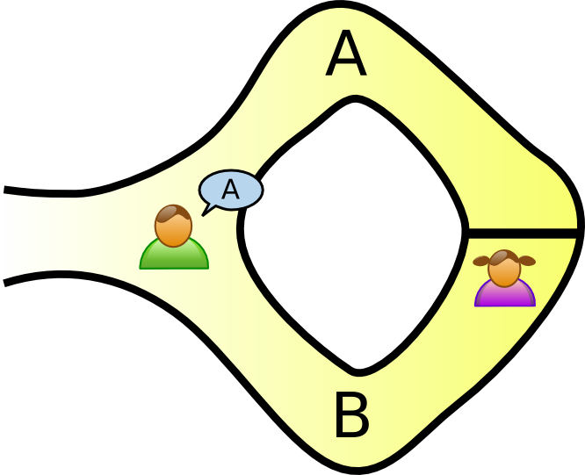
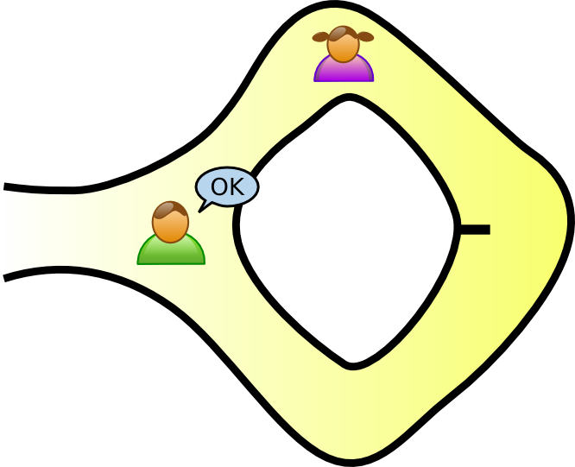
Zero-knowledge (1/4)
Recall regular (interactive) zero-knowledge.
Prove statement s(x) without revealing x.
And not transferring ability to prove to verifier.
Example: password_is(”open sesame”)
Interactivity required?

Slide 67
Zero-knowledge (2/4)
Alice proves to Bob that she knows the password.
Alice commits to a path A or B.
Bob says either A or B.
Alice comes out of said path.

Slide 68
Zero-knowledge (3/4)
Interactivity required?
Can Bob record his view/interaction to then prove to someone else that Alice knows the password?

Slide 69
Zero-knowledge (4/4)
Interactivity required?
What if Bob flips a coin on camera to decide which path to ask Alice to return by?

Slide 70
Non-interactive Zero-knowledge
Replace interactivity with trusted, agreed-upon, source of randomness.
Or a fixed-length random string.
Length depends on security parameter.
Requires initial trusted setup.
“Zero-knowledge signatures”
common random string σ
Interactive
Non-Interactive

Slide 71
Zerocoin

Slide 72
Zerocoin: Minting
Commit the message “I have burned 1 BTC” into the block chain.
Pick random randomness r, serial number S.
C = f(r,S) – a Pederson commitment.
Add transaction into block-chain.
Input 1 BTC
Indicate C in transaction.
Output not redeemable.
Output script cannot run without failing.

Slide 73
Zerocoin: Redeeming (1/2)
To redeem C=f(S,r) for a bitcoin
C has not been spent. Easy as C are part of block-chain.
Prove that C is a commitment to SOME minted zerocoin.

Slide 74
Zerocoin: Redeeming (2/2)
Block-chain maintains accumulator A for zerocoin serial numbers S_{i}.
C_{i} = f(S_{i}, r_{i})
Alice shows that S is one of {S₁, ..., S_{n}}
Alice provides non-interactive zero-knowledge proof that:
I know r that is the random string in C = f(S,r).
Proof is logarithmic in number of zerocoins in accumulator.

Slide 75
Zerocoin: Weaknesses
Proofs for spending zerocoin are 40kB big.
Compare to 1MB block size.
Fixed denominations.
Requires “hard fork” of bitcoin. Majority of miners need to adopt changes to protocol.

Slide 76
Zerocash (1/2)
Addresses proof size and denominations.
Additional requirements.
Trusted random string is very large.

Slide 77
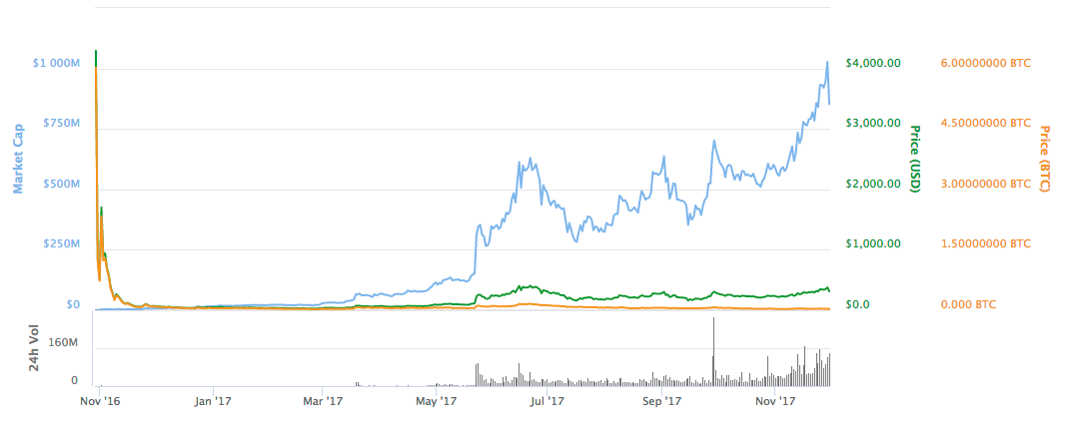
Zerocash (2/2)
Deployed
As of Nov 2017, 1 Zcash = 305USD
Market cap around 833 million USD.
#17 e-coin according to market capitalization.

