Slide 1
Algorithmic Transparency with Quantitative Input Influence
Anupam Datta
Carnegie Mellon University
18734: Foundations of Privacy

Slide 2
Machine Learning Systems are Opaque
?
Credit
Classifier
?
?
User data
Decisions

Slide 3
Machine Learning Systems are Opaque
Credit
Classifier
User data
Decisions

Slide 4
Algorithmic Transparency| Decisions with Explanations [Datta, Sen, Zick IEEE Symposium on Security and Privacy 2016]
How much influence do various inputs (features) have on a given classifier’s decision about individuals or groups?
Age | 27
Workclass | Private
Education | Preschool
Marital Status | Married
Occupation | Farming-Fishing
Relationship to household income | Other Relative
Race | White
Gender | Male
Capital gain | $41310
…..
Negative Factors:
Occupation
Education Level
Positive Factors:
Capital Gain

Slide 5
Challenge | Correlated Inputs
Example: Credit decisions
Conclusion: Measures of association not informative
Classifier
(uses only income)
Age
Decision
Income

Slide 6
Challenge | General Class of Transparency Queries
Individual
Which input had the most influence in my credit denial?
Group
What inputs have the most influence on credit decisions of women?
Disparity
What inputs influence men getting more positive outcomes than women?

Slide 7
Result | Quantitative Input Influence (QII)
A technique for measuring the influence of an input of a system on its outputs.
Causal Intervention
Deals with correlated inputs
Quantity of Interest
Supports a general class of transparency queries

Slide 8
Key Idea 1| Causal Intervention
Classifier
(uses only income)
Age
21
44
28
63
Decision
Income
$90K
$20K
$100K
$10K
Replace feature with random values from the population, and examine distribution over outcomes.

Slide 9
QII for Individual Outcomes
$$U_{i}$$
Inputs: $i∈N$
$$X$$
$$x_{1}$$
$$x_{2}$$
…
$$x_{i}$$
…
$$X_{−i}U_{i}$$
$$x_{1}$$
$$x_{2}$$
…
$$u_{i}$$
$$x_{i}$$
…
$$c$$
$$c$$
Classifier
Outcome
$$Pr\left[c\left(X\right)=1 \right| X=x_{Joe}]$$
$$Pr\left[c\left(X_{−i}U_{i}\right)=1 \right| X=x_{Joe}]$$
Causal Intervention: Replace feature with random values from the population, and examine distribution over outcomes.

Slide 10
Key Idea 2| Quantity of Interest
Various statistics of a system:
Classification outcome of an individual
$$Pr\left[c\left(X\right)=c(x_{0}) \right| X=x_{0}]$$
$$− Pr\left[c\left(X_{−i}U_{i}\right)=c(x_{0}) \right| X=x_{0}]$$
Classification outcomes of a group of individuals
$$Pr\left[c\left(X\right)=1 \right| X is female]$$
$$− Pr\left[c\left(X_{−i}U_{i}\right)=1 \right| X is female]$$
Disparity between classification outcomes of groups
$$Pr\left[c\left(X\right)=1 \right| X is male]−Pr\left[c\left(X\right)=1 \right| X is female]$$
$$− Pr\left[c\left(X_{−i}U_{i}\right)=1 \right| X is male]−Pr\left[c\left(X_{−i}U_{i}\right)=1 \right| X is female]$$

Slide 11
QII | Definition
The Quantitative Input Influence (QII) of an input $i$ on a quantity of interest $𝒬_{𝒜}(X)$ of a system $𝒜$ is the difference in the quantity of interest when the input is replaced with random value via an intervention.
$$ι^{𝒬_{𝒜}}\left(i\right)=𝒬_{𝒜}\left(X\right)−𝒬_{𝒜}(X_{−i}U_{i})$$

Slide 12
Result | Quantitative Input Influence (QII)
A technique for measuring the influence of an input of a system on its outputs.
Causal Intervention
Deals with correlated inputs
Quantity of Interest
Supports a general class of transparency queries

Slide 13
Result | Quantitative Input Influence (QII)
A technique for measuring the influence of an input of a system on its outputs.
Causal Intervention
Deals with correlated inputs
Quantity of Interest
Supports a general class of transparency queries

Slide 14
Challenge | Single Inputs have Low Influence
Classifier
Only accept old, high-income individuals
Young
Age
Decision
Low
Income

Slide 15
Naïve Approach | Set QII
Replace $X_{S}$ with independent random value from the joint distribution of inputs $S⊆N$.
$$ι\left(S\right)=𝒬\left(X\right)−𝒬(X_{−S}U_{S})$$
$$S$$
$$x_{1}$$
$$x_{2}$$
…
$$x_{i}$$
…
$$x_{1}$$
$$x_{2}$$
…
$$u_{i}$$
$$u_{1}$$
$$x_{i}$$
…
$$c$$
$$c$$

Slide 16
Marginal QII
Not all features are equally important within a set.
Marginal QII: Influence of age and income over only income.
$$ι\left(\{age, income\}\right)−ι\left(\{income\}\right)$$
But $age$ is a part of many sets!
Need to aggregate Marginal QII across all sets
$$ι\left(\{age, gender, job\}\right)−ι\left(\{gender, job\}\right)$$
$$ι\left(\{age\}\right)−ι\left(\{\}\right)$$
$$ι\left(\{age, gender\}\right)−ι\left(\{gender\}\right)$$
$$ι\left(\{age, job\}\right)−ι\left(\{job\}\right)$$
$$ι\left(\{age, gender, job\}\right)−ι\left(\{gender, job\}\right)$$
$$ι\left(\{age, gender, income\}\right)−ι\left(\{gender, income\}\right)$$
$$ι\left(\{age, gender, income,job\}\right)−ι\left(\{gender, income,job\}\right)$$

Slide 17
Key Idea 3| Set QII is a Cooperative Game
Cooperative game $<N, v\left(S\right)>$
$N$: set of agents
$v(S)$: value of set $S$
Example of cooperative game
Voting: $v(S)$ = does motion pass if voters in $S$ vote yes?
Marginal contribution of voter $i$: $m_{i}\left(S\right)=v\left(S∪\left\{i\right\}\right)−v(S)$
Our setting
Input features are agents
Influence of feature set $S$ , i.e. Set QII $ι\left(S\right)$ is $v\left(S\right)$
Marginal QII is $m_{i}\left(S\right)=v\left(S∪\left\{i\right\}\right)−v(S)$

Slide 18
Shapley Value | Aggregating Marginal Contributions
Marginal QII of feature i wrt set S
[Shapley’53] The Shapley Value
Only measure that satisfies a set of axioms
These axioms are reasonable in our setting.
Aggregate over all sets

Slide 19
Shapley Axioms
(Symmetry) Equal marginal contribution implies equal influence
Example: cloned features
(Dummy) Zero marginal contribution implies zero influence
Example: features never touched by ML model
(Monotonicity) Consistently higher marginal contribution across games yields higher influence
Necessary to compare feature influence scores of individuals

Slide 20
Shapley Axioms | Math
(Symmetry)
For all $i,j$ and $S⊆N\backslash \{i,j\}$, $v\left(S∪\{i\}\right)=v(S∪\{j\})$, implies ${ φ}_{i}\left(v\right)=φ_{j}\left(v\right)$
(Dummy)
For all $i,S⊆N$, $v\left(S∪\left\{i\right\}\right)=v\left(S\right)$, implies $φ_{i}\left(v\right)=0$
(Monotonicity)
For two games $v_{1}, v_{2}$, if for all $S$, $m_{i}\left(S, v_{1}\right)≥m_{i}(S, v_{2})$, then ${ φ}_{i}\left(v_{1}\right)≥φ_{i}\left(v_{2}\right).$

Slide 21
Experiments | Test Applications
arrests
Predictive policing using the National Longitudinal Survey of Youth (NLSY)
Features: Age, Gender, Race, Location, Smoking History, Drug History
Classification: History of Arrests
~8,000 individuals
income
Income prediction using a benchmark census dataset
Features: Age, Gender, Relationship, Education, Capital Gains, Ethnicity
Classification: Income >= 50K
~30,000 individuals
Implemented with Logistic Regression, Kernel SVM, Decision Trees, Decision Forest

Slide 22
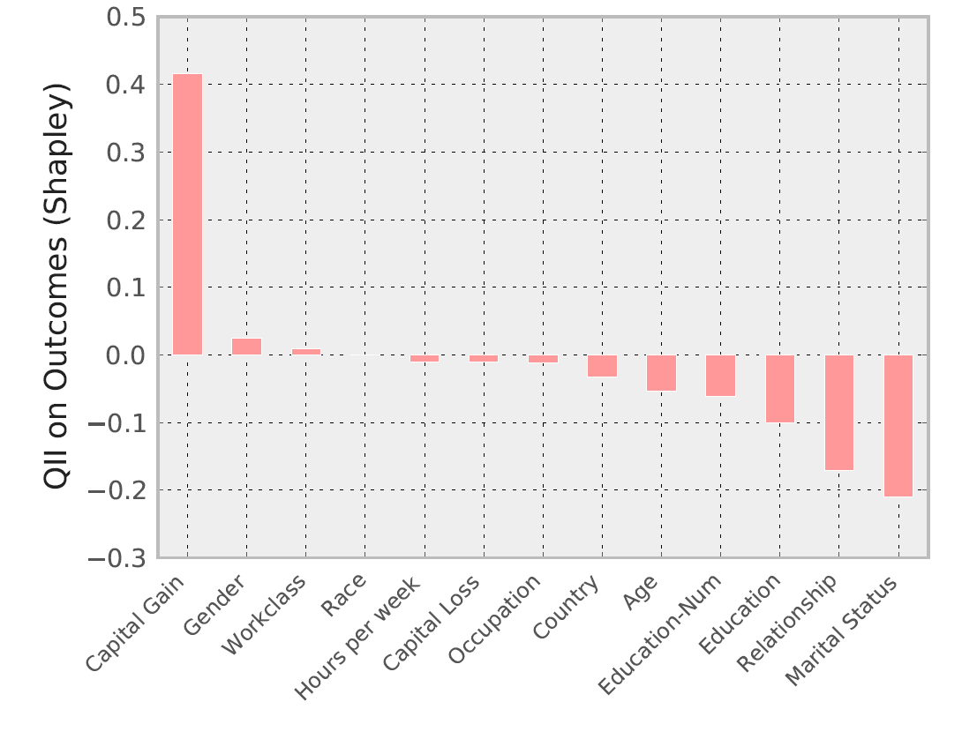
Personalized Explanation | Mr X
Age | 23
Workclass | Private
Education | 11th
Marital Status | Never married
Occupation | Craft repair
Relationship to household income | Child
Race | Asian-Pac Island
Gender | Male
Capital gain | $14344
Capital loss | $0
Work hours per week | 40
Country | Vietnam
Age | 23
Workclass | Private
Education | 11th
Marital Status | Never married
Occupation | Craft repair
Relationship to household income | Child
Race | Asian-Pac Island
Gender | Male
Capital gain | $14344
Capital loss | $0
Work hours per week | 40
Country | Vietnam
Can assuage concerns of discrimination.
income
income

Slide 23
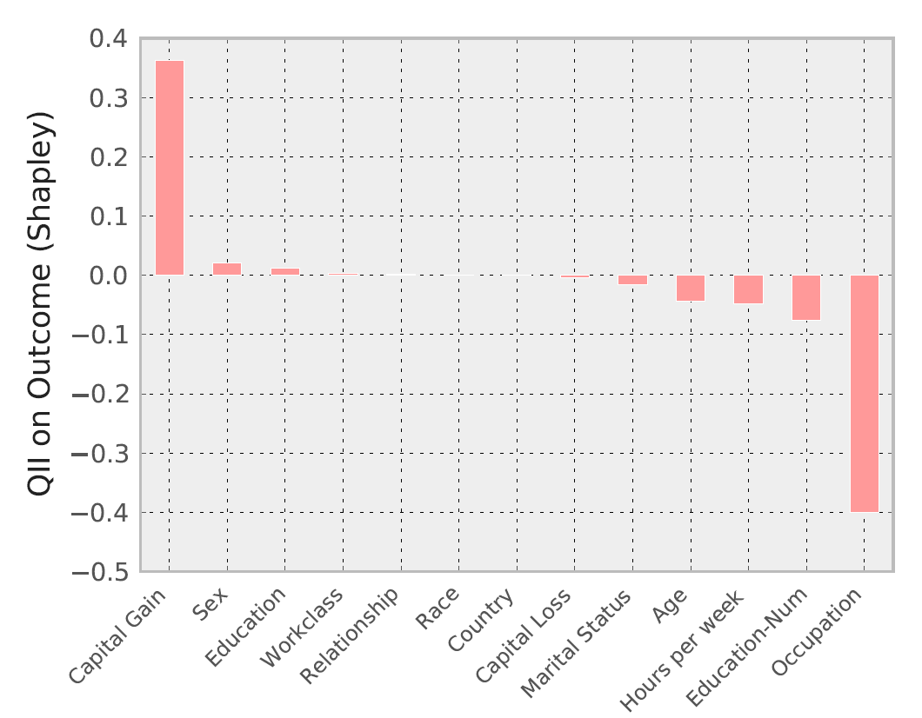
Personalized Explanation | Mr Y
Age | 27
Workclass | Private
Education | Preschool
Marital Status | Married
Occupation | Farming-Fishing
Relationship to household income | Other Relative
Race | White
Gender | Male
Capital gain | $41310
Capital loss | $0
Work hours per week | 24
Country | Mexico
Age | 27
Workclass | Private
Education | Preschool
Marital Status | Married
Occupation | Farming-Fishing
Relationship to household income | Other Relative
Race | White
Gender | Male
Capital gain | $41310
Capital loss | $0
Work hours per week | 24
Country | Mexico
Explanations of superficially similar people can be different.
income

Slide 24
Related Work | Influence Measures
Randomized Causal Intervention
Feature Selection: Permutation Importance [Breiman 2001]
[Kononenko and Strumbelj 2010]
Importance of Causal Relations [Janzing et al. 2013]
Can be viewed as instances of our transparency schema
Do not consider marginal influence or general quantities of interest
Associative Measures
Quantitative Information Flow: Appropriate for secrecy
FairTest [Tramèr et al. 2015]
Indirect Influence [Adler et al. 2016]
Measure potential indirect use
Correlated inputs hide causality

Slide 25
Related Work | Interpretable Models
Interpretability-by-Design
Regularization for simplicity (Lasso)
Bayesian Rule Lists, Falling Rule Lists [Letham et al. 2015, Wang and Rudin 2015]
Possible accuracy loss, but shows promising performance characteristics
Individual explanations can still be useful
Interpretable approximate models
[Baehrens et al. 2010]
LIME [Ribeiro et al. 2016]
Can provide richer explanantions
Causal relation to original model can be unclear

Slide 26
Result | Quantitative Input Influence (QII)
A technique for measuring the influence of an input of a system on its outputs.
Causal Intervention
Deals with correlated inputs
Quantity of Interest
Supports a general class of transparency queries
Cooperative Game
Computes joint and aggregate marginal influence
Performance
QII measures can be approximated efficiently

Slide 27
Thanks!

