Slide 1
Anonymous Credentials
18734: Foundations of Privacy
Piotr Mardziel
(most slides borrowed from Anupam Datta)
CMU
Fall 2017

Slide 2
Credentials: Motivation
ID cards
  Sometimes used for other uses
    E.g. prove you’re over 21, or verify your address
  Don’t necessarily need to reveal all of your information
  Don’t necessarily want issuer of ID to track all of it’s uses
  How can we get the functionality/verifiability of an physical id in electronic form without extra privacy loss

Slide 3
Credentials: Motivation
The goal
  Users should be able to
    Obtain credentials
    Show some properties
  Without
    Revealing additional information
    Allowing tracking

Slide 4
Credentials: Motivation
Other applications
  Transit tokens/passes
  Electronic currency (today)
  Online polling
Implementations
  Idemix (IBM), UProve (Microsoft)

Slide 5
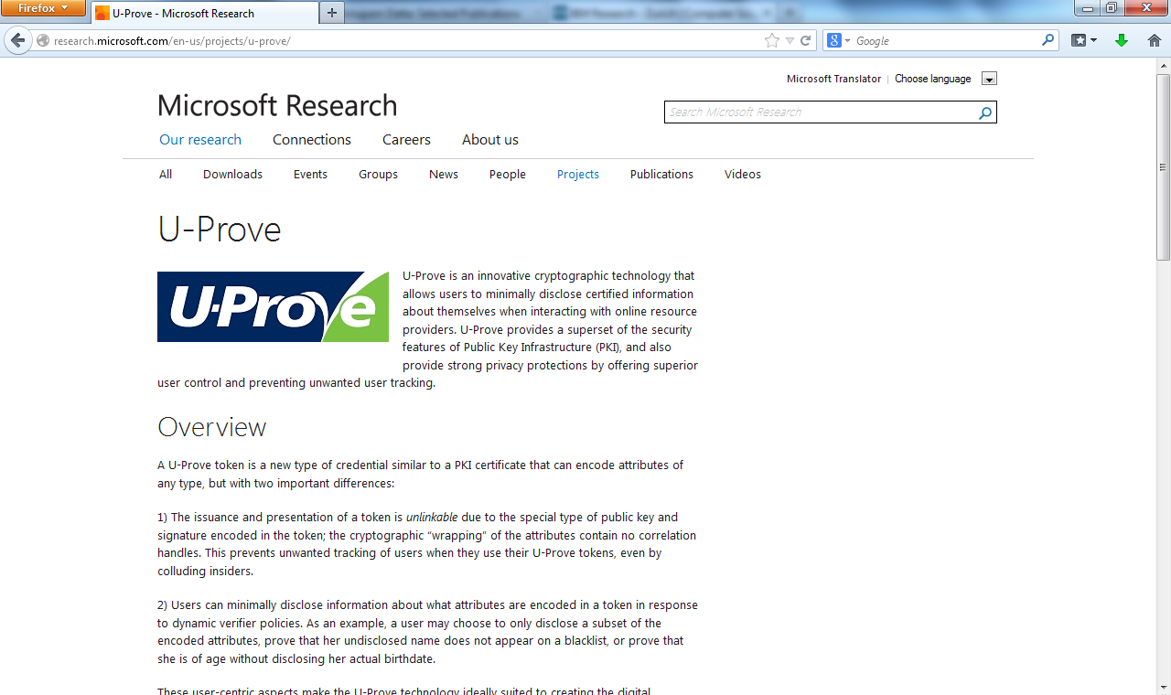

Slide 6
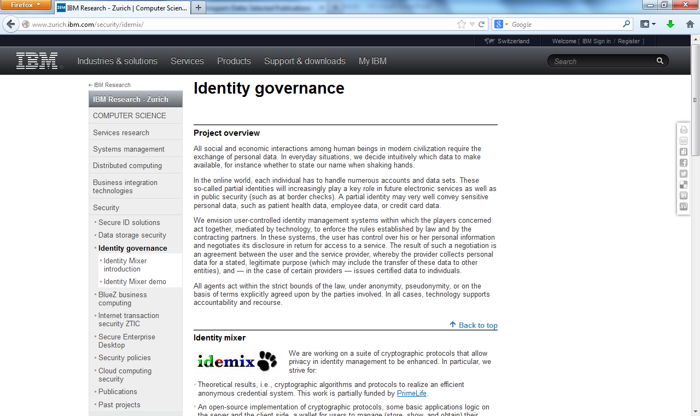

Slide 7
Today: Electronic Cash
Goals
  Alice can ask for Bank to issue coins from her account.
  Alice can spend coins.
  Bank cannot track what Alice spent the coins on.

Slide 8
Today: Electronic Cash
Building blocks
  Commitments
  (Blind) signatures
  RSA Signatures
  Zero-knowledge
Chaum 1985
Chaum et al 1990

Slide 9
Building blocks

Slide 10
Commitments
Goal: make a hidden statement that can be later revealed but not changed.
Can create multiple commitments, reveal some.
  Example?

Slide 11





Commitments
Locked box analogy
  Hiding – hard to tell which message is committed to
  Binding – there is a unique message corresponding to each commitment
m
m

Slide 12
Signatures
Goal: Can sign a message such that everyone else can verify that you have signed it.
  Non-forgeable
  Independently verifiable

Slide 13

Signatures
m
Signing key sk
Message m
Verification key pk
Sign(sk,m)
m,Sign(sk,m)
Verification key pk
Bob checks Check(pk, Sign(m))
Notes:
Design special signature schemes for which there exist efficient proofs
- CL signatures based on RSA, gap DH, LRSW
- [BCKL08, BCCKLS09, CK] signatures based on bilinear pairings

Slide 14
Blind signatures
m
Message: m
Verification key: pk
Signing key: sk
Sign(sk, )
m
Alice learns only signature on her message.
Signer learns nothing.

Slide 15
Background on RSA Signatures
Easy: find e,d,n such that
  (m^{e})^{d =} m (mod n)
Hard: Compute d from e,n.
  e and d will serve as public and private keys, respectively

Slide 16
Background on RSA Signatures
Key Generation
  Generate modulus n.
  Public key = e; private key = d s.t.
    (m^{e})^{d} = m (mod n)
    informally e = 1 / d
Sign
  Sign(d, m) := m^{d} (mod n)
Verify
  Check(e, m, C) := Ce =? m (mod n)
    Note Ce = (m^{e}) ^{d} = m (mod n)

Slide 17
RSA-Based signatures
m
Modulus n
Private key d
Message: m
Modulus n
Public key e
Sign(d,m) = m^{d} (mod n)
m, m^{d}
Modulus n
Public key e
Bob checks Check(e, m^{d}) := (m^{d})^{e} =? m (mod n)
Notes:
Design special signature schemes for which there exist efficient proofs
- CL signatures based on RSA, gap DH, LRSW
- [BCKL08, BCCKLS09, CK] signatures based on bilinear pairings

Slide 18
RSA-Based blind signatures
r^{e}m
Modulus n
Private key d
Message: m
Modulus n
Public key e
Random* r
Sign(d,r^{e}m) = r m^{d} (mod n)
m, m^{d}
Modulus n
Public key e
Bob checks Check(e, m^{d}) := (m^{d})^{e} =? m (mod n)
Notes:
Design special signature schemes for which there exist efficient proofs
- CL signatures based on RSA, gap DH, LRSW
- [BCKL08, BCCKLS09, CK] signatures based on bilinear pairings

Slide 19
Security without Identification
Transaction Systems to Make Big Brother Obsolete
David Chaum 1985

Slide 20
Traceability

Slide 21
Non-tracability

Slide 22
Physical Analogy

Slide 23
Chaum’s scheme (1)
B = r^{e} f(x) (mod n)
Modulus n
e = 3
d is private
Modulus n
Random x, r
f one way function
B is a blinded message: does not reveal information about f(x) to bank
f(x) is a commitment to x

Slide 24
Chaum’s scheme (2)
BC = r f(x)^{1/3} (mod n)
Modulus n
e = 3
d = multiplicative inverse of 3
C = f(x)^{1/3} (mod n)
BC = B^{d} = (r^{e})^{d} f(x)^{d} = r f(x)^{d} (mod n) is a blind signature on B
Bank issues blinded coin and takes $1 from Alice’s account
Alice extracts coin C = f(x)^{d} = f(x)^{1/3}

Slide 25
Chaum’s scheme (3)
Bob verifies bank’s signature on f(x)^{1/3} using bank’s public key (e = 3)
x, f(x)^{1/3} (mod n)
Check: (f(x)^{1/3})³ =? f(x) – bank signed f(x)
Bob calls bank immediately to verify that the electronic coin has not been already spent
Bank checks coin and, if OK, transfers $1 to Bob’s account

Slide 26
Can we do better?
Do not require Bob to call Bank immediately
Catch Alice if she tries to spend the same coin twice

Slide 27
Untraceable Electronic Cash
Chaum, Fiat, Naor 1990

Slide 28
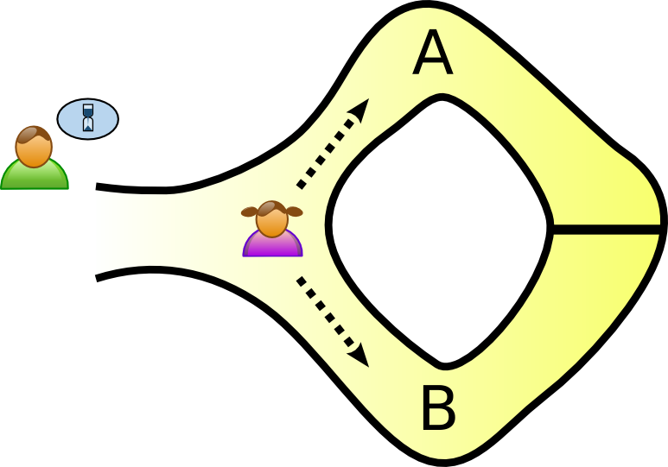
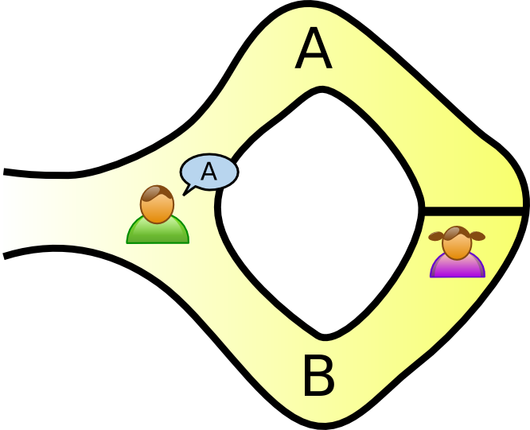
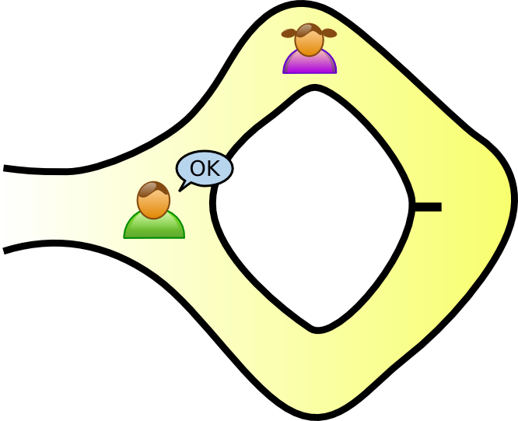
Zero knowledge
Alice proves to Bob that she knows password.
Without revealing password to anyone.
Without revealing that she knows password to anyone else.

Slide 29
Zero knowledge in Chaum et al 1990
Use 1: attest protocol is being followed
Use 2: double-spending results in de-anonymization

Slide 30
CFN90 scheme (1)
modulus n
e = 3
d is private
f, g are collision-resistant functions
k is a security parameter
more details

Slide 31
Obtaining an Electronic Coin

Slide 32
CFN90 scheme (2)
Account#: u
Counter: v
Random
a_{i}, c_{i}, d_{i}, r_{i}
1 ≤ i ≤ k
B_{i} = r_{i}^{e} f(x_{i}, y_{i}) (mod n)
1 ≤ i ≤ k where
x_{i} = g(a_{i}, c_{i})
y_{i} = g(a_{i} ⊕ (u.(v+i)),d_{i})
B_{i} is a blinded message: does not reveal information about f(x_{i},y_{i}) to bank
f(x_{i},y_{i}) is a commitment to (x_{i}, y_{i})
x_{i}, y_{i} are constructed to reveal u in case Alice tries to spend the same coin twice

Slide 33
CFN90 scheme (3)
R = random subset of k/2 indices
Reveal a_{i}, c_{i}, d_{i}, r_{i}
for i in R
Check blinded candidates in R
Ensure Alice following protocol
Assume R = {k/2+1,….,k} to simplify notation

Slide 34


CFN90 scheme (4)
modulus n
e = 3
d = multiplicative inverse of 3
Bank issues blinded coin and takes $1 from Alice’s account
Bank and Alice increments Alice’s counter v by k
Alice extracts coin
Notes:
Alice lexicographically re-indexes s.t.
f(x₁, y₁) <f(x₂, y₂) <…< f(x_{k/2}, y_{k/2})

Slide 35
Paying with an Electronic Coin

Slide 36
CFN90 scheme (5)
x_{i} = g(a_{i}, c_{i})
y_{i} = g(a_{i} ⊕ (u.(v+i)),d_{i})
R’ = random subset of k/4 indices
Check all indices conform with protocol.
For i in R’
Reveal y_{i}, a_{i}, c_{i}
For i not in R’
Reveal x_{i}, d_{i}, a_{i} ⊕ (u.(v+i))
Alice reveals her commitment
Bob check’s Alice’s commitment and Bank’s signature on coin C

Slide 37
Redeeming Electronic Coin

Slide 38
CFN90 scheme (6)
x_{i} = g(a_{i}, c_{i})
y_{i} = g(a_{i} ⊕ (u.(v+i)),d_{i})
Alice’s responses in step (5)
y_{i}, a_{i}, c_{i} For i in R’
x_{i}, d_{i}, a_{i} ⊕ (u.(v+i)) For i not in R’
Bank stores for later
C
a_{i} For i in R’
a_{i} ⊕ (u.(v+i)) For i not in R’

Slide 39
CFN90 scheme (6)
What if Alice double-spends (gives the same coin to both Bob and Charlie)?
If Alice double spends, then wp ½ Bank obtains a_{i} and a_{i} ⊕ (u.(v+i)) for the same i and thus obtains Alice’s identity and transaction counter u.(v+i)

Slide 40
CFN90 scheme (7)
What if Alice colludes with merchant Charlie and sends the same coin C and the same z to him as she did with Bob?
Bank knows that one of Bob and Charlie are lying but not who; cannot trace back to Alice
Solution: Every merchant has a fixed query string different from every other merchant + a random query string

Slide 41
Summary
Electronic Cash
  Untraceable if issued coins are used only once
  Traceable if coin is double spent
  (Some) collusion resistance
Instance of Anonymous Credentials

Slide 42
Questions

Slide 43
Commitment
Temporarily hide a value, but ensure that it cannot be changed later
  Example: sealed bid at an auction
1st stage: commit
  Sender electronically “locks” a message in a box and sends the box to the Receiver
2nd stage: reveal
  Sender proves to the Receiver that a certain message is contained in the box
43

Slide 44
Properties of Commitment Schemes
Commitment must be hiding
  At the end of the 1st stage, no adversarial receiver learns information about the committed value
  If receiver is probabilistic polynomial-time, then computationally hiding; if receiver has unlimited computational power, then perfectly hiding
Commitment must be binding
  At the end of the 2nd stage, there is only one value that an adversarial sender can successfully “reveal”
  Perfectly binding vs. computationally binding
Can a scheme be perfectly hiding and binding?
44

Slide 45
Discrete Logarithm Problem
Intuitively: given g^{x} mod p where p is a large prime, it is “difficult” to learn x
  Difficult = there is no known polynomial-time algorithm
g is a generator of a multiplicative group Z_{p}*
  Fermat’s Little Theorem
    For any integer a and any prime p, a^{p-1}=1 mod p.
  g⁰, g¹ … g^{p-2} mod p is a sequence of distinct numbers, in which every integer between 1 and p-1 occurs once
    For any number y in [1 .. p-1], exists x s.t. g^{x} = y mod p
  If g^{q}=1 for some q>0, then g is a generator of Z_{q}, an order-q subgroup of Z_{p}*
45

Slide 46
Pedersen Commitment Scheme
Setup: receiver chooses…
  Large primes p and q such that q divides p-1
  Generator g of the order-q subgroup of Z_{p}*
  Random secret a from Z_{q}
  h=gª mod p
    Values p,q,g,h are public, a is secret
Commit: to commit to some x in Z_{q}, sender chooses random r in Z_{q} and sends c=g^{x}h^{r} mod p to receiver
  This is simply g^{x}(gª)^{r}=g^{x+ar} mod p
Reveal: to open the commitment, sender reveals x and r, receiver verifies that c=g^{x}h^{r} mod p
46

Slide 47
Security of Pedersen Commitments
Perfectly hiding
  Given commitment c, every value x is equally likely to be the value commited in c
  Given x, r and any x’, exists r’ such that g^{x}h^{r} = g^{x’}h^{r’}
    r’ = (x-x’)a⁻¹ + r mod q (but must know a to compute r’)
Computationally binding
  If sender can find different x and x’ both of which open commitment c=g^{x}h^{r}, then he can solve discrete log
    Suppose sender knows x,r,x’,r’ s.t. g^{x}h^{r} = g^{x’}h^{r’} mod p
    Because h=gª mod p, this means x+ar = x’+ar’ mod q
    Sender can compute a as (x’-x)(r-r’)⁻¹
    But this means sender computed discrete logarithm of h!
47

Slide 48
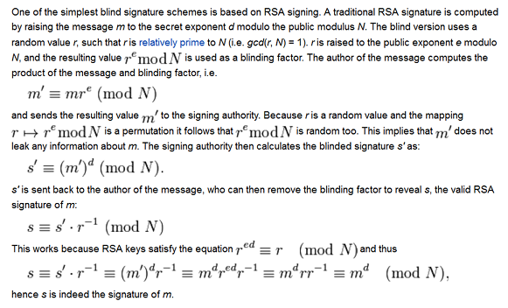
RSA Blind Signatures

