Slide 1
Fairness in Classification
18734: Foundations of Privacy
Anupam Datta
With many slides from Moritz Hardt
Fall 2017

Slide 2

Fairness in Classification
◉
Advertising
Education
Financial aid
$
Banking
Health Care
✚
Taxation
Insurance
many more...

Slide 3

Concern: Discrimination
Certain attributes should be irrelevant!
Population includes minorities
  Ethnic, religious, medical, geographic
Protected by law, policy, ethics

Slide 4

“Big Data: Seizing Opportunities, Preserving Values”
"big data technologies can cause societal harms beyond damages to privacy"

Slide 5

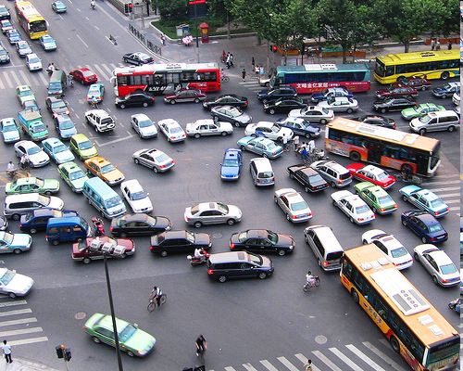

Other notions of “fairness” in CS
Fair scheduling
Distributed computing
Envy-free division (cake cutting)
Stable matching

Slide 6

Discrimination arises even when nobody’s evil
Google+ tries to classify real vs fake names
Fairness problem:
  Most training examples standard white American names: John, Jennifer, Peter, Jacob, ...
  Ethnic names often unique, much fewer training examples
Likely outcome: Prediction accuracy
worse on ethnic names
“Due to Google's ethnocentricity I was prevented from using my real last name (my nationality is: Tungus and Sami)”
- Katya Casio. Google Product Forums.

Slide 7
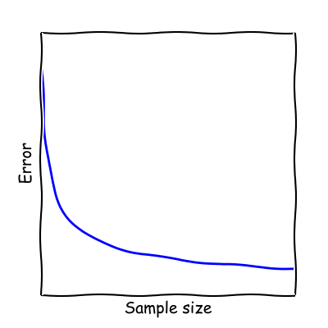
Error vs sample size
Sample Size Disparity:
In a heterogeneous population,
smaller groups face larger error

Slide 8
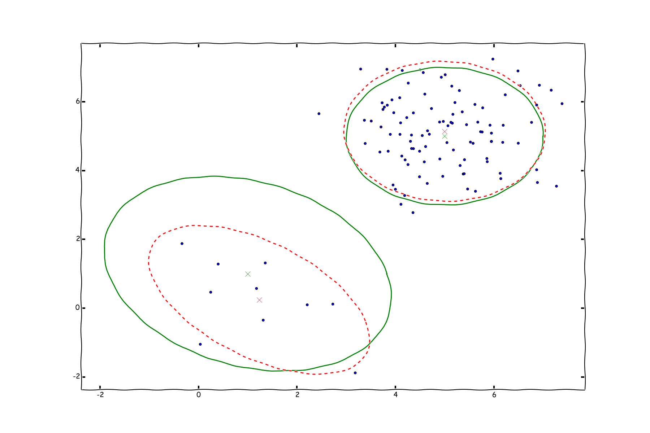

Slide 9

Credit Application
User visits capitalone.com
Capital One uses tracking information provided by the tracking network [x+1] to personalize offers
Concern: Steering minorities into higher rates (illegal)
WSJ 2010

Slide 10

Classifier
(eg. ad network)
Vendor
(eg. capital one)
x
M(x)
V: Individuals
O: outcomes
A: actions

Slide 11

Goal:
Achieve Fairness in the classification step
Assume
unknown,
untrusted,
un-auditable
vendor
x
M(x)
V: Individuals
O: outcomes

Slide 12
First attempt…

Slide 13
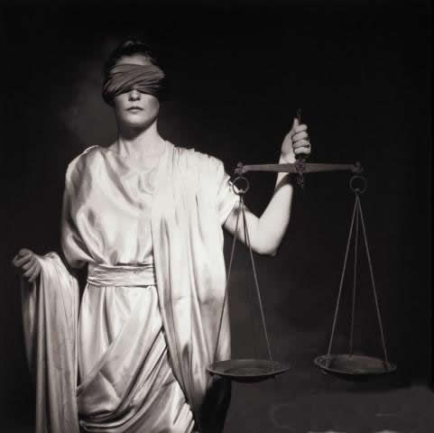
Fairness through
Blindness

Slide 14
Fairness through Blindness
Ignore all irrelevant/protected attributes
“We don’t even look at ‘race’!”

Slide 15
Point of Failure
You don’t need to see an attribute to be able to predict it with high accuracy
E.g.: User visits artofmanliness.com
... 90% chance of being male

Slide 16
Fairness through Privacy?
“It's Not Privacy, and It's Not Fair”
Cynthia Dwork & Deirdre K. Mulligan. Stanford Law Review.
Privacy is no Panacea: Can’t hope to have
privacy solve our fairness problems.
“At worst, privacy solutions can hinder efforts to identify classifications that unintentionally produce objectionable outcomes—for example, differential treatment that tracks race or gender—by limiting the availability of data about such attributes.“

Slide 17
Second attempt…

Slide 18
Statistical Parity (Group Fairness)
Equalize two groups S, T at the level of outcomes
  E.g. S = minority, T = S^{c}
  Pr[outcome o | S] = Pr [outcome o | T]
  “Fraction of people in S getting
  credit same as in T.”

Slide 19
Not strong enough as a notion of fairness
  Sometimes desirable, but can be abused
Self-fulfilling prophecy: Select smartest students in T, random students in S
  Students in T will perform better

Slide 20

Lesson: Fairness is task-specific
Fairness requires understanding of
classification task and protected groups
  “Awareness”

Slide 21
Individual Fairness
Approach

Slide 22
Individual Fairness
Treat similar individuals similarly
Similar for the purpose of
the classification task
Similar distribution
over outcomes

Slide 23

The Similarity Metric

Slide 24
Metric
Assume task-specific similarity metric
  Extent to which two individuals are similar w.r.t. the classification task at hand
Ideally captures ground truth
  Or, society’s best approximation
Open to public discussion, refinement
  In the spirit of Rawls
Typically, does not suggest classificiation!

Slide 25
Examples
Financial/insurance risk metrics
  Already widely used (though secret)
AALIM health care metric
  health metric for treating similar patients similarly
Roemer’s relative effort metric
  Well-known approach in Economics/Political theory
Maybe not so much science fiction after all…
Notes:
Mention only AALIM

Slide 26
How to formalize this?
Think of V as space
with metric d(x,y)
similar = small d(x,y)
How can we
compare
M(x) with M(y)?
y
M(y)
x
M(x)
V: Individuals
O: outcomes

Slide 27
Distributional outcomes
How can we
compare
M(x) with M(y)?
Statistical
distance!
M(y)
y
x
M(x)
V: Individuals
O: outcomes

Slide 28
Metric
Lipschitz condition
This talk: Statistical distance
in [0,1]
M(y)
y
x
M(x)
V: Individuals
O: outcomes

Slide 29
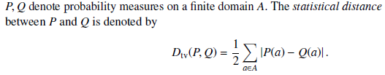
Statistical Distance
Notation match:
M(x) = P
M(y) = Q
O = A

Slide 30
Statistical Distance
Example: High D
A= {0,1}
P(0) = 1, P(1) = 0
Q(0) = 0, Q(1) = 1
D(P, Q) = 1

Slide 31
Statistical Distance
Example: Low D
A= {0,1}
P(0) = 1, P(1) = 0
Q(0) = 1, Q(1) = 0
D(P, Q) = 0

Slide 32
Statistical Distance
Example: Mid D
A= {0,1}
P(0) = P(1) = ½
Q(0) = ¾, Q(1) = ¼
D(P, Q) = ¼

Slide 33
Existence Proof
There exists a classifier that satisfies the Lipschitz condition
Idea: Map all individuals to the same distribution over outcomes
Are we done?

Slide 34
Key elements of approach…

Slide 35
Utility Maximization
Vendor can specify arbitrary utility function
U(v,o) = Vendor’s utility of giving individual v
the outcome o

Slide 36
Maximize vendor’s expected utility subject to Lipschitz condition

Slide 37
Linear Program Formulation
Objective function is linear
  U(x,o) is constant for fixed x, o
  Distribution over V is known
  {M(x)}(x in V} are only variables to be computed
Lipschitz condition is linear when using statistical distance
Linear program can be solved efficiently

Slide 38
Discrimination Harms
Information use
Explicit discrimination
  Explicit use of race/gender for employment
Redundant encoding/proxy attributes
Practices
Redlining
Self-fulfilling prophesy
Reverse tokenism
Notes:
Other attributes that predict the protected one

Slide 39

When does Individual Fairness imply Group Fairness?
Suppose we enforce a metric d.
Question: Which groups of individuals receive (approximately) equal outcomes?
Theorem:
Answer is given by Earthmover distance
(w.r.t. d) between the two groups.

Slide 40
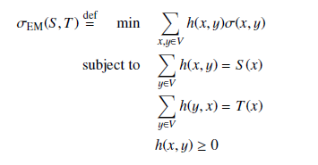
How different are S and T?
T
Earthmover Distance:
Cost of transforming uniform distribution on S to uniform distribution on T
S
(V,d)

Slide 41
bias(d,S,T) = largest violation of statistical parity between S and T
that any d-Lipschitz mapping can create
Theorem:
bias(d,S,T) = d_{EM}(S,T)

Slide 42
Connection to differential privacy
Close connection between individual fairness and differential privacy [Dwork-McSherry-Nissim-Smith’06]
  DP: Lipschitz condition on set of databases
  IF: Lipschitz condition on set of individuals
 | Differential Privacy | Individual Fairness
Objects | Databases | Individuals
Outcomes | Output of statistical analysis | Classification outcome
Similarity | General purpose metric | Task-specific metric

Slide 43
Summary: Individual Fairness
Formalized fairness property based on treating similar individuals similarly
  Incorporates vendor’s utility
Explored relationship between individual fairness and group fairness
  Earthmover distance

Slide 44
Lots of open problems/direction
Metric
  Social aspects, who will define them?
  How to generate metric (semi-)automatically?
Earthmover characterization when probability metric is not statistical distance (but infinity-div)
Explore connection to Differential Privacy
Connection to Economics literature/problems
  Rawls, Roemer, Fleurbaey, Peyton-Young, Calsamiglia
Case Study
Quantitative trade-offs in concrete settings

Slide 45
Questions?

Slide 46
Metric
A metric on a set X is a function d : X × X → R+ (where R+ is the set of non-negative real numbers). For all x, y, z in X, this function is required to satisfy the following conditions:
d(x, y) ≥ 0 (non-negativity)
d(x, y) = 0 if and only if x = y (identity of indiscernibles. Note that condition 1 and 2 together produce positive definiteness)
d(x, y) = d(y, x) (symmetry)
d(x, z) ≤ d(x, y) + d(y, z) (subadditivity / triangle inequality).

Slide 47

Another Statistical Distance

Slide 48
Partial Proof Idea
Theorem:
bias(d,S,T) <= d_{EM}(S,T)
d_{EM}(S,T) cost of best coupling between the two distributions subject to the penalty function d(x,y) = E d(x,y)

Slide 49
Proof Sketch: LP Duality
EM_{d}(S,T) is an LP by definition
Can write bias(d,S,T) as an LP:
max Pr( M(x) = 0 | x in S) – Pr( M(x) = 0 | x in T )
subject to:
M(x) is a probability distribution for all x in V
M satisfies all d-Lipschitz constraints
Program dual to Earthmover LP!

Slide 50
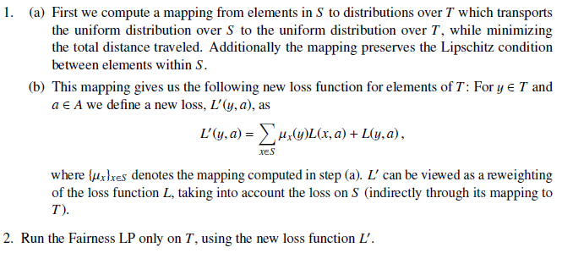
Fair Affirmative Action (1)

Slide 51
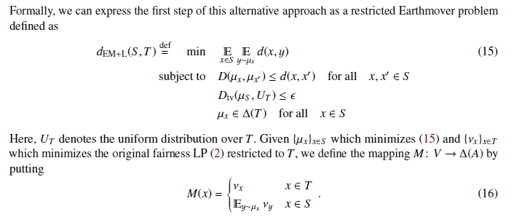
Fair Affirmative Action (2)

Slide 52
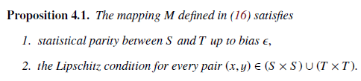

Fair Affirmative Action (3)

Slide 53
Can we import techniques from Differential Privacy?
Based on exponential mechanism [MT’07]
Theorem: Fairness mechanism with “high utility” in metric spaces (V,d) of bounded doubling dimension
(V,d)
B(x,R)
B(x,2R)
|B(x,R)| ≤ O(|B(x,2R))

Slide 54
Some recent work
Zemel-Wu-Swersky-Pitassi-Dwork
“Learning Fair Representations” (ICML 2013)
a
A: labels
S
x
Typical learning task
labeled examples (x,a)
V: Individuals
S: protected set

Slide 55
Web Fairness Measurement
How do we measure the “fairness of the web”?
  Need to model/understand user browsing behavior
  Evaluate how web sites respond to different behavior/attributes
  Cope with noisy measurements
Exciting progress by Datta, Datta, Tschantz

Slide 56
The Story So Far…
Group fairness
Individual fairness
Group fairness does not imply individual fairness
Individual fairness implies group fairness if earthmover distance small
What if earthmover distance large?

Slide 62
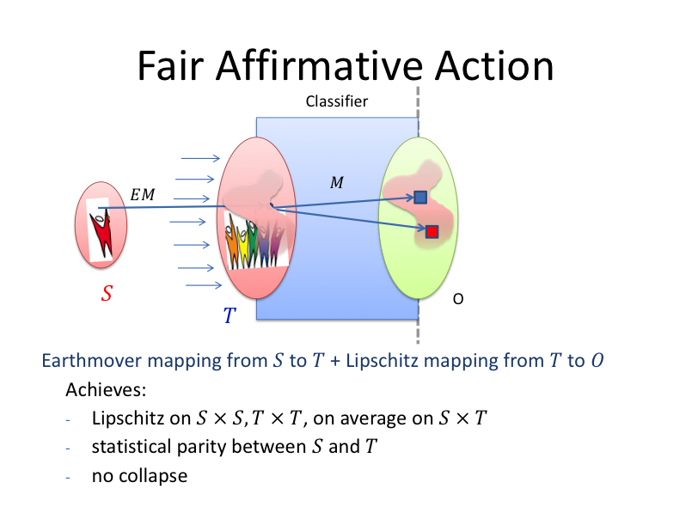

Slide 63
