Slide 1
Differentially Private Recommendation Systems
18734: Foundations of Privacy
Anupam Datta
Fall 2017

Slide 2
Netflix $1,000,000 Prize Competition
User/Movie | …. | 300 | The Notebook | ….
… | … | … | … | …
John |  | 4 | Unrated
Mary |  | Unrated | Unrated
Sue |  | 2 | 5
Joe |  | 5 | 1
… | … | … | … | …
Queries: On a scale of 1 to 5 how would John rate “The Notebook” if he watched it?

Slide 3
Netflix Prize Competition
User/Movie | …. | 13,537 | 13,538 | ….
… | … | … | … | …
258,964 |  | (4, 10/11/2005) | Unrated
258,965 |  | Unrated | Unrated
258,966 |  | (2, 6/16/2005) | (5, 6/18/2005)
258,967 |  | (5, 9/15/2005) | (1,4/28/2005)
… | … | … | … | …
Note: N x M table is very sparse (M = 17,770 movies, N = 500,000 users)
To Protect Privacy:
Each user was randomly assigned to a globally unique ID
Only 1/10 of the ratings were published
The ratings that were published were perturbed a little bit

Slide 4
Root Mean Square Error
- predicted ratings
- actual ratings

Slide 5
Netflix Prize Competition
Goal: Make accurate predictions as measured by Root Mean Squared Error (RMSE)
- predicted ratings
- actual ratings
Algorithm | RMSE
BellKor's Pragmatic Chaos | 0.8567 < 0.8572
Challenge: 10% Improvement | 0.8572
Netflix’s Cinematch (Baseline) | 0.9525

Slide 7
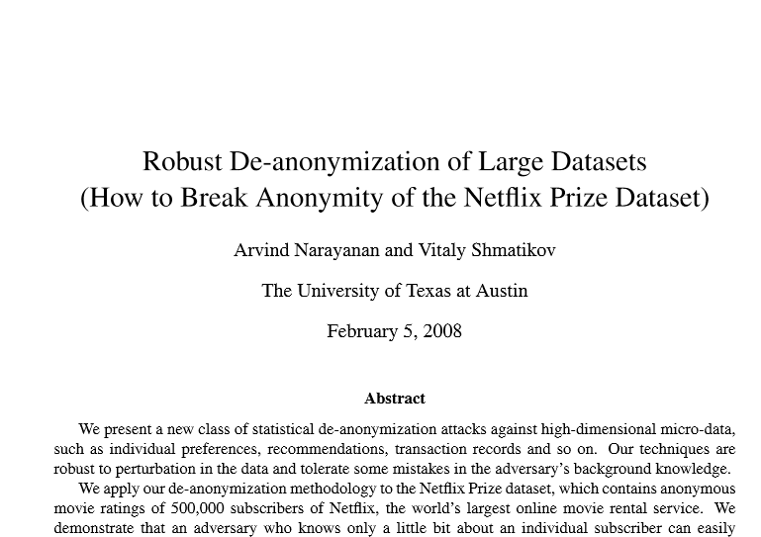
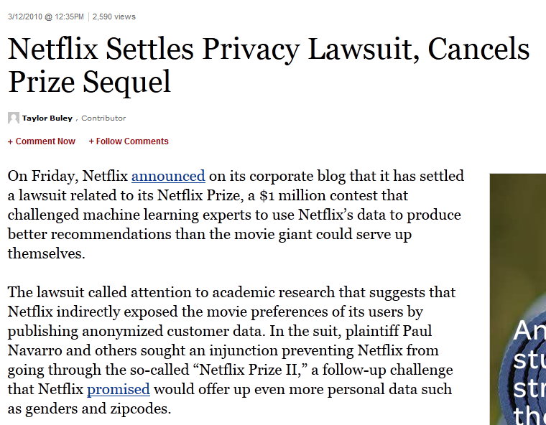
Netflix Privacy Woes

Slide 8
Outline
Recap: Differential Privacy and define Approximate Differential Privacy
Prediction Algorithms
Privacy Preserving Prediction Algorithms
Remaining Issues

Slide 9
Privacy in Recommender Systems
Netflix might base its recommendation to me on both:
My own rating history
The rating history of other users
Goal: not leak other users’ ratings to me
Basic recommendation systems leak other users’ information
Calandrino, et al. Don’t review that book: Privacy risks of collaborative filtering, 2009.
Notes:
In an active attack, the adversary is able to insert his own points into the dataset.
It would be possible to learn about someone else’s ratings history
If we have auxiliary information
Active attacks are a source auxiliary information

Slide 10
Recall Differential Privacy [Dwork et al 2006]
Randomized sanitization function κ has ε-differential privacy if for all data sets D1 and D2 differing by at most one element and all subsets S of the range of κ,
Pr[κ(D1) ∈ S ] ≤ e^{ε} Pr[κ(D2) ∈ S ]
10
Notes:
Intuition: Anything that an adversary could learn about me it could have learned about me anyway…even if my information is not in the dataset
Notice that: Range(K(D1)) = Range(K(D2))

Slide 11
Review: Laplacian Mechanism
$$K\left(D\right)=f\left(D\right)+\operatorname{Lap}\left(\frac{GSf}{ε}\right)$$
Probability Density Function
Question: The Gaussian (Normal) distribution is nicer because it is more tightly concentrated around its mean. Can we use that distribution instead?
$$\operatorname{Lap}\left(x,0,σ\right)∝\frac{1}{2σ}\exp\left(\frac{−\left|x\right|}{σ}\right)$$
Thm: K is 𝞮-differentially private
Picture Proof:
$$≤GSf$$
$$e^{−ε}≤Ratio=\frac{Black}{Red}{≤e}^{ε}$$
$$f\left(D2\right)$$
$$f\left(D1\right)$$

Slide 12
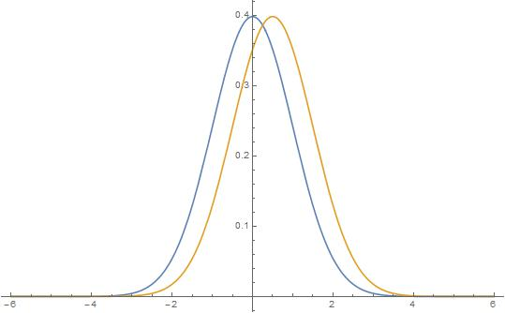
Gaussian Mechanism
$$\text{κ}\left(D\right)=f\left(D\right)+N\left(\frac{GSf}{ε}\right)$$
Probability Density Function
$$N\left(x,0,σ\right)∝\frac{1}{2σ\sqrt{2π}}\exp\left(\frac{{−x}^{2}}{2σ2}\right)$$
Thm? K is 𝞮-differentially private?
Problem: The ratio can be huge at the tails!
$$≤GSf$$
Picture Proof?
$$e^{−ε}≤Ratio=\frac{Black}{Red}{≤e}^{ε}$$
$$e^{−ε}≥Ratio=\frac{Black}{Red}$$
But these events are very unlikely…
$$f\left(D1\right)$$
$$f\left(D2\right)$$

Slide 13
Approximate Differential Privacy
Randomized sanitization function κ has (ε, δ)-differential privacy if for all data sets D1 and D2 differing by at most one element and all subsets S of the range of κ,
Pr[κ(D1) ∈ S] ≤ e^{ε} Pr[κ(D2) ∈ S ] + δ

Slide 14
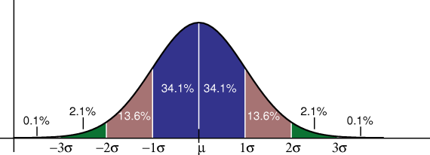
Gaussian Mechanism
$$K\left(D\right)=f\left(D\right)+N\left(σ2\right)$$
Thm K is (𝞮, δ)-differentially private as long as $σ≥\frac{\sqrt{2\ln\left(2/δ\right)}}{ε}×GSf$
Idea Use δ to exclude the tails of the gaussian distribution
Notes:
This also works in the multivariate case

Slide 15
Multivariate Gaussian Mechanism
Suppose that f outputs a length d vector instead of a number
$$K\left(D\right)=f\left(D\right)+N\left(σ2\right)d$$
Thm K is (𝞮, δ)-differentially private as long as
$$σ≥\frac{\sqrt{2\ln\left(2/δ\right)}}{ε}×\max_{D1≈D2}\left\|f\left(D1\right)−f(D2)\right\|2$$
Remark: Similar results would hold with the Laplacian Mechanism, but we would need to add more noise (proportional to the larger L1 norm)

Slide 16
Approximate Differential Privacy
Key Difference
Approximate Differential Privacy does NOT require that:
Range(κ(D1)) = Range(κ(D2))
The privacy guarantees made by (ε,δ)-differential privacy are not as strong as ε-differential privacy, but less noise is required to achieve (ε,δ)-differential privacy.
Notes:
Similar to Differential Privacy, there are nice results about the composition of Approximate Differential Privacy
F(D) = (f(D),g(D))

Slide 17
Achieving Approximate Differential Privacy
Key Differences:
Use of the L2 norm instead of L1 norm to define the sensitivity of Δf
Use of Gaussian Noise instead of Laplace Noise
Notes:
Notes: L2 norm should produce smaller values than the L1 norm AND the Normal Distribution has probability density function tightly concentrated within a few std deviation of the mean

Slide 18
Differential Privacy for Netflix Queries
What level of granularity to consider? What does it mean for databases D1 and D2 to differ on at most one element?
One user (column) is present in D1 but not in D2
One rating (cell) is present in D1 but not in D2
Issue 1: Given a query “how would user i rate movie j?” Consider: K(D-u[i]) - how can it possibly be accurate?
Issue 2: If the definition of differing in at most one element is taken over cells, then what privacy guarantees are made for a user with many data points?
Notes:
A Netflix query is just a tuple (i,j), if the answer cannot reveal too much about any individual then it cannot reveal too much about user i, which defeats the purpose of predicting what rating user i would make. I think this may be why the results are so bad in this case. But it may be possible to adopt an alternative definition of differential privacy here. Namely, for all D2 different from D2 on at most one column except for user I’s column…the intuition being that it is OK if a query release some information about user I, because that is the purpose of the query. User i knows his own ratings anyway so this isn’t really a compromise of privacy. Maybe we could think of a query (i,j) as also containing a ratings history for user i.
Consider the query of the form “how many of the following list of movies has user I watched?”
This query could definitely leak sensitive information about user I, but if the list of movies is large then we might get a very accurate answer.
The issue with definition 2 is that each user (column) is now a large group of cells. The definition of differential privacy says that you cannot learn about individual cells, but the purpose is to allow that learning about the larger group is still feasible. In our case M (the number of movies, or cells associated with a user) is really large. By composability, we get M*epsilon differential privacy, but this may be terrible when M is large enough (in high dimensional datasets like Netflix)
McSherry et Al consider both definitions of granularity. They get positive results when the difference is taken over individual cells and negative results when the definition is taken over entire columns due to too much noise.

Slide 19
Netflix Predictions – High Level
Q(i,j) – “How would user i rate movie j?”
Predicted rating may typically depend on
Global average rating over all movies and all users
Average movie rating of user i
Average rating of movie j
Ratings user i gave to similar movies
Ratings similar users gave to movie j
Sensitivity may be small for many of these queries

Slide 20
Personal Rating Scale
For Alice a rating of 3 might mean the movie was really terrible.
For Bob the same rating might mean that the movie was excellent.
How do we tell the difference?

Slide 21
How do we tell if two users are similar?
Pearson’s Correlation is one metric for similarity of users i and j
Consider all movies rated by both users
Negative value whenever i likes a movie that j dislikes
Positive value whenever i and j agree
We can use similar metrics to measure the similarity between two movies.
Notes:
Li = movies that user i has watched
Lj = movies that user j has watched
Ni = number of movies rated by user I
R_ij = rating of user I for movie j

Slide 22
Netflix Predictions Example
Collaborative Filtering
Find the k-nearest neighbors of user i who have rated movie j by Pearson’s Correlation:
Predicted Rating
similarity of users i and j
k most similar users
Notes:
Explain intuition behind each of the formulas
each users ratings are relative to there own standards
if user I rates movie m low relative to his personal scale and user j rates movie m high according to his personal scale, what happens?
The predicted rating is centered around the average movie rating, plus the average ratings of the other neighbors adjusted around their own average ratings

Slide 23
Netflix Prediction Sensitivity Example
Pretend the query Q(i,j) included user i’s rating history
At most one of the neighbors ratings changes, and the range of ratings is 4 (since ratings are between 1 & 5). The L1 sensitivity of the prediction is:
Δp = 4/k

Slide 24
Similarity of Two Movies
Let U be the set of all users who have rated both movies i and j then
Notes:
If user u like both movies then summand is positive, otherwise negative

Slide 25
K-Nearest Users or K-Nearest Movies?
Find k most similar users to i that have also rated movie j?
Find k most similar movies to j that user i has rated?
Either way, after some pre-computation, we need to be able to find the k-nearest users/movies quickly!

Slide 26
Covariance Matrix
User-User Covariance Matrix?
(NxN) Matrix to measure similarity between users
N ≈ 500,000
Movie-Movie Covariance Matrix
(MxM) matrix
Cov[i][j] measures similarity between movies i and j
M ≈ 17,000
More accurate
Less accurate
Notes:
You can use a rank approximation to the user-user covariance matrix, but this approach tends to be less accurate than movie-movie covariance matrix based approaches

Slide 27
What do we need to make predictions?
For a large class of prediction algorithms it suffices to have:
Gavg – average rating for all movies by all users
Mavg – average rating for each movie by all users
Average Movie Rating for each user
Movie-Movie Covariance Matrix (COV)
Notes:
Question: What is COV[i][j]? Let S be the set of all users who rated movies i AND j. Then Cov[i][j] is Sum over u in S of r[u][i]*r[u][j]

Slide 28
Differentially Private Recommender Systems (High Level)
To respect approximate differential privacy publish
Gavg + NOISE
Mavg + NOISE
COV + NOISE
ΔGavg, ΔMavg are very small so they can be published with little noise
ΔCOV requires more care (our focus)
Don’t publish average ratings for users (used in per-user prediction phase using k-NN or other algorithms)
Source: Differentially Private Recommender Systems(McSherry and Mironov)

Slide 29
Movie-Movie Covariance Matrix
$$Cov=\sum_{u}{\left(\tilde{r_{u}}\right)\left(\tilde{r_{u}}\right)}T$$
$${\tilde{r_{u}}=r}_{u}−\overline{r}$$
User u’s rating for each movie
Average rating for each movie

Slide 30
Movie-Movie Covariance Matrix
$$Cov=\sum_{u}{\left(\tilde{r_{u}}\right)\left(\tilde{r_{u}}\right)}T$$
$$\overline{r}=\left\langle \begin{matrix}3.2 \\ 2 \\ 3\end{matrix}\right\rangle$$
$r_{u2}=\left\langle \begin{matrix}1.5 \\ 4.5 \\ 2\end{matrix}\right\rangle$
$r_{u1}=\left\langle \begin{matrix}4.2 \\ 2 \\ 3\end{matrix}\right\rangle$
30

Slide 31
Movie-Movie Covariance Matrix
$$Cov=\sum_{u}{\left(\tilde{r_{u}}\right)\left(\tilde{r_{u}}\right)}T$$
$$\overline{r}=\left\langle \begin{matrix}3.2 \\ 2 \\ 3\end{matrix}\right\rangle$$
$$\tilde{r_{u2}}=\left\langle \begin{matrix}−1.7 \\ 2.5 \\ −1\end{matrix}\right\rangle$$
$$\tilde{r_{u1}}=\left\langle \begin{matrix}1 \\ 0 \\ 0\end{matrix}\right\rangle$$

Slide 32
Example
$$\tilde{r_{u1}}{\left(\tilde{r_{u1}}\right)}^{T}=\left\langle \begin{matrix}−1.7 \\ 2.5 \\ −1\end{matrix}\right\rangle \left\langle \begin{matrix}−1.7 & 2.5 & −1\end{matrix}\right\rangle$$
$$= \left[\begin{matrix}2.89 & −4.25 & 1.7 \\ −4.25 & 6.25 & −2.5 \\ 1.7 & −2.5 & 1\end{matrix}\right]$$
$$−4.25=−1.7×2.5$$

Slide 33
Example
$$Cov={\tilde{r_{u1}}{\left(\tilde{r_{u1}}\right)}^{T}+\tilde{r_{u2}}{\left(\tilde{r_{u2}}\right)}^{T}}_{}$$
$$= \left[\begin{matrix}3.89 & −4.25 & 1.7 \\ −4.25 & 6.25 & −2.5 \\ 1.7 & −2.5 & 1\end{matrix}\right]$$

Slide 34
Covariance Matrix Sensitivity
Could be large if a user’s rating has large spread or if a user has rated many movies
34

Slide 35
Covariance Matrix Trick I
Center and clamp all ratings around averages. If we use clamped ratings then we reduce the sensitivity of our function.

Slide 36
Example (B = 1)
User 1: $r_{u1}=\left\langle \begin{matrix} 4.2 & 2 3 \end{matrix}\right\rangle$
$$\overline{r_{u1}}=\frac{4.2+2+3}{3}≈3.07$$
$$\hat{r_{u1}}=\left\langle \begin{matrix} 1 & −1 −.07 \end{matrix}\right\rangle$$
$$\min_{}\left\{B,4.2−3.07\right\}$$
$$\max_{}\left\{−B,2−3.07\right\}$$

Slide 37
Covariance Matrix Trick II
Carefully weight the contribution of each user to reduce the sensitivity of the function. Users who have rated more movies are assigned lower weight.
Where is 1 if user u rated movie i
and
Notes:
Note: Cov[i][j] measures the similarity of movies I and j
Compare the definition to the previous notion of similarity
Only difference,
1. Noise
2. Weighed contribution of each user
3. Clamped Ratings Vectors

Slide 38
Publishing the Covariance Matrix
Theorem (roughly):
Add independent Gaussian noise proportional to this sensitivity bound to each entry in covariance matrix
Notes:
What is swept under the rug?
Details about stabilized average ratings for movies and users
Additional “cleansing” tricks on covariance matrix to reduce noise requirements

Slide 39
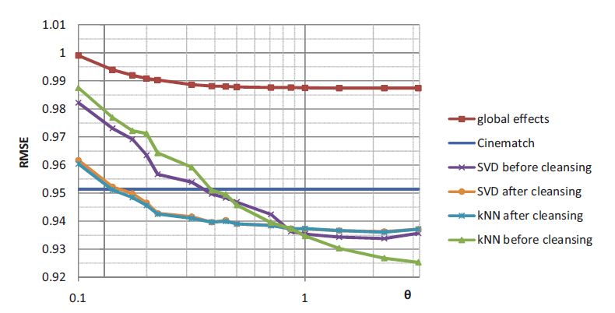
Experimental Results
Privacy decreases
Source: Differentially Private Recommender Systems(McSherry and Mironov)
Notes:
Theta = 1/Sigma
Smaller Theta = > Better Privacy Guarantees, but lower data utility
With Theta = 1 they beat Cinematch (Netflix’s baseline recomender algorithm)
Point: There is some loss of utility if we insist on privacy, but the data is still very useful

Slide 40
Note About Results
Granularity: One rating present in D1 but not in D2
Accuracy is much lower when one user is present in D1 but not in D2
Intuition: Given query Q(i,j) the database D-u[i] gives us no history about user i.
Approximate Differential Privacy
Gaussian Noise added according to L2 Sensitivity
Clamped Ratings (B =1) to further reduce noise

Slide 41
Acknowledgment
A number of slides are from Jeremiah Blocki

Slide 42
Global Averages

Slide 43
Theorem

