Slide 1
18-549 Project Proposal: 2/5/14
Rapid Ocular Sideline Concussion Diagnostics
Team 8
Brandon Lee--Andrew Pfeifer--Thomas Phillips--Ryan Quinn

Slide 2
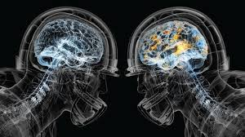
Concept & Motivation
Concussions are a major concern in modern sports
Goal: provide tools to trainers that helps them:
Automate existing diagnostic processes
Expedite existing tests to more quickly treat multiple players
If testing can be done quicker and more accurately, more players can be returned to the game faster
Our focus: ocular nerve testing
Given a suspected concussion, provide a test by an automated eyeset that would normally require a trainer/doctor
Side note: we hope to enter our final design idea in the NFL-GE Head-Health Challenge

Slide 3
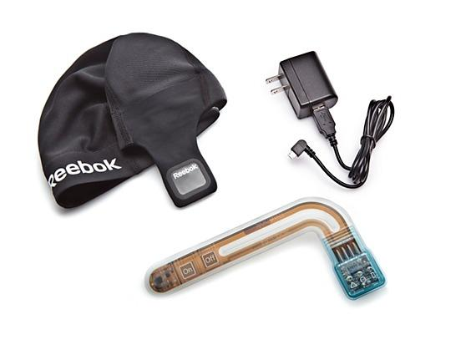
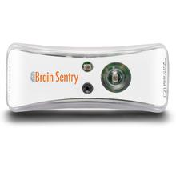
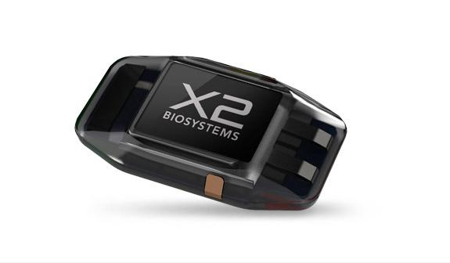
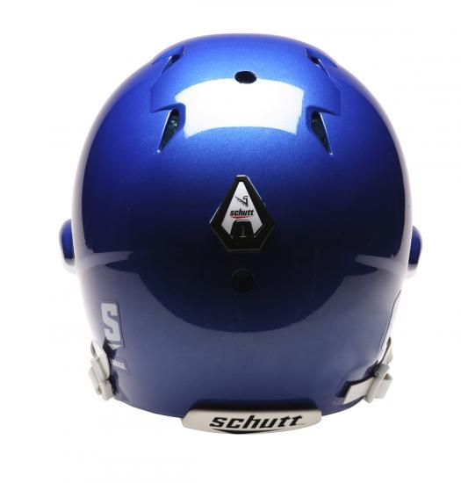
Market Competition
Concussion detection products that exist today:
Reebok Checklight
Skullcap w/embedded accelerometer
Brain Sentry
Adhesive helmet-mounted accelerometer
X2 Patch
Skin patch-mounted accelerometer
Schutt Sports Shockometer
Another accelerometer-based adhesive impact indicator
All of these products can use accelerometers to detect a big hit, but...

Slide 4
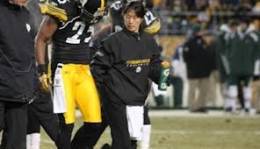
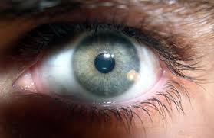
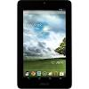
Tentative Requirements
Based upon preliminary discussion with trainers, system should:
Be used when a concussion is suspected
Requires either (i) trainer intervention, or (ii) integration with accelerometer tech
Track retinal responses to a moving light
Be capable of tests requiring depth movement
Detect asymmetric responses across eyes
Provide a simulated “trainer-with-a-pen-light”
Provide ease-of-use
Integrated iPad/Android app for sideline tablet use
Stretch goal: provide integration with general body sensors
Not necessarily concussion related
Generally: provide near-real-time results on sideline
Specifics TBD based on trainer feedback

Slide 5
Technical Specs.
3 main components
Tablet interface for training staff
An easy-to-use, adaptive app that can be used with pre-existing hardware (Apple or Android tablets)
RFID/WiFi communications capability from eyeset to basestation to tablet
Embedded accelerometer on player
An impact detector [accelerometer] embedded into a mouthguard, to provide an initial indication of a concussion
Implies integration with an existing product - can be substituted with traditional trainer or NFL-like “eye in the sky”
Ocular testing device
Administers testing on a player’s eyes after a concussion-level impact
Can replace or supplement sideline “flashlight in eyes” style of possible concussion diagnosis
Consists of combination of small camera, bright LED/LCD display, and CV software

Slide 6
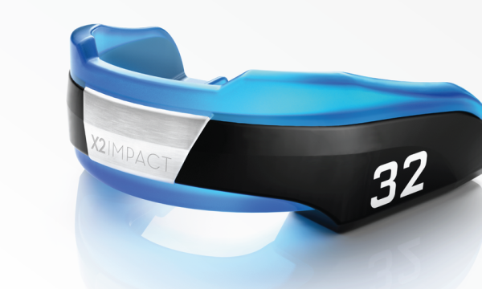
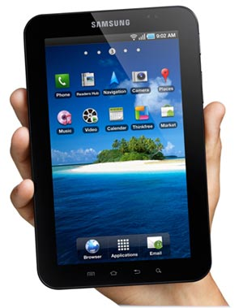
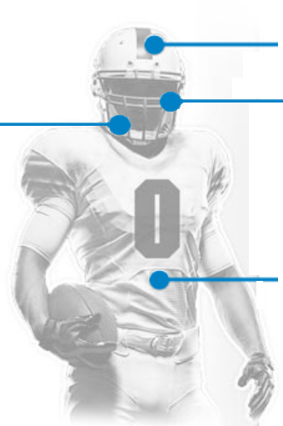
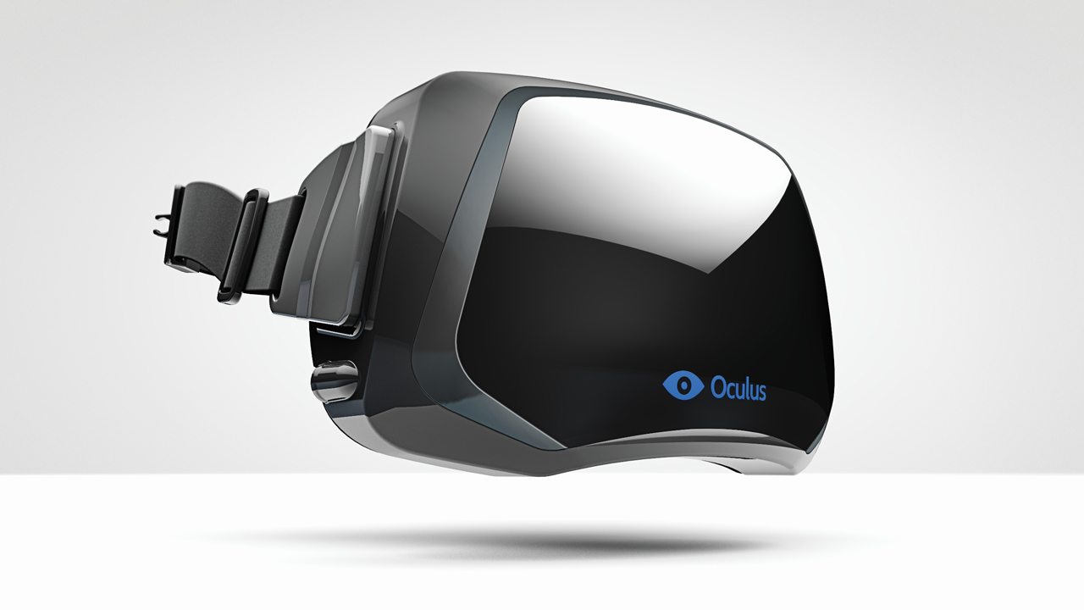
Simplified Architecture
Thresholded hit detected on field via accelerometer sensor/observer
Existing tech can be integrated
Training staff alerted via tablet
Training staff inspects player on sidelines
Player provided with glasses
Ocular test initiated via tablet
Results reported back to tablet
Comparison made relative to player baseline
Trainer uses result to aid decision-making
Future goal: integrate as part of a tracking platform
e.g., real-time, ruggedized EKG vest

Slide 7
Anticipated Risks
Risk: Biometric sensors may not be ergonomic
Mitigation: Look at existing mouthguards, patches, visors, or glasses in order to emulate those styles with which players are already comfortable
Risk: May be difficult to link CV sensor readout to a probabilistic diagnosis
Mitigation: Most sensors used should be sufficiently sensitive to allow accurate calibration; training data may be required
Risk: Battery problems
Mitigation: Hardware used should minimize current draw; light-weight, efficient battery cells are ideal (with minimal risk for health hazards, especially if put into a mouthguard or directly against skin)

