Slide 1
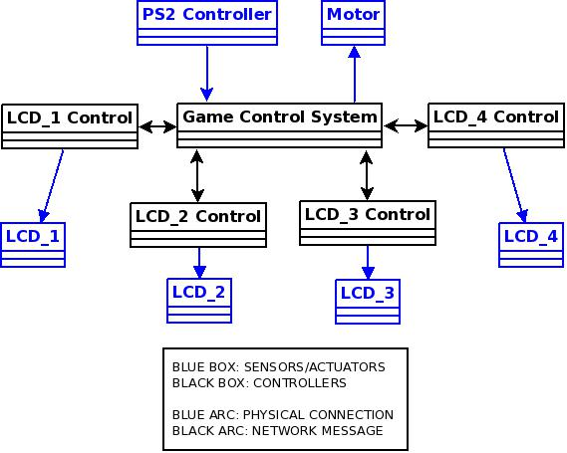
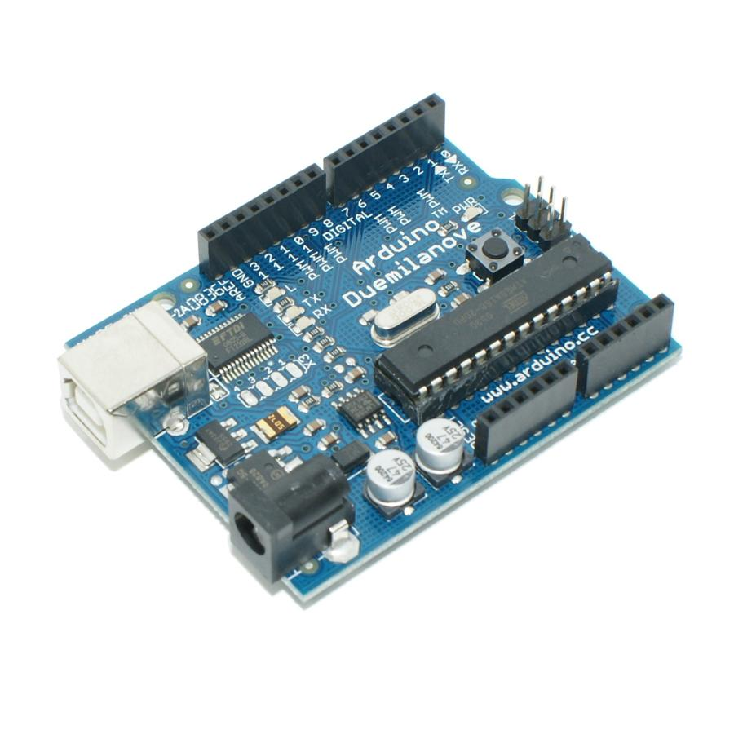
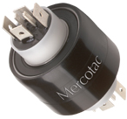
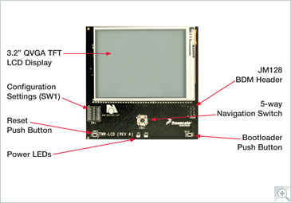
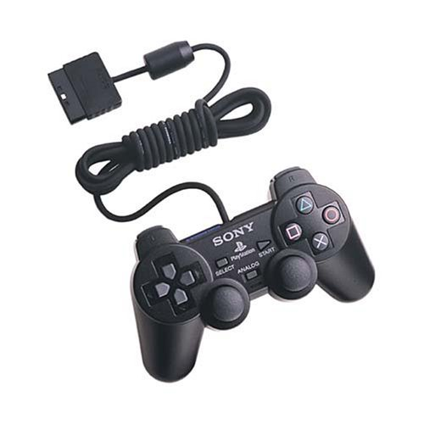
Four Sided Rotating Gaming Device
Architecture
Motivation
Communication:
Star network with Arduino as the central controller
I2C network between central game control system and LCD controllers
A gaming platform with four screens and physical rotation.
User can see only one screen at a time.
The physical rotation of the screens requires the user to think in additional spatial dimension, which can be incorporated into both classic and novel games.
Objective:
Gaming device with a unique method of interaction:
Four independent screens, only one visible at a time
Games running on all four screens concurrently to really challenge the user
Game
Game on each screen can be considered independent, but all screens share common win/lose game state
Games on screens other than currently visible screen are 3x slower
Development Environment
Results
Hardware:
Arduino Duemilanove Microcontroller
FreeScale 3.2" Graphic LCD (with an embeded microcontroller)
Mercotac Model-830 Rotary Electrical Connector
PlayStation 2 Dual Shock controller
Stepper motor for precise rotation
Initial Set of Experiments:
Tested PS2 Controller/Arduino Interface by printing out responses to input on HyperTerminal
Tested motor precision by making numerous rotations and measuring final offset angle
Acceptance Test with Human Interaction:
Mechanical:
Geneva Mechanism for near perfect 90 degrees rotation
Laser cut acrylic plates for overall structure
Software:
Code Warrior Development Studio
Arduino Software
C/C++ language
http://www.ece.cmu.edu/~ece549/spring11/team7/
Hong Jai Cho, Jonathan Francis, Young Woong Park, Anthony Rowles

