Slide 1
Four Lokomotion
Hong Jai Cho
Jon Francis
Young Woong Park
Anthony Rowles

Slide 2
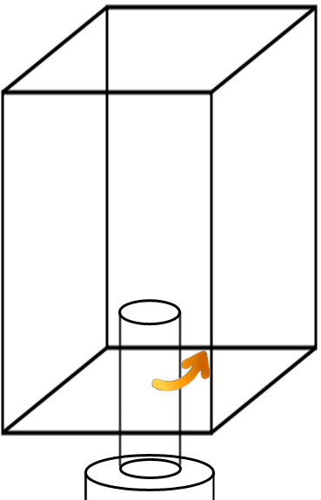
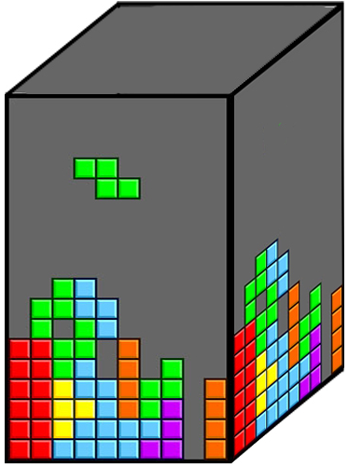
Project Concept

Slide 3
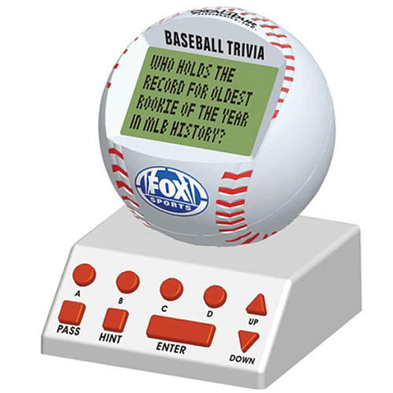
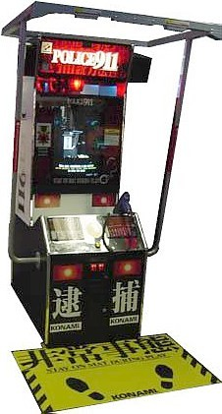
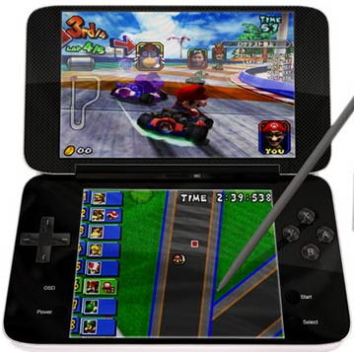
Competitive Analysis
Notes:
No direct competitors
Hand-held version could compete in the digital toys market with a target price near $50
Scaled-up model could be marketed as an arcade game with a unique style of interaction

Slide 4
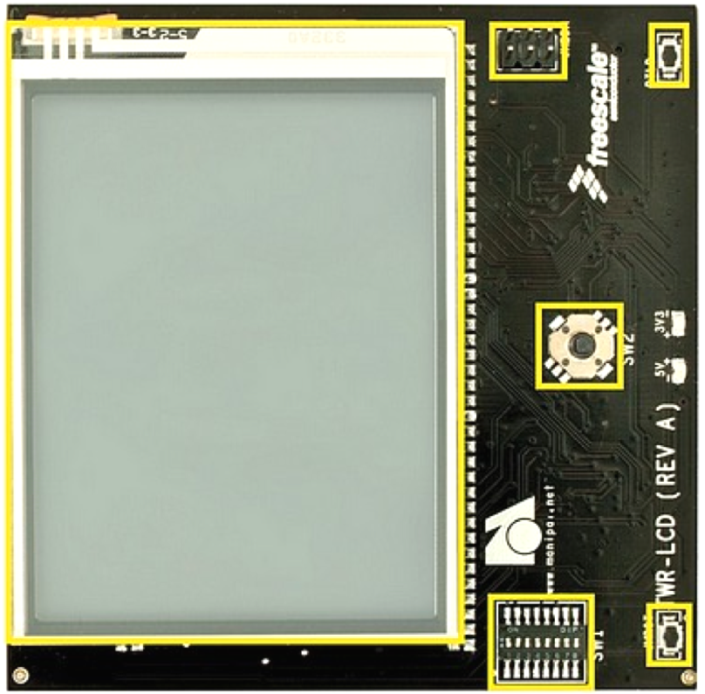
Technical Specifications

